Slide 1



Engineering Electromagnetics
……..God has written the Nature in the language of Mathematics
Girish M.
Swetha K T
Asst. Professor Dept. of ECE ATMECE

Slide 2
Agenda
Syllabus
Text Books and Reference Books IA and Exam Pattern
Objectives and Course Outcomes Importance of Engineering Electromagnetics
Applications of Electromagnetics Prerequisites to understand Electromagnetics

Slide 3
Syllabus - BEC401
Module - 1
Revision of Vector Calculus, Coulomb’s Law, Electric Field Intensity and Flux density: Experimental law of Coulomb, Electric field intensity, Field due to continuous volume charge distribution, Field of a line charge, Field due to Sheet of charge, Electric flux density, Numerical Problem. L1, L2, L3
Module - 2
Gauss’s Law and Divergence: Gauss ‘law, Application of Gauss’ law to Point Charge, line charge, Surface charge and Volume Charge, Point (differential) form of Gauss law, Divergence. Maxwell ‘s First Equation (Electrostatics), Vector Operator ▼and divergence theorem, Numerical Problems. Energy expended or work done in moving a point charge in an Electric field, The line integral, Current and Current density, Continuity of current. L1, L2, L3
Module - 3
Poisson’s and Laplace’s Equations: Derivation of Poisson ‘s and Laplace ‘s Equations, Examples of the solution of Laplace ‘s equation, Numerical problems on Laplace’s equation. Steady Magnetic Field: Biot- Savart Law, Ampere ‘s circuital law, Curl, Stokes ‘theorem, Magnetic flux and magnetic flux density. L1, L2, L3 3

Slide 4
Module -4
Magnetic Forces: Force on a moving charge, differential current elements, Force between differential current elements, Numerical problems. Magnetic Materials: Magnetization and permeability, Magnetic boundary conditions, the magnetic circuit, . L1, L2, L3
Module -5
Faraday’s law of Electromagnetic Induction –Integral form and Point form, Numerical problems. Inconsistency of Ampere’s law with continuity equation, displacement current, Conduction current, Derivation of Maxwell quations in point form, and integral form, Maxwell’s equations for different media, Numerical problems. Uniform Plane Wave: Wave propagation in free space, Uniform plane wave, Derivation of plane wave equations from Maxwell’s equations, Poynting’s Theorem and wave power, Skin effect or Depth of penetration, Numerical problems. L1, L2, L3

Slide 5
Text Books and Reference Books
Text Book:
W.H. Hayt and J.A. Buck, ―Engineering Electromagnetics, 7th
Edition, Tata McGraw-Hill, 2009, ISBN-978-0-07-061223-5.
Reference Books:
  John D Krauss and Daniel A Fleisch, ―Electromagnetics with
applications, McGraw- Hill.
  N. Narayana Rao, ―Fundamentals of Electromagnetics for Engineering, Pearson.

Slide 6
IA and Exam Pattern
Internal Assessment and Assessment(50 marks)
Three IA test will be conducted for 40 marks and Average of best of two will be considered and it is scale down to 25 marks.
Two assessment will be given and it is sum up to 25 marks.
Theory EXAM(60 marks)
The question paper will have TEN questions.
Each full question carries 20 marks.
There will be two full questions (with a maximum of Four sub questions) from each module.
Each full question will have sub questions covering all the topics under a
module.
Students will have to answer 5 full questions, selecting one full question from each module.

Slide 7
Objectives
Study the different coordinate systems, Physical significance of Divergence, Curl
and Gradient.
Understand the applications of Coulomb‘s law and Gauss law to different charge distributions and the applications of Laplace‘s and Poisson‘s Equations to solve real time problems on capacitance of different charge distributions.
Understand the physical significance of Biot-Savart, Ampere‘s Law and Stokes‘ theorem for different current distributions.
Infer the effects of magnetic forces, materials and inductance.
Know the physical interpretation of Maxwell‘ equations and applications for Plane waves for their behaviour in different media
Acquire knowledge of Poynting theorem and its application of power flow.

Slide 8
Course Outcomes(COs)
CO1 - Evaluate problems on electrostatic force, electric field due to point, linear, volume charges by applying conventional methods and charge in a volume.
CO2 - Apply Gauss law to evaluate Electric fields due to different charge distributions and Volume Charge distributions by using Divergence Theorem.
CO3 - Determine potential and energy with respect to point charge and capacitance using Laplace equation and Apply Biot-Savart’s and Ampere’s laws for evaluating Magnetic field for different current configurations
CO4 - Calculate magnetic force, potential energy and Magnetization with respect to magnetic materials and voltage induced in electric circuits.
CO5 - Apply Maxwell’s equations for time varying fields, EM waves in free space and conductors and Evaluate power associated with EM waves using Poynting theorem

Slide 9

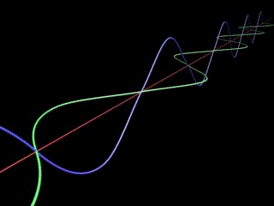
Electromagnetics?
Electric field
Produced by the presence of electrically charged particles, and gives rise to the electric force.
Magnetic field
Produced by the motion of electric charges, or electric current, and gives rise to the magnetic force associated with magnets.

Slide 10
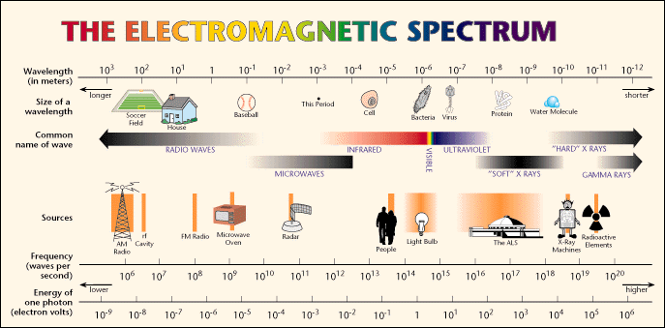
Why do we learn Engineering Electromagnetics
Electric and magnetic field exist nearly everywhere.

Slide 11
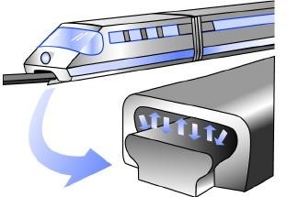
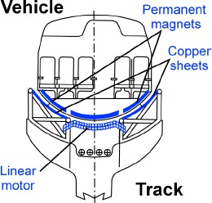
Applications
Train that Float by Magnetic Levitation

Slide 12
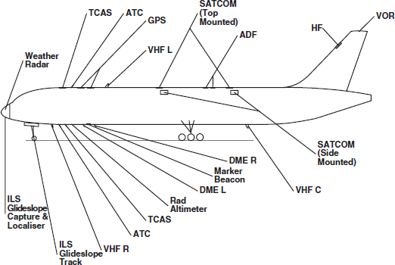
1.5 – 6.4 MHz
1.6/1.5 GHz
1.03-1.9 GHz
108 -
118
MHz
0.19 – 1.8 MHz
2 - 30 MHz
9.33-9.5 GHz
118-136 GHz
4.39 GHZ
0.960-
1.215
GHz
common avionic systems operate in the frequency range 100 kHz to 15 GHz
329 - 335 MHz

Slide 13

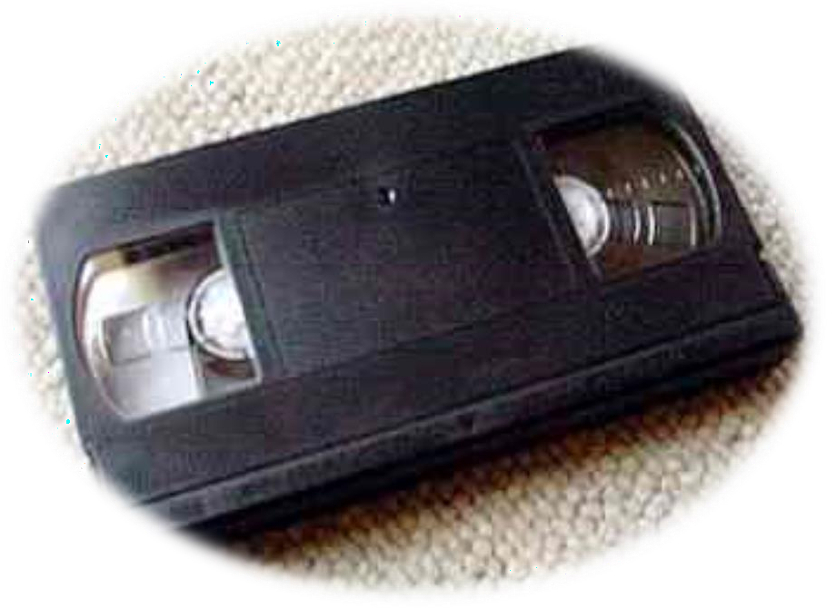
Credit Card Reader Must swipe card
→ generates changing flux Faster swipe → bigger signal
Tape / Hard Drive etc
Tiny coil responds to change in flux as the magnetic domains go by (encoding 0’s or 1’s).

Slide 14
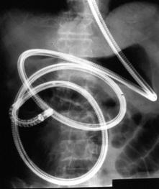
Endoscopy/ Keyhole Surgery
Allows us to look inside the human body through a narrow, flexible scope.
It is mostly used to diagnose
problems in stomach
the oesophagus, and intestines,
including ulcers, bleeding and tumours.
Typically optical fibres are used to transfer light to the end of the endoscope and a miniature
video camera records the image, and viewed on a video screen.
Endoscope inside the body

Slide 15
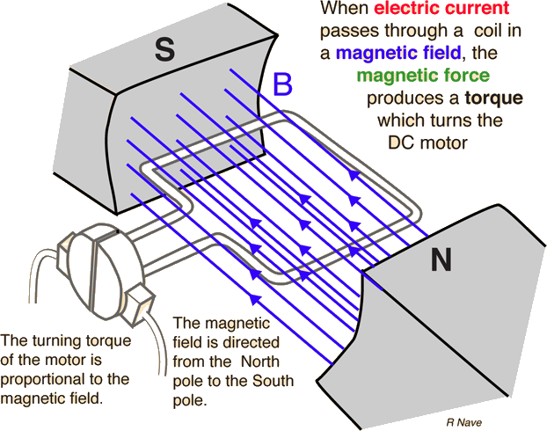
Basic Motor Applications

Slide 16



Daily Life examples

Slide 17
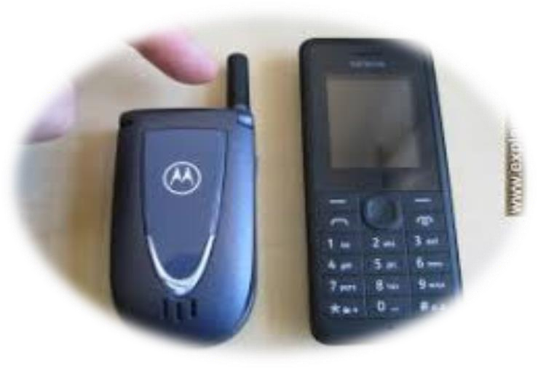
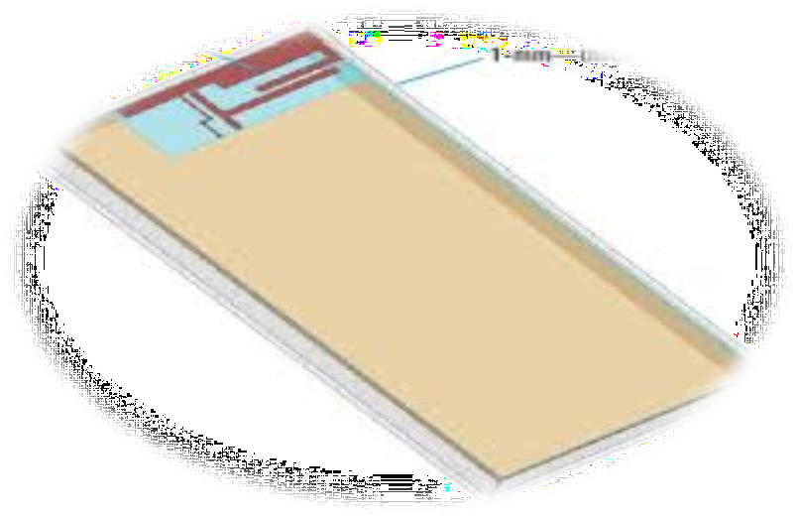
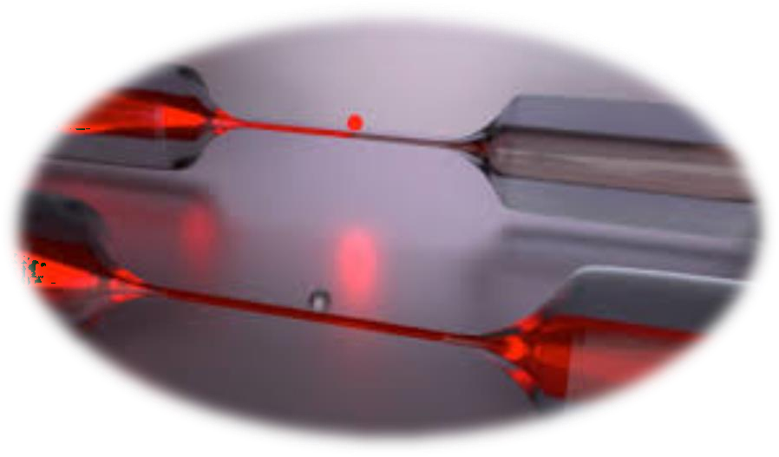
Transmission of EM Signals
- through Wired
- through Wireless

Slide 18
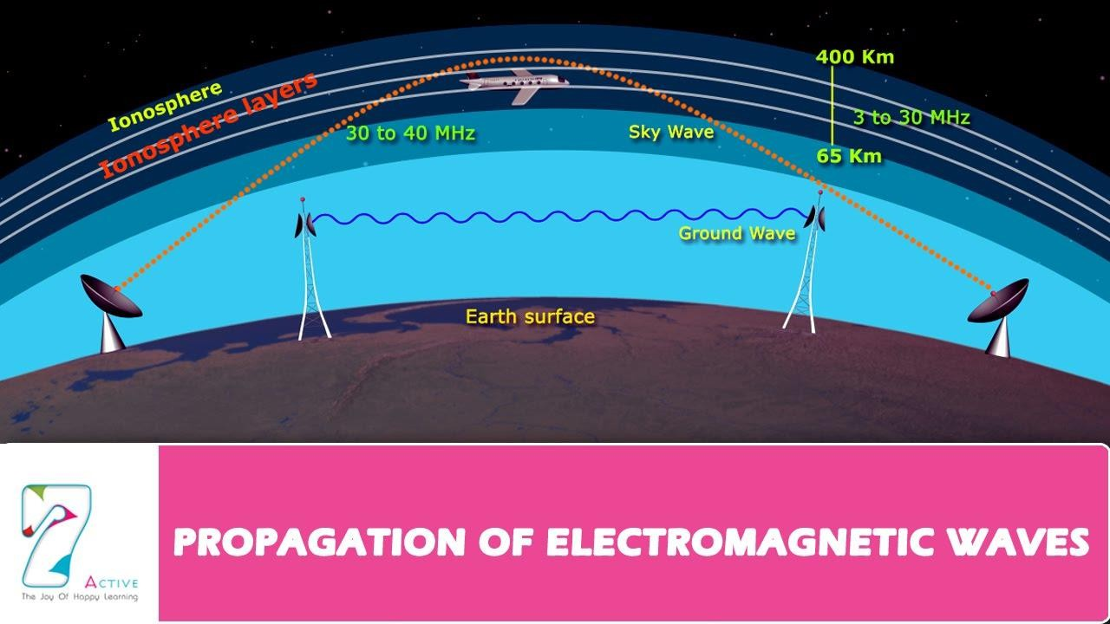

Slide 19
Prerequisites to Understand
Basics of charge properties
Vector Algebra and its Properties
Few Formulae of Differentiation
Few Formulae of Integration
Coordinate Systems

Slide 20
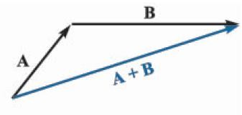
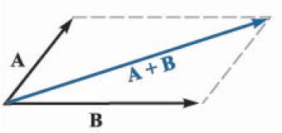
Vector Algebra
A vector quantity has both a magnitude and a direction in space. We especially
concerned with two- and three-dimensional spaces only.
Examples, Displacement, velocity, acceleration, and force are examples of vectors.
A + B = B + A
A + (B + C) = (A + B) + C
A − B = A + (−B)

Slide 21
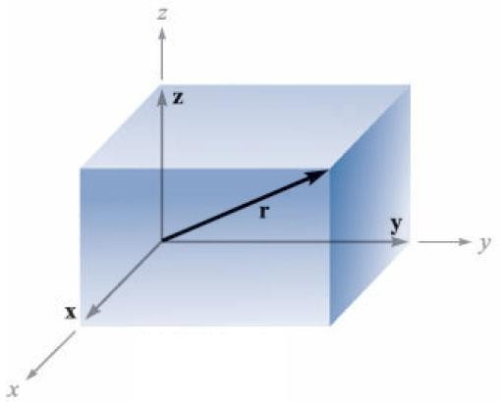
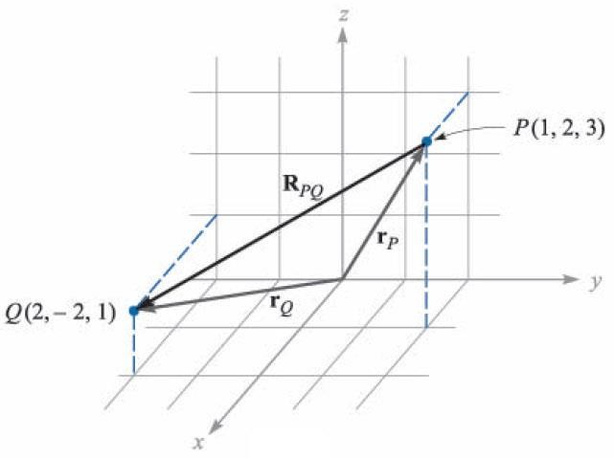
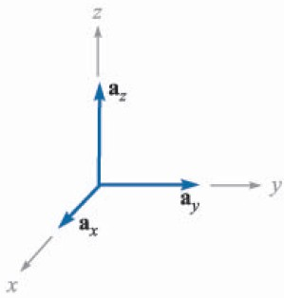
Vector Components and Unit Vectors
R_{PQ} ?
r = x + y + z
r = xa_{x} + ya_{y} + za_{z}
a_{x} , a_{y} , a_{z} : unit vectors
R_{PQ} = r_{Q} − r_{P}
= (2a_{x} − 2a_{y} + a_{z} ) − (1a_{x} + 2a_{y} + 3a_{z} )
= a_{x} − 4a_{y} − 2a_{z}

Slide 22
Vector Components and Unit Vectors
For any vector B,
B = B_{x}a_{x} + B: _{y}a_{y} + B_{z}a_{z}
B = B² + B² + B² = B
x y z
Magnitude of B
B
₌ B
a =
Unit vector in the direction of B
B
B² + B² + B²
x y z
B
Example
Given points M(–1,2,1) and N(3,–3,0), find R_{MN} and a_{MN}.
^{R}MN
= (3a_{x} − 3a_{y} + 0a_{z} ) −(−1a_{x} + 2a_{y} +1a_{z} ) = 4a_{x} − 5a_{y} − a_{z}
₌ ^{R}MN
4a_{x} − 5a_{y} −1a_{z}
a
=
= 0.617a_{x} − 0.772a_{y} − 0.154a
MN
R
₄2
+ (−5)² + (−1)²
z
MN

Slide 23
The Dot Product
Example :The three vertices of a triangle are located at A(6,–1,2), B(–2,3,–4),
and C(–3,1,5). Find: (a) R_{AB}; (b) R_{AC}; (c) the angle θ_{BAC} at vertex A; (d)
R_{AB} = (−2a_{x} + 3a_{y} − 4a_{z} ) −(6a_{x} − a_{y} + 2a_{z} ) = −8a_{x} + 4a_{y} − 6a_{z}
R_{AC} = (−3a_{x} +1a_{y} + 5a_{z} ) −(6a_{x} − a_{y} + 2a_{z} ) = −9a_{x} + 2a_{y} + 3a_{z}
B
^{θ}BAC
C
^{R}AB ^{⋅ R}AC ^{= R}AB ^{R}AC
cosθ_{BAC}
A
(−8a_{x} + 4a_{y} − 6a_{z} ) ⋅ (−9a_{x} + 2a_{y} + 3a_{z} ) (−8)² + (4)² + (−6)² (−9)² + (2)² + (3)²
⇒ cosθ
₌ ^{R} AB ^{⋅ R} AC
^{R} AB ^{R} AC
=
= ⁶² = 0.594
116 94
BAC
⇒θ_{BAC} = cos (0.594)
−1
= 53.56°

Slide 24
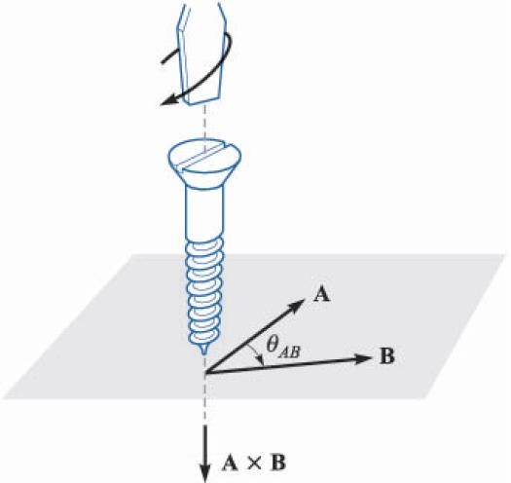
The Cross Product
Given two vectors A and B, the magnitude of the cross product, or vector product, written as A×B, is defines as the product of the magnitude of A, the magnitude of B, and the sine of the smaller angle between them.
The direction of A×B is perpendicular to the plane containing A and B and is in the direction of advance of a right-handed screw as A is turned into B.
A × B = a_{N} A B sinθ_{AB}
a_{x} × a_{y} = a_{z}
a × a = a
y z x
The cross product is a vector, and it is not
commutative:
a_{z} × a_{x} = a_{y}
(B × A) = −(A × B)

Slide 25
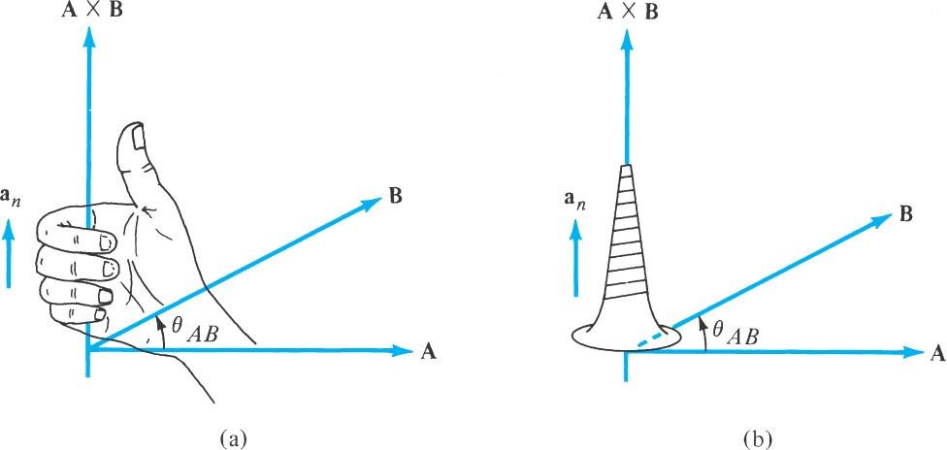

Slide 26
The Cross Product
Example
Given A = 2a_{x}–3a_{y}+a_{z} and B = –4a_{x}–2a_{y}+5a_{z}, find A×B.
A×B = (A_{y} B_{z} − A_{z} B_{y} )a_{x} + (A_{z} B_{x} − A_{x} B_{z} )a_{y} + (A_{x} B_{y} − A_{y} B_{x} )a_{z}
= ((−3)(5) − (1)(−2))a_{x} + ((1)(−4) − (2)(5))a_{y} + ((2)(−2) −(−3)(−4))a_{z}
= −13a_{x} −14a_{y} −16a_{z}

Slide 27
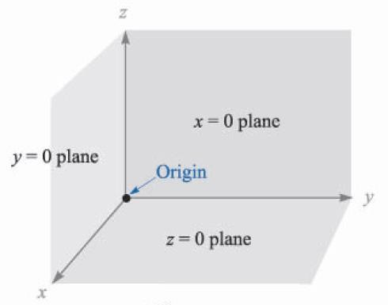
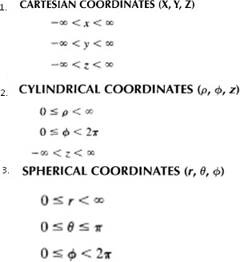
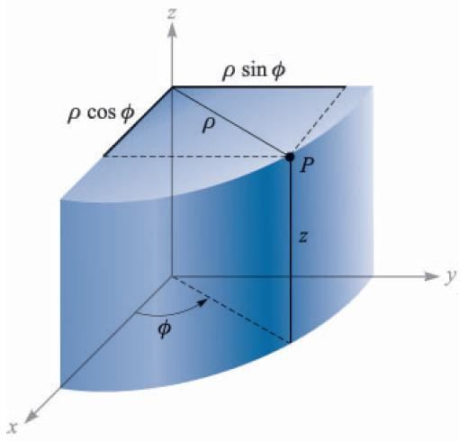
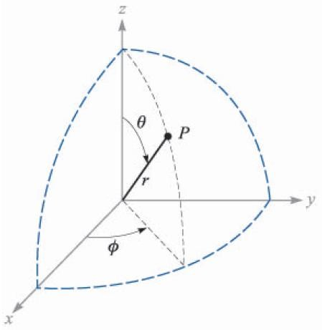
Fundamental Coordinate Systems

Slide 28
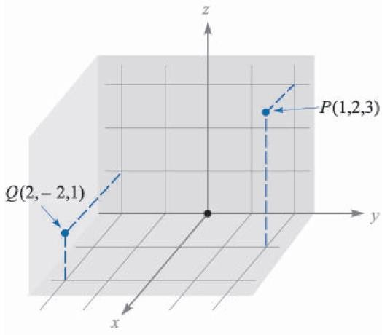
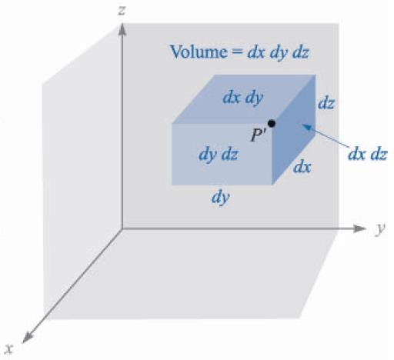
Rectangular Coordinate System
Differential surface units:
dx ⋅ dy dy ⋅ dz dx ⋅ dz
Differential volume unit :
dx ⋅ dy ⋅ dz

Slide 29
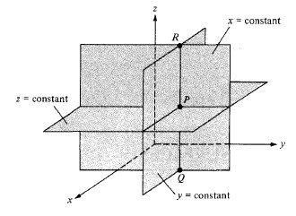

Slide 30

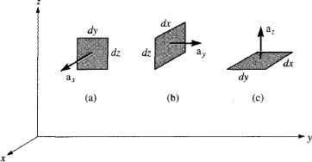

Slide 31
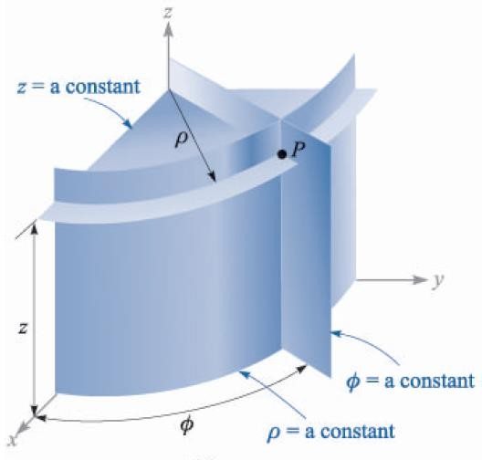
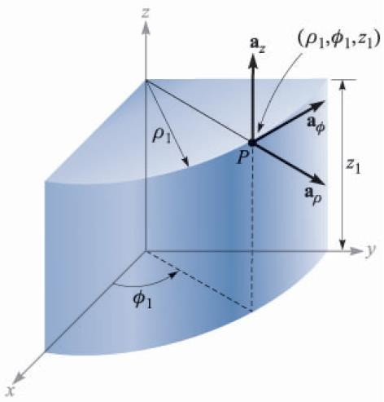
The Cylindrical Coordinate System

Slide 32
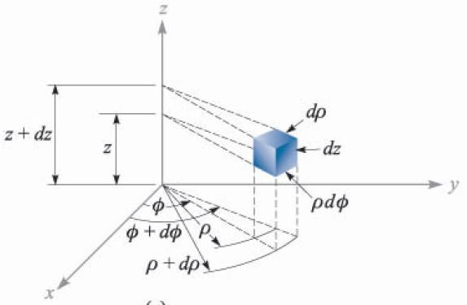
The Cylindrical Coordinate System
Differential Surface
dρ ⋅ dz
ρdφ ⋅ dz
dρ ⋅ ρdφ
Differential volume unit :
dρ ⋅ ρdφ ⋅ dz

Slide 33
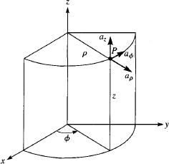
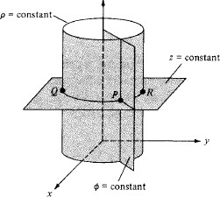

Slide 34

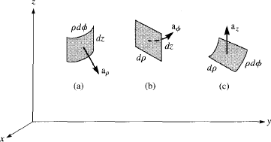

Slide 35
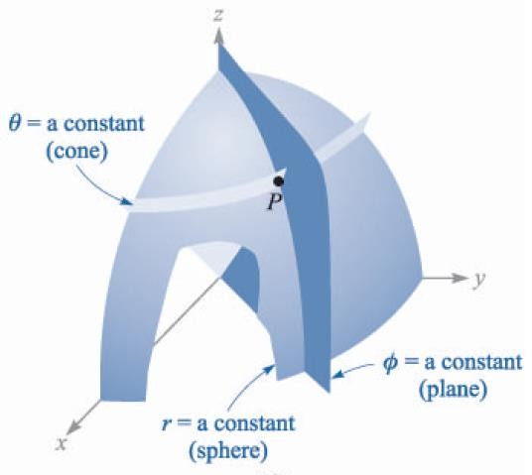
The Spherical Coordinate System

Slide 36
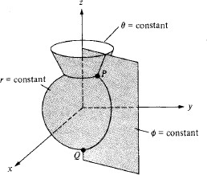

Slide 37

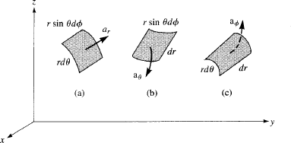


Slide 38
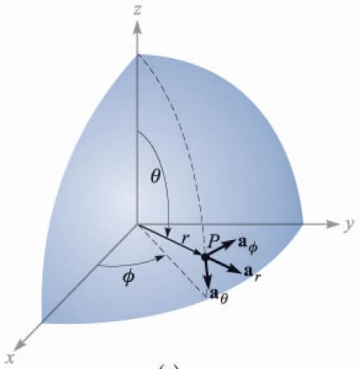
The Spherical Coordinate System
Relation between the rectangular and the spherical coordinate systems
x = r sinθ cosφ r = x² + y² + z² , r ≥ 0
z
y = r sinθ sin φ θ = cos⁻¹
, 0° ≤ θ ≤ 180°
_{x}2
+ y² + z²
y x
z = r cosθ
φ = tan⁻¹

Slide 39
The Spherical Coordinate System
Example
Given the two points, C(–3,2,1) and D(r = 5, θ = 20°, Φ = –70°), find: (a) the spherical coordinates of C; (b) the rectangular coordinates of D.
r = x² + y² + z² = (−3)² + (2)² + (1)² = 3.742
z 1
θ = cos⁻¹
= cos⁻¹
= 74.50°
_{x}2
+ y² + z²
3.742
2
φ = tan^{−1 y} = tan⁻¹ = −33.69° +180° =146.31°
x −3
∴C(r = 3.742,θ = 74.50°,φ = 146.31°)
∴ D(x = 0.585, y = −1.607, z = 4.698)

Slide 40


Slide 41
Module 2
Gauss’s Law and Its Applications
Girish M.
Swetha K T
Asst. Professor Dept. of ECE ATMECE

Slide 42
Agenda
Importance of Engineering Electromagnetics
Takeaways of Module 1
Course Objectives and Outcomes of module 2
Module 2: Gauss’s Law and Divergence
Module 2: Energy, Potential and Conductors
Takeaways of module 2

Slide 43
Takeaways of Module 1
Law of Coulomb :Coulomb stated that the force between two very small objects separated in vacuum or free space by a distance which is large compared to their size is proportional to the charge on each and inversely proportional to the square of the distance between them.
In vector form, Coulomb’s law is written as:
1 Q₁Q_{2 a}
F =
_{R}2
2
4πε
12
0 12
❑ Electric Field Intensity:
1 Q_{1 a}
E = ^{Ft} =
_{R}2
Q 4πε
1t
t
0 1t

Slide 44
Takeaways of Module 1
Charge Distributions:
The total charge within some finite volume is obtained by integrating throughout that
volume:
Q = ∫ ρ_{v}dv
vol
  Similarly Line and surface charge Distribution

Slide 45
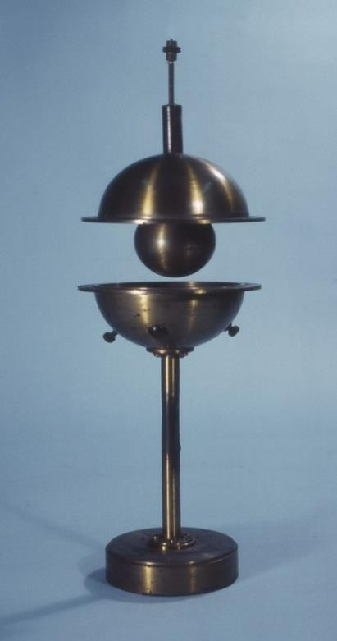
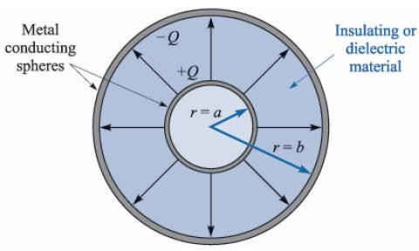
Takeaways of Module 1
Electric Flux: Faraday’s Experiment

Slide 46
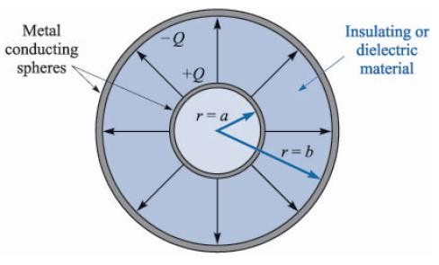
Takeaways of Module 1
At the surface of the inner sphere, ψ coulombs of electric flux are produced by the given charge Q coulombs, and distributed uniformly over a surface having an area of 4πa² m².
The density of the flux at this surface is ψ/4πa
or Q/4πa² C/m².
The new quantity, electric flux density, is measured in C/m² and
denoted with D.
The direction of D at a point is the direction of the flux lines at that point.
The magnitude of D is given by the number of flux lines crossing a surface normal to the lines divided by the surface area.
2

Slide 47
Takeaways of Module 1
Referring again to the concentric spheres, the electric flux density is in the radial direction :
Q
4πa²
D =
a
(inner sphere)
r =a
r
Q
4πb²
D =
a
(outer sphere)
r =b
r
At a distance r, where a ≤ r ≤ b,
Q
4π r ²
D =
a
r
If we make the inner sphere smaller and smaller, it becomes a point charge while still retaining a charge of Q. The electrix flux density at a point r meters away is still given by:
Q
4π r ²
D =
a
r

Slide 48
Takeaways of Module 1
Relation between E and D:
Comparing with the previous chapter, the radial electric field intensity of a point charge in free space is:
Q
Q
4π r ²
E = a
D =
a
4πε r
2
r
r
0
Therefore, in free space, the following relation applies:
D = ε₀E
For a general volume charge distribution in free space:
ρ_{v} dv
E =
∫
a
vol
4πε R
2
R
0
ρ_{v}dv _{a}
D =
∫vol _{4π R}²
R

Slide 49
Example on Electric Flux Density
Example
Find the electric flux density at a point having a distance 3 m from a uniform line charge of 8 nC/m lying along the z axis in free space.
ρ
ρ
8×10⁻⁹
2πρ
1.273×10⁻⁹
ρ
E = ^{L} a_{ρ}
⇒ D = ^{L} a_{ρ} =
a_{ρ} =
a_{ρ} C m
2
2πε₀ ρ
2πρ
For the value ρ = 3 m,
1.273×10⁻⁹
−10
2
2
D = = 4.244×10 a_{ρ} C m
= 0.424a_{ρ} nC m
3

Slide 50
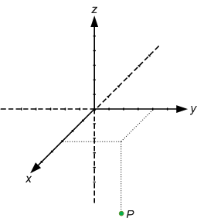
Example on Electric Flux Density
Example
Calculate D at point P(6,8,–10) produced by a uniform surface charge density with ρ_{s}
= 57.2 μC/m² on the plane x = 9.
E = ^{ρs} a
⇒ D = ^{ρs} a
₌ 57.2×10⁻⁶
a_{N} = 28.6a_{N} μC m
2
2ε
N
2
N
2
0
At P(6,8,–10),
a_{N} = −a_{x}
⇒ D = −28.6a_{x} μC m
2

Slide 51
Limitations of Coulomb's Law
Its only applicable for point charges at rest.
Its only applicable in those cases where inverse square law is obeyed.
It is difficult to apply the Coulomb's law when the charges are in arbitrary shape.
Why Gauss’s Law?
The ultimate goal of Gauss's law in electrostatics is to find the electric field for a given charge distribution, enclosed by a closed surface. The determination of electric field becomes much simpler if the body due to closed surface exhibits some symmetry in relation to the given charge distribution.

Slide 52
Module 2: Gauss’s Law
“The electric flux passing through any closed surface is equal to the
total charge enclosed by that surface.”
ψ = Q

Slide 53
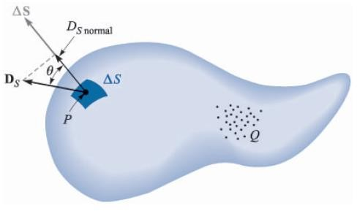
Gauss’s Law
Imagine a distribution of charge, shown as a cloud of point charges, surrounded by a closed surface of any shape.
If the total charge is Q, the Q coulombs of electric flux will pass through the enclosing surface.
At every point on the surface the electric-flux-density vector D will have some value D_{S} (subscript S means that D must be evaluated at the surface).

Slide 54
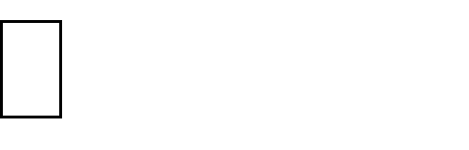
Gauss’s Law
ΔS defines an incremental element of area with magnitude of ΔS and the direction
normal to the plane, or tangent to the surface at the point in question.
At any point P, where D_{S} makes an angle θ with ΔS, then the flux crossing ΔS is the product of the normal components of D_{S} and ΔS.
Δψ = flux crossing ΔS = D_{S} cosθ ⋅ΔS = D_{S} ⋅ΔS
∫ ∫
ψ = dψ =
D_{S} ⋅ dS
closed
surface

Slide 55
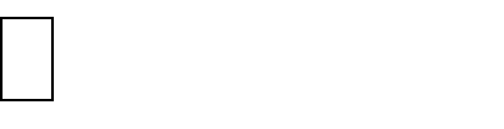
Gauss’s Law
The resultant integral is a closed surface integral, with dS always involves the differentials of two coordinates
  The integral is a double integral.
We can formulate the Gauss’s law mathematically as:
ψ = _{∫S} D_{S} ⋅ dS = charge enclosed = Q
The charge enclosed meant by the formula above might be several point charges, a line charge, a surface charge, or a volume charge distribution.
Q = ∑Q_{n} Q = ∫ ρ_{L}dL Q = _{∫S} ρ_{S} dS Q = _{∫vol} ρ_{v}dv

Slide 56

Example on Gauss’s Law
The electric flux density free space find
  Electric field intensity at r=0.2m
  Total Charge within the sphere of radius 0.3m
nc/m² is in
Ans i) 7.5295a_{r}
ii) 113.097 pC

Slide 57
Example on Gauss’s Law
Given Evaluate the amount of Electric Flux that passes through the portion bounded by - 1≤x≤2, 0≤z≤4 in x=3 plane using gauss’s law.
Ans: Flux=36C

Slide 58
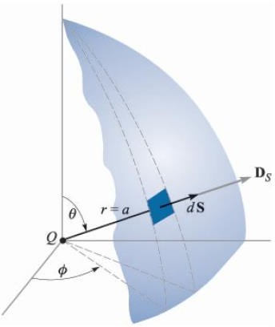
Illustration of Gauss’s Law for Point Charge
. Let a point charge Q be placed at the origin of a spherical coordinate system, and choose a closed surface as a sphere of radius a.
The electric field intensity due to the point charge has been found to be:
Q
E = a
4πε r
2
r
0
Q
4π r ²
D = ε E ⇒ D =
a
0
r

Slide 59
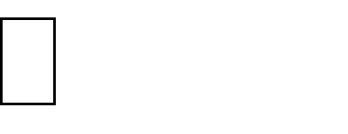
Illustration of Gauss’s Law for Point Charge
At the surface, r = a,
Q
4πa²
D =
a
S
r
dS = a² sinθ dθdφ a
r
Q
4πa²
Q
4π
a sin θdθdφ a ⋅ a
sinθdθdφ
D ⋅ dS =
2
=
S
r r
ψ = _{∫S} D_{S} ⋅ dS
2π π
=
∫ ∫
^{Q} sinθdθdφ
φ =0 θ =0 _{4π}
r =a
Q
π
2π
φ =0
=−
cosθ θ
4π
θ =0
= Q

Slide 60
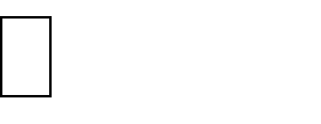
Application of Gauss’s Law: Some Symmetrical Charge Distributions
Let us now consider how to use the Gauss’s law to calculate the electric field
intensity D_{S}:
Q = _{∫S} D_{S} ⋅ dS
The solution will be easy if we are able to choose a closed surface which satisfies two conditions:
  D_{S} is everywhere either normal or tangential to the closed surface, so that D_{S}⋅dS
becomes either D_{S}dS or zero, respectively.
  On that portion of the closed surface for which D_{S}⋅dS is not zero, D_{S} is constant.
For point charge ► The surface of a sphere.
For line charge ► The surface of a cylinder.

Slide 61
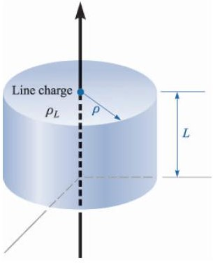
Infinite Line Charge
From the previous discussion of the uniform line
charge, only the radial component of D is present:
D = D_{ρ} a_{ρ}
The choice of a surface that fulfill the requirement is simple: a cylindrical surface.
D_{ρ} is every normal to the surface of a cylinder. It may then be closed by two plane surfaces normal to the z axis.

Slide 62
Infinite Line Charge
Q = _{∫S} D_{S} ⋅ dS
= D_{ρ ∫sides} dS_{ρ ρ =ρ′} + D_{z ∫top} dS_{z}
z=L
^{+ Dz} ∫bottom ^{dSz}
z=0
L 2π
= D
∫ ∫
ρdφdz
ρ
z=0 φ =0
= D_{ρ} 2πρL
Q
2πρ L
⇒ D =
ρ
We know that the charge enclosed is ρ_{L}L,
₌ ρ_{L}
D
ρ
2πρ
E_{ρ} = | ρ_{L}
 | 2πε₀ ρ

Slide 63
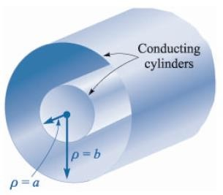
Coaxial Cable
The problem of a coaxial cable is almost identical with that of the line charge.
Suppose that we have two coaxial cylindrical conductors, the inner of radius a and the outer of radius b, both with infinite length.
We shall assume a charge distribution of ρ_{S} on the outer surface of the inner conductor.
Choosing a circular cylinder of length L and radius ρ, a < ρ < b, as the gaussian surface, we find:
Q = D_{S} 2πρ L
The total charge on a length L of the inner conductor is:
L 2π
_{D =} aρ_{S}
Q =
∫ ∫
ρ_{S} adφdz = 2π aLρ
⇒
z=0 φ =0
S
S
ρ

Slide 64
Coaxial Cable
For one meter length, the inner conductor has 2πaρ_{S} coulombs, hence ρ_{L} = 2πaρ_{S},
D = ^{ρL} a
2πρ
ρ
Everly line of electrix flux starting from the inner cylinder must terminate on the inner surface of the outer cylinder:
^{Q}outer cyl ^{= −2π aLρ}S ,inner cyl
^{2πbLρ}S ,outer cyl ^{= −2π aLρ}S ,inner cyl
Due to simplicity, noise immunity and broad bandwidth, coaxial cable is still the most common means of data transmission over short distances.
ρ = − ª ρ
S ,outer cyl S ,inner cyl
b
If we use a cylinder of radius ρ > b,
then the total charge enclosed will be zero.
  There is no external field,

Slide 65
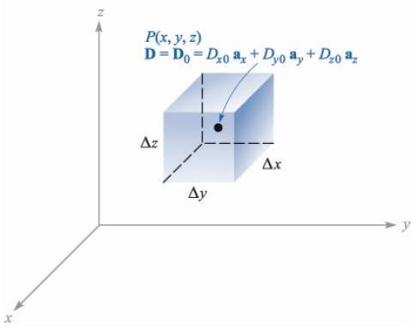


Application of Gauss’s Law: Differential Volume Element
Consider any point P, located by a rectangular
coordinate system.
The value of D at the point P may be expressed in rectangular components:
D₀ = D_{x0}a_{x} + D_{y0}a_{y} + D_{z0}a_{z}
We now choose as our closed surface, the small rectangular box, centered at P, having sides of lengths Δx, Δy, and Δz, and apply Gauss’s law:
_{∫S} D ⋅ dS = Q
∫S ^{D ⋅ dS =} ∫front ⁺∫back ⁺∫left ⁺∫right ⁺∫top ⁺∫bottom

Slide 66





Application of Gauss’s Law: Differential Volume Element
We will now consider the front surface in detail.
The surface element is very small, thus D is essentially constant over this surface (a portion of the entire closed surface):
∫front
^{D}front ^{⋅ ΔS}front
D_{front} ⋅ΔyΔz a_{x}
^{D}x,front ^{ΔyΔz}
The front face is at a distance of Δx/2 from P, and therefore:
D D + ^{Δx} × rate of change of D with x
x,front x 0
2
x
₊ Δx ∂D_{x}
D
x0
2 ∂x

Slide 67





Application of Gauss’s Law: Differential Volume Element
We have now, for front surface:
⎛ _{D}
∫front
⎜ x0
+ ^{Δx ∂Dx ⎞}ΔyΔz
2 ∂x ⎟
⎝ ⎠
In the same way, the integral over the back surface can be found as:
∫back
^{D}back ^{⋅ ΔS}back
D_{back} ⋅ (−ΔyΔz a_{x} )
−D_{x,back} ΔyΔz
₋ Δx ∂D_{x}
D
D
x,back
x0
2 ∂x
∫back
⎛−D + ^{Δx ∂Dx ⎞}ΔyΔz
⎜
x0
⎝
2 ∂x ⎟
⎠

Slide 68




Application of Gauss’s Law: Differential Volume Element
If we combine the two integrals over the front and back surface, we have:
∫
+ ∫ ^{∂Dx} ΔxΔyΔz
front back
∂x
Repeating the same process to the remaining surfaces, we find:
∫
+ ∫ ^{∂Dy} ΔyΔxΔz
right
left
∂y
∫
+ ∫ ^{∂Dz} ΔzΔxΔy
top bottom
∂z
These results may be collected to yield:
⎛ ∂D_{x}
₊ ∂D_{y}
∫_{S}
D ⋅ dS
+ ^{∂Dz ⎞} ΔxΔyΔz
⎜ ∂x ∂y
∂z ⎟
⎝
⎠
⎛ ∂D_{x}
₊ ∂D_{y}
∫
D ⋅ dS = Q
+ ^{∂Dz ⎞} Δv
⎜ ∂x ∂y
∂z ⎟
S
⎝
⎠
28

Slide 69
Application of Gauss’s Law: Differential Volume Element
The previous equation is an approximation, which becomes better as Δv becomes smaller.
For the moment, we have applied Gauss’s law to the closed surface surrounding the volume element Δv, with the result:
⎛ ∂D_{x}
₊ ∂D_{y}
Charge enclosed in volume Δv
+ ^{∂Dz ⎞}× Δv
⎜ ∂x ∂y
∂z ⎟
⎝
⎠

Slide 70
Divergence
Gives a measure of the quantity of flux emanating from any point of the
vector field or the rate of loss of mass, heat, etc.,
“The divergence of the vector flux density A is the outflow of flux from a small closed surface per unit volume as the volume shrinks to zero.”

Slide 71




Divergence
We shall now obtain an exact relationship, by allowing the volume element Δv to shrink to zero.
_{∫S} D ⋅ dS _{= Q}
Δv Δv
₊ ∂D_{y}
⎛ ∂D_{x +} ∂D_{z} ⎞
⎜ ∂x ∂y ∂z ⎟
⎝ ⎠
⇓
⎛ ∂D_{x}
₊ ∂D_{y}
+ ^{∂Dz ⎞} = lim ^{∫S D ⋅ dS} = lim ^{Q}
⎜ ∂x ∂y
∂z ⎟ Δv
Δv→0 _{Δv}
⎝ ⎠
Δv→0
The last term is the volume charge density ρ_{v}, so that:
⎛ ∂D_{x}
₊ ∂D_{y}
+ ^{∂Dz ⎞} = lim ^{∫S D ⋅ dS} = ρ
⎜ ∂x ∂y
∂z ⎟ Δv
v
⎝
⎠
Δv→0

Slide 72


Divergence
Let us no consider one information that can be obtained from the last equation:
⎛ ∂D_{x}
₊ ∂D_{y}
+ ^{∂Dz ⎞} = lim ^{∫S D ⋅ dS}
⎜ ∂x ∂y
∂z ⎟ Δv
⎝ ⎠
Δv→0
This equation is valid not only for electric flux density D, but also to any vector field A
to find the surface integral for a small closed surface.
⎛ ∂A_{x}
₊ ∂A_{y}
+ ^{∂Az ⎞} = lim ^{∫S A ⋅ dS}
⎜ ∂x ∂y
∂z ⎟ Δv
⎝
⎠
Δv→0

Slide 73

Divergence
This operation received a descriptive name, divergence. The divergence of A is
defined as:
Divergence of A = div A = lim ^{∫S A ⋅ dS}
Δv→0
Δv
“The divergence of the vector flux density A is the outflow of flux from a small closed surface per unit volume as the volume shrinks to zero.”
A positive divergence of a vector quantity indicates a source of that vector quantity at
that point.
Similarly, a negative divergence indicates a sink.

Slide 74
Divergence in different coordinate system
₊ ∂D_{z}
div D = ^{∂Dx} + ^{∂Dy}
∂x ∂y ∂z
Rectangular
∂
1
∂D
∂D
div D = ¹
(ρD ) +
φ
+
z
Cylindrical
ρ ∂ρ
ρ
ρ ∂φ ∂z
1
1
∂D_{φ}
div D = ^{1 ∂} (r² D ) +
∂ (sinθD ) +
Spherical
_{r}2
∂r
r
r sinθ ∂θ
θ
r sinθ ∂φ

Slide 75

Maxwell’s First Equation (Electrostatics)
We may now rewrite the expressions developed until now:
div D = lim ^{∫S D ⋅ dS}
Δv→0
Δv
₊ ∂D_{y}
₊ ∂D_{z}
div D = ^{∂Dx}
∂x ∂y ∂z
div D = ρ_{v}
Maxwell’s First Equation
Point Form of Gauss’s Law
This first of Maxwell’s four equations applies to electrostatics and steady magnetic
field.
Physically it states that the electric flux per unit volume leaving a vanishingly small volume unit is exactly equal to the volume charge density there.

Slide 76
The Vector Operator ∇
Divergence is an operation on a vector yielding a scalar, just like the dot product.
We define the del operator ∇ as a vector operator:
∇ = ∂ a + ∂ a + ∂ a
x y
z
∂x ∂y ∂z
Then, treating the del operator as an ordinary vector, we can write:
∇⋅ D = ⎛ ∂ a + ∂ a + ∂ a ⎞⋅(D a
+ D a + D a )
x
y
z ⎟ x x
y y
z z
⎜ ∂x
∂y ∂z
⎝
⎠
₊ ∂D_{y}
₊ ∂D_{z}
∇⋅ D = ^{∂Dx}
∂x ∂y ∂z
₊ ∂D_{z}
div D = ∇⋅ D = ^{∂Dx} + ^{∂Dy}
∂x ∂y ∂z

Slide 77
The Vector Operator ∇ in different coordinate system
The ∇ operator does not have a specific form in other coordinate systems than rectangular coordinate system.
Nevertheless,
∂ 1
∂D
₊ ∂D_{z}
∇⋅ D = ¹
(ρD ) +
φ
Cylindrical
ρ ∂ρ
ρ
ρ ∂φ ∂z
1
1
∂D_{φ}
∇⋅ D = ^{1 ∂} (r² D ) +
∂ (sinθD ) +
Spherical
_{r}2
∂r
r
r sinθ ∂θ
θ
r sinθ ∂φ

Slide 78



Divergence Theorem
We shall now give name to a theorem that we actually have obtained, the Divergence Theorem:
_{∫S} D ⋅ dS = Q = _{∫vol} ρ_{v}dv = _{∫vol} ∇⋅ Ddv
The first and last terms constitute the divergence theorem:
_{∫S} D ⋅ dS = _{∫vol} ∇⋅ D dv
“The integral of the normal component of any vector field over a closed surface is equal to the integral of the divergence of this vector field throughout the volume enclosed by the closed surface.”

Slide 79

Example of Divergence Theorem
Example
Evaluate both sides of the divergence theorem for the field
D = 2xy a_{x} + x² a_{y} C/m² and the rectangular parallelepiped fomed by the planes x = 0 and 1, y = 0 and 2, and z = 0 and 3.
_{∫S} D ⋅ dS = _{∫vol} ∇⋅ D dv
Divergence Theorem
3 2
3 2
∫ ∫ ∫
∫ ∫
D ⋅ dS =
(D) ⋅ (−dydz a ) +
(D)_{x=1} ⋅ (dydz a_{x} )
S
S
0 0
x=0
x
0 0
3 1
3 1
⁺ ∫ ∫
(D) _{y=0} ⋅ (−dxdz a _{y} ) +
∫ ∫
(D) _{y=2} ⋅ (dxdz a_{y} )
0 0
0 0
But
^{(D}x ⁾x=0 ^{= 0, (D}y ⁾y=0 ^{= (D}y ⁾y=2
3 2
3 2
∫
D ⋅ dS =
∫ ∫
(D_{x} )_{x=1} dydz =
∫ ∫
2 ydydz
= 12 C
S
S
0 0
0 0

Slide 80
Example of Divergence Theorem
∇ ⋅ D= ∂ (2xy) + ∂ (x² ) = 2 y
∂x ∂y
3
2 1
∫ ∫ ∫ ∫
∇⋅ D dv = (2 y)dxdydz
vol z =0 y=0 x=0
= x ¹ y² ² z ³
0 0
0
= 12 C
∴ _{∫S} D ⋅ dS = _{∫vol} ∇⋅ D dv = 12 C

Slide 81


Slide 82
Engineering Electromagnetics
Module 3 to 5:
Girish M
Swetha K T
Associate Professor Dept. of ECE

Slide 83

Motivating the Magnetic Field Concept: Forces Between Currents
Magnetic forces arise whenever we have charges in motion. Forces between current-carrying wires
present familiar examples that we can use to determine what a magnetic force field should look like:
Here are the easily-observed facts:
How can we describe a force field around wire 1 that can be used to determine the force on wire 2?

Slide 84

Magnetic Field
The geometry of the magnetic field is set up to correctly model forces between currents that
allow for any relative orientation. The magnetic field intensity, H, circulates around its source, I₁, in a direction most easily determined by the right-hand rule: Right thumb in the direction of the current, fingers curl in the direction of H
Note that in the third case (perpendicular currents), I₂ is in the same direction as H, so that their cross product (and the resulting force) is zero. The actual force computation involves a different field quantity, B, which is related to H through B = μ₀H in free space. This will be taken up in
a later lecture. Our immediate concern is how to find H from any given current distribution.

Slide 85



Biot-Savart Law
The Biot-Savart Law specifies the magnetic field intensity, H, arising from a “point source” current element of differential length dL.
The units of H are [A/m]
Note the similarity to Coulomb’s Law, in which
a point charge of magnitude dQ₁ at Point 1 would
Note in particular the inverse-square distance dependence, and the fact that the cross product will yield a field vector that points into the page. This is a formal statement of the right-hand rule
generate electric field at Point 2 given by:

Slide 86



Magnetic Field Arising From a Circulating Current
At point P, the magnetic field associated with the differential current element IdL is
To determine the total field arising from the closed circuit path, we sum the contributions from the current elements that make up the entire loop, or
The contribution to the field at P from any portion of the current will be just the above integral evalated over just that portion.

Slide 87





Two- and Three-Dimensional Currents
On a surface that carries uniform surface current density K [A/m], the current within width b is
..and so the differential current quantity that
appears in the Biot-Savart law becomes:
The magnetic field arising from a current sheet is thus found from the two-dimensional form of the Biot-Savart law:
In a similar way, a volume current will be made up
of three-dimensional current elements, and so the Biot-Savart
law for this case becomes:

Slide 88






Example of the Biot-Savart Law
In this example, we evaluate the magnetic field intensity on the y axis (equivalently in the xy plane)
arising from a filament current of infinite length in on the z axis.
Using the drawing, we identify:
and so..
so that:

Slide 89


Example: continued
We now have:
Integrate this over the entire wire:
..after carrying out the cross product

Slide 90





Example: concluded
Evaluating the integral:
we have:
Current is into the page.
Magnetic field streamlines
are concentric circles, whose magnitudes decrease as the inverse distance from the z axis
finally:

Slide 91





Field Arising from a Finite Current Segment
In this case, the field is to be found in the xy plane at Point 2.
The Biot-Savart integral is taken over the wire length:
..after a few additional steps (see Problem 7.8), we find:

Slide 92





Another Example: Magnetic Field from a Current Loop
Consider a circular current loop of radius a in the x-y plane, which carries steady current I. We wish to find the magnetic field strength anywhere on the z axis.
We will use the Biot-Savart Law:
where:

Slide 93



Example: Continued
Substituting the previous expressions, the Biot-Savart Law becomes:
carry out the cross products to find:
but we must include the angle dependence in the radial
unit vector:
with this substitution, the radial component will integrate to zero, meaning that all radial components will cancel on the z axis.

Slide 94


Example: Continued
Now, only the z component remains, and the integral evaluates easily:
Note the form of the numerator: the product of the current and the loop area. We define this as the magnetic moment:

Slide 95


Ampere’s Circuital Law
Ampere’s Circuital Law states that the line integral of H about any closed path
is exactly equal to the direct current enclosed by that path.
In the figure at right, the integral of H about closed paths a and b gives the total current I, while the integral over path c gives only that portion of the current that lies within c

Slide 96


Ampere’s Law Applied to a Long Wire
Symmetry suggests that H will be circular, constant-valued at constant radius, and centered on the current (z) axis.
Choosing path a, and integrating H around the circle of radius ρ gives the enclosed current, I:
ρ
so that:
as before.

Slide 97

Coaxial Transmission Line
In the coax line, we have two concentric solid conductors that carry equal and opposite currents, I.
The line is assumed to be infinitely long, and the
circular symmetry suggests that H will be entirely
φ - directed, and will vary only with radius ρ.
Our objective is to find the magnetic field for all values of ρ

Slide 98

Field Between Conductors
The inner conductor can be thought of as made up of a bundle of filament currents, each of which produces the field of a long wire.
Consider two such filaments, located at the same radius from the z axis, ρ₁, but which lie at symmetric
φ coordinates, φ₁ and -φ₁.Their field contributions
superpose to give a net H_{φ} component as shown. The same happens for every pair of symmetrically-located filaments, which taken as a whole, make up the entire center conductor.
The field between conductors is thus found to be the same
as that of filament conductor on the z axis that carries current,
I. Specifically:
a < ρ < b

Slide 99






Field Within the Inner Conductor
With current uniformly distributed inside the conductors, the H can be assumed circular everywhere.
Inside the inner conductor, and at radius ρ, we again have:
But now, the current enclosed is
so that
or finally:

Slide 100



Field Outside Both Conducors
Outside the transmission line, where ρ> c,
no current is enclosed by the integration path, and so
0
As the current is uniformly distributed, and since we have circular symmetry, the field would have to
be constant over the circular integration path, and so it must be true that:

Slide 101



Field Inside the Outer Conductor
Inside the outer conductor, the enclosed current consists of that within the inner conductor plus that portion of the outer conductor current existing at radii less than ρ
Ampere’s Circuital Law becomes
..and so finally:

Slide 102

Magnetic Field Strength as a Function of Radius in the Coax Line
Combining the previous results, and assigning dimensions as shown in the inset below, we find:

Slide 103




Magnetic Field Arising from a Current Sheet
For a uniform plane current in the y direction, we expect an x-directed H field from symmetry. Applying Ampere’s circuital law to the path we find:
or
In other words, the magnetic field is discontinuous across the current sheet by the magnitude of the surface
current density.

Slide 104





Magnetic Field Arising from a Current Sheet
If instead, the upper path is elevated to the line between and , the same current is enclosed and we would have
from which we conclude that so the field is constant in each region (above and below the current plane)
By symmetry, the field above the sheet must be the same in magnitude as the field below the sheet. Therefore, we may state that
and

Slide 105


Magnetic Field Arising from a Current Sheet
The actual field configuration is shown below, in which magnetic field above the current sheet is equal in magnitude, but in the direction opposite to the field below the sheet.
The field in either region is found by the cross product:
where a_{N} is the unit vector that is normal to the current sheet, and that points into the region in which the magnetic field is to be evaluated.

Slide 106

Magnetic Field Arising from Two Current Sheets
Here are two parallel currents, equal and opposite, as you would find in a parallel-plate transmission line. If the sheets are much wider than their spacing, then the magnetic field will be contained in the region between plates, and will be nearly zero outside.
H_{x2} (z > d/2 )
H_{x1} (z > d/2 )
These fields cancel for current sheets of infinite width.
K₁ = -K_{y} a_{y}
H_{x1} (-d /2 < z < d/2 )
H_{x2} (-d /2 < z < d/2 )
These fields are equal and add to give
H = K x a_{N} (-d/2 < z < d/2 )
K₂ = -K_{y} a_{y}
where K is either K₁ or K₂
These fields cancel for current sheets of infinite width.
H_{x1} (z < -d/2 )
H_{x2} (z < -d/2 )

Slide 107

Current Loop Field
Using the Biot-Savart Law, we previously found the magnetic field on the z axis from a circular current loop:
We will now use this result as a building block to construct the magnetic field on the axis of
a solenoid -- formed by a stack of identical current loops, centered on the z axis.

Slide 108




On-Axis Field Within a Solenoid
We consider the single current loop field as a differential contribution to the total field from a stack of N closely-spaced
loops, each of which carries current I. The length of the stack
(solenoid) is d, so therefore the density of turns will be N/d.
z
d/2
Now the current in the turns within a differential length, dz, will be
We consider this as our differential “loop current”
so that the previous result for H from a single loop:
-d/2
now becomes:
in which z is measured from the center of the coil, where we wish to evaluate the field.

Slide 109



Solenoid Field, Continued
The total field on the z axis at z = 0 will be the sum of the field contributions from all turns in the coil -- or the integral of dH over the length of the solenoid.
z
d/2
-d/2

Slide 110




Approximation for Long Solenoids
We now have the on-axis field at the solenoid midpoint (z = 0):
z
d/2
Note that for long solenoids, for which result simplifies to:
,
the
-d/2
( )
This result is valid at all on-axis positions deep within long coils -- at distances from each end of several radii.

Slide 111



Another Interpretation: Continuous Surface Current
The solenoid of our previous example was assumed to have many tightly-wound turns, with several existing within a differential length, dz. We could model such a current configuration as a continuous surface current of density K = K_{a} a_{φ} A/m.
d/2
Therefore:
-d/2
In other words, the on-axis field magnitude near the center of a cylindrical current sheet, where current circulates around the z axis, and whose length is much greater than its radius, is just the surface current density.

Slide 112

Solenoid Field -- Off-Axis
To find the field within a solenoid, but off the z axis, we apply Ampere’s Circuital Law in the following way:
The illustration below shows the solenoid cross-section, from a lengthwise cut through the z axis. Current in
the windings flows in and out of the screen in the circular current path. Each turn carries current I. The magnetic field along the z axis is NI/d as we found earlier.

Slide 113


Application of Ampere’s Law
Applying Ampere’s Law to the rectangular path shown below leads to the following:
Where allowance is made for the existence of a radial H component,

Slide 114

Radial Path Segments
The radial integrals will now cancel, because they are oppositely-directed, and because in the long coil, is not expected to differ between the two radial path segments.

Slide 115

Completing the Evaluation
What is left now are the two z integrations, the first of which we can evaluate as shown. Since
this first integral result is equal to the enclosed current, it must follow that the second integral -- and
the outside magnetic field -- are zero.

Slide 116

Finding the Off-Axis Field
The situation does not change if the lower z-directed path is raised above the z axis. The vertical paths still cancel, and the outside field is still zero. The field along the path A to B is therefore NI/d as before.
Conclusion: The magnetic field within a long solenoid is approximately constant throughout the coil cross-section, and is H_{z} = NI/d.

Slide 117


Toroid Magnetic Field
A toroid is a doughnut-shaped set of windings around a core material. The cross-section could be circular (as shown here, with radius a) or any other shape.
Below, a slice of the toroid is shown, with current emerging from the screen around the inner periphery (in the positive z direction). The windings are modeled
as N individual current loops, each of which carries current I.

Slide 118






Ampere’s Law as Applied to a Toroid
Ampere’s Circuital Law can be applied to a toroid by taking a closed loop integral around the circular contour C at radius ρ. Magnetic field H is presumed to be circular, and a function of radius only at locations within the toroid that are not too close to the individual windings. Under this condition, we would assume:
This approximation improves as the density of turns gets higher (using more turns with finer wire).
Ampere’s Law now takes the form:
so that….
Performing the same integrals over contours drawn in the regions or will lead to zero magnetic field there, because no current is enclosed in either case.

Slide 119




Surface Current Model of a Toroid
Consider a sheet current molded into a doughnut shape, as shown. The current density at radius crosses the xy plane in the z direction and is given in magnitude by K_{a}
Ampere’s Law applied to a circular contour C inside the toroid (as in the previous example) will take the form:
leading to…
inside the toroid…. and the field is zero outside as before.

Slide 120

Ampere’s Law as Applied to a Small Closed Loop.
Consider magnetic field H evaluated at the point shown in the figure. We can approximate the field over the closed path 1234 by making appropriate adjustments in the value of H along each segment.
The objective is to take the closed path integral
and ultimately obtain the point form of Ampere’s Law.

Slide 121


Approximation of H Along One Segment
Along path 1-2, we may write:
where:
And therefore:

Slide 122


Contributions of y-Directed Path Segments
The contributions from the front and back sides will be:
The contribution from the opposite side is:
Note the path directions as specified in the figure, and how these determine the signs used .
This leaves the left and right sides…..

Slide 123


Contributions of x-Directed Path Segments
Along the right side (path 2-3):
…and the contribution from the left side (path 4-1) is:
The next step is to add the contributions of all four sides to find the closed path integral:

Slide 124

Net Closed Path Integral
The total integral will now be the sum:
and using our previous results, the becomes:

Slide 125




Relation to the Current Density
By Ampere’s Law, the closed path integral of H is equal to the enclosed current, approximated in this case by the current density at the center, multiplied by the loop area:
Dividing by the loop area, we now have:
The expression becomes exact as the loop area approaches zero:

Slide 126



Other Loop Orientations
The same exercise can be carried with the rectangular loop in the other two orthogonal orientations. The results are:
Loop in yz plane:
Loop in xz plane:
Loop in xy plane:
This gives all three components of the current density field.

Slide 127

Curl of a Vector Field
The previous exercise resulted in the rectangular coordinate representation of the Curl of H.
In general, the curl of a vector field is another field that is normal to the original field.
The curl component in the direction N, normal to the plane of the integration loop is:
The direction of N is taken using the right-hand convention: With fingers of the right hand oriented in the direction of the path integral, the thumb points in the direction of the normal (or curl).

Slide 128



Curl in Rectangular Coordinates
Assembling the results of the rectangular loop integration exercise, we find the vector field that comprises curl H:
An easy way to calculate this is to evaluate the following determinant:
which we see is equivalent to the cross product of the del operator with the field:

Slide 129


Curl in Other Coordinate Systems
…a little more complicated!
Look these up as needed….

Slide 130

Visualization of Curl
Consider placing a small “paddle wheel” in a flowing stream of water, as shown below. The wheel axis points into the screen, and the water velocity decreases with increasing depth.
The wheel will rotate clockwise, and give a curl component that points into the screen (right-hand rule).
Positioning the wheel at all three orthogonal orientations will yield measurements of all three components of the curl. Note that the curl is directed normal to both the field and the direction of its variation.

Slide 131


Another Maxwell Equation
It has just been demonstrated that:
…..which is in fact one of Maxwell’s equations for static fields:
This is Ampere’s Circuital Law in point form.

Slide 132


….and Another Maxwell Equation
We already know that for a static electric field:
This means that:
(applies to a static electric field)
Recall the condition for a conservative field: that is, its closed path integral is zero everywhere.
Therefore, a field is conservative if it has zero curl at all points over which the field is defined.

Slide 133




Curl Applied to Partitions of a Large Surface
Surface S is paritioned into sub-regions, each of small area
The curl component that is normal to a surface element can be written using the definition of curl:
or:
We now apply this to every partition on the surface, and add the results….

Slide 134



Adding the Contributions
Cancellation here:
We now evaluate and add the curl contributions from all surface elements, and note that adjacent path integrals will all cancel!
This means that the only contribution to the overall path integral will be around the outer periphery of surface S.
No cancellation here:
.
Using our previous result, we now write:

Slide 135


Stokes’ Theorem
We now take our previous result, and take the limit as
.
In the limit, this side becomes the path integral
of H over the outer perimeter because all interior paths cancel
In the limit, this side becomes the integral of the curl of H over surface S
The result is Stokes’ Theorem
This is a valuable tool to have at our disposal, because it gives us two ways to evaluate the same thing!

Slide 136




Obtaining Ampere’s Circuital Law in Integral Form, using Stokes’ Theorem
Begin with the point form of Ampere’s Law for static fields:
Integrate both sides over surface S:
..in which the far right hand side is found from the left hand side using Stokes’ Theorem. The closed path integral is taken around the perimeter of S. Again, note that we use the right-hand convention in choosing the direction of the path integral.
The center expression is just the net current through surface S, so we are left with the integral form of Ampere’s Law:

Slide 137








Magnetic Flux and Flux Density
We are already familiar with the concept of electric flux:
Coulombs
in which the electric flux density in free space is:
and where the free space permittivity is
In a similar way, we can define the magnetic flux in units of Webers (Wb):
Webers
in which the magnetic flux density (or magnetic induction) in free space is: and where the free space permeability is
This is a defined quantity, having to do with the definition of the ampere (we will explore this later).

Slide 138


A Key Property of B
If the flux is evaluated through a closed surface, we have in the case of electric flux, Gauss’ Law:
If the same were to be done with magnetic flux density, we would find:
The implication is that (for our purposes) there are no magnetic charges
-- specifically, no point sources of magnetic field exist. A hint of this has already been observed, in that magnetic field lines always close on themselves.

Slide 139


Another Maxwell Equation
We may rewrite the closed surface integral of B using the divergence theorem, in which the right hand integral is taken over the volume surrounded by the closed surface:
Because the result is zero, it follows that
This result is known as Gauss’ Law for the magnetic field in point form.

Slide 140



Maxwell’s Equations for Static Fields
We have now completed the derivation of Maxwell’s equations for no time variation. In point form, these are:
Gauss’ Law for the electric field
Conservative property of the static electric field
Ampere’s Circuital Law
Gauss’ Law for the Magnetic Field
Significant changes in the above four equations will occur when the fields are allowed to vary with time, as we’ll see later.
where, in free space:

Slide 141

Maxwell’s Equations in Large Scale Form
The divergence theorem and Stokes’ theorem can be applied to the previous four point form equations to yield the integral form of Maxwell’s equations for static fields:
Gauss’ Law for the electric field
Conservative property of the static electric field
Ampere’s Circuital Law
Gauss’ Law for the magnetic field

Slide 142




Example: Magnetic Flux Within a Coaxial Line
Consider a length d of coax, as shown here. The magnetic field strength between conductors is:
and so:
The magnetic flux is now the integral of B over the
flat surface between radii a and b, and of length d along z:
B
d
The result is:
The coax line thus “stores” this amount of magnetic flux in the region between conductors. This will have importance when we discuss inductance in a later lecture.

Slide 143



Scalar Magnetic Potential
We are already familiar with the relation between the scalar electric potential and electric field:
So it is tempting to define a scalar magnetic potential such that:
This rule must be consistent with Maxwell’s equations, so therefore:
But the curl of the gradient of any function is identically zero! Therefore, the scalar magnetic potential is valid only in regions where the current density is zero (such as in free space).
So we define scalar magnetic potential with a condition:

Slide 144



Further Requirements on the Scalar Magnetic Potential
The other Maxwell equation involving magnetic field must also be satisfied. This is:
in free space
Therefore:
..and so the scalar magnetic potential satisfies Laplace’s equation (again with the restriction that current density must be zero:

Slide 145





Example: Coaxial Transmission Line
With the center conductor current flowing out of the screen, we have
Thus:
So we solve:
.. and obtain:
where the integration constant has been set to zero

Slide 146






Ambiguities in the Scalar Potential
The scalar potential is now:
where the potential is zero at
At point P ( ) the potential is
But wait! As increases to
we have returned to the same physical location, and the potential has a new value of -I.
In general, the potential at P will be multivalued, and will acquire a new value after each full rotation in the xy plane:

Slide 147




Overcoming the Ambiguity
To remove the ambiguity, we construct a mathematical barrier at any value of phi. The angle domain cannot cross this barrier in either direction, and so the potential function is restricted to angles on either side. In the present case we choose the barrier to lie at so that
The potential at point P is now single-valued:
Barrier at

Slide 148





Vector Magnetic Potential
We make use of the Maxwell equation:
.. and the fact that the divergence of the curl of any vector field is identically zero (show this!)
This leads to the definition of the magnetic vector potential, A:
Thus:
and Ampere’s Law becomes

Slide 149


Equation for the Vector Potential
We start with:
Then, introduce a vector identity that defines the vector Laplacian:
Using a (lengthy) procedure (see Sec. 7.7) it can be proven that
We are therefore left with

Slide 150



The Direction of A
We now have
In rectangular coordinates:
(not so simple in the
other coordinate systems)
The equation separates to give:
This indicates that the direction of A will be the same as that of the current to which it is associated. The vector field, A, existing in all space, is sometimes described as being a “fuzzy image”
of its generating current.

Slide 151





Expressions for Potential
Consider a differential elements, shown here. On the left is a point charge represented
by a differential length of line charge. On the right is a differential current element. The setups
for obtaining potential are identical between the two cases.
Line Charge
Line Current
Scalar Electrostatic Potential
Vector Magnetic Potential

Slide 152




General Expressions for Vector Potential
For large scale charge or current distributions, we would sum the differential contributions by integrating over the charge or current, thus:
and
The closed path integral is taken because the current must close on itself to form a complete circuit.
For surface or volume current distributions, we would have, respectively: or
in the same manner that we used for scalar electric potential.

