Slide 1

Universal Human Values (UHV) – BUHK408
                Course Coordinator:
                Prof. Yogesh N
                Assistant Professor
                Dept. of CSD
                ATMECE, Mysuru
YN
Prof. Yogesh N, Dept. of CSD, ATMECE
1

Slide 2
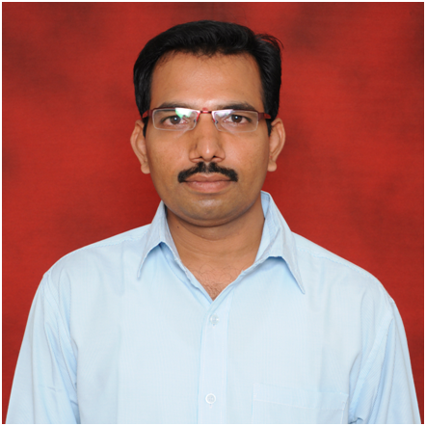
Course Instructor Profile
Prof. Yogesh N
Designation | Assistant Professor
Qualification | B.E, MTech., PGDAC, (PhD)
Email Id | yogeshn_cg@atme.edu.in yogeshneelappa.atme@gmail.com
Contact Number | 9663170150
Office hours | 9am – 5pm
Virtual Office hours | 6pm – 8pm
YN
Prof. Yogesh N, Dept. of CSD, ATMECE
2

Slide 3

Course Overview
The Universal Human Values (UHV) course is a mandatory AICTE-approved, 1-credit foundation program designed to foster a holistic,, value-based perspective on life.
Using self-exploration, it helps students understand harmony within themselves, families, society, and nature to achieve continuous happiness and professional, ethical, and sustainable living.
The course typically begins by establishing that human beings desire both physical prosperity and continuous happiness, but often mistake accumulation of physical facilities for true happiness.
YN
Prof. Yogesh N, Dept. of CSD, ATMECE
3

Slide 4
Course Prerequisites
For the Universal Human Values (UHV) course, there are no strict academic prerequisites. The course is intentionally designed to be accessible to all students, regardless of their discipline or prior background.
Prerequisites / Readiness for UHV Course:
Basic reading and comprehension skills: Ability to read, reflect, and understand simple philosophical and real-life concepts.
Openness to self-reflection: Willingness to examine one’s own thoughts, beliefs, behavior, and assumptions.
Interest in ethical and social issues: Curiosity about human relationships, society, environment, and sustainable living.
No prior technical or philosophical knowledge required: The course does not assume background in ethics, philosophy, or value education.
Basic communication skills: Helpful for discussions, group activities, and expressing viewpoints respectfully.
Respect for diverse viewpoints: Readiness to listen, dialogue, and coexist with differing opinions and experiences.
YN
Prof. Yogesh N, Dept. of CSD, ATMECE
4

Slide 5
Why this Course?
The Universal Human Values (UHV) course is required to foster a holistic, ethical, and self-reflective perspective in students, balancing technical skills with human values like compassion, honesty, and responsibility.
It aims to promote sustainable happiness, mental well-being, and harmonious relationships within society, addressing the rising issues of stress, violence, and unethical behavior in professional and personal life.
The course, often pushed by initiatives like the All India Council for Technical Education (AICTE), ensures that graduates are not only skilled professionals but also conscious, ethical human beings.
YN
Prof. Yogesh N, Dept. of CSD, ATMECE
5

Slide 6
Course Information
Universal Human Values (UHV)
Course Code | BUHK408
Course Type | UHV
Semester | IV Semester
Course Scheme | 2022 Scheme
Teaching Hours/Week (L:T:P:S) | 1:0:0:1
Total Hours of Pedagogy | 15 hrs of Lecture & 15 hrs of Self Study
Credits | 01
CIE Marks | 50
SEE Marks | 50
Total Marks | 100
Exam Hours | 01
YN
Prof. Yogesh N, Dept. of CSD, ATMECE
6

Slide 7

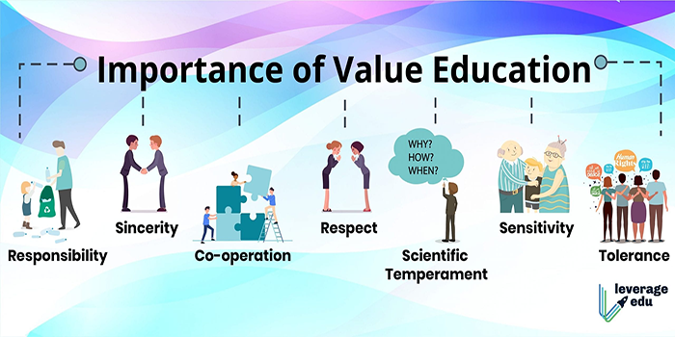
Course Syllabus
Module-1
Introduction to Value Education
Right Understanding, Relationship and Physical Facility (Holistic Development and the Role of Education) Understanding Value Education, Self-exploration as the Process for Value Education, Continuous Happiness and Prosperity – the Basic Human Aspirations, Happiness and Prosperity – Current Scenario, Method to Fulfil the Basic Human Aspirations.
YN
Prof. Yogesh N, Dept. of CSD, ATMECE
7

Slide 8
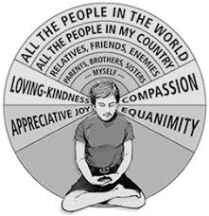

Course Syllabus
Module-2
Harmony in the Human Being
Understanding Human being as the Co-existence of the Self and the Body, Distinguishing between the Needs of the Self and the Body, The Body as an Instrument of the Self, Understanding Harmony in the Self, Harmony of the Self with the Body, Programme to ensure self-regulation and Health.
YN
Prof. Yogesh N, Dept. of CSD, ATMECE
8

Slide 9


Course Syllabus
Module - 3
Harmony in the Family and Society
Interactive Input Methods and Graphical User Interfaces: Graphical Harmony in the Family – the Basic Unit of Human Interaction, 'Trust' – the Foundational Value in Relationship, 'Respect' – as the Right Evaluation, Other Feelings, Justice in Human-to-Human Relationship, Understanding Harmony in the Society, Vision for the Universal Human Order.
YN
Prof. Yogesh N, Dept. of CSD, ATMECE
9

Slide 10


Course Syllabus
Module - 4
Harmony in the Nature/Existence
Understanding Harmony in the Nature, Interconnectedness, self-regulation and Mutual Fulfilment among the Four Orders of Nature, Realizing Existence as Co-existence at All Levels, The Holistic Perception of Harmony in Existence.
YN
Prof. Yogesh N, Dept. of CSD, ATMECE
10

Slide 11


Course Syllabus
Module - 5
Implications of the Holistic Understanding – a Look at Professional Ethics
Natural Acceptance of Human Values, Definitiveness of (Ethical) Human Conduct, A Basis for Humanistic Education, Humanistic Constitution and Universal Human Order, Competence in Professional Ethics Holistic Technologies, Production Systems and Management Models-Typical Case Studies, Strategies for Transition towards Value-based Life and Profession.
YN
Prof. Yogesh N, Dept. of CSD, ATMECE
11

Slide 12
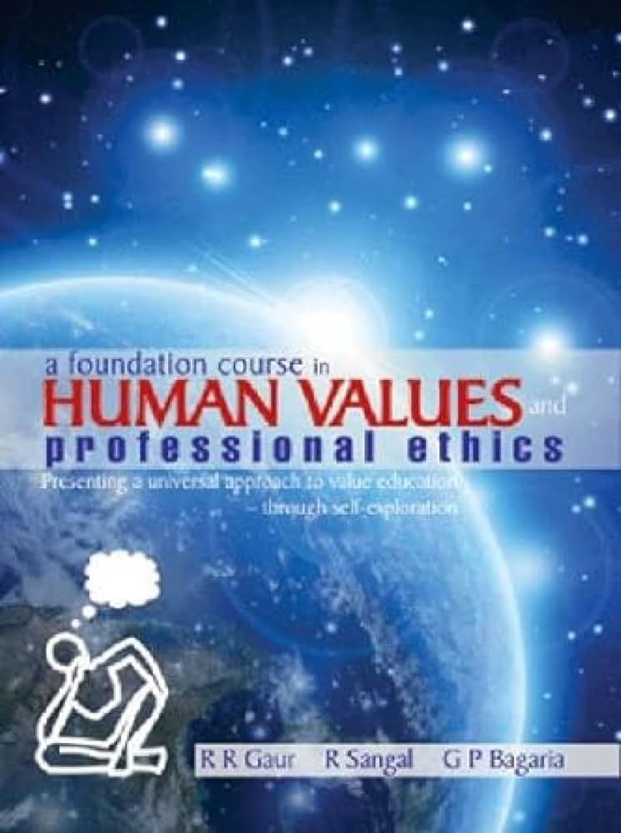
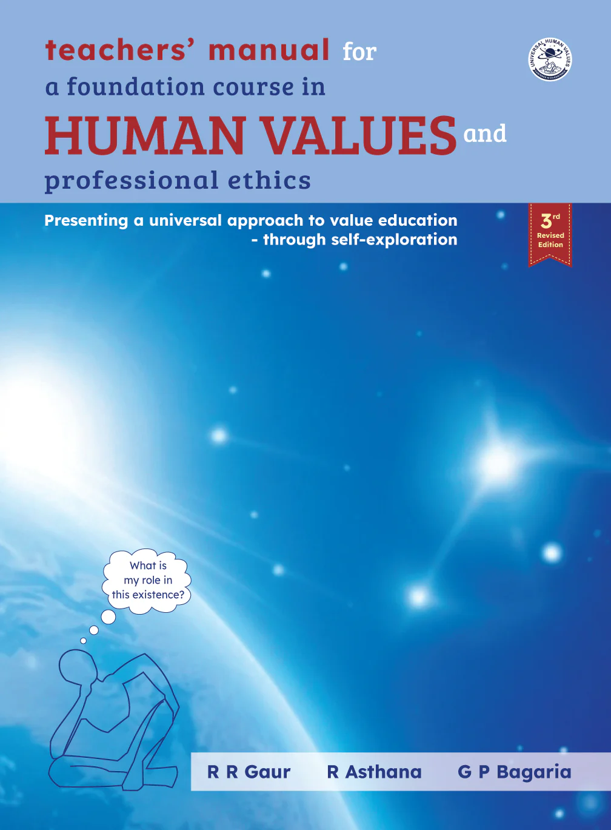
Suggested Learning Resources
Text Books
The Textbook A Foundation Course in Human Values and Professional Ethics, R R Gaur, R Asthana, G P Bagaria, 2nd Revised Edition, Excel Books, New Delhi, 2019. ISBN 978 93-87034- 47-1.
The Teacher’s Manual for A Foundation Course in Human Values and Professional Ethics, R R Gaur, R Asthana, G P Bagaria.
YN
Prof. Yogesh N, Dept. of CSD, ATMECE
12

Slide 13
Suggested Learning Resources
Web links and Video Lectures (e-Resources):
1. Value Education websites,
https://www.uhv.org.in/uhv-ii,
http://uhv.ac.in,
http://www.uptu.ac.in
2. Story of Stuff,
http://www.storyofstuff.com
Activity Based Learning (Suggested Activities in Class)/ Practical Based learning
Reflective Learning
YN
Prof. Yogesh N, Dept. of CSD, ATMECE
13

Slide 14
Course Learning Objectives (CLOs)
This course will enable students to
CLO1. To help the students appreciate the essential complementarity between 'VALUES' and 'SKILLS' to ensure sustained happiness and prosperity which are the core aspirations of all human beings.
CLO2. To facilitate the development of a Holistic perspective among students towards life and profession as well as towards happiness and prosperity based on a correct understanding of the Human reality and the rest of existence. Such a holistic perspective forms the basis of Universal Human Values and movement towards value-based living in a natural way.
CLO3. To highlight plausible implications of such a Holistic understanding in terms of ethical human conduct, trustful and mutually fulfilling human behaviour and mutually enriching interaction with Nature.
CLO4. This course is intended to provide a much-needed orientation input in value education to the young enquiring minds.
YN
Prof. Yogesh N, Dept. of CSD, ATMECE
14

Slide 15
Course Outcomes (COs)
At the end of the course, the student will be able to:
CO1. They would become more responsible in life, and in handling problems with sustainable solutions, while keeping human relationships and human nature in mind.
CO2. They would have better critical ability.
CO3. They would also become sensitive to their commitment towards what they have understood (human values, human relationship and human society).
CO4. It is hoped that they would be able to apply what they have learnt to their own self in different day-to-day settings in real life, at least a beginning would be made in this direction.
YN
Prof. Yogesh N, Dept. of CSD, ATMECE
15

Slide 16
Course Assessment Policy
The weightage of Continuous Internal Evaluation (CIE) is 50% and for Semester End Exam (SEE) is 50%.
The minimum passing mark for the CIE is 40% of the maximum marks (20 marks out of 50) and for the SEE minimum passing mark is 35% of the maximum marks (18 out of 50 marks).
The student is declared as a pass in the course if he/she secures a minimum of 40% (40 marks out of 100) in the sum total of the CIE (Continuous Internal Evaluation) and SEE (Semester End Examination) taken together .
YN
Prof. Yogesh N, Dept. of CSD, ATMECE
16

Slide 17
Course Assessment Policy
Continuous internal Examination (CIE)
For the Assignment component of the CIE, there are 25 marks and for the Internal Assessment Test component, there are 25 marks.
The first test will be administered after 40-50% of the syllabus has been covered, and the second test will be administered after 85-90% of the syllabus has been covered.
Any two assignment methods mentioned in the 22OB2.4, if an assignment is project-based then only one assignment for the course shall be planned. The teacher should not conduct two assignments at the end of the semester if two assignments are planned.
For the course, CIE marks will be based on a scaled-down sum of two tests and other methods of assessment.
The sum of two tests, two assignments, will be out of 100 marks and will be scaled down to 50 marks.
YN
Prof. Yogesh N, Dept. of CSD, ATMECE
17

Slide 18
Course Assessment Policy
Semester End Examinations (SEE)
SEE paper shall be set for 50 questions, each of the 01 marks. The pattern of the question paper is MCQ (multiple choice questions).
The time allotted for SEE is 01 hour.
The student has to secure a minimum of 35% of the maximum marks meant for SEE.
YN
Prof. Yogesh N, Dept. of CSD, ATMECE
18

Slide 19
Universal Human Values
Human values can be understood as the values that have been conceived and preferred by the people in a society that has inspired their actual conduct and behaviour and prepared them to attain the best in their lives.
Human values involve the process of selection, preference and acceptance of certain values for life.
For instance, humans are considered as social animals who have evolved a very complex social system with the enhanced capacity to retain, transmit and improve upon the knowledge they possess.
Throughout the evolution of humankind, understanding of people according to their environment has changed drastically.
The process of change that humans have experienced in different stages of their lives is to a greater extent influenced by human values within a society.
YN
Prof. Yogesh N, Dept. of CSD, ATMECE
19

Slide 20
Universal Human Values
Universal values are core principles or beliefs shared by people across different cultures, societies, and historical periods.
They serve as the foundation for moral and ethical judgments, helping individuals and societies differentiate between right and wrong, good and bad, desirable and undesirable.
The philosopher Isaiah Berlin defined universal values as “values that a great many human beings in the vast majority of places and situations, at almost all times, do in fact hold in common, whether consciously and explicitly or as expressed in their behavior.”
This definition acknowledges that universal values don’t require everyone to articulate them identically or consciously recognize them—what matters is that they’re reflected in how people actually live and what they consider important.
YN
Prof. Yogesh N, Dept. of CSD, ATMECE
20

Slide 21
Universal Human Values
Universal values are based on the inherent dignity and worth of every human being and the recognition of the common humanity that binds us all.
They’re not imposed by any single authority, religion, or institution. Rather, they emerge from shared human experience, our capacity for reason and conscience, and the fundamental needs we all share regardless of where or when we live.
It’s important to understand that calling these values “universal” doesn’t mean they’re applied uniformly everywhere or that everyone prioritizes them identically. Different cultures may emphasize certain values more than others, or express the same underlying value in culturally specific ways.
But the core principles themselves—the importance of treating others with respect, being honest, acting justly, showing compassion—appear across virtually all human societies.
YN
Prof. Yogesh N, Dept. of CSD, ATMECE
21

Slide 22
List of Universal Values
Values Related to Justice and Fairness – Justice, Equality, Freedom
Values Related to Relationships and Connection – Love, Compassion, Empathy, Friendship, Fraternity, Belonging and Acceptance
Values Related to Integrity and Character – Honesty, Trust, Loyalty, Responsibility, Self-Control
Values Related to Respect and Dignity – Respect, Tolerance, Respect for Life, Dignity
Values Related to Community and Society – Solidarity, Concern for Others, Peace, Family, Tradition, Unity with Nature
Values Related to Personal Development - Wisdom and Understanding, Learning, Accomplishment, Perseverance, Self-Control
Values Related to Wellbeing - Personal Contentment, Enjoyment, Gratitude
Values Related to Meaning and Purpose – Spirituality, Hope, Wellbeing of Future Generations
YN
Prof. Yogesh N, Dept. of CSD, ATMECE
22

Slide 23
Examples of Universal Values in Practice
Understanding universal values abstractly is one thing, but seeing how they manifest in real life makes them more tangible and actionable.
Justice in Action
Compassion in Daily Life
Honesty in Difficult Situations
Respect Across Differences
Responsibility for Environmental Impact
Solidarity in Crisis
YN
Prof. Yogesh N, Dept. of CSD, ATMECE
23

Slide 24
Summary
In today’s session, you all have gone through the following topics
Introduction to the course
Course Pre-requisites
Course Objectives and Outcomes
Course Syllabus
Course Assessment Policy
Universal Human Values introduction
YN
Prof. Yogesh N, Dept. of CSD, ATMECE
24

Slide 25

YN
Prof. Yogesh N, Dept. of CSD, ATMECE
25

Slide 26

Discussion and Interaction
YN
Prof. Yogesh N, Dept. of CSD, ATMECE
26

Slide 27


YN
Prof. Yogesh N, Dept. of CSD, ATMECE
27

