Slide 1





Module-1
ARM Embedded
Systems
ATME College of Engineering, Mysuru
Department of CSE-DS, ATMECE
1

Slide 2
Module-1
ARM Embedded Systems
ATME College of Engineering, Mysuru
Department of CSE-DS, ATMECE

Slide 3
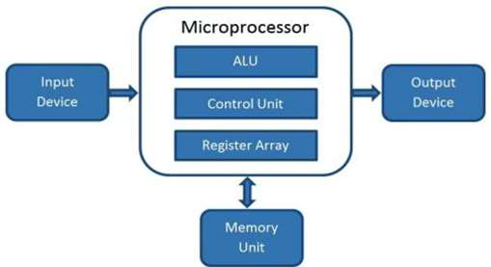
Block Diagram of Microprocessor
ATME College of Engineering, Mysuru
Department of CSE-DS, ATMECE
3

Slide 4
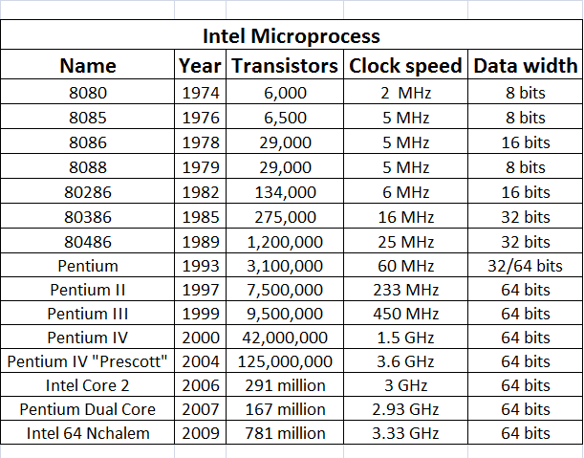
ATME College of Engineering, Mysuru
Department of CSE-DS, ATMECE
4

Slide 5
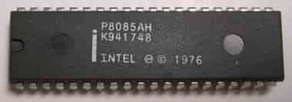
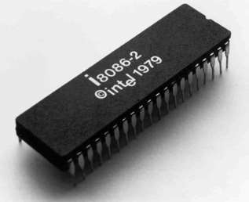
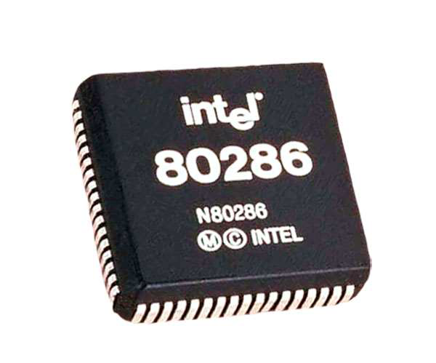
ATME College of Engineering, Mysuru
Department of CSE-DS, ATMECE
5

Slide 6
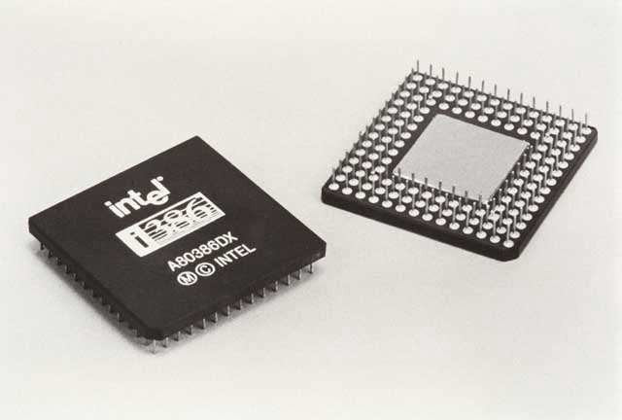
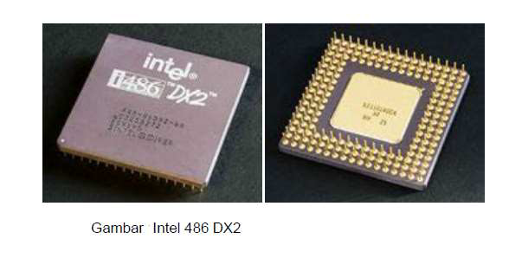
ATME College of Engineering, Mysuru
Department of CSE-DS, ATMECE
6

Slide 7

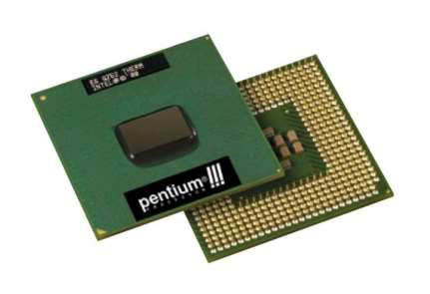
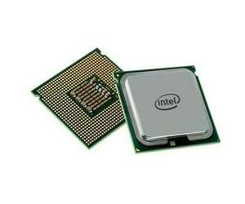
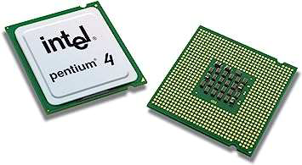
ATME College of Engineering, Mysuru
Department of CSE-DS, ATMECE
7

Slide 8
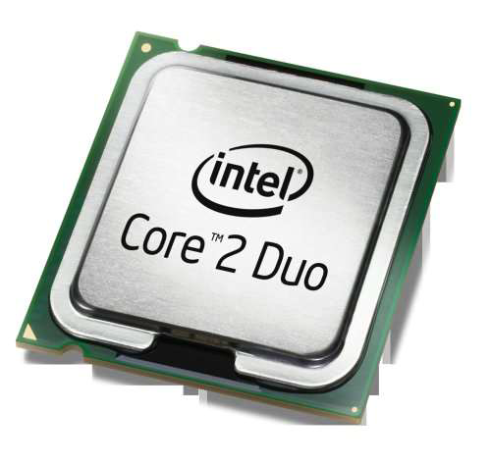
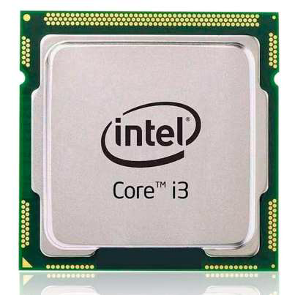
ATME College of Engineering, Mysuru
Department of CSE-DS, ATMECE
8

Slide 9
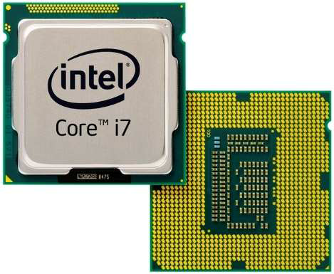
ATME College of Engineering, Mysuru
Department of CSE-DS, ATMECE
9

Slide 10
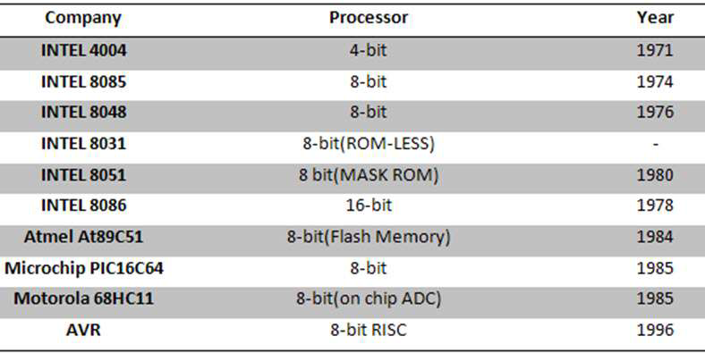
Evalutionof Microcontroller
ATME College of Engineering, Mysuru
Department of CSE-DS, ATMECE
10

Slide 11
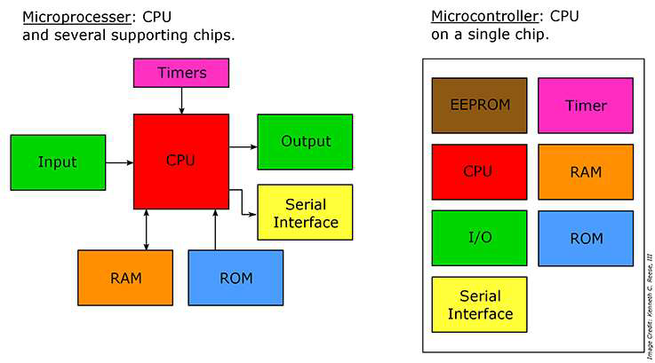
ATME College of Engineering, Mysuru
Department of CSE-DS, ATMECE
11

Slide 12
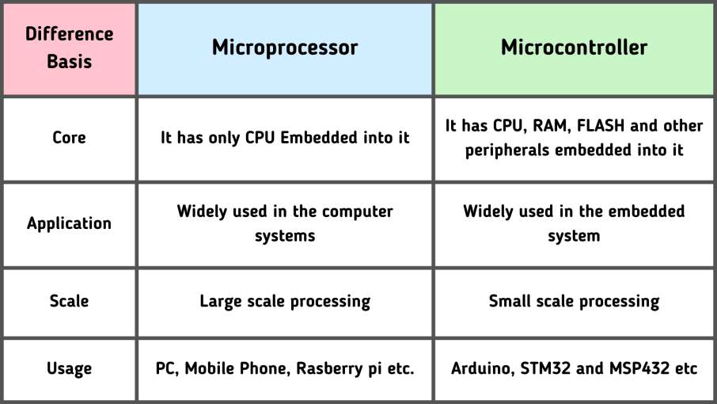
ATME College of Engineering, Mysuru
Department of CSE-DS, ATMECE
12

Slide 13
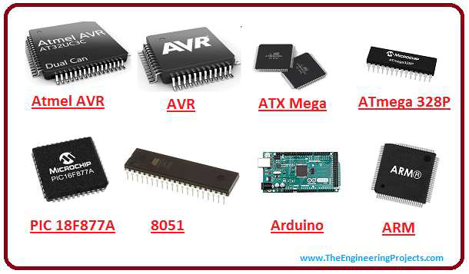
Types of Microcontroller
ATME College of Engineering, Mysuru
Department of CSE-DS, ATMECE
13

Slide 14
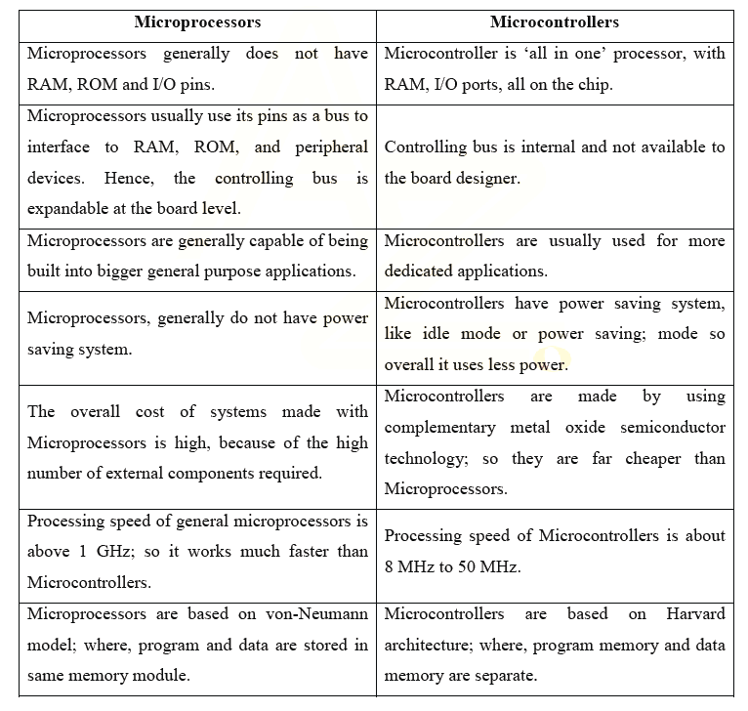
ATME College of Engineering, Mysuru
Department of CSE-DS, ATMECE

Slide 15
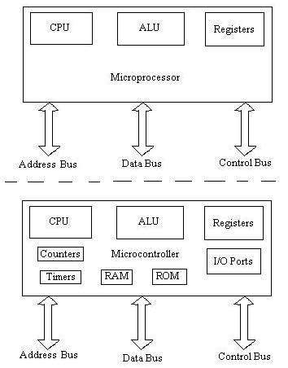
Microprocessor vs Microcontroller
ATME College of Engineering, Mysuru
Department of CSE-DS, ATMECE
15

Slide 16
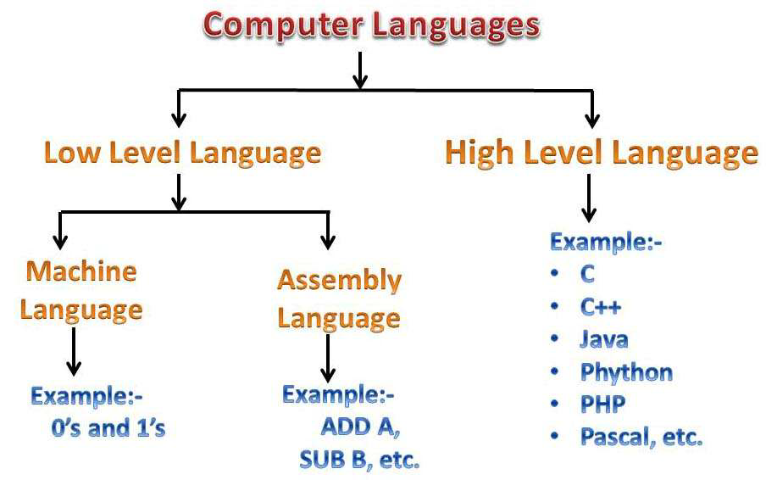
ATME College of Engineering, Mysuru
Department of CSE-DS, ATMECE
16

Slide 17
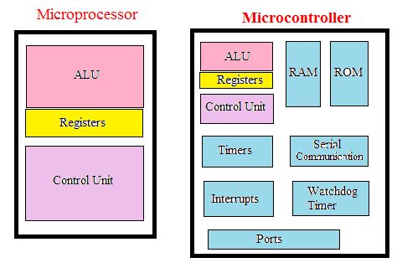
ATME College of Engineering, Mysuru
Department of CSE-DS, ATMECE
17

Slide 18
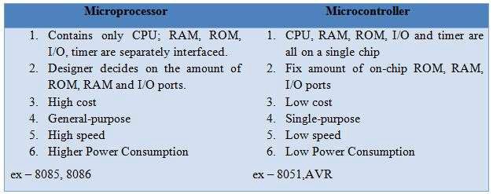
ATME College of Engineering, Mysuru
Department of CSE-DS, ATMECE
18

Slide 19
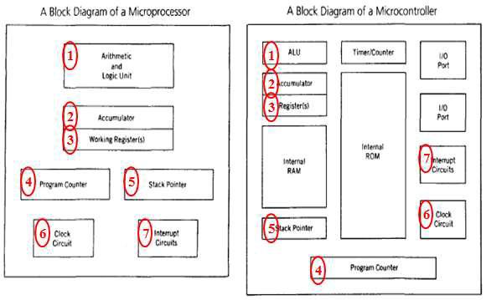
ATME College of Engineering, Mysuru
Department of CSE-DS, ATMECE
19

Slide 20
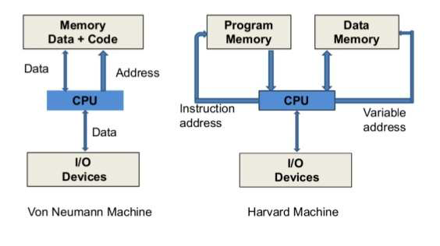
Difference Between Von Neumann
Architecture and Harvard Architecture
ATME College of Engineering, Mysuru
Department of CSE-DS, ATMECE
20

Slide 21
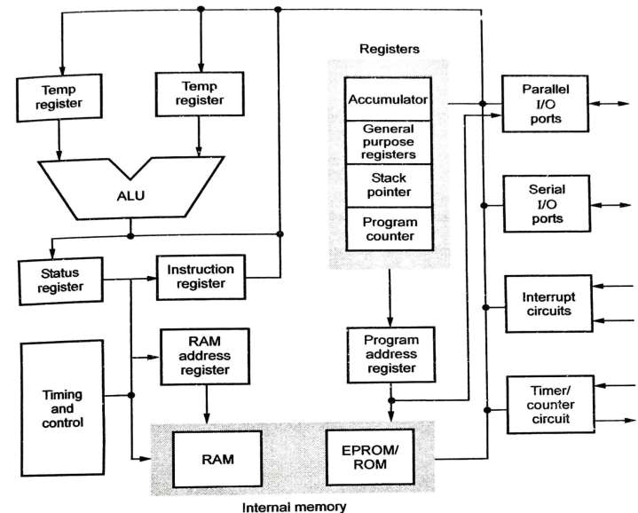
Block diagram of Microcontroller
ATME College of Engineering, Mysuru
Department of CSE-DS, ATMECE
21

Slide 22
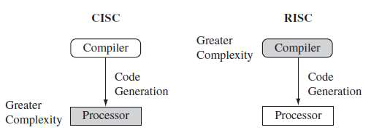
ATME College of Engineering, Mysuru
Department of CSE-DS, ATMECE
22

Slide 23
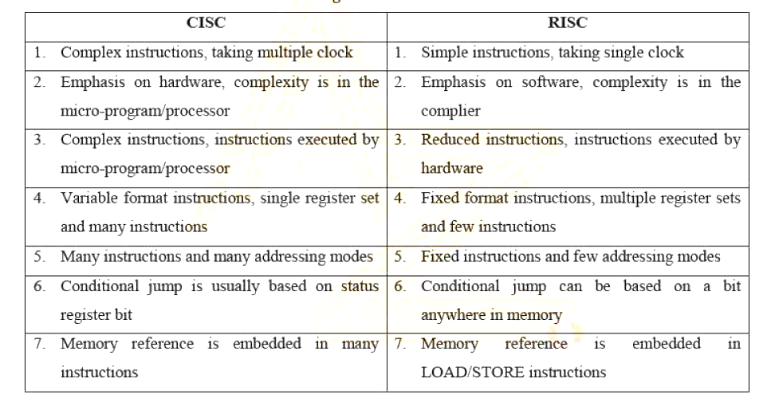
CISC vsRISC
ATME College of Engineering, Mysuru
Department of CSE-DS, ATMECE

Slide 24
ARM EMBEDDED SYSTEMS
•TheARMprocessorcoreisakeycomponentofmany
successful32-bitembeddedsystems.ARMcoresare
widelyusedinmobilephones,handheldorganizers,
and a multitude of other everyday portable
consumerdevices.
•The ARM core uses reduced instruction set computer
(RISC) architecture.
•The first ARM1 prototype was designed in 1985.
ATME College of Engineering, Mysuru
Department of CSE-DS, ATMECE
24

Slide 25
TheRISCphilosophyisimplementedwithfourmajordesignrules:
1. Instructions—RISC processors have a reduced number of
instructionclasses.Theseclassesprovidesimpleoperationsthatcan
eachexecuteinasinglecycle.
2.Pipelines—Theprocessingofinstructionsisbrokendowninto
smallerunitsthatcanbeexecutedinparallelbypipelines.
3.Registers—RISCmachineshavealargegeneral-purposeregister
set.Anyregistercancontaineitherdataoranaddress.Registersact
asthefastlocalmemorystoreforalldataprocessingoperations.
4.Load-storearchitecture—Theprocessoroperatesondata
heldinregisters.Separateloadandstoreinstructionstransfer
databetweentheregisterbankandexternalmemory.
ATME College of Engineering, Mysuru
Department of CSE-DS, ATMECE
25

Slide 26
TheRISCDesignphilosophy
FeaturesofRISC
• RISCisanacronymforReducedInstructionSetComputer.
• MostRISCprocessoruseshardwiredcontrol.
• ThemostoftheRISCmachinesare32bitinstructions.
• Theyhaveveryfewinstructions.
• Thelimitedaddressingmodes.
• Alargeregisterfileandseparateinstruction&datacacheareused.
• RISCarchitectureisusedinARMcores.
ATME College of Engineering, Mysuru
Department of CSE-DS, ATMECE
26

Slide 27
RISC Design
RISC processors follow the “4” major design rules
1. Instructions –a) Reduced number of instructions
b) Simple format instructions
c) Hardwired instructions
d) One instruction per cycle
2. Pipeline
3. Registers
4. Load store architecture
ATME College of Engineering, Mysuru
Department of CSE-DS, ATMECE
27

Slide 28
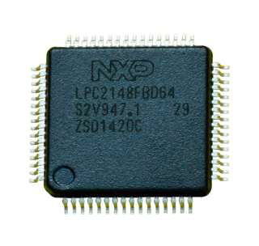
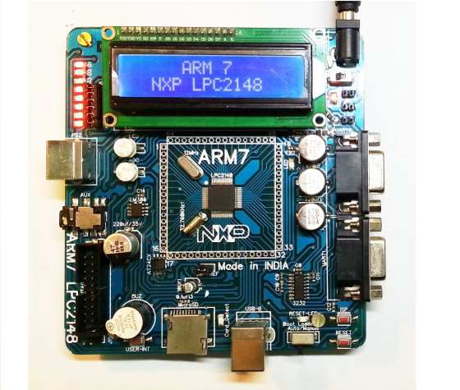
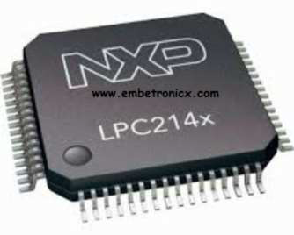
ATME College of Engineering, Mysuru
Department of CSE-DS, ATMECE
28

Slide 29
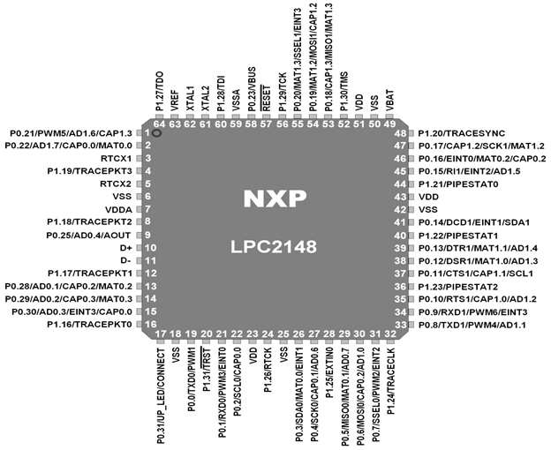
ATME College of Engineering, Mysuru
Department of CSE-DS, ATMECE
29

Slide 30
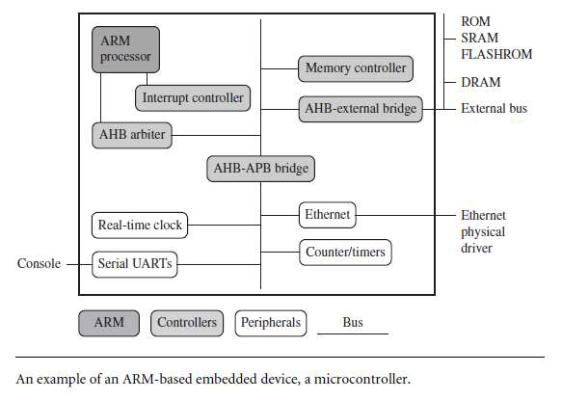
Embedded System Hardware
ATME College of Engineering, Mysuru
Department of CSE-DS, ATMECE
30

Slide 31
Wecanseparatethedeviceintofourmainhardwarecomponents:
• 1.TheARMprocessorcontrolstheembeddeddevice.DifferentversionsoftheARM
processor are available to suit the desired operating characteristics. An ARM
processorcomprisesacore(theexecutionenginethatprocessesinstructionsand
manipulates data) plus the surrounding components (memory and cache) that
interfaceitwithabus.
• 2.Controllerscoordinateimportantfunctionalblocksofthesystem.Twocommonly
foundcontrollersareinterruptandmemorycontrollers.
• 3.Theperipheralsprovidealltheinput-outputcapabilityexternaltothechipandare
responsiblefortheuniquenessoftheembeddeddevice.
• 4.Abusisusedtocommunicatebetweendifferentpartsofthedevice.
ATME College of Engineering, Mysuru
Department of CSE-DS, ATMECE
31

Slide 32
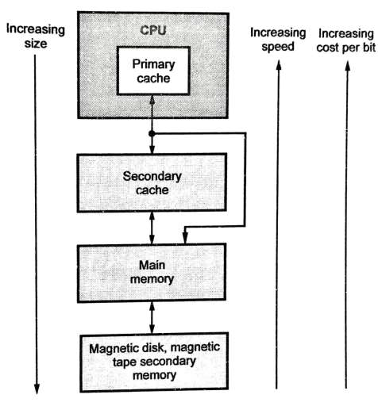
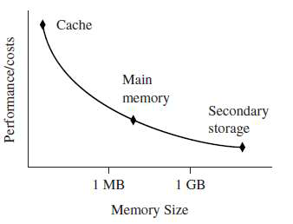
Memory Hierarchy
ATME College of Engineering, Mysuru
Department of CSE-DS, ATMECE
32

Slide 33
• Thecacheisplacedbetweenmainmemoryandthecore.Itisusedto
speedupdatatransferbetweentheprocessorandmainmemory.
• Themainmemoryislarge—around256KBto256MB(orevengreater),
dependingontheapplication—andisgenerallystoredinseparatechips.
Loadandstoreinstructionsaccessthemainmemoryunlessthevalues
havebeenstoredinthecacheforfastaccess.
• Secondarystorageisthelargestandslowestformofmemory.Harddisk
drivesandCD-ROMdrivesareexamplesofsecondarystorage.
ATME College of Engineering, Mysuru
Department of CSE-DS, ATMECE
33

Slide 34
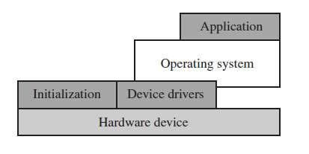
Embedded System Software
• Theinitializationcodeisthefirstcodeexecutedontheboardandisspecifictoa
particulartargetorgroupoftargets.Itsetsuptheminimumpartsoftheboard
beforehandingcontrolovertotheoperatingsystem.
• Theoperatingsystemprovidesaninfrastructuretocontrolapplicationsand
managehardwaresystemresources.
• Thedevicedriversprovideaconsistentsoftwareinterfacetotheperipheralson
thehardwaredevice.
• Anapplicationperformsoneofthetasksrequiredforadevice.
ATME College of Engineering, Mysuru
Department of CSE-DS, ATMECE
34

Slide 35
ARM applications
• Mobile
• Imaging
• Networking
• Automotive
• Robotics
• Video games
• Consumer devices
ATME College of Engineering, Mysuru
Department of CSE-DS, ATMECE
35

Slide 36
Features of ARM processor
1. Large uniform register file
2. Load store architecture
3. Simple Addressing modes
4. Reduced number of instructions
5. Performs simple but powerful operations
6. Uniform and fixed length 32 bit instruction fields
7. Three address instruction format
8. Does not use delayed branch
9. It has control over ALU and shifter
10.Supports auto increment and auto decrement addressing modes
11.Load and Store multiple instructions
ATME College of Engineering, Mysuru
Department of CSE-DS, ATMECE
36

Slide 37
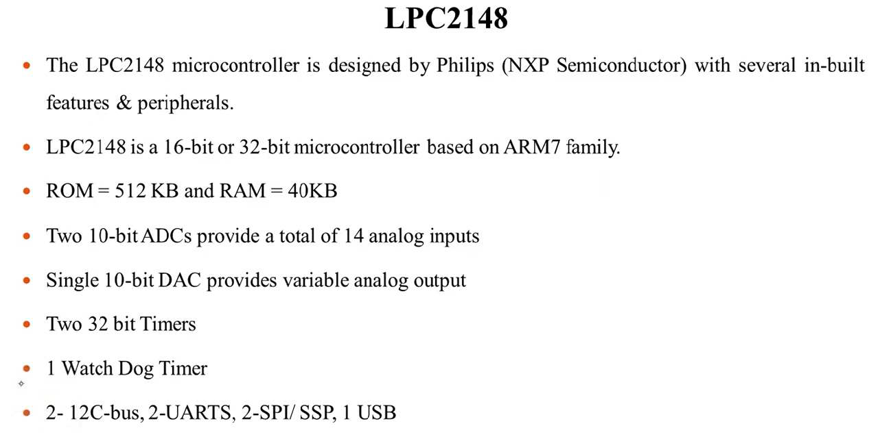
Features of ARM processor
ATME College of Engineering, Mysuru
Department of CSE-DS, ATMECE
37

Slide 38
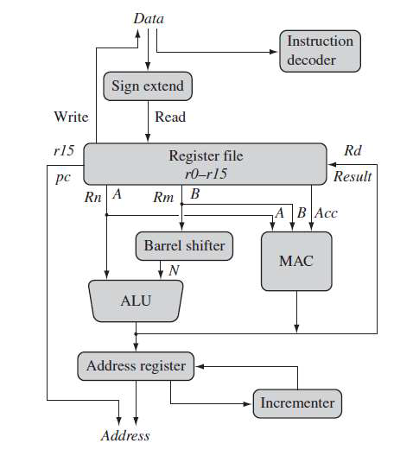
ARM Core data flow model
Multiply Accumulate Unit (MAC)
ATME College of Engineering, Mysuru
Department of CSE-DS, ATMECE
38

Slide 39
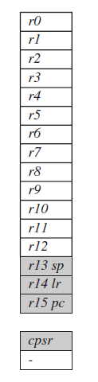
Registers
Thereareupto18activeregisters:16dataregistersand2processorstatus
registers.Thedataregistersarevisibletotheprogrammerasr0tor15.
TheARMprocessorhasthreeregistersassignedtoaparticulartaskor
specialfunction:
r13,r14,andr15.Theyarefrequentlygivendifferentlabelstodifferentiate
themfromtheotherregisters.
In Figure, the shaded registers identify the assigned special-purpose
registers:
■Registerr13istraditionallyusedasthestackpointer(sp)andstoresthe
headofthestackinthecurrentprocessormode.
■Registerr14iscalledthelinkregister(lr)andiswherethecoreputsthe
returnaddresswheneveritcallsasubroutine.
■Registerr15istheprogramcounter(pc)andcontainstheaddressofthe
nextinstructiontobefetchedbytheprocessor.
ATME College of Engineering, Mysuru
Department of CSE-DS, ATMECE
39

Slide 40
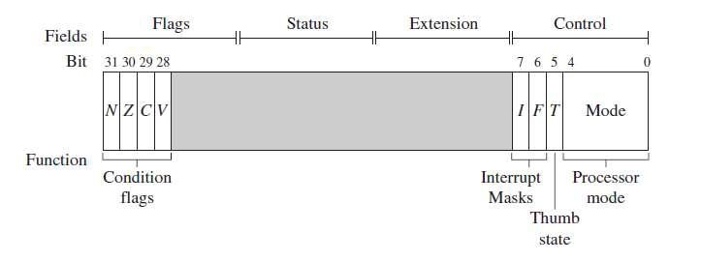
Current Program Status Register ( CPSR )
ATME College of Engineering, Mysuru
Department of CSE-DS, ATMECE
40

Slide 41
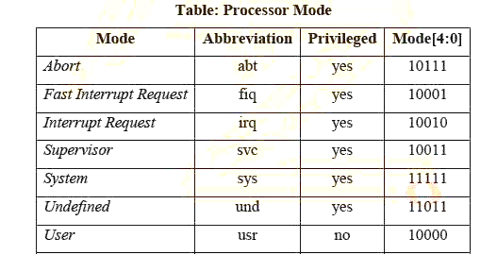
ATME College of Engineering, Mysuru
Department of CSE-DS, ATMECE
41

Slide 42
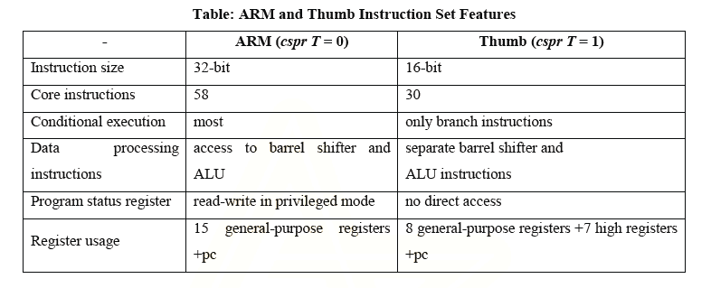
ATME College of Engineering, Mysuru
Department of CSE-DS, ATMECE
42

Slide 43
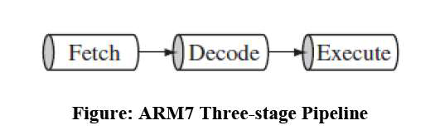
PIPELINE
• A pipeline is the mechanism in a RISC processor, which is used to execute
instructions.
• Pipeline speeds up execution by fetching the next instruction while other
instructions are being decoded and executed.
The above Figure shows a three-stage pipeline:
1. Fetch loads an instruction from memory.
2. Decode identifies the instruction to be executed.
3. Execute processes the instruction and writes the result back to a
register.
ATME College of Engineering, Mysuru
Department of CSE-DS, ATMECE
43

Slide 44
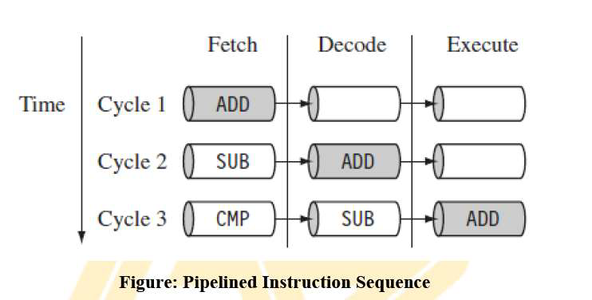
The following Figure illustrates pipeline using a simple example.
ATME College of Engineering, Mysuru
Department of CSE-DS, ATMECE
44

Slide 45

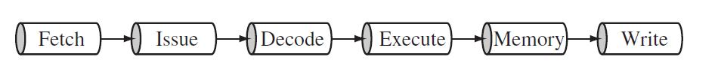
ARM9 five-stage pipeline
ARM10 six-stage pipeline
ATME College of Engineering, Mysuru
Department of CSE-DS, ATMECE
45

Slide 46
• TheFigureshowsasequenceofthreeinstructionsbeingfetched,
decoded,andexecutedbytheprocessor.oThethreeinstructionsare
placedintothepipelinesequentially.
• Inthefirstcycle,thecorefetchestheADDinstructionfrommemory.
• Inthesecondcycle,thecorefetchestheSUBinstructionanddecodes
theADDinstruction.
• Inthethirdcycle,boththeSUBandADDinstructionsaremoved
along the pipeline. The ADD instruction is executed, the SUB
instructionisdecoded,andtheCMPinstructionisfetched.
• Thisprocedureiscalledfillingthepipeline.
ATME College of Engineering, Mysuru
Department of CSE-DS, ATMECE
46

Slide 47
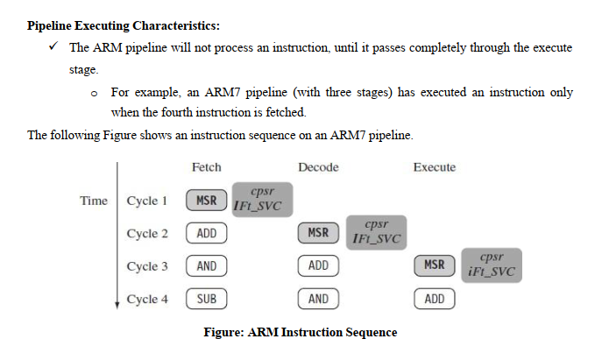
ATME College of Engineering, Mysuru
Department of CSE-DS, ATMECE
46

Slide 48
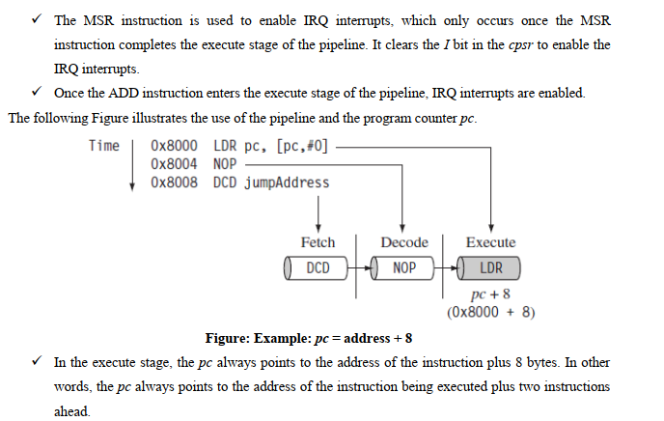
ATME College of Engineering, Mysuru
Department of CSE-DS, ATMECE
46

Slide 49
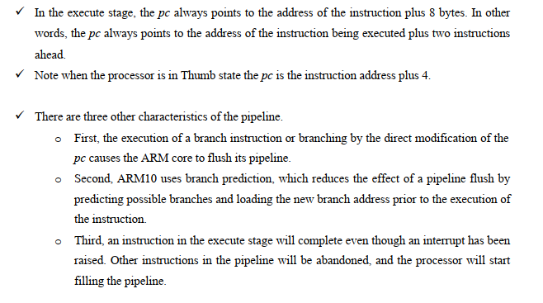
ATME College of Engineering, Mysuru
Department of CSE-DS, ATMECE
46

Slide 50
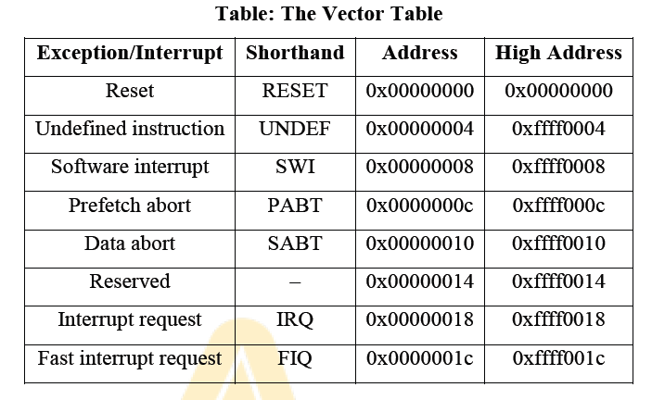
EXCEPTIONS, INTERRUPTS AND THE VECTOR TABLE
• When an exception or interrupt occurs, the processor sets the pc to a specific memory
address. The address is within a special address range called the vector table.
• When an exception or interrupt occurs, the processor suspends normal execution and
starts loading instructions from the exception vector table
ATME College of Engineering, Mysuru
Department of CSE-DS, ATMECE
47

Slide 51
• Resetvectoristhelocationofthefirstinstructionexecutedbytheprocessorwhenpoweris
applied.Thisinstructionbranchestotheinitializationcode.
• Undefinedinstructionvectorisusedwhentheprocessorcannotdecodeaninstruction.
• SoftwareinterruptvectoriscalledwhenyouexecuteaSWIinstruction.TheSWIinstructionis
frequentlyusedasthemechanismtoinvokeanoperatingsystemroutine.
• Prefetchabortvectoroccurswhentheprocessorattemptstofetchaninstructionfromanaddress
withoutthecorrectaccesspermissions.Theactualabortoccursinthedecodestage.
• Dataabortvectorissimilartoaprefetchabort,butisraisedwhenaninstructionattemptsto
accessdatamemorywithoutthecorrectaccesspermissions.
• Interruptrequestvectorisusedbyexternalhardwaretointerruptthenormalexecutionflowof
theprocessor.ItcanonlyberaisedifIRQsarenotmaskedinthecpsr.
• Fastinterruptrequestvectorissimilartotheinterruptrequest,butisreservedforhardware
requiringfasterresponsetimes.ItcanonlyberaisedifFIQsarenotmaskedinthecpsr.
ATME College of Engineering, Mysuru
Department of CSE-DS, ATMECE
48

Slide 52
CORE EXTENSIONS
• Core extensions are the standard hardware components placed next to the ARM core.
• They improve performance, manage resources, and provide extra functionality and are designed to
provide flexibility in handling particular applications.
There are three hardware extensions
1)Cache and Tightly Coupled Memory
2)Memory Management
3)coprocessor interface
ATME College of Engineering, Mysuru
Department of CSE-DS, ATMECE
49

Slide 53
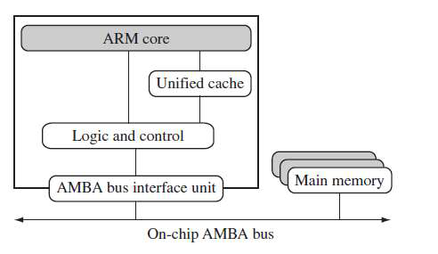
1) Cache and Tightly Coupled Memory
Figure: Von Neumann Architecture with Cache
ATME College of Engineering, Mysuru
Department of CSE-DS, ATMECE
50

Slide 54
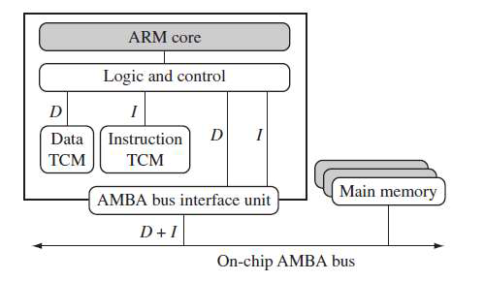
Figure: Harvard Architecture with TCMs
ATME College of Engineering, Mysuru
Department of CSE-DS, ATMECE
51

Slide 55

ATME College of Engineering, Mysuru
Department of CSE-DS, ATMECE
51

Slide 56
2)Memory Management
ARM cores have three different types of memory management hardware—
• No extensions providing no protection
• A memory protection unit (MPU) providing limited protection
• A memory management unit (MMU) providing full protection
3)Coprocessor interface
• CoprocessorscanbeattachedtotheARMprocessor.Acoprocessorextendsthe
processing features of a core by extending the instruction set or by providing
configurationregisters.MorethanonecoprocessorcanbeaddedtotheARMcore
viathecoprocessorinterface.
ATME College of Engineering, Mysuru
Department of CSE-DS, ATMECE
52

Slide 57
Thank You
ATME College of Engineering, Mysuru
Department of CSE-DS, ATMECE
53

