Slide 1
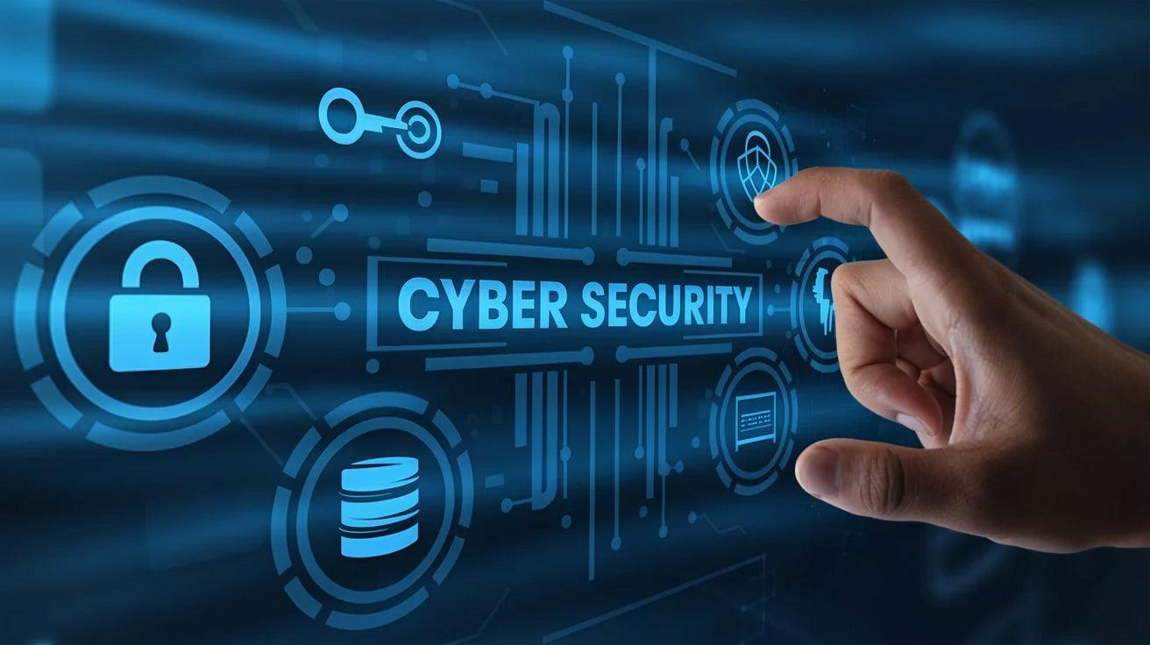
Managed Detection and Resolution (MDR) in Cyber Security (BCY456B)
                Course Coordinator:
                Dr. Pavithra A C
                Associate Professor
                Dept. of CSD
                ATMECE, Mysuru
1

Slide 2

Course Information
6

Slide 3
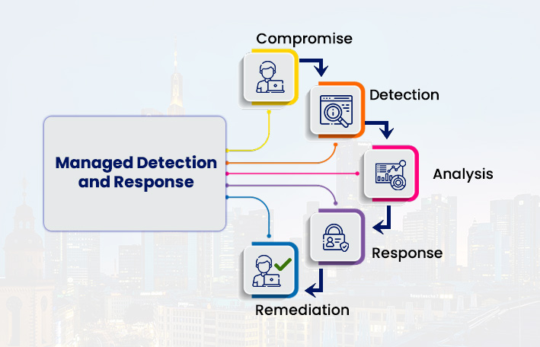
Course Syllabus
Module-1
Introduction to MDR
Introduction to Managed Detection and Resolution (MDR): Definition and importance of MDR. Advantages of using MDR in Cyber security.
7

Slide 4
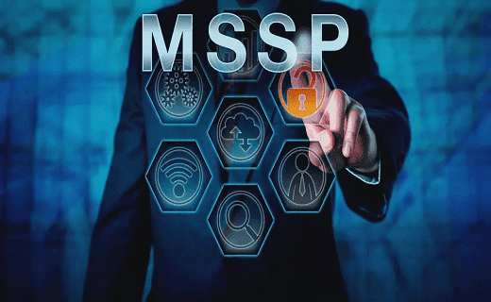
Course Syllabus
Module-2
Introduction to MSSP and SIEM:
Services offered by Managed Security Service Providers (MSSP). Limitations of using MSSP. Definition and offerings of SIEM (Security and Information Event Management). Limitations of using SIEM.
8

Slide 5
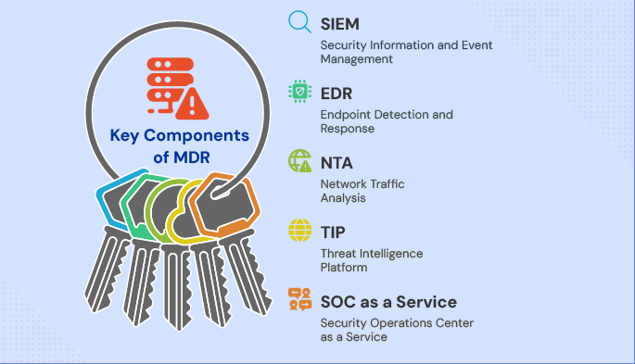
Course Syllabus
Module - 3
Key Components of MDR solutions
Endpoint detection and response (EDR), Threat Intelligence, SOAR (Security Orchestration, Automation and Response), Expert Security Analysts
9

Slide 6
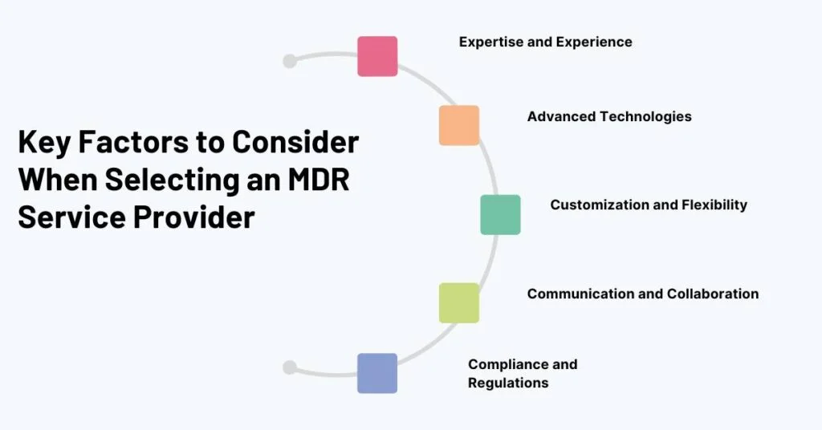
Course Syllabus
Module - 4
Factors to consider during selection of MDR Provider
Security compliance with industry standard security regulations like HIPAA, PCI-DSS and GDPR. Service Level Agreements (SLA), Incident response procedures, Reporting
10

Slide 7
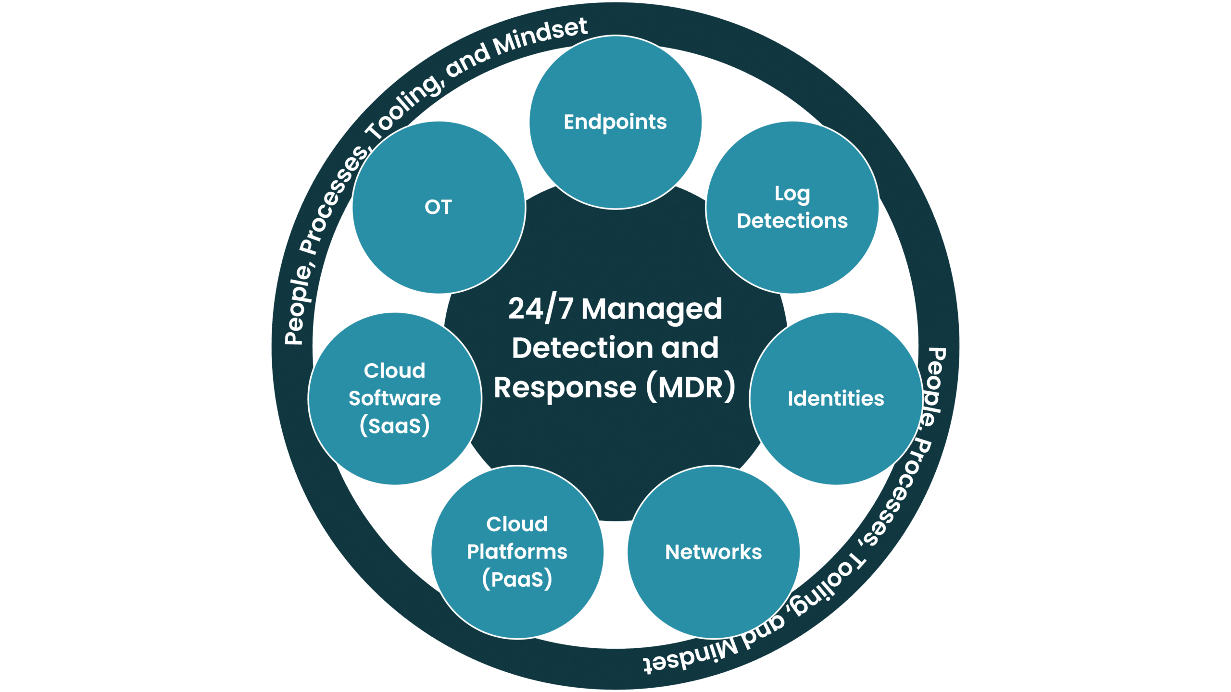
Course Syllabus
Module - 5
Key services provided by MDR Provider
Advanced Threat detection, Proactive threat hunting, Rapid Incident response, seamless integration with existing security tools and processes. .
11

Slide 8
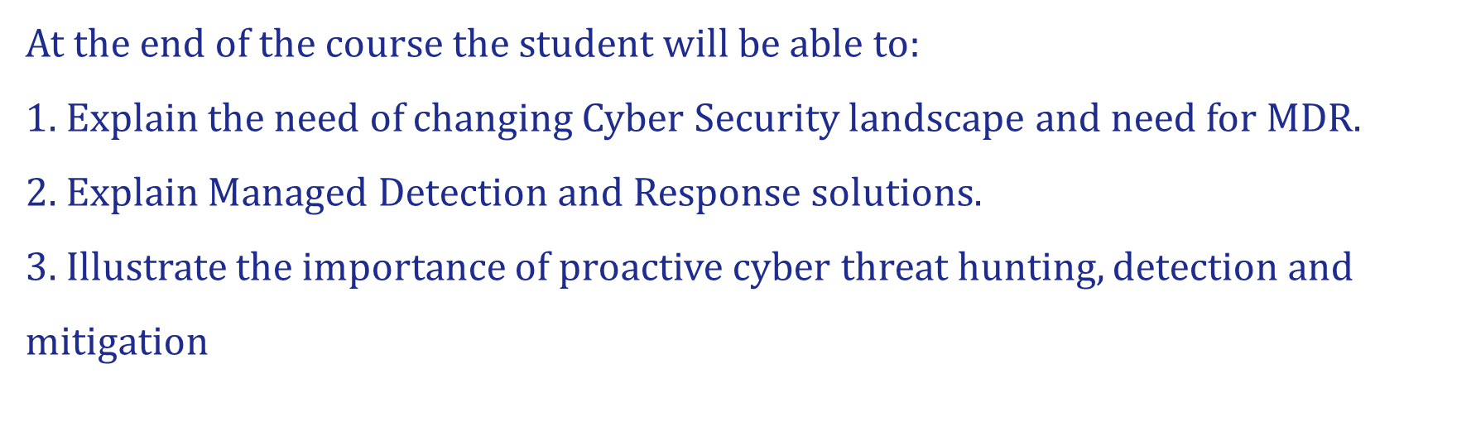

Slide 9
What is managed detection and response (MDR)?
Managed detection and response (MDR) is a cybersecurity service that combines technology with human expertise to rapidly identify and limit the impact of threats by performing threat hunting, monitoring, and response. The main benefit of MDR is that it quickly helps in limiting the impact of threats without the need for additional staffing, which can be costly.

Slide 10
MDR benefits
Organizations using an MDR solution can immediately reduce their time-to-detect (and therefore, time to respond) from the typical 277 days to as little as a few minutes — thereby dramatically reducing the impact of an event.
But reducing time-to-detect from months to mere minutes is not the only benefit. Organizations can also:
Improve security posture and become more resilient to potential attack by optimizing security configuration and eliminating rogue systems.
Identify and stop hidden, sophisticated threats through continuous managed threat hunting.
Respond to threats more effectively and restore endpoints to a known good status through guided response and managed remediation.
Redirect staff from reactive and repetitive incident response work toward more strategic projects.

Slide 11
Business challenges for MDR adoption
Challenge #1: Staffing/Resources
Organizations that were already struggling to keep their security teams fully staffed are facing even greater challenges as they adopt innovative security technologies to address the evolving threat landscape.
Today, most organizations have security tools in their stack that they don’t have time to manage fluently.
The investment they've made in leading-edge tools can end up hurting them instead of helping them if they lack the time or resources to fully deploy and optimize their solutions against increasingly sophisticated threats.

Slide 12
Challenge #2: Alert Fatigue
Another challenge is managing massive numbers of alerts from all these new security technologies. This isn’t a new problem, but it’s growing by orders of magnitude as endpoints proliferate in the forms of IoT, remote workers, connected supply chain partners, and hybrid networks.
Determining how to respond to each alert requires more manpower and expertise than is typically retained in-house — and when a threat is determined to be significant, the organization needs to have the relevant skills to remediate it and return the endpoint to a secure status, and do it quickly before the intrusion can become a serious breach.

Slide 13
MDRs have emerged to fill these gaps. Organizations can quickly stand up an MDR solution that remotely accesses a network to provide 24/7 coverage and access to expertise that would be extremely difficult to find and staff independently.
These experts are on call around the clock, so they can rapidly respond based on their knowledge of every aspect of endpoint security, from detection to restoring the endpoint to a known good status to preventing further compromise.

Slide 14
How MDR works
MDR remotely monitors, detects, and responds to threats detected within your organization. An endpoint detection and response (EDR) tool typically provides the necessary visibility into security events on the endpoint.
Relevant threat intelligence, advanced analytics, and forensic data are passed to human analysts, who perform triage on alerts and determine the appropriate response to reduce the impact and risk of positive incidents. Finally, through a combination of human and machine capabilities, the threat is removed and the affected endpoint is restored to its pre-infected state.

Slide 15
The core capabilities of an MDR are:
1. Prioritization
Managed prioritization helps organizations that struggle with the daily effort of sifting through their massive volume of alerts determine which to address first. Often referred to as “managed EDR,” managed prioritization applies automated rules and human inspection to distinguish benign events and false positives from true threats. The results are enriched with additional context, and distilled into a stream of high-quality alerts.
2. Threat Hunting
Behind every threat is a human being who’s thinking about how to avoid being caught by their targets’ countermeasures. While machines are very smart, machines are not wily: a human mind is needed to add the element that no automated detection system can provide. Human threat hunters with extensive skills and expertise identify and alert on the stealthiest and most evasive threats in order to catch what the layers of automated defenses missed.

Slide 16
3. Investigation
Managed investigation services help organizations understand threats faster by enriching security alerts with additional context. Organizations are able to more completely understand what happened, when it happened, who was affected, and how far the attacker went. With that information, they can plan an effective response.
4. Guided Response
Guided response delivers actionable advice on the best way to contain and remediate a specific threat. Organizations are advised on activities as fundamental as whether to isolate a system from the network to the most sophisticated, such as how to eliminate a threat or recover from an attack on a step-by-step basis.

Slide 17
5. Remediation
The final step in any incident is recovery. If this step is not performed properly, then the organization’s entire investment in its endpoint protection program is wasted. Managed remediation restores systems to their pre-attack state by removing malware, cleaning the registry, ejecting intruders, and removing persistence mechanisms. Managed remediation ensures that the network is returned to a known good state and further compromise is prevented.

Slide 18
MDR vs. EDR
Endpoint detection and response (EDR) is part of the tool set used by MDR providers. EDR records and stores behaviours, and events on endpoints and feeds them into rules-based automated responses and analysis systems. When an anomaly is detected, it is sent to the security team for human investigation. EDR gives security teams the ability to use more than just indicators of compromise (IoCs) or signatures to gain a better understanding of what’s happening on their networks.

Slide 19
Over time EDR offerings have become more complicated, incorporating technologies such as machine learning and behavioral analysis, as well as the ability to integrate with other complex tools. Many in-house security teams lack the resources and the time to fully utilize their EDR systems, which can leave an organization less secure than it was before it purchased its EDR solution.
MDR solves that problem by introducing human expertise, mature processes, and threat intelligence. MDR is designed to help organizations acquire enterprise-grade endpoint protection without incurring the costs of an enterprise-grade security staff or security operations center (SOC).

Slide 20
MDR vs XDR vs MXDR
While MDR is referred to as EDR as a Service at times, Extended Detection and Response (XDR) takes it a step further by integrating data from various sources to improve visibility and reduce risk. It uses a plethora of methodologies and tools such as identity and access management and data loss prevention. By doing so, it gains visibility to more than just endpoints, but all users, networks, assets, emails, workloads, and more. XDR helps to eliminate silos and gaps that put the organization at risk.
MDR manages endpoint security and focuses on mitigating, eliminating and remediating threats with a dedicated, experienced security team. Managed Extended Detection and Response (MXDR) takes XDR to the next step because it is purchased as a service and provides all its capabilities, but is delivered by an external team that acts as a seamless extension of the internal IT and security team. At the moment, MXDR is considered the highest protection standard available in the market.

Slide 21
MDR vs. MSSP
Managed Security Services Providers (MSSPs) are the predecessors of MDR. MSSPs typically provide broad monitoring of the network for events and send validated alerts to other tools or to the security team, along with a range of other services such as technology management, upgrades, compliance, and vulnerability management, but generally do not actively respond to threats. The customer is responsible for performing those activities, which can require specialized expertise that is not often maintained in-house. As a result, MSSP customers must also engage additional consultants or vendors to perform mitigation and remediation.
MDR services are tightly focused on detecting and responding to emerging threats quickly. In addition, MDR delivers mitigation and remediation capabilities, and can deliver immediate value with minimal investment.

Slide 22
MODULE-2
Introduction to MSSP and SIEM: Services offered by Managed Security Service Providers (MSSP). Limitations of using MSSP. Definition and offerings of SIEM (Security and Information Event Management). Limitations of using SIEM.
Services offered by Managed Security Service Providers (MSSP).
An managed security service provider (MSSP) provides outsourced monitoring and management of security devices and systems. Common services include managed firewall, intrusion detection, virtual private network, vulnerability scanning and anti-viral services.
A managed security service provider (MSSP) offers network security services to an organization. As a third party, an MSSP can alleviate the strain on IT teams, as well as free up crucial time the organization needs to support and expand operations.

Slide 23
What are Managed Security Service Providers (MSSPs) Used For?
In addition to understanding what is an MSSP, it is important to know how they are used. Using an MSSP involves outsourcing the management and monitoring of security systems and devices. With critical security systems in the hands of an external entity, IT teams have more time to engage in other projects to further organizational objectives. Common services include:
Managed firewall: A managed firewall refers to a service that provides stronger threat management through the implementation of security experts. These professionals constantly monitor your firewall, as well as respond to potential threats. Using a managed firewall is similar to hiring a watchman, policeman, and detective all at the same time. Your system’s network traffic is scrutinized to observe and track patterns. These patterns are used to form security parameters. When an event acts outside of these parameters, it triggers an alert and the potential threat is addressed.
2. Intrusion detection: Traditionally, networks are often compared to castles. A big enough moat, theoretically, will protect everything you value on the inside. However, modern intrusion detection involves second-guessing all components, people, and software, whether they are inside or outside the “castle.” Intrusion detection by a capable MSSP involves protecting all devices and systems, as well as making sure they are not used by bad actors to harm other systems inside—or outside—your organization.

Slide 24
3.Virtual private network (VPN): In the hands of an MSSP, a VPN can be configured to securely shelter your organization’s operations. Because it is shielded from intrusion by other users, a private VPN minimizes the attack surface significantly. If only necessary users are granted access to the VPN, your MSSP only has to implement security measures to safeguard the network from those users and their devices.
4. Vulnerability scanning: While identifying potential threats is an essential step, an MSSP also scans for vulnerabilities in your network. Sometimes, these include obvious targets for cyber criminals, such as workspaces and sensitive data. In other cases, areas or systems that criminals want to access can be penetrated using a vulnerability two or three degrees removed from it. An MSSP can pinpoint each vulnerability, whether it is inside an attack surface, adjacent to it, or a few degrees away.
5.Antiviral services: The diversity of viral attacks climbs every year, and it is often difficult for IT teams to keep up with the expanding selection of threats. An MSSP has the resources to hone in on the viruses that pose the most imminent threat to your network and its users. The MSSP can then design a portfolio of antiviral services that takes aim at the most salient threats. In addition, general antiviral measures can be implemented at various levels and locations within the network. For example, antiviral solutions can be arranged to meet the protection needs of in-house servers, while different solutions can be designed for cloud servers.

Slide 25
Limitations of using MSSP
One disadvantage that keeps companies from outsourcing their security functions is the risk of letting someone take care of their sensitive data. For many companies, allowing outsiders to handle customer personal identifiable information (PII) is totally unacceptable.
Before diving into the risks associated with hiring an MSSP, it’s important to understand that MSSPs do not completely eliminate your security costs—MSSPs offer security expertise; but they are meant to supplement your own security team, not replace it.
This is why a detailed Service Level Agreement (SLA) is essential to an MSSP relationship—so that confidentiality can be maintained and you are protected legally in the case of a data breach.

Slide 26
Definition and offerings of SIEM
SIEM (Security Information and Event Management) is a technology solution that provides organizations with a centralized view of their security landscape by aggregating, analyzing, and correlating security data from multiple sources. It collects log data from endpoints, servers, applications, firewalls, and other devices, helping security teams identify suspicious events and investigate potential threats.
By offering real-time monitoring, SIEMs can alert security teams to anomalies or incidents and provide critical insights for remediation. The core functionality of SIEMs revolves around event correlation and analysis. They combine predefined rules, behavioural analytics, and machine learning to detect patterns that indicate security incidents.
In addition to threat detection, SIEM systems are integral to compliance and audit processes, as they offer detailed reporting and log retention capabilities. Modern SIEMs include advanced features like user and entity behaviour analytics (UEBA) and security orchestration and automated response (SOAR), making them useful tools for security operations centres (SOCs).

Slide 27
Limitations of using SIEM.
Despite all the benefits, SIEM is not a perfect solution. Like all cybersecurity measures, It has its limitations, such as the following:
Takes a Long Time to Implement Depending on the size of the network, SIEM can take 90 days or more to implement. It requires at least that amount of time to successfully integrate with an organization's security controls and the hosts inside its infrastructure.
The implementation process also doesn't stop there as the system needs to be calibrated and configured for a period of time for it to run effectively.
Requires Technical Expertise
You might be tempted to think that simply purchasing a SIEM tool and installing it will have you good and ready. Unfortunately, that's not how it works.
The effectiveness of your SIEM is based entirely on how it's set up, configured, and monitored. While funnelling all the data about your network activity might seem valuable, it's pointless without context. In fact, if not set up properly, your SIEM can even hinder your cybersecurity efforts.

Slide 28
Analyzing, configuring, and integrating SIEM reports require technical expertise. That's because you don't just need the data; you need it to make sense. An expert can tell you what information is valuable and how it relates to the rest of your network.
That's one of the reasons why many small businesses that lack a robust IT department choose to leverage SIEM from Managed IT Service Providers (MSP).
Expensive
Time and expertise cost a lot of money, and SIEM requires both. It's no wonder that implementing it for your business will need a hefty initial investment. A ballpark estimate of SIEM implementation could be in the hundreds of thousands.
What's more, other costs associated with SIEM implementation add up. From personnel who will manage and monitor your SIEM implementation, annual support, and more, and you're likely to end up with a sizable sum.
Thankfully, some MSPs offer SIEM services as a part of a more robust cybersecurity package, allowing smaller companies to take advantage.
Generates Large Amounts of False Positives
SIEM tools rely on the rules you set up to analyze all recorded data. If you fail to configure it properly, it can generate a large number of false positives per day. In fact, 10,000 alerts are pretty common for a misconfigured SIEM.
That amount makes it more difficult for you to identify potential threats from irrelevant logs. Worse, it can even cause you to miss out on important security events.

Slide 29
MDR vs. Managed SIEM
Security information and event management (SIEM) is a broad technology category. SIEMs all start by aggregating data from many network sources and other security devices, and analyzing it to catch anomalies that may signal suspicious activity. After that, SIEM capabilities vary widely. Some are technology-only solutions while others are more like managed event processing and alerting services.
One thing all SIEMs have in common is that their customers report challenges in resolving problems exposed by their SIEM’s data because they encounter difficulties understanding the results. SIEMs can also be expensive and resource-intensive. MDRs, on the other hand, are characterized by their light network footprint and quick time-to-value.

Slide 30
MODULE-3
Key Components of MDR solutions: Endpoint detection and response (EDR), Threat Intelligence, SOAR (Security Orchestration, Automation and Response), Expert Security Analysts.
Endpoint detection and response (EDR)
EDR is a cybersecurity technology that continuously monitors endpoints for evidence of threats and performs automatic actions to help mitigate them. Endpoints—the many physical devices connected to a network, such as mobile phones, desktops, laptops, virtual machines, and Internet of Things (IoT) technology—give malicious actors multiple points of entry for an attack on an organization. EDR solutions help security analysts detect and remediate threats on endpoints before they can spread throughout your network.
EDR security solutions log behaviors on endpoints around the clock. They continuously analyze this data to reveal suspicious activity that could indicate threats such as ransomware. It can also perform automatic actions to contain threats and alert security professionals, who then use the recorded data to investigate precisely how the breach occurred, what it has affected, and what needs to be done next.

Slide 31
For organizations working to stay safe from a cyberattack, EDR represents a step up from antivirus technology. An antivirus program is designed to bar malicious actors from entering a system by checking for known threats from a database and taking automatic quarantine actions if it detects one of them. Endpoint protection platforms (EPPs) are the first line of defense including advanced antivirus and antimalware protection, and an EDR provides additional protection if a breach happens by enabling detection and remediation.
EDR has the ability to hunt for as-yet-unknown threats—those that get past the perimeter—by detecting and analyzing suspicious behaviors, otherwise known as indicators of compromise (IOCs).

Slide 32
EDR gives security teams the visibility and automation they need to speed up incident response and keep attacks on endpoints from spreading. They’re used to:
Monitor endpoints and keep an exhaustive record of activity to detect suspicious activity in real time.
Analyze this data to determine whether threats warrant investigation and remediation.
Generate prioritized alerts for your security team so they know what needs to be addressed first.
Provide visibility into and context for the full history and scope of a breach to aid security teams’ investigations.
Automatically contain or remediate the threat before it can spread.

Slide 33
While EDR technology may vary with each vendor, they work in broadly the same way. An EDR solution:
Continuously monitors endpoints. When your devices are onboarded, the EDR solution will install a software agent on each of them to ensure the whole digital ecosystem is visible to security teams. Devices with the agent installed are called managed devices. This software agent continuously logs relevant activity on each managed device.
Aggregates telemetry data. The data ingested from each device is sent back from the agent to the EDR solution, which can be in the cloud or on-premises. Event logs, authentication attempts, application use, and other information are made visible to security teams in real time.
Analyzes and correlates data. The EDR solution uncovers IOCs that would otherwise be easy to miss. EDRs typically use AI and machine learning to apply behavioral analytics based on global threat intelligence to help your team fend off advanced tactics being used against your organization.
Surfaces suspected threats and takes automatic remediation actions. EDR solution flags a potential attack and sends an actionable alert to your security team so they can respond quickly. Depending on the trigger, the EDR system may also isolate an endpoint or otherwise contain the threat to prevent it from spreading while the incident is being investigated.
Stores data for future use. EDR technology keeps a forensic record of past events to inform future investigations. Security analysts can use this to consolidate events or to get the big picture about a prolonged or previously undetected attack.

Slide 34
Threat intelligence:
Threat intelligence is the process of collecting, analyzing, and sharing information about potential and existing cyber threats to help organizations understand and mitigate risks. It enables security teams to make informed decisions and proactively defend against attacks. It enables security teams to make informed decisions and proactively defend against attacks.
Types of Threat Intelligence:
Strategic: Provides an overview of the broader threat landscape, including trends and motivations.
Tactical: Focuses on specific threats and campaigns, providing actionable insights for incident response and security operations.
Operational: Provides real-time, actionable insights into active cyber threats targeting an organization.
Why it's important:
Improved Security Posture:
Threat intelligence helps organizations identify vulnerabilities, prioritize security efforts, and implement effective defenses.
Reduced Risk: By understanding the threats they face, organizations can better protect their assets and data.
Enhanced Decision-Making: Threat intelligence provides the information security teams need to make informed decisions about security investments and strategies.
Faster Incident Response: Operational threat intelligence can help security teams identify and respond to incidents more quickly and effectively.

Slide 35
SOAR (Security Orchestration, Automation and Response):
SOAR, or Security Orchestration, Automation, and Response, is a cybersecurity platform that helps organizations manage and respond to threats more efficiently by automating tasks, integrating security tools, and streamlining incident response processes. Security orchestration, automation and response (SOAR) technology helps coordinate, execute and automate tasks between various people and tools all within a single platform. OAR (security orchestration, automation and response) is a stack of compatible software programs that enables an organization to collect data about cybersecurity threats and respond to security events with little or no human assistance. The goal of using a SOAR platform is to improve the efficiency of physical and digital security operations

Slide 36
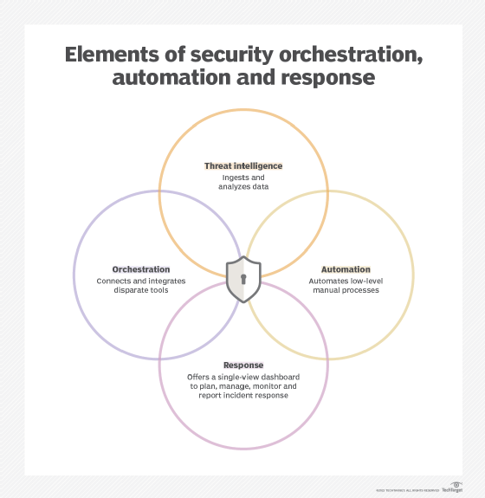

Slide 37
SOAR platforms have three main components: security orchestration, security automation and security response.
Security orchestration:
Security orchestration connects and integrates disparate internal and external tools via built-in or custom integrations and application programming interfaces. Connected systems can include vulnerability scanners, endpoint protection products, user and entity behavior analytics, firewalls, intrusion detection and intrusion prevention systems (IDSes/IPSes), security information and event management (SIEM) platforms, endpoint security software, external threat intelligence feeds and other third-party sources.
The more data gathered through these sources, the better the chance of detecting threats, along with assembling more complete context and improving collaboration. The tradeoffs, however, are more alerts and more data to ingest and analyze. Where security orchestration collects and consolidates data to initiate response functions, security automation takes action.

Slide 38
Security automation
Security automation, fed by the data and alerts collected from security orchestration, ingests and analyzes data and creates repeated, automated processes to replace manual processes. Tasks previously performed by analysts, such as vulnerability scanning, log analysis, ticket checking and auditing capabilities, can be standardized and automatically executed by SOAR platforms. Using artificial intelligence (AI) and machine learning to decipher and adapt insights from analysts, SOAR automation can prioritize threats, make recommendations and automate future responses. Alternately, automation can elevate threats if human intervention is needed.
Security response
Security response offers a single view for analysts into the planning, managing, monitoring and reporting of actions carried out after a threat is detected. This single view enables collaboration and threat intelligence sharing across security, network and systems teams. It also includes post-incident response activities, such as case management and reporting.

Slide 39
What SOAR does:
Automation: SOAR platforms automate repetitive and time-consuming security tasks, freeing up security analysts to focus on more complex issues.
Orchestration: SOAR integrates various security tools and processes, allowing for coordinated and efficient responses to security incidents.
Incident Response: SOAR provides a platform for managing and coordinating incident response activities, from detection to resolution.
Threat Intelligence: SOAR platforms can incorporate threat intelligence feeds to enrich incident data and improve response actions.
Playbooks: SOAR allows for the creation of playbooks, which are standardized procedures for responding to specific types of security incidents.
Key Benefits of SOAR:
Faster Response Times: Automation and orchestration lead to faster detection and response to security incidents.
Reduced Human Error: SOAR minimizes manual tasks and reduces the risk of human error.
Improved Security Posture: By streamlining security operations and automating responses, SOAR helps organizations improve their overall security posture.

Slide 40
Increased Efficiency: SOAR allows security teams to work more efficiently by automating tasks and providing a unified view of security operations.
Better Threat Management: SOAR helps organizations better manage and respond to threats by providing a centralized platform for threat intelligence and incident response.
SOAR Components:
Threat and Vulnerability Management:
SOAR platforms help organizations identify and manage vulnerabilities and threats.
Incident Response:
SOAR provides tools and processes for managing security incidents.
Security Operations Automation:
SOAR automates repetitive tasks and processes within the security operations center (SOC).
Threat Intelligence:
SOAR platforms can integrate threat intelligence feeds to enrich incident data and improve response actions.
Playbooks:
SOAR allows for the creation of playbooks, which are standardized procedures for responding to specific types of security incidents.

Slide 41
What are the benefits of SOAR?
Faster incident detection and reaction times. The volume and velocity of security threats and events are constantly increasing. SOAR's improved data context, combined with automation, can lower mean time to detect, or MTTD, and speed up mean time to respond, or MTTR. By detecting and responding to threats more quickly -- through automated playbooks, when available -- their effects can be lessened.
Better threat context. By integrating more data from a wider array of tools and systems, SOAR platforms can offer more context, better analysis and up-to-date threat information.
Simplified management. SOAR platforms consolidate various security systems' dashboards into a single interface. This helps SecOps and other teams by centralizing information and data handling, simplifying management and saving time.

Slide 42
Scalability. Scaling time-consuming manual tasks can be a drain on employees and even impossible to keep up with as security event volume grows. The orchestration, automation and workflows can meet scalability demands more easily.
Boosted analyst productivity. Automating lower-level threats augments SecOps and security operations center (SOC) teams' responsibilities, enabling them to prioritize tasks more effectively and respond to threats that require human intervention more quickly.
Streamlined operations. Standardized procedures and playbooks that automate lower-level tasks enable SecOps teams to respond to more threats in the same time period. These automated workflows also ensure the same standardized remediation efforts are applied organization-wide across all systems.
Reporting and collaboration. SOAR platforms' reporting and analysis consolidate information quickly, enabling better data management processes and better response efforts to update existing security policies and programs for more effective security. A SOAR platform's centralized dashboard can also improve information sharing across disparate enterprise teams, enhancing communication and collaboration.
Lowered costs. In many instances, augmenting security analysts with SOAR tools can lower costs, as opposed to manually performing all threat analysis, detection and response workflows.

Slide 43
What are the challenges of SOAR?
Other potential drawbacks of SOAR include the following:
Failure to remediate a broader security strategy.
Conflated expectations.
Integration complexities.
Deployment and management complexity.
Lack of or limited metrics.
Expert Security Analysts: As an Expert security Analyst, you will be responsible for both operational security monitoring and security improvements. In this role, you will: Actively monitor security alerts for malicious activity or anomalies, ensuring swift response.

Slide 44
Expert Security Analysts, also known as cybersecurity specialists, are professionals who protect computer systems, networks, and data from unauthorized access, theft, or damage, by identifying and mitigating vulnerabilities and responding to security incidents.
roles and responsibilities:
Key Responsibilities of Expert Security Analysts:
Security Monitoring and Incident Response:
They actively monitor network traffic and systems for suspicious activity and security breaches, and respond to incidents in real-time.
Vulnerability Assessment and Penetration Testing:
They identify weaknesses in systems and networks, and conduct penetration tests to simulate attacks and assess the effectiveness of security measures.
Security System Implementation and Maintenance:
They install, configure, and maintain security tools and software, such as firewalls, intrusion detection systems, and encryption programs.
Security Policy Development and Enforcement:
They develop and enforce security policies and procedures to ensure that organizations maintain a strong security posture.
Threat Research and Analysis:
They stay up-to-date on the latest security threats and vulnerabilities, and conduct research to identify potential risks.

Slide 45
Incident Reporting and Communication: They document security incidents, prepare reports, and communicate findings to stakeholders.
Security Awareness Training: They educate users about security risks and best practices.
Collaboration and Communication: They work with other IT professionals and stakeholders to ensure that security measures are effective and aligned with business needs.
Skills and Qualifications:
Technical Skills:
Strong understanding of network security, operating systems, security protocols, and security tools.
Analytical and Problem-Solving Skills:
Ability to analyze data, identify patterns, and solve complex security problems.
Communication and Interpersonal Skills:
Ability to communicate technical information clearly and effectively, and to work collaboratively with others.
Certifications:
Industry-recognized certifications, such as CISSP (Certified Information Systems Security Professional), CEH (Certified Ethical Hacker), and CCIE Security (Cisco Certified Internetwork Expert Security), demonstrate expertise and credibility.
Experience:
Practical experience in information security, network administration, or related fields is highly valued.

Slide 46
MODULE-4
Factors to consider during selection of MDR Provider– Security compliance with industry standard security regulations like HIPAA, PCI-DSS and GDPR. Service Level Agreements (SLA), Incident response procedures, Reporting.
Security compliance involves implementing controls and practices to meet regulatory obligations, industry standards, and internal policies, ensuring sensitive data is protected, IT assets are secure, and information security risks are minimized. For example, compliance with HIPAA requires organizations handling Protected Health Information (PHI) to establish physical, network, and process security measures.

Slide 47
Here's a more detailed explanation:
1. Understanding Security Compliance:
Security compliance is about aligning your organization's security practices with established rules, regulations, and standards.
It's a proactive approach to managing security risks and vulnerabilities.
Compliance helps build trust with customers, partners, and regulators.
2. Key Aspects of Security Compliance:
Identifying Applicable Regulations:
Determine which regulations and standards (e.g., HIPAA, GDPR, PCI DSS, NIST Cybersecurity Framework) apply to your organization and its operations.
Implementing Controls:
Put in place appropriate security controls (e.g., access controls, encryption, auditing) to meet compliance requirements.
Monitoring and Testing:
Continuously monitor your security posture, conduct regular testing and audits, and identify areas for improvement.
Documentation and Reporting:
Maintain comprehensive documentation of your compliance efforts and be prepared to demonstrate compliance to auditors and regulators.

Slide 48
3. Examples of Security Compliance:
HIPAA Compliance:
Organizations dealing with protected health information (PHI) must comply with HIPAA's rules to ensure the confidentiality, integrity, and availability of e-PHI, and protect against security threats and unauthorized access.
GDPR Compliance:
Organizations handling personal data of EU citizens must comply with GDPR, which includes requirements for data protection, data privacy, and data security.
PCI DSS Compliance:
Organizations handling credit card information must comply with PCI DSS standards, which are designed to protect sensitive cardholder data.
NIST Cybersecurity Framework:
The NIST CSF provides a framework of best practices for cybersecurity risk management, helping organizations identify, protect, detect, respond to, and recover from cybersecurity incidents.

Slide 49
4. Benefits of Security Compliance:
Reduced Risk:
Compliance reduces the risk of data breaches, security incidents, and other security-related problems.
Improved Reputation:
Compliance builds trust with customers and stakeholders.
Legal and Regulatory Compliance:
Compliance ensures that your organization is meeting legal and regulatory obligations.
Competitive Advantage:
Compliance can be a differentiator in the marketplace, helping you stand out from competitors.
HIPAA and the Security Rule The statute requires that the standards do the following: Ensure the integrity and confidentiality of the information. Protect against any reasonably anticipated threats or hazards to the security or integrity of the information and unauthorized uses or disclosures of the information.

Slide 50
PCI-DSS and GDPR
PCI DSS and GDPR are both data protection regulations, but they focus on different types of data and have different scopes. PCI DSS focuses on securing cardholder data for payment transactions, while GDPR is a broader regulation protecting personal data of individuals within the European Union.
PCI DSS (Payment Card Industry Data Security Standard):
Focus: Securing cardholder data during payment card transactions.
Scope: Applies to any organization that processes, stores, or transmits cardholder data.
Goal: To ensure the security and confidentiality of payment information.
GDPR (General Data Protection Regulation):
Focus:
Protecting the privacy rights and private data of individuals within the European Union.
Scope:
Applies to any organization that collects, processes, or stores personal data from EU citizens, regardless of the organization's location.

Slide 51
GDPR (General Data Protection Regulation):
Goal:
To empower individuals with control over their personal data and to ensure data protection, transparency, and accountability.
Key Differences:
Data Focus: PCI DSS is specific to cardholder data, while GDPR covers all personal data.
Geographic Scope: PCI DSS is a global standard, while GDPR is specific to the EU.
Individual Rights: GDPR emphasizes individual rights over their data, while PCI DSS focuses on securing the data itself.

Slide 52
Overlap and Relationship:
While they are distinct, there is some overlap and potential for synergy. Organizations implementing PCI DSS compliance measures may find it easier to meet certain GDPR requirements, particularly those related to data security and access controls. However, it's crucial to understand that PCI DSS does not automatically fulfil GDPR obligations. GDPR requires a broader approach to data protection, encompassing individual rights and transparency, which goes beyond the focus of PCI DSS.
GDPR stands for General Data Protection Regulation, a European Union law that controls how organizations can collect, store, and use personal data of EU citizens. PCI DSS stands for Payment Card Industry Data Security Standard, a set of security standards designed to protect cardholder data and prevent fraud.

Slide 53
Service Level Agreements (SLA)
A Service Level Agreement (SLA) is a contract between a service provider and a customer that outlines the quality, availability, and responsiveness of the services provided, including metrics for measuring performance and remedies for breaches.
Here's a more detailed explanation:
What is a Service Level Agreement (SLA)?
Definition:
An SLA is a formal agreement that specifies the level of service a customer can expect from a provider, including what services will be provided, how they will be measured, and what happens if the service levels are not met.
Purpose:
SLAs help establish clear expectations, hold service providers accountable, and provide a mechanism for recourse if commitments aren't met.
Scope:
While often used in IT contexts, SLAs can apply to any service where performance and reliability are critical.
Legal Binding:
Once signed, an SLA becomes a legally binding contract.

Slide 54
Key Components of an SLA:
Service Description: A clear and concise description of the services covered by the agreement.
Service Levels: Specific, measurable targets for service performance, such as uptime, response time, and resolution time.
Performance Metrics: The metrics used to measure service performance, such as uptime percentage, average response time, and number of incidents.
Responsibilities: A clear outline of the responsibilities of both the service provider and the customer.
Remedies for Breach: The actions that will be taken if the service levels are not met, such as credits, discounts, or additional support.
Escalation Procedures: A process for escalating issues to higher levels of support when necessary.
Cancellation Terms: The conditions under which the agreement can be terminated.

Slide 55
Types of SLAs:
Customer-based SLA:
An agreement between a service provider and a specific customer or customer group.
Service-level SLA:
An agreement that defines the same service offered to multiple customers.
Internal SLA:
An agreement between different teams or departments within the same organization.
Multi-level SLA:
An agreement that covers multiple services or multiple customers with different service plans.

Slide 56
Why are SLAs Important?
Clear Expectations:
SLAs ensure that both the service provider and the customer have a clear understanding of what to expect.
Accountability:
SLAs hold service providers accountable for delivering the agreed-upon level of service.
Improved Service:
By focusing on specific metrics and service levels, SLAs can help improve service quality and performance.
Reduced Disputes:
SLAs can help prevent disputes by clearly defining the terms of the service agreement.
Customer Satisfaction:
By delivering on the promises outlined in the SLA, service providers can improve customer satisfaction.

Slide 57
Incident response procedures, Reporting.
Incident response procedures involve a structured process for managing security incidents, from initial detection to post-incident review. Incident reporting is a crucial component of this process, providing documentation and analysis to improve future responses. Key aspects include defining roles and responsibilities, establishing reporting channels, and documenting incident details, including actions taken and lessons learned.
Incident Response Procedures:
Preparation: Establish a clear incident response plan outlining roles, responsibilities, and communication protocols.
Detection: Implement security tools and systems to detect potential incidents and trigger alerts.
Analysis: Investigate alerts to determine if they are actual incidents and assess the scope and impact.
Containment: Isolate affected systems to prevent further damage and escalation.
Eradication: Remove the root cause of the incident, such as malware or vulnerabilities.
Recovery: Restore affected systems and data to a functional state.
Post-Incident Activity: Review the incident, identify lessons learned, and update the response plan.

Slide 58
Incident Reporting:
Documentation:Record detailed information about the incident, including the date, time, affected systems, and actions taken.
Analysis:Analyze incident data to identify trends, patterns, and vulnerabilities that can inform future prevention and response efforts.
Communication:Provide clear and timely communication to stakeholders, including internal teams, legal counsel, and external parties.
Reporting:Document lessons learned, recommendations, and follow-up actions to prevent similar incidents in the future.
Key Considerations:
Legal and Regulatory Compliance:
Ensure that incident response and reporting procedures adhere to relevant laws and regulations, such as data breach notification laws.

Slide 59
Stakeholder Communication:Establish clear communication protocols for informing relevant stakeholders about incidents and their impact.
Continuous Improvement:Regularly review and update incident response procedures and reporting protocols based on lessons learned and evolving threats.
Incident response is the strategic, organized responsed an organization uses following a cyberattack. The response is executed according to planned procedures that seek to limit damage and repair breached vulnerabilities in systems. IT professionals use incident response plans to manage security incidents
5 Steps to Building an Incident Response Plan
Step 1: Preparation. Preparation is key to an effective response. ...
Step 2: Detection and analysis. Take steps to put security safeguards in place. ...
Step 3: Containment, eradication, and recovery. ...
Step 4: Post-incident activity. ...
Step 5: Test your incident response process.
Incident response reporting in cybersecurity involves documenting and reporting cybersecurity incidents to relevant authorities and stakeholders. This includes documenting the incident, its timeline, impact assessment, and actions taken. The purpose of this reporting is to manage the incident, enhance security measures, and ensure compliance with regulations.

Slide 60
Key aspects of incident response reporting:
Reporting to Internal Teams:
Organizations should immediately report incidents to their internal IT or cybersecurity team for initial assessment and containment, according to Palo Alto Networks.
Reporting to Regulatory Bodies:
Notifying relevant regulatory bodies is crucial if sensitive data or critical infrastructure is involved, according to Palo Alto Networks.
Reporting to Law Enforcement:
Law enforcement agencies like the FBI's Internet Crime Complaint Center (IC3) play a vital role in investigating cybercrimes, according to Palo Alto Networks.
Reporting to Computer Emergency Response Teams (CERTs):
CERTs offer specialized assistance and can coordinate a more extensive response.
Data Breach Notifications:
Organizations may need to notify affected customers or business partners about data breaches.

Slide 61
Details of an Incident Response Report:
Incident Description:
A clear description of the incident, including the chain of events, types of incident (e.g., malware, ransomware), and technical details (e.g., URLs, IP addresses).
Timeline:Documentation of the date and time when the incident occurred and when it was detected, as well as the duration of the incident.
Impact Assessment:An assessment of the severity of the incident and its potential impact on the organization.
Response Actions:A record of the actions taken to contain, eradicate, and recover from the incident.
Recommendations:Suggestions for future prevention and improvement.
Importance of Incident Response Reporting:
Effective Incident Management:Reporting enables organizations to manage incidents effectively and mitigate potential damage.
Compliance:Reporting helps organizations comply with legal and regulatory requirements.
Enhanced Security:Incident response reporting facilitates a systematic approach to handling incidents and enhances overall security posture.
Learning and Improvement:Post-incident analysis based on reports helps organizations identify weaknesses and improve their security measures.

Slide 62
Module-5
Key services provided by MDR Provider – Advanced Threat detection, Proactive threat hunting, Rapid Incident response, seamless integration with existing security tools and processes
Advanced Threat detection
Managed Detection and Response (MDR) providers offer a suite of services for advanced threat detection,including 24/7 monitoring, threat hunting, incident response, and remediation. They use a combination of technology and human expertise to identify and mitigate threats, often including endpoint detection and response (EDR) capabilities.

Slide 63
Key services provided by MDR providers for advanced threat detection:
24/7 Threat Monitoring:
MDR services continuously monitor an organization's IT environment, including endpoints, networks, and cloud infrastructure, for signs of suspicious activity.
Proactive Threat Hunting:
MDR providers actively search for hidden or advanced threats that may not have triggered alerts from automated detection systems, using techniques like threat intelligence and advanced analytics.
Incident Investigation:
When potential threats are detected, MDR providers conduct thorough investigations to understand the nature and scope of the incident, including analyzing data logs, network traffic, and relevant information.

Slide 64
Rapid Incident Response:
MDR services provide rapid and coordinated responses to confirmed security incidents, which may involve isolating systems, removing malware, and restoring affected services.
Forensic Analysis:
Post-incident analysis to understand the attack's origin, method, and potential damage, helping organizations strengthen their defenses.
Alerting and Response:
MDR services generate alerts when suspicious activities are detected, and security analysts assess these alerts, prioritize them, and take appropriate actions to mitigate the threats.
Managed Remediation:
MDR providers offer managed remediation capabilities, restoring endpoints to a known good state after a security incident by removing malware, cleaning the registry, and eliminating persistence mechanisms.

Slide 65
Expert-Led Security Operations:
MDR services provide access to security experts and operational best practices, enhancing security posture and resilience.
Reporting and Communication:
MDR services provide regular reports to the organization, highlighting detected threats, actions taken, and overall security trends, offering transparency and allowing for informed decision-making.
Attack Surface Reduction:
MDR services focus on identifying and mitigating potential attack vectors to reduce the overall attack surface of an organization's IT environment
Proactive threat hunting
Proactive threat hunting is a cybersecurity methodology where security teams actively search for signs of malicious activity in a network, even before an incident has been detected. It's a proactive approach to identify and mitigate potential threats before they can cause harm, unlike reactive incident response which focuses on addressing existing incidents.

Slide 66
Key aspects of proactive threat hunting:
Hypothesis-driven:
Threat hunters develop hypotheses about potential attacks and then actively search for evidence to support or refute those hypotheses.
Cyclical process:
Threat hunting is not a one-time event but an ongoing process of investigation, analysis, and refinement of hypotheses.
Utilizes various tools and techniques:
This includes examining network logs, analyzing endpoint data, and using specialized threat hunting tools to identify anomalies and indicators of compromise.
Focus on detection and remediation:
The goal is to detect malicious activity early and prevent it from spreading, or to quickly remediate existing threats.
Enhances cybersecurity posture:
By proactively hunting for threats, organizations can improve their overall security posture and reduce their risk of breaches.

Slide 67
Examples of proactive threat hunting activities:
Searching for unknown or previously undetected threats:
This involves looking for unusual behaviors, patterns, or indicators that may suggest an attack is underway.
Identifying vulnerabilities and misconfigurations:
Proactive threat hunting can uncover weaknesses in an organization's security infrastructure that could be exploited by attackers.
Investigating potential indicators of compromise (IOCs):
Threat hunters may use information from threat intelligence feeds or other sources to investigate potential IOCs and determine if they are present in the network.
Analyzing network traffic and endpoint data:
By examining network traffic and endpoint logs, threat hunters can identify unusual activity that may indicate a threat.
Developing and testing new threat hunting rules and playbooks:
This helps to improve the effectiveness of threat hunting and automate the process of detecting and responding to threats.

Slide 68
Benefits of proactive threat hunting:
Early detection:
Proactive threat hunting can help organizations detect threats earlier than traditional security tools, allowing for faster response and mitigation.
Reduced impact of breaches:
By identifying and stopping threats early, proactive threat hunting can minimize the potential impact of a breach.
Improved security posture:
Proactive threat hunting helps organizations to identify and address vulnerabilities, strengthening their overall security posture.
Enhanced threat intelligence:
Proactive threat hunting can provide valuable insights into the tactics and techniques used by threat actors, helping organizations to better defend themselves against future attacks.
Rapid incident response is a proactive security approach focused on minimizing the impact of cyberattacks by swiftly identifying, containing, and recovering from incidents. It involves having a well-defined plan, trained personnel, and potentially specialized tools to handle security breaches effectively and quickly.

Slide 69
Key aspects of rapid incident response:
Preparation:
This involves establishing a robust incident response plan, conducting tabletop exercises, and ensuring buy-in from all stakeholders.
Detection & Analysis:
Identifying security incidents through various means, including security information and event management (SIEM) systems, and analyzing the nature and scope of the attack.
Containment:
Taking immediate steps to limit the spread of the attack, such as isolating affected systems or devices.
Eradication:
Removing the root cause of the incident, such as malware or malicious software, and restoring affected systems.

Slide 70
Recovery:
Bringing systems back online and restoring data, ensuring minimal disruption to business operations.
Post-Incident Activity:
Conducting a post-mortem analysis to identify lessons learned and improve future response plans.
Why rapid response is crucial:
Minimizing Damage:
Fast response can prevent further damage to systems, data, and reputation.
Reducing Downtime:
Quick recovery helps businesses get back to normal operations as quickly as possible.
Lowering Costs:
Rapid response can reduce the overall cost associated with a breach, including remediation and legal fees.
Protecting Reputation:
Swift action and effective communication can help maintain customer trust and prevent reputational damage.

Slide 71
Examples of rapid incident response services:
Rapid7 offers incident response experts to investigate incidents and recommend remediation.
Certego's Rapid Incident Response team provides well-defined response procedures and may advise on temporary lockdowns to contain threats.
Eye Security's Rapid Incident Response includes triage, kick-off meetings, containment, recovery, and evaluation phases.
KMicro's Rapid Incident Response & Readiness Service offers expert guidance, proactive readiness activities, and immediate support.

Slide 72
seamless integration with existing security tools and processes
Seamlessly integrating new security tools and processes with existing infrastructure involves ensuring they can communicate, share data, and collaborate effectively. This often requires choosing a central platform, ensuring data quality, setting up automation, and training personnel. Ultimately, the goal is to create a unified security ecosystem that enhances threat detection and response capabilities.
Key aspects of seamless integration:
Identify and understand existing tools:
Begin by mapping out your current security infrastructure, including tools like SIEM, EDR, firewalls, and cloud platforms.
Choose a compatible and interoperable solution:
Select a new tool or platform that can communicate and exchange data with your existing systems.

Slide 73
Centralized platform:
Opt for a central platform that consolidates data from various sources into a single dashboard for enhanced visibility and management.
Data quality and accuracy:
Ensure that data from each security system is accurate and up-to-date to prevent misinterpretations or missed threats.
Automation and workflows:
Implement automation to streamline security operations and reduce response times.
Training and support:
Train personnel on how to use the integrated platform and respond to security incidents effectively.
Testing and validation:
Thoroughly test the integrated system to ensure it functions as expected and that data flows smoothly.
Benefits of seamless integration:

Slide 74
Enhanced threat detection and response:
A unified security ecosystem enables better coordination and collaboration among security tools, leading to faster threat detection and response.
Improved security posture:
By integrating new security solutions, organizations can strengthen their overall security posture and reduce their attack surface.
Increased efficiency:
Automation and centralized platforms streamline security operations, reducing manual effort and improving efficiency.
Better visibility:
Consolidated data from various sources provides a comprehensive view of the organization's security posture, simplifying monitoring and management.

Slide 75
Reduced risk:
Seamless integration helps to mitigate the risk of security vulnerabilities and breaches by ensuring that all security tools are working together effectively.
DevSecOps, which stands for development, security, and operations, is a framework that integrates security into all phases of the software development lifecycle. Organizations adopt this approach to reduce the risk of releasing code with security vulnerabilities.
What are the 3 main security tools used to protect your computer from threats?
Antispyware software, antivirus software, and firewalls are also significant tools to thwart attacks on your device.

Slide 76


