Slide 1
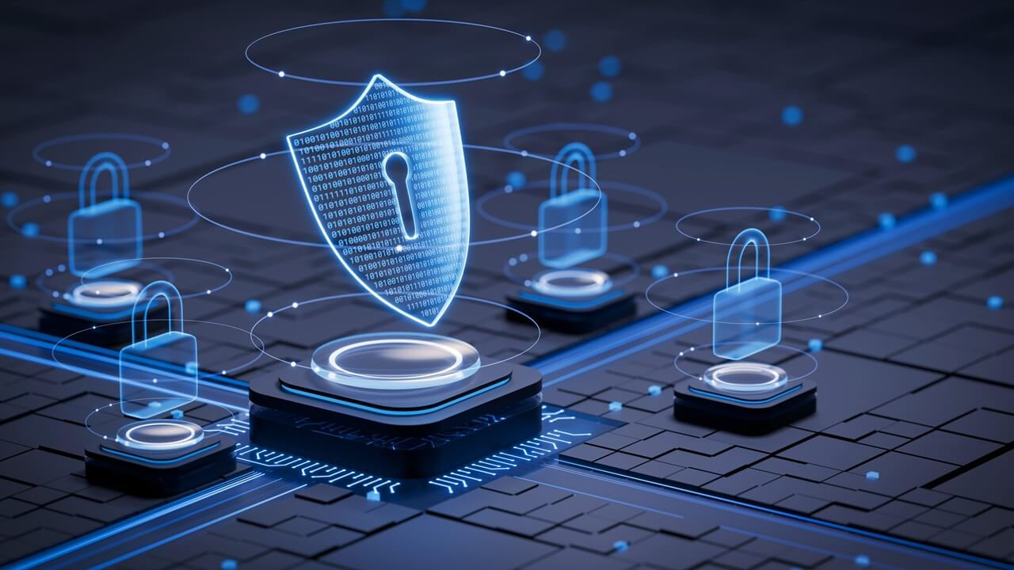
Elements of Cyber Security - (BCY402)
                Course Coordinator:
                Mrs.Razikha Amreen M I
                Assistant Professor
                Dept. of CSE-CY
                ATMECE, Mysuru

Slide 2
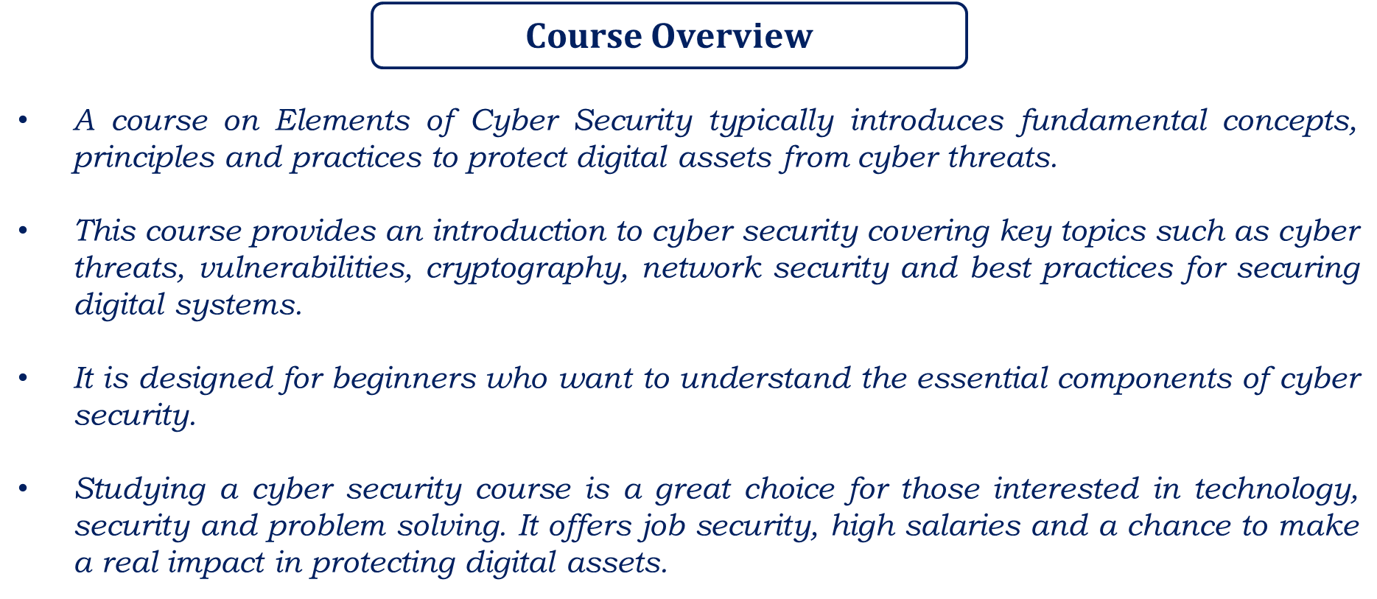

Slide 3
MODULE 1
Basic Cyber Security Concepts, layers of security, Vulnerability, Assets and Threat, motive of attackers, active attacks, passive attacks, Software attacks, hardware attacks, Cyber Threats-Cyber Warfare, Cyber terrorism, Cyber Espionage, etc., Comprehensive Cyber Security Policy.

Slide 4
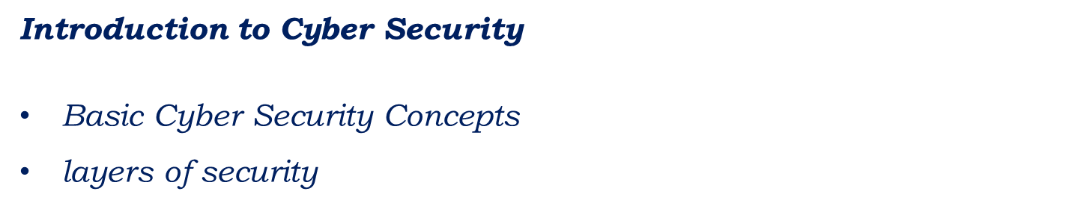

Slide 5
Basics cyber security concepts
Cyber Security is referred to the security offered through online services to protect the online information.
With an increasing amount of people getting connected to the Internet, the security threats are also massively increasing.
Cyber Security is the body of technologies, processes and practices designed to protect networks, devices, programs and data from attack, theft, damage, modification or unauthorized access. It is also called as Information Technology Security.
Cyber Security is the set of principles and practices designed to protect the computing resources and online information against threats.

Slide 6
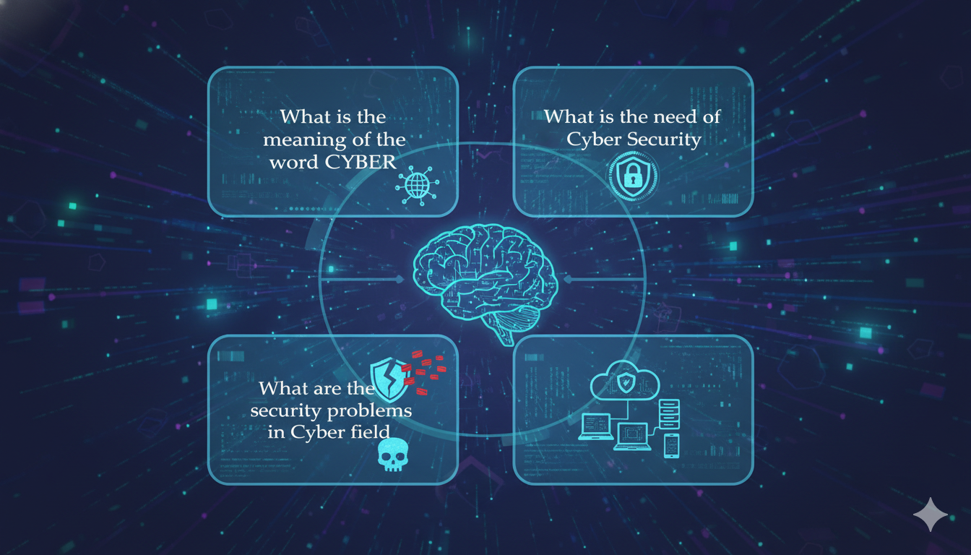
Digital Defense Essentials:Understanding Cyber Security

Slide 7
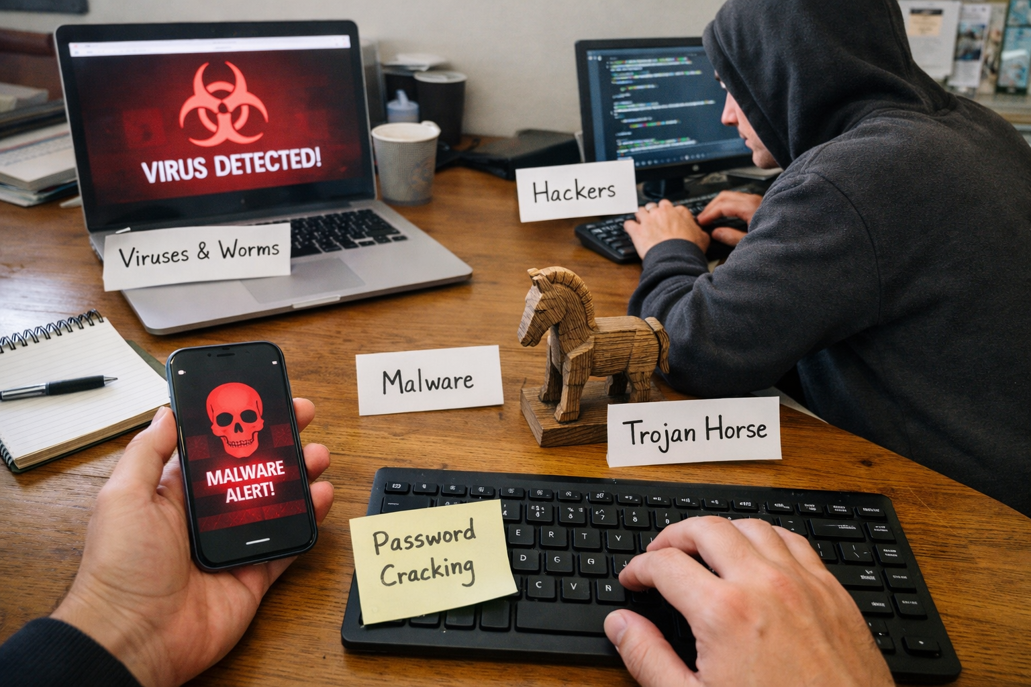
Security Problems & Maintaining Security in Cyber
Viruses & Worms
Hackers
Malware
Trojan Horse
Password Cracking

Slide 8
Viruses & Worms:
A virus is a program that is loaded into the computer without user’s knowledge and runs against the user’s wish.
Maintenance:
Install a security suite that protects the computer against threats such as viruses and worms. (eg., Antivirus).

Slide 9
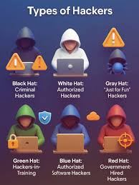

Slide 10
Hackers:
A hacker is a person who uses computers to gain unauthorized access to data.
Types of Hackers:
Black Hat Hackers
White Hat Hackers
Grey Hat Hackers
Maintenance:
It may be impossible to prevent computer hacking, however effective security controls including strong passwords and the use of firewalls.

Slide 11
Black Hat Hackers: (Unethical Hacker or Security Cracker)
These people hack the system illegally to steal money or to achieve their own illegal goals.
They find the banks or organization with weak security and steal money or credit card information, they can also modify or destroy confidential data
White Hat Hackers: (Ethical Hacker or Penetration Tester)
These people use the same technique used by the black hat hackers, but they can only hack the system that they have permission to hack in order to test the security of the system. They focus on securing and protecting IT System. White Hat Hacker is legal.
Grey Hat Hackers:
Grey Hat Hackers are hybrid of Black hat hackers & White hat hackers.
They can hack any system even if they don’t have permission to test the security of the system but they will never steal money or damage the system

Slide 12
Malware: (MALicious softWARE)
Malware is any software that infects and damages a computer system without the owner’s knowledge or permission.
Maintenance:
Download an anti-malware program that also helps prevent infection.
Activate network protection firewall, antivirus.

Slide 13
Trojan Horse:
Trojan horse are email viruses that can duplicate themselves, steal information or harm the computer system. These viruses are the most serious threats to computers.
Maintenance:
Security suits such as Avast Internet Security, which will prevent from downloading Trojan Horses.

Slide 14
Password Cracking:
Password attacks are attacks by hackers that are able to determine passwords or find passwords to different protected electronic areas and social network sites.
Maintenance:
Use always strong password.
Never use same password for two different sites.

Slide 15
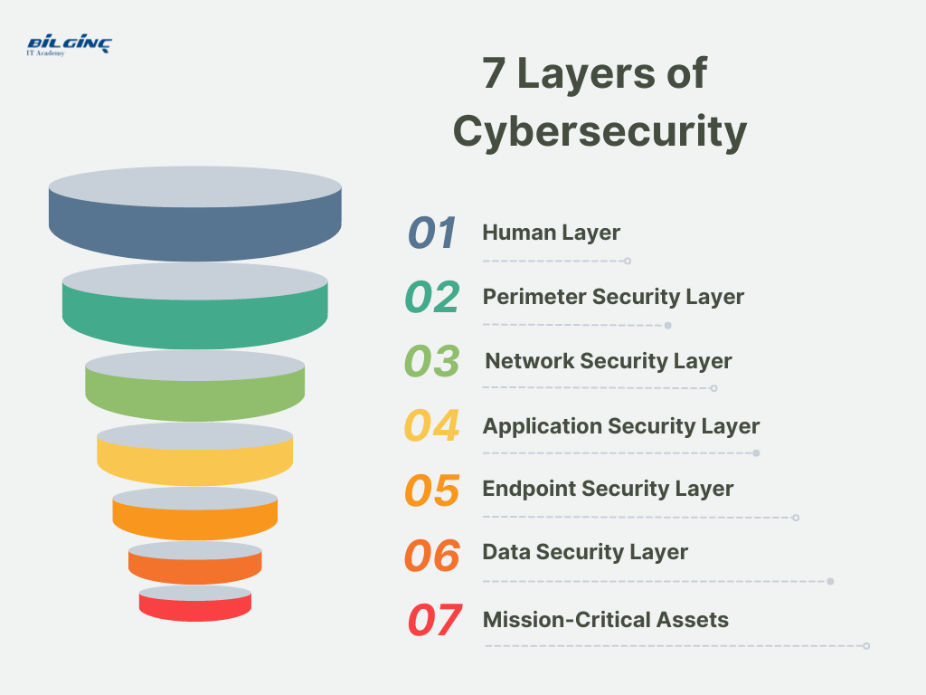
The 7 layers of cyber security should center on the mission critical assets.

Slide 16
Mission Critical Assets: This is the data which need to be protected.
Data Security: It protects the storage and transfer of data.
Application Security: It protects access to an application which handles the mission critical assets and internal security of the application.
Endpoint Security: It protects the connection between devices and the network.
Network Security: It protects an organization’s network to prevent unauthorized access of the network.

Slide 17
Perimeter Security: It includes both the physical and digital security methodologies that protect the overall business.
The Human Layer: Humans are the weakest link in any cyber security posture. Human security control includes phishing simulations and access management control that protect mission critical assets from a wide variety of human threats, including cyber criminals, malicious insiders and negligent users.

Slide 18
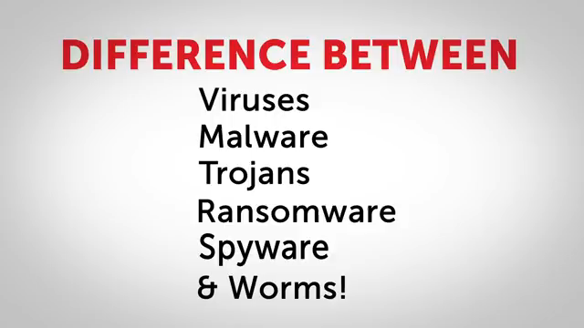
Difference between the attacks

Slide 19
In today’s session, you all have gone through the following topics
Introduction to Cyber Security
Basic Cyber Security Concepts
layers of security

Slide 20

Thank you

