Slide 1
Algorithm
Can be represented in various forms
Unambiguity/clearness
Effectiveness
Finiteness/termination
Correctness

Slide 2
What is an algorithm?
An algorithm is a sequence of unambiguous instructions for solving a problem, i.e., for obtaining a required output for any legitimate input in a finite amount of time.
Problem
Algorithm
“Computer”
Input
Output

Slide 3
Two descriptions of Euclid’s algorithm
Step 1 If n = 0, return m and stop; otherwise go to Step 2
Step 2 Divide m by n and assign the value of the remainder to r
Step 3 Assign the value of n to m and the value of r to n. Go to Step 1.
while n ≠ 0 do
r ← m mod n
m← n n ← r return m

Slide 4
Other methods for computing gcd(m,n)
Consecutive integer checking algorithm
Step 1 Assign the value of min{m,n} to t
Step 2 Divide m by t. If the remainder is 0, go to Step 3; otherwise, go to Step 4
Step 3 Divide n by t. If the remainder is 0, return t and stop; otherwise, go to Step 4
Step 4 Decrease t by 1 and go to Step 2
Is this slower than Euclid’s algorithm? How much slower?

Slide 5
Other methods for gcd(m,n)[cont.]
Middle-school procedure
Step 1 Find the prime factorization of m
Step 2 Find the prime factorization of n
Step 3 Find all the common prime factors
Step 4 Compute the product of all the common prime factors and return it as gcd(m,n)
Is this an algorithm? How efficient is it?

Slide 6
Sieve of Eratosthenes
Input: Integer n ≥ 2
Output: List of primes less than or equal to n
for p ← 2 to n do A[p] ← p
for p ← 2 to sqrt(n) do
if A[p] ≠ 0 //p hasn’t been eliminated on previous passes
j ← p* p
while j ≤ n do
A[j] ← 0 //mark element as eliminated
j ← j + p
Example: 2 3 4 5 6 7 8 9 10 11 12 13 14 15 16 17 18 19 20
Output: 2 3 5 7 11 13 17 19

Slide 7
Informal definition
  A graph is a collection of points called vertices, some of which are connected by line segments called edges.
Modeling real-life problems
  Modeling WWW
  Communication networks
  Project scheduling …
    Examples of graph algorithms
– Graph traversal algorithms
  Shortest-path algorithms
  Topological sorting
Department of CCSSEE
ATME College of Engineering

Slide 8
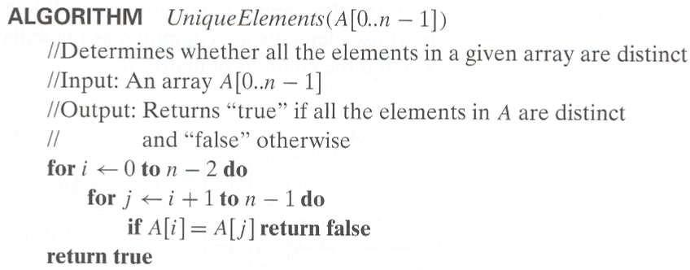
Example 2: Element uniqueness problem

Slide 9
Linear Data Structures
Arrays
  A sequence of n items of the same data type that are stored contiguously in computer memory and made accessible by specifying a value of the array’s index.
Linked List
  A sequence of zero or more nodes each containing two kinds of information: some data and one or more links called pointers to other nodes of the linked list.
  Singly linked list (next pointer)
  Doubly linked list (next + previous pointers)
a1 a2
fixed length (need preliminary reservation of memory)
contiguous memory locations
direct access
Insert/delete
Linked Lists
  dynamic length
  arbitrary memory locations
  access by following links
  Insert/delete

Slide 10
Stacks and Queues
Stacks
  A stack of plates
    insertion/deletion can be done only at the top.
    LIFO
  Two operations (push and pop)
Queues
  A queue of customers waiting for services
    Insertion/enqueue from the rear and deletion/dequeue from the front.
    FIFO
  Two operations (enqueue and dequeue)
20

Slide 11
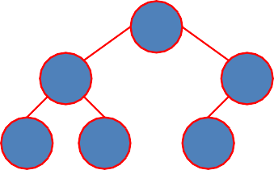
Priority Queue and Heap
Priority queues (implemented using heaps)
  A data structure for maintaining a set of elements, each associated with a key/priority, with the following operations
    Finding the element with the highest priority
    Deleting the element with the highest priority
    Inserting a new element
Scheduling jobs on a shared computer
9
6
8
5 2
3
9 | 6 | 8 | 5 | 2 | 3
21

Slide 12
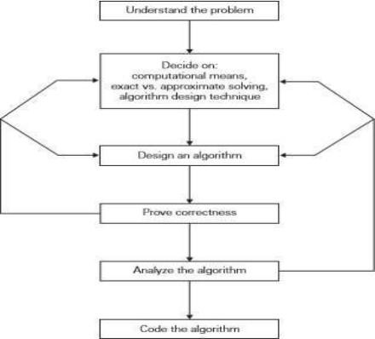

Slide 13
Fundamental steps in solving problems
Statement of the problem
Development of mathematical model
Design of the algorithm
Correctness of the algorithm
Analysis of algorithm for its time and space complexity
Implementation
Program testing and debugging
Documentation

Slide 14
Design and Analysis of Algorithm BCS401
4th Sem

Slide 15

M O D U L E – 1
IN TRODU C TION
1

Slide 16
What is an algorithm?
Algorithmic: The sprit of computing – David Harel.
Another reason for studying algorithms is usefulness in developing analytical skills.
their
Algorithms can be seen as special kinds of solutions to problems – not answers but rather precisely defined procedures for getting answers.
5

Slide 17
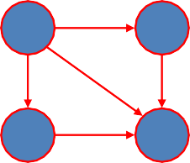
Weighted Graphs
Weighted graphs
– Graphs or digraphs with numbers assigned to the edges.
5
1
2
7
4
6
9
8
3
Department of CCSSEE
ATME College of Engineering

Slide 18
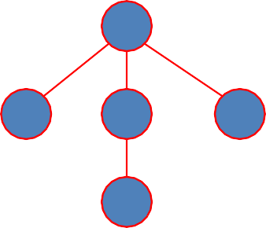
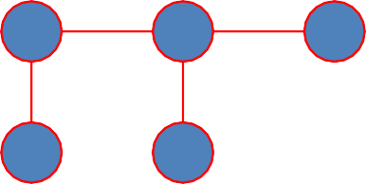
Trees
Trees
  A tree (or free tree) is a connected acyclic graph.
  Forest: a graph that has no cycles but is not necessarily connected.
Properties of trees
  For every two vertices in a tree there always exists exactly one simple path from one of these vertices to the other. Why?
    Rooted trees: The above property makes it possible to select an arbitrary vertex in a free tree and consider it as the root of the so called rooted tree.
    Levels in a rooted tree.
rooted
3
|E| = |V| - 1
1 3 5
2 4
4
1
5
2

Slide 19



















Slide 20
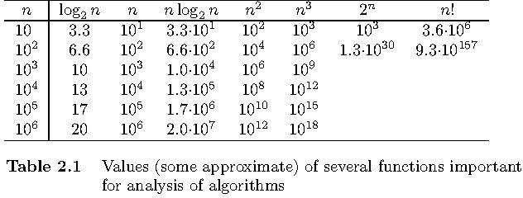
Values of some important functions as n → ∞
ATME College of Engineering

Slide 21
Order of growth
Most important: Order of growth within a constant multiple as n→∞
Example:
  How much faster will the algorithm run on computer that is twice as fast?
  How much longer does it take to solve problem of double input size?
ATME College of Engineering

Slide 22
Best-case, average-case, worst-case
For some algorithms efficiency depends on form of input:
C_{worst}(n) – maximum over inputs of size n
C_{best}(n) – minimum over inputs of size n
Worst case:
Best case:
Average case: C_{avg}(n) – “average” over inputs of size n
Number of times the basic operation will be executed on typical input.
NOT the average of worst and best case.
ATME College of Engineering

Slide 23
Asymptotic order of growth
A way of comparing functions that ignores constant factors and small input sizes
O(g(n)): class of functions f(n) that grow no faster than g(n)
Θ(g(n)): class of functions f(n) that grow at same rate as g(n)
Ω(g(n)): class of functions f(n) that grow at least as fast as g(n)
ATME College of Engineering

Slide 24
Establishing order of growth using the definition
Definition: f(n) is in O(g(n)) if order of growth of f(n) ≤ order of growth of g(n) (within constant multiple),
i.e., there exist positive constant c and non-negative integer n₀
such that
f(n) ≤ c g(n) for every n ≥ n₀
Example:
5n+2 is O(n);
c= 7 and n₀ = 1
Note : The Upper Bound indicates that the function will be the worst case that it does not consume more than this computing time.
ATME College of Engineering

Slide 25
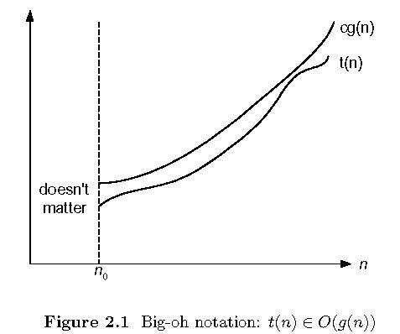
Big-oh
ATME College of Engineering

Slide 26
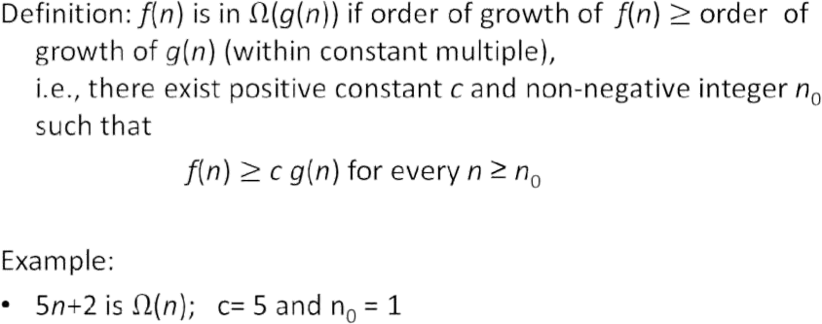
Establishing order of growth using the definition

Slide 27
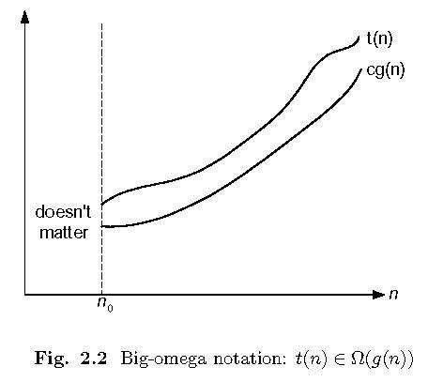
Big-omega
ATME College of Engineering

Slide 28
Establishing order of growth using the definition
Definition: f(n) is in Ɵ(g(n)) iff there exists three positive constants c1,c2 and n₀ with the constraint that c1 g(n) ≤ f(n)
≤ c2 g(n) for every n ≥ n_{0 .}
Example:
3n+2 is Ɵ (n)
c1 g(n) ≤ f(n) ≤ c2 g(n) for every n ≥ n₀
3 n ≤ 3n+2 ≤ 4 n for every n₀ = 2, c1 = 3, c2 = 4
ATME College of Engineering

Slide 29
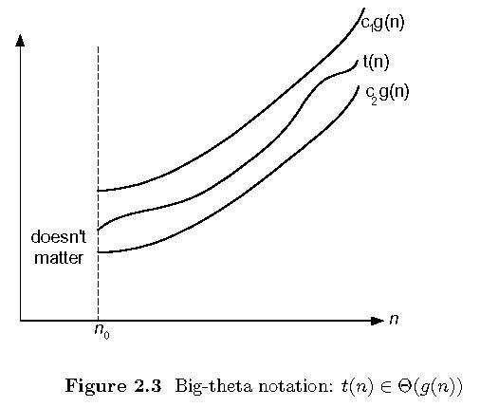
Big-theta
ATME College of Engineering

Slide 30
Course Outcomes(COs):
Course Outcomes:
CO 1. Analyze the performance of the algorithms, state the efficiency using asymptotic notations and analyze mathematically the complexity of the algorithm.
CO 2. Apply divide and conquer approaches and decrease and conquer approaches in solving the problems analyze the same.
CO 3. Apply the appropriate algorithmic design technique like greedy method, transform and conquer approaches and compare the efficiency of algorithms to solve the given problem.
CO 4. Apply and analyze dynamic programming approaches to solve some problems. and improve an algorithm time efficiency by sacrificing space.
CO 5. Apply and analyze backtracking, branch and bound methods and to describe P, NP ans NP Complete
2

Slide 31

Agenda
What is an Algorithm?
Algorithm Specification
Analysis Framework
Performance Analysis: Space complexity, Time complexity
Asymptotic Notations: Big-Oh notation (O), Omega notation (Ω), Theta notation (Θ), and Little-oh notation (o)
Mathematical analysis of Non-Recursive
Recursive Algorithms with Examples .
Important Problem Types: Sorting, Searching, String processing, Graph Problems,
Combinatorial Problems.
Fundamental Data Structures: Stacks, Queues, Graphs, Trees, Sets and Dictionaries.
3

Slide 32
Module 1
Introduction: What is an Algorithm? It’s Properties. Algorithm Specification-using natural language, using Pseudo code convention, Fundamentals of Algorithmic Problem solving, Analysis Framework-Time efficiency and space efficiency, Worst-case, Best-case and Average case efficiency.

Slide 33
Euclid’s Algorithm
Problem: Find gcd(m,n), the greatest common divisor of two nonnegative, not both zero integers m and n
Examples: gcd(60,24) = 12, gcd(60,0) = 60, gcd(0,0) = ?
Euclid’s algorithm is based on repeated application of equality
gcd(m,n) = gcd(n, m mod n)
m mod n is the reminder of the division m &n.
until the second number becomes 0, which makes the problem
trivial.
Example: gcd(60,24) = gcd(24,12) = gcd(12,0) = 12

Slide 34
Important problem types
Sorting
Searching
String processing
Graph problems
Combinatorial problems
Geometric problems
Numerical problems
Department of CCSSEE
ATME College of Engineering

Slide 35
Graph Representation
Adjacency matrix
  n x n boolean matrix if |V| is n.
  The element on the ith row and jth column is 1 if there’s an edge from ith vertex to the jth vertex; otherwise 0.
  The adjacency matrix of an undirected graph is symmetric.
Adjacency linked lists
  A collection of linked lists, one for each vertex, that contain all the vertices adjacent to the list’s vertex.
Which data structure would you use if the graph is a 100-node star shape?
0 1 1 1
0 0 0 1
0 0 0 1
0 0 0 0
2
3
4
4
4
DDeeppaarrttmmeennttooff CCSSEE
AATTMMEECECoCloloelelegggeeeoofffEEngngignineinererirningg

Slide 36
Fundamental steps in solving problems
Statement of the problem
Development of mathematical model
Design of the algorithm
Correctness of the algorithm
Analysis of algorithm for its time and space complexity
Implementation
Program testing and debugging
Documentation

Slide 37
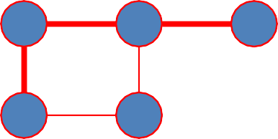
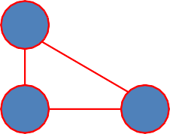
Graph Properties -- Paths and Connectivity
Paths
  A path from vertex u to v of a graph G is defined as a sequence of adjacent (connected by an edge) vertices that starts with u and ends with v.
  Simple paths: All edges of a path are distinct.
  Path lengths: the number of edges, or the number of vertices – 1.
Connected graphs
  A graph is said to be connected if for every pair of its vertices u and v there is a path from u to v.
Connected component
  The maximum connected subgraph of a given graph.
DDeeppaarrttmmeennttooff CCSSEE
AATTMMEECECoCloloelelegggeeeoofffEEngngignineinererirningg

Slide 38
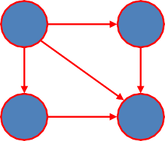
Graph Properties -- Acyclicity
Cycle
  A simple path of a positive length that starts and ends a the same vertex.
Acyclic graph
  A graph without cycles
  DAG (Directed Acyclic Graph)
1 2
3 4
ATME College of Engineering

Slide 39
Rooted Trees (I)
Ancestors
  For any vertex v in a tree T, all the vertices on the simple path from the root to that vertex are called ancestors.
Descendants
  All the vertices for which a vertex v is an ancestor are said to be descendants of v.
Parent, child and siblings
  If (u, v) is the last edge of the simple path from the root to vertex v, u is said to be the parent of v and v is called a child of u.
  Vertices that have the same parent are called siblings.
Leaves
  A vertex without children is called a leaf.
Subtree
  A vertex v with all its descendants is called the subtree of T
rooted at v.

Slide 40

Rooted Trees (II)
Depth of a vertex
  The length of the simple path from the root to the vertex.
Height of a tree
  The length of the longest simple path from the root to a leaf.
h = 2
3
4
1
5
2

Slide 41
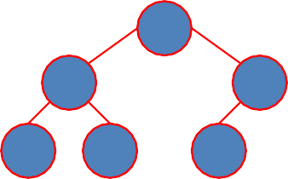

Ordered Trees
Ordered trees
  An ordered tree is a rooted tree in which all the children of each vertex are ordered.
Binary trees
  A binary tree is an ordered tree in which every vertex has no more than two children and each children is designated s either a left child or a right child of its parent.
Binary search trees
  Each vertex is assigned a number.
  A number assigned to each parental vertex is larger than all the numbers in its left subtree and smaller than all the numbers in its right subtree.
⎣log2n⎦ ≤ h ≤ n – 1, where h is the height of a binary tree and n the size.
9
6
6
8
3
9
5 2
3
2 5
8
ATME College of Engineering

Slide 42
Properties of asymptotic order of growth
f(n) ∈ O(f(n))
f(n) ∈ O(g(n)) iff g(n) ∈Ω(f(n))
If f (n) ∈ O(g (n)) and g(n) ∈ O(h(n)) , then f(n) ∈ O(h(n)) Note similarity with a ≤ b
If f₁(n) ∈ O(g₁(n)) and f₂(n) ∈ O(g₂(n)) , then
f₁(n) + f₂(n) ∈ O(max{g₁(n), g₂(n)})
ATME College of Engineering

Slide 43
Time efficiency of nonrecursive algorithms
General Plan for Analysis
Decide on parameter n indicating input size
Identify algorithm’s basic operation
Determine worst, average, and best cases for input of size n
Set up a sum for the number of times the basic operation is executed
Simplify the sum using standard formulas and rules
ATME College of Engineering

Slide 44


















Establishing order of growth using limits
0 order of growth of T(n) < order of growth of g(n
lim T(n)/g(n)
n→₌∞
c > 0 order of growth of T(n) = order of growth of g(n
∞ order of growth of T(n) > order of growth of g(n
Examples:
10n
vs.
n2
n(n+1)/2
vs.
n2
Department of CCSSEE
ATME College of Engineering

Slide 45
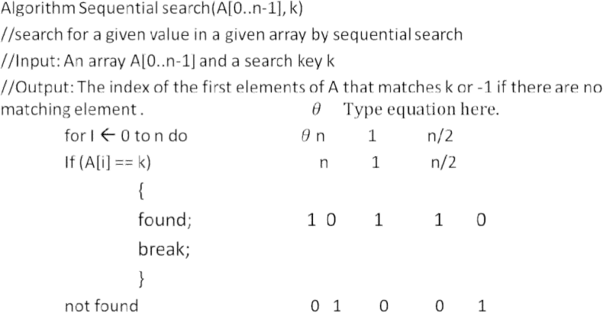
Example: Sequential search
Worst case - O(n) Average case – Θ(n/2)
Best case - Ω(n)
Department of CSE

Slide 46
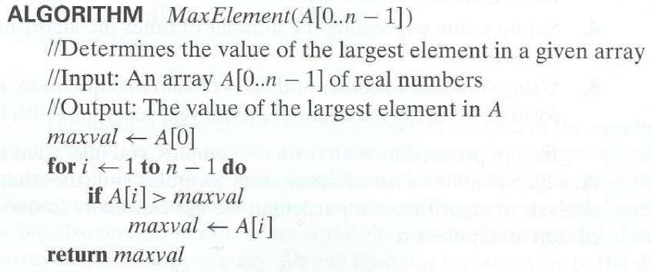

Slide 47
Analysis
Input parameter : n 3.
Basic operation: Comparison A[i] > max
4.
Department of CSE

Slide 48
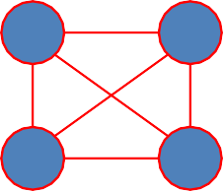
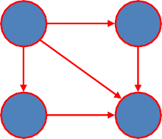
Graphs
Formal definition
  A graph G = <V, E> is defined by a pair of two sets: a finite set V of items called vertices and a set E of vertex pairs called edges.
Undirected and directed graphs (digraphs).
What’s the maximum number of edges in an undirected graph with |V| vertices?
Complete, dense, and sparse graphs
  A graph with every pair of its vertices connected by an edge is called complete, K_{|V|}
1 2
3 4

Slide 49
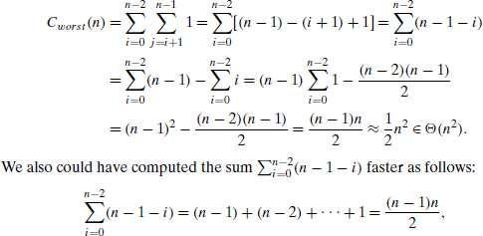
Analysis
Input parameter is input size n
Basic operation: Comparison
3.
A[i] == A[j]
4.
Є O(n²)
Department of 49SE

Slide 50
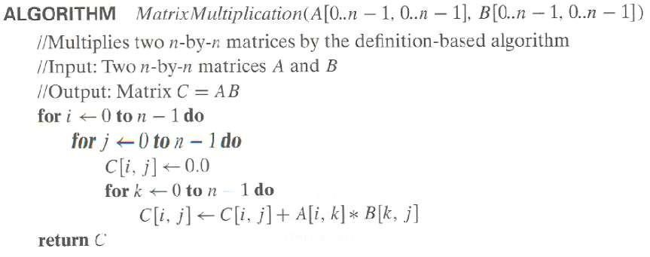
Example 3: Matrix multiplication
DDeeppaartmmeenntoof
AATTMMEECECoCloloelelegggeeeooffEEnnggigninineeerrirningg
50
CCSSEE

Slide 51
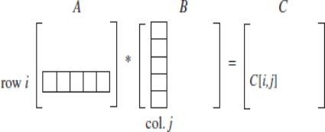
Department of
ATME College of Engineering
51
CCSSEE

Slide 52
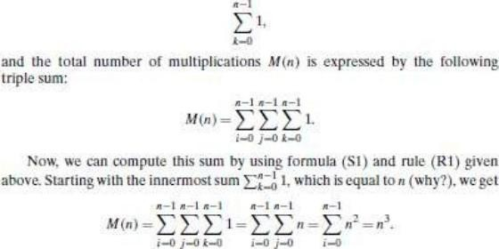
Analysis
Input parameter is input size n² X n²
Basic operation: Comparison C[i,j] == C[i,j] + A[i,k] * B[k,j]
3.
Є O(n³)
Department of CSE
52

Slide 53


Selection Sort
Algorithm SelectionSort (A[0..n-1])
//The algorithm sorts a given array by selection sort
//Input: An array A[0..n-1] of orderable elements
//Output: Array A[0..n-1] sorted in ascending order
for i ← 0 to n – 2 do min ← i
for j ← i + 1 to n – 1 do
if A[j] < A[min]
min ← j swap A[i] and A[min]
Time efficiency:
Θ(n²) comparisons (in the worst case)
DDeeppaartmmeenntoof
AATTMMEECECoCloloelelegggeeeooffEEnnggigninineeerrirningg
53

Slide 54
Solve recurrence relations
X(n) = x(n-1) + 5 for n>1, x(1) = 0 X(n) = x(n-1) + 5
X(n) = x(n-2) + 5+5
= x(n-2) + 2 *5
X(n) = x(n-3) + 3*5
X(n) = x(n-n-1) + n-1 * 5
= x(1) + (n-1) * 5
= O(n-1) = O(n)
Department of CCSSEE
ATME College of Engineering

Slide 55
Solve x(n) = 3x(n-1) for n>1, x(1) =4
x(n) = 3x(n-1)
= 3[3x(n-2)]
= 3² x(n-2)
= 3³ [x(n-3)]
= 3⁴ [x(n-4)]
-
-
= 3^{n-1} [x(n-n-1)]
=3^{n-1} [x(1)] = 3^{n-1} [4] = 4/3 * 3^{n}
Department of CCSSEE
ATME College of Engineering

Slide 56
Solve
X(n) = x(n/2) + n for n>1
T(n) = T(n/2) + T(n/2) + 3 for n> 2 T(2) = 2, T(1) = 1
Department of CCSSEE
ATME College of Engineering

Slide 57
Plan for Analysis of Recursive Algorithms
Decide on a parameter indicating an input’s size.
Identify the algorithm’s basic operation.
Check whether the number of times the basic op. is executed may vary on different inputs of the same size. (If it may, the worst, average, and best cases must be investigated separately.)
Set up a recurrence relation with an appropriate initial condition expressing the number of times the basic op. is executed.
Solve the recurrence (or, at the very least, establish its solution’s order of growth) by backward substitutions or another method.
Department of CCSSEE
ATME College of Engineering

Slide 58
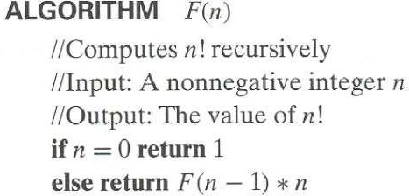
Example 1: Recursive evaluation of
n!
Definition: n ! = 1 ∗ 2 ∗ … ∗(n-1) ∗ n for n ≥ 1 and 0! = 1
Recursive definition of n!: F(n) = F(n-1) ∗ n for n ≥
1 and
F(0) = 1
Size:
Basic operation: Recurrence relation:
Department of 58SE

Slide 59
Solving the recurrence for M(n)
M(n) = M(n-1) + 1, M(0) = 0
Refer Notes
Department of CCSSEE
ATME College of Engineering

Slide 60
Tower of Hanoi Problem
In this problem, we have n disks of different sizes and three pegs.
Initially, all the disks are on the first peg in order of size, the largest on the bottom and the smallest on top.
The goal is to move all the disks to the third peg, using the second one as an auxiliary if necessary.
We can move only one disk at a time, and it is forbidden to place a larger disk on top of a smaller one.
Department of CCSSEE
ATME College of Engineering

Slide 61
Example 2: The Tower of Hanoi Puzzle
1
3
2
Recurrence for number of moves:
DDeeppaarrttmmeennttooff CCSSEE
AATTMMEECECoCloloelelegggeeeoofffEEngngignineinererirningg

Slide 62
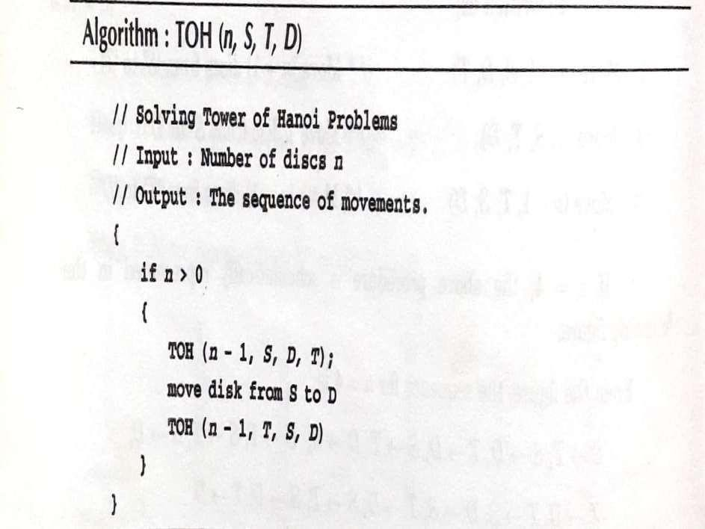
Department of CCSSEE
ATME College of Engineering

Slide 63
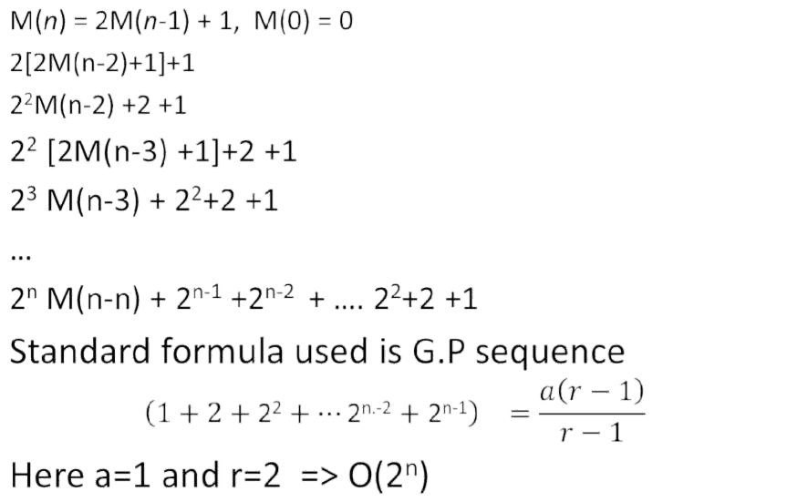
Solving recurrence for number of moves
Department of CCSSEE
ATME College of Engineering

Slide 64
Tree of calls for the Tower of Hanoi Puzzle
n
n-1
n-1
n-2
n-2
n-2
n-2
..
..
..
2
2
2
2
1
1 1
1
1
1 1
1
Department of CCSSEE
ATME College of Engineering

Slide 65
Fibonacci numbers
The Fibonacci numbers:
0, 1, 1, 2, 3, 5, 8, 13, 21, …
The Fibonacci algorithm (recursive )
Fib(n)
{
If n<=1
return n Else
Return F(n-1) + F(n-2)
Department of CCSSEE
ATME College of Engineering

Slide 66
The recurrence equation for this problem is: T(n) = T(n-1) + T(n-2) for n>1 and the initial conditions are T(0) =0, T(1) = 1
Solution to recurrence relation:
T(n) = T(n-1) + T(n-2)
T(n) –T(n-1) –T(n-2) = 0
This is of the form ax(n) +bx(n-1) +cx(n-2) =0 Which is a homogeneous second order linear
relation withDepcaor tmnenst otfaISEntBMcSoIn-ste_{A}it_{T}uf_{M}tefi_{E}ofc_{C}Tiece_{o}h_{l}nn_{le}o_{g}lto_{e}gs_{o}y._{f}a_{E}n_{n}d_{g}M_{in}g_{e}m_{er}t_{ing}
ATME College of Engineering
66

Slide 67
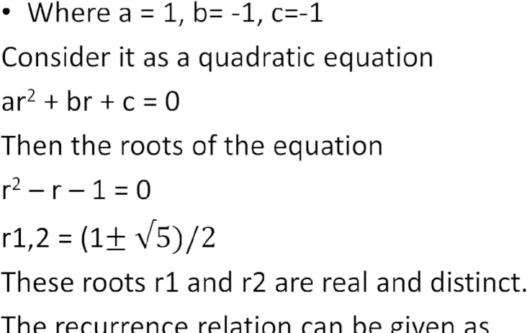
Department of CCSSEE
ATME College of Engineering

Slide 68
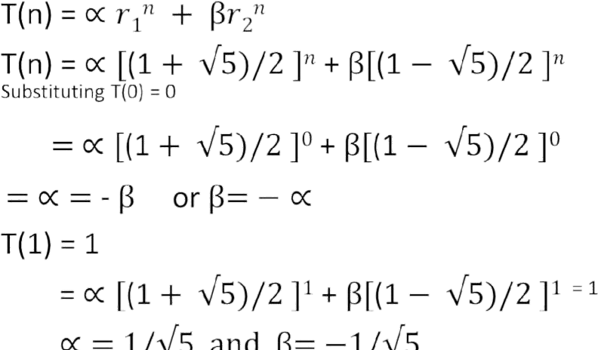
Department of CCSSEE
ATME College of Engineering

Slide 69
Little oh Notation (o)
The asymptotic upper bound provided by O- notation may or may not be asymptotically tight. The bound 2n² = O(n²) is asymptotically tight but the bound 2n = o(n²) is not.
We use o-notation to denote an upper bound that is not asymptotically tight
f(n) = o(g(n)); f(n) is equal to the little oh of g(n), iff f(n) < c, g(n) for any +ve constant c>0, no>0 and n>no
Department of CCSSEE
ATME College of Engineering

Slide 70
Establishing order of growth using limits
0 order of growth of T(n) < order of growth of g(n
lim T(n)/g(n)
n→₌∞
c > 0 order of growth of T(n) = order of growth of g(n
∞ order of growth of T(n) > order of growth of g(n
Examples:
10n
vs.
n2
5n + 2
vs.
n
Department of CCSSEE
ATME College of Engineering

Slide 71
Property of the Asymptotic Notations
Theorem :If t1(n) Є O(g1(n)) and t2(n) Є O(g2(n)), then
t1(n) + t2(n) Є O(max{g1(n), (g2(n)})
Theorem: If f(n) = a_{m} n^{m} + - - - - + a₁ n + a₀ and a_{m} >0, then f(n) = O(n^{m})
Department of CCSSEE
ATME College of Engineering

Slide 72
Brute Force
A straightforward approach, usually based directly on the problem’s statement and definitions of the concepts involved
Examples:
Computing a^{n} (a > 0, n a nonnegative integer)
Computing n!
Multiplying two matrices
Searching for a key of a given value in a list
Department of CCSSEE
ATME College of Engineering

Slide 73
Brute-Force Sorting Algorithm
Selection Sort Scan the array to find its smallest element and swap it with the first element. Then, starting with the second element, scan the elements to the right of it to find the smallest among them and swap it with the second elements. Generally, on pass i (0 ≤ i ≤ n-2), find the smallest element in A[i..n-1] and swap it with A[i]:
A[0] ≤ . . . ≤ A[i-1] | A[i], . . . , A[min], . . ., A[n-1]
in their final positions
Example: 7 3 2 5
Department of CCSSEE
ATME College of Engineering

Slide 74
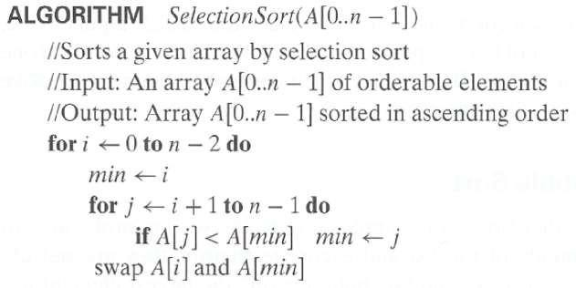


Analysis of Selection Sort
Time efficiency:
Θ(n^2)
In place:
Yes
Stability:
yes
Department of 74SE

Slide 75
Brute-Force String Matching
pattern: a string of m characters to search for
text: a (longer) string of n characters to search in
problem: find a substring in the text that matches the pattern
Brute-force algorithm
Step 1 Align pattern at beginning of text
Step 2 Moving from left to right, compare each character of pattern to the corresponding character in text until
  all characters are found to match (successful search); or
  a mismatch is detected
Step 3 While pattern is not found and the text is not yet exhausted, realign pattern one position to the right and repeat Step 2
Department of CCSSEE
ATME College of Engineering

Slide 76
Examples of Brute-Force String Matching
Pattern: 001011
Text: 10010101101001100101111010
Pattern: happy
Text: It is never too late to have a
happy childhood.
Department of CCSSEE
ATME College of Engineering

Slide 77
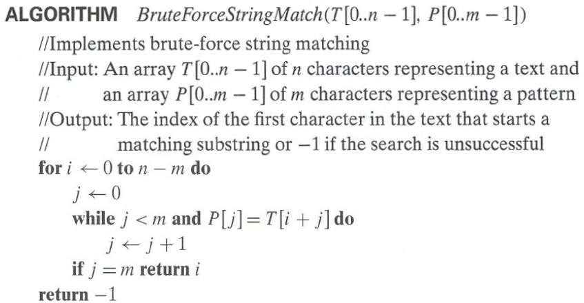




Pseudocode and Efficiency
Time efficiency:
Θ(mn) comparisons (in the worst case)
Department of 77SE

Slide 78
Brute-Force Strengths and
Weaknesses
Strengths
wide applicability
simplicity
yields reasonable algorithms for some important problems (e.g., matrix multiplication, sorting, searching, string matching)
Weaknesses
  rarely yields efficient algorithms
  some brute-force algorithms are unacceptably slow
  not as constructive as some other design techniques
Department of 78SSEE
ATME College of Engineering

Slide 79
M O D U L E – 2
DIVIDE AND C O N Q U E R

Slide 80
Divide-and-Conquer
The most-well known algorithm design strategy
Divide instance of problem into two or more smaller instances
Solve smaller instances recursively
Obtain solution to original (larger) instance by combining these solutions
Department of CCSSEE
ATME College of Engineering

Slide 81
Divide and conquer involves three steps, at each level of recursion.
Divide: Divide the problem into a number of sub problems
Conquer: Conquer the sub problems by solving them recursively. If the sub – problem sizes are small enough, then solve the sub- problem in a straight forward manner.
Combine: combine the solutions to the sub- problems to get the solution to the original problem.
Department of CCSSEE
ATME College of Engineering

Slide 82
















Divide-and-Conquer Technique (cont.)
a problem of size n
(instance)
subproblem 1 of size n/2
subproblem 2 of size n/2
a solution to subproblem 1
a solution to subproblem 2
T(n) = a T(n/b) + f (n)
a solution to
the original problem
In general leads to a recursive algorithm!
where f(n) ∈ Θ(n^{d}), d ≥ 0
DDeeppaarrttmmeennttooff CCSSEE
AATTMMEECECoCloloelelegggeeeoofffEEngngignineinererirningg

Slide 83
Divide-and-Conquer Examples
Sorting: merge sort and quicksort
Finding min and max element in an array
Binary search
Multiplication of large integers
Matrix multiplication: Strassen’s algorithm
Department of CCSSEE
ATME College of Engineering

Slide 84






























































General Divide-and-Conquer Recurrence
T(n) = aT(n/b) + f (n) where f(n) ∈ Θ(n^{d}), d ≥ 0
Master Theorem:
If a < b^{d}, T(n) ∈ Θ(n^{d})
If a = b^{d},
T(n) ∈ Θ(n^{d} log n)
T(n) ∈ Θ(n^{log} b ª )
If a > b^{d},
Note: The same results hold with O instead of Θ.
Θ(n^2)
Examples: T(n) = 4T(n/2) + n ⇒ T(n) ∈ ?
T(n) = 4T(n/2) + n² ⇒ T(n) ∈ ?
T(n) = 4T(n/2) + n³ ⇒ T(n) ∈ ?
Θ(n^2log n)
Θ(n^3)
Department of CCSSEE
ATME College of Engineering

Slide 85
Merge Sort Algorithm
Mergesort(low, high)
//Given an array A of n elements. This algorithm sorts the elements in
//ascending order. The variables low and high are used to identify the
//positions of first and last element in each partition.
If (low< high)
mid = (low+high)/2;
Mergesort (low,mid);
Mergesort(mid+1,high);
Merge(low,mid,high);
End if
Exit
Department of CCSSEE
ATME College of Engineering

Slide 86
Merge Algorithm
Merge(low, mid, high)
/ The variables low, mid, and high are used to identify the portions of elements in each partition.
Initialize i=low, j= mid+1, h=low;
while ((h <= mid) && (j <= high))
if (a[h] < a[j])
b[i++] = a[h++];
else
b[i++] = a[j++];
Department of CCSSEE
ATME College of Engineering

Slide 87
Cont…
4.
if (h > mid)
for(k = j; k <= high; k++) b[i++] = a[k];
else
for (k = h; k <= mid; k++) b[i++] = a[k];
for (k = low; k <= high; k++) a[k] = b[k];
5.
Department of CCSSEE
ATME College of Engineering

Slide 88
Mergesort
Split array A[0..n-1] into about equal halves and make copies of each half in arrays B and C
Sort arrays B and C recursively
Merge sorted arrays B and C into array A as follows:
  Repeat the following until no elements remain in one of the arrays:
    compare the first elements in the remaining unprocessed portions of the arrays
    copy the smaller of the two into A, while incrementing the index indicating the unprocessed portion of that array
  Once all elements in one of the arrays are processed, copy the remaining unprocessed elements from the other array into A.
Department of CCSSEE
ATME College of Engineering

Slide 89
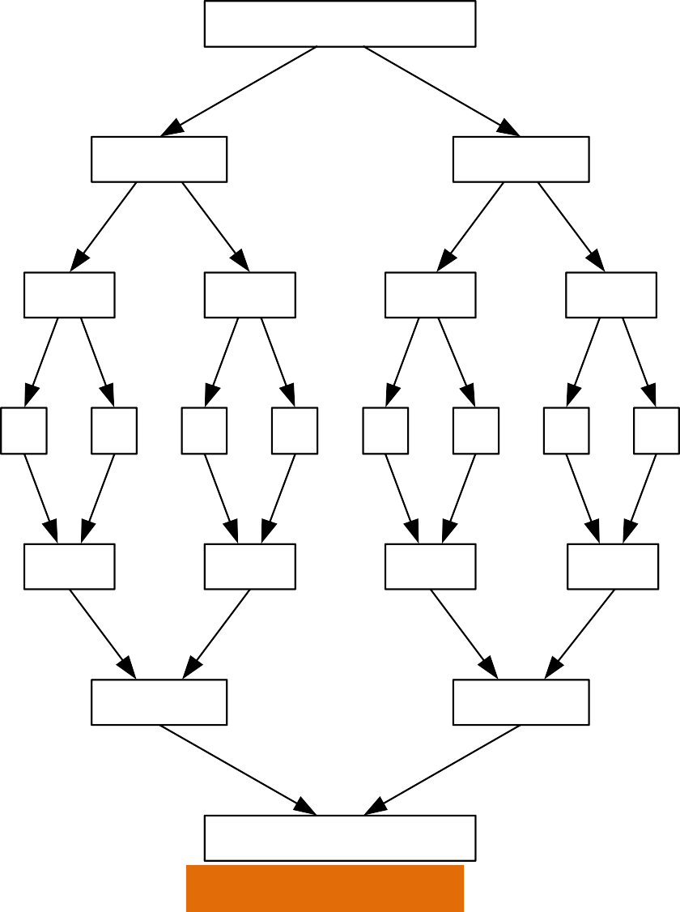
Mergesort Example
8 3 2 9 7 1 5 4
8 3 2 9
7 1 5 4
8 3
2 9
7 1
5 4
8
3
2
9
7
1
5
4
The non-recursive version of Mergesort starts from merging single elements into sorted pairs.
3 8
2 9
1 7
4 5
2 3 8 9
1 4 5 7
1 2 3 4 5 7 8 9
Department of 89SE

Slide 90
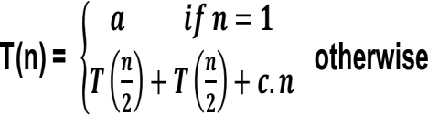
Analysis of Mergesort
Department of CCSSEE
ATME College of Engineering

Slide 91
All cases have same efficiency: Θ(n log n)
Number of comparisons in the worst case is close to theoretical minimum for comparison- based sorting:
⎡log₂ n!⎤ ≈ n log₂ n - 1.44n
Space requirement: Θ(n) (not in-place)
Can be implemented without recursion
Department of CCSSEE
ATME College of Engineering

Slide 92
Quicksort
Select a pivot (partitioning element) – as the first element
•
p
i
j
A[i]≤p
A[i]≥p
 |  | p
A[i]≤p
A[i]≥p
Exchange the pivot with the last element in the first (i.e., ≤) subarray — the pivot is now in its final position
Sort the two subarrays recursively
Note : Invented by
DDeeppaarrttmmeennttooff CCSSEE
AATTMMEECECoCloloelelegggeeeoofffEEngngignineinererirningg

Slide 93
Quick Sort Algorithm
Quick sort(low, high)
// A is an array of elements.
// The variables low and high are used to identify the positions of first and
// last elements in each partition.
If(low< high) then
J= partition(low, high) Quick sort( low, j-1)
Quick sort(j+1, high)
End if Exit
Department of CCSSEE
ATME College of Engineering

Slide 94
Partition Algorithm
Partition(low, high)
//This procedure partitions the element into two lists and places the pivot
//element into a appropriate place. Low = first element of the array, high =
//last element of the array, a[low] = pivot.
Step 1. Set pivot = a[low];
i = low +1;
j = high;
Step 2. Repeat step 3 while (a[i] < pivot && i < high)
Step 3. i++;
Step 4. Repeat step 5 while (a[j] > pivot) Step 5. j--;
Step 6. If(i<j)
swap a[i] and a[j] go to step 2
else
swap a[j] and pivot
Step 7. Return (j)
Department of CSE
ATME College of Engineering
94

Slide 95
Quicksort Example
5 3 1 9 8 2 4 7
2 3 1 4 5 8 9 7
1 2 3 4 5 7 8 9
1 2 3 4 5 7 8 9
1 2 3 4 5 7 8 9
1 2 3 4 5 7 8 9
Department of CCSSEE
ATME College of Engineering

Slide 96



Analysis of Quicksort
Best case: split in the middle — Θ(n log n)
Worst case: sorted array! — Θ(n²)
Average case: random arrays — Θ(n log n)
T(n) = T(n-1) + Θ(n)
Improvements:
  better pivot selection: median of three partitioning
  switch to insertion sort on small subfiles
  elimination of recursion
These combine to 20-25% improvement
Considered the method of choice for internal sorting of large files (n ≥ 10000)
Department of CCSSEE
ATME College of Engineering

Slide 97
Binary Search
Algorithm Binary_Search( A[0…n-1], Key)
Input: Given an array of n elements in sorted order and key is an element to be searched.
Output: Returns the position of key element, if successful and returns -1 otherwise.
Set first = 0, last = n-1
W h i l e ( f i r s t < = l a s t ) mid = (first +last) / 2
if (key == A[mid])
return (mid+1); // successful else if ( key < A[mid] )
last = mid – 1 else
first = mid+1 end while
return -1 // unsuccessful
Department of CCSSEE
ATME College of Engineering

Slide 98
Analysis
Best Case: Best case occurs, when we are searching the middle element itself. In that case, total number of comparisons required is 1. there fore best case time complexity of binary search is Ω(1).
Worst Case: Let T(n) be the cost involved to search ‘n’ elements. Let T(n/2) be the cost involved to search either left part or the right part of an array.
Department of CCSSEE
ATME College of Engineering

Slide 99
Analysis
T(n) =
a
if n = 1
T(n/2) + b otherwise
T(n/2) → Time required to search either the left part or the right part of the array.
b → Time required to compare the middle element. Where a and b are some positive integer constants.
T(n) = O(log ₂n )
Department of CCSSEE
ATME College of Engineering

Slide 100
Analysis
Average Case:
The average case occurs when an element is found some where in the recursive calls, but not till the recursive call ends.
The average number of key comparisons made by binary search is only slightly smaller than that in this worst case.
T(n) = log ₂n
The average number of comparison in a successful search is
T(n) = log ₂n – 1
The average number of comparison in a unsuccessful search is
T(n) = log ₂n + 1
Department of CCSSEE
ATME College of Engineering

Slide 101
Algorithm for straight forward maximum and minimum
StraightMaxMin(a,n,max,min)
// set max to the maximum and min to the minimum of a[1:n].
{
max := min := a[1]; for i := 2 to n do
{
if(a[i] > max) then max := a[i];
if(a[i] < min) then min := a[i];
}
}
Department of CCSSEE
ATME College of Engineering

Slide 102
Analysis
This algorithm requires 2(n-1) element comparisons in the best, average, and worst cases.
Now the Best case occurs when the elements are in increasing order. The number of element comparisons is n-1.
The worst case occurs when the element are in decreasing order. In this case number of comparisons is 2(n-1).
Department of CCSSEE
ATME College of Engineering

Slide 103
Finding maximum and minimum using divide and conquer technique
Algorithm max_min(i, j, max, min)
{
// Input: a[1:n] is a global array. Parameters i and j are integers, 1<=i <= j<= n.
// output: to set max and min to the largest and smallest values in a[i: j], respectively.
If (i == j) then // Small(P)
{ max = min ← A[i];
}
Department of CCSSEE
ATME College of Engineering
103

Slide 104
else if ( i =j-1) then // Another case of Small(P)
{
if (A[i] < A[j]) then
{
max ← A[j]
min ← A[i]
}
else
{
max ← A[i]
min ← A[j]
}
}
DDeeppaarrttmmeennttooff
AATTMMEECECoCloloelelegggeeeoofffEEngngignineinererirningg
CCSSEE

Slide 105
else
{
// if P is not small, divide P into sub problems. // Find where to split the set
mid := (i+j)/2;
// Solve the sub problems.
max_min(i,mid,max,min); max_min(mid+1, j, max1,min1);
// Combine the solutions
if( max < max1) then max := max1; if( min > min1) then min:= min1;
}
}
DDeeppaarrttmmeennttooff AATTMMEECECoCloloelelegggeeeoofffEEngngignineinererirningg
CCSSEE

Slide 106
Analysis
0
1
T(n/2) + T(n/2) + 2
n=1 n=2 n>2
T(n) =
When n is a power of two, n = 2^{k}
T(n) = 2T(n/2) + 2
= 2T(2^{k-1)} ) + 2
= 2(2T(2^{k-2}) + 2) + 2
= 2²T(2^{k-2}) + 2² + 2
= 2³T(2^{k-3}) + 2³ + 2² + 2
. . .
for some positive integer k, then
= 2k-1 T(2k-(k-1)) + 2k-2 + 2k-1 + - - - + 21
= 2^{k-1} + 2^{k-2} + - - - + 2¹
= 2. (2^{k-1} – 1)/ 2-1 = O(n)
Department of CCSSEE
ATME College of Engineering

Slide 107
Multiplication of Large Integers
Consider the problem of multiplying two (large) n-digit integers represented by arrays of their digits such as:
A = 12345678901357986429 B = 87654321284820912836
The grade-school algorithm:
a₁ a₂ … a_{n} b₁ b₂ … b_{n}
(d10) d11d12 … d1n
(d20) d21d22 … d2n
… … … … … … …
(dn0) dn1dn2 … dnn
Efficiency: Θ(n²) single-digit multiplications
Department of CCSSEE
ATME College of Engineering

Slide 108
First Divide-and-Conquer Algorithm
A small example: A ∗ B where A = 2135 and B = 4014 A = (21·10² + 35), B = (40 ·10² + 14)
So, A ∗ B = (21 ·10² + 35) ∗ (40 ·10² + 14)
= 21 ∗ 40 ·10⁴ + (21 ∗ 14 + 35 ∗ 40) ·10² + 35 ∗ 14
In general, if A = A₁A₂ and B = B₁B₂ (where A and B are n-digit, A₁, A₂, B₁, B₂ are n/2-digit numbers),
A ∗ B = A₁ ∗ B₁·10^{n} + (A₁ ∗ B₂ + A₂ ∗ B₁) ·10^{n/2} + A₂ ∗ B₂
Recurrence for the number of one-digit multiplications M(n): M(n) = 4M(n/2), M(1) = 1
Solution: M(n) = n²
Department of CCSSEE
ATME College of Engineering

Slide 109
Second Divide-and-Conquer Algorithm
A ∗ B = A₁ ∗ B₁·10^{n} + (A₁ ∗ B₂ + A₂ ∗ B₁) ·10^{n/2} + A₂ ∗ B₂
The idea is to decrease the number of multiplications from 4 to 3: (A₁ + A₂ ) ∗ (B₁ + B₂ ) = A₁ ∗ B₁ + (A₁ ∗ B₂ + A₂ ∗ B₁) + A₂ ∗ B_{2,}
I.e., (A₁ ∗ B₂ + A₂ ∗ B₁) = (A₁ + A₂ ) ∗ (B₁ + B₂ ) - A₁ ∗ B₁ - A₂ ∗ B_{2,}
which requires only 3 multiplications at the expense of (4-1) extra add/sub.
Recurrence for the number of multiplications M(n):
M(n) = 3M(n/2), M(1) = 1
Solution: M(n) = 3^{log} 2^{n} = n^{log} 2³ ≈ n^{1.585}
What if we count both multiplications and additions?
Department of CCSSEE
ATME College of Engineering

Slide 110


Example of Large-Integer Multiplication
2135 ∗ 4014
= (21*10^2 + 35) * (40*10^2 + 14)
= (21*40)*10^4 + c1*10^2 + 35*14
where c1 = (21+35)*(40+14) - 21*40 - 35*14, and 21*40 = (2*10 + 1) * (4*10 + 0)
= (2*4)*10^2 + c2*10 + 1*0
where c2 = (2+1)*(4+0) - 2*4 - 1*0, etc.
This process requires 9 digit multiplications as opposed to 16.
Department of CCSSEE
ATME College of Engineering

Slide 111
Matrix Multiplication
Brute-force algorithm
c11 c12
c21 c22
a11 a12
b11 b12
=
*
a21 a22
b21 b22
a11 * b11
+ a₁₂ * b₂₁
a11 * b12
+ a₁₂ * b₂₂
=
a21 * b11
+ a₂₂ * b₂₁ + a₂₂ * b₂₂
a21 * b12
8 multiplications
Efficiency class in general: Θ (n³)
4 additions
Department of CCSSEE
ATME College of Engineering

Slide 112
Strassen’s Matrix Multiplication
Strassen’s algorithm for two 2x2 matrices (1969):
c11 c12 a11 a12 b11 b12
= *
c21 c22 a21 a22 b21 b22
C1 = E + I + J - G
C2 = D + G
=
C3 = E + F C4 = D + H + J - F
D = A1(B2 – B4)
E = A4( B3 – B1)
F = ( A 3 + A 4 ) B 1
G = (A1 + A2) B4
7 multiplications
H = (A3 – A1) (B1 + B2)
I = (A2 – A4) (B3 +B4) J = (A1 +A4)(B1 +B4)
18 additions
DDeeppaarrttmmeennttooff CCSSEE
AATTMMEECECoCloloelelegggeeeoofffEEngngignineinererirningg
112

Slide 113
Strassen’s Matrix Multiplication
A = | 1 | 2 | B = | 1 | 1
 | 3 | 4 |  | 2 | 2
A1 = 1, A2 =2, A3 = 3, A4 = 4
B1 = 1, B2 = 2, B3 = 2, B4 = 2
D = A1(B2 – B4) = 1(1 – 2) = -1
E = A4(B3-B1) = 4(2-1) = 4
F = (A3 + A4) B1 = (3+4)1 = 7
G = (A1 + A2)B4 = (1+2)2 = 6
Department of CCSSEE
ATME College of Engineering

Slide 114
H = (A3 – A1) (B1 + B2) = (3-1)(1+1) = 4
I = (A2 – A4)(B3+B4) = (2-4)(2+2) = -8
7. J = (A1+A4)(B1+B4) = (1+4)(1+2) = 15
C1 = E +I+J-G = 4+(-8) +15-6 = 5 C2 = D + G = -1 +6 = 5
C3 = E + F = 4 + 7 = 11
5 5
11 11
C =
C4 = D + H + J – F = -1 +4 +15 -7 = 11
Department of CCSSEE
ATME College of Engineering

Slide 115
Strassen’s Matrix Multiplication
Strassen observed [1969] that the product of two matrices can be computed in general as follows:
C00 C01
A00 A01
B00 B01
=
*
C10 C11
A10 A11
B10 B11
M₁ + M₄
M₂ + M₄
- M₅ + M₇
M₃ + M₅
=
M₁ + M₃ - M₂ + M₆
DDeeppaarrttmmeennttooff CCSSEE
AATTMMEECECoCloloelelegggeeeoofffEEngngignineinererirningg

Slide 116
Formulas for Strassen’s Algorithm
M₁ = (A₀₀ + A₁₁) ∗ (B₀₀ + B₁₁)
M₂ = (A₁₀ + A₁₁) ∗ B₀₀ M₃ = A₀₀ ∗ (B₀₁ - B₁₁) M₄ = A₁₁ ∗ (B₁₀ - B₀₀)
M₅ = (A₀₀ + A₀₁) ∗ B₁₁
M₆ = (A₁₀ - A₀₀) ∗ (B₀₀ + B₀₁)
M₇ = (A₀₁ - A₁₁) ∗ (B₁₀ + B₁₁)
Department of CCSSEE
ATME College of Engineering

Slide 117
M4 = A11 ∗ (B10 - B00)
= 4 * (2 - 1) = 4
A00
A01
B00 B01
1
M5 = (A00 + A01) ∗ B11
= (1 + 2) * 2 = 6
2
1
1
M6 = (A10 - A00) ∗ (B00 + B01)
= (3 - 1) * (1 + 1) = 4
3
4
2
2
A10
A11 B10
B11
M7 = (A01 - A11) ∗ (B10 + B11)
= (2 - 4) * (2 + 2) = -8
M1 = (A00 + A11) ∗ (B00 + B11)
= (1 + 4) * (1+2) = 15
C00
C01
M1 + M4 - M5 + M7
M3 + M5
5
5
M = (A
+ A ) ∗ B
2
10 11 00
= (3 + 4) * 1 = 7
=
M2 + M4
M1 + M3 - M2 + M6
11
11
M = A ∗ (B - B )
3 00 01 11
= 1 * (1 - 2) = -1
C10
C11
Department of CCSSEE
ATME College of Engineering

Slide 118
M4 = A11 ∗ (B10 - B00)
= 4 * (1 - 5) = -16
A00
A01
B00 B01
2
M5 = (A00 + A01) ∗ B11
= (2 + 1) * 2 = 6
1
5
2
M6 = (A10 - A00) ∗ (B00 + B01)
= (3 - 2) * (5 + 2) = 7
3
4
1
2
A10
A11 B10
B11
M7 = (A01 - A11) ∗ (B10 + B11)
= (1 - 4) * (1 + 2) = -9
M1 = (A00 + A11) ∗ (B00 + B11)
= (2 + 4) * (5+2) = 42
C00
C01
M1 + M4 - M5 + M7
M3 + M5
11
6
M = (A
+ A ) ∗ B
2
10 11 00
= (3 + 4) * 5 = 35
=
M2 + M4
M1 + M3 - M2 + M6
19
14
M = A ∗ (B - B )
3 00 01 11
= 2 * (2 - 2) = 0
C10
C11
Department of CCSSEE
ATME College of Engineering

Slide 119
Solve
1 0 2 1
4 1 1 0
0 1 3 0
5 0 2 1
0 1 0 1
2 1 0 4
2 0 1 1
1 3 5 0
A =
B =
A1 A2
1 0
4 1
B1
B2
0 1
0 4
2 1
1 0
0 1
2 1
0 1
5 0
3 0 | 2 0 | 1 1
2 1 | 1 3 | 5 0
A3
A4
B3 B4
Department of CCSSEE
ATME College of Engineering

Slide 120
1. D = A1 (B2 – B4)
0 1
0 4
1 1
5 0
1 0
4 1
-
*
1 0
4 1
-1 0
-5 4
*
-6 0
-9 4
2. E = A4 (B3 – B1)
Department of CCSSEE
ATME College of Engineering

Slide 121
Analysis of Strassen’s Algorithm
If n is not a power of 2, matrices can be padded with zeros.
Number of multiplications:
M(n) = 7M(n/2),
M(n) = 7M(2 ^{k-1})
= 7[7M(2 ^{k-2})] = 7 ² M(2 ^{k-2})]
M(1) = 1
= 7 ^{k} M(2 ^{k-k})] = 7 ^{k} (1)
Solution: M(n) = 7^{log} _{2n} = n_{log 27} ≈ n_{2.807} vs. n₃ of brute-force alg.
Department of CCSSEE
ATME College of Engineering

Slide 122
Advantages and Disadvantages
Difficult problems is broken down into sub problems and each sub problem is solved independently.
It gives efficient algorithms like quick sort, merge sort, streassen’s matrix multiplication.
Sub problems can be executed on parallel processor.
Disadvantage
It makes use of recursive methods and the recursion is slow and complex.
Department of CCSSEE
ATME College of Engineering

Slide 123
Decrease-and-Conquer
The decrease and conquer technique is almost similar to the divide and conquer technique, but instead of dividing the problem into size n/2, it is decremented by a constant or constant factor.
There are three variations of decrease and conquer
Decrease by a constant
Decrease by a constant factor
Variable size decrease
The problems can be solved either top down (recursively) or bottom up ( without recursion)
Department of CCSSEE
ATME College of Engineering

Slide 124
Decrease by a constant
In this type of variation, the size of an instance is reduced by the same constant ‘1’ on each iteration. So, if a problem is of size ‘n’ , then a sub problem of size ‘n-1’ is solved first but before a sub sub problem of size ‘n-2’ is solved and so on.
Department of CCSSEE
ATME College of Engineering

Slide 125
Decrease by a constant
1
2
n
…….
Problem of Size n
1 |  | ……. |  | n-1
ub Problem of Siz |  |  | e (n – 1) … . (n -2)
S
Solution to sub problem
Solution to the Original Problem
Department of CCSSEE
ATME College of Engineering

Slide 126
Decrease by a constant
Example: Consider a problem for computing a ^{n}
where n is a positive integer exponent
Let f(n) = a ^{n}
a ^{n} = a ^{n-1} . a
= a ^{n-2} . a . a
= a ^{n-3} . a . a . a
= a. a. a. a. . . n times
F(n) =
f(n-1 ) . a if n> 1 a if n = 1
The above definition is a recursive definition i.e, a top down approach
Eg: Insertion sort, Depth First Search, Breath First Search, Topological Sort
DDeeppaarrttmmeennttooff CCSSEE
AATTMMEECECoCloloelelegggeeeoofffEEngngignineinererirningg

Slide 127
Decrease by a constant factor
In this type of variation, the size of instance is reduced by a constant factor on each iteration (most of the case it is 2).
So, if a problem of size ‘n’ is to be solved then first the sub problem of size n/2 is to be solved which in-turn requires the solution for the sub sub problem n/4 and so on.
Department of CCSSEE
ATME College of Engineering

Slide 128
Decrease by a constant factor
1
2 n
 |  | …….
Problem of Size n
1 |  | ……. |  | n/2
ub Problem of Si |  |  | ze (n / 2) (n / 4) - - -
S
Solution to sub problem
Solution to the Original Problem
Department of CCSSEE
ATME College of Engineering

Slide 129
Decrease by a constant factor
Example: Consider a problem for computing a^{n} As the problem is to be halved each time (Since
the constant factor is 2, to solve a ^{n,} first solve a^{n/2}
, but before solve a^{n/4} and so on.
an
(an/2 ) 2
(an-1/2 ) 2
a
if n is even and > 1 if n is odd and > 1
if n = 1
=
Department of CCSSEE
ATME College of Engineering

Slide 130
Decrease by a constant factor
The efficiency of this variation i.e decrease by a constant factor is O(log n) because, the size is reduced by at least one half at the expense of no more than two multiplications on each iteration
Eg: Binary search and the method of bisection, Fake coin problem
Department of CCSSEE
ATME College of Engineering

Slide 131
Variable size decrease
In this type, the reduction in the size of the problem instance is varied from one iteration to another.
Eg: Euclid’s a l gorithm for computing GCD of two nos.
gcd (m,n) =
gcd (n, m mod n) m
if n> 0 if n=0
Eg: Computing a median, Interpolation Search and Binary Search Tree
Department of CCSSEE
ATME College of Engineering

Slide 132
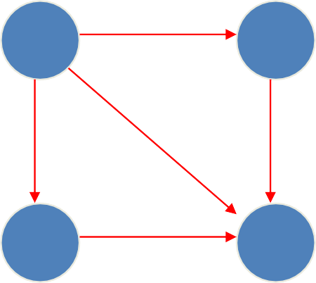
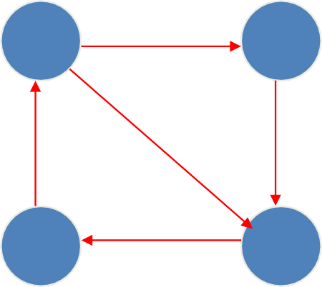
DAGs and Topological Sorting
A dag: a directed acyclic graph, i.e. a directed graph with no (directed) cycles
a b a b
a dag not a dag
c
d
c
d
Arise in modeling many problems that involve prerequisite constraints (construction projects, document version control)
Vertices of a dag can be linearly ordered so that for every edge its starting vertex is listed before its ending vertex (topological sorting). Being a dag is also a necessary condition for topological sorting to be possible.
Department of CCSSEE
ATME College of Engineering

Slide 133
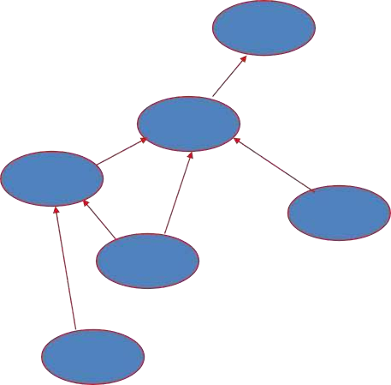
Topological Sorting Example
Order the following items in a food chain
tiger
human
fish
sheep
shrimp
plankton
wheat
Department of CCSSEE
ATME College of Engineering

Slide 134
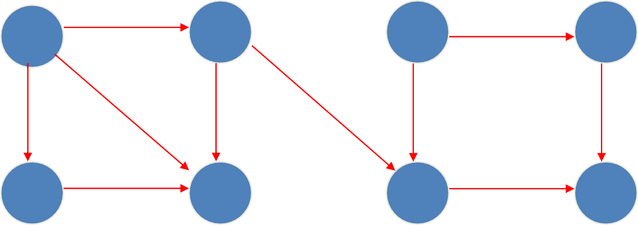
DFS-based Algorithm
DFS-based algorithm for topological sorting
Perform DFS traversal, noting the order vertices are popped off the traversal stack
Reverse order solves topological sorting problem
Back edges encountered?→ NOT a dag!
Example:
b
a
c
d
e
f
g
h
Department of CCSSEE
ATME College of Engineering

Slide 135
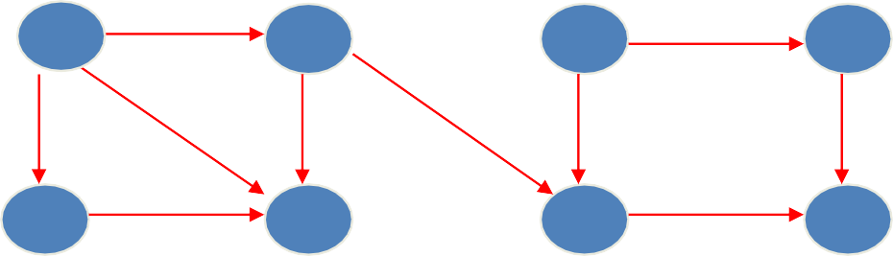
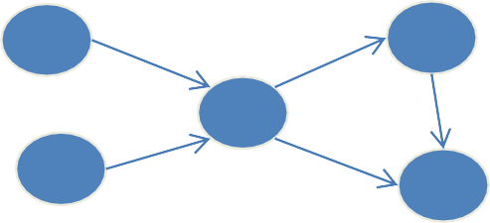
Source Removal Algorithm
Repeatedly identify and remove a source (a vertex with no incoming edges) and all the edges incident to it until either no vertex is left or there is no source among the remaining vertices (not a dag)
Example: 1
a
b c d
e f g h
Efficiency: same as efficiency of the DFS-based algorithm, but how would you identify a source? How do you remove a source from the dag?
a
d
Example 2
c
b
e
Department of CCSSEE
ATME College of Engineering

Slide 136
Source Removal Algorithm
Topological Sort(G)
Find the indegree INDG(n) of each node n of G.
Put in a queue Q all the nodes with zero indegree.
Repeat step 4 and 5 until G becomes empty.
Repeat the element n of the queue Q and add it to T (Set Front = Front +1).
Department of CCSSEE
ATME College of Engineering

Slide 137
Source Removal Algorithm
Repeat the following for each neighbour, m of the node n
  Set INDEG(m) = INDG(m)-1
  If INDEG(m) = 0 then add m to the rear end
of the Q.
Exit.
Note: For Problems refer class notes
Department of CCSSEE
ATME College of Engineering

Slide 138
M O D U L E – 3
G R E E DY M ETHO D
Department of CSE

Slide 139
Greedy Method
Approach for Solving problem
Used for Solving Optimization Problem
Optimization Problem : Problems which demands minimum/maximum results
Example:
12 hrs
Minimum cost
A B
S1 S2 S3 S4 S5……
Optimal solution
Feasible solutions
There will be only one minimum solution
DDeeppaartmmeenntoof
AATTMMEECECoCloloelelegggeeeooffEEnnggigninineeerrirningg
139
CCSSEE

Slide 140
Strategies used for Optimization Problem
Greedy Method
Dynamic Programming
Branch and Bound
Department of
ATME College of Engineering
140
ATME College of Engineering
CCSSEE

Slide 141
Greedy Technique
Greedy algorithms, construct a solution through a
sequence of steps, each step expanding a partially constructed solution obtained so far, until a complete solution to the problem is reached.
feasible -it has to satisfy the problem’s constraints
locally optimal - it has to be the best local choice among all feasible choices available on that step
irrevocable - once made, it cannot be changed on subsequent steps of the algorithm
24-08-2020
Department of CSE
4
141

Slide 142
General method control abstraction
Algorithm Greedy(a, n)
// a[1..n] contains the ‘n’ inputs
{
Solution := 0;
for i:= 1 to n do
{
//Initialize the solution
X : = Select(a);
If Feasible(Solution, x) then
Solution:= Union(Solution, x);
}
Return Solution;
}
Department of
ATME College of Engineering
142

Slide 143
Applications of the Greedy Strategy
Optimal solutions:
  change making for “normal” coin denominations
  minimum spanning tree (MST)
  single-source shortest paths
  simple scheduling problems
  Huffman codes
Approximations/heuristics:
  traveling salesman problem (TSP)
  knapsack problem
  other combinatorial optimization problems
DDeeppaartmmeenntoof
AATTMMEECECoCloloelelegggeeeooffEEnnggigninineeerrirningg
143

Slide 144
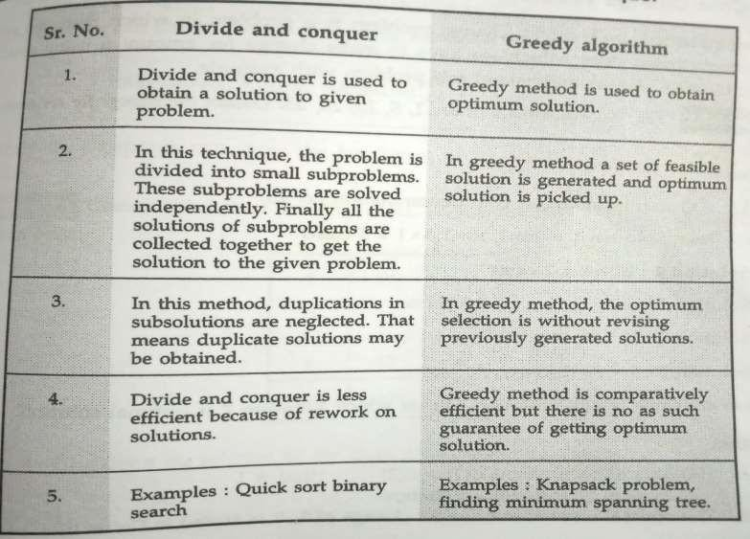
Differences b/w Divide and conquer and greedy Method
144

Slide 145
Change-Making Problem
Problem Statement: Given coins of several denominations find out a way to give a customer an amount with fewest number of coins.
Example: if denominations are 1,5,10, 25 and 100 and the change required is 30, the solutions are,
Amount : 30
Solutions : 3 x 10 ( 3 coins )
6 x 5 ( 6 coins )
1 x 25 + 5 x 1 ( 6 coins )
1 x 25 + 1 x 5 ( 2 coins )
The last solution is the optimal one as it gives us change only with 2
coins.
Department of CSE ATME College of Engineering CSE
145
ATME College of Engineering

Slide 146
Change-Making Problem
Given unlimited amounts of coins of denominations d₁ > … >d_{n}, give change for amount n with the least number of coins
Example: d₁ = 25c, d₂ =10c, d₃ = 5c, d₄ = 1c and n = 48c
Greedy solution is optimal for any amount and “normal’’ set of denominations
Solution: <1, 2, 0, 3>
DDeeppaarrttmmeennttooff CCSSEE
AATTMMEECECoCloloelelegggeeeoofffEEngngignineinererirningg

Slide 147
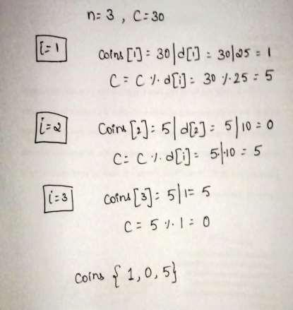
cashier’s Algorithm
Algorithm coinchange()
//Input: Denomination d[1] > d[2] > d*3+ … d*n+
//Amount to obtain change – C
// Output: The optimal number of coins for change of C, is stored in Coins[i]
{25,10,1} for 30c
for i ← 1 to n do
{
Coins[i] = C/d[i];
C = C mod d[i] Print coins[i]
}
DDeeppaarrttmmeennttooff CCSSEE
AATTMMEECECoCloloelelegggeeeoofffEEngngignineinererirningg

Slide 148
Change-Making Problem
For example, d1 = 25c, d2 = 10c, d3 = 1c, and n = 30c
Solution: <1, 0, 5>
May not be optimal for all denominations
DDeeppaarrttmmeennttooff CCSSEE
AATTMMEECECoCloloelelegggeeeoofffEEngngignineinererirningg

Slide 149
Knapsack Problem (Fractional knapsack problem)
Given n objects and a knapsack or bag. Object i has a weight wi and the knapsack has a capacity m. if the fraction Xi, 0<=Xi<=1, of object i is placed into the knapsack, then a profit of Pi*Xi is earned.
The objective is to maximize the total profit earned. Since the knapsack capacity is m, we require the total weight of all chosen objects to be at most m.
DDeeppaarrttmmeennttooff CCSSEE
AATTMMEECECoCloloelelegggeeeoofffEEngngignineinererirningg

Slide 150
Knapsack Problem - 1
Obtain the optimal solution for the knapsack
problem following:
M = 15
n = 7 p1,p2,p3,p4,p5,p6,p7 =
using greedy method given the
10,5,15,7,6,18,3
w1,w2,w3,w4,w5,w6,w7= 2,3,5,7,1,4,1
Department of CSE
AATTMMEECCoollleleggeeoof fEEnngginineeer irningg

Slide 151
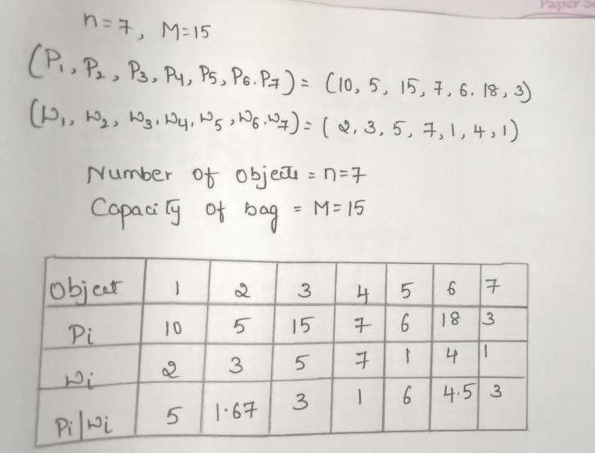
There are several greedy methods to obtain the feasible solutions.
Department of CSE
AATTMMEECCoollleleggeeoof fEEnngginineeer irningg

Slide 152
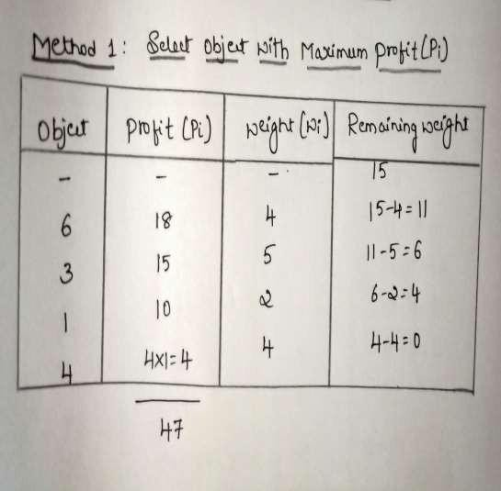
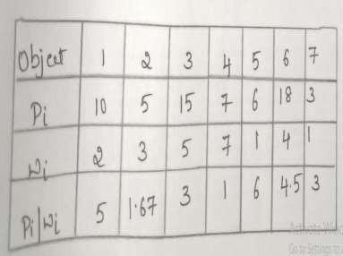
Profits = Solution Vector = (1, 0,1, 4/7,0,1,0)= (1, 0,1, 0.57,0,1,0)
Optimal solution using this method is (x1, x2, x3,x4,x5,x6,x7) = (1, 0,1, 0.57,0,1,0) with profit = 47
Department of CSE
AATTMMEECCoollleleggeeoof fEEnngginineeer irningg

Slide 153
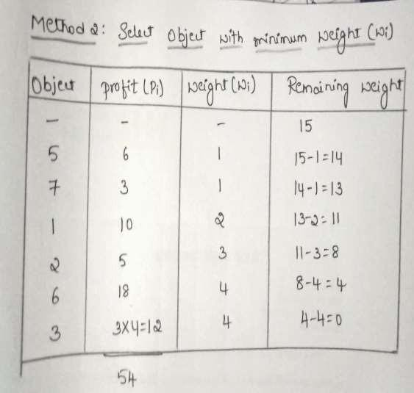
Profits = Solution Vector = (1, 1,4/5,0,1,1,1)= (1, 1,0.8,0,1,1,1)
Optimal solution using this method is (x1, x2, x3,x4,x5,x6,x7) = (1, 1,0.8,0,1,1,1) with profit = 54
Optimal solution is not guaranteed using method 1 and 2
Department of CSE
AATTMMEECCoollleleggeeoof fEEnngginineeer irningg

Slide 154
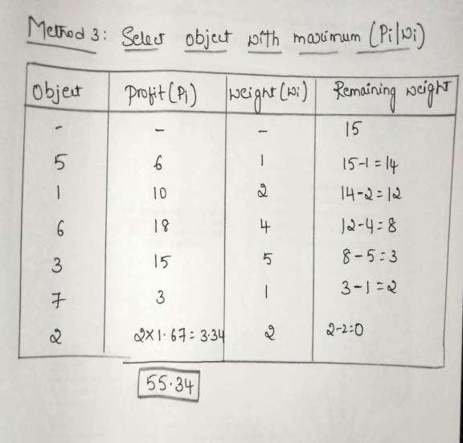

Profits =
Solution Vector = (1, 2/3,1,0, 1,1,1)= (1, 0.67,1,0, 1,1,1)
Optimal solution is (x1, x2, x3,x4,x5,x6,x7) = (1, 0.67,1,0, 1,1,1) with profit [1*10+0.67*5+1*15+0*7+1*6+1*18+1*3]= 55.34 Weight=[1*2+0.67*3+1*5+0*7+1*1+1*4+1*1]=15
This greedy approach always results optimal solution
Department of CSE
AATTMMEECCoollleleggeeoof fEEnngginineeer irningg

Slide 155
Knapsack Problem (Fractional knapsack problem)
Given n objects and a knapsack or bag. Object i has a weight wi and the knapsack has a capacity m. if the fraction Xi, 0<=Xi<=1, of object i is placed into the knapsack, then a profit of Pi*Xi is earned.
The objective is to maximize the total profit earned. Since the knapsack capacity is m, we require the total weight of all chosen objects to be at most m.
DDeeppaarrttmmeennttooff CCSSEE
AATTMMEECECoCloloelelegggeeeooffEEnnggigninineeerrirningg
155

Slide 156
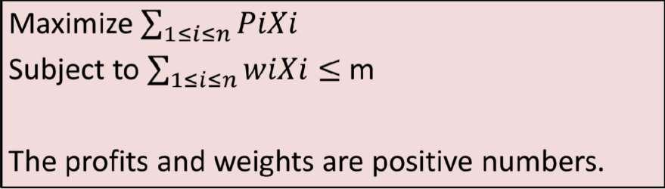
Knapsack problem
Department of CSE
AATTMMEECCoollleleggeeoof fEEnngginineeer irningg

Slide 157
Knapsack Algorithm
Algorithm Greedy Knapsack(m,n)
//p[1:n] and w[1:n] contain the profits and weights respectively, of the n objects ordered such that p[i]/w[i] >= p[i+1]/w[i+1].
// m is the knapsack size and x[1:n] is the solution vector
{
for i := 1 to n do x[i] := 0.0; //Initialize x
U := m;//sack capacity
for i:=1 to n do
{
if (w[i] > U) then break; // weight of an object is greater than sack capacity
x[i] := 1.0; U:=U-w[i];
}
If(i<=n) then x[i]:=U/w[i];
}
Analysis: Disregarding the time to initially sort the object, each of the above strategies use O(n) time
Department of CSE
AATTMMEECCoollleleggeeoof fEEnngginineeer irningg

Slide 158
Problem - 2
Obtain the optimal solution for the knapsack
problem following:
M=40
using greedy method given the
, n=3
w1,w2,w3 = 20,25,10
p1,p2,p2 = 30,40,35
Department of CSE
AATTMMEECCoollleleggeeoof fEEnngginineeer irningg

Slide 159
Job Sequencing with Deadline
Given an array of jobs where every job has a deadline and associated profit, the job is to be finished before the deadline. It is also given that every job takes single unit of time. So the minimum possible deadline for any job is 1. the objective is to maximize total profit, provided only one job can be scheduled at a time.
Department of CSE
AATTMMEECCoollleleggeeoof fEEnngginineeer irningg

Slide 160
For the following sequence of job, give the snapshot of execution which will achieve maximum profit.
Problem 1
Jobs n= 5
p1,p2,p3,p4,p5 = 20,15,10,1,6
d1,d2,d3,d4,d5 = 2, 2, 1, 3,3
Department of CSE
AATTMMEECCoollleleggeeoof fEEnngginineeer irningg

Slide 161
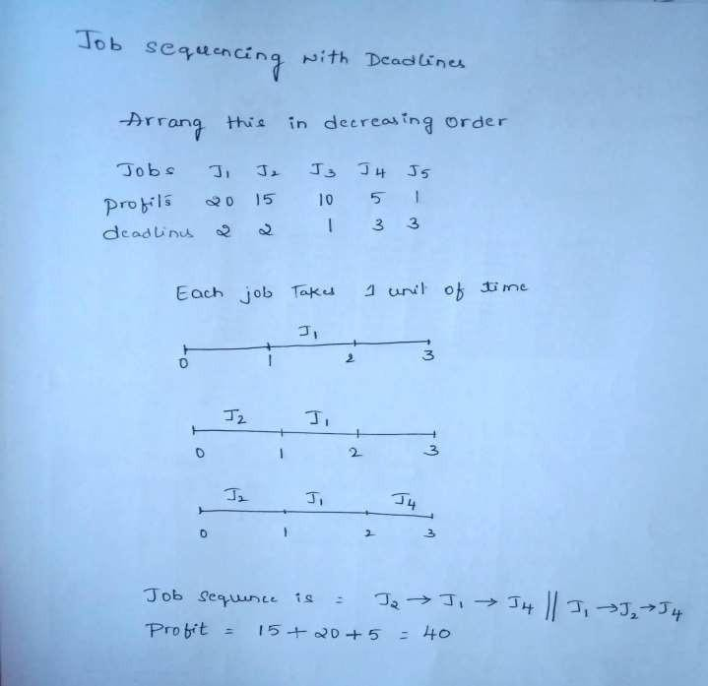
Problem 1

Slide 162
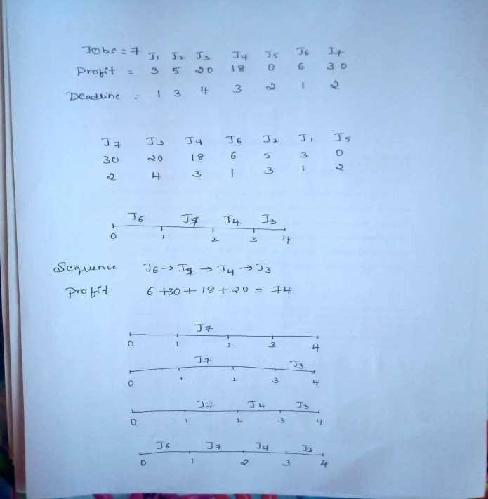

Slide 163
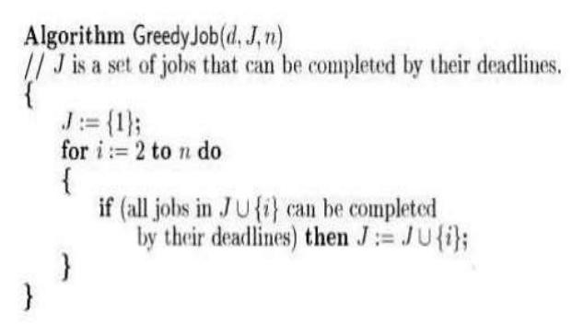
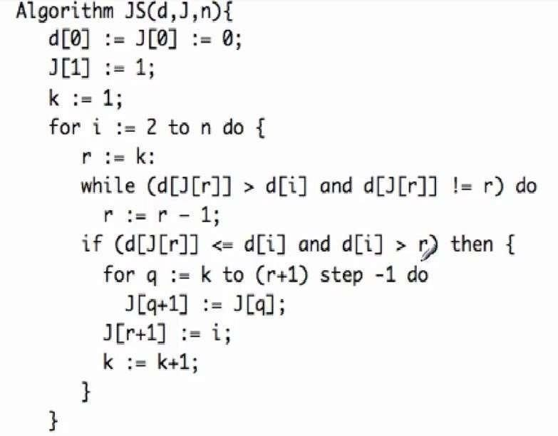
Job Sequencing with Deadline
Department of CSE
AATTMMEECCoollleleggeeoof fEEnngginineeer irningg

Slide 164



Minimum Spanning Tree (MST)
Spanning tree of a connected graph G: a connected acyclic subgraph of G that includes all of G’s vertices
6
c
6
c
c
a
a
a
4
1
1
1
4
2
2
d
d
d
b
3
b
b
3
Department of CSE
AATTMMEECCoollleleggeeoof fEEnngginineeer irningg

Slide 165

Minimum spanning tree of a weighted, connected graph G: a spanning tree of G of the minimum total weight
Example:
6
c
6
c
c
a
a
a
1
1
1
4
4
2
2
d
d
d
b
3
b
b
3
COST=11 COST=6
DDeeppaartmmeenntoof
AATTMMEECECoCloloelelegggeeeooffEEnnggigninineeerrirningg
165

Slide 166

Department of CCSSEE
ATME College of Engineering

Slide 167
Minimum Cost spanning Tree algorithms
Prim’s algorithm
Kruskal’s algorithm
Department of CCSSEE
ATME College of Engineering

Slide 168






MST – Prim’s algorithm
Department of CCSSEE
ATME College of Engineering

Slide 169



Department of CCSSEE
ATME College of Engineering

Slide 170






ent of ISE
nd
llege
Mgmt
170
BAMTSMIEnCsotitluletgeeofofTEencghinnoeloegr iynga

Slide 171

eering
171
ATATMMEECoColeleggeeoof fEEnngginineeeeririnngg

Slide 172
Efficiency
The time efficiency of depends on the data structures used for implementing the priority queue and for representing the input graph.
Since we have implemented using weighted matrix and unordered array, the efficiency is O(|V²|).
If we implement using adjacency list and the priority queue for min-heap, the efficiency is O(|E|log|V|).
Department of CSE
ATME College of Engineering
172

Slide 173
Kruskal’s algorithm
Kruskal's algorithm finds MST of a weighted connected graph G=<V,E> as an acyclic subgraph with |V| - 1 edges. Sum of all the edges weight should be minimum.
The algorithm begins by sorting the graph’s edges in increasing order of their weights.
Then it scans this sorted list starting with the empty sub graph and it adds the next edge on the list to the current sub graph, if such an inclusion doesn’t create a cycle and simply skipping the edges.
 | Department of CSE | A_{A}T_{T}M_{M}E_{E}C_{C}o_{o}ll_{l}e_{le}g_{g}e_{e}of_{o}E_{f} n_{E}g_{n}in_{g}e_{in}e_{e}ri_{e}n_{r}g_{ing}
173

Slide 174

Department of CCSSEE
ATME College of Engineering

Slide 175







Department of CCSSEE
ATME College of Engineering

Slide 176



Department of CCSSEE
ATME College of Engineering

Slide 177

Time complexity
The crucial check whether two vertices belong to the same tree can be found out using union -find algorithms.
Department of CCSSEE
ATME College of Engineering

Slide 178
Shortest paths – Dijkstra’s algorithm
The Dijkstra’s algorithm finds the shortest path
from a given vertex to all the remaining vertices in a diagraph.
The constraint is that each edge has non-
negative cost. The length of the path is the sum of the costs of the edges on the path.
We have to find out the shortest path from a
given source vertex ‘S’ to each of the destinations (other vertices ) in the graph.
DDeeppaarrttmmeennttooff CCSSEE
AATTMMEECECoCloloelelegggeeeoofffEEngngignineinererirningg

Slide 179


Example
1
2
3
4
5 0 1 | 0 | 0 | 0 | 0
Initially
S
1
∞ 1 | 60 | 100 | ∞ | 10
d
60
100
1
2
10
3
60
10
0
10
20
2
3
50
20
20
4
50
20
5
5
4
BAATMTMSMEECInCostoiltluleletgegeooeffTEoefncgEhinnoge₅ilenoregiynegarndinMggmt
DDeeppaarrttmmeennttooff CCSSEE
5

Slide 180
Example
1
2
3
4
5
1 | 0 | 0 | 0 | 1
S
1
1 | 60 | 100 | ∞ | 10
d
60
100
1
2
10
3
60
100
10
20
2
3
50
20
20
4
50
20
5
5
4
BAATMTMSMEECInCostoiltluleletgegeooeffTEoefncgEhinnoge₅ilenoregiynegarndinMggmt
DDeeppaarrttmmeennttooff CCSSEE
5

Slide 181

Example
1
2
3
4
5
1 | 0 | 0 | 1 | 1
S
1
1 | 60 | 100 | 15 | 10
d
60
100
1
2
10
3
60
100
10
20
2
3
50
20
20
4
50
20
5
5
4
BAATMTMSMEECInCostoiltluleletgegeooeffTEoefncgEhinnoge₅ilenoregiynegarndinMggmt
DDeeppaarrttmmeennttooff CCSSEE
5

Slide 182
Example
1
2
3
4
5
1 | 0 | 1 | 1 | 1
S
1
1 | 60 | 35 | 15 | 10
d
60
100
1
2
10
3
60
100
10
20
2
3
50
20
20
4
50
20
5
5
4
BAATMTMSMEECInCostoiltluleletgegeooeffTEoefncgEhinnoge₅ilenoregiynegarndinMggmt
DDeeppaarrttmmeennttooff CCSSEE
5

Slide 183
Example
Final distance form note 1 to all other nodes
1 2 3 4 5
1 | 1 | 1 | 1 | 1
S
1
1 | 60 | 35 | 15 | 10
d
60
100
1
2
10
3
60
100
10
20
2
3
50
20
20
4
50
20
5
5
4
BAATMTMSMEECInCostoiltluleletgegeooeffTEoefncgEhinnoge₅ilenoregiynegarndinMggmt
DDeeppaarrttmmeennttooff CCSSEE
5

Slide 184

Example2
_{b} 4
c
4
3
6
2 5
_{a} 7 _{dd}
e
Tree vertices
a(-,0)
Remaining vertices
4
b(a,3) c(-,∞) d(a,7) e(-,∞)
b
c
3
2
6
5
a
7
d
4
e
b(a,3)
c(b,3+4) d(b,3+2) e(-,∞)
b
4
c
3
6
2
5
a
7
d
4
e
d(b,5)
c(b,7)
e(d,5+4)
_{b} 4 _{c}
3
6
2 5
a
7
d
4
e
c(b,7)
e(d,9)
4
b
c
3
6
2
5
a
7
d
4
e
e(d,9)
Department of
AATTMMEECCoollleleggeeoof fEEnngginineeer irningg
184
CSE

Slide 185
Dijkstra’s algorithm
Dijkstra’s( s)
// Finds shortest path from source vertex to all other vertices
//Input: Weighted connected graph G=<V,E> with nonnegative weights and its vertices s
//Output: The length of distance of a shortest path from s to v
{
for i = 1 to n do // Intialize
S[i] = 0;
d[i] = a[s][i];
S[s] = 1; //Assume 1 as the source vertex
d[s] = 1;
DDeeppaarrttmmeennttooff CCSSEE
AATTMMEECECoCloloelelegggeeeoofffEEngngignineinererirningg

Slide 186
Dijkstra’s algorithm
3. for i = 1 to n do
{
Choose a vertex u in v-s such that d[u] is minimum
S = s u
for each vertex v in v-s do
d[v] = min{ d[u], d[u]+c[u,v]}
}
}
DDeeppaarrttmmeennttooff CCSSEE
AATTMMEECECoCloloelelegggeeeoofffEEngngignineinererirningg

Slide 187
Key points on Dijkstra’s algorithm
Doesn’t work for graphs with negative weights
(whereas Floyd’s algorithm does, as long as there is no negative cycle).
Applicable to both undirected and directed graphs.
Efficiency O(|V²|) for graphs represented by weight matrix and array implementation of priority queue
O(|E|log|V|) for graphs represented by adj. lists and min-heap implementation of priority queue
DDeeppaarrttmmeennttooff CCSSEE
AATTMMEECECoCloloelelegggeeeoofffEEngngignineinererirningg

Slide 188
M O D U L E – 4
DYNAMIC PROGRAMMING
Department of
AATTMMEECCoollleleggeeoof fEEnngginineeer irningg
188
CSE

Slide 189
Dynamic Programming
Invented by American mathematician Richard Bellman in the
1950s to solve optimization problems
Optimization Problem : Problems which demands minimum/maximum results
Dynamic “ means “changing” Programming” means “planning”
Dynamic Programming is a general algorithm design technique for solving problems with overlapping sub-problems.
Main idea:
-Solve smaller instances once.
-Record solutions in a table.
-Get solution to a larger instance from some smaller instances.
-Optimal solution for the initial instance is obtained from that table.
DDeeppaartmmeenntoof
AATTMMEECECoCloloelelegggeeeooffEEnnggigninineeerrirningg
189

Slide 190

Principle of Optimality
Problems can be solved by taking sequence of decisions to get optimal solutions
Department of CCSSEE
ATME College of Engineering
190
ATME College of Engineering

Slide 191



Example: Fibonacci numbers
ATME College of Engineering
191
ATATMMEECoColeleggeeoof fEEnngginineeeeririnngg

Slide 192

Example: Fibonacci numbers
Department of CCSSEE
ATME College of Engineering

Slide 193

Department of CCSSEE
ATME College of Engineering

Slide 194


ATME College of Engineering
194
ATATMMEECoColeleggeeoof fEEnngginineeeeririnngg
CSE

Slide 195












Examples of DP algorithms
Computing a binomial coefficient
Longest common subsequence
Warshall’s algorithm for transitive closure
Floyd’s algorithm for all-pairs shortest paths
Constructing an optimal binary search tree
Some instances of difficult discrete optimization problems:
  traveling salesman
  knapsack
Department of
AATTMMEECCoollleleggeeoof fEEnngginineeer irningg
195
CSE

Slide 196
Multistage Graph
A Multi stage graph G = <V,E> which is a directed graph. In this graph all the vertices and partitioned into K stages where K>=2.
In multistage graph problem we have to find the shortest path from source to sink.
The cost of each path is calculated by using the weight given along that edge.
In multistage graph can be solved using forward and backward approach.
DDeeppaartmmeenntoof
AATTMMEECECoCloloelelegggeeeooffEEnnggigninineeerrirningg
196

Slide 197

Department of
ATME College of Engineering
197
CCSSEE

Slide 198


ATME College of Engineeringgy and Mgmt
BMATSMEInCostitluletgeeofofTEencghinnoeloeri
ng

Slide 199







ATATMMEECoColeleggeeoof fEEnngginineeeeririnngg

Slide 200


ATME College of Engineeringy and Mgmt
BMATSMIEnCostitluletgeeofofTEencghninoeloegri
ng

Slide 201

Department of CCSSEE
ATME College of Engineering

Slide 202


Warshall’s Algorithm: Transitive Closure
Department of CCSSEE
ATME College of Engineering

Slide 203
Warshall’s Algorithm: Transitive Closure
Constructs transitive closure T as the last matrix in the sequence of n-by-n matrices R⁽⁰⁾, … , R^{(k)}, … , R^{(n)} where
R^{(k)}[i,j] = 1 iff there is nontrivial path from i to j k vertices allowed as intermediate
Note: that R⁽⁰⁾ = A (adjacency matrix), R^{(n)} = T
with only the first
(transitive closure)
DDeeppaarrttmmeennttooff CCSSEE
AATTMMEECECoCloloelelegggeeeoofffEEngngignineinererirningg

Slide 204

Department of CCSSEE
ATME College of Engineering

Slide 205




ATME College of Engineering
205
ATATMMEECoColeleggeeoof fEEnngginineeeeririnngg

Slide 206






Department of
ATME College of Engineering
206
CCSSEE

Slide 207




































Warshall’s Algorithm (recurrence)
On the k-th iteration, the algorithm determines for every pair of vertices i, j if a path exists from i and j with just vertices 1,…,k allowed as intermediate
{
R^{(k-1)}[i,j] (path using just 1 ,…,k-1) or
R^{(k)}[i,j] =
R^{(k-1)}[i,k] and R^{(k-1)}[k,j]
(path from i to k
and from k to j
using just 1 ,…,k-1)
k
i
Initial condition?
j
Department of CSE

Slide 208











































Warshall’s Algorithm (matrix generation)
Recurrence relating elements R^{(k)} to elements of R^{(k-1)} is:
R^{(k)}[i,j] = R^{(k-1)}[i,j] or (R^{(k-1)}[i,k] and R^{(k-1)}[k,j])
It implies the following rules for generating R^{(k)} from R^{(k-1)}:
Rule 1 If an element in row i and column j is 1 in R^{(k-1)}, it remains 1 in R^{(k)}
Rule 2 If an element in row i and column j is 0 in R^{(k-1)}, it has to be changed to 1 in R^{(k)} if and only if
the element in its row i and column k and the element in its column j and row k are both 1’s in R^{(k-1)}
Department of CSE

Slide 209


Warshall’s Algorithm (pseudocode and analysis)
Time efficiency: Θ(n³)
DDeeppaarrttmmeennttooff CCSSEE
AATTMMEECECoCloloelelegggeeeoofffEEngngignineinererirningg

Slide 210

Floyd’s Algorithm: All pairs shortest paths
Problem:
In a weighted (di)graph, find shortest paths between every pair of vertices
Same idea: construct solution through series of matrices D⁽⁰⁾, …, D ^{(n)} using increasing subsets of the vertices allowed as intermediate
Example:
DDeeppaarrttmmeennttooff CCSSEE
AATTMMEECECoCloloelelegggeeeoofffEEngngignineinererirningg

Slide 211



ME C llege of Engineering
211
BMATSMIEnstColege of Engineering
itute of Technology and Mgmt

Slide 212

Floyd’s Algorithm (matrix generation)
On the k-th iteration, the algorithm determines shortest paths between every pair of vertices i, j that use only vertices among 1,…,k as intermediate
D^{(k)}[i,j] = min {D^{(k-1)}[i,j], D^{(k-1)}[i,k] + D^{(k-1)}[k,j]}
D^{(k-1)}[i,k]
k
i
D^{(k-1)}[k,j]
D^{(k-1)}[i,j]
Initial condition?
j
Department of
AATTMMEECCoollleleggeeoof fEEnngginineeer irningg
212
CSE

Slide 213


Time efficiency: Θ(n³)
Note: Works on graphs with negative edges but without negative cycles.
DDeeppaartmmeenntoof
AATTMMEECECoCloloelelegggeeeooffEEnnggigninineeerrirningg
213
CCSSEE

Slide 214

Optimal Binary Search Tree
Binary Tree
Department of CCSSEE
ATME College of Engineering

Slide 215

total number of BSTs with n nodes is given by C(2n,n)/(n+1)
Department of CCSSEE
ATME College of Engineering

Slide 216

Cost of searching any Key
Department of CCSSEE
ATME College of Engineering

Slide 217

Cost of BST-Frequencies
18
ATME College of Engineering
217
ATATMMEECoColeleggeeoof fEEnngginineeeeririnngg

Slide 218

Optimal Binary Search Tree
Problem: Given n keys a₁ < …< a_{n} and probabilities p₁, …, p_{n} searching for them, find a BST with a minimum average number of comparisons in successful search.
Since total number of BSTs with n nodes is given by C(2n,n)/(n+1), which grows exponentially, brute force is not recommended.
DDeeppaarrttmmeennttooff CCSSEE
AATTMMEECECoCloloelelegggeeeoofffEEngngignineinererirningg

Slide 219


Example: What is an optimal BST for keys A, B, C, and D with search probabilities 0.1, 0.2, 0.4, and 0.3, respectively?
Average # of comparisons
= 1*0.4 + 2*(0.2+0.3) + 3*0.1
= 1.7
C
B
D
A
DDeeppaarrttmmeennttooff CCSSEE
AATTMMEECECoCloloelelegggeeeoofffEEngngignineinererirningg

Slide 220

Obtain the optimal binary search tree for the following
(do, if, int, while) with the following probability(0.1,0.2,0.4,0.3)
ATATMMEECoCollleleggeeoof fEEnngginineeeeririnngg

Slide 221





ATME College of Engineelroinggy and Mgmt
BMATSMIEnCostitluletgeeofofTEencghninoeeri
ng

Slide 222

ATATMMEECoCollleleggeeoof fEEnngginineeeeririnngg

Slide 223

ATATMMEECoCollleleggeeoof fEEnngginineeeeririnngg

Slide 224

Department of CCSSEE
ATME College of Engineering

Slide 225

Department of CCSSEE
ATME College of Engineering

Slide 226

ATATMMEECoCollleleggeeoof fEEnngginineeeeririnngg

Slide 227

ATATMMEECoCollleleggeeoof fEEnngginineeeeririnngg

Slide 228


ATATMMEECoColeleggeeoof fEEnngginineeeeririnngg

Slide 229

Department of
ATME College of Engineering
229
CCSSEE

Slide 230
Knapsack Problem
Given n objects of known weights w1,w2…wn and profit p1, p2, … pn for those n objects and a knapsack of capacity M i.e is not exceeding the weight M. Let a variable xi be ‘0’ if we do not select the object ‘i’ or ‘1’ if we include the object ‘i’ into the knapsack.
The objective is to maximize the total profit
earned. Since the knapsack capacity is M, we require the total weight of all chosen objects to be at most M.
Department of CSE

Slide 231
Knapsack problem
Department of CSE

Slide 232

For the given instances of problem obtain the optimal solution for the knapsack problem
The capacity of knapsack is W=5
Department of CSE

Slide 233


Department of CCSSEE
ATME College of Engineering

Slide 234



ATME College of Engineering
M gmt
234
BAMTSMIEnCstoitluletgeeoof fTEencghinnoeloegr iyngand

Slide 235

ATME College of Engineering
235
ATATMMEECoColeleggeeoof fEEnngginineeeeririnngg

Slide 236


Department of CSE
ATME College of Engineering
236

Slide 237

ATATMMEECoCollleleggeeoof fEEnngginineeeeririnngg

Slide 238


ATATMMEECoCollleleggeeoof fEEnngginineeeeririnngg

Slide 239

ATATMMEECoCollleleggeeoof fEEnngginineeeeririnngg

Slide 240

Department of CCSSEE
ATME College of Engineering

Slide 241

To find items to be selected
Department of CCSSEE
ATME College of Engineering

Slide 242


ATATMMEECoCollleleggeeoof fEEnngginineeeeririnngg

Slide 243


ATATMMEECoCollleleggeeoof fEEnngginineeeeririnngg

Slide 244
Knapsack Problem by DP (pseudocode)
Algorithm DPKnapsack(int: w[1..n], int: p[1..n], M) int: V[0..n,0..M]
for j := 0 to M do
V[0,j] := 0
for i := 0 to n do
V[i,0] := 0
for i := 1 to n do
for j := 1 to M do
if w[i] ≤ j and p[i] + V[i-1,j-w[i]] > V[i-1,j] then
V[i,j] := p[i] + V[i-1,j-w[i]];
else
V[i,j] := V[i-1,j];
return V[n,M]
Running time and space: O(nW).
DDeeppaartmmeenntoof
AATTMMEECECoCloloelelegggeeeooffEEnnggigninineeerrirningg
244

Slide 245

Department of CCSSEE
ATME College of Engineering

Slide 246
Department of CCSSEE
ATME College of Engineering

Slide 247

Department of CCSSEE
ATME College of Engineering

Slide 248

Department of CCSSEE
ATME College of Engineering

Slide 249
Memory Function Knapsack
Example: Knapsack of capacity M = 5
item | weight | value
1 | 2 | $8
2 | 1 | $6
3 | 3 | $16
4 | 2 | $11 | capacity j
0 1 2 3 4 5
0 0 0 0 0 0
0
w = 2, p = 8 1
w = 1, p = 6 2
3
4
0 -1 -1 -1 -1 -1
1
1
0 | -1 | -1 | -1 | -1 | -1
0 | -1 | -1 | -1 | -1 | -1
2
2
w = 3, p = 16
3
3
w₄ = 2, p₄= 11
0 -1 -1
A⁻T¹ME C⁻o¹llege⁻o¹f En?gineer ing
249

Slide 250

Memory Function Knapsack
i=4, j=5, p[i]=11, wi =2
J-wi = 5-2 = 3 ( able to fit into knapsack)
Find V[4,5] = max{ mfk[i-1,j], p[i] + mfk[i-1, j-wi]}
= max{ mkf(3,5), 11+mfk(3,3)}
= max{ ---------, 11+ -------)}
Find V[3,5] = max{ mkf(2,5), 16+mfk(2,2)}
= max{ , 16+ }
Department of CCSSEE
ATME College of Engineering

Slide 251
Memory Function Knapsack
Find V[3,3] = max{ mfk[i-1,j], p[i] + mfk[i-1, j-wi]}
= max{ mkf(2,3), 16+mfk(2,0)}
= max{ ----, 16+ -----)}
Find V[2,5] = max{ mkf(1,5), 6+mfk(1,4)}
= max{ , 6+ }
Find V[2,2] = max{ mkf(1,2), 6+mfk(1,1)}
= max{ , 6 + }
Department of CCSSEE
ATME College of Engineering

Slide 252
Find V[2,3] = max{ mkf(1,3), 6+mfk(1,2)}
= max{ , 6 + -}
Find V[1,5] = max{ mkf(0,5), 8+mfk(0,3)}
= max{ 0 , 8 + 0} = 8
Find V[1,4] = max{ mkf(0,4), 8+mfk(0,2)}
= max{ 0 , 8 + 0} = 8
Find V[1,2] = max{ mkf(0,2), 8+mfk(0,0)}
= max{ 0 , 8 + 0} = 8
Find V[1,3] = max{ mkf(0,3), 8+mfk(0,0)}
= max{ 0 , 8 + 0} = 8
Find V[1,1] = max{ mkf(0,1)} = 0
Back Substitute these values
Department of CCSSEE
ATME College of Engineering

Slide 253
Find V[2,3] = max{ mkf(1,3), 6+mfk(1,2)}
= max{ 8, 6 + 8} = 14
Find V[1,5] = max{ mkf(0,5), 8+mfk(0,3)}
= max{ 0 , 8 + 0} = 8
Find V[1,4] = max{ mkf(0,4), 8+mfk(0,2)}
= max{ 0 , 8 + 0} = 8
Find V[1,2] = max{ mkf(0,2), 8+mfk(0,0)}
= max{ 0 , 8 + 0} = 8
Find V[1,3] = max{ mkf(0,3), 8+mfk(0,0)}
= max{ 0 , 8 + 0} = 8
Find V[1,1] = max{ mkf(0,1)} = 0
Back Substitute these values
Department of CCSSEE
ATME College of Engineering

Slide 254
Memory Function Knapsack
Find V[3,3] = max{ mfk[i-1,j], p[i] + mfk[i-1, j-wi]}
= max{ mkf(2,3), 11+mfk(2,0)}
= max{ 14 , 16+ 0)} = 16
Find V[2,5] = max{ mkf(1,5), 6+mfk(1,4)}
= max{ 8, 6+ 8} = 14
Find V[2,2] = max{ mkf(1,2), 6+mfk(1,1)}
= max{ 8, 6 + 0} = 8
Department of CCSSEE
ATME College of Engineering

Slide 255
Memory Function Knapsack
V[i,j] = max{ mfk[i-1,j], p[i] + mfk[i-1, j-wi]} i=4, j=5, p[i]=11, wi =2
J-wi = 5-2 = 3 ( able to fit into knapsack)
Find V[4,5] = max{ mfk[i-1,j], p[i] + mfk[i-1, j-wi]}
= max{ mkf(3,5), 11+mfk(3,3)}
= max{ 24 , 11+ 16)} = 27
Find V[3,5] = max{ mkf(2,5), 16+mfk(2,2)}
= max{ 14, 16+ 8} = 24
Department of CCSSEE
ATME College of Engineering

Slide 256

Memory Function Knapsack
Example: Knapsack of capacity M = 5 item weight value
1
2
3
4
2
1
3
2
$8
$6
$16
$11
capacity j
0 1 2 3 4 5
 |  | 0 | 0 0 | 0 | 0 0 0 0 0 | 0 | 0 | 0 | 0
w = 2, w = 1, | p = 8 p = 6 | 1 2 | 0 -1 0 -1 | -1 -1 | -1 -1 -1 0 0 -1 -1 -1 0 -1 | 8 8 | 8 14 | 8 -1 | 8 14
w = 3, w₄ = 2, | p = 16 p₄= 11 | 3 4 | 0 -1 0 -1 | -1 -1 | -1 -1 -1 0 -1 A⁻T¹ME C⁻o¹llege ⁻o¹f En?gin⁰eer ing⁻¹ | -1 -1 | 16 -1 | -1 -1 | 24 27 256
1
1
2
2
3
3

Slide 257
Memory Function Knapsack Algo.
ALGORITHM MFKnapsack(i, j) //Implements the memory function method for the knapsack problem //Input: A nonnegative integer i indicating the number of the first // items being considered and a nonnegative integer j indicating // the knapsack capacity //Output: The value of an optimal feasible subset of the first i items //Note: Uses as global variables input arrays Weights[1..n], Values[1..n], //and table V[0..n, 0..W]whose entries are initialized with −1’s except for //row 0 and column 0 initialized with 0’s if V[i, j]< 0 if j<Weights[i] = value←MFKnapsack(i −1,j) else value←max,MFKnapsack(i −1, j), values[i]+MFKnapsack(i −1, j−Weights*i+)- V[i, j+←value return V[i, j]
 | Department of CSE | A_{A}T_{T}M_{M}E_{E}C_{C}o_{o}ll_{l}e_{le}g_{g}e_{e}of_{o}E_{f} n_{E}g_{n}i_{g}ne_{in}e_{e}ri_{e}n_{r}g_{ing}
257

Slide 258
M O D U L E – 5
BACKTRACKING
Department of CSE
AATTMMEECCoollleleggeeoof fEEnngginineeer irningg

Slide 259
Backtracking
Backtrack’ the Word was first introduced by Dr. D.H. Lehmer in 1950s.
R.J Walker Was the First man who gave algorithmic description in 1960.
Later developed by S. Golamb and L. Baumert.
Backtracking technique resembles a depth-first – search in a directed graph. The graph concerned here is usually a tree, the aim of backtracking is to search the state space tree systematically. The aim of the search is to find solutions to some problems.
Department of CSE
AATTMMEECCoollleleggeeoof fEEnngginineeer irningg

Slide 260
What is Backtracking?
When the search begins, solution to the problem is unknown. Each move along an edge of the tree corresponds to adding a new element to a partial solution, that is to narrowing down the remaining possibilities for a complex solution.
The search is successful if, a solution can be completely defined. At this stage an algorithm may terminate or it may continue for an alternative solution.
The search is unsuccessful if at some stage the partial solution constructed so far cannot be completed. In this case the search backtracks like a depth first search, removing elements that were added at each stage.
Department of CSE
AATTMMEECCoollleleggeeoof fEEnngginineeer irningg

Slide 261
State Space Tree
In state space tree, root represents an initial state before the search for a solution begins. The nodes of the first level in the tree represent the choice made for the first component of a solution, the nodes of the second level represent the choices for the second components, and so on. A node in a state space tree is said to be promising if it corresponds to a partially constructed solution that may lead to a complete solution; otherwise a node is said to be non promising.
Department of CSE
AATTMMEECCoollleleggeeoof fEEnngginineeer irningg

Slide 262

Department of CSE
AATTMMEECCoollleleggeeoof fEEnngginineeer irningg

Slide 263

N-Queen Problem
Department of CSE
AATTMMEECCoollleleggeeoof fEEnngginineeer irningg

Slide 264


N Queen Problem
Department of CSE
AATTMMEECCoollleleggeeoof fEEnngginineeer irningg

Slide 265
Constraints
Explicit Constraints: All ‘n’ queens must be placed on the chessboard in the columns 1,2,3, …. N. Xi belongs to S where S =
{1,2,3, …. N }
Implicit Constraints: In this all Xi Values must be distinct No two queens can be on the same row
No two queens can be on the same column No two queens can be on the same diagonal
Department of CSE
AATTMMEECCoollleleggeeoof fEEnngginineeer irningg

Slide 266

Horizontal Attack:
Row wise attacking is avoided by placing 1st queen in 1st row, 2nd queen in 2nd row and so on.
By placing ith queen in ith row, horizontal attacking can be avoided
Department of CSE
AATTMMEECCoollleleggeeoof fEEnngginineeer irningg

Slide 267
Vertical Attack:
(i, x[i])→ means the position of ith queen in row i and column x[i]
(k, x[k])→ means the position of kth queen in row k and column x[k]
If ith & kth queen are in same column then
X[i] == x[k] --------------- (1)
Hence indicate that queens attack vertically
(1,1) & (4,1) x[i] == x[k] to be avoided
Q1
Q4
Department of CSE
AATTMMEECCoollleleggeeoof fEEnngginineeer irningg

Slide 268
Diagonal Attack:
Top left corner to bottom right corner: The difference between row value and column value is same.
(1,3) & (2,4) |i - x[i]| = |k - x[k]|-------(2) to be avoided
1,1 | 1,2 | 1,3 | 1,4
2,1 | 2,2 | 2,3 | 2,4
3,1 | 3,2 | 3,3 | 3,4
4,1 | 4,2 | 4,3 | 4,4
Department of CSE
AATTMMEECCoollleleggeeoof fEEnngginineeer irningg

Slide 269
Diagonal Attack:
Top right corner to bottom left corner: The difference between row value and column value is same.
(1,3) & (3,1) i + x[i] = k + x[k] ------(3) to be
avoided
Using eqn. (2) and (3)
i – k = x[i] - x[k] -----------------(4)
i – k = - x[i] + x[k] ----------------(5)
|i – k| = |x[i] - x[k]| indicates queens attack diagonally.
X[i] == x[k] || abs(i –k) = abs(x[i] – x[k]) → two queens attack each other and cannot be placed.
1,1 | 1,2 | 1,3 | 1,4
2,1 | 2,2 | 2,3 | 2,4
3,1 | 3,2 | 3,3 | 3,4
4,1 | 4,2 | 4,3 | 4,4
Department of CSE
AATTMMEECCoollleleggeeoof fEEnngginineeer irningg

Slide 270

Algorithm
Department of CSE
AATTMMEECCoollleleggeeoof fEEnngginineeer irningg

Slide 271

State Space Tree for 4 Queens
Department of CSE
AATTMMEECCoollleleggeeoof fEEnngginineeer irningg

Slide 272


Two Solutions of 4 Queen Problem
Department of CSE
AATTMMEECCoollleleggeeoof fEEnngginineeer irningg

Slide 273
Hamiltonian Cycle
Hamiltonian Path in an undirected graph is a path that visits each vertex exactly once. A Hamiltonian cycle (or Hamiltonian circuit) is a Hamiltonian Path such that there is an edge (in graph) from the last vertex to the first vertex of the Hamiltonian Path. Determine whether a given graph contains Hamiltonian Cycle or not. If it contains, then print the path. Following are the input and output of the required function.
Input:
A 2D array graph[V][V] where V is the number of vertices in graph and graph[V][V] is adjacency matrix representation of the graph. A value graph[i][j] is 1 if there is a direct edge from i to j, otherwise graph[i][j] is 0.
Output:
An array path[V] that should contain the Hamiltonian Path. path[i] should represent the ith vertex in the Hamiltonian Path. The code should also return false if there is no Hamiltonian Cycle in the graph.
Department of CSE
AATTMMEECCoollleleggeeoof fEEnngginineeer irningg

Slide 274

Example 2
Department of CSE
AATTMMEECCoollleleggeeoof fEEnngginineeer irningg

Slide 275

Department of CSE
AATTMMEECCoollleleggeeoof fEEnngginineeer irningg

Slide 276

Example
Department of CSE
AATTMMEECCoollleleggeeoof fEEnngginineeer irningg

Slide 277


Hamiltonian Cycle
X[1] =1 | X[2] = 0 | X[3]=0 | X[4]=0
1
2
1
2
3
4
4
3
3
2 4
Dead end
3
4
2
1
1
Solution
Solution
Department of CSE
AATTMMEECCoollleleggeeoof fEEnngginineeer irningg

Slide 278

Department of CSE
AATTMMEECCoollleleggeeoof fEEnngginineeer irningg

Slide 279

for (int i = 1; i <= n; i++)
x[i] = 0;
1
x[1] = 1;
void HamiltonianMethod(int k) { while (true) {
NextValue(k, G, x, n);
if (x[k] == 0)
return;
if (k == n) {
for (int i = 1; i <= k; i++)
System.out.print(x[i] + " ");
2
3
4
3
3
2
4
Dead end
4
2
System.out.println(x[1]);
System.out.println(); found = true;
return;
} else
HamiltonianMethod(k + 1);
1
1
Solution
}
}
Department of CSE
ATME College of Engineering
279

Slide 280
void NextValue(int k, int G[][], int x[], int n) { while (true) {
x[k] = (x[k] + 1) % (n + 1);
if (x[k] == 0) return;
if (G[x[k - 1]][x[k]] != 0) {
int j;
for (j = 1; j < k; j++) if (x[k] == x[j]) break;
if (j == k)
if ((k < n) || ((k == n) && G[x[n]][x[1]] != 0)) return;
}
}
}
Hamiltonian Cycle
Enter the number of the vertices: 4
If edge between the following vertices enter 1 else 0:
1 and 2: 1
1 and 3: 1
1 and 4: 1
2 and 3:
1
2 and 4: 0
3 and 4: 1
Solution: 1 2 3 4 1
1 4 3 2 1
Department of CSE

Slide 281

1
2
3
4
3
2 4
Dead end
3
4
2
1
1
Solution
Solution
Department of CSE

Slide 282

Department of CSE

Slide 283

Sum of subsets
Department of CSE

Slide 284

Sum of subsets
Department of CSE

Slide 285
Sum of Subsets
Find a subset of a given set S= {S1, S2, S3, S4, ------ Sn}
Of n +ve integers whose sum is equal to given +ve integer d subject to the constrains
Implicit: All Xi values should be distinct and should belong to the set S
Explicit: optimal solution be ∑ 𝑖 = d
𝑖=1
Xi of the solution vector is either 1 or 0 depending on weather the weight Wi is included or not.
Department of CSE

Slide 286
For a node at level i, the left child corresponds to Xi = 1 and the right child to Xi = 0
The bounding function X[X1, X2, X3, -----Xn] = true iff
∑
𝑖 𝑖 + ∑ 𝑖 ≥
𝑖=+1
𝑖
=1
X1, X2, -----Xk cannot lead to an promising node if this condition is not satisfied.
Department of CSE

Slide 287
The bounding function can be strengthened if we assume that Wi’s are initially in increasing order.
In this case X1 – Xk can not lead to promising node if X[X1, X2, X3, -----Xn] = true iff
∑ 𝑖 𝑖 + _{+ 1 ≤}
𝑖=1
X1, X2, -----Xk cannot lead to an promising node if this condition is not satisfied.
Department of CSE

Slide 288
Therefore the bounding function will be
∑
𝑖 𝑖 + ∑ 𝑖 ≥
𝑖=+1
𝑖
=1
∑
𝑖=1
𝑖 𝑖 + _{+ 1 ≤}
Department of CSE

Slide 289
State space tree
0, 1, 21
X1=1
X1=0
3, 2, 18
0, 2, 18
X2=1
X2=0
8, 3, 13
3, 3, 13
X3=1
X3=0
X3=1
X3=0
14, 4, 7
8, 4, 7
9, 4, 7
3, 4, 7
X4=1
15, 5, 0
Solution
Department of CSE

Slide 290

Sum of subsets
Department of CSE

Slide 291

Sum of subsets
Department of CSE

Slide 292

Sum of subsets
Department of CSE

Slide 293
Coding
for (int i = 1; i <= n; i++)
sum = sum + S[i];
if (sum < d || S[1] > d) System.out.println("No Subset possible"); else
SumofSub(0, 0, sum);
Department of CSE

Slide 294
static void SumofSub(int i, int weight, int total)
{ if (promising(i, weight, total) == true)
if (weight == d) {
for (int j = 1; j <= i; j++) { if (soln[j] == 1)
System.out.print(S[j] + " ");
}
System.out.println();
} else {
soln[i + 1] = 1;
SumofSub(i + 1, weight + S[i + 1], total - S[i + 1]); soln[i + 1] = 0;
SumofSub(i + 1, weight, total - S[i + 1]);
}
}
Department of CSE
ATME College of Engineering
294

Slide 295
static boolean promising(int i, int weight, int total) {
return ((weight + total >= d) && (weight == d || weight + S[i + 1] <= d));
Department of CSE

Slide 296

Graph Coloring
Department of CSE

Slide 297

Department of CSE

Slide 298

Department of CSE

Slide 299

Graph Coloring
Department of CSE

Slide 300

Graph Coloring
Department of CSE

Slide 301
Branch and Bound
The term Branch means the way in which we search the state space tree and Bound means assigning bounding function at each node. This bounding function is used to prevent the expansion of nodes that cannot possibly lead to an answer node.
Basically there are two methods used in branch and bound technique.
FIFO based Branch & Bound
In this method, the live node form a queue (FIFO Structure) & each live node will be taken from the queue and next live node is selected.
Department of CSE

Slide 302
Branch and Bound
Least Cost Branch and Bound
At each node, an intelligent ranking function is used to assign a value to that node. The next live node is selected on the basis of the least cost.
Travelling sales man problem, a sales man must visit n
cities. The sales man visits each city exactly once and comes back to the starting city.
The travelling sales man problem is minimization problem and hence we require to find the lower bound.
Department of CSE

Slide 303
Example 1
Assignment Problem : given n jobs <j1,j2,--- jn> and n persons
<p1,p2,p3 ---pn>, it is required to assign all n jobs to all n persons with the constraint that one job has to be assigned to one person and the cost involved in completing all the jobs should be minimum.
 | J1 | J2 | j3 | j4
A | 9 | 2 | 7 | 8
B | 6 | 4 | 3 | 7
C | 5 | 8 | 1 | 8
D | 7 | 6 | 9 | 4
Department of CSE

Slide 304
Example 1
 | J1 | J2 | j3 | j4
A | 9 | 2 | 7 | 8
B | 6 | 4 | 3 | 7
C | 5 | 8 | 1 | 8
D | 7 | 6 | 9 | 4
Take minimum in each row
2
3
1
4
10
 | a → J1 | a → J2 | a → J3 | a → J4
a | 9 | 2 | 7 | 8
b | 3 | 3 | 4 | 3
c | 8 | 5 | 5 | 5
d | 4 | 4 | 4 | 6
 | 24 | 14 | 20 | 22
Department of CSE

Slide 305
Example 1
 | J1 | J2 | J3 | J4
A | 9 | 2 | 7 | 8
B | 6 | 4 | 3 | 7
C | 5 | 8 | 1 | 8
D | 7 | 6 | 9 | 4
Take minimum in each row
2
3
1
4
10
 | b → J1 | b → J3 | b → J4
a | 2 | 2 | 2
b | 6 | 3 | 7
c | 1 | 5 | 1
d | 4 | 4 | 7
 | 13 | 14 | 17
Department of CSE

Slide 306
Example 1
 | J1 | J2 | J3 | J4
A | 9 | 2 | 7 | 8
B | 6 | 4 | 3 | 7
C | 5 | 8 | 1 | 8
D | 7 | 6 | 9 | 4
Take minimum in each row
2
3
1
4
10
 | C → J3 | C → J4
a | 2 | 2
b | 6 | 6
c | 1 | 8
d | 4 | 9
 | 13 | 25
 | C → J4
a | 2
b | 6
c | 1
d | 4
 | 13
Department of CSE

Slide 307
Start
Lb=10
a –> J1
a – >J2
a –> J3
a –> J4
Lb=24
Lb=14
Lb=20
Lb=22
b –> J1
b –> J3
c –> J4
Lb=13
Lb=14
Lb=17
c –> J3
Lb=13
d –> J4
Lb=13
c –> J4
Lb=25
Department of CSE

Slide 308
Example 2
 | J1 | J2 | j3 | j4
A | 10 | 3 | 8 | 9
B | 7 | 5 | 4 | 8
C | 6 | 9 | 2 | 9
D | 8 | 7 | 10 | 5
Department of CSE

Slide 309


Knapsack Problem
Knapsack Problem: Given n items of known weights wi and values vi, i=1, 2, . . . , n,and a knapsack of capacity W, find the most valuable subset of the items that fit in the knapsack. It is convenient to order the items of a given instance in descending order by their value-to-weight ratios. Then the first item gives the best payoff per weight unit and the last one gives the worst payoff per weight unit
Department of CSE

Slide 310

First arrange in V/W in decreasing order
Since it is a maximization problem. The upper bound is calculated using the function
i =0 , v=0, w=0 v _{i+1}/w_{i+1} = 10 Ub = 0 + (10) 10 = 100
Department of CSE

Slide 311
w=0. v=0
Ub = 100
With item 1
i =1, w=4. v=40, v i+1/wi+1 = 6
Without item 1
i =1, w=0. v=0, v i+1/wi+1 = 6
Ub = v + (W-w)(v i+1/wi+1 )
= 40 + 6. 6
= 76
Ub = v + (W-w)(v i+1/wi+1 )
= 0 + 10 . 6
= 60
With item 2
i =2, w=7. v=42, v i+1/wi+1 = 5
With out item 2
i =2, w=0+4. v=40+0, v i+1/wi+1 = 5
Ub = v + (W-w)(v i+1/wi+1 )
= 42 + (10 – 11) . 5
= Not Feasible
Ub = v + (W-w)(v i+1/wi+1 )
= 40 + 6. 5
= 70
Department of CSE

Slide 312
w=0. v=0
Ub = 100
With item 3
i =3, w=5+4. v=40+25, v i+1/wi+1 = 4
Without item 3
i =3, w=4+0. v=40+0, v i+1/wi+1 = 4
Ub = v + (W-w)(v i+1/wi+1 )
= 65 + 1. 4
= 69
Ub = v + (W-w)(v i+1/wi+1 )
= 40 + 6 . 4
= 64
With item 4
i =4, w=9+3 =12.
With out item 4
i =4, w=0+9. v=65+0, v i+1/wi+1 = 1
Ub = v + (W-w)(v i+1/wi+1 )
= Not Feasible
Ub = v + (W-w)(v i+1/wi+1 )
= 65 + 1. 1
= 66
Department of CSE

Slide 313
w=0. v=0
Ub = 100
With item 1
i =1, w=4. v=40, v _{i+1}/w_{i+1} = 6
Without item 2
i =1, w=0. v=0, v _{i+1}/w_{i+1} = 6
= 76
= 60
With item 2
i =2, w=7. v=42, v i+1/wi+1 = 5
With out item 2
i =2, w=0+4. v=40+0, v _{i+1}/w_{i+1} = 5
= Not Feasible
= 70
With item 3
i =3, w=5+4. v=40+25, v _{i+1}/w_{i+1} = 4
Without item 3
i =3, w=4+0. v=40+0, v _{i+1}/w_{i+1} = 4
= 69
= 64
With item 4
i =4, w=9+3 =12.
With out item 4
i =4, w=0+9. v=65+0, v _{i+1}/w_{i+1} = 0
Not Feasible
= 65
Department of CSE

Slide 314

Travelling Sales Person Problem
4
a
d
In the travelling sales man problem, a sales man must visit n cities. The sales man visits each city exactly once and comes
2 back to the starting city.
The travelling sales man problem is minimization problem and hence we require to find the lower bound.
1
3
1
b
c
5
Lower bound = lb = S / 2; Where S = [Va+ Vb+Vc+Vd]
Va = sum of distances from vertex a to the nearest vertices 1 + 3 = 4
Vb = 1+3 = 4
Vc = 1+2= 3
Vd = 1+2 = 3
Lb = [4 +4 +3+3] / 2 = 14 / 2 = 7
Department of CSE

Slide 315
Now find,
a → b = (3+1)+(3+1)+(1+2)+(1+2) = 14/ 2 = 7 a → c = (1+3)+(3+1)+(1+2)+(1+2) = 14/ 2 = 7 a → d = (4+1)+(1+3)+(1+2)+(4+1) = 17/2 = 8
Start
Lb=7
a –> b
a – > c
a –> d
Lb=7
Lb=7
Lb=8
Department of CSE

Slide 316
Now find,
b → c = (3+1)+(5+1)+(5+1)+(1+2) = 19/ 2 = 9
b → d = (1+3)+(1+3)+(1+2)+(1+2) = 14/ 2 = 7
c → b = (1+3)+(5+1)+(5+1)+(1+2) = 19/2 = 9 c → d = (1+3)+(3+1)+(2+1)+(2+1) = 14/ 2 = 7
Start
Lb=7
a –> b
a – > c
a –> d
Lb=7
Lb=7
Lb=8
b –> c
b – > d
c –> b
c –> d
Lb=9
Lb=7
Lb=9
Lb=7
Department of CSE

Slide 317
Now find,
d → c = (1+3)+(1+3)+(2+1)+(1+2) = 14/2 = 7 d → b = (1+3)+(1+3)+(1+2)+(1+2) = 14/2 = 7 c → a = (1+3)+(1+3)+(1+2)+(1+2) = 14/2 = 7 b → a = (3+1)+(3+1)+(1+2)+(1+2) = 14/2 = 7
Start
Lb=7
a –> b
a – > c
a –> d
Lb=7
Lb=7
Lb=8
a→ b –> c
a→ b –> d
a→ c –> b
a –> c → d
Lb=9
Lb=7
Lb=9
Lb=7
 | a →b – > d → c
 | Lb=7
a →b – > d → c
Lb=7
a →c → d – > b
Lb=7
a →c → d – > b
Lb=7
Department of CSE

Slide 318
Thank you
24-08-2020
Department of CSE

