Slide 1
ENVIRONMENTA STUDIES AND E-WASTE MANAGEMENT
BCS508

Slide 2
Course Name
ENVIRONMENTA STUDIES AND E-WASTE MANAGEMENT
Course Code
BCS508
Course type
MCQ
Contact Hours
14
50
CIE Marks
SEE Marks
50

Slide 3
Continuous Internal Evaluation:
Three Unit Tests each of 20 Marks (duration 01 hour)
1. First test at the end of 5th week of the semester
2. Second test at the end of the 10th week of the semester
3. Third test at the end of the 15th week of the semester
Two assignments each of 10 Marks
4. First assignment at the end of 4th week of the semester
5. Second assignment at the end of 9th week of the semester
Group discussion/Seminar/quiz any one of three suitably planned to attain the COs and POs for 20 Marks
(duration 01 hours)
6. At the end of the 13th week of the semester
The sum of three tests, two assignments, and quiz/seminar/group discussion will be out of 100 marks and will be scaled down to 50 marks

Slide 4
Course Learning Objectives
Identify the major challenges of environmental issues
Develop skills, critical thinking and demonstrate socio-economic skills for Environmental protection
Analyze the impact of issues w. r. t. waste management .
Course outcome
At the end of the course the student will be able to:
Comprehend the principles of ecology and environmental issues pertaining to air, land, and water on a global scale.
Acquire observation skills for solving problems related to the environment.
Conduct survey to describe the realities of waste management system.

Slide 5
Module-1
Ecosystem: Structure of Ecosystem, Types: Forest, Desert, Wetlands, Riverine, Oceanic ecosystems. Sustainability: 17SDG targets and possible actions.
Self-Study Component (SSC): Components of the environment
Module-2
Natural resources and Energy: Natural Resources: Water resources – Availability & Quality aspects, Water borne diseases & water induced diseases, Fluoride problem in drinking water. Energy:Different types of energy, Conventional sources & Non -Conventional sources of Energy, Solar energy, Wind Energy, Hydrogen as an alternative energy
Self-Study Component (SSC): Alternative Energy sources
Module-3
Environmental Pollution: Environmental Pollution: Water Pollution, Noise pollution, Air pollution (Sources, Impacts, Preventive measures and Public Health Aspects.
Self-Study Component (SSC): Case studies of air pollution episodes

Slide 6
Module-4
Waste management: Waste management: Solid Waste Management , types and sources, functional elements of SWM, Biomedical Waste Management - Sources, Characteristics Environmental Legislation: Solid Waste Management Rules,2016, Biomedical Waste Management Rules, 2016.
Self-Study Component (SSC): Case studies on waste management options
Module-5
E - Waste Management E- waste; composition and generation. Global context in e- waste; E-waste pollutants, E waste hazardous properties, Effects of pollutant (E- waste) on human health and surrounding environment, domestic e-waste disposal, Basic principles of E waste management, Component of E waste management. E-waste (Management and Handling) Rules, 2011; and E-Waste (Management) Rules, 2022 - Salient Features and its implications.
Self-Study Component (SSC): E-Waste (Management) Amendment Rules, 2023, 2024 .

Slide 7
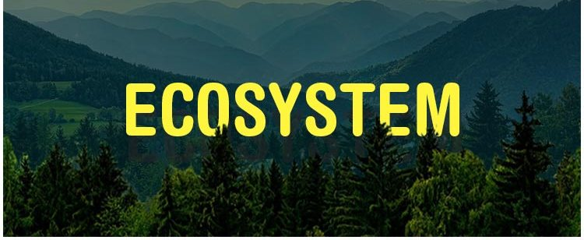

Slide 8
What is an Ecosystem?
The ecosystem is the structural and functional unit of ecology where the living organisms interact with each other and the surrounding environment.
In other words, an ecosystem is a chain of interaction between organisms and their environment. The term “Ecosystem” was first coined by A.G.Tansley, an English botanist, in 1935.
Ecology: Ecology is the study of how organisms interact with one another and with their physical environment.
Ecological balance is a term used to describe the equilibrium between living organisms such as human being, plants, and animals as well as their environment.

Slide 9
STRUCTURE OF THE ECOSYSTEM
The structure of an ecosystem is characterized by the organization of both biotic and abiotic components. This includes the distribution of energy in our environment.
The structure of an ecosystem can be split into two main components, namely:
Biotic Components
Abiotic Components
The biotic and abiotic components are interrelated in an ecosystem. It is an open system where the energy and components can flow throughout the boundaries

Slide 10
Biotic components refer to all life in an ecosystem. Based on nutrition, biotic components can be categorised into autotrophs, heterotrophs and saprotrophs (or decomposers)
On the basis of their role in the ecosystem the biotic components can be classified into three main groups:
(A) Producers
(B) Consumers
(C) Decomposers or Reducers
Producers include all autotrophs such as plants. They are called autotrophs as they can produce food through the process of photosynthesis

Slide 11
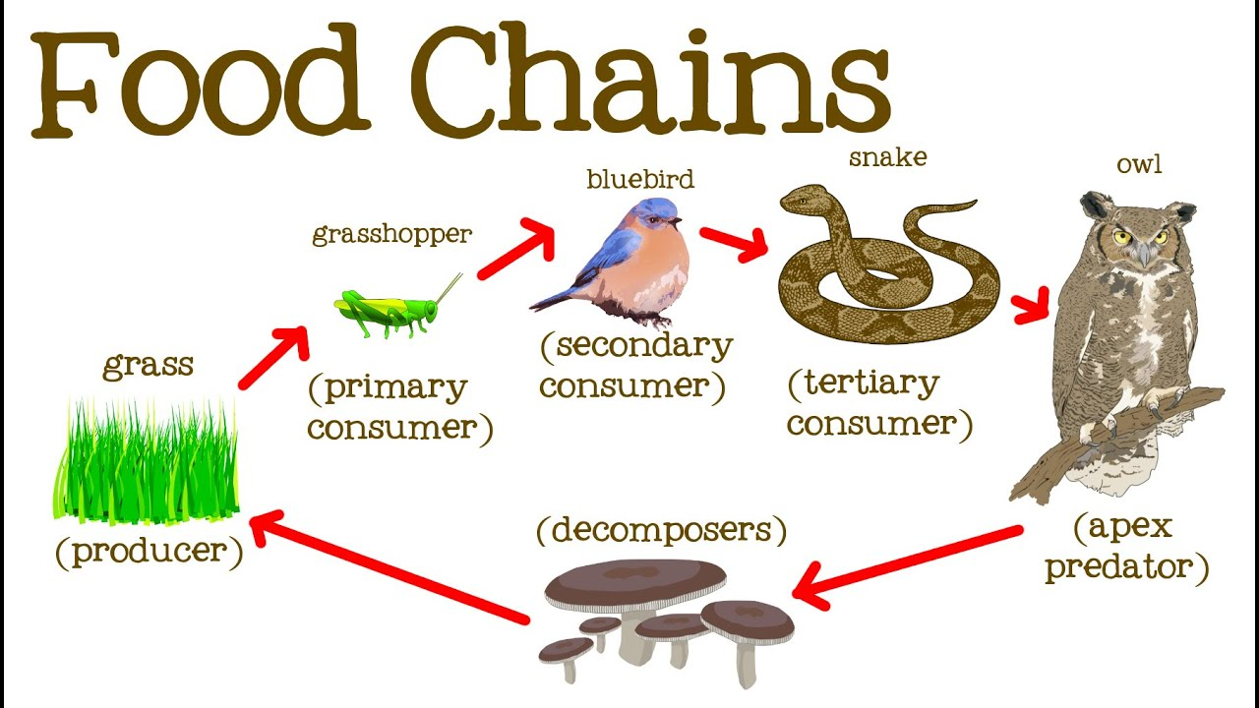

Slide 12
Consumers or heterotrophs are organisms that depend on other organisms for food. Consumers are further classified into primary consumers, secondary consumers and tertiary consumers.
Primary consumers are always herbivores that they rely on producers for food.
Secondary consumers depend on primary consumers for energy. They can either be a carnivore or an omnivore.
Tertiary consumers are organisms that depend on secondary consumers for food. Tertiary consumers can also be an omnivore.
Quaternary consumers are present in some food chains. These organisms prey on tertiary consumers for energy. Furthermore, they are usually at the top of a food chain as they have no natural predators.

Slide 13
Decomposers include saprophytes such as fungi and bacteria. They directly thrive on the dead and decaying organic matter. Decomposers are essential for the ecosystem as they help in recycling nutrients to be reused by plants.
Abiotic Components
Abiotic components are the non-living component of an ecosystem. It includes air, water, soil, minerals, sunlight, temperature, nutrients, wind, altitude, turbidity, etc.

Slide 14
Functions of Ecosystem
The functions of the ecosystem are as follows:
  It regulates the essential ecological processes, supports life systems and renders stability.
  It is also responsible for the cycling of nutrients between biotic and abiotic components.
  It maintains a balance among the various trophic levels in the ecosystem.
  It cycles the minerals through the biosphere.
  The abiotic components help in the synthesis of organic components that involves the exchange of energy

Slide 15

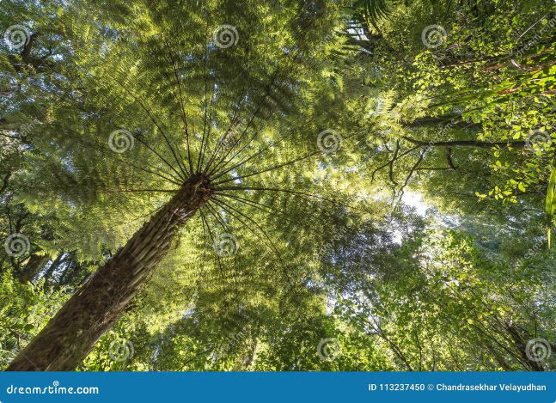
Ecosystems: Exploring Our Living World
Ecosystems are intricate networks of living organisms and their physical environment. They encompass a wide array of habitats, from lush forests and scorching deserts to tranquil wetlands and vast oceans. These complex systems are interconnected, with each component playing a vital role in maintaining the delicate balance of life on Earth. Exploring the structure and function of ecosystems allows us to gain a deeper understanding of the intricate relationships between living organisms and their surrounding environment. We can learn about the processes that drive these systems, the challenges they face, and the crucial role they play in sustaining life.

Slide 16
Forest Ecosystem: Structure and Function
Structure
Function
Threats
Forests are complex ecosystems characterized by a layered structure. The canopy layer, the uppermost layer, receives the most sunlight and houses a diverse array of trees, such as towering oak, maple, and pine trees. The understory, below the canopy, provides a shaded environment for shrubs, ferns, and smaller trees. The forest floor is home to a rich community of decomposers, such as fungi and bacteria, which play a vital role in nutrient cycling.
Forests provide numerous ecological services. They act as carbon sinks, absorbing carbon dioxide from the atmosphere and mitigating climate change. They regulate water cycles, filtering water and preventing soil erosion. Forests are also important habitats for countless species, providing food, shelter, and breeding grounds.
Forest ecosystems face various threats, including deforestation, habitat fragmentation, and climate change. These factors disrupt the intricate balance of the forest ecosystem, leading to biodiversity loss, soil degradation, and increased risk of wildfires.

Slide 17
Desert Ecosystem: Structure and Function
Structure
Function
Threats
Deserts are characterized by extreme aridity, with low rainfall and high temperatures. The sparse vegetation is adapted to conserve water, with plants like cacti, succulents, and shrubs having deep roots, thick cuticles, and reduced leaf surfaces. Animal life is also adapted to the harsh conditions, with nocturnal activity, burrowing, and water conservation strategies prevalent.
Desert ecosystems, despite their harsh conditions, play vital roles in the global ecosystem. They regulate water cycles, providing valuable ground water resources. They provide habitats for specialized flora and fauna, contributing to biodiversity. Deserts also play a role in carbon storage and climate regulation.
Desert ecosystems face a variety of threats, including desertification, caused by human activities like overgrazing, unsustainable agriculture, and climate change. These threats disrupt the delicate balance of the desert ecosystem, leading to biodiversity loss, soil degradation, and increased vulnerability to extreme weather events.

Slide 18

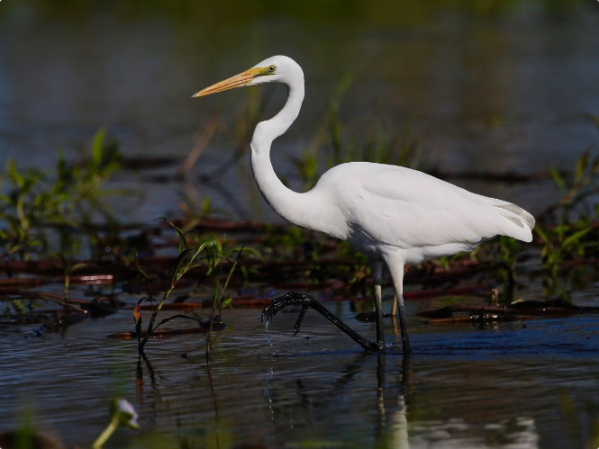
Wetlands Ecosystem: Structure and Function
1
Biodiversity Hotspot
2
Water Filtration and Regulation
Wetlands are incredibly diverse ecosystems, supporting a wide array of plant and animal life. They provide habitats for various species of birds, amphibians, reptiles, fish, and invertebrates.
Wetlands play a crucial role in regulating water cycles and filtering pollutants. They act as natural sponges, absorbing excess water and releasing it gradually, preventing flooding. They also filter pollutants, improving water quality and protecting downstream ecosystems.
3
Carbon Sequestration
4
Threats
Wetlands are highly effective at sequestering carbon, storing large amounts of carbon in their soils and vegetation. This contributes to climate change mitigation and helps regulate the global carbon cycle.
Wetlands are facing significant threats from human activities, including drainage, pollution, and habitat destruction. These threats disrupt the delicate balance of the wetland ecosystem, leading to biodiversity loss, water quality degradation, and reduced carbon sequestration capacity.

Slide 19

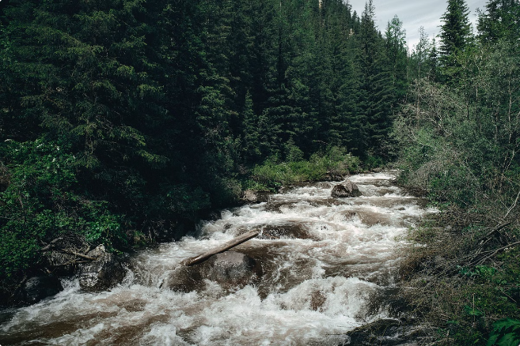
River Ecosystem: Structure and Function
1
Source
Rivers begin at their source, which can be springs, glaciers, or lakes. The water is typically cold, clear, and oxygen-rich, supporting specific aquatic life like trout and other cold-water fish.
2
Mid-Course
As the river flows downstream, it widens and becomes warmer, with increased sediment and nutrients. The river supports a diverse range of aquatic life, including bass, catfish, and amphibians.
3
Mouth
The river's mouth where it meets the ocean or a lake is characterized by a slower flow, higher nutrient levels, and a wider variety of aquatic life, including shellfish, crabs, and migratory fish.

Slide 20

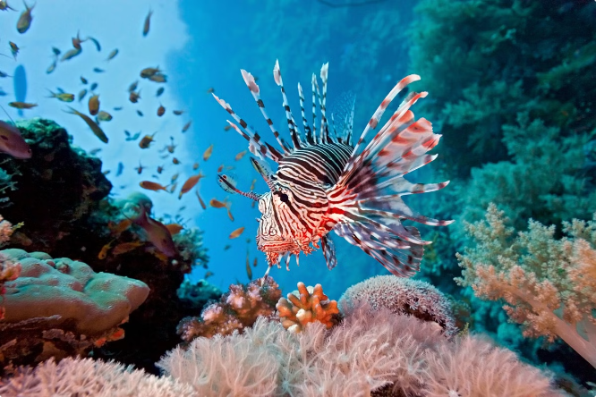
Oceanic Ecosystem: Structure and Function
Sunlight Zone
Twilight Zone
The sunlit upper layer of the ocean, also known as the epipelagic zone, is home to a wide diversity of marine life, including phytoplankton, zooplankton, fish, and marine mammals. This zone is characterized by high levels of sunlight, oxygen, and nutrients, making it the most productive region of the ocean.
The mesopelagic zone, also known as the twilight zone, is a dimly lit region that extends from 200 meters to 1000 meters below the surface. This zone is characterized by reduced sunlight, colder temperatures, and a unique community of organisms adapted to low light conditions, including bioluminescent fish and squid.
Midnight Zone
Abyssal Zone
The bathypelagic zone, or the midnight zone, is a dark and cold region that extends from 1000 meters to 4000 meters below the surface. This zone is characterized by extreme pressure, low oxygen levels, and a sparse community of organisms adapted to these harsh conditions.
The abyssal zone, the deepest part of the ocean, extends from 4000 meters to the ocean floor. This zone is characterized by constant darkness, extreme pressure, and low temperatures. It supports a diverse community of organisms adapted to these extreme conditions, including deep-sea fish, invertebrates, and bacteria.

Slide 21

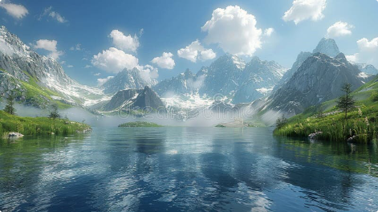



Lake Ecosystem: Structure and Function
Littoral Zone
Limnetic Zone
Profundal Zone
The shallow, near-shore area of a lake, characterized by sunlight penetration, abundant plant life, and a diverse range of organisms, including insects, amphibians, and fish.
The open water area of a lake, characterized by sunlight penetration and a high concentration of phytoplankton, zooplankton, and fish.
The deep water area of a lake, characterized by low light penetration, low oxygen levels, and a sparse community of organisms adapted to these conditions, such as bottom-dwelling invertebrates and fish.

Slide 22

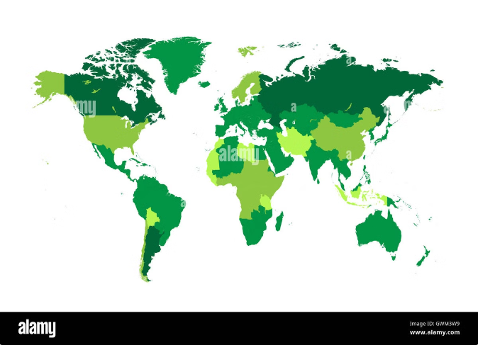
Sustainability and the 17 SDGs: History and Targets
Year
Event
Description
1972
United Nations Conference on the Human Environment (Stockholm)
First major international conference to focus on environmental issues. Led to the establishment of the United Nations Environment Programme (UNEP).
1987
Publication of the Brundtland Report (Our Common Future)
Introduced the concept of sustainable development as "development that meets the needs of the present without compromising the ability of future generations to meet their own needs."
2000
Adoption of the Millennium Development Goals (MDGs)
Established eight goals to address poverty, hunger, disease, illiteracy, environmental degradation, and other global challenges.
2015
Adoption of the Sustainable Development Goals (SDGs)
Established 17 goals to achieve a more sustainable future for all. These goals address a wide range of issues, including poverty, hunger, health, education, inequality, climate change, and conservation.

Slide 23
No Poverty – Eradicate extreme poverty.
Zero Hunger – End hunger, achieve food security.
Good Health & Well-being – Ensure healthy lives.
Quality Education – Inclusive and equitable education.
Gender Equality – Achieve equality for all.
Clean Water & Sanitation – Universal access to safe water.
Affordable & Clean Energy – Sustainable energy for all.
Decent Work & Economic Growth – Promote sustainable economic growth.
Industry, Innovation & Infrastructure – Build resilient infrastructure.
Reduced Inequalities – Reduce inequality within and among countries.
Sustainable Cities & Communities – Make cities inclusive and safe.
Responsible Consumption & Production – Sustainable resource use.
Climate Action – Combat climate change.
Life Below Water – Conserve marine ecosystems.
Life on Land – Protect terrestrial ecosystems.
Peace, Justice & Strong Institutions – Promote just societies.
Partnerships for the Goals – Strengthen global partnerships.

Slide 24






Implementing the 17 SDGs
Global Partnerships
Sustainable Investment
Successful implementation of the SDGs requires collaboration between governments, businesses, civil society, and individuals. This includes sharing knowledge, resources, and technologies to achieve common goals.
Financing sustainable development is crucial to achieving the SDGs. This requires shifting investments toward sustainable projects, promoting green technologies, and fostering responsible financial practices.
Strong Policies
Education and Awareness
Governments play a critical role in implementing the SDGs by developing and enforcing policies that promote sustainable practices, protect the environment, and address social inequalities.
Raising awareness about the SDGs and promoting education on sustainable development are essential for building public support and fostering individual action toward a more sustainable future.

Slide 25


Capacity Development for Sustainable Ecosystems
1
Education and Training
2
Research and Innovation
Investing in education and training programs focused on sustainable ecosystem management is crucial for equipping individuals with the knowledge, skills, and attitudes needed to protect and restore ecosystems.
Investing in research and innovation is essential for developing new technologies, techniques, and approaches to sustainable ecosystem management, including conservation, restoration, and climate change adaptation.
3
Community Engagement
4
Policy and Governance
Engaging local communities in ecosystem management is critical for ensuring sustainable practices, fostering a sense of ownership, and promoting effective conservation efforts.
Developing and implementing sound policies and governance frameworks is essential for creating the enabling environment for sustainable ecosystem management, including land-use planning, pollution control, and resource management.

