Slide 1





NoSQL Databases - BCD515C
Prepared By,
J N Karthik
CSE-Data Science
ATME College of Engineering, Mysuru
ATME College of Engineering, Mysuru
Department of CSE-DS, ATMECE

Slide 2
Syllabus
Module-1:
Why NoSQL : The Value of Relational Databases, Getting at Persistent Data, Concurrency, Integration, A (Mostly) Standard Model, Impedance Mismatch, Application and Integration Databases, Attack of the Clusters, The Emergence of NoSQL
Aggregate Data Models: Aggregates, Example of Relations and Aggregates, Consequences of Aggregate Orientation, Summarizing Aggregate-Oriented Databases. More Details on Data Models: Relationships, Graph Databases, Schema less Databases, Materialized Views,
Module-2:
Distribution Models: Single Server, Sharding, Master-Slave Replication, Peer-to-Peer Replication, Combining Sharding and Replication. Consistency: Update Consistency, Read Consistency, Relaxing Consistency, The CAP Theorem.
Version Stamps: Business and System Transactions, Version Stamps on Multiple Nodes.
Text Book 1: Chapter : 4, 5, 6
Module-3:
Map-Reduce: Basic Map-Reduce, Partitioning and Combining, Composing Map-Reduce Calculations, A Two Stage Map-Reduce Example, Incremental Map- Reduce Key-Value Databases: What Is a Key-Value Store, Key-Value Store Features: Consistency, Transactions, Query Features, Structure of Data, Scaling, Suitable Use Cases: Storing Session Information, User Profiles, Preference, Shopping Cart Data, When Not to Use: Relationships among Data, Multioperation Transactions, Query by Data, Operations by Sets.
Text Book 1: Chapter : 7, 8
Module-4:
Document Databases: What Is a Document Database? Features: Consistency, Transactions, Availability, Query Features, Scaling, Suitable Use Cases: Event Logging, Content Management Systems, Blogging Platforms, Web Analytics or Real-Time Analytics, ECommerce Applications, When Not to Use: Complex Transactions Spanning Different Operations, Queries against Varying Aggregate Structure
Text Book 1: Chapter : 9
Module-5
Graph Databases: What Is a Graph Database? Features, Consistency, Transactions, Availability, Query Features, Scaling, Suitable Use Cases: Connected Data, Routing, Dispatch, and Location-Based Services, Recommendation Engines, When Not to Use.
Text Book 1: Chapter : 11
ATME College of Engineering, Mysuru
Department of CSE-DS, ATMECE

Slide 3
Module 1-Why NoSQL?
Topics
1. The Value of Relational Databases
2. Getting at Persistent Data
3. Concurrency, Integration, A (Mostly) Standard Model
4. Impedance Mismatch
5. Application and Integration Databases
6. Attack of the Clusters
7. The Emergence of NoSQL
ATME College of Engineering, Mysuru
Department of CSE-DS, ATMECE

Slide 4
Module 1-Why NoSQL?
Topic 1: The Value of Relational Databases
Relational databases are used so often in computing that we sometimes forget how important they are. With the rise of NoSQL and new data systems, it's important to remember the key benefits that relational databases still provide.
Why Relational Databases Still Matter?
✔ Proven Reliability: Trusted for decades in mission-critical systems.
✔ Robust Data Integrity: Ensures valid and consistent data through constraints.
✔ ACID Transactions: Guarantees atomicity, consistency, isolation, and durability.
✔ SQL Standard: Declarative and powerful querying language.
✔ Structured Modeling: Supports normalization and relationship mapping.
✔ Mature Tooling: Enterprise-ready with extensive ecosystem.
ATME College of Engineering, Mysuru
Department of CSE-DS, ATMECE

Slide 5
Module 1-Why NoSQL?
Topic 2: Getting at Persistent Data
Probably the most obvious value of a database is keeping large amounts of persistent data.
Most computer architectures have the notion of two areas of memory: a fast volatile “main memory” and a larger but slower “backing store.”
Main memory is both limited in space and loses all data when you lose power or something bad happens to the operating system.
Therefore, to keep data around, we write it to a backing store, commonly seen a disk (although these days that disk can be persistent memory).
ATME College of Engineering, Mysuru
Department of CSE-DS, ATMECE

Slide 6
Module 1-Why NoSQL?
The backing store (like a hard drive or SSD) can be organized in different ways.
For simple programs, like word processors, the data is usually saved as a file in the computer’s file system.
But for larger and more complex applications—like those used in businesses (enterprise applications)—the data is usually stored in a database instead of just files.
This is because a database is more powerful. It lets you store lots of data in an organized way and helps the program quickly find and use small pieces of that data when needed.
ATME College of Engineering, Mysuru
Department of CSE-DS, ATMECE

Slide 7
Module 1-Why NoSQL?
Topic 3: Concurrency
Enterprise applications tend to have many people looking at the same body of data at once,
possibly modifying that data.
Most of the time they are working on different areas of that data, but occasionally they operate
on the same bit of data. As a result, we have to worry about coordinating these interactions to
avoid such things as double booking of hotel rooms.
Concurrency is notoriously difficult to get right, with all sorts of errors that can trap even the
most careful programmers. Since enterprise applications can have lots of users and other systems
all working concurrently, there’s a lot of room for bad things to happen. Relational databases
help handle this by controlling all access to their data through transactions.
ATME College of Engineering, Mysuru
Department of CSE-DS, ATMECE

Slide 8
Module 1-Why NoSQL?
Integration
Enterprise applications live in a rich ecosystem that requires multiple applications, written by
different teams, to collaborate in order to get things done.
This kind of inter-application collaboration is awkward because it means pushing the human organizational boundaries. Applications often need to use the same data and updates made through one application have to be visible to others.
A common way to do this is shared database integration where multiple applications store their
data in a single database.
Using a single database allows all the applications to use each others’ data easily, while the database’s concurrency control handles multiple applications in the same way as it handles multiple users in a single application.
ATME College of Engineering, Mysuru
Department of CSE-DS, ATMECE

Slide 9
Module 1-Why NoSQL?
Integration
Enterprise applications live in a rich ecosystem that requires multiple applications, written by
different teams, to collaborate in order to get things done.
This kind of inter-application collaboration is awkward because it means pushing the human organizational boundaries. Applications often need to use the same data and updates made through one application have to be visible to others.
A common way to do this is shared database integration where multiple applications store their
data in a single database.
Using a single database allows all the applications to use each others’ data easily, while the database’s concurrency control handles multiple applications in the same way as it handles multiple users in a single application.
ATME College of Engineering, Mysuru
Department of CSE-DS, ATMECE

Slide 10
Module 1-Why NoSQL?
A (MOSTLY) STANDARD MODEL
Relational databases have succeeded because they provide the core benefits we outlined earlier
in a (mostly) standard way.
As a result, developers and database professionals can learn the basic relational model and
apply it in many projects.
Although there are differences between different relational databases, the core mechanisms
remain the same: Different vendors’ SQL dialects are similar, transactions operate in mostly the same way.
ATME College of Engineering, Mysuru
Department of CSE-DS, ATMECE

Slide 11
Module 1-Why NoSQL?
Topic 4: Impedance Mismatch
Relational databases provide many advantages, but they are by no means perfect.
For application developers, the biggest problem has been what’s commonly called the impedance mismatch:
The difference between the relational model and the in-memory data structures.
The relational data model organizes data into a structure of tables and rows, or more properly, relations and tuples. In the relational model, a tuple is a set of name-value pairs and a relation is a set of tuples.
All operations in SQL consume and return relations, which leads to the mathematically elegant relational algebra.
ATME College of Engineering, Mysuru
Department of CSE-DS, ATMECE

Slide 12
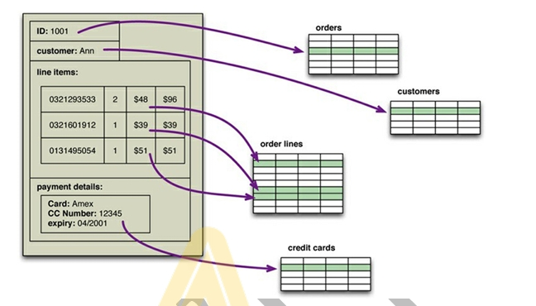
Module 1-Why NoSQL?
Fig: An order, which looks like a single aggregate structure in the UI, is split into many rows from many tables in a relational database
ATME College of Engineering, Mysuru
Department of CSE-DS, ATMECE

Slide 13
Module 1-Why NoSQL?
The impedance mismatch is a major source of frustration to application developers, and in the 1990s many people believed that it would lead to relational databases being replaced with databases that replicate the in-memory data structures to disk.
That decade was marked with the growth of object-oriented programming languages, and with them came object-oriented databases—both looking to be the dominant environment for software development in the new millennium.
However, while object-oriented languages succeeded in becoming the major force in programming, object-oriented databases faded into obscurity. Relational databases saw off the challenge by stressing their role as an integration mechanism, supported by a mostly standard language of data manipulation (SQL) and a growing professional divide between application developers and database administrators.
ATME College of Engineering, Mysuru
Department of CSE-DS, ATMECE

Slide 14
Module 1-Why NoSQL?
Topic 5: Application and Integration Databases
The exact reasons why relational databases triumphed over OO databases are still the subject of an occasional pub debate for developers of a certain age. But in our view, the primary factor was the role of SQL as an integration mechanism between applications.
In this scenario, the database acts as an integration database—with multiple applications, usually developed by separate teams, storing their data in a common database.
This improves communication because all the applications are operating on a consistent set of persistent data.
There are downsides to shared database integration. A structure that’s designed to integrate many applications ends up being more complex—indeed, often dramatically more complex—than any single application needs.
Furthermore, should an application want to make changes to its data storage, it needs to coordinate with all the other applications using the database.
ATME College of Engineering, Mysuru
Department of CSE-DS, ATMECE

Slide 15
Module 1-Why NoSQL?
Different applications have different structural and performance needs, so an index required by one application may cause a problematic hit on inserts for another.
The fact that each application is usually a separate team also means that the database usually cannot trust applications to update the data in a way that preserves database integrity and thus needs to take responsibility for that within the database itself.
A different approach is to treat your database as an application database—which is only directly accessed by a single application codebase that’s looked after by a single team.
With an application database, only the team using the application needs to know about the database structure, which makes it much easier to maintain and evolve the schema.
Since the application team controls both the database and the application code, the responsibility for database integrity can be put in the application code.
ATME College of Engineering, Mysuru
Department of CSE-DS, ATMECE

Slide 16
Module 1-Why NoSQL?
Topic 6: Attack of the Clusters
In 2000 several large web properties increases in large scale.
This increase in scale was happening along many dimensions.
Websites started tracking activity and structure in a very detailed way.
Large sets of data appeared: links, social networks, activity in logs, mapping data.
With this growth in data came a growth in users—as the biggest websites grew to be vast estates regularly serving huge numbers of visitors.
Coping with the increase in data and traffic required more computing resources.
To handle this kind of increase, two choices: up or out.
Scaling up implies bigger machines, more processors, disk storage, and memory. But bigger machines get more and more expensive, not to mention that there are real limits as your size increases.
The alternative is to use lots of small machines in a cluster.
A cluster of small machines can use commodity hardware and ends up being cheaper at these kinds of scales.
It can also be more resilient—while individual machine failures are common, the overall cluster can be built to keep going despite such failures, providing high reliability
ATME College of Engineering, Mysuru
Department of CSE-DS, ATMECE

Slide 17
Module 1-Why NoSQL?
As large properties moved towards clusters, that revealed a new problem relational databases are not designed to be run on clusters.
Clustered relational databases, such as the Oracle RAC or Microsoft SQL Server, work on the concept of a shared disk subsystem.
They use a cluster-aware file system that writes to a highly available disk subsystem—but this means the cluster still has the disk subsystem as a single point of failure. Relational databases could also be run as separate servers for different sets of data, effectively sharding the database.
While this separates the load, all the sharding has to be controlled by the application which has to keep track of which database server to talk to for each bit of data. Also, we lose any querying, referential integrity, transactions, or consistency controls that cross shards.
ATME College of Engineering, Mysuru
Department of CSE-DS, ATMECE

Slide 18
Module 1-Why NoSQL?
Topic 7: The Emergence of NoSQL
The term “NoSQL” first made its appearance in the late 90s as the name of an open source relational database Strozzi NoSQL]. Led by Carlo Strozzi , this database stores its tables as ASCII files, each tuple represented by a line with fields separated by tabs.
The name comes from the fact that the database doesn’t use SQL as a query language. Instead, the database is manipulated through shell scripts that can be combined into the usual UNIX pipelines. Other than the terminological coincidence, Strozzi’s NoSQL had no influence on the databases.
The usage of “NoSQL” that we recognize today traces back to a meetup on June 11, 2009 in San Francisco organized by Johan Oskarsson, a software developer based in London. The example of BigTable and Dynamo had inspired a bunch of projects experimenting with alternative data storage, and discussions of these had become a feature of the better software conferences around that time.
ATME College of Engineering, Mysuru
Department of CSE-DS, ATMECE

Slide 19
Module 1-Why NoSQL?
Johan wanted a name for the meetup—something that would make a good Twitter hashtag: short, memorable, and without too many Google hits so that a search on the name would quickly find the meetup.
He asked for suggestions on the #cassandra IRC channel and got a few, selecting the suggestion of “NoSQL” from Eric Evans (a developer at Rackspace, no connection to the DDD Eric Evans). While it had the disadvantage of being negative and not really describing these systems, it did fit the hashtag criteria. At the time they were thinking of only naming a single meeting and were not expecting it to catch on to name this entire technology trend [Oskarsson].
The term “NoSQL” caught on like wildfire, but it’s never been a term that’s had much in the way of a strong definition. The original call [NoSQL Meetup] for the meetup asked for “open-source, distributed, nonrelational databases.”
ATME College of Engineering, Mysuru
Department of CSE-DS, ATMECE

Slide 20
Module 1-Why NoSQL?
To begin with, there is the obvious point that NoSQL databases don’t use SQL. Some of them do have query languages, and it makes sense for them to be similar to SQL in order to make them easier to learn.
To begin with, there is the obvious point that NoSQL databases don’t use SQL.
Some of them do have query languages, and it makes sense for them to be similar to SQL in order to make them easier to learn. Cassandra’s CQL is like this—“exactly like SQL (except where it’s not)” [CQL].
But so far none have implemented anything that would fit even the rather flexible notion of standard SQL.
Another important characteristic of these databases is that they are generally open-source projects.
Most NoSQL databases are driven by the need to run on clusters, and this is certainly true of those that were talked about during the initial meetup. This has an effect on their data model as well as their approach to consistency. Relational databases use ACID transactions (p. 19) to handle consistency across the whole database. This inherently clashes with a cluster environment, so NoSQL databases offer a range of options for consistency and distribution.
ATME College of Engineering, Mysuru
Department of CSE-DS, ATMECE

Slide 21
Module 1-Why NoSQL?
Databases are one style of NoSQL databases that uses a distribution model similar to relational databases but offers a different data model that makes it better at handling data with complex relationships.
NoSQL databases are generally based on the needs of the early 21st century web estates, so usually only systems developed during that time frame are called NoSQL.
NoSQL databases operate without a schema, allowing you to freely add fields to database records without having to define any changes in structure first.
This is particularly useful when dealing with nonuniform data and custom fields which forced relational databases to use names like customField6.
All of the above are common characteristics of things that we see described as NoSQL databases. None of these are definitional, and indeed it’s likely that there will never be a coherent definition of “NoSQL”
ATME College of Engineering, Mysuru
Department of CSE-DS, ATMECE

Slide 22
Module 1- Why NoSQL?
When you first hear “NoSQL,” an immediate question is what does it stand for—a “no” to SQL? Most people who talk about NoSQL say that it really means “Not Only SQL,” but this interpretation has a couple of problems.
Most people write “NoSQL” whereas “Not Only SQL” would be written “NOSQL.” Also, there wouldn’t be much point in calling something a NoSQL database under the “not only” meaning—because then, Oracle or Postgres would fit that definition, we would prove that black equals white and would all get run over on crosswalks.
The “not-only” interpretation does have its value, as it describes the ecosystem that many people think is the future of databases. This is in fact what we consider to be the most important contribution of this way of thinking—it’s better to think of NoSQL as a movement rather than a technology.
We don’t think that relational databases are going away—they are still going to be the most common form of database in use. Even though we’ve written this book, we still recommend relational databases.
The change is that now we see relational databases as one option for data storage. This point of view is often referred to as polyglot persistence—using different data stores in different circumstances.
ATME College of Engineering, Mysuru
Department of CSE-DS, ATMECE

Slide 23
Module 1- Why NoSQL?
Instead of just picking a relational database because everyone does, we need to understand the nature of the data we’re storing and how we want to manipulate it.
The result is that most organizations will have a mix of data storage technologies for different circumstances.
In our account of the history of NoSQL development, we’ve concentrated on big data running on clusters. While we think this is the key thing that drove the opening up of the database world, it isn’t the only reason we see project teams considering NoSQL databases.
An equally important reason is the old frustration with the impedance mismatch problem. The big data concerns have created an opportunity for people to think freshly about their data storage needs, and some development teams see that using a NoSQL database can help their productivity by simplifying their database access even if they have no need to scale beyond a single machine.
There are two primary reasons for considering NoSQL. One is to handle data access with sizes and performance that demand a cluster; the other is to improve the productivity of application development by using a more convenient data interaction style.
ATME College of Engineering, Mysuru
Department of CSE-DS, ATMECE

Slide 24
Module 1- Aggregate data models
Topic 1: Aggregates
Aggregate Data Model:​
A data model is a way to organize and manage data in a database. It helps users understand how they can interact with the data.​
Relational Data Model: The most common data model used over the years is relational, which organizes data into tables (like a spreadsheet). Each table has rows (entities like customers or orders) and columns (attributes like name, price, etc.). Tables can be linked through relationships (e.g., a product maybe long to an order).​
NoSQL Data Models: NoSQL databases move away from this table structure. Instead, they use different ways to organize data, which fall into four categories:​
Key-Value​
Document​
Column-Family​
Graph​
Three of these models (key-value, document, and column-family) focus on what’s called aggregate orientation, meaning they group data together in larger chunks or “aggregates” that are stored and retrieved as a unit.
ATME College of Engineering, Mysuru
Department of CSE-DS, ATMECE

Slide 25
Module 1- Aggregate data models
Topic 1: Aggregates
In relational databases (SQL), data is stored in rows (tuples), which are very simple and don’t allow more complex structures, such as nesting data or including lists of values. This simplicity makes relational databases efficient for specific operations but limits flexibility.
Aggregates in NoSQL Databases:​
Aggregate orientation in NoSQL databases allows you to store more complex records (collections of related data) as a single unit, which is called an aggregate. Instead of dividing data into rows, NoSQL databases(like key-value, document, and column-family databases) treat an aggregate as a group of related data that is processed and stored together.​
Aggregate: A collection of related data (objects, lists, records) treated as one unit, often used for performing tasks like updates or queries in a single operation.​
ATME College of Engineering, Mysuru
Department of CSE-DS, ATMECE

Slide 26
Module 1- Aggregate data models
Relational Model:​
Tuples (Rows): Data is divided into tuples, which are rows in a table.​
Limited Structure: Tuples capture a set of values, and you cannot nest one tuple inside another.​
Simplicity: The simplicity of tuples allows all operations to work on and return tuples.​
Aggregate Orientation:​
Complex Structure: Data is viewed as more complex than simple rows (tuples),allowing lists and nested records.​
Aggregates: A term used for a complex record structure that includes related objects.​
Uses: Key-value, document, and column-family databases use these aggregates.​
Atomic Operations: Aggregates allow easier atomic updates (one change at a time).​
Cluster-Friendly: Aggregates help with data replication and sharding across a cluster.​
Programmer-Friendly: Application developers find it easier to manipulate data using aggregates.​
ATME College of Engineering, Mysuru
Department of CSE-DS, ATMECE

Slide 27
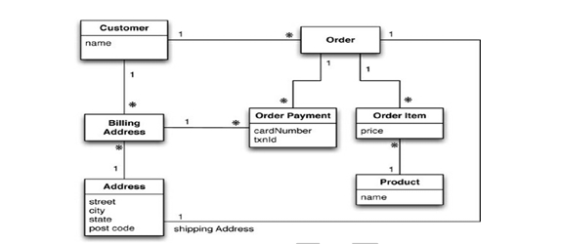
Module 1- Aggregate data models
Relational Data Model :​
In a relational database, data is stored in separate tables.​
Think of it like storing customers in one table and orders in another table. To connect them, you use a key (like a customer ID) to show which customer placed which order.​
Example:​
Customer Table:​
ID: 1, Name: Martin​
Order Table:​
Order ID: 99, Customer ID: 1, Product: "NoSQL Distilled", Price: $32.45​
The tables are linked using the Customer ID. When you need to get details about an order, you have to join these tables based on the Customer ID.​
ATME College of Engineering, Mysuru
Department of CSE-DS, ATMECE

Slide 28
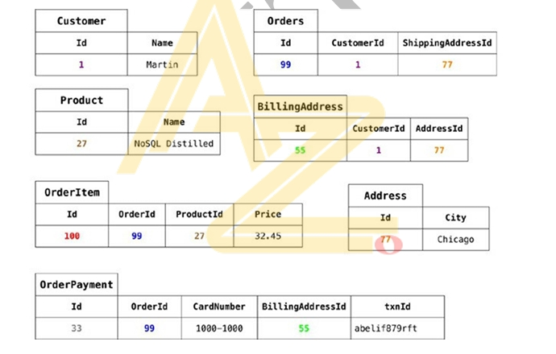
Module 1- Aggregate data models
ATME College of Engineering, Mysuru
Department of CSE-DS, ATMECE

Slide 29
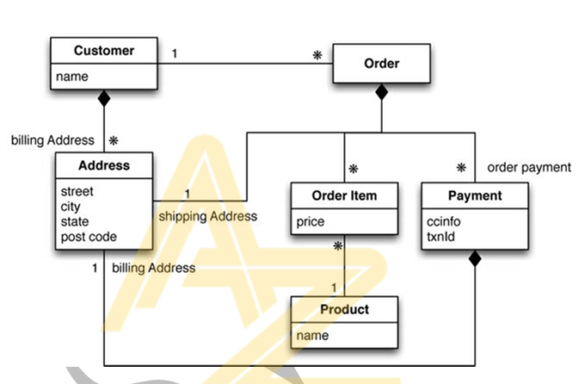
Module 1- Aggregate data models
Aggregate Data Model:​
In a NoSQL database, data is stored as aggregates, meaning all related data is bundled together in one place, often as a single document.​
Instead of having separate tables for customers and orders, you store all customer information and their orders in one place.​
ATME College of Engineering, Mysuru
Department of CSE-DS, ATMECE

Slide 30
Module 1- Aggregate data models
// in customers
{ "id":1,
"name":"Martin", "billingAddress":[{"city":"Chicago"}]
}
// in orders {
"id":99,
"customerId":1, "orderItems":[
{ "productId":27,
"price": 32.45,
"productName": "NoSQL Distilled"
}
],
"shippingAddress":[{"city":"Chicago"}] "orderPayment":[
{
"ccinfo":"1000-1000-1000-1000",
"txnId":"abelif879rft", "billingAddress": {"city": "Chicago"}
}
],
}
ATME College of Engineering, Mysuru
Department of CSE-DS, ATMECE

Slide 31
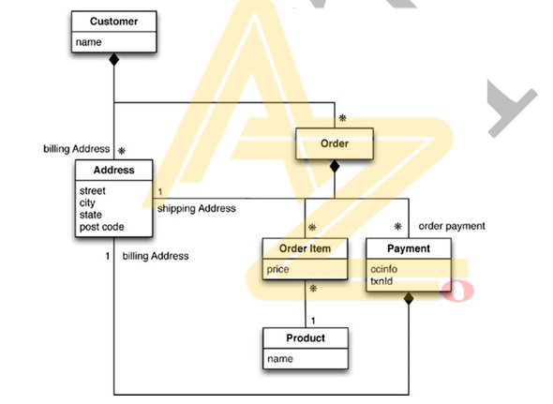
Module 1- Aggregate data models
// in customers
{
"customer": { "id": 1,
"name": "Martin",
"billingAddress": [{"city": "Chicago"}],"orders":[ {
"id":99,
"customerId":1, "orderItems":[
{
"productId":27,
"price": 32.45,
"productName": "NoSQL Distilled“
}
],
"shippingAddress":[{"city":"Chicago"}]"orderPayment"[
{
"ccinfo":"1000-1000-1000-1000",
"txnId":"abelif879rft", "billingAddress": {"city": "Chicago"}
}], }] } }
Fig: Embed all the objects for customer and the customer’s orders
ATME College of Engineering, Mysuru
Department of CSE-DS, ATMECE

Slide 32
Module 1- Aggregate data models
Consequences of Aggregate Orientation
Relational Model:​
Relational databases store data without considering aggregates (groups of related data).​
Relationships are expressed through foreign keys, but these do not distinguish between aggregations and other relationships.​
Aggregate Ignorance:​
Relational databases and some NoSQL databases (like graph databases) are aggregate-ignorant.​
This means they don't treat aggregates (e.g., an order with items, shipping, and payment) as a single unit.​
Aggregate-Oriented Databases:​
Aggregate-oriented databases focus on how data is used in applications. They allow us to work with data units (e.g., an order) that are easier to manipulate as a whole.​
Cluster Efficiency:​
Aggregates are helpful when running databases on clusters (multiple servers). By grouping related data together (e.g., an entire order), we minimize the number of nodes (servers) we need to query.​
ATME College of Engineering, Mysuru
Department of CSE-DS, ATMECE

Slide 33
Module 1- Aggregate data models
Key-Value Database
Storage​
In a key-value database, data is stored as pairs of elements: a key and a value. The key acts as a unique identifier for the data, while the value represents the actual data itself. This is similar to a dictionary, where each word (key) has a corresponding definition (value).​
Access​
To retrieve data from a key-value database, you simply provide the key. The database then immediately returns the associated value. This makes it very fast and efficient for accessing specific pieces of data.​
Structure​
There's no predefined structure for the values in a key-value database. This means you can store any type of data, including text, numbers, images, or even complex objects. The database doesn't impose any restrictions on the format or content of the values.​
Flexibility​
Key-value databases are highly flexible due to the lack of a predefined structure. You can store any type of data in any format, making them suitable for a wide range of applications.​
Querying​
Key-value databases have limited querying capabilities. You can only retrieve data by specifying the exact key. This means you can't search for data based on its content or properties, only by its unique identifier.​
Examples​
Common examples of key-value databases include Redis and Memcached. These databases are often used for caching, session management, and other applications where fast data access is essential.​
ATME College of Engineering, Mysuru
Department of CSE-DS, ATMECE

Slide 34
Module 1- Aggregate data models
Document Databases​
Storage​
In a document database, data is stored as documents. These documents are structured data units that resemble real-world documents, such as JSON or XML files. Each document contains a set of fields, where each field has a name and a value.​
Access​
To retrieve data from a document database, you use queries. These queries allow you to specify conditions based on the fields within the documents. For example, you can search for documents where a specific field matches a particular value.​
Structure​
Documents in a document database have a predefined structure. This means that the fields and their data types must conform to a specific template. This provides a more organized and predictable way to store and manage data.​
Flexibility​
While document databases are less flexible than key-value databases in terms of structure, they still offer a considerable amount of flexibility. You can define custom fields and data types to suit your specific needs, and you can modify the structure of documents over time.​
Querying​
Document databases have rich querying capabilities that allow you to perform complex searches. You can use various operators and functions to filter, sort, and aggregate data based on different criteria. This makes them well-suited for applications that require advanced data analysis and retrieval.​
Examples​
Common examples of document databases include MongoDB and CouchDB. These databases are often used for applications that deal with large amounts of semi-structured or unstructured data, such as web applications, content management systems, and IoT platforms.
ATME College of Engineering, Mysuru
Department of CSE-DS, ATMECE

Slide 35
Module 1- Aggregate data models
Column - Family​ Stores
Column Family databases organize data into groups of columns, making it easier to handle and access related pieces of information together.​
Key Points:​
Row Key: Each row has a unique ID (like a customer's ID).​
Column Families: The data is grouped into families, where each family contains related information. For example, one family could store a customer's profile details (like name and address), and another family could store their order history.​
Flexible Columns: Not all rows need to have the same columns. One customer might have more details or orders than another, so the structure is flexible.​
Simple Analogy:​
Imagine a file cabinet:​
Each drawer (row) has a label (key), like a customer’s name or ID.​
Inside each drawer, there are folders (column families), where one folder holds personal details, and another holds purchase history.​
Some drawers might have more folders than others, depending on how much information is stored about each customer.​
So, a column family organizes related data neatly, making it easy to access specific pieces of information when needed!​
​
ATME College of Engineering, Mysuru
Department of CSE-DS, ATMECE

Slide 36
Module 1- Aggregate data models
Definition: A column-family database organizes data into rows and columns, but it’s not like a traditional table in relational databases. Think of it as a two-level structure: each row has multiple columns grouped into "families."​
Row and Columns: Each row has a unique identifier (like a customer ID), and each row contains multiple columns. These columns are grouped into "column families," which represent related data.​
Column Family: A column family is a group of related columns, like a customer’s profile information(name, address, etc.) and order history (items purchased, dates, etc.). All columns in one family are usually accessed together.​
Flexible Structure: Unlike traditional databases, rows don’t need to have the same columns. For example, one row can have a customer’s name and address, while another row can have a customer’s name, address, and phone number.​
Wide and Skinny Rows:​
Wide Row: A row can have many columns, even thousands. This is used when we want to store a lot of related data for one row, like a customer’s entire order history.​
Skinny Row: A row with fewer columns, typically used when the data for each row is uniform, such as each row storing the same types of information.​
Nested Columns: In some column-family databases (like Cassandra), columns can be nested inside other columns (called super columns), allowing even more flexibility.​
Sorting: Column families can define a sort order for their columns, which helps when accessing data in a specific sequence, like retrieving orders by date.​
No Schema: There’s no fixed schema, meaning you can add new columns to a row at any time without predefined structure, but adding new column families is less frequent and more controlled.​
Common Use: These databases are good for situations where we need to store large amounts of data that can be grouped, such as user profiles, orders, logs, etc.​
Examples: Google Big Table, HBase, and Cassandra are popular examples of column-family databases.​
ATME College of Engineering, Mysuru
Department of CSE-DS, ATMECE

Slide 37
Module 1- Aggregate data models
Column-family databases organize their columns into column families. Each column has to be part of a single column family, and the column acts as unit for access, with the assumption that data for a particular column family will be usually accessed together. This also gives you a couple of ways to think about how the data is structured.​
• Row-oriented: Each row is an aggregate (for example, customer with the ID of 1234) with column families representing useful chunks of data (profile, order history)within that aggregate.​
• Column-oriented: Each column family defines a record type(e.g., customer profiles) with rows for each of the records. You then think of a row as the join of records in all column families. ​
ATME College of Engineering, Mysuru
Department of CSE-DS, ATMECE

Slide 38
Module 1- Aggregate data models
Summarizing Aggregate-Oriented Databases
Summarizing Aggregate-Oriented Databases refers to providing a concise overview of different styles of databases that focus on aggregates (collections of data) as their central data model. These databases are particularly useful for running on clusters, ensuring that all data for an aggregate is stored together and allowing for controlled updates. There are three main types of aggregate-oriented databases: key-value, document, and column-family models​.
Aggregate Concept:​
All aggregate-oriented databases use the idea of an aggregate (a collection of related data)indexed by a key.​
The aggregate is stored on a single node in a cluster, ensuring all its data is in one place.​
Aggregates serve as the atomic unit for updates, giving some level of transactional control.​
Key-Value Data Model:​
Treats the aggregate as a single, opaque (hidden) unit.​
Only allows key-based lookups for the entire aggregate, meaning you can’t query or retrieve just part of the data.​
Document Data Model:​
Makes the aggregate transparent to the database, allowing queries and partial retrievals.​
Lacks a fixed schema, so the database can’t optimize how it stores or retrieves parts of the document.​
Column-Family Data Model:​
Divides the aggregate into column families, where data within each column family can be treated separately.​
Adds some structure to the aggregate, enabling the database to optimize storage and retrieval based on this structure, improving accessibility.​
ATME College of Engineering, Mysuru
Department of CSE-DS, ATMECE

Slide 39
Module 1- More Details on data models
Relationships
Aggregates and Relationships in NoSQL
Aggregates store data that is often accessed together (e.g., customer + their orders).
Sometimes, related data is accessed differently:
  Some apps want customer data with order history (single aggregate).
  Others process orders separately (orders as separate aggregates).
When separate, you can link orders to customers by embedding the customer ID inside each order record.
  To get customer details:
    Read the order.
    Extract the customer ID.
    Query the customer data.
This works, but the database won’t know about the relationship unless explicitly stored.
Some databases make relationships visible:
  Document stores → Use aggregate content for indexes & queries.
  key-value store → Stores link info in metadata, supports partial retrieval & link-walking.
Atomicity in NoSQL:
  Aggregate-oriented DBs ensure atomicity only within a single aggregate.
  Updating multiple aggregates requires handling partial failures manually.
  Relational databases allow multi-record transactions with full ACID guarantees.
Drawback:
  Aggregate-oriented databases are awkward for operations spanning multiple aggregates.
  Relational DBs handle relationships better but can struggle with very complex joins and performance issues.
ATME College of Engineering, Mysuru
Department of CSE-DS, ATMECE

Slide 40
Module 1- More Details on data models
Graph Databases
.
Different from other NoSQL databases – Most NoSQL databases focus on storing large records with simple links for cluster performance. Graph databases store small records with complex connections.
What they store – Data is stored as nodes (entities) and edges (connections). Example: people, books, products, etc., connected by relationships.
Real-world use – Good for social networks, product recommendations, and complex rules where relationships matter more than the size of the data.
Data storage styles – Some databases like FlockDB store only nodes and edges. Others like Neo4j allow properties to be attached to them.
Querying advantage – Graph databases make relationship traversal fast because they prepare the connections at insert time, unlike relational databases where joins can be slow for highly connected data.
Typical query style – Start from a known node (e.g., “Anna”) and navigate through edges to find connected data (“things Anna and Barbara like”).
Performance trade-off – They are usually single-server (not large clusters) and focus on fast reads, sometimes sacrificing insert speed.
Relation to NoSQL – They reject the relational model like other NoSQL systems but are optimized for navigating relationships, not storing big aggregates.
ATME College of Engineering, Mysuru
Department of CSE-DS, ATMECE

Slide 41
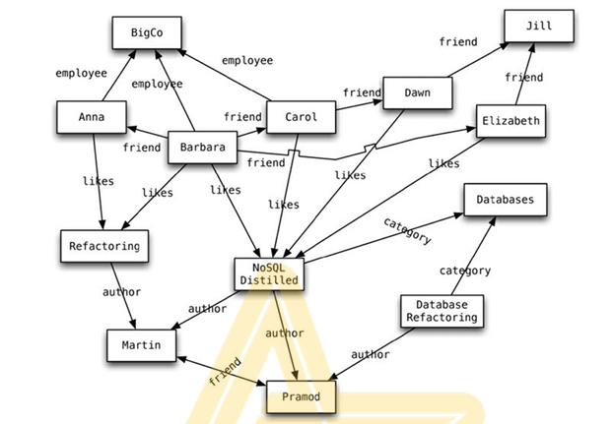
Module 1- More Details on data models
.
An example graph structure
ATME College of Engineering, Mysuru
Department of CSE-DS, ATMECE

Slide 42
Module 1- More Details on data models
.
Schema less Databases
1. NoSQL databases store and manage data without using a fixed, predefined schema, giving developers the freedom to design flexible data models.
2. They come in different types such as Key-Value stores, Document databases, Column-Family stores, and Graph databases, each optimized for different data and query needs.
3. Because the data structure is flexible, you can easily add or remove fields in records without impacting existing stored data or requiring a full migration.
4. Even though the database itself doesn’t enforce a strict schema, most applications still rely on an “implicit schema” embedded in the application’s code to keep data organized.
5. The absence of a built-in schema means the database doesn’t automatically validate data, which can lead to potential conflicts when different applications use the same database differently.
6. Since the database doesn’t know the exact structure of the data, certain optimizations like indexing or query planning can be more challenging compared to relational systems.
7. These problems can be reduced by encapsulating database access through an API layer or by separating datasets so that different applications don’t interfere with each other’s data.
8. While relational databases can also have their schema modified, NoSQL databases are especially effective for storing non-uniform, rapidly changing, or unpredictable data structures.
ATME College of Engineering, Mysuru
Department of CSE-DS, ATMECE

Slide 43
Module 1- More Details on data models
Materialized Views
.
Materialized Views vs Relational Views
Relational View (Normal View)
  A view in a relational database is a virtual table created by running a query over base tables.
  It is not stored physically—data is computed on demand every time the view is accessed.
  This gives flexibility to access data differently from how it’s stored.
  However, if the query is complex, computing it repeatedly can be slow.
Materialized View
  A materialized view is a precomputed and stored version of a query result.
  Data is cached on disk so it can be accessed quickly without recomputation.
  Useful for queries that are read frequently but can tolerate slightly stale data.
  Common in aggregate-oriented databases and also used in some NoSQL systems.
Why Materialized Views are Important in Aggregate-Oriented Models
  In aggregate-oriented NoSQL databases, all data for an aggregate (e.g., an order) is stored together for fast retrieval.
  This is efficient for queries on the whole aggregate, but inefficient for queries needing only a specific detail (e.g., total sales of a product over time), because it may require scanning many aggregates.
  Materialized views help by precomputing such summaries.
ATME College of Engineering, Mysuru
Department of CSE-DS, ATMECE

Slide 44
Module 1- More Details on data models
.
Strategies for Building Materialized Views
Eager Strategy (Real-Time Updates)
  Update the materialized view immediately whenever the base data changes.
  Example: When a new order is added, also update the sales summary for each product.
  Good when reads are more frequent than writes, and freshness of data is important.
  Can be implemented using the application database approach to ensure base data and materialized view stay in sync.
Lazy Strategy (Batch Updates)
  Update the materialized view at regular intervals via scheduled batch jobs.
  Reduces write overhead but may result in stale data between updates.
  Requires knowing how much staleness is acceptable for the business.
Outside-the-Database Computation
  Read data from the database, compute the materialized view externally, and write it back.
  Gives flexibility but may require more complex external processes.
.
ATME College of Engineering, Mysuru
Department of CSE-DS, ATMECE

Slide 45
Module 1- More Details on data models
.
Database-Supported Materialized Views
Many databases can automatically handle materialized view creation and refreshing.
You define the computation logic and set update parameters (e.g., refresh every 10 minutes).
Within the Same Aggregate
Materialized views can exist inside an aggregate for quick access to summary data.
Example: An order document contains a summary section so summary queries don’t have to read the full order.
Column Family Databases Approach
Use separate column families to store materialized views.
Benefit: Both the base data and materialized view can be updated in the same atomic operation, ensuring consistency.
.
ATME College of Engineering, Mysuru
Department of CSE-DS, ATMECE

