Slide 1
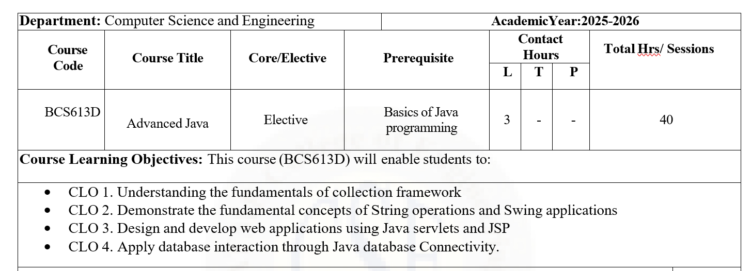

Slide 2
Java Collections Framework
Collections Framework is used to store, manage, and manipulate groups of objects
Arrays were mainly used to store multiple elements, but arrays had several limitations.
To overcome these limitations, Java introduced the Collections Framework.

Slide 3
Need for Collections Framework
First, arrays have a fixed size, meaning once an array is created, its size cannot be changed.
Second, arrays do not provide built-in methods for common operations such as sorting, searching, insertion, and deletion.
Third, handling large data using arrays increases programming complexity.

Slide 4
What is a Collection?
A Collection in Java is an object that represents a group of objects as a single unit. Instead of handling individual objects separately, collections allow programmers to manage multiple elements together.
Collections are dynamic in nature, which means elements can be added or removed at runtime. All collection-related classes and interfaces are present in the java.util package.
Collections form the foundation for advanced data handling in Java and are extensively used in enterprise and real-time applications.

Slide 5
Collections Framework
The framework is composed of three major components: interfaces, classes, and algorithms.
Interfaces define the basic structure and behavior of collections, classes provide concrete implementations of these interfaces, and algorithms provide methods for operations like sorting, searching, and reversing.
The framework offers a unified and consistent architecture that improves code reusability, reduces programming effort, and ensures better performance.

Slide 6
Core Interfaces
The Collection interface is the root interface from which most collection interfaces inherit.
The List interface represents an ordered collection that allows duplicate elements.
The Set interface represents a collection that does not allow duplicate elements.
The Queue interface represents a collection that follows FIFO order.
The Map interface is separate from Collection and stores elements as key-value pairs. Understanding these interfaces is crucial because all collection classes are built upon them.

Slide 7
List Interface
The List interface represents an ordered collection of elements where insertion order is preserved.
Lists allow duplicate elements and provide index-based access, meaning elements can be accessed using their position.
This interface is useful when the order of elements is important.
Common real-life examples include student attendance lists or marks lists.
Since List maintains order and allows duplicates, it is widely used in applications where sequence matters.

Slide 8
ArrayList
ArrayList is a concrete class that implements the List interface.
Internally, it uses a dynamic array to store elements.
ArrayList allows fast random access because elements are stored in contiguous memory locations.
However, insertion and deletion operations are slower compared to LinkedList because shifting of elements is required.
ArrayList is best suited for applications where retrieval operations are more frequent than insertion or deletion.

Slide 9
LinkedList
LinkedList is another implementation of the List interface and is based on a doubly linked list data structure.
Each element is stored as a node containing references to the previous and next elements.
This structure allows fast insertion and deletion operations because elements do not need to be shifted.
However, accessing elements is slower compared to ArrayList since traversal is required.
LinkedList is suitable when frequent insertion and deletion operations are needed.

Slide 10
Set Interface
The Set interface represents a collection that does not allow duplicate elements.
It does not guarantee any specific order of elements.
Set is mainly used when uniqueness of data is important.
Examples include storing roll numbers, employee IDs, or voter IDs.
If duplicate elements are added, they are ignored. The Set interface helps maintain data integrity by ensuring uniqueness.

Slide 11
HashSet vs TreeSet
HashSet uses hashing to store elements and does not maintain any order.
It provides fast performance for basic operations like add, remove, and search.
TreeSet, on the other hand, stores elements in sorted order and uses a tree-based structure.
While TreeSet provides ordered output, it is slower compared to HashSet.
The choice between HashSet and TreeSet depends on whether speed or sorted order is required.

Slide 12
Queue Interface
The Queue interface represents a collection designed for holding elements prior to processing.
It follows the FIFO (First In First Out) principle, where the element inserted first is removed first.
Queues are commonly used in scheduling, buffering, and real-time systems.
Real-life examples include a queue at a bank counter or a ticket booking line.
Queue interface ensures orderly processing of elements.

Slide 13
PriorityQueue
PriorityQueue is an implementation of the Queue interface where elements are processed based on priority rather than insertion order.
The element with the highest priority is removed first.
PriorityQueue does not strictly follow FIFO order.
It is commonly used in CPU scheduling, task management, and emergency systems.
This structure ensures that critical elements are handled before others.

Slide 14
Map Interface
The Map interface stores elements in the form of key-value pairs.
Each key is unique, while values can be duplicated.
Map does not extend the Collection interface, making it a separate hierarchy.
Maps are widely used in applications where data needs to be associated with unique identifiers, such as roll numbers, usernames, or IDs.
Map plays a crucial role in efficient data retrieval.

Slide 15
HashMap vs TreeMap
HashMap stores elements using hashing and does not maintain any order of keys.
It provides fast access and is commonly used in performance-critical applications.
TreeMap stores keys in sorted order and uses a tree-based structure.
While TreeMap ensures ordered output, it is slower compared to HashMap.
The selection depends on the need for speed or sorting.

Slide 16
Collections Utility Class
The Collections class provides static utility methods that operate on collection objects.
These methods include sorting elements, reversing order, shuffling elements randomly, and finding maximum or minimum values.
This class simplifies common operations and improves code readability.
The utility methods reduce the need to write complex logic manually.

Slide 17
Advantages
It reduces programming effort by providing ready-made data structures and algorithms.
It improves performance through optimized implementations.
It promotes code reuse and ensures consistency across applications.

Slide 18
Thank you

