Slide 1
RESEARCH METHODOLOGY AND INTELLECTUAL PROPERTY RIGHTS
Course code: BRMK557
By: Dr. Pujitha Ganapathi C.
Assistant Professor
Department of Civil Engineering

Slide 2
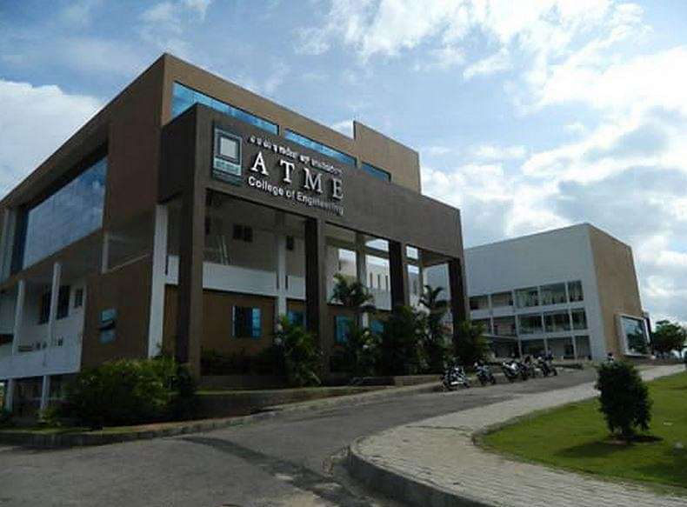
OVERVIEW
INTRODUCTION
1
LITERATURE REVIEW AND TECHNICAL READING
2
INTELLECTUAL PROPERTY RIGHTS, PATENTS AND PROCESS OF PATENTING
3
COPYRIGHTS AND RELATED RIGHTS AND TRADEMARKS
4
INDUSTRIAL DESIGN, GEOGRAPHICAL INDICATIONS AND CASE STUDIES ON PATENTS
5

Slide 3
OVERVIEW
INTRODUCTION
1
LITERATURE REVIEW AND TECHNICAL READING
2
INTELLECTUAL PROPERTY RIGHTS, PATENTS AND PROCESS OF PATENTING
3
COPYRIGHTS AND RELATED RIGHTS AND TRADEMARKS
4
INDUSTRIAL DESIGN, GEOGRAPHICAL INDICATIONS AND CASE STUDIES ON PATENTS
5

Slide 4
MODULE 1: INTRODUCTION
Meaning of Research, Objectives of Engineering Research, and Motivation in Engineering Research, Types of Engineering Research, Finding and Solving a Worthwhile Problem. Ethics in Engineering Research, Ethics in Engineering Research Practice, Types of Research Misconduct, Ethical Issues Related to Authorship.

Slide 5
INTRODUCTION
WHAT IS RESEARCH ?
Art of scientific investigation.
Search for knowledge, formulation or theory to discover unknown aspects of a specific subject.
Ascertaining whether the conclusions fit the hypothesis.
OBJECTIVES OF RESEARCH
To discover answers to questions through the application of scientific procedures.
Exploratory or Formulative research studies
Descriptive research studies
Diagnostic research studies
Hypothesis-testing research studies

Slide 6
INTRODUCTION
Exploratory or Formulative Research Studies
To gain insights and understanding of a problem where little prior information is available.
Studying the potential use of agricultural waste ash as a binder in geopolymer concrete (initial feasibility).
Investigating emerging trends in 3D-printed construction materials.
Descriptive Research Studies
To describe characteristics of a population, phenomenon, or situation.
Market research surveys to understand customer preference
A study observing children's playground behavior

Slide 7
INTRODUCTION
Diagnostic Research Studies
To determine the causes of a problem or identify factors responsible for a condition.
Why sales are declining by analyzing customer data
Why is concrete cracking at early ages
Hypothesis-Testing Research Studies
To test specific hypotheses or relationships using experiments/statistical analysis.
Testing whether a new marketing campaign increases sales.
Testing whether the addition of a chemical or fiber can increase the strength.

Slide 8
INTRODUCTION
WHAT MOTIVATES TO DO RESEARCH ?
  Personal motivation in solving unsolved problems, intellectual joy
  Wanting to do better than what has been achieved in the world
  Improve the state of the art in technology
  Contribute to the improvement of society
Extrinsic motivating factors like rewards for good work include money, fame, awards, praise, and status are very strong motivators, but may block creativity.
Patents
Collaborations
Funding opportunities
Govt. directives
Terms of employment

Slide 9
INTRODUCTION
TYPES OF ENGINEERING RESEARCH ?
Descriptive vs Analytical
The researcher holds no control over the variables; rather only reports as it is.
Descriptive research also includes attempts to determine causes even though the variables cannot be controlled.
In analytical research, already available facts for analysis and critical evaluation are utilized.
Descriptive research aims to describe a situation, while analytical research seeks to explain the reasons behind it. Descriptive research focuses on "what is," while analytical research delves into "why" and "how".
Applied vs Fundamental
Applied research seeks to solve an immediate problem facing the organization. Objective of applied research is to determine a solution for compelling problems in actual practice.
Fundamental research is concerned with generalizations and formulation of a theory. Basic research is aimed at seeking information which could have a broad base of applications in the medium to long term.

Slide 10
INTRODUCTION
TYPES OF ENGINEERING RESEARCH ?
Qualitative vs Quantitative
Qualitative researchers rely on a few non-representative cases or verbal narrative in behavioral studies.
Quantitative research uses statistical observations.
Conceptual vs Empirical
Conceptual research is that related to some abstract idea(s) or theory.
Empirical research is data-based research, coming up with conclusions which are capable of being verified by observation or experiment. We can also call it as experimental type of research.

Slide 11
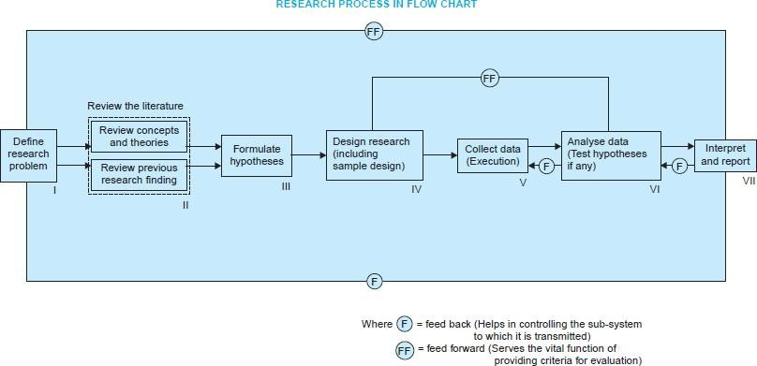
INTRODUCTION

Slide 12
INTRODUCTION
FINDING AND SOLVING A WORTHWHILE PROBLEM
A researcher may start out with the research problems stated by the Supervisor or posed by others that are yet to be solved.
Sometimes, an oral presentation by somebody which is followed by asking questions or introspection provides this perspective which reading papers do not.
Future scope stated in research articles and thesis of a previous work.
Not all problems that one solves will be great, and sometimes major advancements are made through solutions to small problems dealt with effectively.

Slide 13
INTRODUCTION
ETHICS IN ENGINEERING RESEARCH
Ethics generally refers to a set of rules distinguishing acceptable and unacceptable conduct
Caroline Whitbeck is a prominent figure in engineering ethics, known for her work on the practical and moral dimensions of engineering practice and research.
Whitbeck raised two simple but significant questions to address the tricky issue of authorship in research:
  Who should be included as an author and
  The appropriate order of listing of authors.
Government bodies and universities worldwide have adopted certain codes for research ethics.
Research ethics examines the appropriate application of research outcomes, while responsible conduct of research deals with the way the work is undertaken.

Slide 14
INTRODUCTION
ETHICS IN ENGINEERING RESEARCH PRACTICE
Privacy issues and data related to surveillance systems
Certain practices may be acceptable to certain people in certain situations, and the reasons for unacceptability may be perfectly valid.
Unprecedented access to data today
It is a vital ethical responsibility of researchers to ensure that hazards/risks associated with the technologies that they develop, are minimized and alternative safer mechanisms are considered.
The reason that ethics matter in data used in engineering research is usually because there is impact on humans.

Slide 15
INTRODUCTION
TYPES OF RESEARCH MISCONDUCT
Fabrication (Illegitimate creation of data): conjuring data or experiments with a belief of knowledge about what the conclusion of the analysis or experiments would be
Falsification (Inappropriate alteration of data): misrepresentation or misinterpretation, or illegitimate alteration of data or experiments. Misleading data can also crop up due to poor design of experiments or incorrect measurement practices.
Plagiarism (Taking other’s work sans attribution): when someone uses or reuses the work (including portions) of others (text, data, tables, figures, illustrations or concepts) as if it were his/her own without explicit acknowledgement.

Slide 16
INTRODUCTION
How are supervisors, reviewers or editors alerted to plagiarism?
Original author comes to know and informs everyone concerned.
Sometimes a reviewer finds out about it during the review process.
Or, readers who come across the article or book, while doing research
Many free tools and also paid tools are available to identify plagiarism

Slide 17
INTRODUCTION
ETHICAL ISSUES RELATED TO AUTHORSHIP
  Credit for research contributions is attributed in three major ways in research publications:
    By authorship (of the intended publication),
    By citation (of previously published or formally presented work), and
    Through a written acknowledgment (of some inputs to the present research).
All listed authors have the full obligation of all contents of a research article.
It is imperative that their consent is sought with respect to the content and that they be agreeable to the submission.
Double submission is an important ethical issue related to authorship

