Slide 1
DESIGN OF STEEL STRUCTURAL ELEMENTS
Course code: BCV701
By: Dr. Pujitha Ganapathi C.
Assistant Professor
Department of Civil Engineering

Slide 2

OVERVIEW
INTRODUCTION;
PLASTIC BEHAVIOUR OF STRUCTURAL STEEL
1
BOLTED CONNECTIONS
2
WELDED CONNECTIONS
3
DESIGN OF TENSION MEMBERS; DESIGN OF COLUMN BASES
4
DESIGN OF COMPRESSION MEMBERS
5

Slide 3
MODULE 1: INTRODUCTION
Advantages and Disadvantages of Steel Structures, Limit state method Limit State of Strength, Structural Stability, Serviceability Limit states, Failure Criteria of steel, Design Consideration, Loading and load combinations, IS code provisions, Specification and Section classification.

Slide 4
INTRODUCTION
STEEL STRUCTURES?
Assemblage of structural steel components.
They are effectively joined or fastened to act as a single unit.
Famous steel structures: Howrah bridge, Brooklyn bridge, Eiffel tower, Railway constructions
CODE OF PRACTICE FOR GENERAL STEEL CONSTRUCTION – IS800 - 2007
WHAT IS STEEL ?
Alloy of iron and carbon. Apart from these, a small percentage of manganese, silicon, phosphorous, nickel and copper are also added to modify specific properties of steel.

Slide 5
INTRODUCTION
ADVANTAGES OF STEEL STRUCTURES
High strength to weight ratio
Good ductility
Great stiffness
Easy fabrication
Low cost
Easy erection
WHAT IS STRUCTURAL STEEL?
Steel used as construction materials for manufacturing structural steel shapes like beams, plates, channel sections, hallow sections, angles etc.

Slide 6
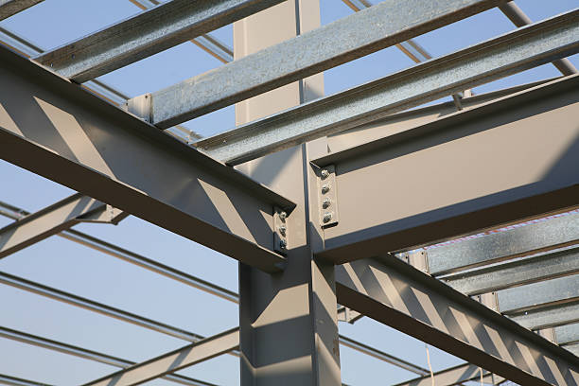
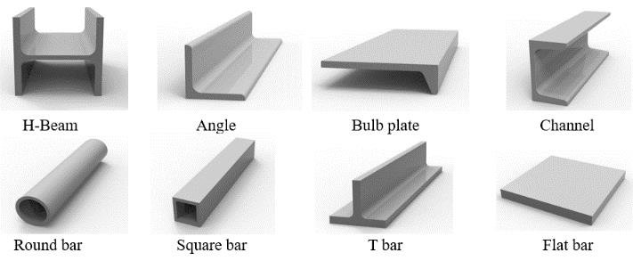
INTRODUCTION

Slide 7
INTRODUCTION
PROPERTIES OF STRUCTURAL STEEL
Density (γ) = 7850 kg/m³
Modulus of elasticity (E) = 2 * 10⁵ N/mm²
Poissons ratio (µ) = 0.3
Modulus of rigidity (G) = 0.769 * 10⁵ N/mm²
Co-efficient of thermal expansion (α) = 12 * 10⁻⁶ /°C
TYPES OF STRUCTURAL STEEL
Hot-rolled steel
Cold-rolled steel

Slide 8
INTRODUCTION
CLASSIFICATION OF CROSS SECTION
Class I or Plastic section
Class II or Compact section
Class III or Semi-compact section
Class IV or Slender sections
DISADVANTAGES OF STEEL STRUCTURES
They are costly
It is susceptible to corrosion
They require regular maintenance, maintenance cost is high
They become more elastic when exposed to fire
Needs high degree of control to ensure proper fitting of various structural elements

Slide 9
INTRODUCTION
LOADS AND LOAD COMBINATIONS
Dead loads – IS875 (Part I)
Imposed loads – IS875 (Part II)
Wind loads – IS875 (Part III)
Snow load – IS875 (Part IV)
Accidental loads – IS875 (Part V)
Seismic loads – IS1893:2002
DESIGN PHILOSOPHIES
Working stress method
Ultimate load method
Limit state method

Slide 10

INTRODUCTION
WORKING STRESS METHOD
This method provides un-economical sections.
Permissible stress = $\frac{Yield stress}{Factor of safety}$
ULTIMATE LOAD METHOD (OR) LOAD FACTOR METHOD
No guarantee for serviceability of structure.
Load factor = $\frac{Design load}{Working load}$
LIMIT STATE METHOD
This method take care of both strength and serviceability requirements.
Limit state of strength – takes care of strength, overturning, sliding, buckling, fatigue
Limit state of serviceability – deals with excessive deflection, vibration, cracking, corrosion, durability and fire

Slide 11

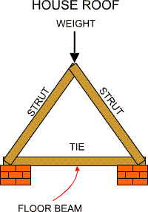
INTRODUCTION
STRUCTURAL ELEMENTS
Struts and ties
Beams and columns

Slide 12
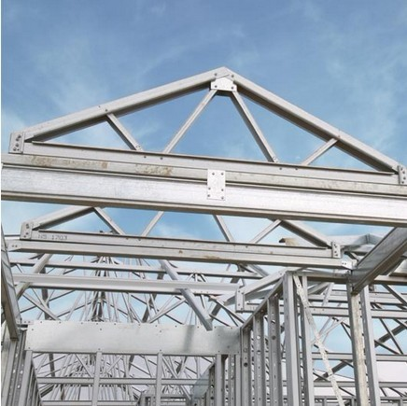
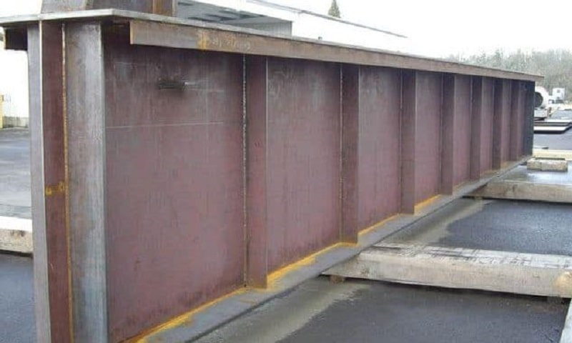
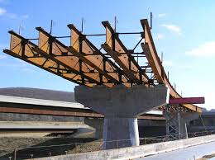
INTRODUCTION
STRUCTURAL ELEMENTS
Plate girders
Roof truss

Slide 13
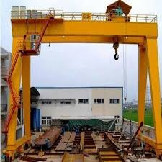
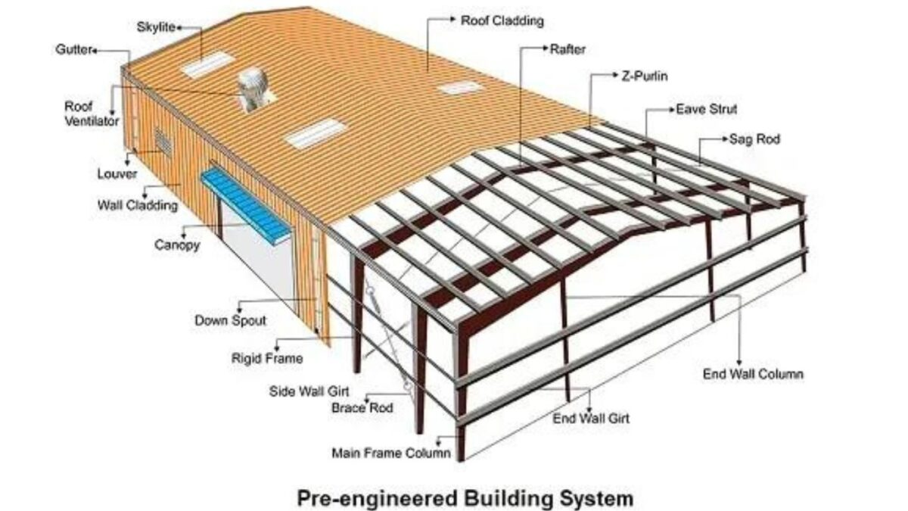
INTRODUCTION
STRUCTURAL ELEMENTS
Gantry girder

Slide 14
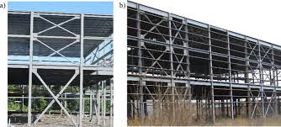
INTRODUCTION
STRUCTURAL ELEMENTS
Bracings

Slide 15
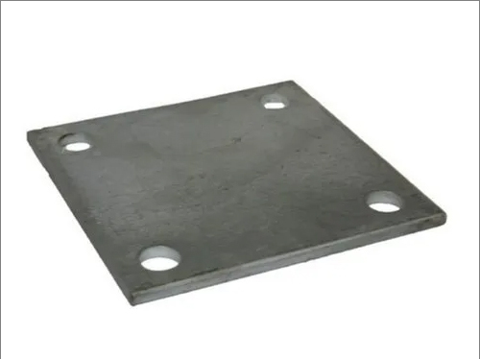

INTRODUCTION
STRUCTURAL ELEMENTS
Connections
Steel base

Slide 16
MODULE 1: PLASTIC BEHAVIOUR OF STRUCTURAL STEEL
Introduction, Plastic theory, Plastic Hinge Concept, Plastic collapse load, load factor, Shape factor, Theorem of plastic collapse, Methods of Plastic analysis.

Slide 17
PLASTIC ANALYSIS
The traditional analysis of structures is based on the linear elastic behavior of materials, implying that the material follows Hooke’s law.
Steel structures are often designed based on plastic analysis because it allows engineers to take advantage of steel’s ductility and reserve strength beyond first yield, leading to more economical and reliable designs.
FIRST ORDER ELASTIC ANALYSIS
It is assumed that the original dimensions of the structure can be used in the analysis.
SECOND ORDER ELASTIC ANALYSIS
Shall allow for the effects of design loads acting on the structure in their displaced or deformed configuration.

Slide 18
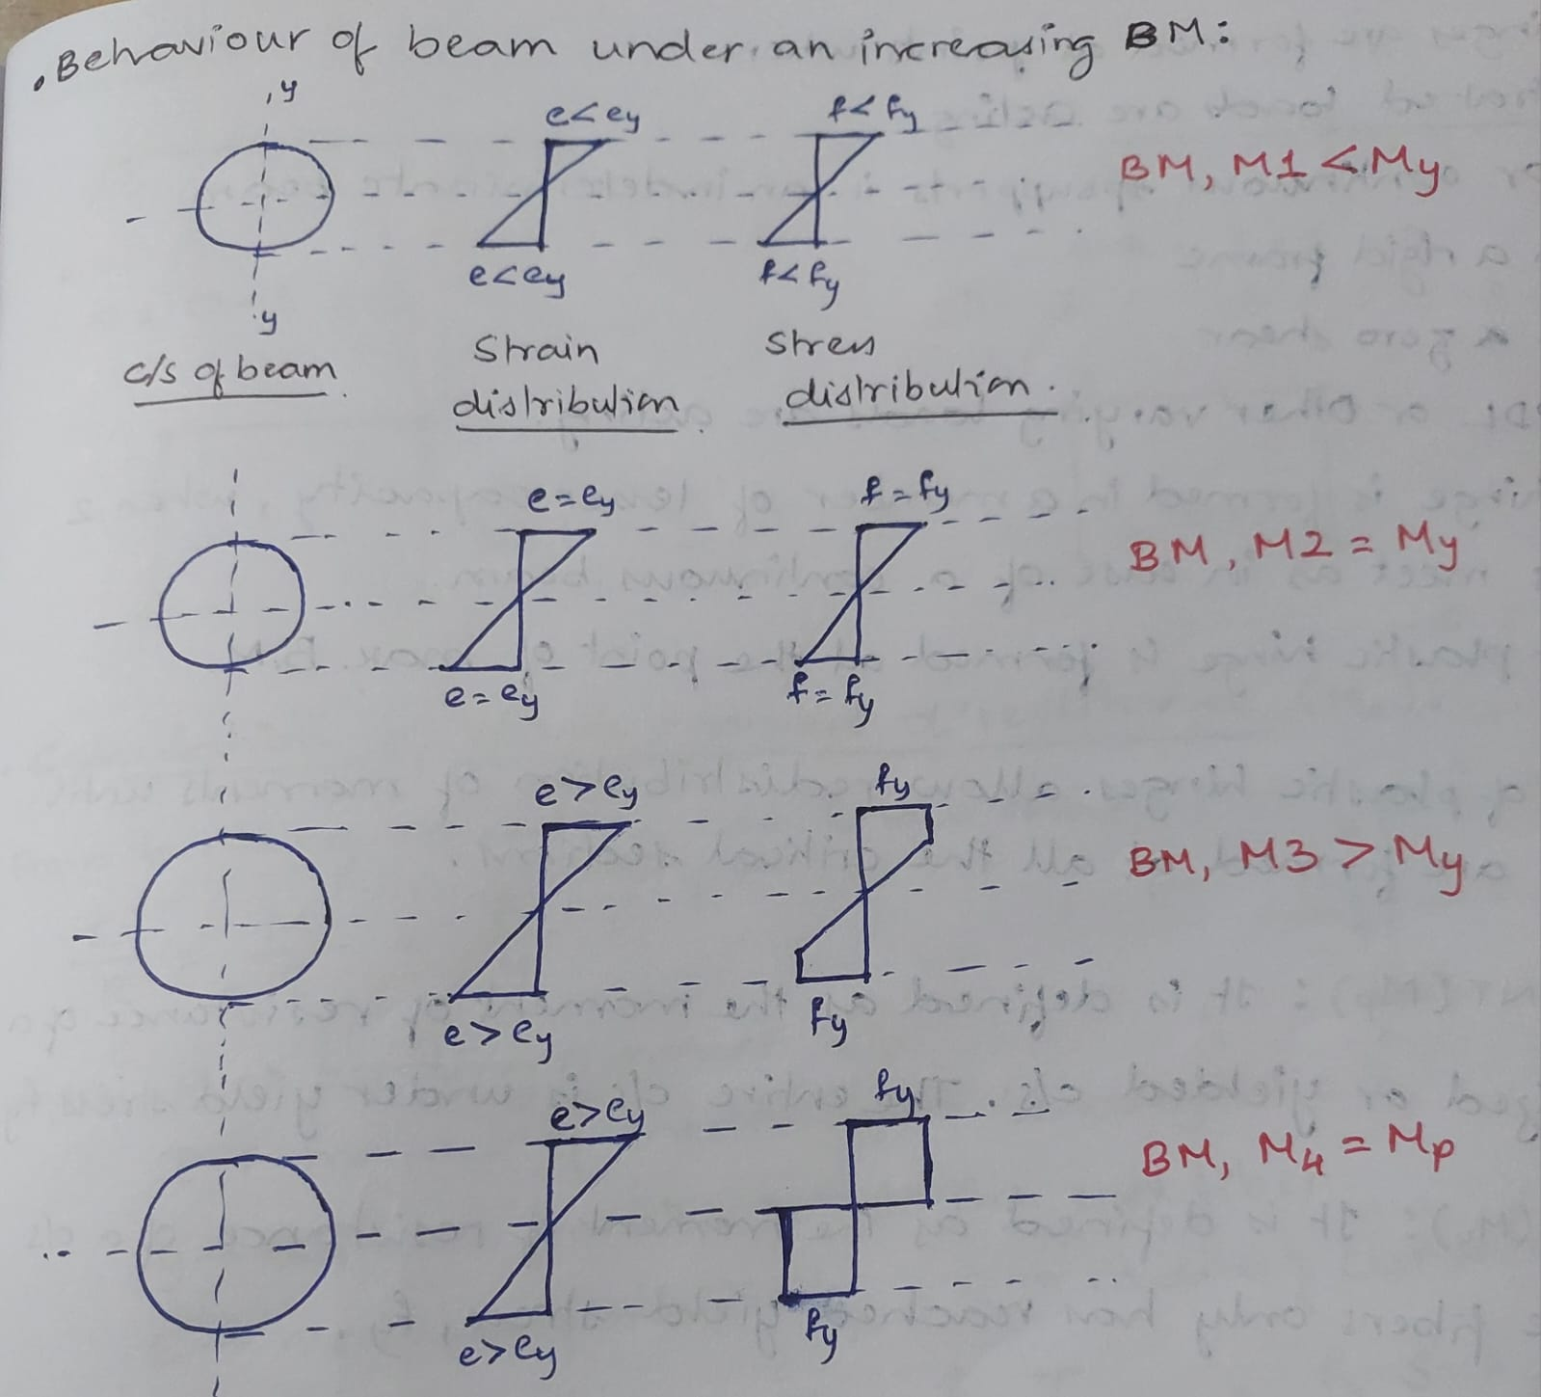
PLASTIC ANALYSIS
STRAIN HARDENING
PLASTIC THEORY OF BEAMS
BEHAVIOUR OF BEAM UNDER INCREASING BENDING MOMENT

Slide 19
PLASTIC ANALYSIS
When the stress distribution reaches fully plastic distribution, a plastic hinge is said to have formed because no additional moment can be resisted at the section.
Plastic hinge is defined as a point in a flexural member where full plastic moment has developed and is rotating at a constant moment, Mp.
Plastic hinges are formed at points where,
Concentrated loads are acting
Fixed or continuous supports in an intermediate beam
Joints in a rigid frame
Points of zero shear
When UDL and other varying loads are acting
Plastic hinge is formed in a member with lesser capacity when 2 members meet as in case of a continuous beam
The first plastic hinge is formed at the point of max. BM

Slide 20
PLASTIC ANALYSIS
The formation of sufficient number of plastic hinges converts the structure into a mechanism where the given structure breaks into rigid links with large deformations (collapse).
The maximum no. of plastic hinges (n) that form a collapse mechanism
n = r + 1
Where r = degree of indeterminacy
SIGNIFICANCE OF SHAPE FACTOR
It gives an indication of the reserve capacity of a section from yielding at extreme fibers to fully plastic.
A section with higher shape factor gives a longer warning before collapse.
A section with higher shape factor is more ductile and gives greater deflection at collapse.

Slide 21
PLASTIC ANALYSIS
ELASTIC MOMENT
The elastic moment refers to the bending moment a structural member can withstand while remaining within its elastic limit, meaning it will return to its original shape after the load is removed.
COLLAPSE LOAD OF A STRUCTURE
It is the minimum load that results in the collapse of a structure.
Collapse load can be found for a structure by investigating various possible collapse mechanisms of the structure.

