Slide 1
MODULE – 3
FINANCIAL ACCOUNTING PROCESS: Journalizing transactions: Journals, Rules of Debit and Credit, Compound Journal Entry, Opening Entry. Ledger posting and trial balance: Ledger, Posting, Relationship between journal and ledger, Rules regarding posting, Trial Balance.

Slide 2
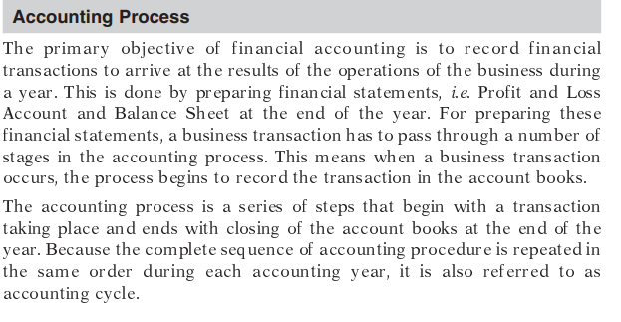

Slide 3
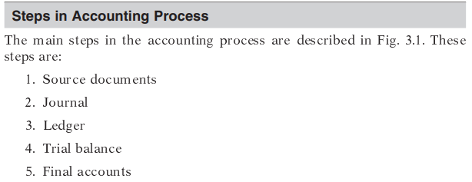

Slide 4
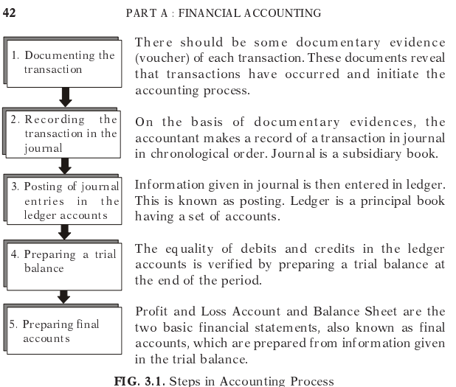

Slide 5
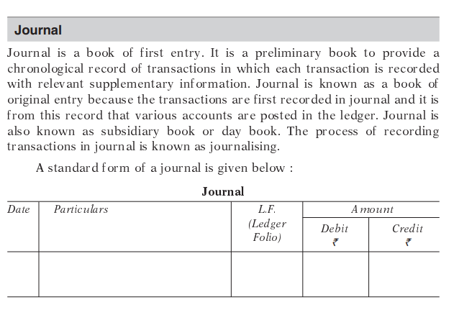

Slide 6
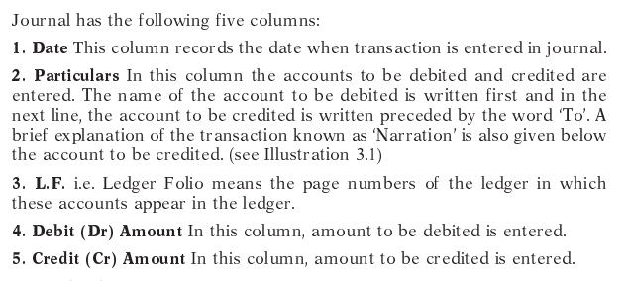

Slide 7
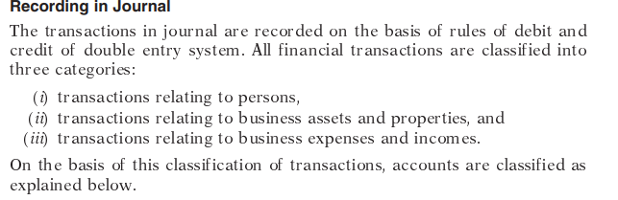

Slide 8
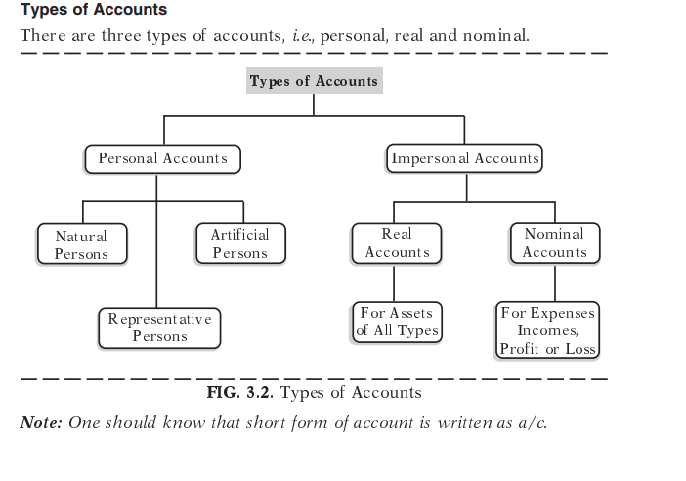

Slide 9
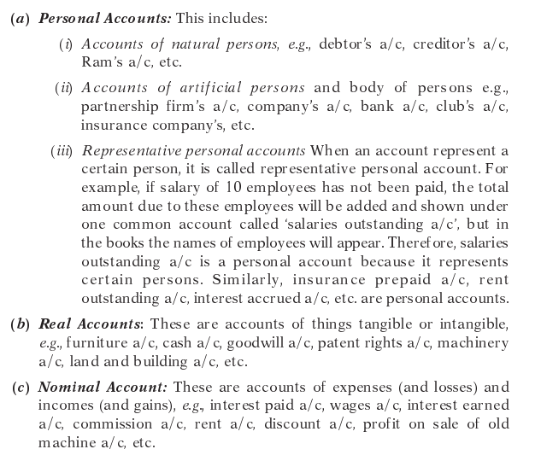

Slide 10
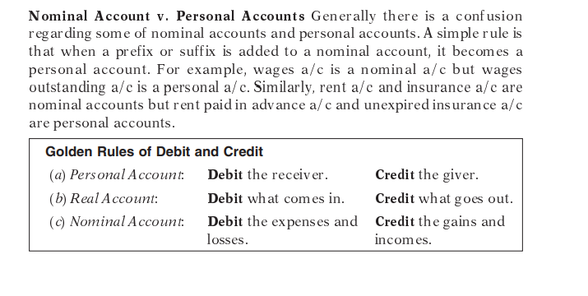

Slide 11
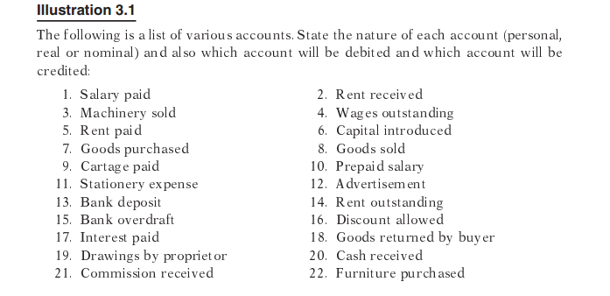

Slide 12
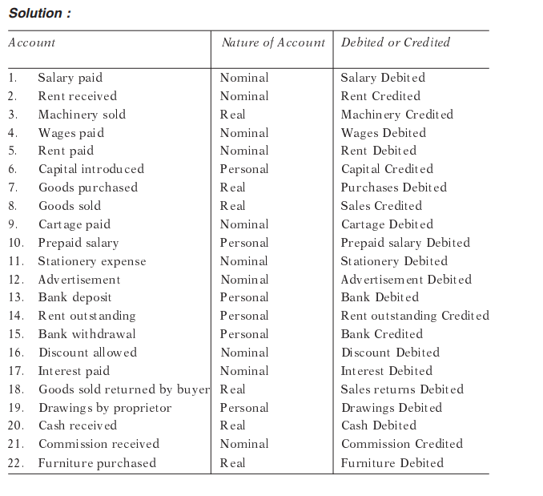

Slide 13
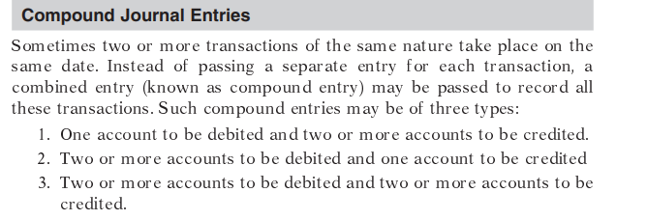

Slide 14
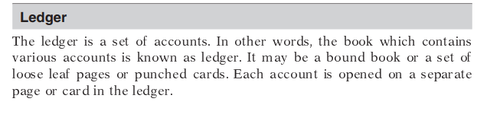
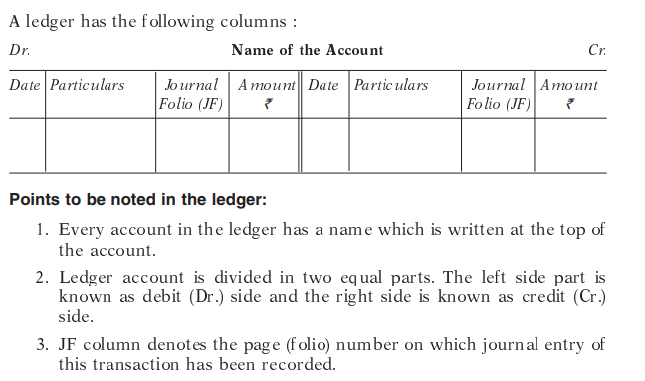

Slide 15
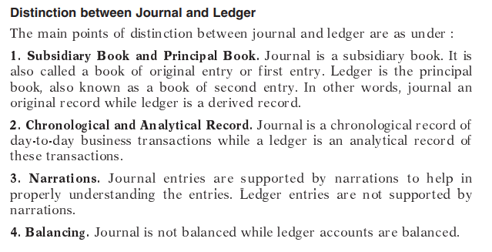

Slide 16
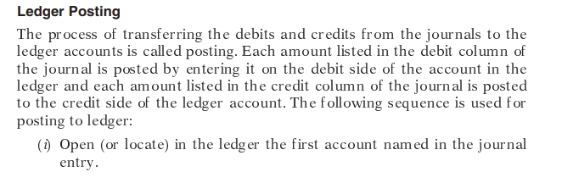
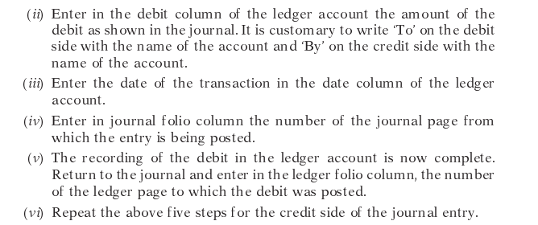

Slide 17
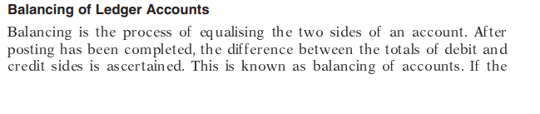
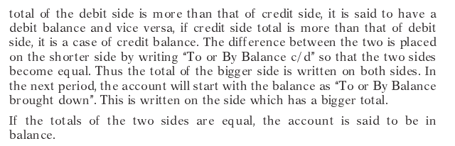

Slide 18
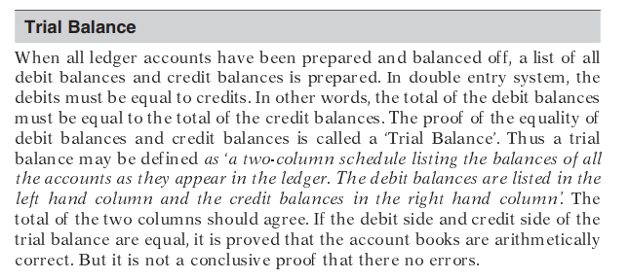

Slide 19
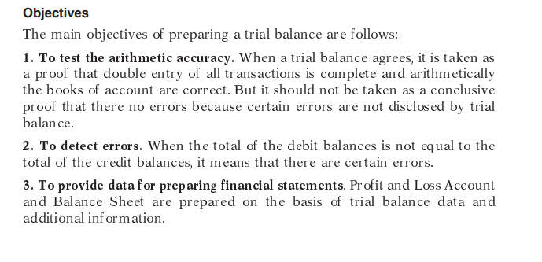

Slide 20
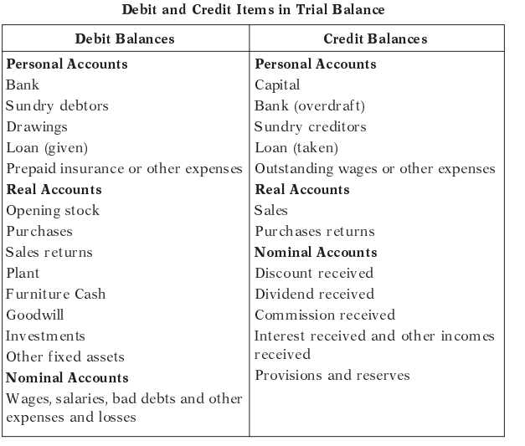

Slide 21
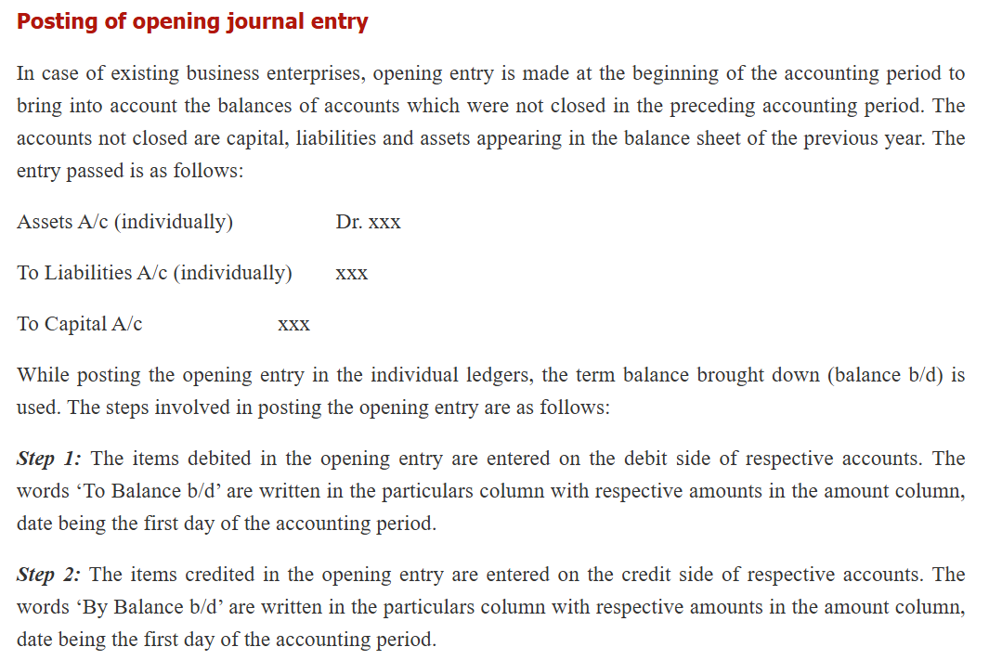

Slide 22
Posting of compound journal entry
When a journal entry has more than one debit or more than one credit or both, it is called a compound entry. For items debited in the compound entry, entries are made on the debit side in the respective accounts with the respective amount debited. For items credited in the compound entry, entries are made on the credit side in the respective accounts with the respective amount credited.
Balancing of ledger accounts
After posting the transactions, the business person is interested to know the position of various accounts. For this purpose, the accounts are balanced at the end of the accounting period or after a certain period to ascertain the net balance in each account. Balancing means that the debit side and credit side amounts are totalled and the difference between the total of the two sides is placed in the amount column as ‘Balance c/d’ on the side having lesser total, so that the total of both debit and credit columns are equal.
When the total of the debit side is more than the total of credit side the difference is debit balance and is placed on the credit side as ‘By Balance c/d’. If the credit side total is more than the total of debit side, the difference is credit balance and is placed on the debit side as ‘To Balance c/d’.

Slide 23
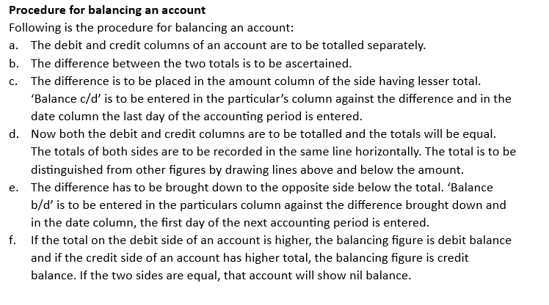

Slide 24
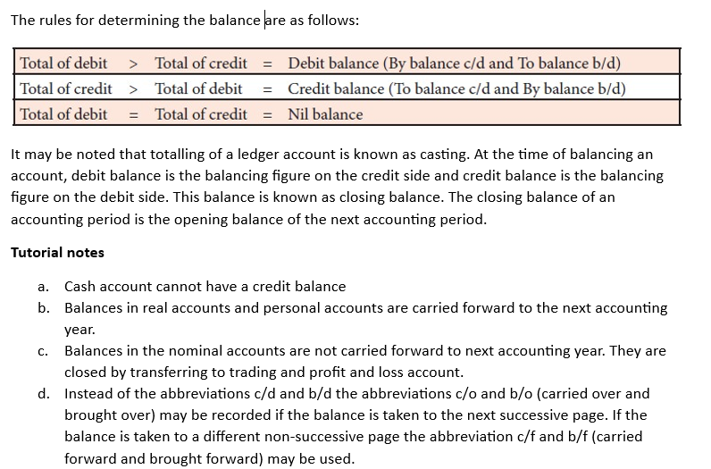

Slide 25
