Slide 1
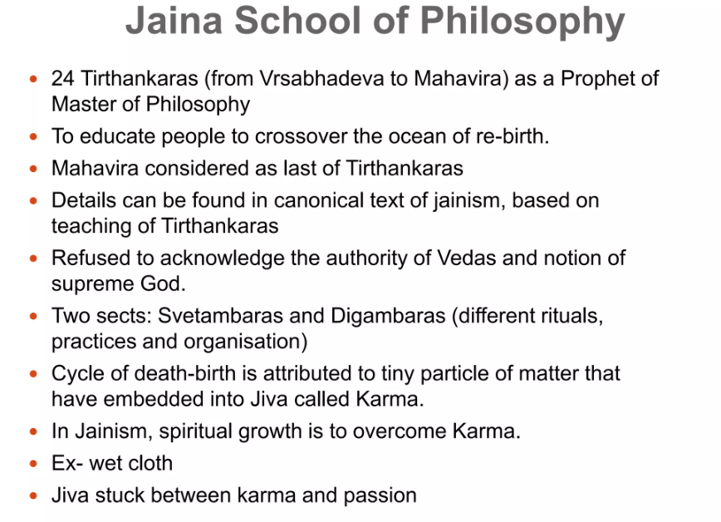
Other Dharmic Traditions

Slide 2
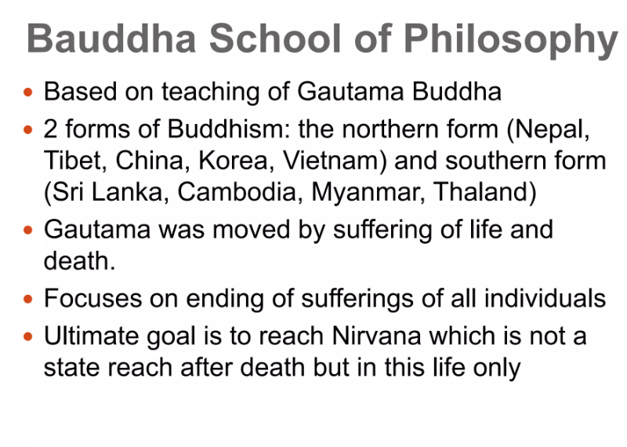

Slide 3
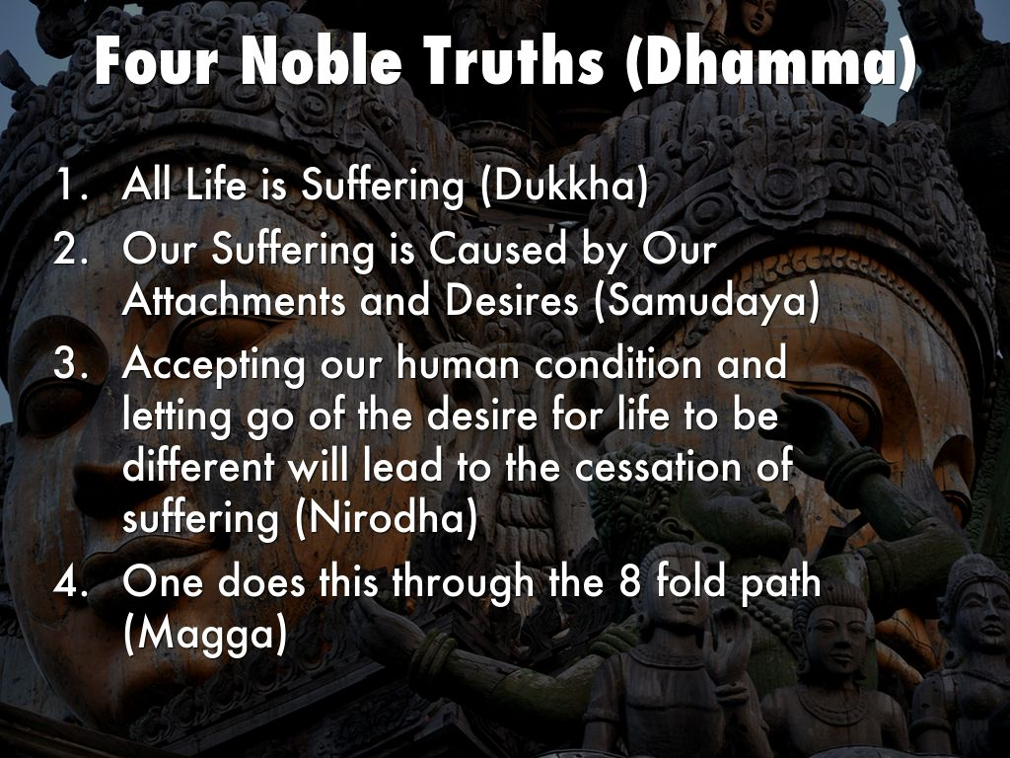

Four Nobel Truths Of Buddhism

Slide 4
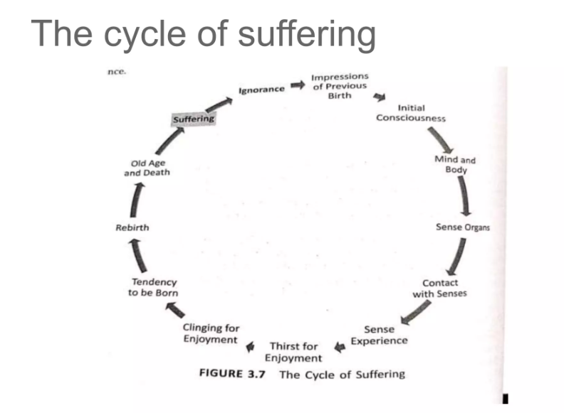

Slide 5
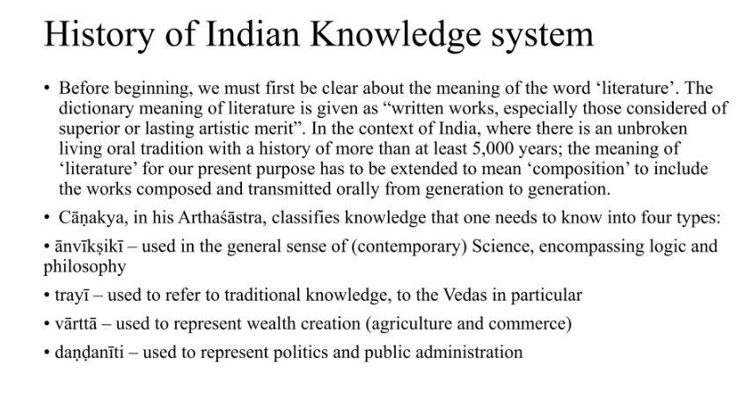

Slide 6
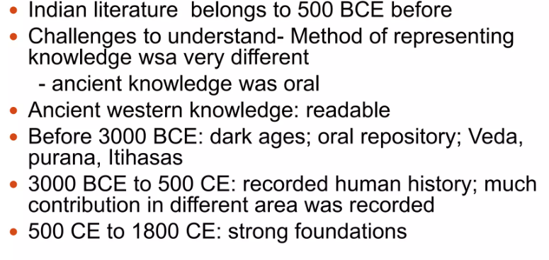
Historicity of IKS

Slide 7
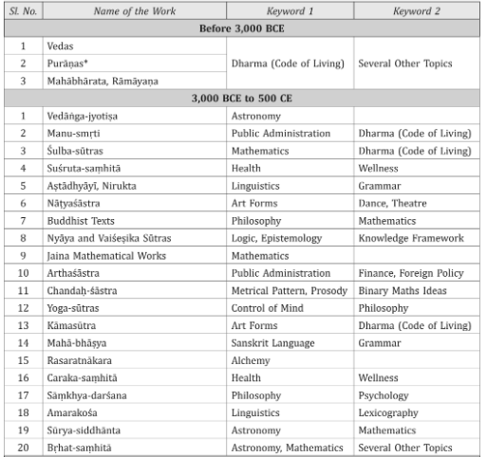
A list of IKS Repository.

Slide 8
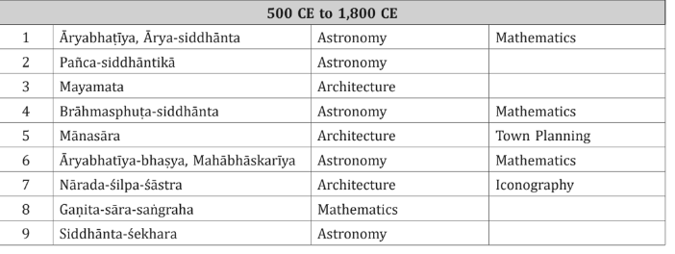
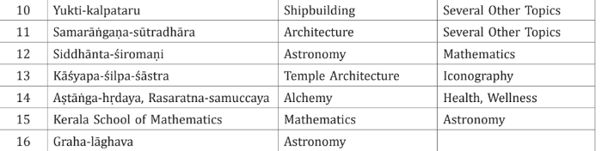

Slide 9
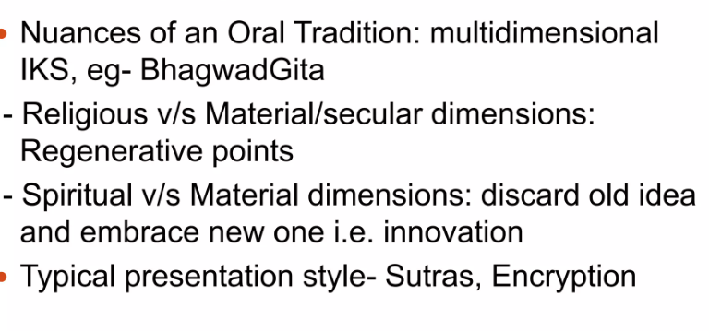
Some Unique aspects of IKS

Slide 10
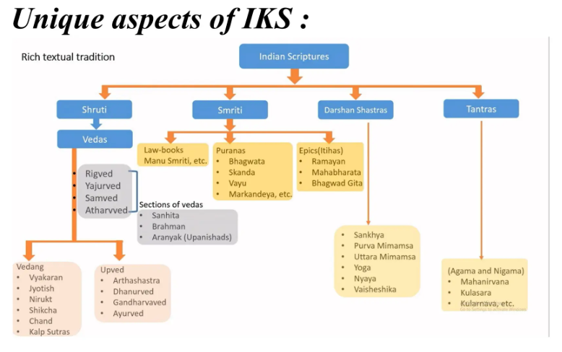

Slide 11


Slide 12


Slide 13
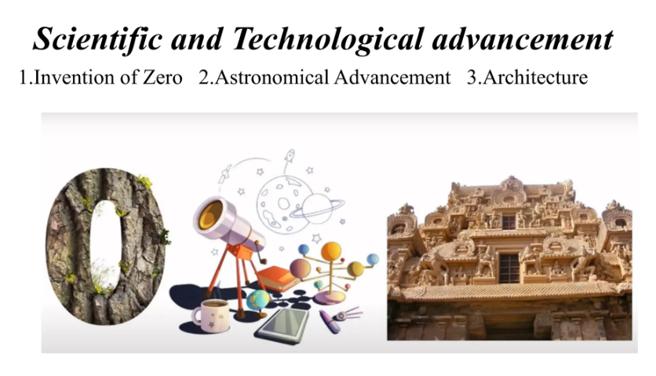

Slide 14


Slide 15


Slide 16
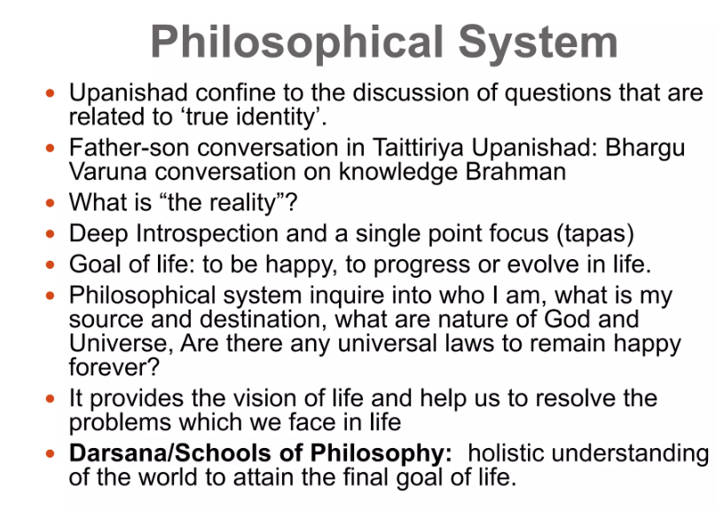

Slide 17
Indian Philosophical system (IPS):
Development and unique features
Teaching of Upanishads suggest that attainment of Brahman is the highest goal of life.
Happiness require Jiva, the Universe/Jagat and the God/Isvara
Rgveda: mantras to inquiry about functioning of devtas. One of famous sukta about origin of Universe.
Purusa and Brahman
Unique features:
1. IPS based on religious thoughts
2. Two generic classes (Vedic and Non Vedic)
3. All IPS agrees on certain common parameters (karma/fruit of action, birth death cycle/Samsara, Mukti
4. ultimate goal of life
5. Every school employ Pramana for establishment of valid knowledge
6. Healthy and respectful culture b/w all schools despite divergent views
7. Debate and interaction between all philosophical schools

Slide 18
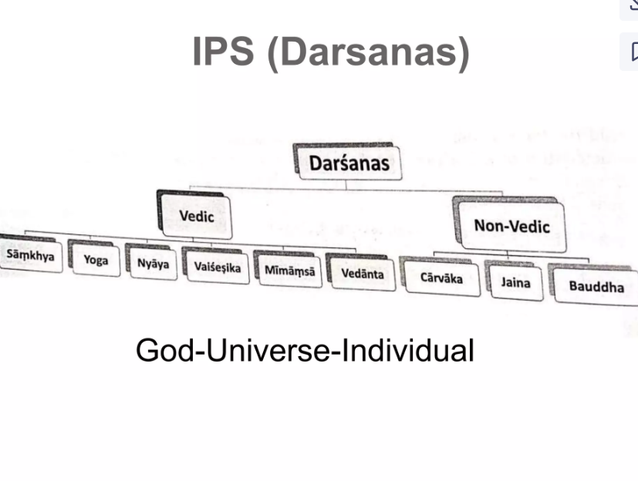

Slide 19
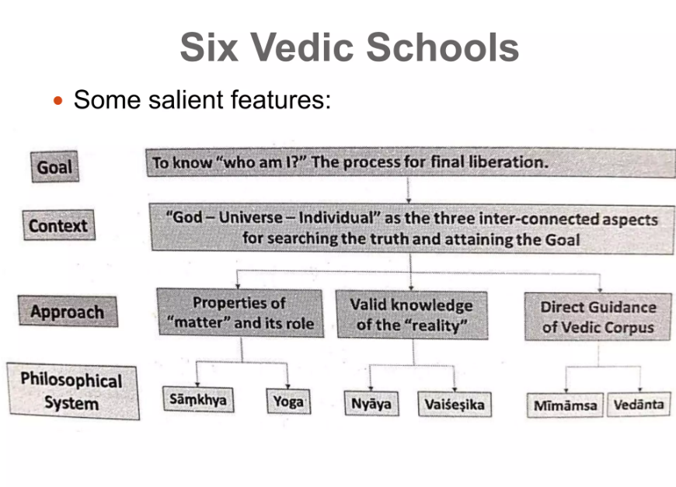

Slide 20
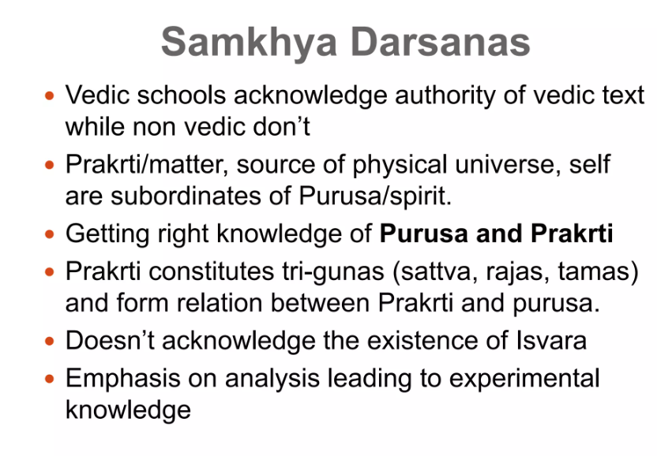
Samkhya and Yoga

Slide 21
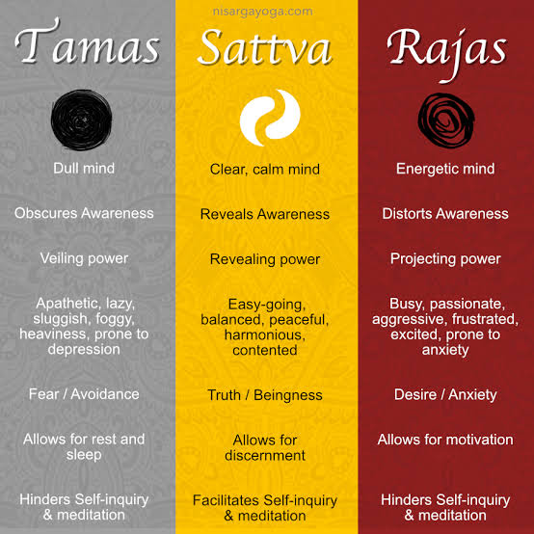


Slide 22
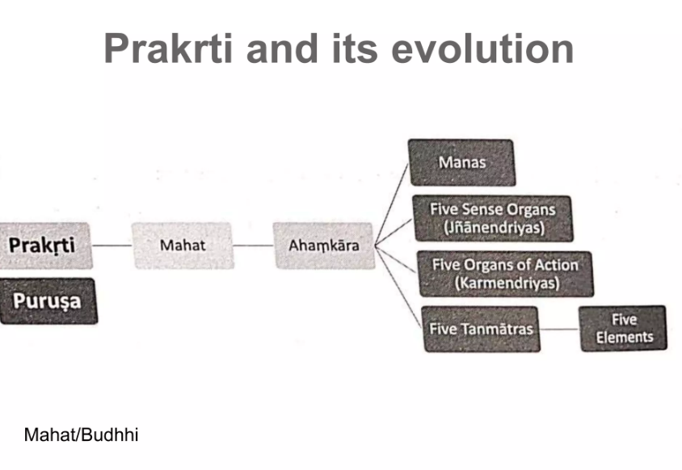

Slide 23
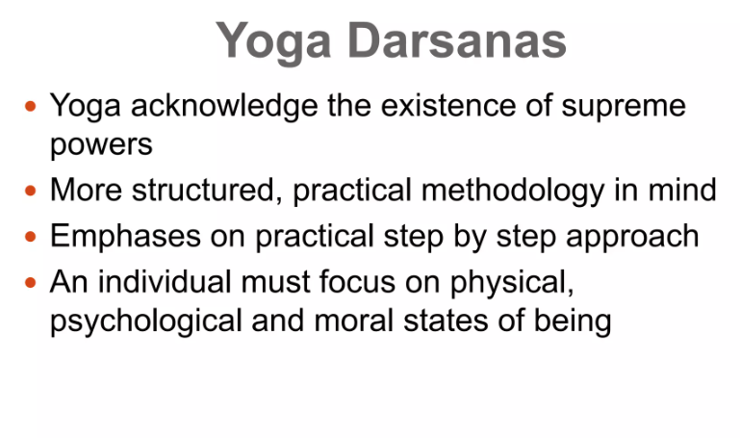

Slide 24


Slide 25
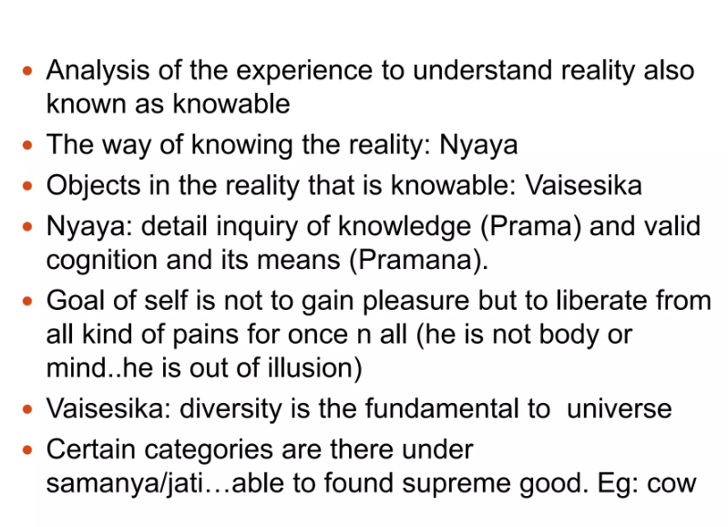
Nyaya and Vaisesika

Slide 26
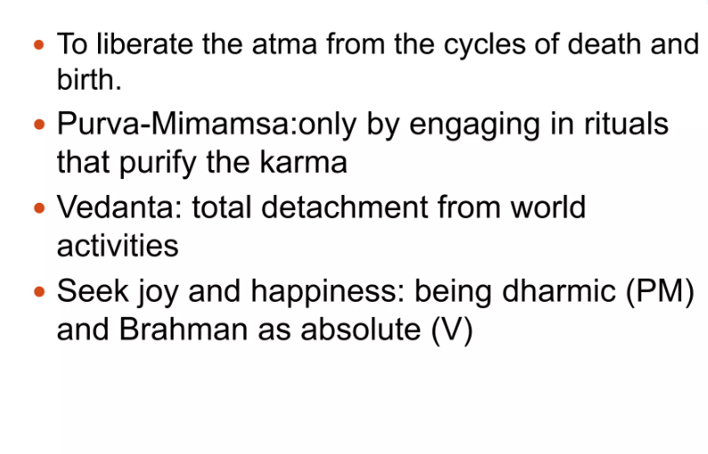
Purva Mimamsa and Vedanta

Slide 27


Slide 28
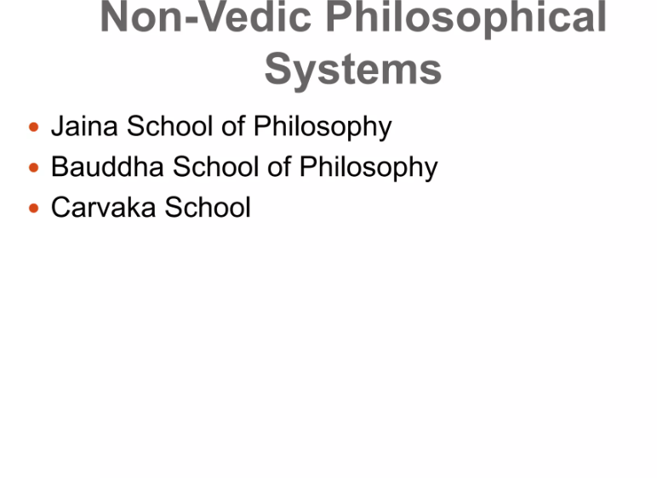

Slide 29
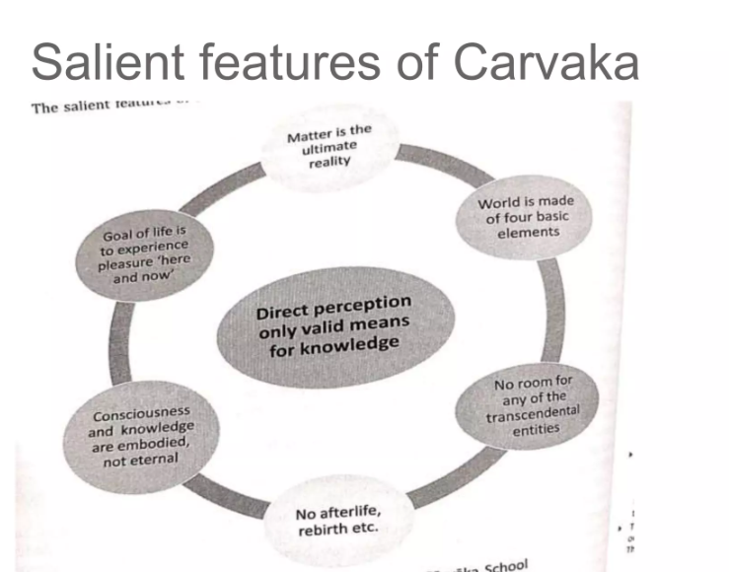
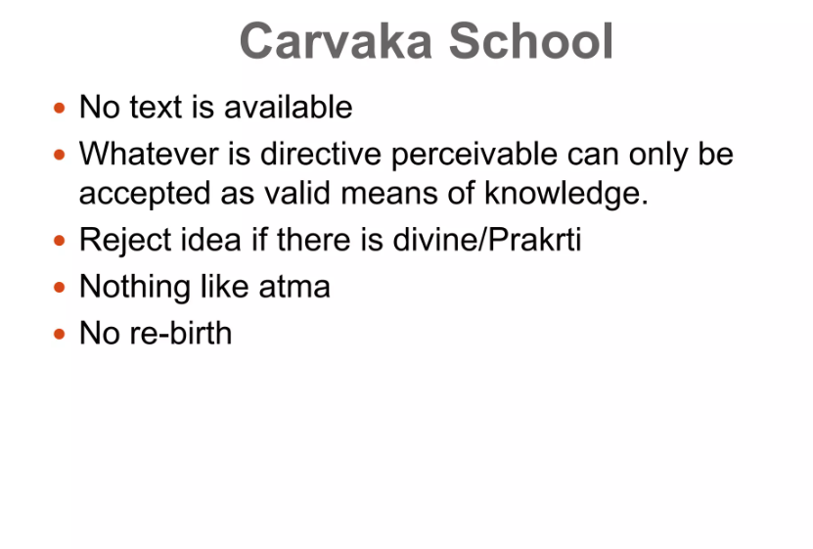
Carvaka School

Slide 30
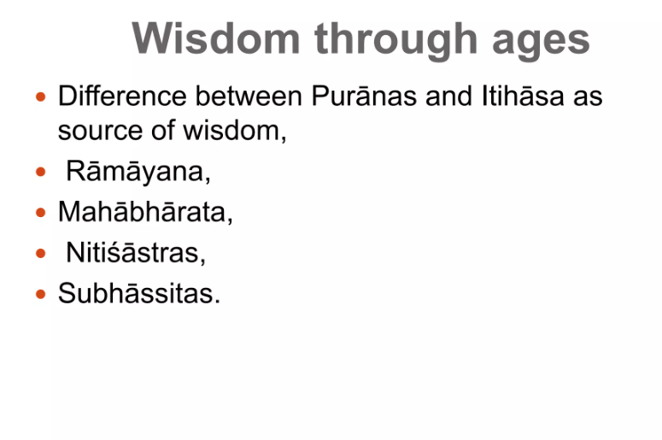

Slide 31
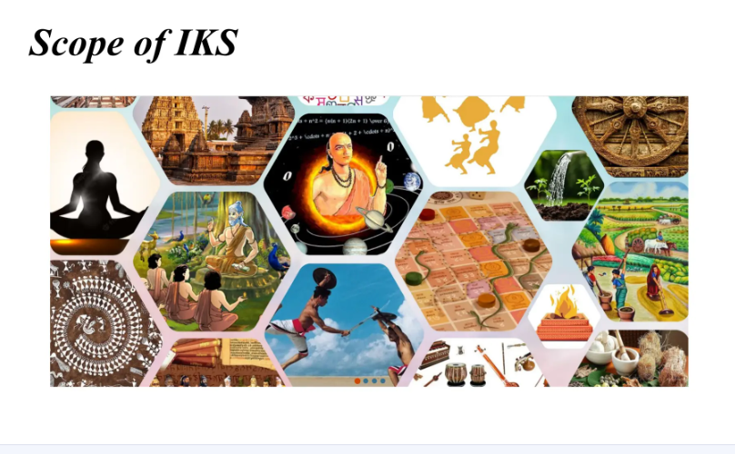

Slide 32
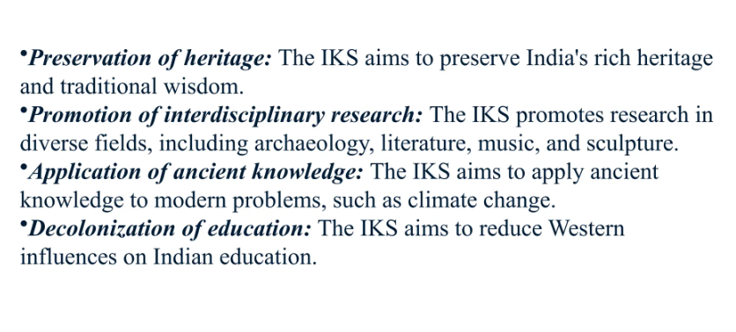

Slide 33
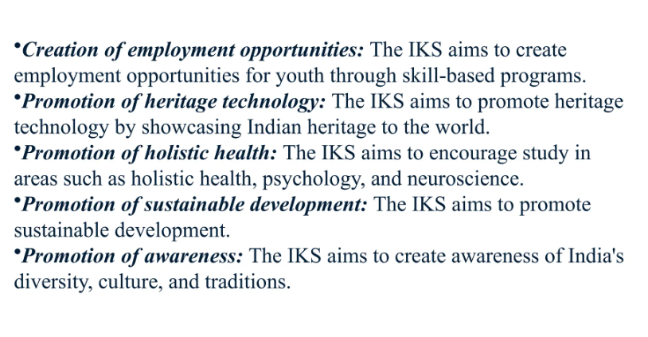

Slide 34
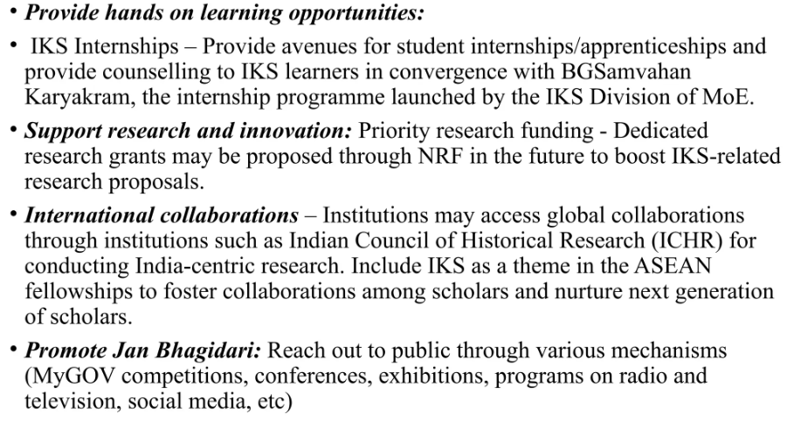

Slide 35
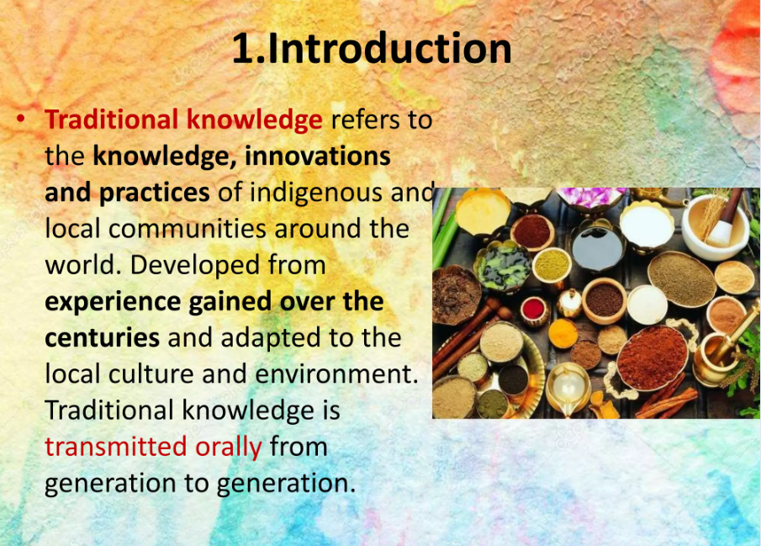

Slide 36


Slide 37
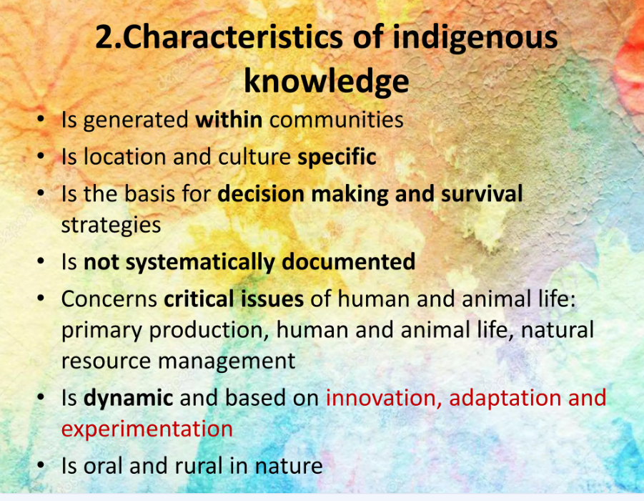

Slide 38
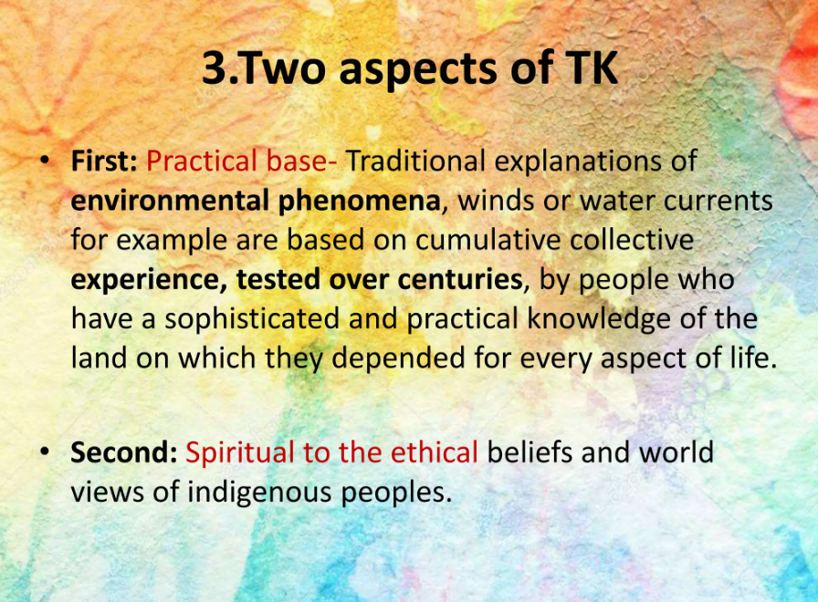

Slide 39


Slide 40
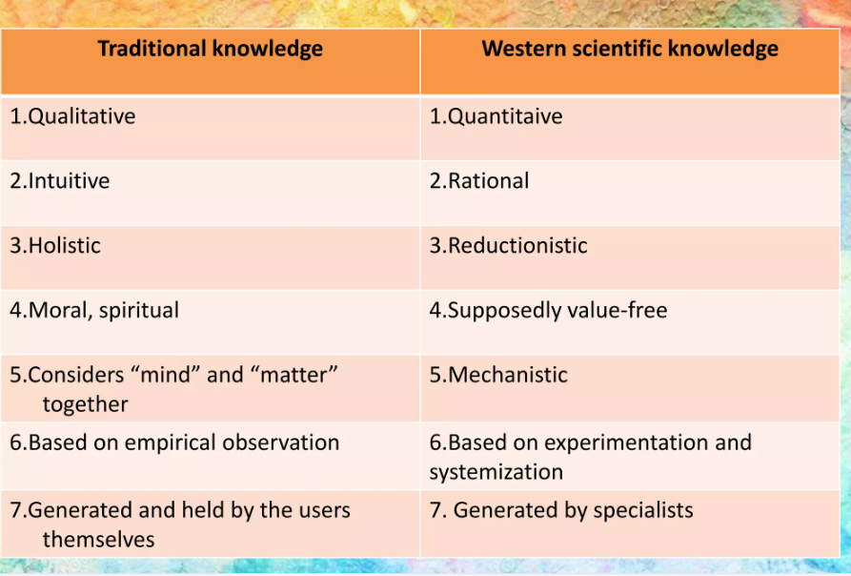

Slide 41


Slide 42


Slide 43


Slide 44


Slide 45


Slide 46
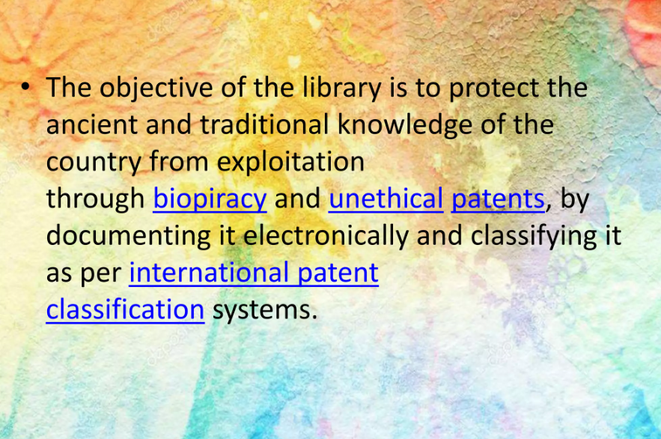

Slide 47


Slide 48
