Slide 1





Module-1
Introduction to Big Data, Big Data Analytics
Department of CSE- Data Science

Slide 2
Contents
Classification of data
Characteristics
Evolution and definition of Big data
What is Big data
Why Big data
Traditional Business Intelligence Vs Big Data
Typical data warehouse and Hadoop environment
Big Data Analytics: What is Big data Analytics
Classification of Analytics
Importance of Big Data Analytics
Technologies used in Big data Environments
Few Top Analytical Tools , NoSQL, Hadoop.
Department of CSE- Data Science

Slide 3
Introduction
Irrespective of the size of the enterprise (big or small), data continues to be a precious and irreplaceable asset.
Data is present internal to the enterprise and also exists outside the four walls and firewalls of the enterprise.
Data is present in homogeneous sources as well as in heterogeneous sources. The need of the hour is to understand, manage, process, and take the data for analysis to draw valuable insights.
Data → Information
Information → Insights
Department of CSE- Data Science

Slide 4
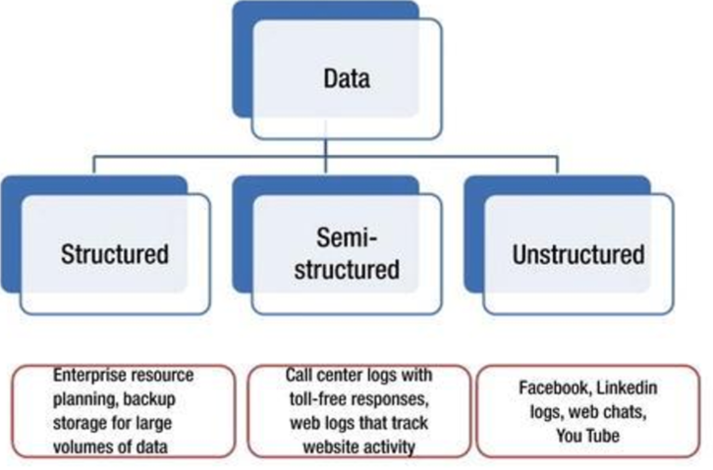
Classification of Digital data
Department of CSE- Data Science

Slide 5
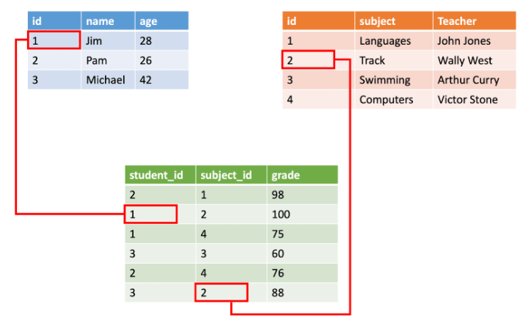
Structured data
data which is in an organized form(e.g, rows and columns) and can be easily used by a computer program.
Relationships exist between entities of data, such as classes and their objects.
Data stored in databases is an example of structured data.
Department of CSE- Data Science

Slide 6
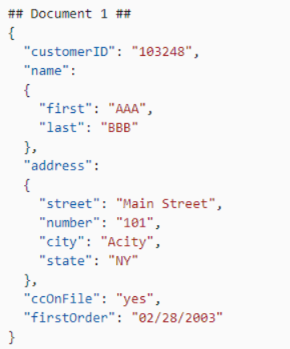
Semi-structured data
Data which does not conform to a data model but has some structure.
It is not in a form which can be used easily by a computer program.
For example, emails, XML, markup languages like HTML etc.,
Department of CSE- Data Science

Slide 7
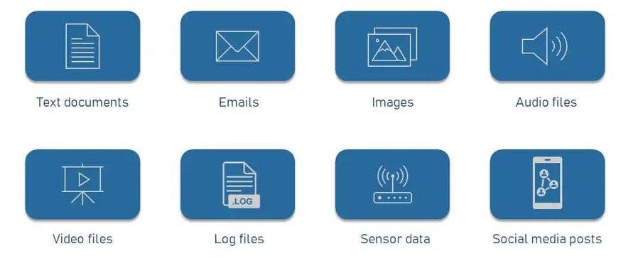
Unstructured data
Data which does not conform to a data model or is not in a form which can be used easily by a computer program.
About 80%-90% data of an organization is in this format
For example, memos, chat rooms, powerpoint presentations, images, videos, letters etc,.
Department of CSE- Data Science

Slide 8
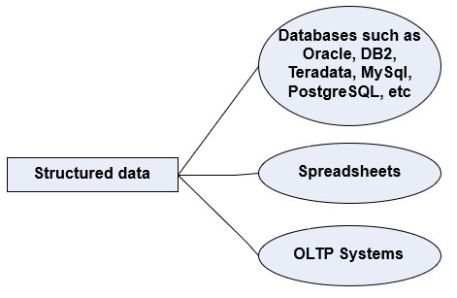
Structured Data
Sources of Structured Data
Department of CSE- Data Science

Slide 9
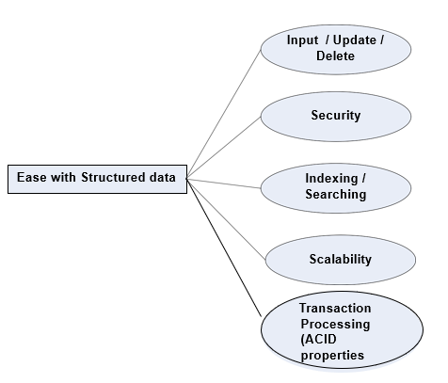
Ease of Working with Structured Data
Department of CSE- Data Science

Slide 10
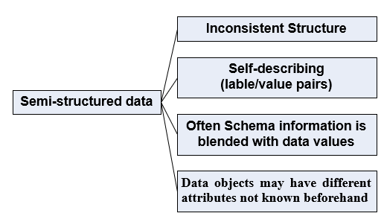
Semi-structured Data
Characteristics of semi-structured data
Department of CSE- Data Science

Slide 11
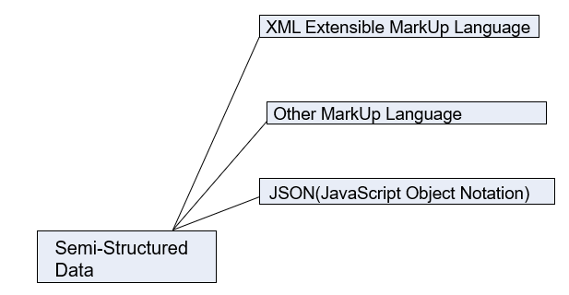
Sources of Semi-Structured Data
Department of CSE- Data Science

Slide 12
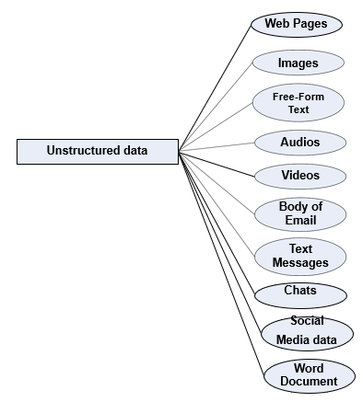
Unstructured Data
Sources of Unstructured Data
Department of CSE- Data Science

Slide 13
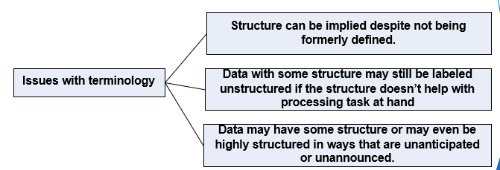
Issues with Unstructured Data
Department of CSE- Data Science

Slide 14
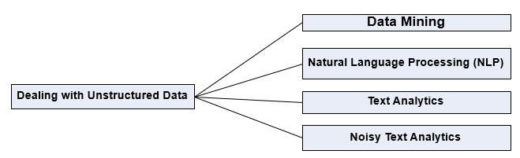
Dealing with Unstructured Data
Department of CSE- Data Science

Slide 15
Properties | Structured data | Semi-structured data | Unstructured data
Technology | It is based on Relational database table | It is based on XML/RDF(Resource Description Framework). | It is based on character and binary data
Transaction management | Matured transaction and various concurrency techniques | Transaction is adapted from DBMS not matured | No transaction management and no concurrency
Version management | Versioning over tuples,row,tables | Versioning over tuples or graph is possible | Versioned as a whole
Flexibility | It is schema dependent and less flexible | It is more flexible than structured data but less flexible than unstructured data | It is more flexible and there is absence of schema
Scalability | It is very difficult to scale DB schema | It’s scaling is simpler than structured data | It is more scalable.
Robustness | Very robust | New technology, not very spread | —
Query performance | Structured query allow complex joining | Queries over anonymous nodes are possible | Only textual queries are possible
Department of CSE- Data Science

Slide 16
Characteristics of Data
Data has three characteristics:
Composition: deals with structure of data, that is, the sources of data , the granularity, the types, and the nature of the data as to whether it is static or real-time streaming.
Condition: The condition of data deals with the state of the data that is “can one use this data as is for analysis?” or “Does it require cleansing for further enhancement and enrichment?”
Context: deals with “Where has this data been generated?”, “Why was this data generated?” and so on.
Department of CSE- Data Science

Slide 17
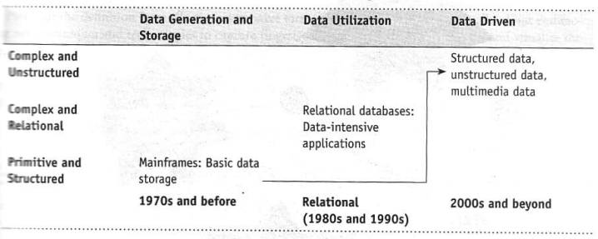
EVOLUTION OF BIG DATA
Department of CSE- Data Science

Slide 18
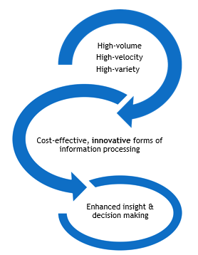
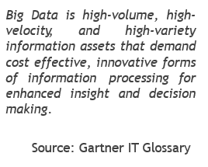
Definition of Big Data
Department of CSE- Data Science

Slide 19
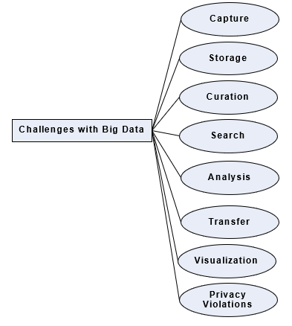
Challenges With Big Data
Department of CSE- Data Science

Slide 20
Data today is growing at an exponential rate. Most of the data that we have today has been generated in the last 2-3 years. This high tide of data will continue to rise incessantly. The key questions here are: “Will all this dara be useful for analysis?”, “Do we work with all this data or a subset of it?”, “How will we separate the knowledge from the noise?”, etc. Cloud computing and virtualization are here to stay.
Cloud computing is the answer to managing infrastructure for big data as far as cost-efficiency, elasticity, and easy upgrading/downgrading is concerned. This further complicates the decision to host big data solutions outside the enterprise.
The other challenge is to decide on the period of retention of big data. Just how long should one retain this data? A tricky question indeed as some data is useful for making long-term decisions, whereas in few cases, the data may quickly become irrelevant and obsolete just a few hours after having being generated.
Department of CSE- Data Science

Slide 21
There is a dearth of skilled professionals who possess a high level of proficiency in data sciences that is vital in implementing big data solutions.
Then, of course, there are other challenges with respect to capture, storage, preparation, search, analysis, transfer, security, and visualization of big data. Big data refers to datasets whose size is typically beyond the storage capacity of traditional database software tools. There is no explicit definition of how big the dataset should be for it to be considered “big data.” Here we are to deal with data that is just too big, moves way to fast, and does not fit the structures of typical database systems. The data changes are highly dynamic and therefore there is a need o ingest this as quickly as possible.
Data visualization is becoming popular as a separate discipline. We are short by quite a number, as far as business visualization experts are concerned.
Department of CSE- Data Science

Slide 22
WHAT IS BIG DATA?
Big data is data that is big in volume, velocity, and variety.
Volume
Typical internal sources:
  Data Storage- File systems, SQL, NoSQL (MongoDB, Cassandra).
  Archives – Archives of scanned documents, paper archives, customer records, patient health records etc,.
2. External data sources:
  public web - Wikipedia, weather, regulatory, census etc.
Department of CSE- Data Science

Slide 23
3. Both (internal+external)
  Sensor data – Car sensors, smart electric meters, office buildings etc,.
  Machine log data – Event logs, application logs, Business process logs, audit logs etc.
  Social media – Twitter, blogs, Facebook, LinkedIn, Youtube, Instagram etc,.
  Business apps – ERP,CRM, HR, Google Docs, and so on.
  Media – Audio, Video, Image, Podcast, etc.
  Docs – CSV, Word Documents, PDF,XLS, PPT and so on.
Department of CSE- Data Science

Slide 24
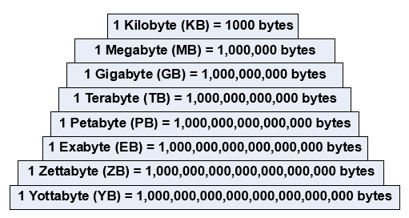
A Mountain of Data
Department of CSE- Data Science

Slide 25
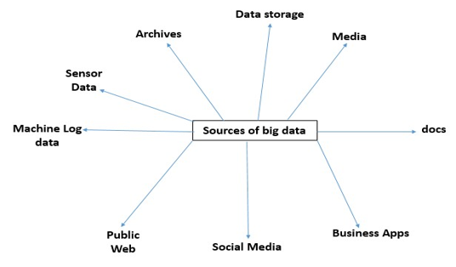
Sources of Big Data
Department of CSE- Data Science

Slide 26
Velocity
Variety
Variety deals with a wide range of data types and sources of data.
Structured data: From traditional transaction processing systems and RDBMS, etc.
Semi-structured data: For example Hyper Text Markup Language (HTML), eXtensible Markup Language (XML).
Unstructured data: For example unstructured text documents, audios, videos, emails, photos, PDFs, social media, etc.
Batch → Periodic → Near real time → Real-time processing
Department of CSE- Data Science

Slide 27
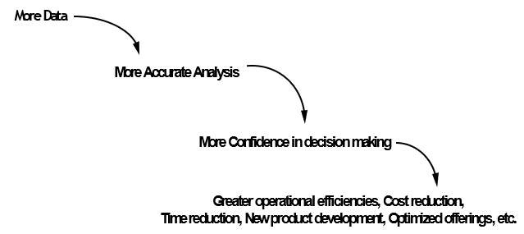
Why Big Data?
Department of CSE- Data Science

Slide 28
Traditional Business Intelligence (Bi) Versus Big Data
In traditional BI environment, all the enterprise’s data is housed in a central server whereas in a big data environment data resides in a distributed file system. The distributed file system scales by scaling in or out horizontally as compared to typical database server that scales vertically.
In traditional BI, data is generally analyzed in an offline mode whereas in big data, it is analyzed in both real time as well as in offline mode.
Traditional BI is about structured data and it is here that data is taken to processing functions whereas big data is about variety and here the processing functions are taken to the data.
Department of CSE- Data Science

Slide 29
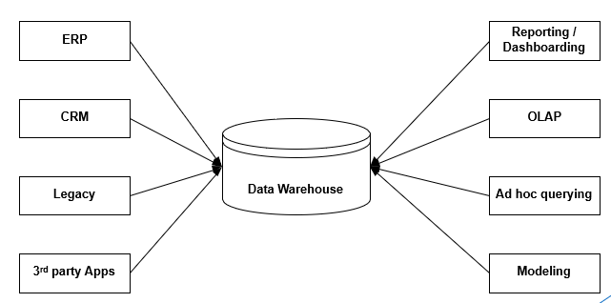
A Typical Data Warehouse Environment
Department of CSE- Data Science

Slide 30
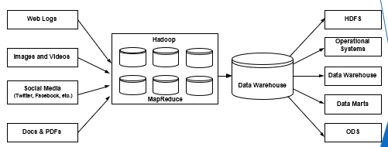
A Typical Hadoop Environment
Department of CSE- Data Science

Slide 31
WHAT IS BIG DATA ANALYTICS?
Technology-enabled analytics: Quite a few data analytics and visualization tools are available in the market today from leading vendors such as IBM, Tableau, SAS, R Analytics, Statistical, World Programming Systems (WPS), etc. to help process and analyze your big data.
About gaining a meaningful, deeper, and richer insight into your business to steer in the right direction, understanding the customer’s demographics to cross-sell and up-sell to them, better leveraging the services of your vendors and suppliers, etc.
Author’s experience: The other day I was pleasantly surprised to get a few recommendations via email from one of my frequently visited online retailers, They had recommended clothing line from my favorite brand and also the color suggested was one to my liking. How did they arrive at this? In the recent past, I had been buying clothing line of a particular brand and the color preference was pastel shades. They had it stored in their database and pulled it out while making recommendations to me.
Department of CSE- Data Science

Slide 32
About a competitive edge over your competitors by enabling you with findings that allow quicker and better decision-making.
A tight handshake between three communities: IT, business users, and data scientists.
Working with datasets whose volume and variety exceed the current storage and processing capabilities and infrastructure of your enterprise.
About moving code to data. This makes perfect sense as the program for distributed processing is tiny (just a few KBs) compared to the data (Terabytes or Petabytes today and likely to be Exabytes or Zettabytes in the near future).
Department of CSE- Data Science

Slide 33
Classification Of Analytics
These are basically two schools of thought:
Those that classify analytics into basic, operationalized, advanced, and
monetized.
Those that classify analytics into analytics 1.0, analytics 2.0, and analytics 3.0.
First School of Thought
Basic analytics: This primarily is slicing and dicing of data to help with basic business insights. This is about reporting on historical data, basic visualization, etc.
Operationalized analytics: It is operationalized analytics if it gets woven into the enterprise’s business processes.
Advanced analytics: This largely is about forecasting for the future by way of predictive and prescriptive modeling.
Monetized analytics: This is analytics in use to derive direct business revenue.
Department of CSE- Data Science

Slide 34
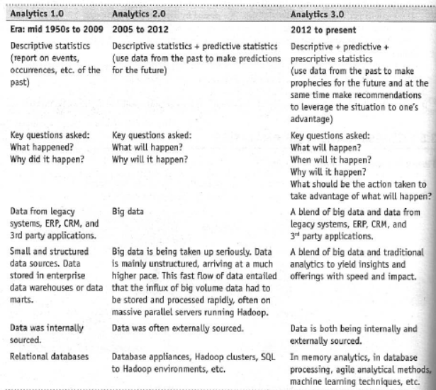
Second School of Thought
Let us take a closer look at analytics 1.0, analytics 2.0, and analytics 3.0.
Table : Analytics 1.0, 2.0, and 3.0
Department of CSE- Data Science

Slide 35
Department of CSE- Data Science

Slide 36
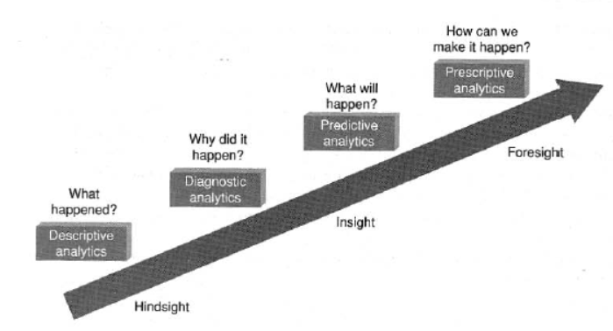
Figure : Analytics 1.0, 2.0, and 3.0.
Department of CSE- Data Science

Slide 37
Importance of Big Data Analytics
Let us study the various approaches to analysis of data and what it leads to.
Reactive — Business Intelligence: What does Business Intelligence (BI) help us with? It allows the businesses to make faster and better decisions by providing the right information to the right person at the right time in the right format. It is about analysis of the past or historical data and then displaying the findings of the analysis or reports in the form of enterprise dashboards, alerts, notifications, etc. It has support for both pre-specified reports as well as ad hoc querying.
Reactive — Big Data Analytics: Here the analysis is done on huge datasets but the approach is still reactive as it is still based on static data.
Department of CSE- Data Science

Slide 38
Proactive — Analytics: This is to support futuristic decision making by the use of data mining, predictive modeling, text mining, and statistical analysis. This analysis is not on big data as it still us the traditional database management practices on big data and therefore has severe limitations on the storage capacity and the processing capability.
Proactive - Big Data Analytics: This is sieving through terabytes, petabytes, exabytes of information to filter out the relevant data to analyze. This also includes high performance analytics to gain rapid insights from big data and the ability to solve complex problems using more data.
Department of CSE- Data Science

Slide 39
Terminologies used in Big data Environments
In-Memory Analytics
Data access from non-volatile storage such as hard disk is a slow process. The more the data is required to be fetched from hard disk or secondary storage, the slower the process gets. One way to combat this challenge is to pre-process and store data (cubes, aggregate tables, query sets, etc.) so that the CPU has to fetch a small subset of records. But this requires thinking in advance as to what data will be required for analysis.
If there is a need for different or more data, it is back to the initial process of pre-computing and storing data or fetching it from secondary storage. This problem has been addressed using in-memory analytics. Here all the relevant data is stored in Random Access Memory (RAM) or primary storage thus eliminating the need to access the data from hard disk. The advantage is faster access, rapid deployment, better insights, and minimal IT involvement.
Department of CSE- Data Science

Slide 40
In-Database Processing
In-database processing is also called as in-database analytics. It works by fusing data warehouses with analytical systems.
Typically the data from various enterprise On Line Transaction Processing (OLTP) systems after cleaning up (de-duplication, scrubbing, etc.) through the process of ETL is stored in the Enterprise Data Warehouse (EDW) or data marts.
The huge datasets are then exported to analytical programs for complex and extensive computations.
With in-database processing, the database program itself can run the computations eliminating the need for export and thereby saving on time. Leading database vendors are offering this feature to large businesses.
Department of CSE- Data Science

Slide 41
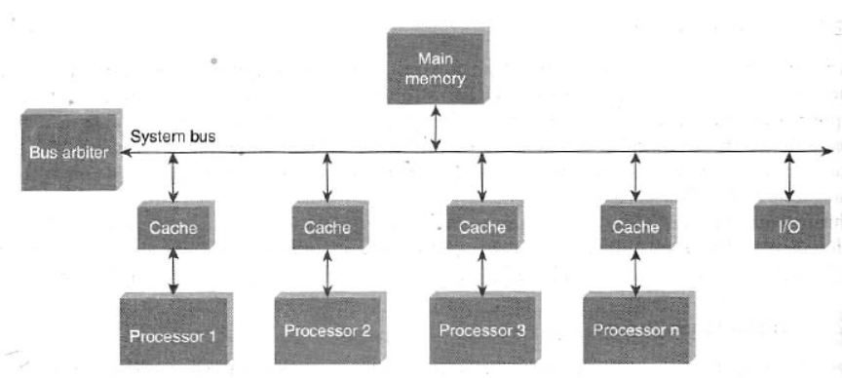
Symmetric Multiprocessor System (SMP)
In SMP there is a single common main memory that is shared by two or more identical processors.
The processors have full access to all I/O devices and are controlled by a single operating system instance.
SMP are tightly coupled multiprocessor systems. Each processor has its own high-speed memory, called cache memory and are connected using a system bus.
Figure : Symmetric Multiprocessor System.
Department of CSE- Data Science

Slide 42
Massively Parallel Processing
Massive Parallel Processing (MPP) refers to the coordinated processing of programs by a number of processors working parallel.
The processors, each have their own operating systems and dedicated memory. They work on different parts of the same program.
The MPP processors communicate using some sort of messaging interface. The MPP systems are more difficult to program as the application must be divided in such a way that all the executing segments can communicate with each other.
MPP is different from Symmetrically Multiprocessing (SMP) in that SMP works with the processors sharing the same operating system and same memory. SMP is also referred to as tightly-coupled multiprocessing.
Department of CSE- Data Science

Slide 43
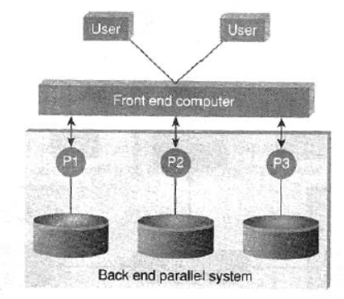
Difference Between Parallel and Distributed Systems
Parallel Systems
A parallel database system is a tightly coupled system. The processors co-operate for query processing.
Figure : Parallel system
Department of CSE- Data Science

Slide 44
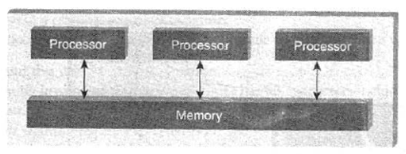
The user is unaware of the parallelism since he/she has no access to a specific processor of the system.
Either the processors have access to a common memory or make use of message passing for communication.
Figure : Parallel system.
Department of CSE- Data Science

Slide 45
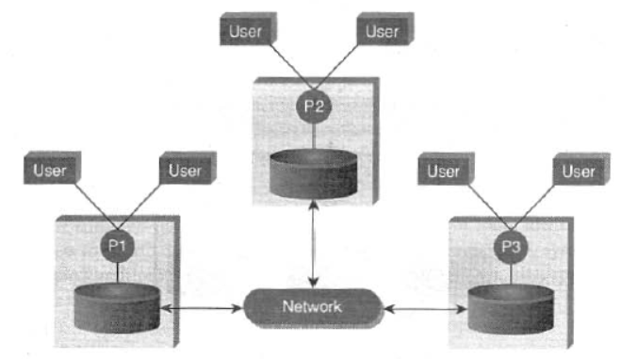
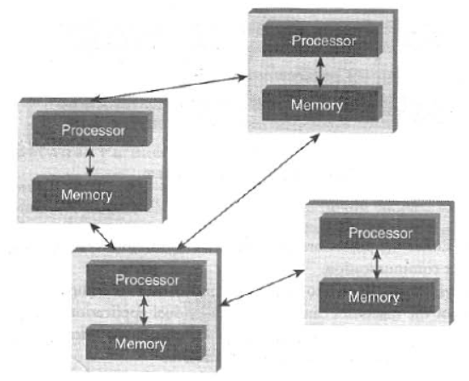
Distributed database systems
Distributed database systems are known to be loosely coupled and are composed by individual machines.
Each of the machines can run their individual application and serve their own respective user. The data is usually distributed across several machines, thereby necessitating quite a number of machines to be accessed to answer a user query.
Figure : Distributed system.
Department of CSE- Data Science

Slide 46
Shared Nothing Architecture
Let us look at the three most common types of architecture for multiprocessor high transaction rate systems.
They are:
Shared Memory (SM)
Shared Disk (SD).
Shared Nothing (SN).
In shared memory architecture, a common central memory is shared by multiple processors.
In shared disk architecture, multiple processors share a common collection of disks while having their own private memory
In shared nothing architecture, neither memory nor disk is shared among multiple processors.
Department of CSE- Data Science

Slide 47
Advantages of a “Shared Nothing Architecture”
Fault Isolation: A “Shared Nothing Architecture” provides the benefit of isolating fault. A fault in single node is contained and confined to that node exclusively and exposed only through messages (or lack of it).
Scalability: Assume that the disk is a shared resource. It implies that the controller and the disk bandwidth are also shared. Synchronization will have to be implemented to maintain a consistent shred state. This would mean that different nodes will have to take turns to access the critical data. This imposes a limit on how many nodes can be added to the distributed shared disk system, thus compromising on scalability.
Department of CSE- Data Science

Slide 48
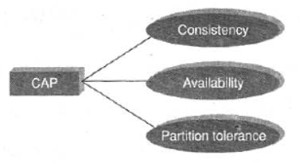
CAP Theorem Explained
The CAP theorem is also called the Brewer’s Theorem. It states that in a distributed computing environment a collection of interconnected nodes that share data), it is impossible to provide the following guarantees.
At best you can have two of the following three — one must be sacrificed.
1. Consistency
2. Availability
3. Partition tolerance
Figure : Brewer's CAP.
Department of CSE- Data Science

Slide 49
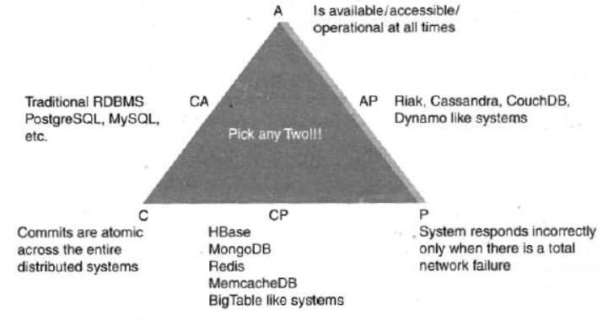
Consistency implies that every read fetches the last write.
Availability implies that reads and writes always succeed. In other words, each non-failing node will return a response in a reasonable amount of time.
Partition tolerance implies that the system will continue to function when network partition occurs.
Department of CSE- Data Science

Slide 50
NoSQL (NOT ONLY SQL)
The term NoSQL was first coined by Carlo Strozzi in 1998 to name his lightweight, open-source, relational database that did not expose the standard SQL interface.
Few features of NoSQL databases are as follows: .
They are open sources
They are nonrelational
They are distributed
They are schema less
They are cluster friendly
They are born out of 21st century web applications.
Department of CSE- Data Science

Slide 51
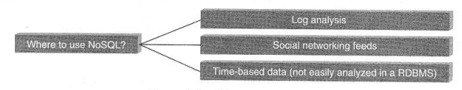
Where is it Used?
NoSQL databases are widely used in big data and other real-time web applications.
NoSQL. databases is used to stock log data which can then be pulled for analysis.
It is used to store social media data and all such data which cannot be stored and analyzed comfortably in RDBMS.
Figure : Where to use NoSQL?
Department of CSE- Data Science

Slide 52
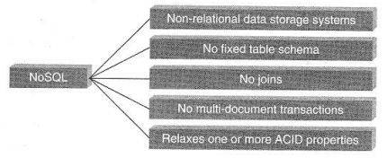
What is it?
NoSQL stands for Not Only SQL. These are non-relational, open source, distributed databases. They are hugely popular today owing to their ability to scale out or scale horizontally and the adeptness at dealing with a rich variety of data: structured, semi-structured and unstructured data,
Figure: What is NoSQL?
Department of CSE- Data Science

Slide 53
Are non-relational: They do not adhere to relational data model, In fact, they are either key-value pairs or document-oriented or column-oriented or graph-based databases.
Are distributed: They are distributed meaning the data is distributed across several nodes in a cluster constituted of low-cost commodity hardware.
Offer no support for ACID properties (Atomicity, Consistency, Isolation, and Durability): They do not offer support for ACID properties of transactions. On the contrary, they have adherence to Brewer’s CAP (Consistency, Availability, and Partition tolerance) theorem and are often seen compromising on consistency in favor of availability and partition tolerance.
Provide no fixed table schema: NoSQL databases are becoming increasing popular owing to their support for flexibility to the schema. They do not mandate for the daa to strictly adhere to any schema structure at the time of storage.
Department of CSE- Data Science

Slide 54

Types of NoSQL Databases
Key-value
Schema-less.
Key-value
It maintains a big hash table of keys and values.
For example, Dynamo, Redis, Riak, etc. Sample Key-Value Pair in Key-Value Database
Department of CSE- Data Science

Slide 55
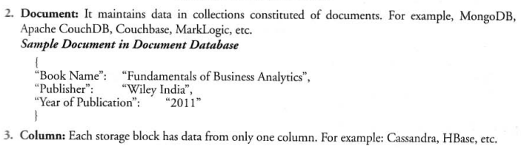
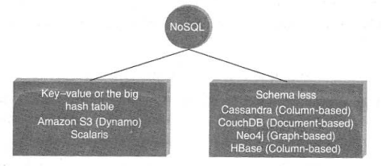
Figure : Types of NoSQL databases
Department of CSE- Data Science

Slide 56
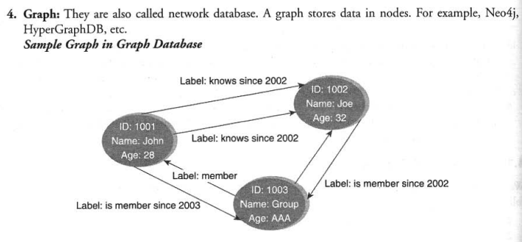
Department of CSE- Data Science

Slide 57
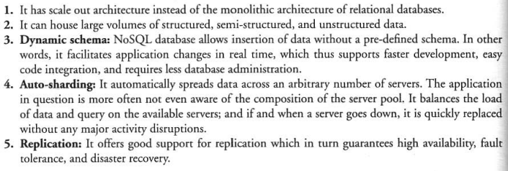
Why NoSQL?
Department of CSE- Data Science

Slide 58
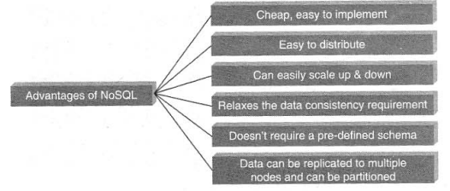
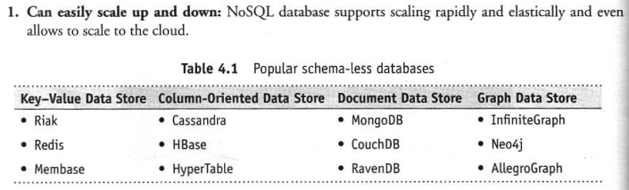
Advantages of NoSQL
Department of CSE- Data Science

Slide 59
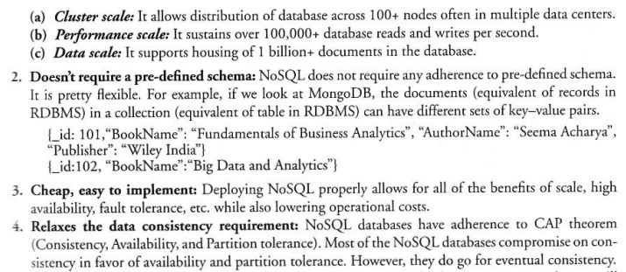
Department of CSE- Data Science

Slide 60
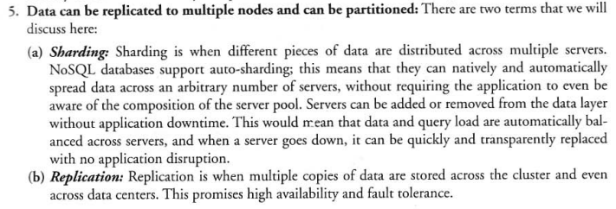
Department of CSE- Data Science

Slide 61
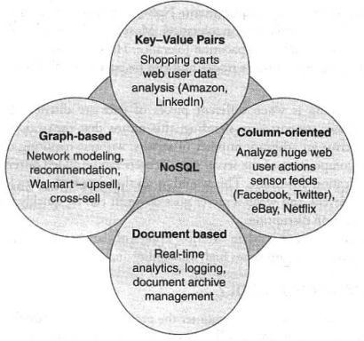
Use of NoSQL in Industry
Department of CSE- Data Science

Slide 62
HADOOP
Hadoop is an open-source project of the Apache foundation.
It is a framework written in Java, originally developed by Doug Cutting in 2005 who named it after his son's toy elephant. He was working with Yahoo then.
It was created to support distribution for “Nutch”, the text search engine. Hadoop uses Google’s MapReduce and Google File System technologies as its foundation.
Hadoop is now a core part of the computing infrastructure for companies such as Yahoo, Facebook, Linkedn, Twitter, etc.
Department of CSE- Data Science

Slide 63
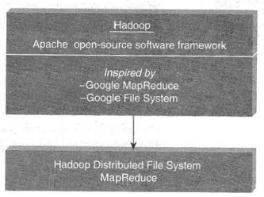
Figure : Hadoop
Department of CSE- Data Science

Slide 64
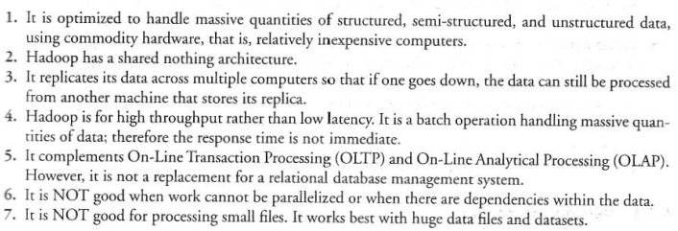
Features of Hadoop
Department of CSE- Data Science

Slide 65
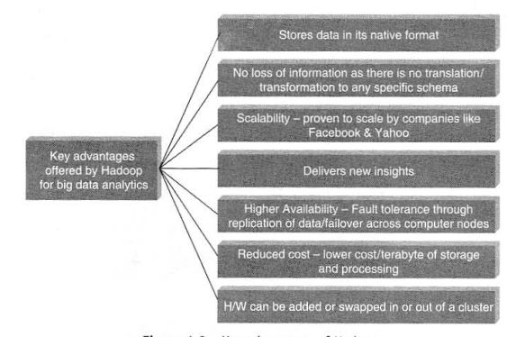
Key Advantages of Hadoop
Department of CSE- Data Science

Slide 66
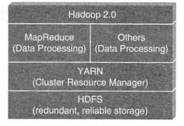
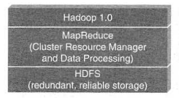
Versions of Hadoop
There are two versions of Hadoop available:
Hadoop 1.0
Hadoop 2.0
Department of CSE- Data Science

Slide 67
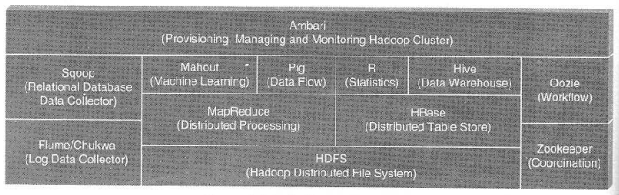
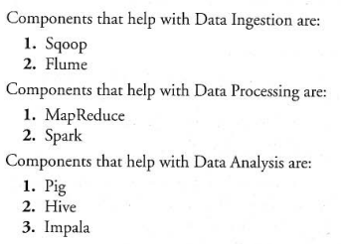
Overview of Hadoop Ecosystems
There are components available in the Hadoop ecosystem for data ingestion, processing, and analysis.
Data Ingestion → Data Processing → Data Analysis
Department of CSE- Data Science

Slide 68
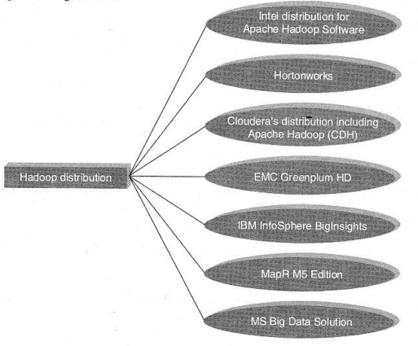
Hadoop Distributions
The core aspects of Hadoop include the following:
Hadoop Common
Hadoop Distributed File System (HDFS)
Hadoop YARN (Yet Another Resource Negotiator)
Hadoop MapReduce
Department of CSE- Data Science

