Slide 1





ML Lab: Experiment 1
Exploring the California Housing Dataset
Prepared By,
Dr. Anitha DB
Associate Professor & Head
Department of CSE-Data Science
ATME College of Engineering, Mysuru
ATME College of Engineering, Mysuru
Department of CSE-DS, ATMECE

Slide 2
Machine Learning Lab- Experiment 1
Experiment 1: Exploring the California Housing Dataset
Problem Statement: Develop a program to create histograms for all numerical features and analyze the distribution of each feature. Generate box plots for all numerical features and identify any outliers. Use California Housing dataset.
Introduction to the Dataset
  The dataset is from the 1990 California census, used in Aurélien Géron's book Hands-On Machine Learning with Scikit-Learn and TensorFlow.
  It's great for beginners due to its simple structure and moderate size.
  Contains housing information from various California districts, allowing for an easy introduction to machine learning.
ATME College of Engineering, Mysuru
Department of CSE-DS, ATMECE

Slide 3
Machine Learning Lab- Experiment 1
Dataset Overview
Columns:
  longitude: Geographical coordinate (longitude).
  latitude: Geographical coordinate (latitude).
  housing_median_age: Median age of the houses.
  total_rooms: Total number of rooms in the houses.
  total_bedrooms: Total number of bedrooms.
  population: Number of people in the district.
  households: Number of households in the district.
  median_income: Median income of the district.
  median_house_value: Target variable, median house value.
  ocean_proximity: Distance from the ocean (categorical variable).
ATME College of Engineering, Mysuru
Department of CSE-DS, ATMECE

Slide 4
Machine Learning Lab- Experiment 1
Data Preprocessing
Data Cleaning Steps:
  Missing values were handled by replacing total_bedrooms with the median value.
  Duplicated rows and missing data were checked.
  Converted some columns like total_rooms, total_bedrooms, etc., to integers.
Key Code:
df['total_bedrooms'].fillna(df['total_bedrooms'].median(), inplace=True)
ATME College of Engineering, Mysuru
Department of CSE-DS, ATMECE

Slide 5
Machine Learning Lab- Experiment 1
Descriptive Statistics
Summary of basic statistics:
  df.describe() gives a quick look at the distribution of numerical features.
Key Insights:
  Range of values for each column.
  Identifying potential outliers or unusual distributions.
ATME College of Engineering, Mysuru
Department of CSE-DS, ATMECE

Slide 6
Machine Learning Lab- Experiment 1
Univariate Analysis (Histograms)
Visualizations for Numerical Features:
  Histograms for longitude, latitude, housing_median_age, total_rooms, median_income, population, and median_house_value.
  Key Observations:
    Longitude and Latitude show geographic clustering.
    Housing Median Age indicates a concentration of older houses.
    Total Rooms has a skewed distribution.
    Median Income shows a concentration of lower-to-mid-income households.
Population and Households show large urban areas with high population and households.
ATME College of Engineering, Mysuru
Department of CSE-DS, ATMECE

Slide 7
Machine Learning Lab- Experiment 1
Univariate Analysis (Boxplots)
Boxplots for Numerical Features:
  Key goal: Identify outliers in each feature.
  Key Observations:
    Total Rooms and Total Bedrooms: Several outliers with very high values.
    Population shows a significant number of outliers with extreme values.
    Median House Value has outliers near the upper end.
ATME College of Engineering, Mysuru
Department of CSE-DS, ATMECE

Slide 8
Machine Learning Lab- Experiment 1
Outlier Analysis
Outliers: Identified in several numerical features, such as:
  Total Rooms and Total Bedrooms: Extreme values.
  Population: Extreme high values.
  Median Income: Potentially skewed by high-income outliers.
Handling Outliers:
  Transformation: Use log or square root transformation for highly skewed data.
  Removal: Remove outliers if they are due to data errors or irrelevant for analysis.
ATME College of Engineering, Mysuru
Department of CSE-DS, ATMECE

Slide 9
Machine Learning Lab- Experiment 1
Suggested Actions for Outlier Handling
General Actions:
  Transformation: Apply log or square root transformations to features like total rooms, population, and median income.
  Removal: If outliers are errors, remove or adjust them.
Further Exploration: Investigate the root cause of extreme values before deciding on their removal
ATME College of Engineering, Mysuru
Department of CSE-DS, ATMECE

Slide 10
Machine Learning Lab- Experiment 1
Summary:
  The California Housing Dataset is a great starting point for learning machine learning and data analysis.
  While the data isn't perfectly clean, it provides a solid foundation for exploring preprocessing, descriptive statistics, and feature engineering.
  Outlier analysis and transformations are essential steps before building machine learning models.
Next Steps:
  Build a machine learning model to predict median_house_value.
  Apply feature scaling and transformation techniques to improve model accuracy.
ATME College of Engineering, Mysuru
Department of CSE-DS, ATMECE

Slide 11
Machine Learning Lab- Experiment 1
Program
import pandas as pd
import numpy as np
import matplotlib.pyplot as plt
import seaborn as sns
import warnings
warnings.filterwarnings('ignore')
df=pd.read_csv(r'C:\Datasets\housing.csv')
df.head()
df.shape
df.info()
df.nunique()
ATME College of Engineering, Mysuru
Department of CSE-DS, ATMECE

Slide 12
Machine Learning Lab- Experiment 1
# Data Cleaning
df.isnull().sum()
df.duplicated().sum()
df['total_bedrooms'].median()
# Handling missing values
df['total_bedrooms'].fillna(df['total_bedrooms'].median(), inplace=True)
#Feature Engineering
for i in df.iloc[:,2:7]:
df[i] = df[i].astype('int')
df.head()
ATME College of Engineering, Mysuru
Department of CSE-DS, ATMECE

Slide 13
Machine Learning Lab- Experiment 1
#Disciptive Statistics
df.describe().T
Numerical = df.select_dtypes(include=[np.number]).columns
print(Numerical)
Uni-Variate Analysis
for col in Numerical:
plt.figure(figsize=(10, 6))
df[col].plot(kind='hist', title=col, bins=60, edgecolor='black')
plt.ylabel('Frequency')
plt.show()
ATME College of Engineering, Mysuru
Department of CSE-DS, ATMECE

Slide 14
Machine Learning Lab- Experiment 1
for col in Numerical:
plt.figure(figsize=(6, 6))
sns.boxplot(df[col], color='blue')
plt.title(col)
plt.ylabel(col)
plt.show()
ATME College of Engineering, Mysuru
Department of CSE-DS, ATMECE

Slide 15
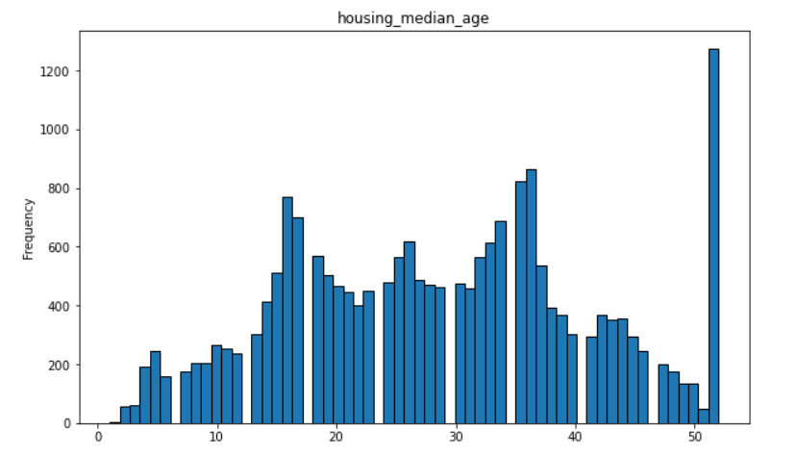
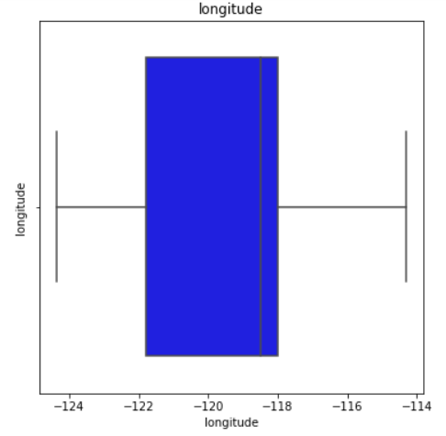
Machine Learning Lab- Experiment 1
Sample Outputs
ATME College of Engineering, Mysuru
Department of CSE-DS, ATMECE

