Slide 1


Introduction to Deep Learning
                BY:
                Prof. Neethi M V
                Assistant Professor
                Dept. of CSE-DS
                ATMECE, Mysuru
Department of Computer Science and Engineering - DS

Slide 2
Module 1 – Introduction
Introduction to Deep Learning: Introduction, Deep learning Model, Historical Trends in Deep Learning,
Machine Learning Basics: Learning Algorithms, Supervised Learning Algorithms, Unsupervised Learning Algorithms.
Department of Computer Science and Engineering - DS

Slide 3
Introduction
Today, artificial intelligence (AI) is a thriving field with many practical applications and active research topics.
We look to intelligent software to automate routine labor, understand speech or images, make diagnoses in medicine and support basic scientific research
The true challenge to artificial intelligence proved to be solving the tasks that are easy for people to perform but hard for people to describe formally—problems that we solve intuitively, that feel automatic, like recognizing spoken words or faces in images
Department of Computer Science and Engineering - DS

Slide 4
Introduction
A computer can reason about statements in these formal languages automatically using logical inference rules. This is known as the knowledge base approach to artificial intelligenc
A simple machine learning algorithm called logistic regression can determine whether to recommend cesarean delivery
The performance of these simple machine learning algorithms depends heavily on the representation of the data they are given
The quintessential example of a representation learning algorithm is the auto encoder.
An autoencoder is the combination of an encoder function that converts the input data into a different representation, and a decoder function that converts the new representation back into the original format.
Department of Computer Science and Engineering - DS

Slide 5
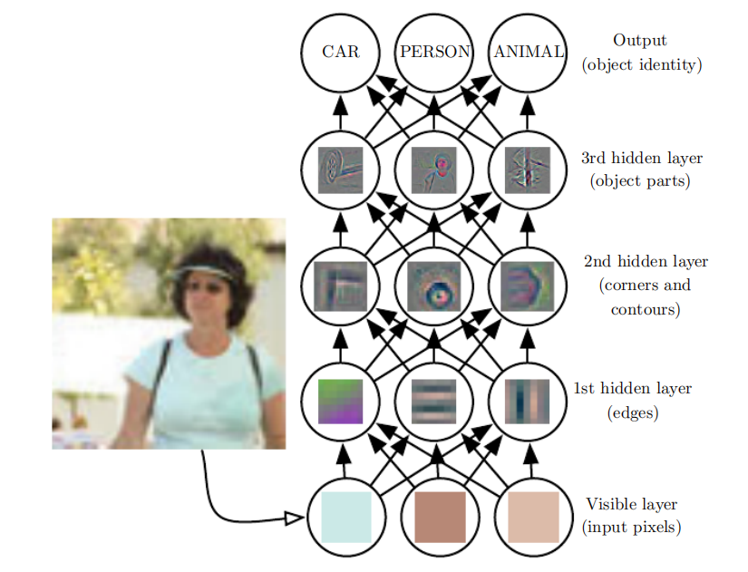
Introduction
Deep learning solves this central problem in representation learning by introducing representations that are expressed in terms of other, simpler representations.
The quintessential example of a deep learning model is the feedforward deep network or multilayer perceptron (MLP).
Department of Computer Science and Engineering - DS

Slide 6
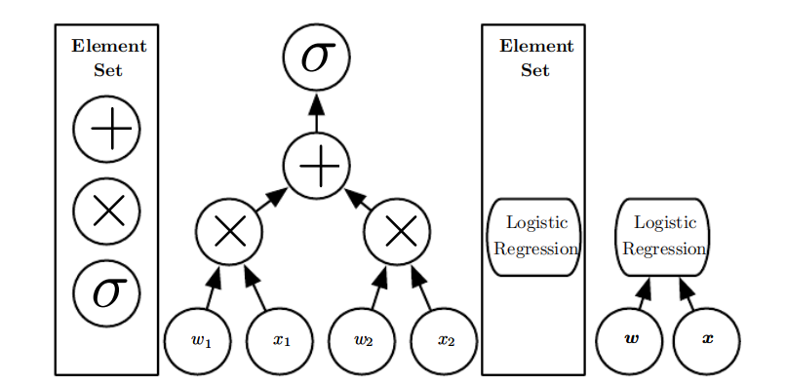
Introduction
The input is presented at the visible layer, so named because it contains the variables that we are able to observe..
Then a series of hidden layers extracts increasingly abstract features from the image.
Figure 1.3: Illustration of computational graphs mapping an input to an output where
each node performs an operation.
Department of Computer Science and Engineering - AIML

Slide 7
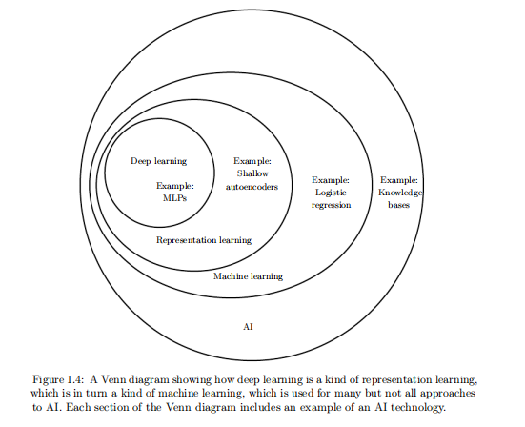

Slide 8
Historical Trends in Deep Learning
It is easiest to understand deep learning with some historical context. Rather than providing a detailed history of deep learning, we identify a few key trends:
Deep learning has had a long and rich history, but has gone reflecting different philosophical view points, and has waxed and waned in popularity.
Deep learning has become more useful as the amount of available training data has incresed
Deep learning models have grown in size over time as computer infrastructure for deep learning has improved.
Deep accuracy learning has solved increasingly complicated applications with increasing over time.
Department of Computer Science and Engineering - DS

Slide 9
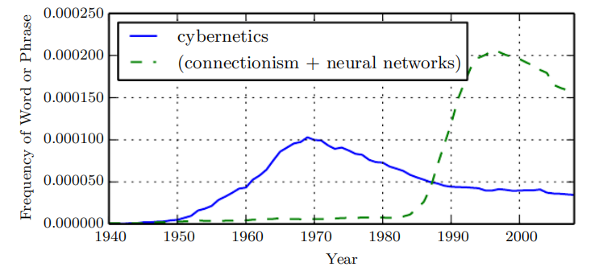
The Many Names and Changing Fortunes of Neural Networks
Broadly speaking, there have been three waves of development of deep learning:
Deep learning known as cybernetics in the 1940s–1960s,
Deep learning known as connectionism in the 1980s–1990s, and the current resurgence under the name
Deep learning beginning in 2006.
As a result, one of the names that deep learning has gone by is artificial neural networks (ANNs).
Department of Computer Science and Engineering - DS

Slide 10
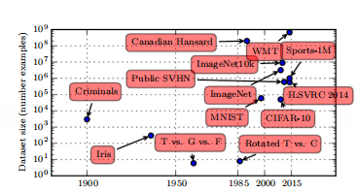
Increasing Dataset Sizes
Deep learning has been successfully used in commercial applications since the 1990s
This trend is driven by the increasing digitization of society.
As more and more of our activities take place on computers,more and more of what we do is recorded
The age of “Big Data” has made machine learning much easier because the key burden of statistical
estimation—generalizing well to new data after observing only a small amount of data—has been considerably lightened
Department of Computer Science and Engineering - DS

Slide 11
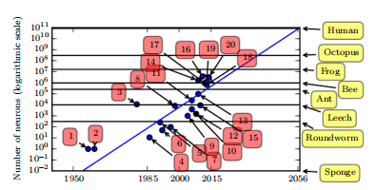

Slide 12
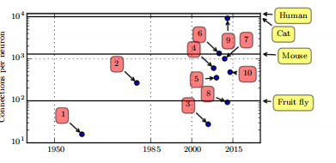
➔
Increasing Model Sizes
One of the main insights of connection_x0002_ism is that animals become intelligent when many of their neurons work together.
Since the introduction of hidden units, artificial neural networks have doubled in size roughly every 2.4 years.
This growth is driven by faster computers with larger memory and by the availability of larger datasets
Even today’s networks, which we consider quite large from a computational systems point of view, are smaller than the nervous system of even relatively primitive vertebrate animals like frogs.
The increase in model size over time, due to the availability of faster CPUs,the advent of general purpose GPUs faster network connectivity and better software infrastructure for distributed computing, is one of the most important trends in the history of deep learning
Department of Computer Science and Engineering - DS

Slide 13

Department of Computer Science and Engineering - AIML

