Slide 1
PROBLEM-SOLVING THROUGH PROGRAMMING
Course Name
Course Code
BPOPS203
Course Coordinator
Darshini Y
Assistant Professor Dept of CSD ATMECE, Mysuru
Contact Hours
40
CIE Marks
50
SEE Marks
50

Slide 2
Course Outcomes
Elucidate the basic architecture and functionalities of a Computer CLO
Apply programming constructs of C language to solve the real-world problems
Explore user-defined data structures like arrays, structures and pointers in implementing solutions to problems
Design and Develop Solutions to problems using structured programming constructs such as functions and procedures

Slide 3
Text Book
1. E. Balaguruswamy, Programming in ANSI C, 7th Edition, Tata McGraw-Hill
2. Brian W. Kernighan and Dennis M. Ritchie, The ‘C’ Programming Language, Prentice Hall of India.
Reference:
1. Reema Thereja , Programming in C , Cengage publication,
Web links and Video Lectures (e-Resources):
1. elearning.vtu.ac.in/econtent/courses/video/BS/15PCD23.html
2. https://nptel.ac.in/courses/106/105/106105171/
3. MOOC courses can be adopted for more clarity in understanding the topics and
verities of problem solving methods.

Slide 4
Principles of Programming
Using C

Slide 5


Programming Languages
Programming Languages is the main medium for communicating between the computer systems.
A program is a collection of instructions that can be executed by computer to perform a specific task.
There were several programming languages used to communicate with the Computer.

Slide 6
C programming is a general-purpose, procedural, computer programming language developed in 1972 by Dennis M. Ritchie at the Bell Telephone Laboratories to develop the UNIX operating system.
C is the most widely used computer language.

Slide 7
Some of the key advantages of learning C Programming:
Easy to learn
Structured language
It produces efficient programs
It can handle low-level activities
It can be compiled on a variety of computer platforms

Slide 8
Facts about C
C was invented to write an operating system called UNIX.
C is a successor of B language which was introduced around the early 1970s.
The language was formalized in 1988 by the American National Standard Institute (ANSI).
The UNIX OS was totally written in C.
Today C is the most widely used and popular System Programming Language.
Most of the state-of-the-art software have been implemented using C.

Slide 9
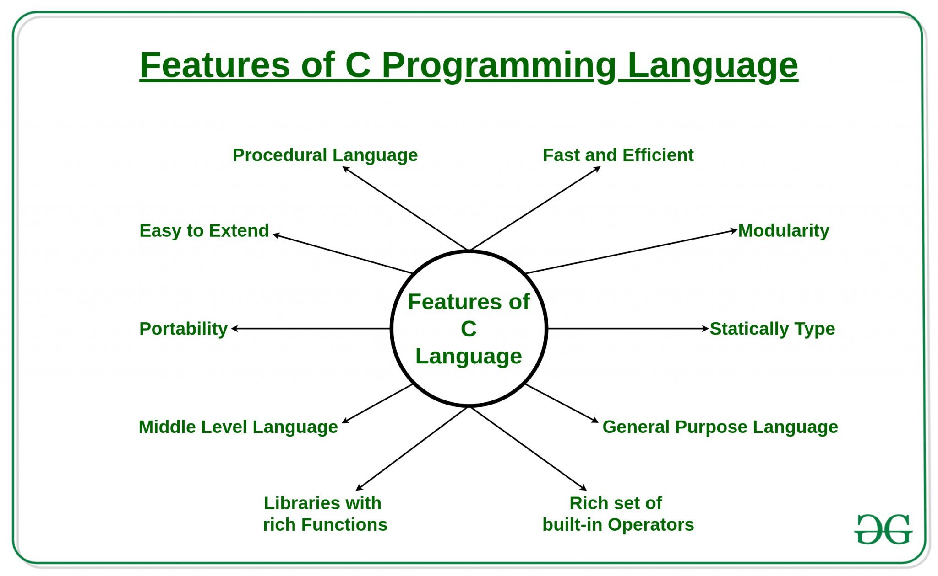

Slide 10
#include <stdio.h>
int main()
{ /* my first program in C */
printf("Hello, World! \n");
return 0;
}

Slide 11
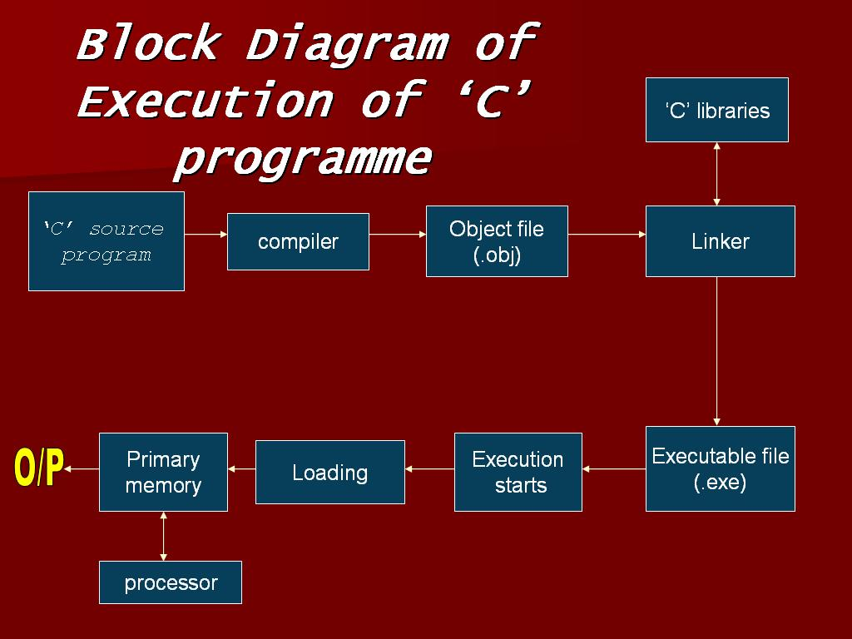

Slide 12
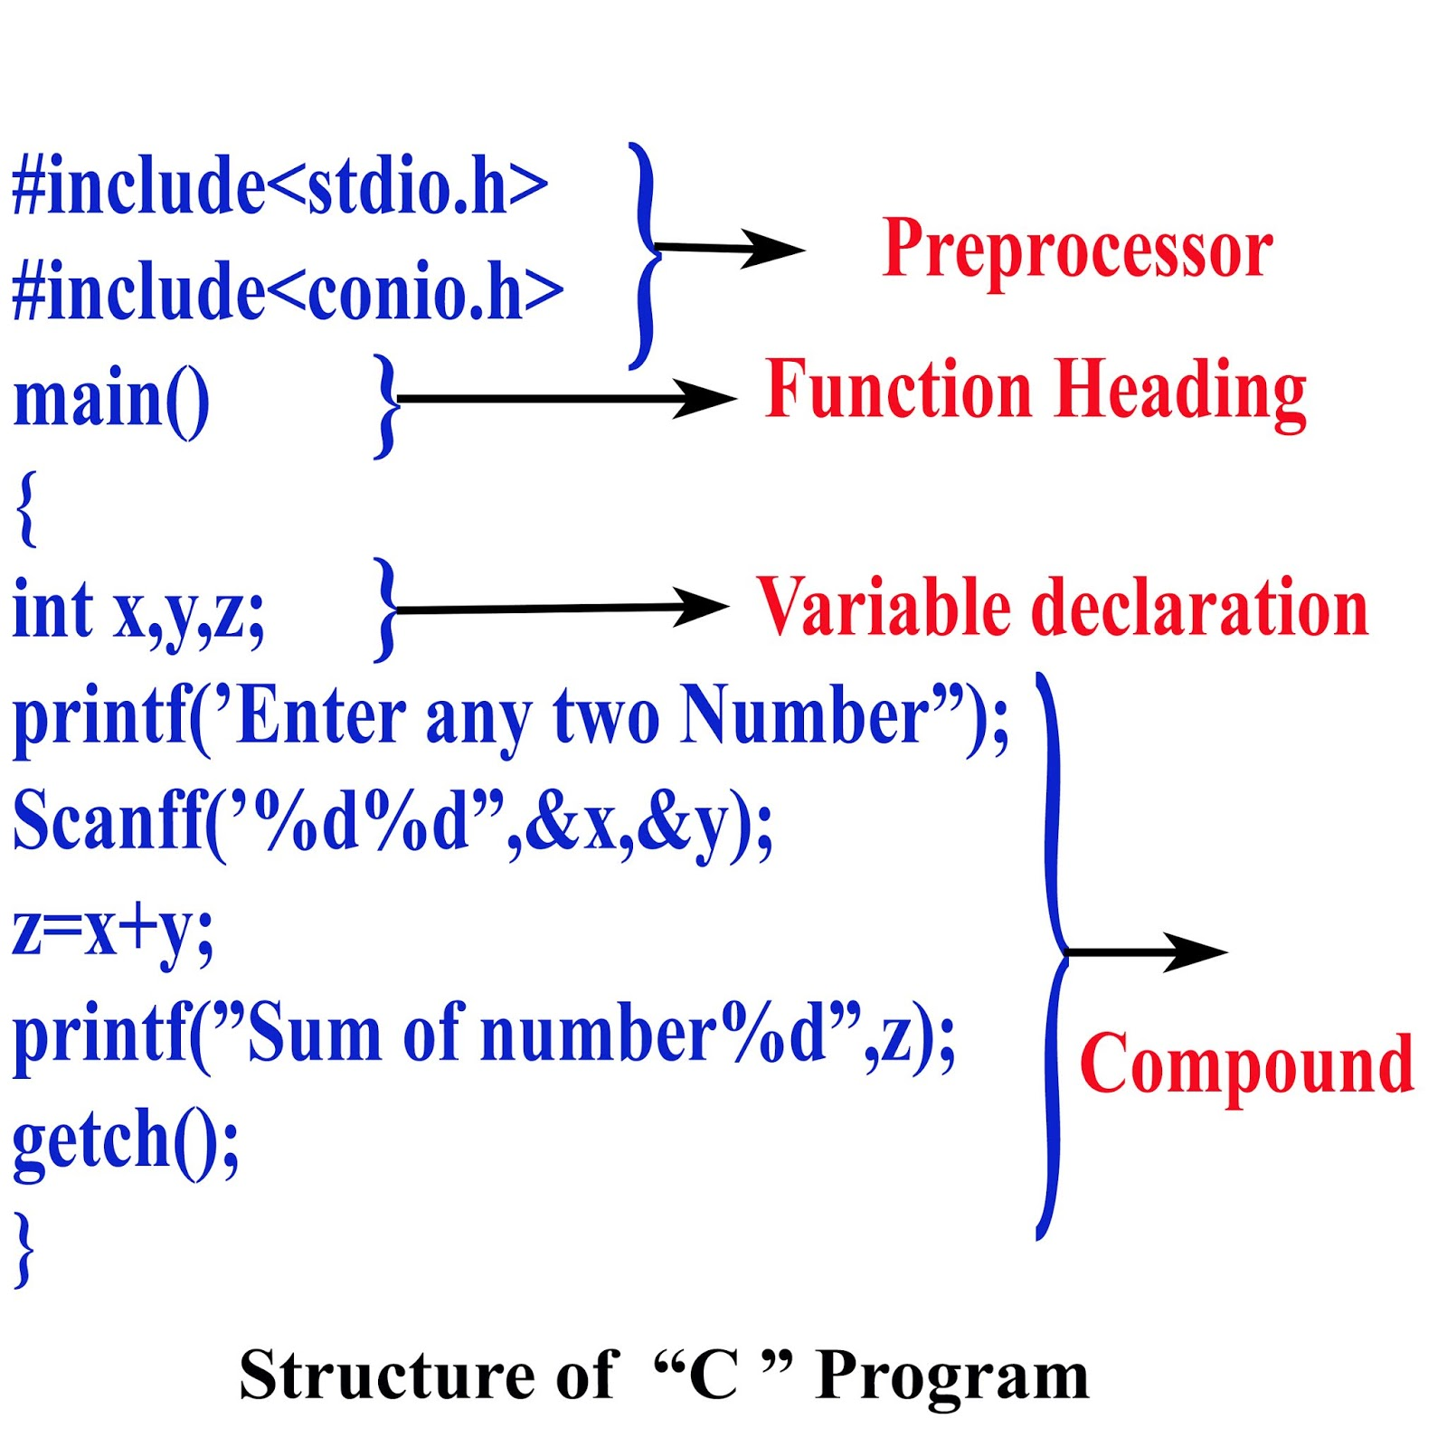

Slide 13
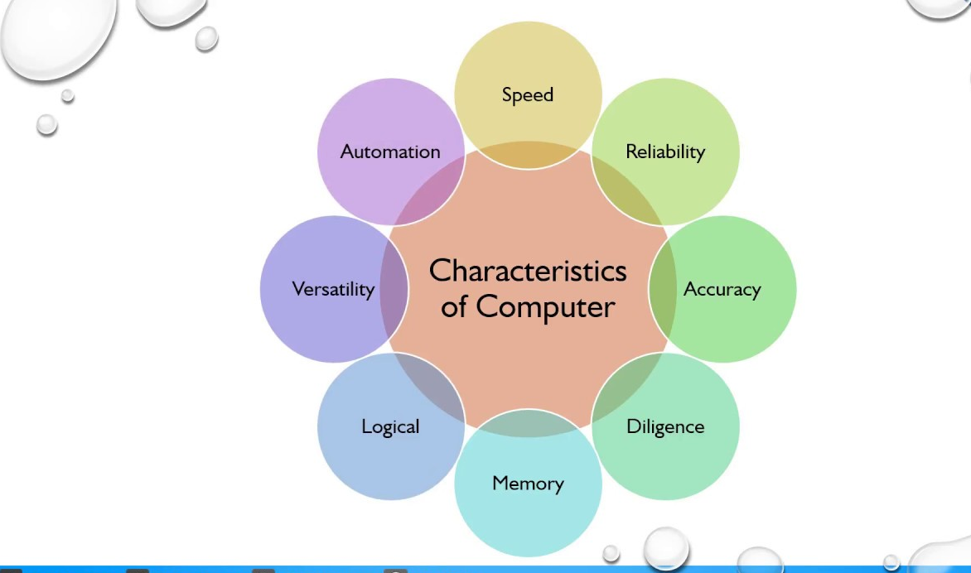
Characteristics of Computer

Slide 14
1.Speed
A computer works with much higher speed and accuracy compared to humans while performing mathematical calculations.
Computers can process millions (1,000,000) of instructions per second.
The time taken by computers for their operations is microseconds and nanoseconds.
2.Accuracy
Computers perform calculations with 100% accuracy.
In case of errors user who fed wrong input will be responsible i.e garbage-in, garbage-out(GIGO)

Slide 15
Automation
Computers are automable devices i.e it can perform task without any user intervention
User just need to sasign task, after which it automatically control different devices attached to it and execute program instructions
Diligence
A computer can perform millions of tasks or calculations with the same consistency and accuracy. It doesn’t feel any fatigue or lack of concentration. Its memory also makes it superior to that of human beings.
Versatility
Quality of being flexible
Versatility refers to the capability of a computer to perform different kinds of works with same accuracy and efficiency.(at same time)
PC at home(play games, send emails)

Slide 16
3.Memory
Just like we use notebook to store data ,computer has built-in memory called primary memory (internal)where it stores data.
Secondary storage(external) are removable devices such as CDs, pen drives, etc., which are also used to store data .
When data is to be used, they are copied from secondary memory into internal memory often known as random access memory
4.NO IQ
Now trend is to induce AI in them , so they do not have decision making ability of their own, hence IQ level is zero
5.Economical
Reduces man power
It saves time, energy and money
computers can do work in less time

Slide 17

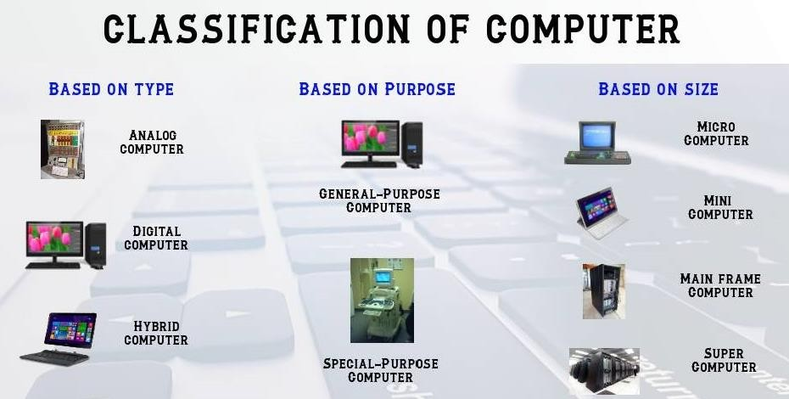
Computer Types

Slide 18
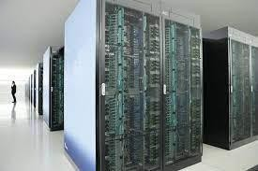
Based On Size
Super Computers
These are huge machines having the most powerful and fastest processors. A supercomputer uses multiple CPUs for parallel data processing.
Supercomputers are too powerful to be used for transaction processing.
They are also used to solve complex scientific problems, used for weather forecasting, analysis of geological
data, nuclear simulation and space exploration.
Because of their exorbitant cost, they are mainly used by government agencies.

Slide 19
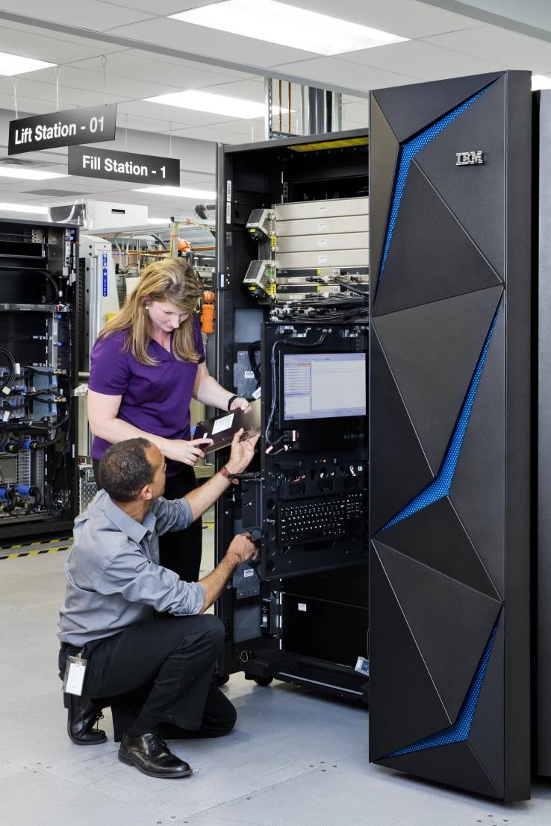
Mainframe Computers
These are multi-user machines that can support hundreds or thousands of users using the feature of time sharing supported by systems like Linux.
Users interact with this system using a terminal and keyboard, which is similar to the way we use PCs.
Mainframes can concurrently run multiple programs even with a single CPU.
The processor speed in a mainframe is measured in mip (million instructions per
second).
The capability to handle large amounts of data makes the mainframe suitable for use in government, banks and financial institutions, and large corporations.

Slide 20
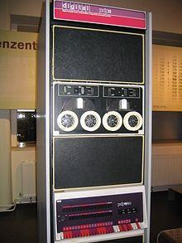
Mini Computers
Minicomputers or midrange computers as they can be considered as downsized mainframes since they have the essential features of mainframes.
Minicomputers can serve hundreds of users and are small enough to partially occupy a room. But they are not affordable enough to be used in the home.
The minicomputer, which Digital Equipment Corporation (DEC) introduced in the 1970s, is thus rightly positioned between a mainframe and a micro- computer.
Minicomputers are used in smaller organizations.

Slide 21
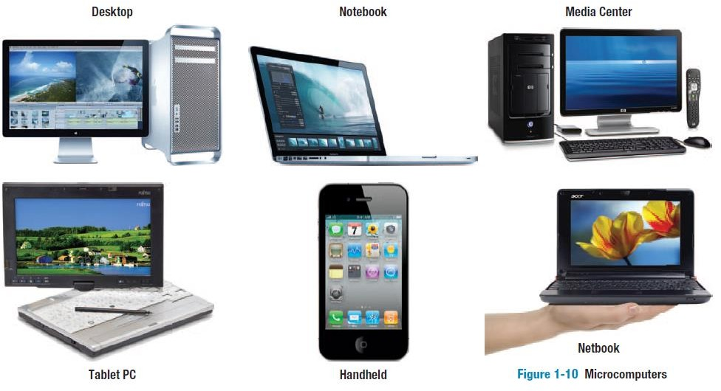
Micro Computers
The microcomputer or personal computer (PC) introduced by Apple
and later endorsed by IBM.
This computer is a single-user machine powered by a single microprocessor.
A microcomputer takes the form of a desktop, notebook (laptop) or a netbook (smaller Laptop).
They are used both in the standalone mode (at home) and in a network (in office).
PCs today are powered by three types of operating systems Windows, Mac OS and Linux.
Businesses and individuals use the PC for word processing, spread sheet handling and desktop publishing; PCs also support Internet browsing software like Firefox and Google Chrome.
All PCs are multimedia ready, they can handle images, audio & video files. PC is now entertainment device.

Slide 22
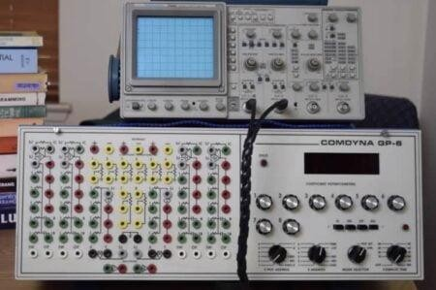
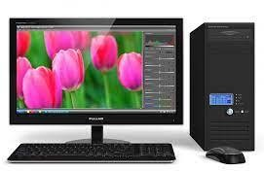
Based On Mechanism
Analog Computer
Accept input data in continuous form and output is obtained in the form of graphs.
Digital Computer
Operates by counting numbers or digits and gives output in digital form.
Hybrid Computer
The user can process both the continuous (analog) and discontinuous (digital) data.

Slide 23
Based On Purpose
Special Purpose Computer
These are designed to perform a specific task.
They perform the task for which they are designed very efficiently. Eg: Air craft control system, missile guidance system etc.
General Purpose Computer
General purpose computers is one that can be used for a variety of applications.
Its creativity enables execution of programs of almost any time. These are used in business application.

Slide 24
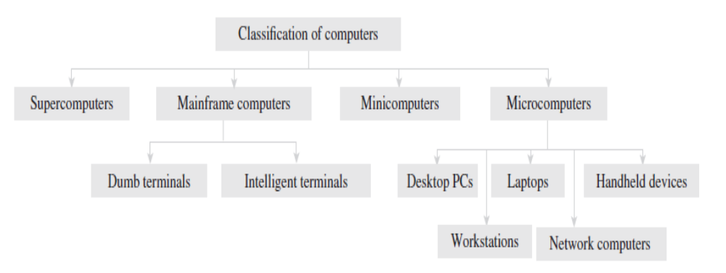

Slide 25

Desktop PCs
A desktop PC is the most popular model of PCs. It is widely used in homes and offices.
Laptops
Laptops (Figure ) are small microcomputers that can easily fit inside a briefcase.
They are very handy and can easily be carried from one place to another.
They may also be placed on the user’s lap (thus the name). Hence, laptops are very useful, especially when going on long journeys.
Laptops operate on a battery and do not always have to be
plugged in like desktop computers.

Slide 26
The memory and storage capacity of a laptop is almost equivalent to that of a desktop computer.
As with desktop computers, laptops also have hard disk drives, USB drives,
etc.
For input, laptops have a built-in keyboard and a trackball/touchpad, which is used as a pointing device (as a mouse is used for a desktop PC).
However, a drawback is that laptops are generally more expensive than desktop computers.
These computers are very popular among business travellers.

Slide 27
Workstations
Workstations are single-user computers that have the same features as PCs, but their processing speed matches that of a minicomputer or mainframe computer.
Workstation computers have advanced processors, more RAM and storage capacity than PCs. Therefore, they are more expensive and powerful than a normal desktop computer.
Network Computers
Network computers have less processing power, memory, and storage than a desktop computer.
.

Slide 28
These are specially designed to be used as terminals in a networked environment.
For example, some network computers are specifically designed to access data stored on a network (including the Internet and intranet).
Some network computers do not have any storage space and merely rely on the network’s server for data storage and processing tasks.
Network computers that are specifically designed to access only the Internet or intranet are often known as Internet PCs or Internet boxes.
Some network computers used in homes do not even have a monitor. Such computers may be connected to a television, which serves as the output device.
The most common example of a home-based network computer is Web TV, which enables the user to connect a television to the Internet

Slide 29
The Web TV is equipped with a special set-top box that is used to connect to the Internet.
The set-top box also provides controls to enable the user to navigate the Internet, send and receive e-mails, and to perform other tasks on the network while watching television.
The other reason for the popularity of network computers is that they are cheaper to purchase and maintain than PCs

Slide 30
Handheld Computers
The mid-1990s witnessed a range of small personal computing devices that are commonly known as handheld computers, or mobile computers.
These computers are called handheld computers because they can fit in one hand, while users can use the other hand to operate them.
Handheld computers are very small in size, and hence they have small-sized screens and keyboards.
These computersare preferred by business travellers and mobile employees whose jobs require them to move from place to place.
Some examples of handheld computers are as follows:
Smartphones
Tablet PCs

Slide 31
Smartphones
cellular phones are web-enabled telephones.
Such phones are also known as smartphones because, in addition to basic phone capabilities, they also facilitate the users to access the Internet and send e-mails, edit Word documents, generate an Excel sheet, create a presentation, and lots more.
Smartphones run an advanced mobile operating system that enables it to run various applications.
The four major mobile operating systems are iOS, Android, BlackBerryOS, and Windows Mobile.

Slide 32

A tablet PCis a computing device that is smaller than a laptop, but bigger than a smartphone.
Features such as user-friendly interface, portability, and touch screen have made them very popular in the last few years.
While all of them look similar from outside, they may differ in features such as operating system, speed of data connectivity, camera specifications, size of the screen, processing power, battery life, and storage capability.
Some operating systems that are used in tablets are Android Jellybean (an open-source operating system built by Google), Windows 8, and iOS (developed by Apple).

Slide 33
Following are the uses of Tablet PCs:
• View presentations
• Videoconferencing
• Reading e-books, e-newspaper
• Watching movies
• Playing games
• Sharing pictures, video, songs, documents, etc.
Browsing the Internet
• Keeping in touch with friends and family on popular social networks, sending emails
• Business people use them to perform tasks such as editing a document, exchanging documents, taking notes, and giving presentations
• Tablets are best used in crowded places such as airports and coffee shops, where size and portability become more important

Slide 34
APPLICATIONS OF COMPUTERS
When the first computers were developed, they were used only in the fields of mathematics and science.
In fact, the first effective utilization of computers was for decoding messages in military applications.
Later on, computers were used in real-time control systems, like for landing on the moon.
Today, computers are widely used in fields such as engineering, health care, banking, education,etc.

Slide 35
Word processing
enables users to read and write documents.
Users can also add images, tables, and graphs for illustrating a concept.
The software automatically corrects spelling mistakes and includes copy–paste features (which is very useful where the same text has to be repeated several times).

Slide 36
Internet
The Internet is a network of networks that connects computers all over the world.
Using e-mail, the user can communicate in seconds with a person who is located thousands of miles away.
Chat software enables users to chat with another person in real-time (irrespective of the physical location of that person).
Video conferencing tools are becoming popular for conducting meetings with people who are unable to be present at a particular place.

Slide 37
Digital video or audio composition
Computers make audio or video composition and editing very simple.
This has drastically reduced the cost of equipment to compose music or make a film.
Desktop publishing
Desktop publishing software enables us to create page layouts for entire books.

Slide 38
After discussing how computers are used in today’s scenario, let us now have a look at the different areas where computers are being widely utilized.
e-Business
e-Business or electronic business is the process of conducting business via the Internet.
This may include buying and selling of goods and services using computers and the Internet.
Use of email and videoconferencing technology has revolutionized the way business is being conducted these days.

Slide 39
The following are techniques in which e-commerce helps users to conduct business transactions.
Business-to-consumer or B2C
In this form of electronic commerce, business companies deploy their websites on the Internet to sell their products and services to the customers.
On their websites, they provide features such as catalogues, interactive order processing system, secure electronic payment system, and online customer support.

Slide 40
Business-to-business or B2B
This type of electronic commerce involves business transactions performed between business partners (customers are not involved).
For example, companies use computers and networks (in the form of extranets) to order raw materials from their suppliers.
Companies can also use extranets to supply their products to their dealers.

Slide 41
Consumer-to-consumer or C2C
This type of electronic commerce enables customers to carry business transactions among themselves.
For example, on auction websites, a customer sells his/her product which is purchased by another customer.
Electronic banking
Electronic banking, also known as cyberbanking or online banking, supports various banking activities conducted from home, a business, or on the road instead of a physical bank location.
Bioinformatics
Bioinformatics is the application of computer technology to manage large amount of biological information.
Computers are used to collect, store, analyse, and integrate biological and genetic information to facilitate gene-based drug discovery and development

Slide 42
Bioinformatics
Bioinformatics is the application of computer technology to manage large amount of biological information.
Computers are used to collect, store, analyse, and integrate biological and genetic information to facilitate gene-based drug discovery and development

Slide 43
Applications of Computer
Government
To keep records on legislative actions, internal revenue service records
Traffic control
IN USA computers are used by government for city planning and traffic control
To eliminate problem of gridlock(when traffic is stuck for 15 min)
Legal System
Computers are used by lawyers to shorten the time required to conduct legal precedent and case research.
Lawyers use computers to look through millions of individual cases and find whether similar or parallel cases have been approved, denied, criticized, or overruled in the past.
This enables the lawyers to formulate strategies based on past case decisions.
Moreover, computers are also used to keep track of appointments and prepare legal documents and briefs in time for filling cases.

Slide 44
Retail Business
Computers are used in retail shops to enter orders, calculate costs, and print receipts.
Travel and Tourism
Computers are used to prepare tickets, monitor the train’s or airplane’s route, and guide the plane to a safe landing. They are also used to research about hotels in an area, reserve rooms, or to rent a car.
Sports
computers are used to compile statistics, identify weak players and strong players by analysing statistics, sell tickets, create training programs and diets for athletes, and suggest game plan strategies based on the competitor’s past performance.
Music
All computers have MIDI(musical insatrument digital interface) facility which links musical instrument to PC(enabling computer to generate variety of sounds)
Movies
For creating special effects, animations, cartoons, videos

Slide 45
Business and Industry
Computers are used for data processing, which includes task such as word processing analysing data, entering records
Hospitals
To record information about patients, admission bill at exit time
To aid physically handicapped people
Simulation
Supercomputers that can process enormous amount of data are widely used in simulation tests.
Simulation of automobile crashes or airplane emergency landings is done to identify potential weaknesses in designs without risking human lives.
Supercomputers also enable engineers to design aircraft models and simulate the effects that winds and other environmental forces have on those designs.

Slide 46
Astronomy
Spacecrafts are usually monitored using computers that not only keep a continuous record of the voyage and of the speed, direction, fuel, and temperature, but also suggest corrective action if the vehicle makes a mistake.
Education
A computer is a powerful teaching aid and can act as another teacher in the classroom.
Teachers use computers to develop instructional material.
Moreover, teachers at all levels can use computers to administer assignments and keep track of grades.
Students can also give exams online and get instant results.
Industry and Engineering Computers are found in all kinds of industries, such as thermal power plants, oil refineries, and chemical industries, for process control, computer-aided designing (CAD), and computer-aided manufacturing (CAM).

Slide 47
Geology
Civil engineers use computers to evaluate effects of earthquake on structure of building
Weather Forecasting
When computers are fed with mathematical equations along with data about air pressure, temperature and humidity solution of these equations gives accurate prediction of weather of particular area.
Online Banking
Moving towards cashless society where yu need not have money in your pocket
Just have credit card/debit card
Industry and Engineering
Computers are found in all industries
    Thermal power plants
      Oil refineries
      Chemical industries
      CAD
      CAM(Computer aided manufacturing)
CAM phase begins when CAD phase ends
In this phase metal or other materials are manufactured while complying with their specifications

Slide 48
Robotics
Robots are computer-controlled machines mainly used in the manufacturing process in extreme conditions where humans cannot work.
For example, in high temperature, high pressure conditions or in processes that demand very high levels of accuracy.
The main distinguishing feature between a robot and other automated machines is that a robot can be programmed to carry out a complex task and then reprogrammed to carry out another complex tasks.
Decision Support Systems
Managers also use decision support systems to analyse market research data, to size up the competition, and to plan effective strategies for penetrating their markets.
Expert Systems
Expert systems are used to automate the decision-making process in a specific area, such as analysing the credit histories for loan approval and diagnosing a patient’s condition for prescribing an appropriate treatment.
To create an expert system, an extensive amount of human expertise in a specific area is collected and stored in a database, also known as a knowledge base.
A software called an interface engine analyses the data available in the knowledge base and selects the most appropriate response.
Adding more to it, in today’s scenario, computers are used to find jobs on the Internet, read news and articles online, find your batchmates, send and receive greetings pertaining to different occasions, etc.

Slide 49
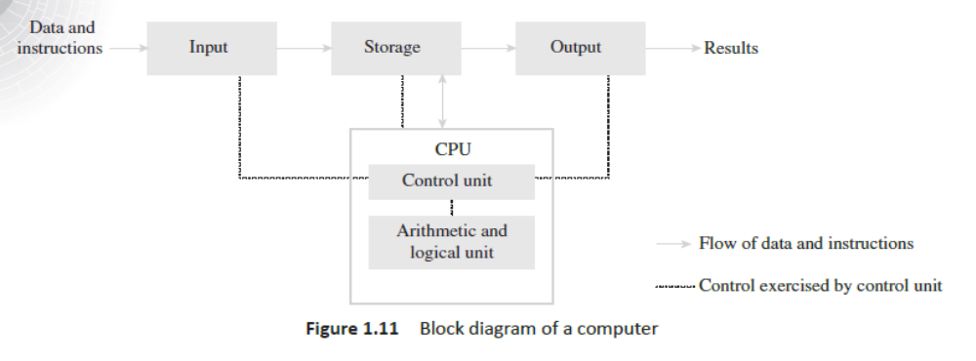
A computer is an electronic device that performs five major operations:
• Accepting data or instructions (input)
• Storing data
• Processing data
• Displaying results (output)
• Controlling and coordinating all operations inside a computer
interaction between the different units of a computer system is shown below

Slide 50
Input
This is the process of entering data and instructions (also known as programs ) into the computer system.
The data and instructions can be entered by using different input devices such as keyboard, mouse, scanner, and trackball.
Note that computers understand binary language, which consists of only two symbols (0 and 1), so it is the responsibility of the input devices to convert the input data into binary codes.
Storage
Storage is the process of saving data and instructions permanently in the computer so that they can be used for processing.
The computer storage space not only stores the data and programs that operate on that data but also stores the intermediate results and the final results of processing.

Slide 51
A computer has two types of storage areas:
Primary storage
Primary storage, also known as the main memory , is the storage area that is directly accessible by the CPU at very high speeds.
It is used to store the data and parts of programs, the intermediate results of processing, and the recently generated results of jobs that are currently being worked on by the computer.
Primary storage space is very expensive and therefore limited in capacity.
Another drawback of main memory is that it is volatile in nature; that is, as soon as the computer is switched off, the information stored gets erased.
Hence, it cannot be used as a permanent storage of useful data and programs for future use.
An example of primary storage is random access memory (RAM).
Secondary storage
Also known as auxiliary memory, this memory is just the opposite of primary memory.
It overcomes all the drawbacks of the primary storage area.
It is cheaper, non-volatile, and used to permanently store data and programs of those jobs that are not being currently executed by the CPU.
Secondary memory supplements the limited storage capacity of the primary memory.
An example is the magnetic disk used to store data, such as C and D drives, for future use.

Slide 52
Output
Output is the process of giving the result of data processing to the outside world (external to the computer system).
The results are given through output devices such as monitor, and printer.
Since the computer accepts data only in binary form and the result of processing is also in binary form, the result cannot be directly given to the user.
The output devices, therefore, convert the results available in binary codes into a human-readable language before displaying it to the user.
Control
The control unit (CU) is the central nervous system of the entire computer system.
It manages and controls all the components of the computer system.
It is the CU that decides the manner in which instructions will be executed and operations performed. It takes care of the step-by-step processing of all operations that are performed in the computer.
Note that the CPU is a combination of the arithmetic logic unit (ALU) and the CU.
The CPU is better known as the brain of the computer system because the entire processing of data is done in the ALU, and the CU activates and monitors the operations of other units (such as input, output, and storage) of the computer system.

Slide 53
Processing
The process of performing operations on the data as per the instructions specified by the user (program) is called processing .
Data and instructions are taken from the primary memory and transferred to the ALU, which performs all sorts of calculations.
The intermediate results of processing may be stored in the main memory, as they might be required again.
When the processing completes, the final result is then transferred to the main memory. Hence, the data may move from main memory to the ALU multiple times before the processing is over.

Slide 54
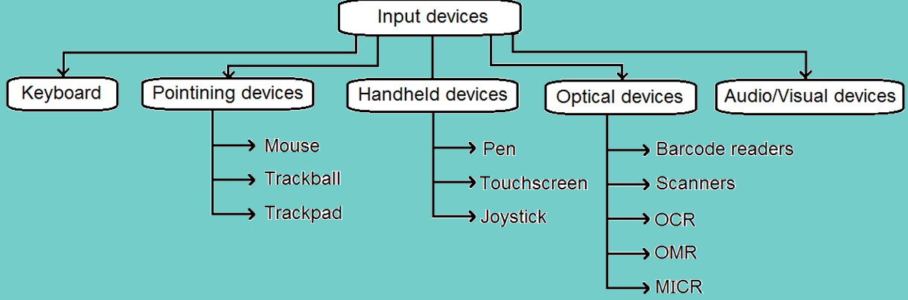
Categories of Input devices

Slide 55
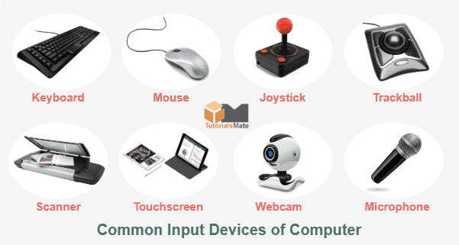

Input Devices
Keyboard
Mouse
Joy Stick
Light pen
Track Ball
Scanner
Graphic Tablet
Microphone
Magnetic Ink Card Reader(MICR)
Optical Character Reader(OCR)
Bar Code Reader
Optical Mark Reader(OMR)

Slide 56
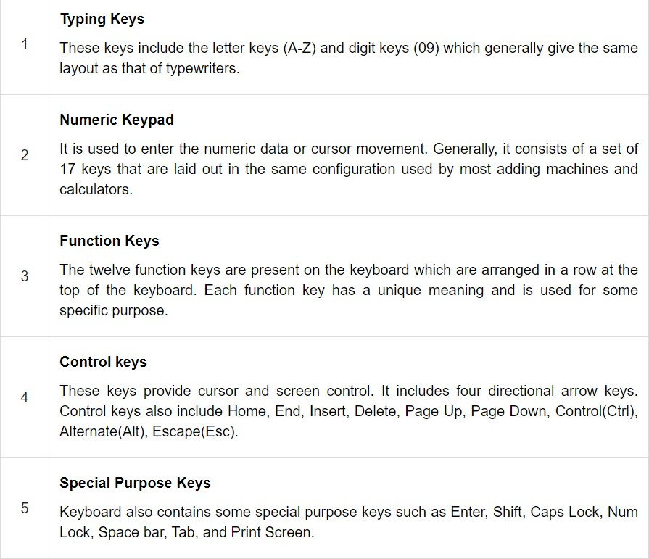
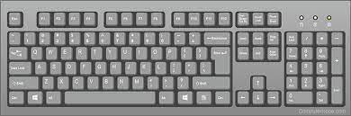
Keyboard

Slide 57
Inside Computer
Keyboard has its own processor and circuitry to carry information to and from that processor
It has key matrix, which is a grid of circuits underneath the keys
When key is pressed it corresponds to pressing a switch thereby completing the circuit
When processor finds closed circuit , it compares the location of circuit on key matrix to character map in its ROM
Character map is a lookup table that tells processor what each keystroke represents
Example: pressing key ‘c’ corresponds to small c
But shift + ‘c’ = ‘C’
Adv
Easy to use and cheap
Disadv
Cannot be used to draw figure
Moving cursor from one position to other is slow

Slide 58


POINTING DEVICES
Mouse
  Point
  Click
  Drag
  Scroll
Mechanical mouse
  rubber or metal ball is places at its bottom and electronic circuit containing sensors
  Sensors detect the direction of movement of ball
  Electronic circuit translates movement into signals and feed it as input to computer
Optical mouse
  More advanced
  Contains ball inside
  Movement is detected using laser technology, by using optical sensors
Cordless mouse
  wireless mouse
  Movement is detected using infrared llight waves
It is a very famous cursor-control device having a small palm size box with a round ball at its base, which senses the movement of the mouse and sends corresponding signals to the CPU when the mouse buttons are pressed.
Generally, it has two buttons called the left and the right button and a wheel is present between the buttons.

Slide 59


Track ball is an input device that is mostly used in notebook or laptop computer, instead of a mouse.
This is a ball which is half inserted and by moving fingers on the ball, the pointer can be moved.
Since the whole device is not moved, a track ball requires less space than a mouse.
Track ball
Pointing device
Adv
Better resolution
Occupies less space
Less hand and arm movements
Dis adv
Often covered with dust so must be cleaned regularly

Slide 60
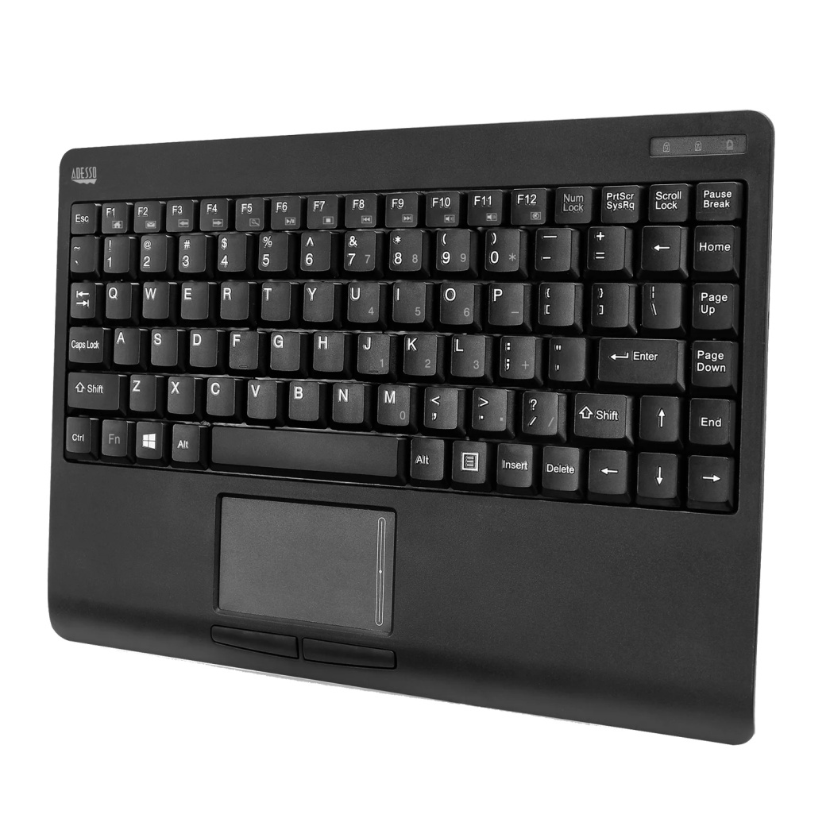
Touch pad
Pointing device
Slide his/her fingertrips across the surface of pad
Converts position of user finger to relative position on screen
laptop
Advantages
Less space
Less hand and arm movements
Inbuilt and no need to carry

Slide 61
Mouse
Track Ball
It is a very famous cursor-control device having a small palm size box with a round ball at its base, which senses the movement of the mouse and sends corresponding signals to the CPU when the mouse buttons are pressed.
Generally, it has two buttons called the left and the right button and a wheel is present between the buttons.
Track ball is an input device(pointing device) that is mostly used in notebook or laptop computer, instead of a mouse.
This is a ball which is half inserted and by moving fingers on the ball, the pointer can be moved.
Since the whole device is not moved, a track ball requires less space than a mouse.

Slide 62

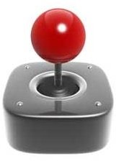
Handheld devices
Joystick
Computing device with display screen and miniature keyboard
Stylus(pen) and touchscreens are input data to handheld devices
One or more push buttons, called switches whose position can be read by computer
Pointer continues moving in direction in which joystick is moving
To stop user must return joystick to upright position
- Joystick is a handheld devices, which is used to move the cursor position on a monitor screen.
-The function of the joystick is similar to that of a mouse. It is mainly used in Computer Aided Designing (CAD) and playing computer games.

Slide 63
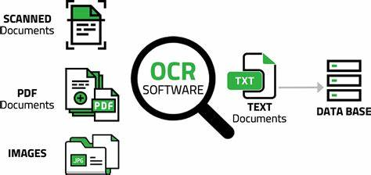
Optical Devices
Known as data scanning devices
Use light as source of input for detecting and recogonizing different objects such as character,codes….converts objects to digital data and sends to computer for processing

Slide 64






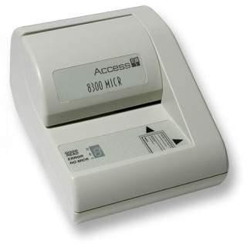
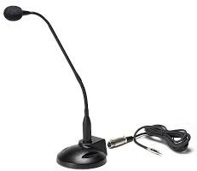
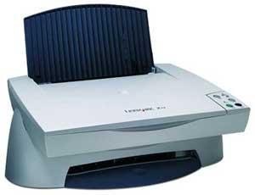
Microphone
Magnetic Ink Card Reader (MICR)
Optical Character Reader (OCR)
- Microphone is an input device to input sound that is then stored in a digital form.
-The microphone is used for various applications such as adding sound to a multimedia presentation or for mixing music.
MICR input device is generally used in banks as there are large number of cheques to be processed every day.
The bank's code number and cheque number are printed on the cheques with a special type of ink that contains particles of magnetic material that are machine readable.
- OCR is an input device used to read a printed text. OCR scans the text optically, character by character, converts them into a machine readable code, and stores the text on the system memory.

Slide 65



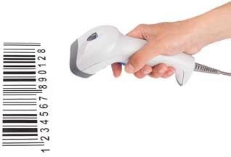
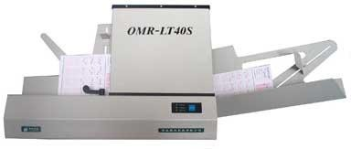

Bar Code Readers
Optical Mark Reader (OMR)
Light Pen
Bar Code Reader is a device used for reading bar coded data (data in the form of light and dark lines).
Bar coded data is generally used in labelling goods, numbering the books, etc.
It may be a handheld scanner or may be embedded in a stationary scanner.
OMR is a special type of optical scanner used to recognize the type of mark made by pen or pencil.
It is used where one out of a few alternatives is to be selected and marked.
It is specially used for checking the answer sheets of examinations having multiple choice questions.
- Light pen is a pointing device similar to a pen. It is used to select a displayed menu item or draw pictures on the monitor screen.
- It consists of a photocell and an optical system placed in a small tube.
- When the tip of a light pen is moved over the monitor screen and the pen button is pressed, its photocell sensing element detects the screen location and sends the corresponding signal to the CPU.

Slide 66
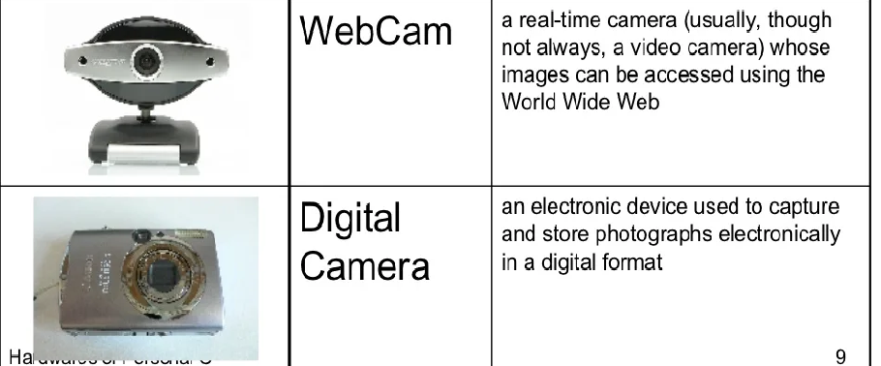
Audio/Visual input devices

Slide 67
Recording and retrieving audio data
Microphone -→ sound card sound card → speakers

Slide 68
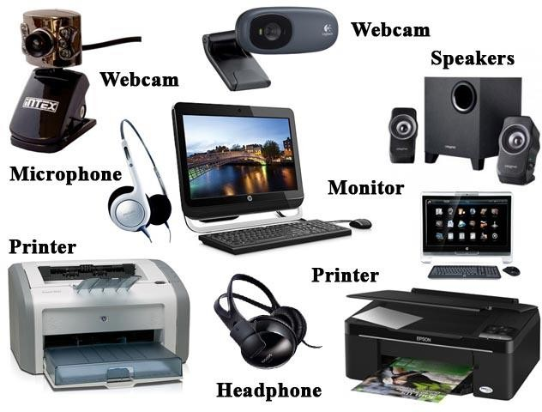

Output Devices
Monitors
Printers
Plotters
Projectors
Speakers

Slide 69
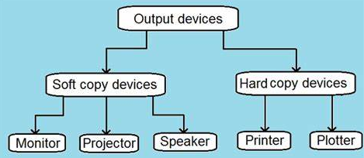
Classification of output devices

Slide 70
Soft Copy Devices
Produce electronic version of output
Eg file stored on hard disk or pen drive
Features
Output can be viewed only when computer is on
Edit soft copy output
Cannot be use dby people who do not have computer
Easy, fast and cheaper

Slide 71
Monitors
Monitors, commonly called as Visual Display Unit (VDU), are the main output device of a computer.
It forms images from tiny dots, called pixels that are arranged in a rectangular form. The sharpness of the image
depends upon the number of pixels.
There are two kinds of viewing screen used for monitors
Cathode-Ray Tube (CRT)
Liquid crystal display(LCD)
Plasma

Slide 72
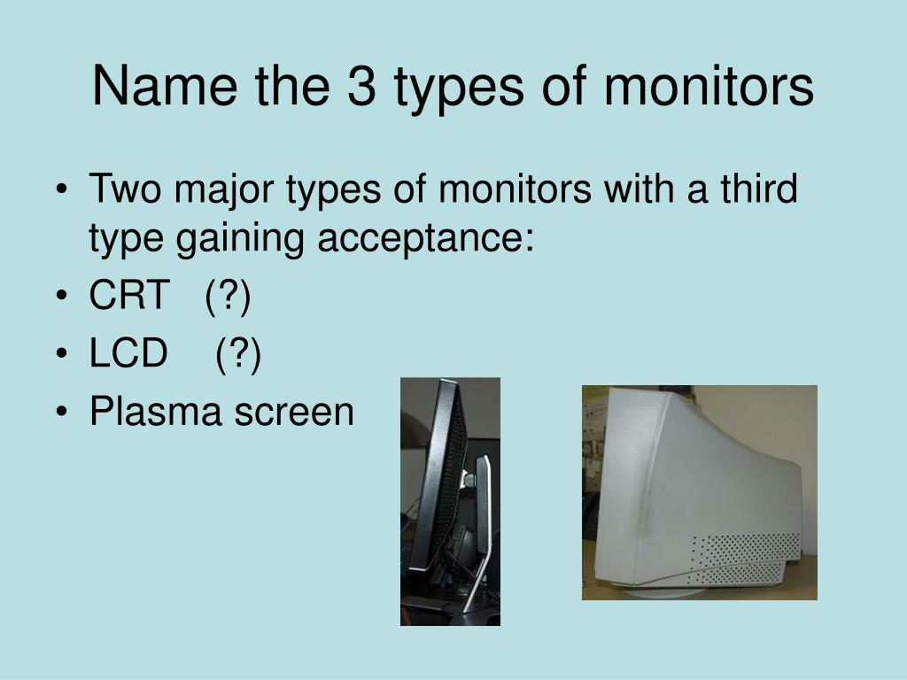

Slide 73
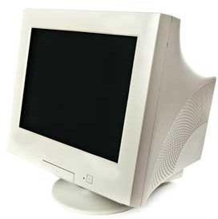
Cathode-Ray Tube (CRT) Monitor
The CRT display is made up of small picture elements called pixels. The
smaller the pixels, the better the image clarity or resolution.
Most screens are capable of displaying 80 characters of data horizontally and 25 lines vertically.
There are some disadvantages of CRT −
Large in Size
High power consumption

Slide 74
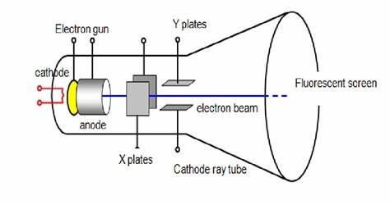

Slide 75
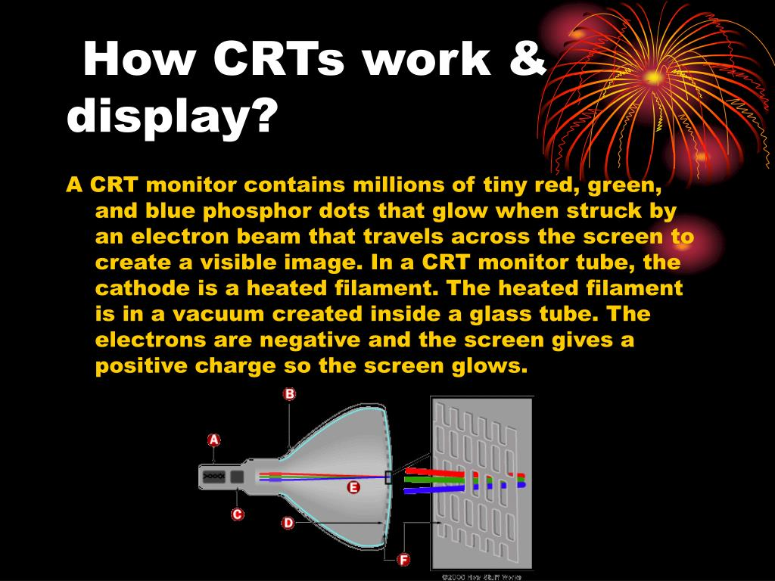

Slide 76
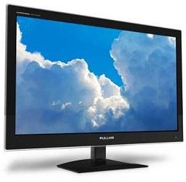
Flat-Panel Display Monitor
The flat-panel display refers to a class of video devices that have reduced
volume, weight and power requirement in comparison to the CRT.
Current uses of flat-panel displays include video games, monitors, laptop
computer, and graphics display.
The flat-panel display is divided into two categories −
Emissive Displays − Emissive displays are devices that convert electrical energy into light. For example, plasma panel and LED (Light-Emitting Diodes)
Non-Emissive Displays − Non-emissive displays use optical effects to convert sunlight or light from some other source into graphics patterns. For example, LCD (Liquid-Crystal Device).

Slide 77
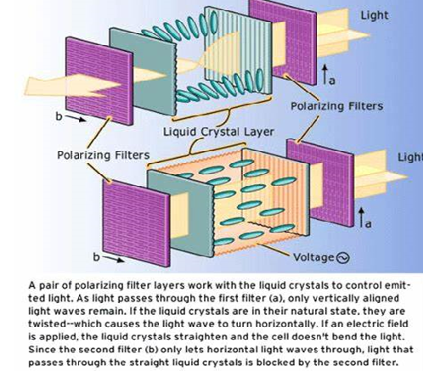

Slide 78
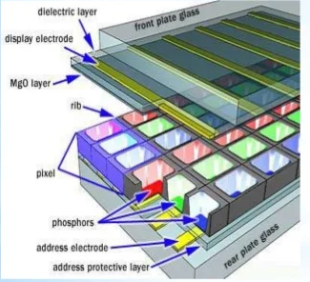
Plasma monitor
Thin and fast monitors widely used in televisions and computers
Display contains two glass plates that have hundreds of tiny cells fixed with xenon and neon gases
Address electrode and transparent display electrode are sandwiched between glass plates
Display electrode is covered by magnesium oxide protective layer and is arranged in horizontal rows along the screen
While address electrodes are arranged in vertical columns forming grid like structure

Slide 79
Once the intersecting electrodes are charged an electric current begins to flow through gas in cell
Current creates a rapid flow of charged particles thereby stimulating gas atoms to release ultraviolet photons
When these UV photons hit a phosphor atom in cell, one of phosphors electrons jump to high energy level and the atom heats up
When electron falls back to normal level it releases energy in form of visible light photon
Disadv
Expensive
High power consumption

Slide 80
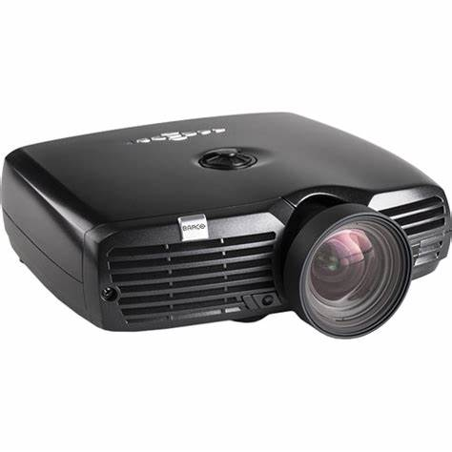
PROJECTOR
Takes an image from video source and projects it on screen
Two categories
1. LCD projector
Uses their own light to display image on screen
Room must be darkened else the image will be blurred
2. Digital light processing (DLP) projector
Use number of mirrors to reflect light
May or may not be darkened because it displays clear image on screen

Slide 81
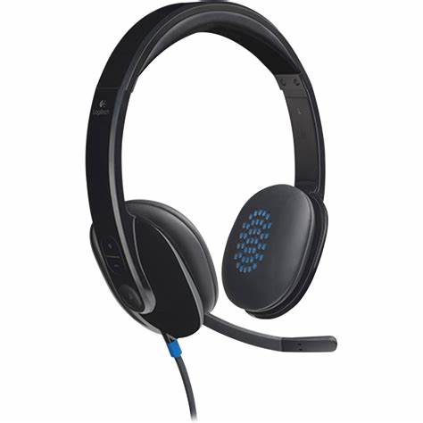
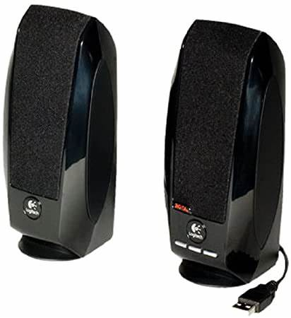

Headphone
Speaker
Headset

Slide 82
Hard copy devices
Produce a physical form of output
Eg:- content of file printed on paper
Features
Computer not needed to see output
Editing id difficult
Easy distributed
Searching data is difficult
Costly and slower as well

Slide 83
Qualities of printers that are of interest are
Colour
Resolution
Speed
memory

Slide 84
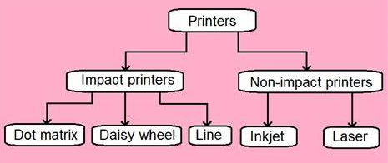
Printers
Printer is an output device, which is used to print information on paper.

Slide 85
Impact printers print the characters by striking them on the ribbon, which is then pressed on the paper.
Characteristics of Impact Printers
Very low consumable costs
Very noisy
Useful for bulk printing due to low cost
There is physical contact with the paper to produce an image

Slide 86


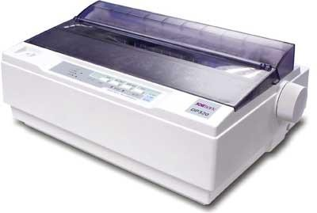
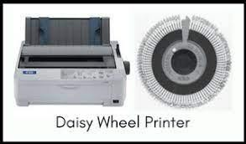
Character printers are the printers which print one character at a time.
Daisy Wheel
Dot Matrix Printer
One of the most popular printers is Dot Matrix Printer.
Each character printed is in the form of pattern of dots and head consists of a Matrix of Pins of size which come out to form a character which is why it is called Dot Matrix Printer. Advantages
Inexpensive
Widely Used
Other language characters can be printed
Disadvantages
Slow Speed
Poor Quality
Head is lying on a wheel and pins corresponding to characters are like petals of Daisy (flower) which is why it is called Daisy Wheel Printer. These printers are generally used for word- processing in offices that require a few letters to be sent here and there with very nice quality.
Advantages
More reliable than DMP
Better quality
Fonts of character can be easily changed
Disadvantages
Slower than DMP
Noisy
More expensive than DMP

Slide 87


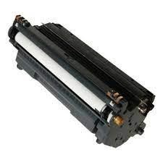
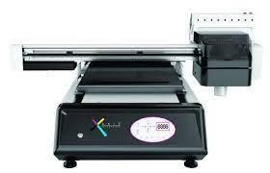
Line printers are the printers which print one line at a time.
Chain Printer
Drum Printer
- This printer is like a drum in shape hence it is called drum printer. The surface of the drum is divided into a number of tracks. Total tracks are equal to the size of the paper, i.e. for a paper width of 132 characters, drum will have 132 tracks. One rotation of drum prints one line. Drum printers are fast in speed and can print 300 to 2000 lines per minute.
Advantages
Very high speed
Disadvantages
Very expensive
Characters fonts cannot be changed
In this printer, a chain of character sets is used, hence it is called Chain Printer. A standard character set may have 48, 64, or 96 characters.
Advantages
Character fonts can easily be changed.
Different languages can be used with the same printer.
Disadvantages
Noisy

Slide 88
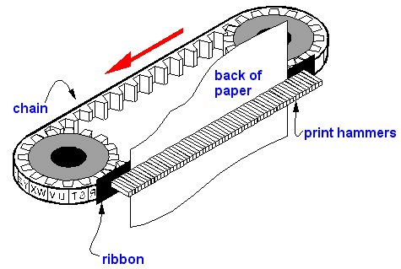
Band printer
Band or metal loop to produce typed characters
Set of characters are permanently embossed on band and these set cannot be changed unless band is changed

Slide 89
Non-impact printers print the characters without using the ribbon. These printers print a complete page at a time, thus they are also called as Page Printers.
Characteristics of Non-impact Printers
Faster than impact printers
They are not noisy
High quality
Supports many fonts and different character size

Slide 90


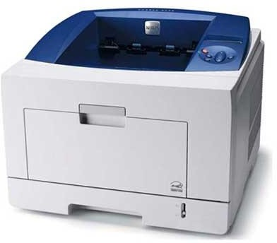
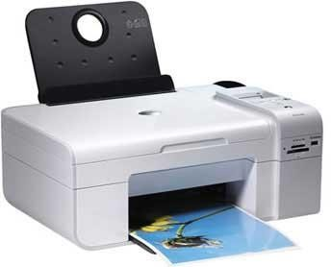
Laser Printers
Inkjet Printers
These are non-impact page printers. They use laser lights to produce the dots needed to form the characters to be printed on a page.
Advantages
Very high speed
Very high quality output
Good graphics quality
Supports many fonts and different character size
Disadvantages
Expensive
Cannot be used to produce multiple copies of a document in a single printing
Inkjet printers are non-impact character printers based on a relatively new technology. They print characters by spraying small drops of ink onto paper. Inkjet printers produce high quality output with presentable features. Color printing is also possible. Some models of Inkjet printers can produce multiple copies of printing also.
Advantages
High quality printing
More reliable
Disadvantages
Expensive as the cost per page is high
Slow as compared to laser printer

Slide 91



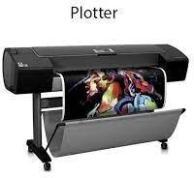
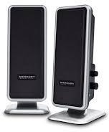
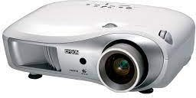
Plotter
Projector
Speaker
- Plotters actually draw point-to-point lines directly from vector graphics files.
- The plotter was the first computer output device that could print graphics as well as accommodate full-size engineering and architectural drawings.
- Using multiple colored pens, plotters were also able to print in color long before inkjet printers became an alternative.
A projector is an output
device that projects an image onto a large surface, such as a white screen or wall.
It may be used an alternative to a monitor or television when
showing video or images to a large
group of people.
- A computer speaker is an output device that connects to a computer to generate sound.
-The signal used to produce the sound that comes from a computer speaker is created by the computer's sound cards.

Slide 92
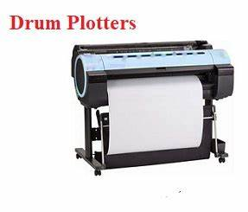

Plotter
Drum plotter
Draw graphics on paper wrapped around drum
Used with mainframe and minicomputer
Flatbed plotter
Paper spread on flat surface of plotter and pen is moved over it

Slide 93


"Why should we learn a programming language?"
What is Program?
Instruction 1
Instruction 2
Instruction 3
.
.
.
.
Instruction n
A Program is a group of instructions given by the programmer to the computer to perform specific task
Dennis Ritchie

Slide 94


Story
Paragraphs Sentences
Words
Alphabets
programs
Functions Statements
Tokens
Characters
Process of learning English language
Process of learning C language

Slide 95

Character sets of C language

Slide 96

A token is a collection of characters. One or more characters of the character sets are combined to form meaningful words called tokens.
C- TOKENS

Slide 97

Keywords
How many keywords are there in C language
- The meaning of these words is already known to computer (compiler) - Predefined meaning
- Keywords are also called as Reserve words
- There are 32 keywords are there in C, whose meaning is already known to the computer

Slide 98


Identifiers
A Byte of the memory chip
- Identifiers are such words which do not have predefined meaning.
.
.
.
- Identifier is a name given to the memory location in
the computer.
129
manju
- Identifiers are also called as Variables.
Memory chip of Computer
Identifier/V ariable
128(2⁷) 64(2⁶) 32(2⁵) 16(2⁴) 8(2³)
4(2²)
2(2¹)
1(2⁰)
manju
129
1 | 0 | 0 | 0 | 0 | 0 | 0 | 1

Slide 99
Rules for constructing identifiers/variable names:
The first characters in the name must be an alphabet (A-Z or a-z) or an underscore(_).
The first character may be followed by any number of letters or digits. (max length be <=8)
The only special symbol permitted in the identifies is an underscore(_).
Two successive underscores are not permitted.
A blank space is not allowed in an identifier.
Keywords can't be used as identifiers.

Slide 100


Valid Identifiers:
Manju MANJU
maNJu123 Manju2_Sanju12 m_a_n_j_u
Invalid Identifiers: 1manju Manju,sanju
Man ju
for
goto
Manju sanju

Slide 101
Constants
A quantity does not change during the execution of a program is called as Constant.
Constants
Floating Point
(real)Constants
Integer Constants
Rules:
must have at least one digit
must not have decimal point
could be either +ve or -ve
no commas or blank spaces are allowed
default sign is +ve
Valid | Invalid
87 | 12.34
-63 | 8.7
+94 | 21 23
0723 | 100.
956 | 12,34
Rules:
must have at least one digit
must have decimal point
could be either +ve or -ve
Valid | Invalid
82.1 | 234
1000.6 | 10.34.2
3.212 | 22/7
-0.5 | 1.2.3
100. | 112
- no commas or blank spaces are
allowed
- default sign is +ve

Slide 102
Data Types
The type of the data that variable can hold. They also specify, the number of bytes to be allocated.
There are 5 primitive data types in C
Data types in C language
int
float
double
char
void

Slide 103
Data type | Purpose | No. of bytes allocated | Range
int | To hold integer constant | 2 bytes | -32768 to +32767
float | To hold real constant | 4 bytes | -3.4e38 to +3.4e38
double | To hold real constant | 8 bytes | -1.7e308 to +1.7e308
char | To hold character constant | 1 byte | -128 to +127
void | non-specific | No memory is allocated | ------

Slide 104
Differences between float and double datatype
float | double
Float type variables can hold real constants with lesser accurancy | Float type variables can hold real constants with more accurancy
Real constants can be stored upto an accuracy of 6 digits after the decimal point | Real constants can be stored upto an accuracy of 16 digits after the decimal point
4 bytes are allocated | 8 bytes are allocated
-3.4e38 to +3.4e38 is the range | -1.7e308 to +1.7e308 is the range

Slide 105

The general syntax of declaring a variable is:
datatype variable; (or) datatype variable1, variable 2, ------ variable n;
 | Eg. for int: |  | Eg. for int: int a, b; a = 592; b = 123;
 | int manju;
 | manju = 129;
int a;
float a, b,c;
double num, avg, abc;
 | Eg. for float: float a,b,c; Int d; a = 35.56; //legal b = 456.798876; //legal
Eg. for char: |  | d= 10;
char a, b a = 'x'; b = '?';
Eg. for double:
double a,b,c;
// a = 23.45; //legal
b = 372.468789; //legal
c = 234.7787897897789789; //legal

Slide 106

The basic structure of a C program:
preprocessor directives
Start with # symbol and used to include header files eg: #include<stdio.h> #include<conio.h>
global declarations;
Variables are declared in this session. Existence of variable known to all the functions in the pgm
void main()
{
local declarations;
Execution begins from the main function. Every C program must have only one main function.
Variables are declared in this session. Existence of variable known to only main function in the program. Not to all the functions in the program.
statement 1;
statement 2;
statement 3;
.
.
statement n;
Instructions given to the computer to perform specific task.
}
user defined functions;
Functions return by user and it is not compulsory.

Slide 107

2 bytes
preprocessor directives
#include<stdio.h>
a
10
global declarations;
void main()
{
int a, b,c; a=10; b=20;
c=a+b; printf("%d", c);
}
b
20
void main()
{
local declarations;
c
30
statement 1;
statement 2;
statement 3;
a
0 | 0 | 0 | 0 | 0 | 0 | 0 | 0
0 | 0 | 0 | 0 | 1 | 0 | 1 | 0
statement n;
}
b
0 | 0 | 0 | 0 | 0 | 0 | 0 | 0
0 | 0 | 0 | 1 | 0 | 1 | 0 | 0
user defined functions;
c
0 | 0 | 0 | 0 | 0 | 0 | 0 | 0
0 | 0 | 0 | 1 | 1 | 1 | 1 | 0

Slide 108
Operators
a + b;
Operand 3
c = a + b;
Operand 1
Operand 2
Operand 1
Operator
Operand 2
Operator
Operator
Operators are one of the type of the tokens in C language. Operators act on operands and give
the required results.

Slide 109





Operators in C
Unary
Binary
Ternary
Special
Incrementation (++) Decrementaion(--) Unary minus(-) Logical Not(!)
Arithmetic Operators (+, -, *, /, %)
Relational Operators
(>, >=, <, <=, ==, !=)
Logical Operators (&&, ||)
Bitwise Operators (<<, >>, &, |, ^)
Assignment Operators
(=, +=, -=, /=, *=,%=)
Conditional Operator (?:)
Size of Comma(,) Address of operator (&) Dot Operator (.)

Slide 110

Arithmetic Operators
The following table shows all the arithmetic operators supported by the C language.
Assume variable A holds 10 and variable B holds 20, then −

Slide 111

Relational Operators
Assume
variable A holds 10 and variable B holds 20

Slide 112

Logical Operators
Assume variable A holds 1 and variable B holds 0

Slide 113

Bitwise Operators
Assume variable 'A' holds 60 and variable 'B' holds 13, A = 0011 1100
B = 0000 1101
A&B = 0000 1100
A|B = 0011 1101
A^B = 0011 0001
~A = 1100 0011

Slide 114


Slide 115

Assignment Operators

Slide 116
++
Incrementation
Incrementation Operator
Incrementation Operator increments the value of the variable by 1
int a = 50; ++a; //a=a+1 | int a = 50; ++a; | int a = 50; ++a;
Printf("%d", a); | ++a; | ++a;
 | Printf("%d", a); | ++a; Printf("%d", a);
a=a+2; or ++a;
++a;
a=a+3; or ++a;
++a;
++a;

Slide 117
Post incrementation
Pre incrementation
#include<stdio.h> void main()
{
int a;
a=50;
++a;
printf("%d", a);
}
#include<stdio.h> void main()
{
int a; a=50; a++;
printf("%d", a);
}
output 51
Output 51

Slide 118
#include<stdio.h> void main()
{
int a,b;
a=50;
b=++a;
Printf("a=%d b=%d", a,b);
}
output a=51 b=51
#include<stdio.h> void main()
{
int a,b; a=50;
b=a++;
Printf("a=%d b=%d0", a,b);
}
output a=51 b=50
Incrementation | First operation | Next operation
Pre Incrementation | Incremention | Assignment
Post Incrementation | Assignment | Incremention

Slide 119
--
Decrementation
Decrementation Operator
Decrementation Operator decrements the value of the variable by 1
int a = 50; --a; //a=a-1 | int a = 50; --a; | int a = 50; --a;
Printf("%d", a); | --a; | --a;
 | Printf("%d", a); | --a; Printf("%d", a);
a=a-2; or --a;
--a;
a=a-3; or --a;
--a;
--a;

Slide 120
Post decrementation
Pre decrementation
#include<stdio.h> void main()
{
int a;
a=50;
--a;
printf("%d", a);
}
#include<stdio.h> void main()
{
int a; a=50; a--;
printf("%d", a);
}
output 49
output 49

Slide 121
#include<stdio.h> void main()
{
int a,b;
a=50;
b=--a;
Printf("a=%d b=%d", a,b);
}
output a=49 b=49
#include<stdio.h> void main()
{
int a,b; a=50;
b=a--;
Printf("a=%d b=%d0", a,b);
}
output a=49 b=50
decrementation | First operation | Next operation
Pre decrementation | decremention | Assignment
Post decrementation | Assignment | decremention

Slide 122




General form: expression 1 ? expression 2 : expression 3;
Conditional Operator / Ternary Operator / (?:)
Expression 1
True
False
Ex:
x > 50 ? y =10 : y = 20;
Expression 2
Expression 3

Slide 123



Special Operators in C
size of operator
comma operator
address of operator
dereference operator
dot operator
sizeof (datatype);
sizeof (variable);
int a; int b; int c; or
int a,b,c;
&
*
.

Slide 124
int a=5, b=7, c;
c = ++a + b;
printf("a = %d b= %d c=%d", a, b, c);
int a=5, b=7, c; c = a++ + b;
printf("a = %d b= %d c=%d", a, b, c);
int a=100, b=200, c=300, d; d= ++a + ++b + ++c;
printf("a = %d b= %d c=%d d=%d", a, b, c,d);
int a=100, b=200, c=300, d; d= a++ + b++ + c++;
printf("a = %d b= %d c=%d d=%d", a, b, c,d);

Slide 125
O/p: a= 6 b= 7, c= 13
O/p: a= 6 b= 7, c= 12
O/p: a= 101 b= 201, c= 301 d=603
O/p: a= 101 b= 201, c= 301 d=600

Slide 126
int a=3, b=4, c; c = b++ / a--; printf("%d", c);
int a=3, b=4, c; c = a++ - b--; printf("%d", c);
O/p: c= 1
O/p: c= 1

Slide 127

Expressions
Expression consisting of one or more operators with an assignment operator
Arithmetic Operators Precedence
Precedence - Priority
Assume a=15, b=10, c=5;
Assume a=15, b=10, c=5;
d=a+b*c;
₁st
*, /, %
d=15+10*5;
2nd +, -
(L - R)
d=a+b*c;
d=25*5;
d=15+10*5;
d=125
d=15+50;
d=65
Invalid Evaluation
Valid Evaluation

Slide 128

Eg 2:
int a=2, b=3, c=2, d=5, e;
Eg 1:
Assume a=15, b=10, c=5, d=?;
₁st
*, /, %
e=a+b-c*d/a;
d=a/b*c;
2nd +, -
(L - R)
e=2+3-2*5/2;
(first * is evaluated)
d=15/10*5;
e=2+3-10/2;
(next / is evaluated)
d=1*5;
e=2+3-5;
(next + is evaluated)
d=5
e=5-5;
(next - is evaluated)
e=0
(is the final result)

Slide 129
Eg 4:
int a=1, b=2, c=3, d=4, e;
Eg 3:
int a=2, b=3, c=2, d=5,e;
e = (d + c) / (c + b) * (d % b) - c;
e=(a+b-c)*d/a;
e = (4 + 3) / (3 + 2) * (4 % 2) - 3; //first 4+3 is evaluated
e = 7 / (3 + 2) * (4 % 2) - 3; //next 3+2 is evaluated
e = 7 / 5 * (4 % 2) - 3; // next 4%2 is evaluated
e = 7 / 5 * 0 - 3; //next 7/5 is evaluated
e = 1 * 0 - 3; //next 1*0 is evaluated
e = 0 - 3; //next 0-3 is evaluated
e = -3 //final result
e=(2+3-2)*5/2;
//first + is evaluated
e=(5-2)*5/2;
//next - is evaluated
e=3*5/2;
//next * is evaluated
e=15/2;
//next / is evaluated
e=7

Slide 130
Eg 5:
int a=1. B=2, c=3, d=4, e;
e=( ( ( (a + b) / 2) -3) * d) + a * d;
e=( ( ( (1+2)/2)-3)*4)+1*4;
e=(((3/2)-3)*4)+1*4;
e=((1-3)*4)+1*4; e= (-2*4)+1*4; e=-8+1*4;
e=-8+4; e=-4

Slide 131

Evaluation of expression containing only relational operators
Eg:
int a=1, b=2, c=3, d=4, e;
e= a < b >= c != a == b <= a;
1st <,>,<=,>=
2nd !=,== L - R
e = 1 < 2 >= 3 != 1 == 2 <= 1;
//first 1<2 is evaluated
e= 1 >= 3 != 1 == 2 <=1;
//next 1>=3 is evaluated
e= 0 != 1 == 2 <= 1;
//next 2<=1 is evaluated
e= 0 != 1 == 0;
//next 0!=1 is evaluated
e= 1 == 0;
//next 1==0 is evaluated
e=0

Slide 132
Evaluation of expression containing Arithmetic and Relational operators
int a=1, b=2, c=3, d=4, e;
e = a + b < b + c >= c / a == d * a - b;
e = 1 + 2 < 2 + 3 >= 3 / 1 == 4 * 1 - 2;
e = 1 + 2 < 2 + 3 >= 3 == 4 * 1 - 2;
e = 1 + 2 < 2 + 3 >=3 == 4 - 2;
e = 3 < 2 + 3 >= 3 == 4 - 2;
e = 3 < 5 >= 3 == 4 - 2;
e = 3 < 5 >= 3 == 2;
e = 1 >= 3 == 2;
e = 0 == 2;
e = 0
1. First evaluate all the arithmetic operators.
(*, /,%,)(+,-)
//first 3/1 is evaluated
//next 4*1 is evaluated
//next 1+2 is evaluated
//next 2+3 is evaluated
//next 4-2 is evaluated
//next 3<5 is evaluated
//next 1>=3 is evaluated
//next 0==2 is evaluated
//is the final answer
2. Next evaluate all the relational operators. (<,>,<=,>=)(!=,==)

Slide 133
int a=1, b=2, c=3, d=4, e;
e = (a + b < b + c) >= (c / a == d) * a - b;
e = (1 + 2 < 2 + 3) >= (3 / 1 == 4) * 1 - 2;
e = (3 < 2 + 3) >= (3 / 1 == 4) * 1 - 2;
e = (3 < 5) >= (3 / 1 == 4) * 1 - 2;
e = 1 >= (3 / 1 == 4) * 1 - 2;
e = 1 >= (3 == 4) * 1 - 2;
e = 1 >= 0 * 1 - 2;
e = 1 >= 0 - 2;
e = 1 >= -2;
e = 1
// first 1+2 is evaluated
//next 2+3 is evaluated
//next 3<5 is evaluated
//next 3/1 is evaluated
//next 3==4 is evaluated
//next 0*1 is evaluated
//next 0-2 is evaluated
//next 1>=-2 is evaluated
//is the final result

Slide 134
Evaluation of expression containing Arithmetic, Relational and Logical operators
Steps:
First evaluate all the arithmetic operators. (*, /,%,) (+,-)
Next evaluate all the relational operators. (<,>,<=,>=) (!=,==)
Then evaluate the logical operators. (&&) (||)

Slide 135
int a=1, b=2, c=3, d=4, e;
e = a + b < b + c && c / a == d * a || b / a > c;
e = 1 + 2 < 2 + 3 && 3 / 1 == 4 * 1 || 2 / 1 > 3;
e = 1 + 2 < 2 + 3 && 3 == 4 * 1 || 2 / 1 > 3;
e = 1 + 2 < 2 + 3 && 3 == 4 || 2 / 1 > 3;
e = 1 + 2 < 2 + 3 && 3 == 4 || 2 > 3;
e = 3 < 2 + 3 && 3 == 4 || 2 > 3;
e = 3 < 5 && 3 == 4 || 2 > 3;
e = 1 && 3 == 4 || 2 > 3;
e = 1 && 3 == 4 || 0;
e = 1 && 0 || 0;
e = 0 || 0;
e = 0;
// first 3/1 is evaluated
// next 4*1 is evaluated
// next 2/1 is evaluated
// next 1+2 is evaluated
// next 2+3 is evaluated
// next 3<5 is evaluated
// next 2>3 is evaluated
// next 3==4 is evaluated
// next 1&&0 is evaluated
// next 0||0 is evaluated
// is the final result

Slide 136


Slide 137


Slide 138
Source code file
source code with extension .c
Header File
separate out certain subroutines from main()
One way is to copy the desired subroutine
Standard header files
string.h --- for string handling functions
stdlib.h --- for some miscellaneous functions
stdio.h --- for standardized input and output functions
math.h --- for mathematical functions
alloc.h --- for dynamic memory allocation
conio.h --- for clearing the screen
Object files
Generated by the compiler as a result of processing source code
Compact binary code of function definitions
Linker combines these object files to produce excetable files

Slide 139
Binary executable files
Generated by linker
.exe
Can be directly executed

Slide 140
Type Conversion/Type Casting
Type Conversion is the way to convert a variable from one data type to another data type
There are 2 types of Conversions:
Implicit Type Conversion - Performed Compiler
Explicit Type Conversion - Performed by Programmer

Slide 141
1. Implicit Type Conversion
- > Automatic Type Conversion (because it is done by the compiler on its own)
int a = 3; int b = 2; int c = a/b;
printf("%d", c);
int a =10; float d = a;
printf("%f", d);
O/p = 10.000000
O/p = 1

Slide 142
It is user defined
2. Explicit Type Conversion
Here user can type cast the result to make it of a particular data type.
Syntax:
(data type) expression
Ex:
int a = 11; int b = 2;
float c = (float) a/b;
printf("%f", c);
o/p: 5.500000

Slide 143
Text
Module 2
Managing Input and Output operations, Conditional Branching and Loops, Example programs, Finding roots of quadratic equation, Computation of binomial coefficients, Plotting of Pascals triangle

Slide 144


Managing Input and Output operations
Input functions gets the data from keyboard and sends it to the memory
Input Unit
Memory Unit
Output Unit
Output functions gets the data from memory unit and sends it to the monitor

Slide 145
I/O functions
Library functions
#include<stdio.h>
What are the different I/O functions supported by C language?
I/O functions | Input functions | Output functions
Un-formated functions | getch() | putch()
Formatted functions | scanf() | printf()

Slide 146
What is the difference between formatted and un-formated I/O functions?
-->Formatted I/O functions allows programmer to read input from keyboard and display output on monitor in more formatted form (user friendly or user readable).
-->Fine tuning of I/O operation is not possible using un-formated I/O functions

Slide 147
Reading and Writing a Character
The general form of the getch() is as given below -
Syntax:
ch = getch();
The general form of the putch() is as given below -
Syntax:
putch(ch);
ch=getch() would place the character read from the keyboard onto the variable ch in memory
Input Unit
ch
putch(ch) would display the character ch on screen
Memory Unit
Output Unit

Slide 148
Ex: program to read character from keyboard and display it on the monitor
#include<stdio.h>
void main()
{
char ch;
printf("enter M for male and F for Female");
ch=getch();
Printf("the character you entered is ");
putch(ch);
}
Disadvantages of un-formated I/O functions
-> They can read or write just one character at a time,
-> Only characters can be read from the keyboard. int, float, double type data cannot be read.
->Output displayed on the monitor is not user friendly.

Slide 149


Slide 150
Formatted Input Output functions
scanf() - input function (read input from the keyboard)
printf() - output function (display output on the monitor)
The printf() function
General form : printf("format string", variable list);
Format string consists:
1. A series of characters
2. Format specifier
3. Escape sequence
->Variable list: list of variables whose values are to be printed

Slide 151
Ex 1: printf("I love my country");
O/p : I love my country
Ex 2:
int a=2;
printf("the value of the a is %d", a);
O/p : the value of the a is 2
Ex 3:
int a=2;
int b=3;
printf("the value of the a is %d\n and b is %d", a,b);
O/p : the value of the a is 2
and b is 3
Ex 4:
int a=2;
float b=3.5;
char c='A';
printf("the value of the a is %d\t and b is %f\t and c is %c", a,b,c);
O/p : the value of the a is 2 and b is 3.500000 and c is A

Slide 152

Format specifiers(conversion characters)

Slide 153

Escape sequences(backslash constants)

Slide 154
Field width specifications in printf() function -
Used inside the printf().
Specified the width of the space allocated for a variable on the screen.
Ex:
int a=24564;
printf("%5d", a);
Ex:
Int a=43244;
printf("%8d",a);
Ex:
Int a=43244;
printf("%-8d",a);
2 | 4 | 5 | 6 | 4
 |  |  | 4 | 3 | 2 | 4 | 4
4 | 3 | 2 | 4 | 4
Ex:
float b=3.5;
printf("%f", b);
Ex:
float b=3.5;
printf("%.2f", b);
Ex:
float b=3.5;
printf("%8.2f", b);
3 | . | 5 | 0 | 0 | 0 | 0 | 0
3 | . | 5 | 0
 |  |  |  | 3 | . | 5 | 0

Slide 155
The scanf() function
The general form: scanf("format specifier", list of address of variables);
Ex:
1) scanf("%d", &a);
2) scanf("%d%f", &a, &b);
#include<stdio.h>
void main()
{
int a;
printf("how old are you\n");
scanf("%d", &a);
printf("you are %d years old", a);
}
a
1000
20
5000
2000
6000

Slide 156
Advantages of formatted I/O functions
1. These functions can be used to read or write multiple values at a time.
2. Character, int, float, double type variables can be read and displayed on the screen.
3. Produce output in more formatted form i.e more user friendly and readable outputs.

Slide 157
Decision Control Constructs
Decisions ! Decisions ! Decisions !
Example 1:
if (my PUC marks are good)
{
I will continue my studies
}
else
{
I will search for some job
}
my PUC marks are good
True
False
I will continue my studies
I will search for some job

Slide 158
How many decision control constructs are there in C language?
if control construct
if else control construct
else if ladder
nested if else control construct
switch control construct

Slide 159
if control construct:
Is used to execute a set of statements if the condition is true. If the condition is false, it skips executing those set of statements.
Statement 1;
Statement 2;
Statement 3;
Statement 1;
Statement 2;
Statement 3;
If (condition)
{
Statement 4;
Statement 5;
Statement 6;
Statement 7;
}
Statement 8;
Syntax
Flow chart
Condition
False
True
Statement 4;
Statement 5;
Statement 6;
Statement 7;
Statement 8;

Slide 160

Example for if control construct
Program to check if the given number is even
Algorithm
Flow chart
Program
#include<stdio.h>
void main()
{
int n;
printf("enter the number");
scanf("%d",&n);
if(n%2==0)
{
printf("even number");
}
}
Algorithm: check even number
Step 1: [read the number]
input n
Step 2: [check if the number is even]
If (n%2==0)
{
print"even number"
}
Step 3: [finished]
stop

Slide 161
Is used to execute one set of statement if the condition is true and another set of statement if the condition is false
if else control construct
Statement 1;
Statement 2;
Statement 3;
Statement 1;
Statement 2;
Statement 3;
If (condition)
{
Statement 4;
Statement 5;
Statement 6;
}
else
{
Statement 7;
Statement 8;
Statement 9;
}
Statement 10;
Statement 11;
Syntax
Flow chart
True
If Condition
False
Statement 4;
Statement 5;
Statement 6;
Statement 7;
Statement 8;
Statement 9;
Statement 10;
Statement 11;

Slide 162

Example for if else control construct
Program to check if the given number is even or odd
Algorithm
Flow chart
Program
#include<stdio.h>
void main()
{
int n;
printf("enter the number");
scanf("%d",&n);
if(n%2==0)
{
printf("even number");
}
else
{
printf("odd number");
}
}
Algorithm: To check even or odd number
Step 1: [read the number]
input n
Step 2: [check if the number is even or odd]
if (n%2==0)
{
print"even number"
}
else
{
print"odd number"
}
Step 3: [finished]
stop

Slide 163

Program to check whether the given number is positive or not
Algorithm
Flow chart
Program
#include<stdio.h>
void main()
{
int n;
printf("enter the number");
scanf("%d",&n);
if(n<0)
{
printf("negative number");
}
else
{
printf("positive number");
}
}
Algorithm: To check number is positive or negative
Step 1: [read the number]
input n
Step 2: [check if the number is positive or negative]
if (n<0)
{
print"negative number"
}
else
{
print"positive number"
}
Step 3: [finished]
stop

Slide 164
Is used to execute one set of statements out of many sets of statements depending upon the outcome of the condition
else if control construct
Statement 1;
Statement 2;
Statement 3;
if(condition 1)
{
Statement 4;
}
else if(condition 2)
{
Statement 5;
}
else if(condition 3)
{
Statement 6;
}
else
{
Statement 7;
}
Statement 8;
Statement 9;
Statement 1;
Statement 2;
Statement 3;
Syntax
If condition 1
True
Statement 4;
False
If condition 2
True
Statement 5;
False
If condition 3
True
Statement 6;
False
Statement 7;
Statement 8;
Statement 9;

Slide 165
Program to find biggest of three numbers
Algorithm
Flow chart
Program
Algorithm: to find the largest number
Step 1: [read 3 numbers]
Input a,b,c
Step 2:[find the largest of 3 numbers]
If(a>b && a>c)
{ print ”a is bigger” }
else if (b>a &&b>c)
{ print“b is bigger” }
else
{ print ”c is bigger” }
Step 3: [finished]
stop
#include<stdio.h>
void main()
{
Int a,b,c;
printf("enter 3 different numbers\n");
scanf("%d%d%d",&a,&b,&c);
if(a>b&&a>c)
{
printf("a is bigger\n");
}
else if("b>a&&b>c)
{
printf("b is bigger\n");
}
else
{
printf("c is bigger\n");
}
}

Slide 166

Is used to execute one set of statements out of many sets of statements depending upon the outcome of the condition. It consists of if else control construct with in an another if or else control construct and hence the name nested if control construct.
nested if statement
Statement 1;
If (condition 1)
{
If(condition 2)
{
  Statement 2;
}
else
{
Statement 3;
}
}
else
{
If(condtion 3)
{
Statement 4;
}
Else
{
Statement 5;
}
}
Statement 5;
Syntax
Flow chart

Slide 167

Algorithm: to find the largest number
Step 1: [read 3 numbers] Input a,b,c
Step 2:[find the largest of 3 numbers]
If(a>b)
{
If(a>c)
{
print ”a is bigger”
}
else
{
Print “c is bigger”
}
}
else
{
If(b>c)
{
Print "b is bigger"
}
else
{
Print " c is bigger"
}
}
Step 3: [finished]stop
Find the biggest of three numbers using nested if control construct

Slide 168
When to use various types of control constructs?
If control construct is used when a selection is to be made out of one route.
If-else control construct is used when one route has to be selected out of 2 possible routes.
nested if-else and else if ladder must be used if one route has to be selected out of many possible routes.
Switch control construct must be used if one route has to be selected out of many possible routes.

Slide 169
2 alternative paths
many alternative paths
?
an integer expression
..........................
2 way branch
multi-way branch

Slide 170
Algorithm
Flow chart
Start
switch (an integer expression)
{
case value 1: statement 1;
  break;
case value 2: statement 2;
  break;
case value 3: statement 3;
break;
default: statement 4;
}
an integer expression
Case 1
Case 2
Case 3
Case 4
Statement 1
Statement 2
Statement 3
Statement 4
Stop

Slide 171
Rules for Switch Statement
->The switch statement must be an integral type.
->Case labels must be constant or constant expression.
->Case labels must be unique. No two labels can have the same value.
->Case labels must end with colon.
->The break statement transfer the control out of the switch statement.
->The break statement is optional. So two or more case labels may belong to the same statements.
->The default label is optional. If present, it will be executed when the expression does not find a matching case label.
->There can be at most one default label.
->The default may be placed any where but usually placed at the end.
->It is permitted to nest switch statements.
•

Slide 172
Program to simulate simple calculator (Addition, subtraction, multiplication, division)
Algorithm: calculator
Step 1: [read the operation]
Input choice
Step 2: [read 2 operands]
Input a and b
Step 3: [perform the operation]
Switch (choice)
{
Case '+' : result= a+b
Print the result
Break
Case '-' : result= a-b
Print the result
Break
Case '*' : result= a*b
Print the result
break
Case '/' : if(b==0)
{
Print "divide by zero"
}
else
{
result= a/b
Print the result
Break
}
default : print "invalid operation"
}
Step 4: [finished]
Stop

Slide 173


Slide 174
#include <stdio.h>
void main() {
char operator;
int a, b,result;
printf("Enter an operator (+, -, *,/: ");
scanf("%c", &operator);
printf("Enter two operands: ");
scanf("%d %d", &a, &b);
switch (operator) {
case '+':
result=a+b;
printf("%d",result);
break;
case '-':
result=a-b;
printf("%d",result);
break;
case '*':
result=a*b;
printf("%d",result);
break;
case '/':
if(b==0)
{
printf("b is zero");
}
else
{
result=a/b;
printf("%d",result);
}
break;
default:
printf("Error! operator is not correct");
}
}

Slide 175
Unconditional Control Construct
Conditional control construct:
Simple if control construct
If-else control construct
Else if ladder control construct
Nested if else control construct
Switch control construct
Condition is checked then decision is made
An unconditional control construct is a control construct which alters the sequential control flow without checking any condition
goto
break
continue

Slide 176

goto control construct (goto statement): Jump statement
The goto control construct is used to transfer control from one point in the program to another point without checking any condition
Syntax: goto lable;

Slide 177
Backward jump
Farward jump
#include<stdio.h>
void main()
{
int i=1;
back:if(i!=5)
{
i++;
printf("i love ATME\n");
goto back;
}
}
#include<stdio.h>
void main()
{
printf("i love India\n");
goto back;
printf("i love karnataka\n");
printf("i love bangalore\n");
back: printf("i love Mysore\n");
}
output:
i love ATME
i love ATME
i love ATME
i love ATME
output:
i love India
i love Mysore

Slide 178
Break control construct:
->The break is a keyword in C which is used to bring the program control out of the loop.
->The break statement is used inside loops or switch statement.
->Break control construct sends the control out of the loop.
For loop without break:
for(i = 1; i<=3; i++)
{
printf("India\n");
}
O/p: India
India
India
For loop with break:
for(i = 1; i<=3; i++)
{
printf("India\n");
break;
}
O/p: India

Slide 179
Continue Control Construct:
->Instead of forcing termination, it forces the next iteration of the loop to take place, skipping any code in between.
For loop without continue:
for(i = 1; i<=3; i++)
{
printf("India\t");
printf("Karnataka\n");
}
O/p: India Karnataka
India Karnataka
India Karnataka
For loop with continue:
for(i = 1; i<=3; i++)
{
printf("India\t");
continue;
printf("Karnataka\n");
}
O/p: India India India

Slide 180
Looping Control Constructs
while (hungry)
{
eat an idly;
}
study well;
while (boring)
{
Watch a movie;
}
sleep well;
The looping control constructs are the control constructs which enable us to perform an activity more than once till the condition is true, i.e as long as the condition holds good, the activity is repeatedly executed. Once the condition fails, the control flows to the statement outside the body

Slide 181
C language has 3 looping control constructs:
1) for loop
2) while loop
3) do while loop
Note: All these 3 looping control constructs are used to execute a set of statements more than once
What is the difference them:
looping control constructs have to perform 3 tasks,
initialization, condition checking and incrementation

Slide 182
for loop
Start
Syntax
Flowchart
Statement 1
Statement 2
statement 1;
statement 2;
for (initialization; condition; incrementation)
{
statement 3;
statement 4;
statement 5;
}
statement 6;
statement 7;
Initialization
false
Condition check
incrementation
true
Statement 3
Statement 4
Statement 5
Statement 6
Statement 7
End

Slide 183
while loop
Start
Syntax
Flowchart
Statement 1
Statement 2
statement 1;
statement 2;
Initialization;
while(condition)
{
statement 3;
statement 4;
statement 5;
incrementation;
}
statement 6;
statement 7;
Initialization
Condition check
false
true
Statement 3
Statement 4
Statement 5
Incrementation
Statement 6
Statement 7
End

Slide 184
do while loop
Start
Syntax
Flowchart
Statement 1
Statement 2
statement 1;
statement 2;
Initialization;
do
{
statement 3;
statement 4;
statement 5;
incrementation;
} while(condition);
statement 6;
statement 7;
Initialization
Statement 3
Statement 4
Statement 5
Incrementation
Condition check
false
true
Statement 6
Statement 7
End

Slide 185
for loop
2
7
1
for (initialization; condition check; incrementation)
{
    statement 1;
  statement 2;
statement 3;
}
Ex:
for(i=1; i<=5; i++)
{
printf("I love India\n");
}
printf("I love Karnataka\n");
3
4
6
O/p:
I love India
I love India
I love India
I love India
I love India
I love Karnataka
5

Slide 186
while loop
Ex:
i=1;
while(i<=5)
{
printf("I love India\n");
i++;
}
printf("I love Karnataka\n";
initialization;
while(condition)
{
Statement;
incrementation;
}
Statement;
O/p:
I love India
I love India
I love India
I love India
I love India
I love Karnataka

Slide 187
do while loop
Ex:
i=1;
do
{
printf("I love India\n");
i++;
} while(i<=5);
printf("I love Karnataka\n");
initialization;
do
{
Statement;
incrementation;
} while(condition);
Statement;
O/p:
I love India
I love India
I love India
I love India
I love India
I love Karnataka

Slide 188
Difference between while and do-while loop
while loop | do-while loop
Condition is checked at the beginning of the loop. Hence it is a top-testing loop or entry control loop | Condition is checked at the end of the loop. Hence it is bottom testing loop or exit control loop
syntax: initialization; while(condition) { Statement; incrementation; } | syntax: initialization; do { Statement; incrementation; } while(condition);
If the condition evaluates to be false(in the very first check)then there is a possibility of zero execution of the loop. | The statements inside the loop gets executed at least once since the condition is checked at the end of the loop
i=1; while(i==5) { printf("I love my country\n"); i++; } | i=1; do { printf("I love my country\n"); i++; }while(i==5);
Ex:
i=1;
while(i<=5)
{
printf("I love India\n");
i++;
}
Ex:
i=1;
do
{
printf("I love India\n");
i++;
}while(i<=5);
Note: don't put semicolon here
Note: semicolon is compulsory

Slide 189
When to use which loop?
1) If you know in advance the number of times you must loop, then use a for loop.
2) If you don't know in advance the number of times you must loop, then use a while loop.
3) you know in advance the number of times you must loop, but if you are sure that body should get executed at least once, then use a do-while loop.

Slide 190
Control Constructs in C
Decision Control Constructs
Looping Control Constructs
(iterative statements)
for construct
Conditional Control Constructs
(branching statements)
Un-conditional Control Constructs
(jump statements)
while constructs
do while constructs
If construct
goto construct
If else construct
break construct
Nested if else construct
continue construct
Else if ladder
Switch construct

Slide 191
Finding roots of quadratic equation
A quadratic equation will always have two roots. The nature of roots may be either real or imaginary.
The general form of quadratic equation: ax²+ bx + c=0 where a,b,c are coefficients.
Example: 4x²+ 6x + 12=0
The roots of a quadratic equation are given by the quadratic formula:
The term b2 - 4ac is known as the discriminant of a quadratic equation. It tells the nature of the roots.

Slide 192



Ex1: x²-7x+12=0
x²-4x-3x+12=0
x(x-4)-3(x-4)=0
(x-3)(x-4)=0
x=3, x=4
a=1, b=-7, c=12
Discriminent=b²-4ac
=(-7)²-4*1*12
=49-48
=1
Discriminent > 0
Ex2: x²-6x+9=0
x²-3x-3x+9=0
x(x-3)-3(x-3)=0
(x-3)(x-3)=0
x=3, x=3
a=1, b=-6, c=9
Discriminent=b2-4ac
=(-6)²-4*1*9
=36-36
=0
Discriminent = 0
Discriminent=b2-4ac
=(-1)²-4*1*1
=1-4
=-3
Discriminent < 0
Ex3: x2+x+1=0
a=1, b=1, c=1
No real solutions because the discriminant is negative

Slide 193
If discriminant > 0
If discriminant = 0
If discriminant < 0

Slide 194
Algorithm to find roots of quadratic equations
Algorithm: Roots of a quadratic equation
Step 1: [read the coefficients a,b,c]
Read a ,b and c
Step 2: [compute the value of the discriminant]
Discriminant = b²-4ac
Step 3: [compare if Discriminant is greater than zero]
if(Discriminant >0) then
Print "roots are real and distinct"
root1=[-b + sqrt(b^2 - 4ac)]/2a
root2=[-b - sqrt(b^2 - 4ac)]/2a
Printf root1 and root2
Goto step6
Step 4: [Compare if discrimination is equal to zero]
If (discrimination ==0) then
Print "roots are equal"
Root1 = -b/2a
Root2 = -b/2a
Print "root1 and root2"
Goto step 6
Step 5: [Compare if discrimination is lesser than zero]
if(discrimination <0) then
Print "roots are complex"
Realpart=-b/2a
imaginarypart=sqrt(-discriminant) / (2 * a);
Root1 = (realpart) + i (imaginarypart)
Root2 = (realpart) - i (imaginarypart)
Print "root1 and root2
End if
Step 6: [Finished]
Stop

Slide 195

Flow chart

Slide 196
Program to find roots of quadratic equations
#include <stdio.h>
#include <math.h>
void main()
{
float a, b, c, discriminant, root1, root2, realPart, imagPart;
printf("Enter coefficients a, b and c: ");
scanf("%f %f %f", &a, &b, &c);
discriminant = b * b - 4 * a * c;
// condition for real and different roots
if (discriminant > 0)
{
printf("roots are real and distinct\n");
root1 = (-b + sqrt(discriminant)) / (2 * a);
root2 = (-b - sqrt(discriminant)) / (2 * a);
printf("root1 = %f and root2 = %f", root1, root2);
}
// condition for real and equal roots
else if (discriminant == 0)
{
printf("roots are equal\n");
root1 = root2 = -b / (2 * a);
printf("root1 = root2 = %f;", root1);
}
// if roots are complex
else
{
printf("roots are complex\n");
realPart = -b / (2 * a);
imagPart = sqrt(-discriminant) / (2 * a);
printf("root1 = %f+i%f and root2 = %f-i%f", realPart, imagPart, realPart, imagPart);
}
}

Slide 197
Example Programs
1. Write a C program to find sum of first n natural numbers
5
1+2+3+4+5=15
10
1+2+3+4+5+6+7+8+9+10=55
n
1+2+3+..........................+n
sum=0;
for(i=1;i<=5;i++)
{
sum=sum+i;
}
Cycle 1:
Sum=0;
i=1
Sum=sum+i
=0+1
=1
Cycle 2:
Sum=1;
i=2
Sum=sum+i
=1+2
=3
Cycle 3:
Sum=3;
i=3
Sum=sum+i
=3+3
=6
Cycle 4:
Sum=6;
i=4
Sum=sum+i
=6+4
=10
Cycle 5:
Sum=10;
i=5
Sum=sum+i
=10+5
=15

Slide 198
#include<stdio.h>
Void main()
{
int i,n,sum;
Printf("enter the value of n\n");
Scanf("%d", &n);
sum=0;
for(i=1;i<n;i++)
{
sum=sum+i;
}
Printf("%d", sum);
}

Slide 199
2. Write a C program to find sum of squares of first n natural numbers
5
1²+2²+3²+4²+5²=55
#include<stdio.h>
Void main()
{
Int n,i,sum;
Printf("enter the value of n\n");
Scanf("%d", &n);
sum=0;
for(i=1;i<=5;i++)
{
sum=sum+i*i;
}
Printf("%d", sum);
}
sum=0;
for(i=1;i<=n;i++)
{
sum=sum+i*i;
}

Slide 200
Factorial of a number 5!=5*4*3*2*1=120
#inlcude<stdio.h>
void main()
{
fact=1;
Printf("enter the no\n");
Scanf("%d",&n);
For(i=1;i<=n;i++)
{
fact=fact*i;
}
printf("factorial of a number is %d", fact);
}

Slide 201
3. Write a C program to find sum of odd numbers and sum of even numbers from 1 to n. Output the sum in 2 different lines with suitable messages
#include<stdio.h>
Void main()
{
Int n,i,evensum,oddsum;
Printf("enter the value of n\n");
Scanf("%d", &n);
evensum=0;
oddsum=0;
for(i=1;i<=n;i++)
{
if(i%2==0)
{
evensum=sum+i;
}
else
{
oddsum=oddsum+i;
}
}
Printf("%d", evensum);
Printf("%d",oddsum);
}

Slide 202
4. Write a C program to find the GCD and LCM of two integers and output the result along with the given integers
#include<stdio.h>
Void main()
{
Int m,n,a,b,r,lcm,gcd;
Printf("enter 2 numbers \n");
Scanf("%d%d", &m,&n);
a=m;
b=n;
While(b!=0)
{
r=a%b;
a=b;
b=r;
}
gcd=a;
lcm=(m*n)/gcd;
Printf("GCD=%d and LCM=%d",gcd,lcm);
}

Slide 203
5. Write a C program to check whether number is prime or not
#include<stdio.h>
Void main()
{
Int n,i;
Printf("enter the value of n\n");
Scanf("%d", &n);
for(i=2;i<=n-1;i++)
{
If(n%i==0)
{
Printf("number is not prime\n");
}
}
Printf("prime number\n");
}
Ex:
n=7
1,2,3,4,5,6,7
n=13
1,2,3,4,5,6,7,8,9,10,11,12,13

Slide 204
6.Write a C program to generate and print first n fibonacci numbers.
#include<stdio.h>
Void main()
{
Int n,prev1,prev2,cur,i;
Printf("enter the value of n\n");
Scanf("%d", &n);
Prev2=0;
Prev1=1;
If(n==1)
{
Printf("%d", prev2);
}
Else if(n==2)
{
Printf("%d\t%d", prev2, prev1);
}
Else if(n>2)
{
Printf("the fibonacci series is\n");
Printf("%d\t%d", prev2,prev1);
For(i=3;i<=n;i++)
{
Cur=prev1+prev2;
Printf("\t%d", cur);
Prev2=prev1;
Prev1=cur;
}
}
Else
{
Printf("enter valide number\n");
}
N= 1 2 3 4 5 6 7 8 9
Fib(n)=0 1 1 2 3 5 8 13 21
cur
prev1
prev2
cur
prev1
prev2

Slide 207
1, if k=0 or n=k
^{n}C_{k} =
C(n-1,k-1)+C(n-1,k) for n>k>0
If n<k no value Ex: ²C₁₀ invalid
^{n}C_{k} = 1 if k=0 or n=k
^{n}C_{k} = C(n-1,k-1)+C(n-1,k) if n>k>0
_{n}\^{k} | 0 | 1 | 2 | 3 | 4 | 5
0 | 1 | X | X | X | X | X
1 | 1 | 1 | X | X | X | X
2 | 1 | 2 | 1 | X | X | X
3 | 1 | 3 | 3 | 1 | X | X
4 | 1 | 4 | 6 | 4 | 1 | X
5 | 1 | 5 | 10 | 10 | 5 | 1
2C2=1
2C3
3C2 =C(2,1)+C(2,2) = 2+1=3
4C3 = C(3,2)+(3,3) =3+1 = 4
3C1=C(3-1,1-1)+C(3-1,1)
=C(2,0)+C(2,1)
=1+2
=3
5C4=C(5-1,4-1)+C(5-1,4)
=C(4,3)+C(4,4)
=4+1
=5
²C₁=C(2-1,1-1)+C(2-1,1)
=C(1,0)+C(1,1)
=1+1=2
N =2 k =1

Slide 208
Algorithm: Binomial Coefficient
Step1: read n and k values
Input n and k
Step2: if n >= k
for i=0 to n
{
for j=0 to k
{
If j=0 or i==j
Then c[i][j]=1;
Else
c[i][j] = c[i-1][j-1] + c[i-1][j];
}
}
Print c[n][k]
Step3: [Finished]
Stop

Slide 209
#include<stdio.h>
void main() {
int i, j, n, k, c[20][20];
printf("\n Enter the value of n and k: ");
scanf("%d%d", &n,&k);
if(n >= k)
{
for(i=0; i<=n; i++)
{
for(j = 0; j <= k; j++)
{
if(j==0 || j == i)
{
c[i][j] = 1;
}
else
{
c[i][j] = c[i-1][j-1] + c[i-1][j];
}
}
}
printf("%dC%d = %d\t",n,k,c[n][k]);
printf("\n");
}
else
{
printf("\n Invalid input \n Please enter the value such that n>=k \n");
}
}

Slide 210
#include<stdio.h>
void main()
{
int i, j, n, k, c;
printf("\n Enter the value of n and k: ");
scanf("%d%d", &n,&k);
if(n >= k)
{
for(i=0; i<=n; i++)
{
for(j = 0; j <= k; j++)
{
if(j==0 || j == i)
{
c = 1;
}
else
{
c=((c*(i-j+1))/j);
}
}
}
printf("%dC%d = %d\t",n,k,c);
printf("\n");
}
else
{
printf("\n Invalid input \n Please enter the value such that n>=k \n");
}
}
If j=0 or i=j put c=1
Else use formula to calculate c c=((c*(i-j+1))/j);

Slide 211


Plotting of Pascals triangle
Pascal's triangle is a triangular array of the binomial coefficients that arises in probability theory, combinatorics, and algebra.
https://images.app.goo.gl/YswczwQSxQXfAEEr7

Slide 212
Algorithm: Pascal triangle
Step 1: read the number of rows
Input n
Step 2: for i = 0 to n (rows)
{
for k=1 to n-i (space)
{ Print " " }
for j=0 to i
{
If(i=0 or j=0)
C=1;
Esle
c=((c*(i-j+1))/j)
Print "c"
}
Print "\n"
}
Step 3: [finished]
stop

Slide 213
#include<stdio.h>
void main()
{
int i,j,k,n,c;
printf("\n Enter the number of rows: ");
scanf("%d",&n);
For(i=0;i<n;i++) //for number of rows
{
for(k=1;k<(n-i);k++) //for spaces
{
printf(" ");
}
for(j=0;j<=i;j++) //to print data or value
{
if(i==0 || j==0)
c=1;
else
c=((c*(i-j+1))/j);
printf(" %d",c);
}
printf("\n");
}
}
// program to display pascal triangle

Slide 214
Module - 3
Arrays (1-D, 2-D), Character arrays and Strings, Basic algorithms: Searching and sorting algorithms(Linear search, Binary search, Bubble sort, Selection sort)

Slide 215



Array, Array, Array......!!!!!
What is an array data structure?
Why programmer prefer array to store data?
int a=80;
int b=75;
int c= 90;
int a=80;
int b=75;
int c= 90;
int d=60;
int e=70;
Int f= 67;
Int g=85;

Slide 216




Tree
Array of trees
Student
Array of students

Slide 217
35
23
45
20
100
70
35.5
11.5
34.3
15.9
90.6
46.7
m
a
t
u
w
r
Array means, a series of entities or a sequence of entities of the same type (homogeneous). In C language entities can be char, int, float and double type data

Slide 218
How do we store single integer in memory and how do we store array of integers in memory?
To store single integer,
int a = 35;
a
To store array of integers,
int a[5] = {35,39,87,53,28}
35
35 | 39 | 87 | 53 | 28
a
a[0]
a[1]
a[2]
a[3]
a[4]
Note: Array is a Indexed Data Structure
Total size of the array=size of the array * number of bytes per block
=5*2
=10 bytes

Slide 219

Declaration of 1-D array
Syntax:
datatype arrayname[size];
Ex: int a[5];
float b[5];
A declaration statement tells the compiler,
->data type of the array
->name of the array
->size of the array
Compiler then allocate memory depending upon the declaration.
a
a[0]
a[1]
a[2]
a[3]
a[4]
b
b[0]
b[1]
b[2]
b[3]
b[4]

Slide 220
Initialization of 1-D array
1) Direct Initialization (Compile time initialization)
2) Initialization using a for loop (Run time initialization)
1) Direct Initialization : Mentioning array size is not compulsory.
Ex: int a[5] = {29, 47, 132, 229, 50 }
29
47
132
229
50
a[0]
a[1]
a[2]
a[3]
a[4]
Ex: float b[5] = {29.3, 47.1, 132.4, 229.6, 50.3 }
29.3
47.1
132.4
229.6
50.3
b[0]
b[1]
b[2]
b[3]
b[4]

Slide 221
2) Initialization using a for loop:
->Using a for loop to initialize the array blocks
->Mentioning array size is compulsory
int a[5];
int i;
printf(" Enter an integer");
for(i=0; i<=4; i++)
{
scanf("%d", &a[i]);
}
a[0]
a[1]
a[2]
a[3]
a[4]
29
47
132
229
50
a[0]
a[1]
a[2]
a[3]
a[4]

Slide 222
-> An array is a collection of elements (entities) of the same type.
-> first element of the array is numbered zero and last element is one less than the size of the array. For array of size n , first block is a[0] and last block is a[n-1].
-> It is compulsory to declare an array before it is used in the program.

Slide 223
Programs on Arrays
1.Example for direct initialization
2.Example for initializing array using for loop
#include <stdio.h>
void main()
{
int i, n=5;
int a[5];
printf("enter an values to be stored in array\n");
for(i=0; i<=n-1; i++)
{
scanf("%d", &a[i]);
}
printf("Array elements are:\n");
for(i=0; i<=n-1;i++){
printf("%d\t",a[i]);
}
}
#include <stdio.h>
void main()
{
int i,n=5;
int a[]={1,2,3,4,5};
printf("Are elements are:\n");
for(i=0; i<=n-1;i++)
{
printf("%d\t",a[i]);
}
}

Slide 224
3. Write a C program to read N integers into an array and find the sum of all integers.
Logic: read N numbers from keyboard and store them in a array, later access the numbers from array and find sum
5 | 10 | 9 | 7 | 20
a[0]
a[1]
a[2]
a[3]
a[4]
Sum=0;
Sum= 0+a[0]=0+5=5
Sum=5+a[1]=5+10=15
Sum=15+a[2]=15+9=24
Sum= 24+a[3]=24+7=31
Sum=31+a[4]=31+20=51
sum=sum+a[i]
sum=0;
for(i=0; i<=n-1; i++)
{
sum=sum+a[i];
}

Slide 225
#include <stdio.h>
void main()
{
int n,i,a[10],sum=0;
printf("Enter the total number of elements to be stored in array\n");
scanf("%d",&n);
printf("enter the array elements\n");
for(i=0; i<=n-1; i++)
{
scanf("%d", &a[i]);
}
sum=0;
for(i=0;i<=n-1;i++)
{
sum=sum+a[i];
}
printf("sum=%d",sum);
}

Slide 226
#include <stdio.h>
void main()
{
int a[5], n=5, i, Psum=0, Nsum=0, avg;
printf("Enter array elements:\n");
for(i=0; i<n; i++)
{
scanf("%d", &a[i]);
}
printf("Array elements are:\n");
for(i=0; i<n; i++)
{
printf("%d\t", a[i]);
}
for(i=0; i<n; i++)
{
if(a[i]>0)
{
Psum = Psum + a[i];
}
else
{
Nsum = Nsum + a[i];
}
}
printf("\nPositiveSum is:%d", Psum);
printf("\nNegativeSum is:%d", Nsum);
avg = (Psum+Nsum)/2;
printf("\naverage of all the numbers:%d\n", avg);
}
3. Write a C program to read N integers (+ve and -ve) into an array A.
A) find sum of negative integers.
B) find the sum of positive integers.
C) find the average of all input numbers
Output the various results computed with proper headings.

Slide 227
#include <stdio.h>
void main()
{
int a[5], n=5, i, Esum=0, Osum=0, avg;
printf("Enter array elements:\n");
for(i=0; i<n; i++)
{
scanf("%d", &a[i]);
}
printf("Array elements are:\n");
for(i=0; i<n; i++)
{
printf("%d\t", a[i]);
}
for(i=0; i<n; i++)
{
if(a[i]%2 == 0)
{
Esum = Esum + a[i];
}
else
{
Osum = Osum + a[i];
}
}
printf("\nPositiveSum is:%d", Esum);
printf("\nNegativeSum is:%d", Osum);
avg = (Esum+Osum)/2;
printf("\naverage of all the numbers:%d\n", avg);
}
3. Write a C program to read N integers (+ve and -ve) into an array A.
A) find sum of ODD integers.
B) find the sum of EVEN integers.
C) find the average of all input numbers
Output the various results computed with proper headings.

Slide 228
Program to print sum of first 100 numbers using array
#include <stdio.h>
void main()
{
int a[100],i,n=100,sum;
for(i=0;i<=n-1;i++)
{
a[i]=i;
}
printf("elements of array:\n");
for(i=0;i<=n-1;i++)
{
printf("%d ",a[i]);
}
sum=0;
for(i=0;i<=n-1;i++)
{
sum=sum+a[i];
}
printf("sum is %d",sum);
}

Slide 229
Searching Techniques
What is searching?
Searching is the process of finding for an element(key), in an array of elements.
If key found - successful search
If key not found - unsuccessful search
There are various searching techniques,
1. Linear search (sequential search)
2. Binary search
3. Depth first search
4. Breadth first search

Slide 230






1. Linear search (sequential search)
For(i=0;i<=n-1;i++)//0,1,2,3
{
If(key==a[i])
{
Printf("search successful");
exit(0);
}
}
Printf("search unsuccessful");

Slide 231
#include<stdio.h>
#include<stdlib.h>
void main()
{
int i, n,a[10],key;
printf("enter the number of integers:\n");
scanf("%d", &n);
printf("enter array elements:\n");
for(i=0;i<=n-1;i++)
{
scanf("%d", &a[i]);
}
printf("enter the key element:\n");
scanf("%d",&key);
for(i=0;i<=n-1;i++)
{
if(key==a[i])
{
printf("search successful and key %d found at the position %d\n",key, i+1);
exit(0);
}
}
printf("search unsuccessful\n");
}

Slide 232
Disadvantages:
->Linear search is advantageous if key found at the beginning part of the array i.e only few comparisons required.
->If key found at the end of the array, then more number of comparisons are required.
->The case would be even worse if key is not there in the array simply we have to search all the elements in the array

Slide 233

2. Binary search
Low=0;
High=n-1;
Mid=(low+high)/2;
If(key<mid)
High=mid-1;
If(key>mid)
low=mid+1;

Slide 234

If key==a[mid]
If key<a[mid]

Slide 235
while(low <= high)
{
mid = (low+high)/2;
if(key == a[mid])
{
found = 1;
break;
}
else if(key < a[mid])
high = mid-1;
else
low = mid+1;
}
if(found==1)
printf("\nKey element %d found at position %d\n", key, mid+1);
else
printf("\nKey element not found\n");
}
#include<stdio.h>
void main()
{
int a[100], n, i, mid, low, high, found, key;
printf("\nEnter the number of elements\n");
scanf("%d",&n);
printf("\nEnter the elements in ascending order\n");
for(i=0; i<n; i++)
{
scanf("%d", &a[i]);
}
printf("\nEnter the key element\n");
scanf("%d", &key);
found = 0;
low = 0;
high = n-1;

Slide 236
Bubble Sort Program
11. Develop a program to sort the given set of N numbers using Bubble sort.
Bubble Sort is the simplest sorting algorithm that works by repeatedly swapping the adjacent elements if they are in wrong order.
0
1
2
3
4
Input array
7 | 2 | 8 | 5 | 4
0
1
2
3
4
Output array
2 | 4 | 5 | 7 | 8

Slide 237

Pass/cycle 1
Pass 2
Pass 3
Pass 4

Slide 238
for() //for the passes
{
for() //for the operation
{
If(no. on left > no. on right)
{
Exchange or swap the numbers
}
}
}
Example to swap 2 numbers
a=10, b=20
temp=a;
a=b;
b=temp;
for(j=1; j<n; j++)
{
for(i=0; i<n-j; i++)
{
If(a[i] > a[i+1])
{
temp=a[i];
a[i]=a[i+1];
a[i+1]=temp;
}
}
}
If there are 5 elements in array then it will take 4 cycles to sort the array
If there are n elements then it will take n-1 cycles to sort the array
i.e from cycle 1 to less than n

Slide 239

#include<stdio.h>
void main()
{
int a[10], n, i, j, temp;
printf("Enter the number of elements\n");
scanf("%d",&n);
printf("Enter the array elements\n");
for(i=0; i<n; i++)
{
scanf("%d", &a[i]);
}
for(j=1; j<n; j++)
{
for(i=0; i<n-j; i++)
{
if(a[i]> a[i+1])
{
temp=a[i];
a[i]=a[i+1];
a[i+1]=temp;
}
}
}
printf("The sorted array is\t");
for(i=0; i<n; i++) {
printf("%d\t", a[i]); }
}
Algorithm
1. Start
2. Input number of elements, Read n
3. Input all n elements
For i=0 to n-1 do
Read a[i]
End i for loop
4. Sort the elements
For j=1 to n-1 do
For i = 0 to n-j do
If (a[i] > a[i+1])
temp = a[i]
a[i] = a[i+1]
a[i+1] = temp
End if
End i for loop
End j for loop
5. Print the sorted elements
For i=0 to n-1 do
Display a[i]
End i for loop
6. Stop

Slide 240
Pass 1
Pass 2
Pass 3
Pass 4
a[0] a[1] a[2] a[3] a[4]
7 2 8 5 4
J=1, j<n 1<5 true
i=0 i<n-j 0<4 true
If(a[0]>a[1]) 7>2 true
Temp=7;
a[0]=2;
a[1]=7;
a[0] a[1] a[2] a[3] a[4]
2 7 8 5 4
i=1 i<n-j 1<4 true
If(a[1]>a[2]) 7>8 false
a[0] a[1] a[2] a[3] a[4]
2 7 8 5 4
i=2 i<n-j 2<4 true
If(a[2]>a[3]) 8>5 true
Temp=8;
a[2]=5;
a[3]=8;
a[0] a[1] a[2] a[3] a[4]
2 7 5 8 4
i=3 i<n-j 3<4 true
If(a[3]>a[4]) 8>4 true
Temp=8;
a[3]=4;
a[4]=8;
a[0] a[1] a[2] a[3] a[4]
2 7 5 4 8
i=4 i<n-j 4<4 false
Control come out of the inner for loop
a[0] a[1] a[2] a[3] a[4]
2 7 5 4 8
j=2, j<n 2<5 true
i=0 i<n-j 0<3 true
If(a[0]>a[1]) 2>7 false
a[0] a[1] a[2] a[3] a[4]
2 7 5 4 8
i=1 i<n-j 1<3 true
If(a[1]>a[2]) 7>5 true
Temp=7;
a[1]=5;
a[2]=7;
a[0] a[1] a[2] a[3] a[4]
2 5 7 4 8
i=2 i<n-j 2<3 true
if(a[2]>a[3]) 7>4 true
Temp=7;
a[2]=4;
a[3]=7;
a[0] a[1] a[2] a[3] a[4]
2 5 4 7 8
i=3 i<n-j 3<3 false
Control come out of the inner for loop
a[0] a[1] a[2] a[3] a[4]
2 5 4 7 8
j=3 j<n 3<5 true
i=0 i<n-j 0<2 true
if(a[0]>a[1]) 2>5 false
a[0] a[1] a[2] a[3] a[4]
2 5 4 7 8
i=1 i<n-j 1<2 true
if(a[1]>a[2]) 5>4 true
Temp=5;
a[1]=4;
a[2]=5;
a[0] a[1] a[2] a[3] a[4]
2 4 5 7 8
i=2 i<n-j 2<2 false
Control come out of the inner for loop
a[0] a[1] a[2] a[3] a[4]
2 4 5 7 8
j=4 j<n 4<5 true
i=0 i<n-j 0<1 true
If(a[0]>a[1]) 2>4 false
a[0] a[1] a[2] a[3] a[4]
2 4 5 7 8
i=1, i<n-j 1<1 false
Control come out of the inner for loop
j is incremented to 5, condition fails i.e 5<5 false so control come out of the outer for loop
for(j=1; j<n; j++)
{
for(i=0; i<n-j; i++)
{
If(a[i] > a[i+1])
{
temp=a[i];
a[i]=a[i+1];
a[i+1]=temp;
}
}
}

Slide 241
Selection Sort
->The selection sort algorithm sorts an array by repeatedly finding the minimum element from unsorted part and putting it at the beginning.
0
1
2
3
4
Input array
3 | 7 | 2 | 4 | 1
0
1
2
3
4
Output array
1 | 2 | 3 | 4 | 7

Slide 242
i
j
i
j
i
j
i
j
0
1
2
3
4
0
1
2
3
4
0
1
2
3
4
0
1
2
3
4
a
3
7
2
4
1
a
1
7
3
4
2
a
1
2
7
4
3
a
1
2
3
7
4
i
j
i
j
i
j
i
j
0
1
2
3
4
0
1
2
3
4
0
1
2
3
4
0
1
2
3
4
a
3
7
2
4
1
a
1
3
7
4
2
a
1
2
4
7
3
1
2
3
4
7
i
j
i
j
i
0
1
2
3
4
0
1
2
3
4
0
1
2
3
4
For(i=0;i<n-1; i++ )
{
For(j=i+1; j<n; j++)
{
If(a[i] >a[j])
{
Temp = a[i];
a[i] = a[j]
a[j] = temp }
}
}
a
2
7
3
4
1
a
1
3
7
4
2
a
1
2
3
7
4
i
j
i
0
1
2
3
4
0
1
2
3
4
a
2
7
3
4
1
a
1
2
7
4
3
i
0
1
2
3
4
a
1
7
3
4
2

Slide 243
#include<stdio.h>
void main()
{
int n, i, j, temp, a[10];
printf("enter the array size:\n");
scanf("%d", &n);
printf("enter array elements:\n");
for(i=0; i<n; i++)
{
scanf("%d", &a[i]);
}
for(i=0; i<n-1; i++)
{
for(j=i+1; j<n; j++)
{
if(a[i] > a[j])
{
temp = a[i];
a[i] = a[j];
a[j] = temp;
}
}
}
printf("sorted array elements are:\n");
for(i=0; i<n; i++)
{
printf("%d ", a[i]);
}
}

Slide 244

Two Dimensional Array
Student
1-D array of Students
2-D array of Student

Slide 245

Why we need 2-D array?
To store matrices in the memory of a computer.
Int a;
Int a[50];
a[0]
a[1]
a[2]
a[3]
a[4]
Int a[3][4];

Slide 246
Declaration of 2-D array
Ex:
int a[4][3];
General Syntax:
datatype array name[no.of rows][no.of columns];
Declaration statement tell the compiler that
->the datatype of the array
->the name of the array
->the number of rows in the array
->the number of columns in the array
Col 0
Col 1
Col 2
row 0
row 1
row 2
row 3

Slide 247
Initialization of 2-D array
-> Direct Initialization
-> Using for-loops
1.Direct Initialization:
int a[4][3] = {{10,80,60},{30,5,19},{20,3,16},{18,15,100}};
Col 0
Col 1
Col 2
row 0
10 | 80 | 60
30 | 5 | 19
20 | 3 | 16
18 | 15 | 100
row 1
row 2
row 3

Slide 248
10 | 80 | 60
30 | 5 | 19
20 | 3 | 16
18 | 15 | 100
int a[4][3] = {10,80,60,30,5,19,20,3,16,18,15,100};
int a[ ][3] = {10,80,60,30,5,19,20,3,16,18,15,100};
Mentioning the column dimension is important wheras row is optional
Illegal:
int a[4][ ] = {10,80,60,30,5,19,20,3,16,18,15,100};
int a[ ][ ] = {10,80,60,30,5,19,20,3,16,18,15,100};

Slide 249
2. Using a for loop to initialize the array blocks
int a[4][3];
for(i=0;i<4;i++)
{
for(j=0;j<3;j++)
{
scanf("%d", &a[i][j]);
}
}
j
Col 0
Col 1
Col 2
i
[0][0] | [0][1] | [0][2]
[1][0] | [1][1] | [1][2]
[2][0] | [2][1] | [2][2]
[3][0] | [3][1] | [3][2]
row 0
row 1
row 2
row 3

Slide 250
Example - direct initialization
Example - for loop initialization
//direct initialization of 2-D array and printing array values
#include<stdio.h>
void main()
{
int i,j;
int a[4][3]={10,80,60,30,5,19,20,3,16,18,15,100};
//int a[4][3]={{10,80,60},{30,5,19},{20,3,16},{18,15,100}};
//int a[ ][3]={{10,80,60},{30,5,19},{20,3,16},{18,15,100}};
printf("2D array elements are:\n");
for(i=0;i<4;i++)
{
for(j=0;j<3;j++)
{
printf("%d\t",a[i][j]);
}
printf("\n");
}
}
//for loop initialization of 2-D array and printing array values
#include<stdio.h>
void main()
{
int i,j,a[4][3];
printf("enter the elements for 2D array:\n");
for(i=0;i<4;i++)
{
for(j=0;j<3;j++)
{
scanf("%d",&a[i][j]);
}
}
printf("2D array elements are:\n");
for(i=0;i<4;i++)
{
for(j=0;j<3;j++)
{
printf("%d\t",a[i][j]);
}
printf("\n");
}
}

Slide 251
C program to read 2 matrices A (mxn) and B (mxn) and perform addition or subtraction and print the matrices A,B and output matrix
5 | 10 | 15
1 | 3 | 9
6 | 2 | 8
3 | 5 | 1
7 | 2 | 9
5 | 3 | 5
8 | 15 | 16
8 | 5 | 18
11 | 5 | 13
+
=
5 | 10 | 15
1 | 3 | 9
6 | 2 | 8
3 | 5 | 1
7 | 2 | 9
5 | 3 | 5
2 | 5 | 14
-6 | 1 | 0
1 | -1 | 3
-
=

Slide 252
#include<stdio.h>
void main()
{
int i,j,a[3][3],b[3][3],c[3][3];
printf("enter the elements for array A:\n");
for(i=0;i<3;i++)
{
for(j=0;j<3;j++)
{
scanf("%d",&a[i][j]);
}
}
printf("enter the elements for array B:\n");
for(i=0;i<3;i++)
{
for(j=0;j<3;j++)
{
scanf("%d",&b[i][j]);
}
}
//printing matrix A
printf("array A is :\n");
for(i=0;i<3;i++)
{
for(j=0;j<3;j++)
{
printf("%d\t",a[i][j]);
}
printf("\n");
}
//printing matrix B
printf("array B is :\n");
for(i=0;i<3;i++)
{
for(j=0;j<3;j++)
{
printf("%d\t",b[i][j]);
}
printf("\n");
}
//adding 2 matrices
for(i=0;i<3;i++)
{
for(j=0;j<3;j++)
{
c[i][j]=a[i][j]+b[i][j];
}
}
//printing resultant matrix
printf("array after addition :\n");
for(i=0;i<3;i++)
{
for(j=0;j<3;j++)
{
printf("%d\t",c[i][j]);
}
printf("\n");
}
}

Slide 253
Write a C program to read a matrix A. Find the transpose of the given matrix and print both input and output(transposed) matrix
4 | 1 | 3 | 7
6 | 2 | 8 | 1
17 | 5 | 9 | 3
4 | 6 | 17
1 | 2 | 5
3 | 8 | 9
7 | 1 | 3
A =
A¹ =

Slide 254
#include<stdio.h>
void main()
{
int i,j,a[3][3],b[3][3];
printf("enter the elements for array A:\n");
for(i=0;i<3;i++)
{
for(j=0;j<3;j++)
{
scanf("%d",&a[i][j]);
}
}
printf("array A is :\n");
for(i=0;i<3;i++)
{
for(j=0;j<3;j++)
{
printf("%d\t",a[i][j]);
}
printf("\n");
}
//transpose of matrix A
for(i=0;i<3;i++)
{
for(j=0;j<3;j++)
{
b[j][i]=a[i][j];
}
}
printf("tranposed matrix is :\n");
for(i=0;i<3;i++)
{
for(j=0;j<3;j++)
{
printf("%d\t",b[i][j]);
}
printf("\n");
}
}

Slide 255
Transpose of a matrix by reading order of a matrix
#include<stdio.h>
void main()
{
int i,j,a[5][5],b[5][5],m,n;
printf("enter the order of matrxi:\n");
scanf("%d%d",&m,&n);
printf("enter the elements for array A:\n");
for(i=0;i<m;i++)
{
for(j=0;j<n;j++)
{
scanf("%d",&a[i][j]);
}
}
printf("array A is :\n");
for(i=0;i<m;i++)
{
for(j=0;j<n;j++)
{
printf("%d\t",a[i][j]);
}
printf("\n");
}
//transpose of matrix A
for(i=0;i<m;i++)
{
for(j=0;j<n;j++)
{
b[j][i]=a[i][j];
}
}
printf("tranposed matrix is :\n");
for(i=0;i<m;i++)
{
for(j=0;j<n;j++)
{
printf("%d\t",b[i][j]);
}
printf("\n");
}
}

Slide 256
Write a C program to read a square matrix A and find the trace of the matrix
Assume A is the given square matrix
0 1 2
0
1
2
3 | 1 | 7
2 | 8 | 1
7 | 9 | 5
A =
trace=0;
For(i=0;i<m;i++)
{
For(j=0;j<n;j++)
{
If(i==j)
{
Trace=trace+a[i][j];
}
}
}
Trace of matrix A is the sum of all the elements along its principle diagonal
Trace=3+8+5=16
3 has the index (0,0)
8 has the index (1,1)
5 has the index (2,2)

Slide 257
#include<stdio.h>
void main()
{
int i,j,a[5][5],m,n,trace;
printf("enter the order of matrxi:\n");
scanf("%d%d",&m,&n);
printf("enter the elements for array A:\n");
for(i=0;i<m;i++)
{
for(j=0;j<n;j++)
{
scanf(`"%d",&a[i][j]);
}
}
printf("array A is :\n");
for(i=0;i<m;i++)
{
for(j=0;j<n;j++)
{
printf("%d\t",a[i][j]);
}
printf("\n");
}
trace=0;
for(i=0;i<m;i++)
{
for(j=0;j<n;j++)
{
if(i==j)
{
trace=trace+a[i][j];
}
}
}
printf("the trace of the matrix A is %d",trace);
}

Slide 258
Matrix multiplication Program
Develop a program to introduce 2-D array manipulation and implement matrix multiplication and ensure the rules of the multiplication are checked

Slide 259
Advantages of Arrays:
1. Arrays can be used to store numerous values of the same data type (homogeneous data).
2.Programmer is freed from creating many variables (He just has to create a single array of the required size).
3. Reading and writing from and to the array is simple (loops can be used for this purpose).
Disadvantages:
1. Single array can't store heterogeneous data (data of different types).
2. Arrays demands contiguous memory locations to store data.
3. Size of the array has to be mentioned at the beginning of the program itself. This may lead to inefficient memory utilization since all the reserved space may not be utilized.
4. Addition or deletion of element at the middle of an array is a problem.

Slide 260
Character array - Strings
Array which has character in it is called as String
Strings end with special character called null character(\0).
Declaration:
char a[8];
Initialization:
char a[8] = {'H','e','l','l','o','\0'};
Or
char a[]="HelloHi";
0 1 2 3 4 5 6 7
a
0 1 2 3 4 5 6 7
a
H | e | l | l | o | \0
0 1 2 3 4 5 6 7
a
H | e | l | l | o | H | i | \0

Slide 261
Printing and Reading Strings
Formatted - printf (for output)
- scanf (for input)
Un formatted - puts (for output)
- gets (for input)
#include<stdio.h>
Void main()
{
char name[20];
Printf("enter your name:");
Scanf("%s", name);
Printf("your name is %s:", name);
}
Ex. for reading string using formatted input function:
char c[20];
scanf("%s", c);
O/p:
enter your name: Sachin Tendulkar
your name is: Sachin

Slide 262
#include<stdio.h>
Void main()
{
char name[20];
printf("enter your name:");
gets(name);
printf("your name is:");
puts(name);
}
O/p:
enter your name: Sachin Tendulkar
your name is: Sachin Tendulakar

Slide 263
String Manipulation Functions - include <string.h> header file
String Functions | Description
strlen(str); | Returns the length of the string
strcpy(destination_variable,source_variable); | Copy the string from one variable to another variable
strncpy(destination, source, length); | Copy the string from one variable to another variable,but only upto specified length
strcmp(string 1, string 2); | Compare 2 strings they are case sensitive
stricmp(string 1, string 2); | Compare 2 strings they are not case sensitive
strncmp(string 1, string 2, length); | Compare 2 strings only upto specified length. They are case sensitive
strnicmp(string 1, string 2, length); | Compare 2 strings only upto specified length but not case sensitive
strlwr("string"); | Converts uppercase characters to lowercase
strupr("string"); | Converts lowercase characters to uppercase
strcat(string1,string2); | Join or concatenate 2 strings
strrev(string); | Reverse the characters in a given string
strset(string,symbol); | Replace all the characters of a string with a given symbol
strnset(string,symbol,n); | Replace all the characters of a string with a given symbol but only to a specified length
Text

Slide 264
strlen()
#include<stdio.h>
#include<conio.h> //to include clrscr() and getch() functions
#include<string.h>
void main()
{
char a[30];
int l;
clrscr(); //to clear the output screen
Printf("enter a string:");
scanf("%s",a); //you can also use - gets(a);
l=strlen(a);
Printf("length of the given string is: %d",l);
getch(); //to hold the output on the output screen until we press enter key.
}
Output: enter a string: Sachin
length of the given string is: 6

Slide 265
strcpy()
#include<stdio.h>
#include<conio.h>
#include<string.h>
void main()
{
char a[30],b[30];
clrscr();
printf("enter a string a:");
scanf("%s",a);
strcpy(b,a);
printf("value of string a is: %s",a);
printf("value of string b is: %s",b);
getch();
}
Output: enter a string a: Sachin
value of string a is: Sachin
value of string b is: Sachin
strncpy()
#include<stdio.h>
#include<conio.h>
#include<string.h>
void main()
{
char a[30],b[30];
clrscr();
printf("enter a string a:");
scanf("%s",a);
strncpy(b,a,3);
printf("value of string a is: %s",a);
printf("value of string b is: %s",b);
getch();
}
Output: enter a string a: Sachin
value of string a is: Sachin
value of string b is: Sac

Slide 266
strcmp()
#include<stdio.h>
#include<conio.h>
#include<string.h>
void main()
{
char a[30],b[30];
Int n;
clrscr();
printf("enter a string1:");
Scanf("%s",a);
printf("enter a string2:");
scanf("%s",b);
n=strcmp(a,b);
if(n==0)
{
Printf("both the strings are equal");
}
else
{
Printf("Strings are not equal");
}
getch();
}
Output1: enter a string1: Sachin
enter a string2: Sachin
Both the strings are equal
Output2: enter a string1: Sachin
enter a string2: Rahul
strings are not equal
Output3: enter a string1: SAChin
enter a string2: sachin
strings are not equal
(because uppercase and lowercase)

Slide 267
stricmp()
#include<stdio.h>
#include<conio.h>
#include<string.h>
void main()
{
char a[30],b[30];
Int n;
clrscr();
printf("enter a string1:");
Scanf("%s",a);
printf("enter a string2:");
scanf("%s",b);
n=stricmp(a,b);
if(n==0)
{
Printf("both the strings are equal");
}
else
{
Printf("Strings are not equal");
}
getch();
}
Output1: enter a string1: Sachin
enter a string2: Sachin
Both the strings are equal
Output2: enter a string1: SACHIN
enter a string2: sachin
strings are equal

Slide 268
strncmp()
#include<stdio.h>
#include<conio.h>
#include<string.h>
void main()
{
char a[30],b[30];
Int n;
clrscr();
printf("enter a string1:");
Scanf("%s",a);
printf("enter a string2:");
scanf("%s",b);
n=strncmp(a,b,3);
if(n==0)
{
Printf("both the strings are equal upto 3 charactes");
}
else
{
Printf("Strings are not equal");
}
getch();
}
Output1: enter a string1: Sangeetha
enter a string2: Sanketh
Both the strings are equal upto 3 characters
Output2: enter a string1: SANGEETHA
enter a string2: Sanketh
Strings are not equal

Slide 269
strnicmp()
#include<stdio.h>
#include<conio.h>
#include<string.h>
void main()
{
char a[30],b[30];
Int n;
clrscr();
printf("enter a string1:");
Scanf("%s",a);
printf("enter a string2:");
scanf("%s",b);
n=strnicmp(a,b,3);
if(n==0)
{
Printf("both the strings are equal upto 3 charactes");
}
else
{
Printf("Strings are not equal");
}
getch();
}
Output1: enter a string1: Sangeetha
enter a string2: Sanketh
Both the strings are equal upto 3 characters
Output2: enter a string1: SANGEETHA
enter a string2: Sanketh
Both the strings are equal upto 3 characters

Slide 270
strlwr()
strupr()
#include<stdio.h>
#include<conio.h>
#include<string.h>
void main()
{
char a[30];
clrscr();
printf("enter a string in uppercase:");
Scanf("%s",a);
Printf("final string is : %s:", strlwr(a));
getch();
}
Output:
enter a string in uppercase: SACHIN
final string is : sachin
#include<stdio.h>
#include<conio.h>
#include<string.h>
void main()
{
char a[30];
clrscr();
printf("enter a string in lowercase:");
Scanf("%s",a);
Printf("final string is : %s:", strupr(a));
getch();
}
Output:
enter a string in lowercase: sachin
final string is : SACHIN

Slide 271
strcat()
strrev()
#include<stdio.h>
#include<conio.h>
#include<string.h>
void main()
{
char a[30],b[30];
clrscr();
printf("enter string1:");
scanf("%s",a);
printf("enter string 2:);
scanf("%s",b);
strcat(a,b);
printf("final string is : %s",a);
getch();
}
Output:
enter string 1: Sachin
enter string 2: Tendulkar
Final string is : SachinTendulkar
#include<stdio.h>
#include<conio.h>
#include<string.h>
void main()
{
char a[30];
clrscr();
printf("enter string:");
scanf("%s",a);
strrev(a);
printf("reversed string is: %s",a);
getch();
}
Output:
enter string: Sachin
revered string is: nihcaS

Slide 272
strset()
strnset()
#include<stdio.h>
#include<conio.h>
#include<string.h>
void main()
{
char a[30];
int b;
clrscr();
printf("enter string:");
scanf("%s",a);
Printf("enter the symbol to replace the string:");
scanf("%c",&b);
strset(a,b);
printf("string after strset : %s",a);
getch();
}
Output:
enter string : Sachin
enter the symbol to replace the string: #
string after strset: ######
#include<stdio.h>
#include<conio.h>
#include<string.h>
void main()
{
char a[30];
int b;
clrscr();
printf("enter string:");
scanf("%s",a);
Printf("enter the symbol to replace the string:");
scanf("%c",&b);
strnset(a,b,3);
printf("string after strset : %s",a);
getch();
}
Output:
enter string : Sachin
enter the symbol to replace the string: #
string after strset: ###hin

Slide 273
Program to check whether string is palindrome or not
#include<stdio.h>
#include<string.h>
void main()
{
char s1[30], s2[30];
int result;
printf("enter any string:");
scanf("%s", s1);
strcpy(s2,s1);
strrev(s2);
result=strcmp(s1,s2);
If(result==0)
{
printf("It is a palindrome string\n");
}
else
{
printf("It is not a palindrome string\n");
}
}
Output: enter any string : madam
Is is a palindrome string
Output: enter any string : sachin
Is is not a palindrome string

Slide 274
Program to copy one string to another string without using strcpy
#include<stdio.h>
void main()
{
char s1[30], s2[30];
int i;
printf("enter string1:");
scanf("%s", s1);
for(i=0; s1[i]!='\0'; i++)
{
s2[i]=s1[i];
}
s2[i]='\0';
Printf("value of string 2 is %s",s2);
}
Output: enter string1 : sachin
Value of string 2 is sachin

Slide 275
Program to compare 2 strings without using strcmp
#include<stdio.h>
void main()
{
char s1[30], s2[30];
int i, temp=0;
printf("enter string1:");
scanf("%s", s1);
printf("enter string2:");
scanf("%s", s2);
for(i=0; s1[i]!='\0'; i++)
{
If(s1[i] == s2[i])
{
temp = 1;
}
else
{
temp = 0;
}
}
Program cond...
if(temp==1)
{
printf("both the strings are same");
}
else
{
printf("strings are not equal");
}
}
Output: enter string1 : sachin
enter string2: sachin
both the strings are same
Output: enter string1 : sachin
enter string2: Rahul
strings are not equal

Slide 276
Program to reverse a string without using strrev
#include<stdio.h>
#include<string.h>
void main()
{
char str[100];
printf("enter a string to reverse:");
gets(str);
int i,j;
i=strlen(str)-1;
j=0;
char temp[100];
while(i>=0)
{
temp[j]=str[i];
j++;
i--;
}
temp[j]='\0';
strcpy(str,temp);
printf("reversed string:%s",str);
}
Output: enter string to reverse : sachin
reversed string: nihcas

Slide 277
Module 4
User defined functions and Recursion.
Example programs, Finding a factorial of a positive integer and Fibonacci series

Slide 278



Slide 279
#include<stdio.h>
void main()
{
Statement 1;
Statement 2;
fun1();
Statement 3;
Statement 4;
}
fun1()
{
Statement 1;
Statement 2;
Statement 3;
}
Working of a function call:
This function call
here
The control
Brings the control here
Returns

Slide 280
Example program:
#include<stdio.h>
void main()
{
printf("Good morning students\n");
printf("Welcome back\n");
fun();
printf("Thank you\n");
}
fun()
{
printf("how was your exams?\n");
}
OUTPUT:
Good morning students
Welcome back
how was your exams?
Thank you

Slide 281
Function call, function definition and function declaration - Elements of user defined function
#include<stdio.h>
int add(int,int);
void main()
{
int a, b, c;
printf("enter a and b values\n");
scanf("%d%d",&a, &b);
c=add(a,b);
printf("sum is %d",c);
}
int add(int x,int y)
{
int z;
z=x+y;
return z;
}
Function declaration/function prototype
Function call/function signature
Function body

Slide 282
Function declaration/prototype is not required
Function declaration/prototype is required
int add(int x, int y)
{
Statement 1;
Statement 2;
}
int add(int, int);
Function declaration
Function body
d=add(a,b);
Function call
int add(int x, int y)
{
Statement 1;
Statement 2;
}
d=add(a,b);
Function call
Function body

Slide 283
Category of functions
Category of functions
Function with no arguments(parameters) and no return value
Function with arguments(parameters) and no return value
Function with arguments(parameters) and with return value
Function with no arguments(parameters) and with return value

Slide 284
Function with no argument and no return value
#include<stdio.h>
void addition();
void main()
{
clrscr();
printf("Addition of 2 numbers");
addition();
getch();
}
void addition()
{
int a,b,c;
printf("enter values for a and b");
scanf("%d%d",&a,&b);
c=a+b;
printf("sum is %d", c);
}
Function declaration/function prototype
Function call/function signature
Function body

Slide 285
Function with argument and no return value
#include<stdio.h>
void addition(int,int);
void main()
{
int a,b;
clrscr();
printf("Addition of 2 numbers");
printf("enter values for a and b");
scanf("%d%d",&a,&b);
addition(a,b);
getch();
}
void addition(int x,int y)
{
int z;
z=x+y;
printf("sum is %d", z);
}
Function declaration/function prototype
Function call/function signature
Function body

Slide 286
Function with argument and with return value
#include<stdio.h>
int addition(int,int);
void main()
{
int a,b,c;
clrscr();
printf("Addition of 2 numbers");
printf("enter values for a and b");
scanf("%d%d",&a,&b);
c=addition(a,b);
printf("sum is %d", c);
getch();
}
int addition(int x,int y)
{
int z;
z=x+y;
return z;
}
Function declaration/function prototype
Function call/function signature
Function body

Slide 287
Function with no argument and with return value
#include<stdio.h>
void addition();
void main()
{
clrscr();
printf("Addition of 2 numbers");
z=addition();
Printf("sum is %d",z);
getch();
}
Int addition()
{
int a,b,c;
printf("enter values for a and b");
scanf("%d%d",&a,&b);
c=a+b;
return c;
}
Function declaration/function prototype
Function call/function signature
Function body

Slide 288


preprocessor directives
global declarations;
void main()
{
  local declarations;
  statement 1;
  statement 2;
  statement 3;
    .
    .
  statement n;
}
user defined functions;
What are local and global variables?

Slide 289
#include<stdio.h>
int addition(int,int);
void main()
{
int a,b,c;
printf("enter values for a and b");
scanf("%d%d",&a,&b);
c=addition(a,b);
printf("sum is %d", c);
}
int addition(int x,int y)
{
int z;
z=x+y;
return z;
}
What are actual parameters and formal parameters?
Actual
parameters
Formal parameters

Slide 290
Parameters Passing Techniques/Type of argument passing
Pass/call by value
int fun(int a, int b)
{
a=20;
b=10;
{
int x=10, y=20
fun(x,y);
x
y
a
b
10
20
20
10
20
10

Slide 291
Parameters Passing Techniques/Type of argument passing
Pass/call by reference
int fun(int *a, int *b)
{
*a=20;
*b=10;
{
int x=10, y=20
fun(&x,&y);
x
y
a
b
10
20
20
10
1000
2000
1000
2000

Slide 292
Parameters Passing Techniques/Type of argument passing
Pass/call by value
Pass/call by reference
#include <stdio.h>
void fun(int, int);
void main()
{
int x=10;
int y=20;
printf("value of x is: %d\t and y is %d\n",x,y);
fun(x,y);
printf("value of x is: %d\t and y is %d\n",x,y);
}
void fun(int a, int b)
{
a=20;
b=10;
}
#include <stdio.h>
void fun(int *, int *);
void main()
{
int x=10;
int y=20;
printf("value of x is: %d\t and y is %d\n",x,y);
fun(&x,&y);
printf("value of x is: %d\t and y is %d\n",x,y);
}
void fun(int *a, int *b)
{
*a=20;
*b=10;
}

Slide 293
Parameters Passing Techniques/Type of argument passing
Pass/call by value
Pass/call by reference
#include <stdio.h>
void exchange(int a, int b)
{
int temp;
temp=a;
a=b;
b=temp;
}
void main()
{
int a=10;
int b=20;
printf("value of a and b before exchange:%d\t %d\n",a,b);
exchange(a,b);
printf("value of a and b after exchange:%d\t %d\n",a,b);
}
#include <stdio.h>
void exchange(int *a, int *b)
{
int temp;
temp=*a;
*a=*b;
*b=temp;
}
void main()
{
int a=10;
int b=20;
printf("value of a and b before exchange:%d\t %d\n",a,b);
Exchange(&a,&b);
printf("value of a and b after exchange:%d\t %d\n",a,b);
}

Slide 294
Benefits of functions
Programming becomes easier
Readability of the program increases
Functions promote re usability
Debugging becomes easy

Slide 295

Recursion
A process of a function calling itself is what is called Recursion
Recursion refers to the process where a function calls itself directly or indirectly
Recursion
Direct
Recursion
Indirect
Recursion

Slide 296
Direct Recursion
Indirect Recursion
Function calls itself directly
func1()
{
func1()
{
func2()
{
func1();
func2();
func1();
}
}
}

Slide 297
Direct Recursion
Indirect Recursion
Example:
#include<stdio.h>
void main()
{
printf("I LOVE MY COUNTRY\n");
main();
}
Output:
I LOVE MY COUNTRY
I LOVE MY COUNTRY
...
...
...
(infinte number of times I LOVE MY COUNTRY will printed )
Example:
#include<stdio.h>
void fun(void);
void main()
{
printf("I LOVE MY COUNTRY\n");
fun();
}
fun()
{
main();
}
Output:
I LOVE MY COUNTRY
I LOVE MY COUNTRY
...
(infinte number of times I LOVE MY COUNTRY will printed )

Slide 298
General format of recursive function:
rec-fun()
is exit condition satisfied?
body
No
Yes
Stop

Slide 299
Write a program to compute the factorial of a given number n using recursion.
0! = 1
1! = 1*(1-1)! = 1*1 =1
2! = 2*(2-1)! = 2*1 = 2
3! = 3*(3-1)! = 3*2 = 6
4! = 4*(4-1)! = 4*6 = 24
.
.
n! = n*(n-1)!
{
1 if n==0
n*fact(n-1) if n>0
fact(n) =

Slide 300
Write a program to compute the factorial of a given number n using recursion.
#include<stdio.h>
int fact(int);
void main()
{
int n,ans;
printf("enter the value of n\n");
scanf("%d",&n);
ans=fact(n);
printf("answer is %d",ans);
}
int fact(int n)
{
if(n==0)
{
return 1;
}
else
{
return n*fact(n-1);
}
}
0! = 1
1! = 1*(1-1)! = 1*1 =1
2! = 2*(2-1)! = 2*1 = 2
3! = 3*(3-1)! = 3*2 = 6
4! = 4*(4-1)! = 4*6 = 24
.
.
.
n! = n*(n-1)!
{
1 if n==0
n*fact(n-1) if n>0
fact(n) =

Slide 301

Write a program to find the n^{th} fibonacci number using recursion.
a series of numbers in which each number ( Fibonacci number ) is the sum of the two preceding numbers.
n 1 2 3 4 5 6 7 8 9 10
fib(n) 0 1 1 2 3 5 8 13 21 34
{
0 if n==1
1 if n==2
fib(n-1)+fib(n-2) if n>2
fib(n) =

Slide 302
#include<stdio.h>
int fib(int);
void main()
{
int n,ans;
printf("enter the value of n\n");
scanf("%d",&n);
ans=fib(n);
printf("answer is %d",ans);
}
int fib(int n)
{
if(n==1)
{
return 0;
}
if(n==2)
{
return 1;
}
if(n>2)
{
return fib(n-1)+fib(n-2);
}
}

Slide 303
Module 5

Slide 304
Structures
Pointers
Preprocessor Directives

Slide 305
Structures
struct student
{
  char name[5];
  int age;
  int marks;
  char USN;
};
Student:
Name
Age
Marks
USN
int a;
struct tree
{
  char name[5];
  int No.of branches;
  float height;
};
Tree:
Name
No. of branches
height
float b;

Slide 306
Structures
Structure provides a mechanism for the programmer to create his/her own data type called "user defined date type"
struct student
{
  char name[20];
  int age;
  int marks;
  float height;
};
Keyword for creating structure
Name of the structure
Structure members/data

Slide 307
Syntax
Ex. 1
Ex. 2
struct structure_name
{
  datatype member variable 1;
  datatype member variable 2;
  datatype member variable 3;
  datatype member variable 4;
};
struct student
{
  char name[20];
  int age;
  int marks;
  float height;
};
struct tree
{
  char name[5];
  int No.of branches;
  float height;
};

Slide 308
Structures
struct student
{
  char name[5];
  int age;
  int marks;
  float height;
};
struct tree
{
  char name[5];
  int No.of branches;
  float height;
};
To access members of a structure, a structure variable has to be created
struct student s1;
struct tree t1;

Slide 309
struct student
{
  char name[5];
  int age;
  int marks;
  float height;
};
struct student s1;
0
1
2
3
4
5
6
7
8
9
10
11
12
13
14
15
s1
Memory to store name
Memory to store age
Memory to store marks
Memory to store height
Fig: Memory for structure member

Slide 310
struct student
{
  char name[5];
  int age;
  int marks;
  float height;
};
struct student s1;
R
a
J
u
/0
s1
0
1
2
3
4
5
6
7
8
9
10
11
12
13
14
15
23
s1.name="Raju";
s1.age=23;
s1.marks=80;
s1.height=5.5;
.(dot) -> Member access operator
80
5.5

Slide 311
t1
struct tree
{
  char name[5];
  int noofbranches;
  float height;
};
struct tree t1;
t
e
a
k
/0
0
1
2
3
4
5
6
7
8
9
10
11
12
13
14
15
23
t1.name="teak";
t1.noofbranches=23;
t1.height=31.71;
.(dot) -> Member access operator
31.71

Slide 312
//program to read and display student details using structures
#include <stdio.h>
struct student
{
char name[20];
int age;
int marks;
float height;
};
void main()
{
struct student s1;
printf("Enter Student Details\n");
printf("enter the name of the student\n");
scanf("%s", s1.name);
printf("enter student age\n");
scanf("%d", &s1.age);
printf("enter student marks\n");
scanf("%d", &s1.marks);
printf("enter student height\n");
scanf("%f", &s1.height);
printf("Student details you entered:\n");
printf("Student name is: %s\n",s1.name);
printf("Student age is: %d\n",s1.age);
printf("Student marks is: %d\n", s1.marks);
printf("student height is: %.2f\n",s1.height);
}

Slide 313
//program to read and display tree details using structures
#include <stdio.h>
struct tree
{
char name[20];
float height;
int noofbranches;
};
void main()
{
struct tree t1;
printf("enter the name of the tree\n");
scanf("%s", t1.name);
printf("enter tree height\n");
scanf("%f", &t1.height);
printf("enter number of noofbranches\n");
scanf("%d", &t1.noofbranches);
printf("the tree name is: %s\n",t1.name);
printf("the tree height is: %f\n",t1.height);
printf("noofbranches in the tree are: %d\n",t1.noofbranches);
}

Slide 314
Array | Structure
Array is a collection of related data elements of same data type. (homogeneous data) | Structure is collection of logically related data elements of different data types. (heterogeneous data)
Array data are accessed using index | Structure data are accessed using structure name and dot operator
No key word is used to create array | Struct keyword is used create structure
Each element will be of same size | Size of the elements can be different

Slide 315
Structures and Functions
#include <stdio.h>
struct tree
{
char name[20];
float height;
int noofbranches;
};
void disp(struct tree tr)
{
printf("the tree name is: %s\n",tr.name);
printf("the tree height is: %f\n",tr.height);
printf("noofbranches in the tree are: %d\n",tr.noofbranches);
}
void main()
{
struct tree t1;
printf("enter the name of the tree\n");
scanf("%s", t1.name);
printf("enter tree height\n");
scanf("%f", &t1.height);
printf("enter number of noofbranches\n");
scanf("%d", &t1.noofbranches);
disp(t1);
}

Slide 316
Array of Structures
0 1 2 3 4 5 6 7 8
s
1000
2000
3000
1000
2000
3000
Aftab
Amulya
Name
hhs235
dsd23
USN
80
90
70

Slide 317
void main()
{
struct tree t1[2];
for(int i=0; i<=1; i++)
{
printf("enter the name of the tree\n");
scanf("%s", t1[i].name);
printf("enter tree height\n");
scanf("%f", &t1[i].height);
printf("enter number of noofbranches\n");
scanf("%d", &t1[i].noofbranches);
}
for(int i=0; i<=1; i++)
{
printf("the tree name is: %s\n",t1[i].name);
printf("the tree height is: %f\n",t1[i].height);
printf("noofbranches in the tree are: %d\n",t1[i].noofbranches);
}
}
Array of Structures
#include <stdio.h>
struct tree
{
char name[20];
float height;
int noofbranches;
};

Slide 318
Typedefing a Structures
#include<stdio.h>
typedef struct
{
char name[10];
int usn;
}student;
void main()
{
student s1;
printf("enter student name:\n");
scanf("%s", s1.name);
printf("enter student usn:\n");
scanf("%d", &s1.usn);
printf("student name is %s",s1.name);
printf("student usn is %d", s1.usn);
}
typedef struct
{
char name[10];
int usn;
}student;

Slide 319
Different ways of writing a program using structure
#include<stdio.h>
struct student
{
char name[10];
int usn;
};
void main()
{
struct student s1;
printf("enter student name:\n");
scanf("%s", s1.name);
printf("enter student usn:\n");
scanf("%d", &s1.usn);
printf("student name is %s\n",s1.name);
printf("student usn is %d", s1.usn);
}
#include<stdio.h>
struct student
{
char name[10];
int usn;
}s1;
void main()
{
printf("enter student name:\n");
scanf("%s", s1.name);
printf("enter student usn:\n");
scanf("%d", &s1.usn);
printf("student name is %s\n",s1.name);
printf("student usn is %d", s1.usn);
}
#include<stdio.h>
typedef struct
{
char name[10];
int usn;
}student;
void main()
{
student s1;
printf("enter student name:\n");
scanf("%s", s1.name);
printf("enter student usn:\n");
scanf("%d", &s1.usn);
printf("student name is %s\n",s1.name);
printf("student usn is %d", s1.usn);
}

Slide 320

Pointers
->Pointer is a variable which can hold the address of another variable
->An alternative method to access the content of a memory location
1) Direct method
int num;
num=26;
printf("the content of the num is %d", num);
Printf("the address of the num is %x", &num); .

Slide 321
2. Indirect method (by using a pointer)
a. Creation of a pointer (declaration)
b. Assigning the created pointer the address
c. De-referencing the pointer access to the data
100 101
n
24
int n;
int *p;
n=24;
p=&n;
printf("%d", *p);
100 101
n
?
*p
p
?
p
100
100 101
n
24
Output: 24
p
100

Slide 322
100 101 102 103
Syntax for declaring a pointer
datatype * variable;
Ex: int *p;
float *q;
double *r;
float num;
float *q;
num=385.2367;
q=&num;
num
q
?
?
100 101 102 103
num
385.2367
q
100
Dangling pointers: Created pointers are not pointing to any particular variable

Slide 323
Pointer can be declared and initialized in the same line
int a;
a=10;
int a=10;
or
int *p;
p=&a;
int *p=&a;
In C language * is used for 3 purpose
1) To create a pointer
int *p;
2) To de reference a pointer
*p;
3) To multiply 2 variables
a * b;
In indirect method * is used for 2 purpose
1) To create a pointer
int *p;
2) To de reference a pointer
*p;

Slide 324
1.
int n=5;
int p;
p=&n;
printf("%d", *p);
2.
int n=5;
int *p;
p=n;
printf("%d", *p);
3.
int n=5;
int *p;
p=&n;
printf("%d", p);
4.
int n=5;
float *p;
p=&n;
printf("%d", *p);

Slide 325
Accessing variables through pointer
#include <stdio.h>
void main()
{
int a,b,c;
int *p, *q;
a=5;
b=10;
p=&a;
q=&b;
c=*p+*q;
printf("c is:%d",c);
}
1000
2000
3000
a
?
b
?
c
?
5000
6000
p
?
q
?
1000
2000
3000
a
5
b
10
c
?
p
1000
q
2000
Output:
c is: 15

Slide 326
Can there be more than one pointer to a variable?
#include <stdio.h>
void main()
{
int a;
int *p,*q,*r;
a=365;
p=&a;
q=&a;
r=&a;
printf("the value of a is:%d\n", a);
printf("the value of p is:%d\n",*p);
printf("the value of q is:%d\n",*q);
printf("the value of r is:%d\n",*r);
}
1000
a
?
5000
6000
7000
p
?
q
?
r
?
1000
a
365
5000
6000
7000
p
1000
q
1000
r
1000

Slide 327
1000
2000
3000
a
?
?
?
Can one pointer point to more than one variable?
b
c
6000
#include <stdio.h>
void main()
{
int a,b,c;
int *p;
a=30;
b=40;
c=50;
p=&a;
printf("the value of a is %d\n",*p);
p=&b;
printf("the value of b is %d\n",*p);
p=&c;
printf("the value of c is %d\n",*p);
}
p
?
1000
2000
3000
a
30
b
40
c
50
6000
p
1000
1000
2000
3000
a
30
b
40
c
50
6000
p
2000
1000
2000
3000
a
30
b
40
c
50
6000
p
3000

Slide 328
Difference between pointer variable and normal variable
Pointer Variable | Normal Variable
1. Pointer Variable holds the address | 1. A normal variable holds data
2. int *p; | 2. int a;
3. We must de-reference a pointer to access data | 3. There is no need to de-refernce a normal variable to access data

Slide 329
Pointers and Functions
Pass by value
Pass by reference
#include <stdio.h>
void exchange(int a, int b)
{
int temp;
temp=a;
a=b;
b=temp;
printf("value of a after exchange:%d\n",a);
printf("value of b after exchange:%d",b);
}
void main()
{
int a=10;
int b=20;
printf("value of a before exchange:%d\n",a);
printf("value of b before exchange:%d\n",b);
exchange(a,b);
}
#include <stdio.h>
void exchange(int *a, int *b)
{
int temp;
temp=*a;
*a=*b;
*b=temp;
printf("value of a after exchange:%d\n",*a);
printf("value of b after exchange:%d",*b);
}
void main()
{
int a=10;
int b=20;
printf("value of a before exchange:%d\n",a);
printf("value of b before exchange:%d\n",b);
exchange(&a,&b);
}

Slide 330
Passing Structures by reference
#include <stdio.h>
struct student
{
char name[50];
int usn;
};
void disp(struct student *stu)
{
printf("Name is: %s\n", stu->name);
printf("USN is: %d\n", stu->usn);
}
void main()
{
struct student s1;
printf("Enter the student name:");
scanf("%s", s1.name);
printf("Enter USN:");
scanf("%d",&s1.usn);
disp(&s1);
}
Enter the student name:Sachin
Enter USN:24
Name is: Sachin
USN is: 24

Slide 331
Pointers and Arrays
0 1 2 3 4
int a[5]={10,20,30,40,50};
a
10 20 30 40 50
100 101 102 103 104
*p
int *p;
p=&a[0]; or p=a;
p
0 1 2 3 4
for(int i=0; i<4; i++)
{
printf("%d\t", *p);
p++;
}
a
10 20 30 40 50
100 101 102 103 104
*p
p

Slide 332
0 1 2 3 4
a
1.1 1.2 1.3
100 101 102 103 104
*p
p
sum = sum + *(p+i)
Sum=0.0+1.1=1.1
Sum=1.1+1.2=2.3
sum=2.3+1.3=dfkdj

Slide 333
Direct method to display Arrays elements
Indirect method to display Arrays elements
#include<stdio.h>
void main()
{
int a[4]={10,20,30,40};
for(int i=0; i<4; i++)
{
printf("%d\t", a[i]);
}
}
#include<stdio.h>
void main()
{
int a[4]={10,20,30,40};
int *p;
p=a; //p=&a[0];
for(int i=0; i<4; i++)
{
printf("%d\t", *p);
p++;
}
}

Slide 334
Pointer to Pointer / Double Pointer
int **q;
Ex:
int n=24;
int *p;
int **q;
p=&n;
q=&p;
n
24
100
*p
**q
p
100
200
q
200
300
Single pointer is used to store the address of a normal variable
Double pointer is used to store the address of a pointer variable

Slide 335
Pointer to Pointer / Double Pointer
#include<stdio.h>
void main()
{
  int a=24;
  int *p;
Int **q;
p=&a;
q=&p;
Printf("a is %d\n",a);
Printf("p is %d\n",*p);
Printf("q is %d\n",**q);
}
Output:
a is 24
p is 24;
q is 24

Slide 336
Example program:
#include<stdio.h>
void main()
{
int a;
int *p;
int **q;
a=10;
p=&a;
q=&p;
printf("value of a is %d\n",a);
printf("address of a is %u\n",&a);
printf("\nvalue of p is %d\n", *p);
printf("address of p is %u\n", &p);
printf("address inside p is %u\n", p);
printf("\nvalue of q is %d\n", **q);
printf("address of q is %u\n", &q);
printf("address inside q is %u\n", q);
}
Output:
value of a is 10
address of a is 591967452
value of p is 10
address of p is 591967456
address inside p is 591967452
value of q is 10
address of q is 591967464
address inside q is 591967456

Slide 337
Pointer Arithmetic
#include <stdio.h>
void main()
{
char a;
char *p=&a;
printf("value of pointer p before incrementation :%u\n",p);
p++;
printf("value of pointer p before incrementation :%u\n",p);
}
Incrementation
Decrementation
Addition
Subtraction
Comparison

Slide 338


Slide 339
Preprocessor Directives
Preprocessor is a program which is invoked by the compiler before the compilation of user written program.
All preprocessor commands begin with a hash symbol (#)
#include - to include header files
#define - to define macros
#undef - undefining a macro
#ifdef - to verify whether macro is defined or not
#ifndef - it checks whether macro is defined or not. If not defined, it assumes the condition to be true
#if- is used to write generalized conditions using relational operator
#else - is used as alternative to #if
#error - prints an error message

Slide 340

Dynamic memory allocation
Conversion from HLL to MLL
Decision to allocate memory to variable
Execution of machine level instructions
Decision to allocate memory to variable
Compilation
Execution
Static Memory Allocation
Dynamic Memory Allocation

Slide 341
Static Memory Allocation
Wastage of memory
Reediting is a time consuming process
Dynamic Memory Allocation
malloc()
calloc()
realloc()
free()

Slide 342

malloc()
malloc stands for Memory allocation
General form of memory allocation using malloc is,
datatype *ptr = (datatype *) malloc(RequiredAmountOfMemory * sizeof(datatype));
If malloc() is unable to find the required amount of memory, it returns NULL

Slide 343
#include<stdio.h>
#include<stdlib.h>
void main()
{
int n,i;
printf("enter the number of elements\n");
scanf("%d",&n);
int *p = (int *)malloc(n*sizeof(int));
if(p == NULL)
{
printf("enough memory not available");
exit(0);
}
printf("enter array elements\n");
for(i=0; i<n; i++)
{
scanf("%d", p+i);
}
printf("array elements are\n");
for(i=0; i<n; i++)
{
printf("%d\t", *(p+i));
}
}

Slide 344

calloc()
calloc stands for Contiguous allocation
General form of memory allocation using calloc is,
datatype *ptr = (datatype *) calloc(RequiredAmountOfMemoryForElements, sizeof(datatype));
If calloc() is unable to find the required amount of memory, it returns NULL

Slide 345
#include<stdio.h>
#include<stdlib.h>
void main()
{
int n,i;
printf("enter the number of elements\n");
scanf("%d",&n);
int *p = (int *)calloc(n,sizeof(int));
if(p == NULL)
{
printf("enough memory not available");
exit(0);
}
printf("enter array elements\n");
for(i=0; i<n; i++)
{
scanf("%d", p+i);
}
printf("array elements are\n");
for(i=0; i<n; i++)
{
printf("%d\t", *(p+i));
}
}

Slide 346

realloc()
realloc stands for re allocation
General form of memory allocation using realloc is,
ptr = (datatype *) realloc(p, newsize*sizeof(datatype));

Slide 347
#include<stdio.h>
#include<stdlib.h>
void main()
{
int n,i,new;
printf("enter the number of elements\n");
scanf("%d",&n);
int *p = (int *)malloc(n*sizeof(int));
if(p == NULL)
{
printf("enough memory not available");
exit(0);
}
printf("enter array elements\n");
for(i=0; i<n; i++)
{
scanf("%d", p+i);
}
printf("array elements are\n");
for(i=0; i<n; i++)
{
printf("%d\t", *(p+i));
}
printf("\nenter the new number of elements\n");
scanf("%d",&new);
p=(int *)realloc(p,new*sizeof(int));
printf("enter array elements\n");
for(i=0; i<new; i++)
{
scanf("%d", p+i);
}
printf("array elements are\n");
for(i=0; i<new; i++)
{
printf("%d\t", *(p+i));
}
}

Slide 348

free()
Dynamically allocated memory form calloc() or malloc() should be freed(released) using free().
General format:
void free(void *ptr);
Or
free(ptr);

Slide 349
#include<stdio.h>
#include<stdlib.h>
void main()
{
int n,i,new;
printf("enter the number of elements\n");
scanf("%d",&n);
int *p = (int *)malloc(n*sizeof(int));
if(p == NULL)
{
printf("enough memory not available");
exit(0);
}
printf("enter array elements\n");
for(i=0; i<n; i++)
{
scanf("%d", p+i);
}
printf("array elements are\n");
for(i=0; i<n; i++)
{
printf("%d\t", *(p+i));
}
free(p);
}

Slide 350
Thank You

