Slide 1

Module-2
Cyber Offenses

Slide 2
Module-2 Syllabus
Cyber Offenses:
How Criminals Plan Them: Introduction, How criminals plan the attacks, Social Engineering, Cyber Stalking, Cybercafe & cybercrimes.
Botnets: The fuel for cybercrime, Attack Vector.

Slide 3
Learning Objectives of Cyber Offenses:
Understand different types of cyberattacks.
Get an overview of the steps involved in planning cybercrime.
Understand tools used for gathering information about the target.
Get an overview of social engineering- what and how.
Learn about the role of cyber cafes in cybercrime.
Understand what cyber stalking is.
Learn about Botnets and attack vectors.
Get an overview of cloud computing-what and how.

Slide 4
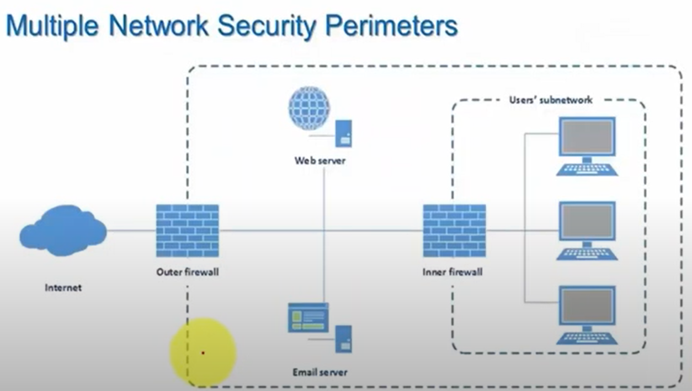

Slide 5
Introduction
Technology is a “double-edged sword” as it can be used for both good and bad purposes
People with the tendency to cause damage or carrying out illegal activities will use it for bad purposes.
Computers and tools available in IT are also used as targets of offense.
In today’s world of the Internet and computer networks, criminal activity can be carried out across national borders. Cybercriminals use the World Wide Web and the Internet to an optimum level for all illegal activities to store data, contacts, account information, etc.
The criminals take advantage of the widespread lack of awareness about cybercrimes and cyber laws among the people who are constantly using the IT infrastructure for official and personal purposes.

Slide 6

Hackers, Crackers, and Phreakers
Hackers: A hacker is a person with a strong interest in computers who enjoys learning and experimenting with them. Hackers are usually very talented, smart people who understand computers better than others. The term is often confused with cracker that defines someone who
breaks into computers

Slide 7
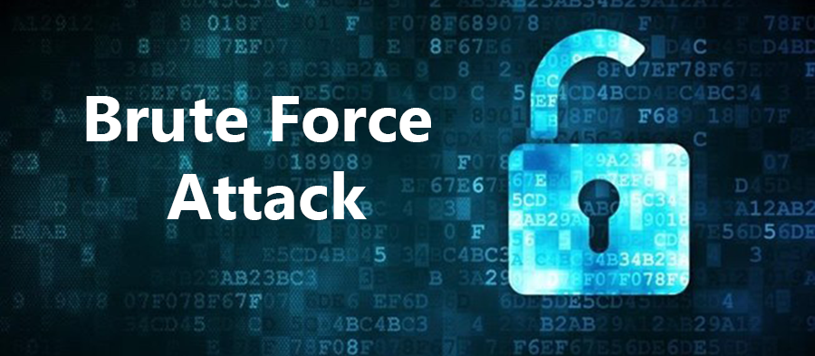
Brute force hacking: It is a technique used to find passwords or encryption keys. Brute force hacking involves trying every possible combination of letters, numbers, etc., until the code is
broken.

Slide 8

Cracker: A cracker is a person who breaks into computers. Crackers should not be confused with hackers. The term “cracker” is usually connected to computer criminals. Some of their
crimes include vandalism, theft and snooping in unauthorized areas.

Slide 9
Cracking: It is the act of breaking into computers. Cracking is a popular, growing subject on the Internet. Many sites are devoted to supplying crackers with programs that allow them to crack computers. Some of these programs contain dictionaries for guessing passwords. Others are used to break into phone lines (called “phreaking”). These sites usually display warnings such as “These files are illegal; we are not responsible for what you do with them.”
Cracker tools: These are programs used to break into computers. Cracker tools are widely distributed on the Internet. They include password crackers, Trojans, viruses, war dialers and worms.

Slide 10
Phreaking: This is the notorious art of breaking into phones or other communication systems. Phreaking sites on the Internet are popular among crackers and other criminals.
War dialer: Program automatically dials phone numbers looking for computers on the other end. It catalogs numbers so that the hackers can call back and try to break in. An attacker would look to exploit the vulnerabilities in the networks, most often so because the networks are not adequately protected.

Slide 11
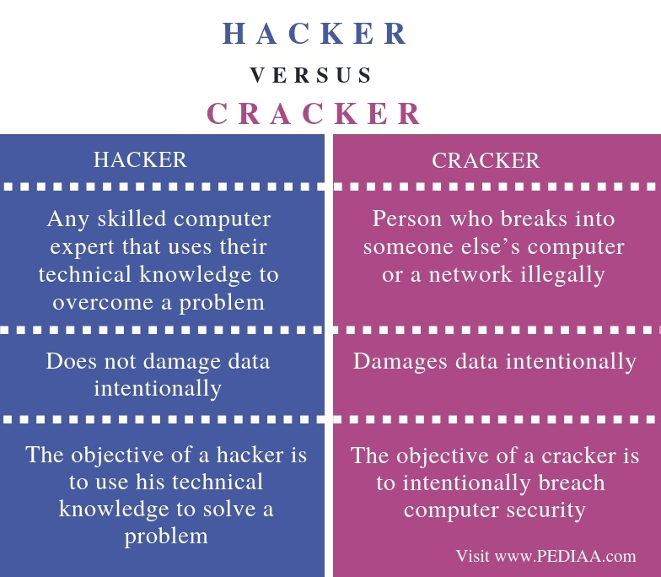

Slide 12
Most often attackers would look to exploit the vulnerabilities in the networks, as they are not adequately protected. The vulnerabilities are:
1. Inadequate border protection (weak firewall)
2. Remote Access Servers (RASs) with weak access controls
3. Application servers with well-known exploits;
4. Misconfigured systems and systems with default configurations.

Slide 13

What Color is Your Hat in the Security World?

Slide 14

A black hat is also called a “cracker” or “dark side hacker.” Such a person is a malicious or criminal hacker. Typically, the term “cracker” is used within the security industry. However, the general public uses the term hacker to refer to the same thing. In computer terminology, the meaning of “hacker” can be much broader. The name comes from the opposite of “white hat hackers.”

Slide 15

A gray hat hacker is one who thinks before acting or committing a malice or non-malice deed. A grey hat commonly refers to a hacker who releases information about any exploits or security holes he/she finds openly to the public. He/she does so without concern for how the information is used in the end (whether for patching or exploiting)

Slide 16

A white hat hacker is considered an ethical hacker. In the realm of IT, a “white hat hacker” is a person who is ethically opposed to the abuse of computer systems. It is said that the term is derived from American western movies, where the protagonist typically wore a white cowboy hat and the antagonist typically wore a black one. As a simplified explanation, a “white hat” generally focuses on securing IT systems, whereas a “black hat” (the opposite) would like to break into them, so this sounds like an age-old game of a thief and a police.

Slide 17
Categories of Cybercrime:
Cybercrime can be categorized based on the following:
1. The target of the crime and
2. whether the crime occurs as a single event or as a series of events.
Cybercrime can be targeted against individuals (persons), assets (property) and/or organizations (government, business and social).

Slide 18
Crimes targeted at individuals: The goal is to exploit human weaknesses such as greed and naivety. These crimes include financial fraud, sale of non-existent or stolen items, child pornography, copyright violation, harassment, etc. with the development in IT and the Internet; thus, criminals have a new tool that allows them to expand the pool of potential victims. However, this also makes it difficult to trace and apprehend the criminals.
Crimes targeted at property: This includes stealing mobile devices such as cell phone, laptops, personal digital assistant (PDAs), and removable medias (CDs and pen drives); transmitting harmful programs that can disrupt functions of the systems and/or can wipe out data from hard disk, and can create the malfunctioning of the attached devices in the system such as modem, CD drive, etc

Slide 19
Crimes targeted at organizations: Cyber terrorism is one of the distinct crimes against organizations/ governments. Attackers (individuals or groups of individuals) use
computer tools and the Internet to usually terrorize the citizens of a particular country by
stealing the private information, and also to damage the programs and fi les or plant
programs to get control of the network and/or system
Single event of cybercrime: It is the single event from the perspective of the victim. For example, unknowingly open an attachment that may contain virus that will infect the system (PC/laptop). This is known as hacking or fraud.
Series of events: This involves attacker interacting with the victims repetitively. For
example, attacker interacts with the victim on the phone and/or via chat rooms to
establish relationship first and then they exploit that relationship to commit the sexual
assault

Slide 20

Patriot Hacking:
Patriotic hacking is a term for computer hacking or system cracking in which citizens or supporters of a country, traditionally industrialized Western countries but increasingly developing countries, attempt to perpetrate attacks on, or block attacks by, perceived enemies of the state.
Although patriot hacking is declared as illegal in the US, however, it is reserved only for government agencies [i.e., Central Intelligence Agency (CIA) and National Security Agency (NSA)] as a legitimate form of attack and defense. Federal Bureau of Investigation (FBI) raised the concern about rise in cyber attacks like website defacements (explained in Box 1.4, Chapter1) and denial-of-service attacks (DoS – refer to Section 4.9, Chapter 4), which adds as fuel into increase in international tension and gets mirrored it into the online world.

Slide 21
Examples of Patriotic Hacking
1. After the war in Iraq in 2003, it is getting popular in the North America, Western Europe, and Israel. These are countries that have the greatest threat to Islamic terrorism and its aforementioned digital version.
2. The official websites of 10 different Indian universities were hacked and defaced in 2017. A group going by the name of ‘Pakistan Haxor Crew’ (PFC) claimed responsibility for the breach, saying it was retaliation for Pakistan’s railway ministry website being hacked by an Indian crew few days before this breach.

Slide 22
How Criminals plan the Attacks
Criminals use many methods and tools to locate the vulnerabilities of their target.
The target can be an individual and/or an organization.
Criminals plan passive and active attacks.
Active attacks are usually used to alter the system (i.e., computer network) whereas passive attacks attempt to gain information about the target.
Active attacks may affect the availability, integrity and authenticity of data whereas passive attacks lead to violation of confidentiality.

Slide 23
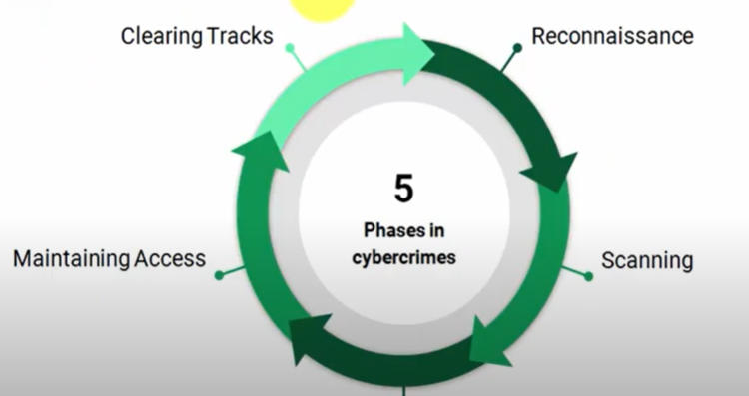
How Criminals plant the Attacks
Gaining Access

Slide 24
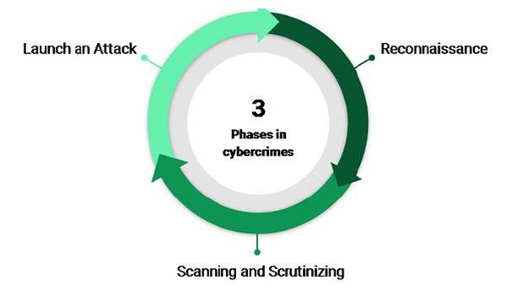

Slide 25
The following phases are involved in planning cybercrime:
1. Reconnaissance (information gathering) is the first phase and is treated as a passive attack.
2. Scanning and scrutinizing the gathered information for the validity of the information as
well as to identify the existing vulnerabilities.
3. Launching an attack (gaining and maintaining the system access).

Slide 26
Reconnaissance:
The literal meaning of “Reconnaissance” is an act of finding something or somebody (especially to gain information about an enemy or potential enemy).
In the world of “hacking,” reconnaissance phase begins with “Footprinting” – this is the preparation toward pre-attack phase and involves accumulating data about the target’s environment and computer architecture to find ways to intrude into that environment.
Foot printing gives an overview about system vulnerabilities and provides a judgment about possible exploitation of those vulnerabilities.

Slide 27
The objective of this preparatory phase is to understand the system, its networking ports and services, and any other aspects of its security that are needful for launching the attack.
Thus, an attacker attempts to gather information in two phases: passive and active attacks. Let us understand these two phases.

Slide 28
Passive Attacks:
This attack is used to gather information about a target without their knowledge. These attacks include:
Google or Yahoo search
Facebook, LinkedIn, and other social sites
Blogs, newsgroup, press releases, etc.
Job posting on Naukri, Monster, Craigslist, etc.
Network sniffing

Slide 29
Active Attacks:
This attack involves exploring the network to discover individual hosts to confirm the data gathered using passive attacks.
This attack involves the risk of being detected and so it is called “Active Reconnaissance”
This attack allows the attacker to know the security measures in place.

Slide 30
Demonstration:
archive.org.
FOCA (Fingerprinting Organizations with Collected Archives)
Nmap (Network Mapper).

Slide 31
Active Network:
An active attack involves probing the network to discover individual hosts to confirm the information gathered in the passive attack phase. It involves the risk of detection and is also called “Rattling the doorknobs” or “Active reconnaissance.” Active reconnaissance can provide confirmation to an attacker about security measures in place (e.g., whether the front door is locked?), but the process can also increase the chance of being caught or raising suspicion.

Slide 32
Scanning and Scrutinizing Gathered Information:
Scanning involves an intelligent examination of gathered information about the target
The objectives of scanning are:
Port scanning
Network scanning
Vulnerability scanning

Slide 33
Scrutinizing is also called enumeration
90% of the time in hacking is spent in reconnaissance scanning and scrutinizing information.
The objectives are :
  Find valid user accounts or groups
  Find network resources or shared resources
  OS and different applications running on the target

Slide 34
Attack (Gaining and Maintaining the System Access):
After the scanning and enumeration, the attack is launched using the following steps:
Crack the password.
Exploit the privileges.
Execute the malicious commands/applications.
Hide the files (if required).
Cover the tracks – delete the access logs, so that there is no trail illicit activity.

Slide 35
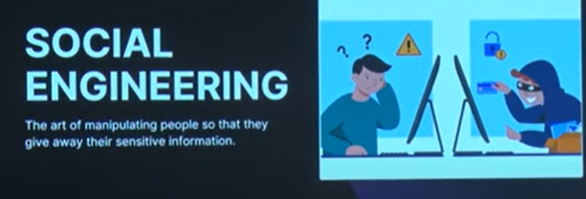

Slide 36


Social Engineering:

Slide 37
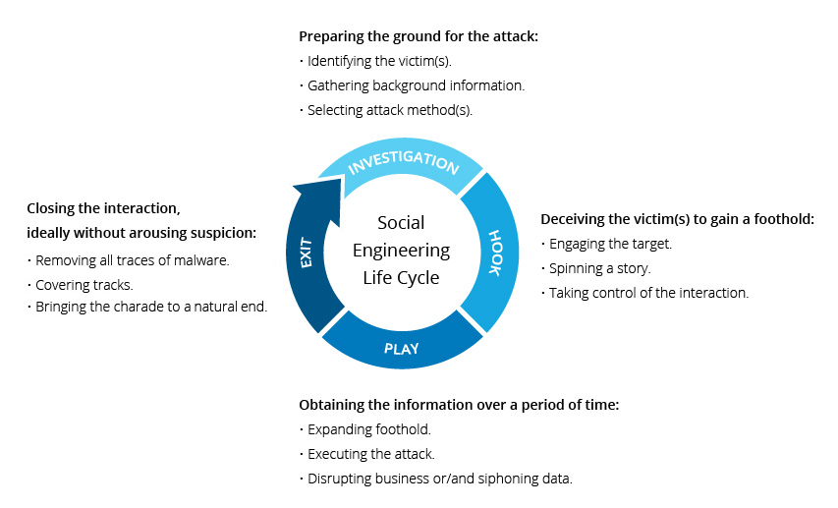
Social Engineering:

Slide 38
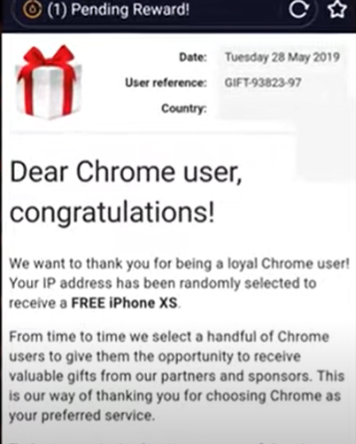
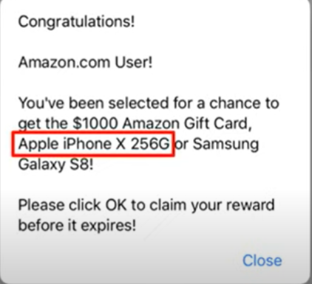
Social Engineering:

Slide 39
Social Engineering:
Social engineering is the “technique to influence” and “persuasion to deceive” people to obtain the information or perform some action.
Social engineers exploit the natural tendency of a person to trust social engineers’ word, rather than exploiting computer security holes.
It is generally agreed that people are the weak link in security and this principle makes social engineering possible.
A social engineer usually uses telecommunication (i.e., telephone and/or cell phone) or Internet to get them to do something that is against the security practices and/or policies of the organization

Slide 40
It is an art of exploiting the trust of people, which is not doubted while speaking in a normal manner.
The goal of a social engineer is to fool someone into providing valuable information or access to that information.
Social engineer studies the human behavior so that people will help because of the desire to be helpful, the attitude to trust people, and the fear of getting into trouble.
The sign of truly successful social engineers is that they receive information without any suspicion

Slide 41
Classification of Social Engineering
Human-Based Social Engineering
Computer-based social engineering

Slide 42
Human-Based Social Engineering
Human-Based Social Engineering refers to person-to-person interaction to get the required/desired information.
An example is calling the help desk and trying to find out a password.
Impersonating an employee or valid user:
“Impersonation” is perhaps the greatest technique used by social engineers to deceive people.
Social engineers “take advantage” of the fact that most people are basically helpful, so it seems harmless to tell someone who appears to be lost where the computer room is located, or to let someone into the building who “forgot” his/her badge, etc., or pretending to be an employee or valid user on the system.
Human-Based Social Engineering:

Slide 43
Posing as an important user:
The attacker pretends to be an important user – for example, a Chief Executive Officer (CEO) or high-level manager who needs immediate assistance to gain access to a system.
The attacker uses intimidation so that a lower-level employee such as a help-desk worker will help him/her in gaining access to the system. Most of the low-level employees will not ask any question to someone who appears to be in a position of authority.
Using a third person:
An attacker pretends to have permission from an authorized source to use a system. This trick is useful when the authorized personnel is on vacation or cannot be contacted for verification.

Slide 44
Calling technical support:
Calling the technical support for assistance is a classic social engineering example.
Help-desk and technical support personnel are trained to help users, which makes them good prey for social engineering attacks.
Shoulder surfing:
It is a technique of gathering information such as usernames and passwords by watching over a person’s shoulder while he/she logs into the system, thereby helping an attacker to gain access to the system.

Slide 45
Dumpster diving:
It involves looking in the trash for information written on pieces of paper or computer printouts.
This is a typical North American term; it is used to describe the practice of rummaging through commercial or residential trash to find useful free items that have been discarded.
It is also called dumpstering, binning, trashing, garbing or garbage gleaning.
“Scavenging” is another term to describe these habits.

Slide 46
Computer-Based Social Engineering
Computer-based social engineering refers to an attempt made to get the required/desired information by using computer software/Internet.
For example, sending a fake E-Mail to the user and asking him/her to re-enter a password in a webpage to confirm it.
  Fake e-mail
  E-Mail attachments
  Pop-up windows

Slide 47
Fake email:
The attacker sends fake E-Mails to users such that the user finds it as a real e-mail
This activity is also called “Phishing”.
It is an attempt to attract Internet users (netizens) to reveal their personal information, such as usernames, passwords and credit card details by impersonating as a trustworthy and legitimate organization or an individual.
Banks, financial institutes and payment gateways are the common targets.
Phishing is typically carried out through E-Mails or instant messaging and often directs
users to enter details at a website, usually designed by the attacker with abiding the look and feel of the original website.
Thus, Phishing is also an example of social engineering techniques used to fool netizens.
The term “Phishing” has been evolved from the analogy that Internet scammers are using
E-Mails attract to fish for passwords and financial data from the sea of Internet users (i.e., netizens).

Slide 48
E-Mail attachments:
E-Mail attachments are used to send malicious code to a victim’s system, which will automatically (e.g., keylogger utility to capture passwords) get executed.
Viruses, Trojans, and worms can be included cleverly in the attachments to entice a victim to open the attachment.
Pop-up windows:
Pop-up windows are also used, in a similar manner to E-Mail attachments. Pop-up windows with special offers or free stuff can encourage a user to unintentionally install malicious software.

Slide 49
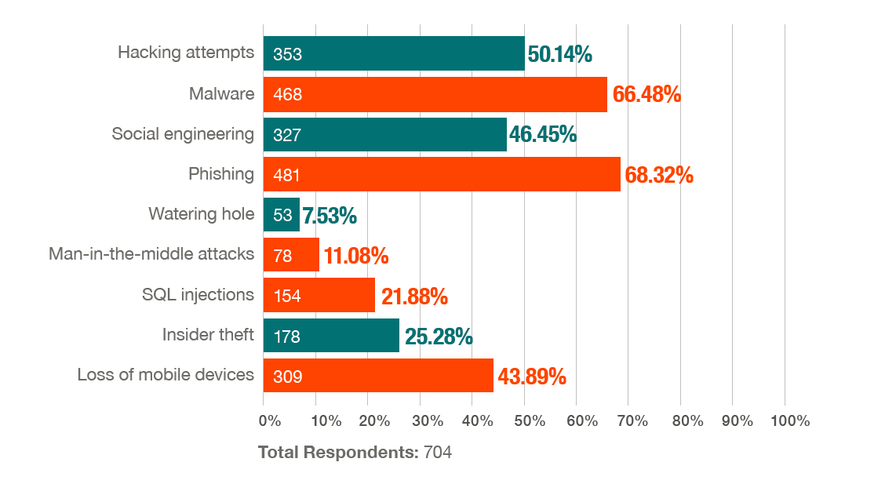

Slide 50
New Cyber Security Trends and Predictions for 2023
Newer ways of social engineering attacks
With 5G comes new vulnerabilities
Increased adoption of cyber insurance
AI could be manipulated using false/misleading information
The ransomware ecosystem will evolve
Crypto-related scams are expected to reach an all-time high in 2023

Slide 51
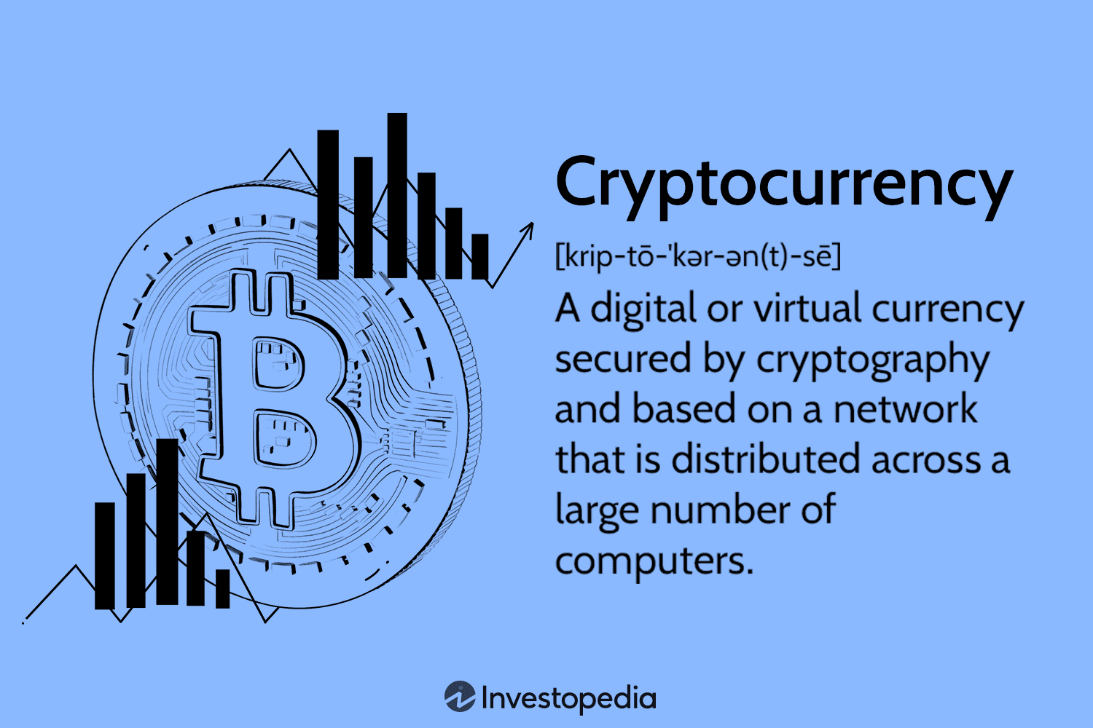
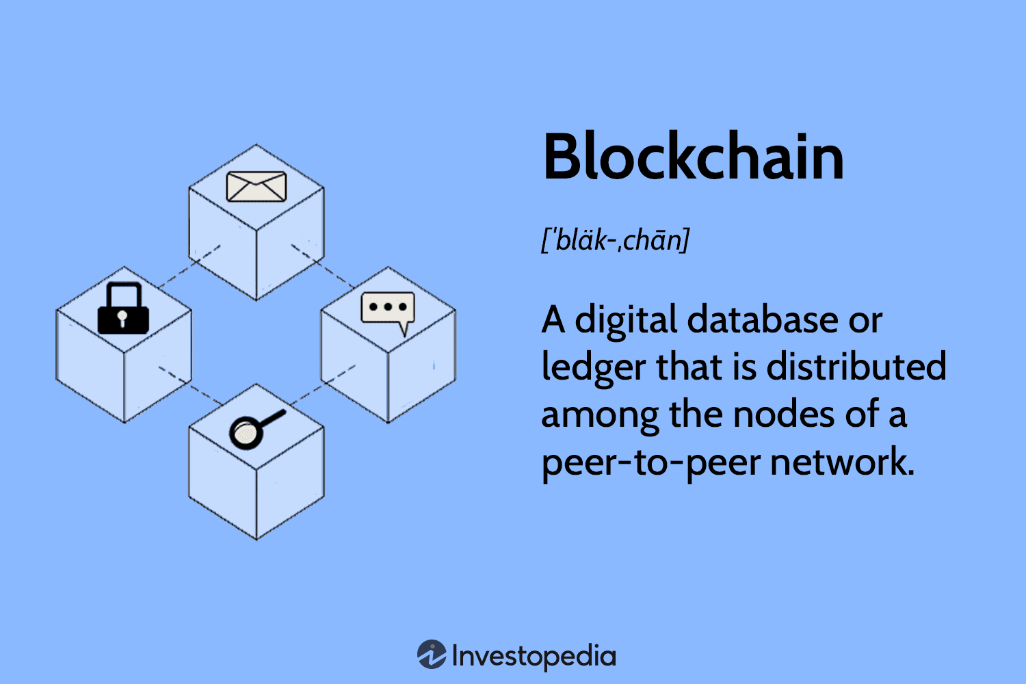

n
Bitcoin
Cryptocurrency: Encrypted Currency
Blockchain
Satoshi Nakamoto

Slide 52
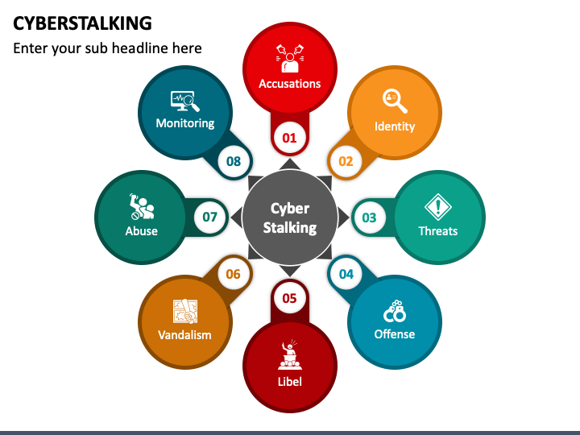

Slide 53
Cyberstalking
The dictionary meaning of “stalking” is an “act or process of following prey
trying to approach somebody or something.”
Cyberstalking has been defined as the use of information and communications
technology, particularly the Internet, by an individual or group of individuals to harass
another individual, group of individuals, or organization.
The behavior includes monitoring, transmission of threats, ID theft,
damage to data or equipment, solicitation of minors for sexual purposes, and gathering
information for harassment purposes.

Slide 54
Cyberstalking refers to the use of Internet and/or other electronic communications
devices to stalk another person.

Slide 55
Types of Stalkers
There are primarily two types of stalkers.
Online stalkers:
They aim to start the interaction with the victim directly with the help of the Internet.
E-Mail and chat rooms are the most popular communication medium to get connected with the victim, rather than using traditional instrumentation like telephone/cell phone.
The stalker makes sure that the victim recognizes the attack attempted on him/her.
The stalker can make use of a third party to harass the victim

Slide 56
2. Offline stalkers:
The stalker may begin the attack using traditional methods such as following the
victim, watching the daily routine of the victim, etc.
Searching on message boards/newsgroups, personal websites, and people finding
services or websites are most common ways to gather information about the victim
using the Internet.
The victim is not aware that the Internet has been used for an attack against them.

Slide 57
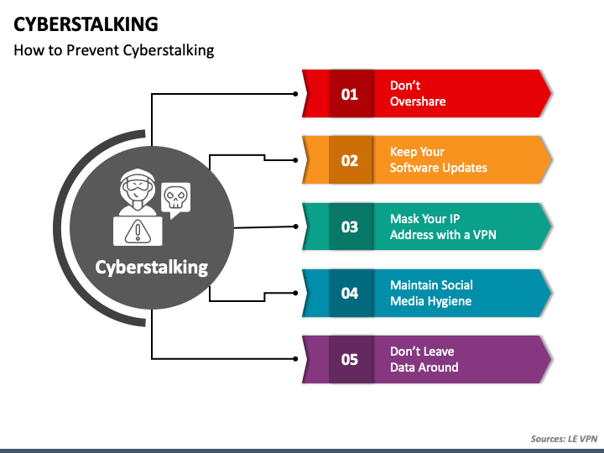

Slide 58
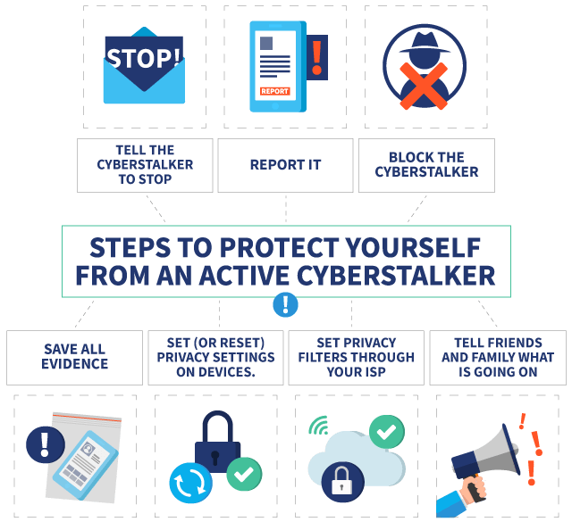

Slide 59
Cyberbullying
The National Crime Prevention Council defines Cyberbullying as “when the Internet, cell phones or other devices are used to send or post text or images intended to hurt or embarrass another person.”
www.StopCyberbullying.org, an expert organization dedicated to Internet safety, security, and privacy defines cyberbullying as “a situation when a child, tween, or teen is repeatedly ‘tormented, threatened, harassed, humiliated, embarrassed, or otherwise targeted’ by Cyber Offenses another child, tween, or teen using text messaging, E-Mail, instant messaging, or any other type of digital technology.”

Slide 60
First, we do not know what programs are installed on the computer – that is, risk of malicious programs such as keyloggers or Spyware, which maybe running at the background that can capture the keystrokes to know the passwords and other confidential information and/or monitor the browsing behavior.
Second, over-the-shoulder surfing can enable others to find out your passwords. Therefore, one has to be extremely careful about protecting his/her privacy on such systems, as one does not know who will use the computer after him/her

Slide 61
Indian Information Technology Act (ITA) 2000, does not define cybercafes and interprets cybercafes as “network service providers” referred to under the Section 79, which imposed on them a responsibility for “due diligence” failing which they would be liable for the offenses committed in their network.
Cybercriminals prefer cybercafes to carry out their activities.
The criminals tend to identify one particular personal computer (PC) to prepare it for their use.
Cybercriminals can either install malicious programs such as keyloggers and/or Spyware or launch an attack on the target.
Cybercriminals will visit these cafes at a particular time and on the prescribed frequency, maybe alternate day or twice a week

Slide 62
A recent survey conducted in one of the metropolitan cities in India reveals the following facts:
Pirated software(s) such as OS, browser, office automation software(s) (e.g., Microsoft Office) are installed in all the computers.
Antivirus software is found to be not updated to the latest patch and/or antivirus signature.
Several cybercafes had installed the software called “Deep Freeze” for protecting the computers from prospective malware attacks. Deep Freeze can wipe out the details of all activities carried out on the computer when one clicks on the “restart” button. Such practices present challenges to the police or crime investigators when they visit the cybercafes to pick up clues after the Interet Service Provider (ISP) points to a particular IP address from where a threat mail was probably sent or an online Phishing attack was carried out, to retrieve logged files.

Slide 63
4. Annual maintenance contract (AMC) found to be not in a place for servicing the computers; hence, hard disks for all the computers are not formatted unless the computer is down. Not having the AMC is a risk from cybercrime perspective because a cybercriminal can install a Malicious Code on a computer and conduct criminal activities without any interruption.
5.Pornographic websites and other similar websites with indecent contents are not blocked.
6. Cybercafe owners have very less awareness about IT Security and IT Governance.

Slide 64
7. Government/ISPs/State Police (cyber cell wing) do not seem to provide IT Governance guidelines to cybercafe owners.
8. Cybercafe association or State Police (cyber cell wing) do not seem to conduct periodic visits to cybercafes – one of the cybercafe owners whom we interviewed expressed a view that the police will not visit a cybercafe unless criminal activity is registered by filing an First Information Report (FIR). Cybercafe owners feel that police either have a very little knowledge about the technical aspects involved in cybercrimes and/or about conceptual understanding of IT security. There are thousands of cybercafes across India.

Slide 65
In the event that a central agency takes up the responsibility for monitoring cybercafes, an individual should take care while visiting and/or operating from cybercafe. Here are a few tips for safety and security while using the computer in a cybercafe:
Always logout
Stay with the computer
Clear history and temporary files
Be alert
Avoid online financial transactions
Change passwords
Use Virtual keyboard
Security warnings

Slide 66
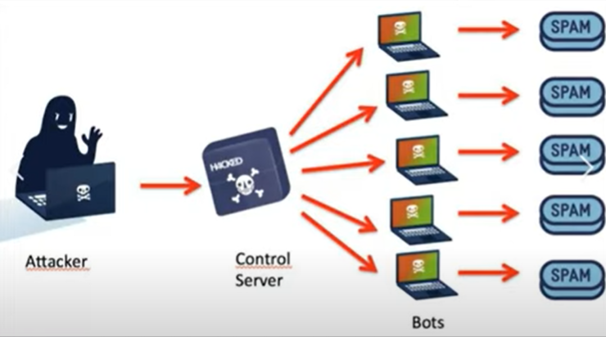
Botnet:

Slide 67
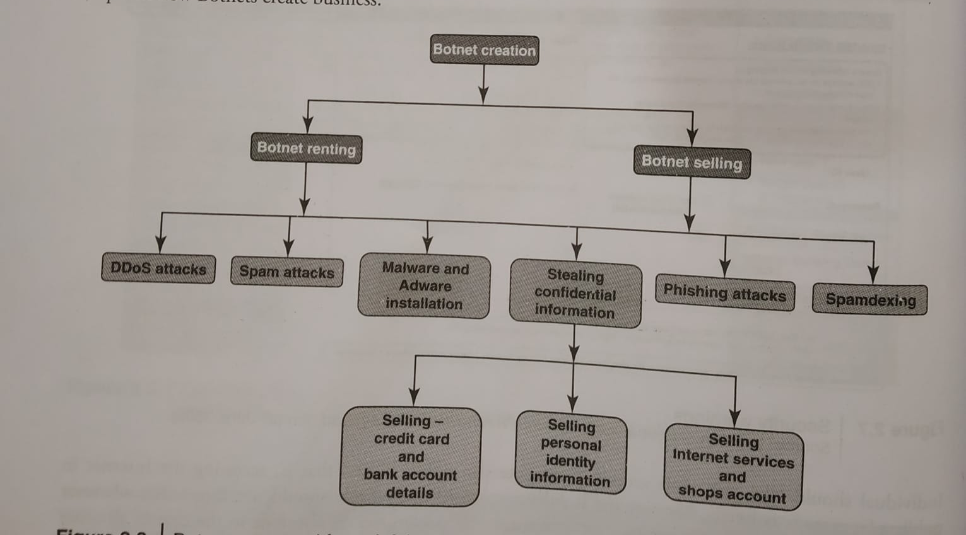

Slide 68
Bot refers to an automated program for performing a task, often over a network
Botnet refers to a collection of bots
Botnets are often like distributing Denial-of-Service used to perform malicious activities spam and spread viruses to conduct (DoS) attacks

Slide 69
A botnet is a network of computers infected with a malicious program that allows cybercriminals to control the infected machines remotely without the users'
Knowledge.
The dictionary meaning of Bot is “(computing) an automated program for doing some particular task, often over a network.”
Botnet is a term used for the collection of software robots, or Bots, that run autonomously and automatically.
The term is often associated with malicious software but can also refer to the network of computers using distributed computing software.
In simple terms, a Bot is simply an automated computer program One can gain the
control of computer by infecting them with a virus or other Malicious Code that gives the access

Slide 70
Computer system maybe a part of a Botnet even though it appears to be operating normally.
Botnets are often used to conduct a range of activities, from distributing Spam and viruses to conducting denial-of-service (DoS) attacks.
A Botnet (also called as zombie network) is a network of computers infected with a malicious program that allows cybercriminals to control the infected machines remotely without the users’ knowledge.
“Zombie networks” have become a source of income for entire groups of cybercriminals. The invariably low cost of maintaining a Botnet and the ever diminishing degree of knowledge required to manage one are conducive to the growth in popularity and, consequently, the number of Botnets.

Slide 71
‘encryption of these programs’ code can also be ordered in the same way to protect them from detection by antivirus tools.
Another option is to steal an existing Botnet.
One can reduce the chances of becoming part of a Bot by limiting access into the system.
Leaving your Internet connection ON and unprotected is just like leaving the front door of the house wide open.

Slide 72
One can ensure the following to secure the system:
Use antivirus and anti-Spyware software and keep it up-to-date
Set the OS to download and install security patches automatically
Use a firewall to protect the system from hacking attacks while it is connected on the Internet: A firewall is a software and/or hardware that is designed to block unauthorized access while permitting authorized communications.
Disconnect from the Internet when you are away from your computer
Downloading the freeware only from websites that are known and trustworthy
Check regularly the folders in the mailbox – “sent items” or “outgoing” – for those messages you did not send
Take immediate action if your system is infected

Slide 73
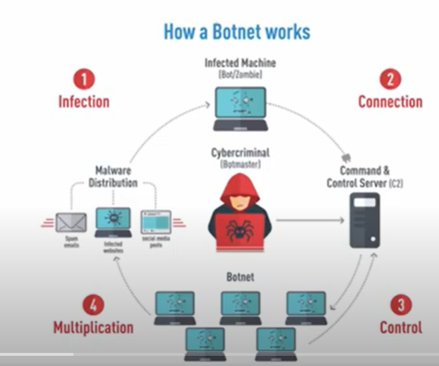

Slide 74
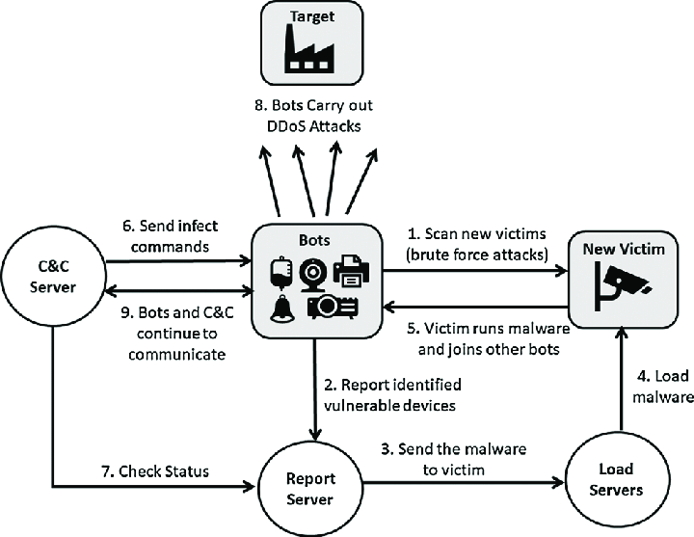
MIRAI

Slide 75
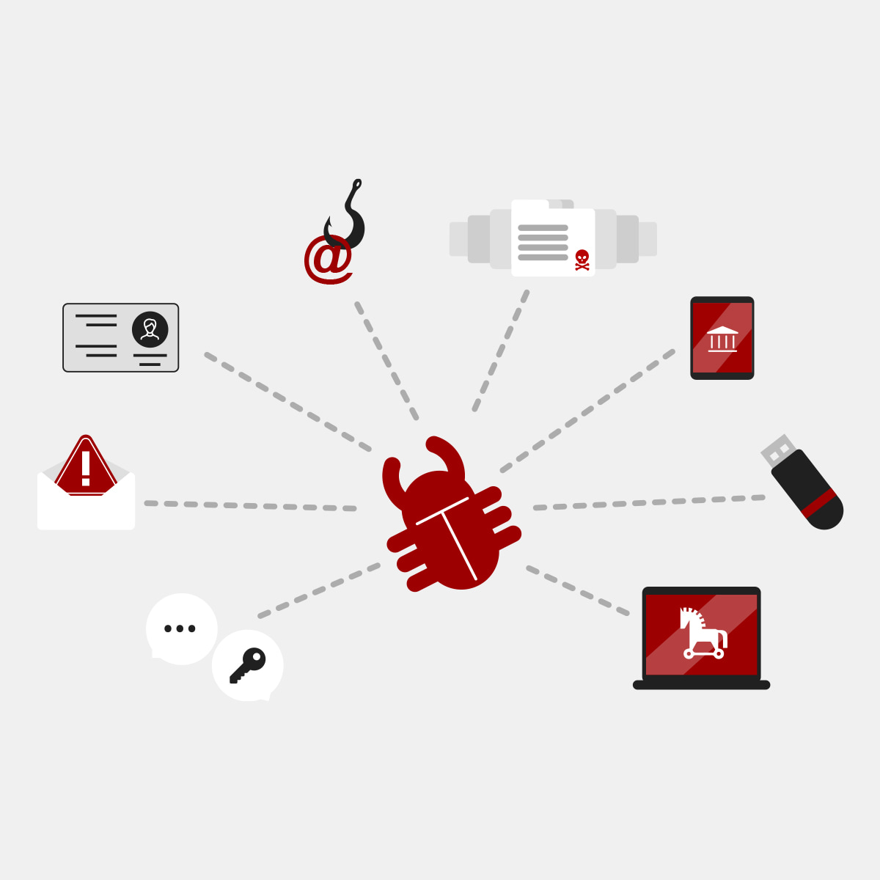

Technical Term:
Malware: It is malicious software, designed to damage a computer system without the owner’s
informed consent. Viruses and worms are the examples of malware.
Adware: It is advertising-supported software, which automatically plays, displays, or downloads advertisements to a computer after the software is installed on it or while the application is being used. Few Spywares are classified as Adware.

Slide 76
Spam: It means unsolicited or undesired E-Mail messages
DDoS: Distributed denial-of-service attack (DDoS) occurs when multiple systems flood the bandwidth or resources of a targeted system, usually one or more web servers. These systems are compromised by attackers using a variety of methods.

Slide 77
Attack Vector:
An “attack vector” is a path, which an attacker can gain access to a computer or to a network server to deliver a payload or malicious outcome.
Attack vectors enable attackers to exploit system vulnerabilities, including the human element.
Attack vectors include viruses, E-Mail attachments, webpages, pop-up windows, instant messages, chat rooms, and deception. All of these methods involve programming, except deception, in which a human operator is fooled into removing or weakening system defenses.
To some extent, firewalls and antivirus software can block attack vectors.

Slide 78
A defense method that is effective today may not remain so for long because attackers are constantly updating attack vectors, and seeking new ones, in their quest to gain unauthorized access to computers and servers.
The most common malicious payloads are viruses, Trojan Horses, worms, and Spyware.
In technical terms, the payload is the necessary data being carried within a packet or other transmission unit – in this scenario, payload means the malicious activity that the attack performs.

Slide 79
Attack by E-Mail
Attachments (and other files)
Attack by deception
Hackers
Heedless guests (attack by webpage)
Attack of the worms
Malicious macros
Foistware (sneakware)
Viruses

Slide 80
Zero-Day Attack:
A zero-day (or zero hour) attack is a computer threat that attempts to exploit computer application vulnerabilities that are unknown to anybody in the world (i.e., undisclosed to the software vendor and software users) and/or for which no patch (i.e., security fix) is available. Zero-day exploits are used or shared by attackers before the software vendor knows about the vulnerability.

Slide 81
Zero-day emergency response team (ZERT): This is a group of software engineers who work to release non-vendor patches for zero-day exploits. Nevada is attempting to provide support with the Zeroday Project at www.zerodayproject.com, which surpports to provide information on upcoming attacks and provide support to vulnerable systems. Also, visit the weblink http://www.isotf.org/zert to get more information about it.

Slide 82


