Slide 1
Course Name
INTRODUCTION TO C PROGRAMMING
Course Code
BESCK204E
Course type
Integrated
Contact Hours
40
50 (30+20)
CIE Marks
Mrs AKHILA C G
Assistant Professor
Dept of CIVIL Engineering
ATMECE, Mysuru
SEE Marks
50

Slide 2
Course Learning Objectives
1. Elucidate the basic architecture and functionalities of a Computer
2. Apply programming constructs of C language to solve the real-world problems
3. Explore user-defined data structures like arrays, structures and pointers in implementing solutions to problems
4. Design and Develop Solutions to problems using modular programming constructs such as functions and procedures

Slide 3
Module-1
Introduction to C: Introduction to computers, input and output devices, designing efficient programs.
Introduction to C, Structure of C program, Files used in a C program, Compilers, Compiling and executing C programs, variables, constants, Input/output statements in C
Module-2
Operators in C, Type conversion and typecasting.
Decision control and Looping statements: Introduction to decision control, Conditional branching statements, iterative statements, nested loops, break and continue statements, goto statement.

Slide 4
Module-3
Functions: Introduction using functions, Function definition, function declaration, function call, return statement, passing parameters to functions, scope of variables, storage classes, recursive functions.
Arrays: Declaration of arrays, accessing the elements of an array, storing values in arrays, Operations on arrays, Passing arrays to functions.
Module-4
Two dimensional arrays, operations on two-dimensional arrays, two-dimensional arrays to functions, multidimensional arrays.
Applications of arrays and introduction to strings:Applications of arrays, case study with sorting techinques.
Introduction to strings: Reading strings, writing strings, summary of functions used to read and write characters. Suppressing input using a Scanset .

Slide 5

Module-5
Strings: String taxonomy, operations on strings, Miscellaneous string and character functions, arrays of strings.
Pointers: Understanding the Computers Memory, Introduction to Pointers, Declaring Pointer Variables
Structures: Introduction to structures

Slide 6
Course Outcomes
1. Elucidate the basic architecture and functionalities of a computer and also recognize the hardware parts.
2. Apply programming constructs of C language to solve the real world problem
3. Explore user-defined data structures like arrays in implementing solutions to problems like searching and sorting
4. Explore user-defined data structures like structures, unions and pointers in implementing solutions
5. Design and Develop Solutions to problems using modular programming constructs using functions

Slide 7
Computer fundamentals and programming in c, “Reema Thareja”, Oxford University, Second edition, 2017.
Text Book
E. Balaguruswamy, Programming in ANSI C, 7th Edition, Tata McGraw-Hill.
Reference Books
Brian W. Kernighan and Dennis M. Ritchie, The ‘C’ Programming Language, Prentice Hall of India.
C Programming techniques by A.M. Padma Reddy

Slide 8
Question Paper Pattern
The question paper will have ten questions.
Each full Question consisting of 20 marks.
There will be 2 full questions (with a maximum of four sub questions) from each module.
Each full question will have sub questions covering all the topics under a module.
The students will have to answer 5 full questions, selecting one full question from each module.

Slide 9
MODULE -01
Introduction to COMPUTER
Notes:
1
1

Slide 10
Definition of a computer
By definition, a computer is an electronic device that inputs data, processes data(converting it into information that is useful to people) outputs and stores information.
Generally a Computer is a device that accepts input, processes it, stores data, and produces output.
Various activities are performed based on the instructions that are stored in the memory of the computer at tremendous speed with very high accuracy.

Slide 11
Necessity to know about a COMPUTER
Computer’s are being used everywhere.
Used in all fields of engineering and non engineering disciplines.
So, it is necessary for us to know how to use it, how it works and how we can make use of it to do our activities by giving instructions to it.

Slide 12
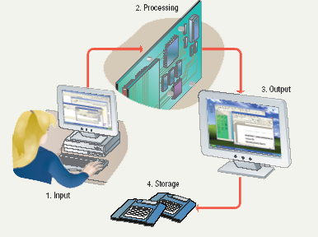
Information Processing Cycle
Steps followed to process data
  Input
  Processing
  Output
  Storage

Slide 13
INPUT
Input: Information provided to the computer by a person, the environment, or another computer.
Examples of Input
  words and symbols
  numbers
  pictures
  audio signals from a microphone
  signals from another computer
  temperature, speed, pressures, etc. from sensors

Slide 14
PROCESSING
Processing - manipulation of data.
  Data are symbols that represent raw facts, objects, and ideas about people, places, events, and things that are of importance in an organization.
  A computer program or software is a series of instructions that tell a computer how to carry out a processing task.
Examples of Processing
  Arithmetic calculations
  Sorting a list
  Modifying pictures
  Drawing graphs

Slide 15
OUTPUT
Output - the result produced by a computer after processing the data.
Output device –displays, prints, or transmits the results after processing.
Examples of Output
  images on a monitor
  printed documents
  sounds
  signals to device controllers

Slide 16
Memory and Storage
Memory - the area of a computer that temporarily holds data that is being processed or waiting to be processed, stored, or output.
Storage - The area where data can be left on a permanent basis while it is not needed for processing.
Examples of Storage
  magnetic disks
  CD-ROM (Compact Disk Read-Only Memory)
  magnetic tapes
  Flash disk
  Memory card, Floppy disk etc..

Slide 17
Computer Operations
Input
Processing
Output
External Storage
Notes:
9
9

Slide 18
Input devices
keyboard
Handheld devices
Audio/Visual devices
Microphone
Web/digital camera
Pointing devices
Optical devices
Barcode readers
Scanner
OCR
MICR
OMR
Mouse
Trackball
Track pad
Pen
Touch screen
Joystick

Slide 19
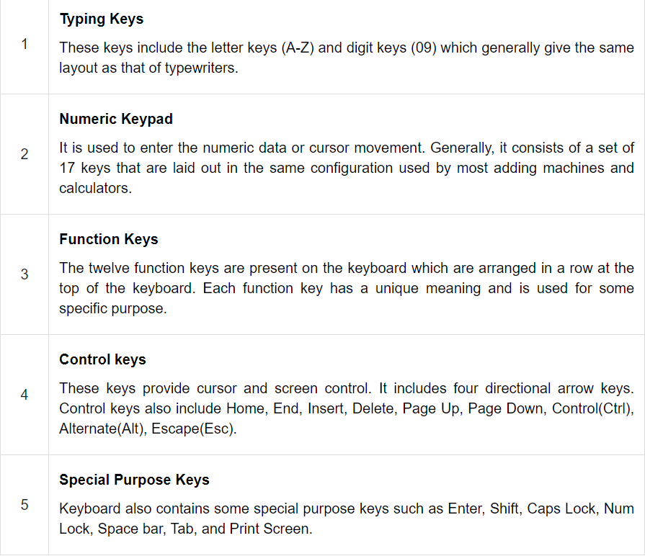
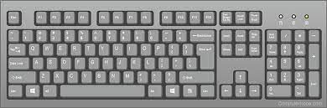
Keyboard

Slide 20



Mouse
Track Ball
Trackpad
- It is a very famous cursor-control device having a small palm size box with a round ball at its base, which senses the movement of the mouse and sends corresponding signals to the CPU when the mouse buttons are pressed.
- Generally, it has two buttons called the left and the right button and a wheel is present between the buttons.
- Track ball is an input device that is mostly used in notebook or laptop computer, instead of a mouse.
- This is a ball which is half inserted and by moving fingers on the ball, the pointer can be moved.
- Since the whole device is not moved, a track ball requires less space than a mouse.
It is small, flat, rectangular stationery pointing device with a sensor.
A special area on a laptop or other computer that you touch in order to move the cursor or give an instruction.
Also special buttons around the edge of the pad that works like mouse buttons.
The working of a touchpad is similar to that of a mouse or a trackball

Slide 21



Light Pen
Touch-screen
Joystick
- Light pen is a pointing device similar to a pen. It is used to select a displayed menu item or draw pictures on the monitor screen.
- It consists of a photocell and an optical system placed in a small tube.
- When the tip of a light pen is moved over the monitor screen and the pen button is pressed, its photocell sensing element detects the screen location and sends the corresponding signal to the CPU.
-It is a display screen that can identify the occurrence and position of a touch inside the display region.
-The user can touch the screen either by fingers or a stylus.
Touchsreen monitors are an easy way of entering information into the computer.
- Joystick is also a pointing device, which is used to move the cursor position on a monitor screen.
-The function of the joystick is similar to that of a mouse. It is mainly used in Computer Aided Designing (CAD) and playing computer games.

Slide 22
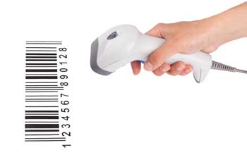
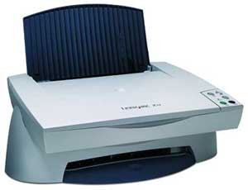

Bar Code Readers
Scanner
Optical Character Reader
(OCR)
- Bar Code Reader is a device used for reading bar coded data (data in the form of light and dark lines).
- Bar coded data is generally used in labelling goods, numbering the books, etc.
- It may be a handheld scanner or may be embedded in a stationary scanner.
A scanner is a device that captures images, printed text, and handwriting from different sources and converts them into digital image for editing and display on computers.
Scanners come in handheld, feed in, and flatbed types.
The scanners that we see in our colleges or offices are flatbed scanners.
OCR is an input device used to read a printed text.
- OCR scans the text optically, character by character, converts them into a machine readable code, and stores the text on the system memory.
- OCR stores text documents as text files, hence it requires less storage space.

Slide 23
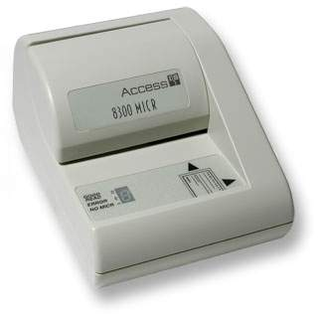
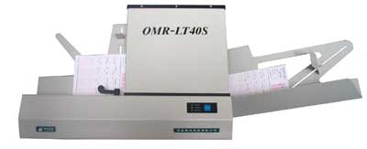
Magnetic Ink Card Reader (MICR)
Optical Mark Reader
(OMR)
- MICR input device is generally used in banks as there are large number of cheques to be processed every day.
- The bank's code number and cheque number are printed on the cheques with a special type of ink that contains particles of magnetic material that are machine readable.
- OMR is a special type of optical scanner used to recognize the type of mark made by pen or pencil.
- It is used where one out of a few alternatives is to be selected and marked.
- It is specially used for checking the answer sheets of examinations having multiple choice questions.

Slide 24
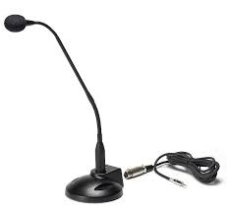


Microphone
Digital camera
Web camera
- Microphone is an input device to input sound that is then stored in a digital form.
-The microphone is used for various applications such as adding sound to a multimedia presentation or for mixing music.
-it is a handheld and easily portable device used to capture images or videos
-The digital camera digitizes image or video and stores them on a memory card
- The data can then be transferred to the computer
- They are easily edited, printed or transmitted through mails
Web cameras too capture videos that can be transmitted via the internet in real time.
they are cheap, and this is one of the reason to use them widely for security and privacy purpose.

Slide 25
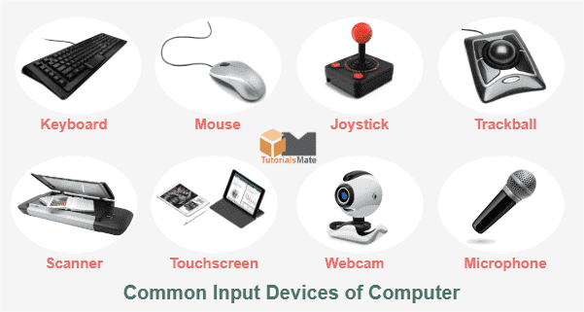
Input Devices

Slide 26
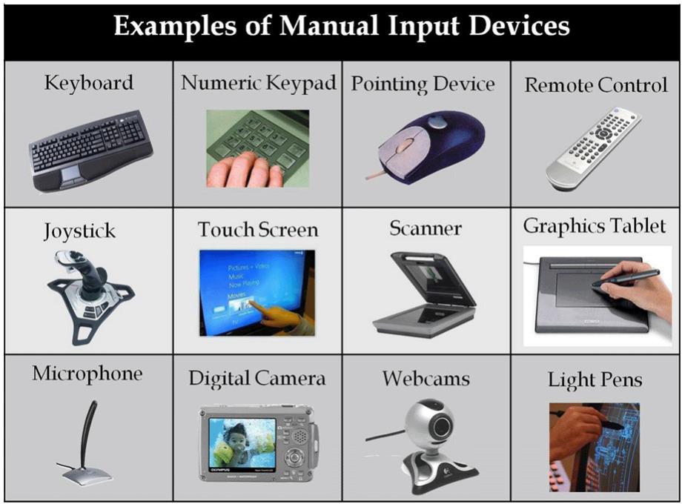

Slide 27
Output devices
Soft copy devices
Hard copy devices
Monitor
Projector
Speaker
Printer
Plotter

Slide 28
Monitors
Monitor is a softcopy output device used to display video and graphics information generated by the computer.
They are similar to television screens but they display information at much higher quality.
It forms images from tiny dots, called pixels that are arranged in a rectangular form.
The sharpness of the image depends upon the number of pixels.
There are two kinds of viewing screen used for monitors
Cathode-Ray Tube (CRT)
Liquid crystal display (LCD)
Plasma

Slide 29
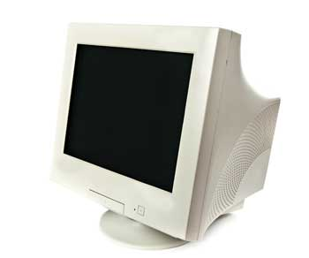
Cathode-Ray Tube (CRT) Monitor
.
The CRT display is made up of small picture elements called pixels. The smaller the pixels, the better the image clarity or resolution.
It looks similar to traditional televisions and very huge in size.
It work by firing charged electrons at a phosphorous film.

Slide 30
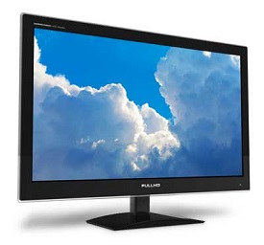
Liquid crystal display (LCD)
LCD monitor is thin, flat electronic output devices
They offer equivalent graphics quality.
These days, LCR monitors are replacing CRT monitors as they are cheaper, light weight and occupy less space.

Slide 31
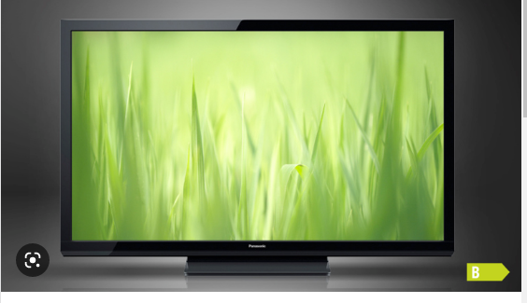
Plasma monitor
Plasma monitors are thin and flat monitors
The display contains two glass plates that have thousands of cells filled with xenon and neon.
These monitors are very expensive and requires high power consumption

Slide 32
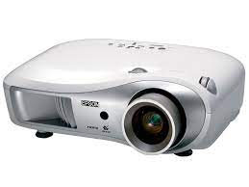
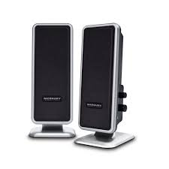
Projector
Speaker
- A projector is an output device that projects an image onto a large surface, such as a white screen or wall.
- It may be used an alternative to a monitor or television when showing video or images to a large group of people.
- A computer speaker is an output device that connects to a computer to generate sound.
-The signal used to produce the sound that comes from a computer speaker is created by the computer's sound cards.

Slide 33
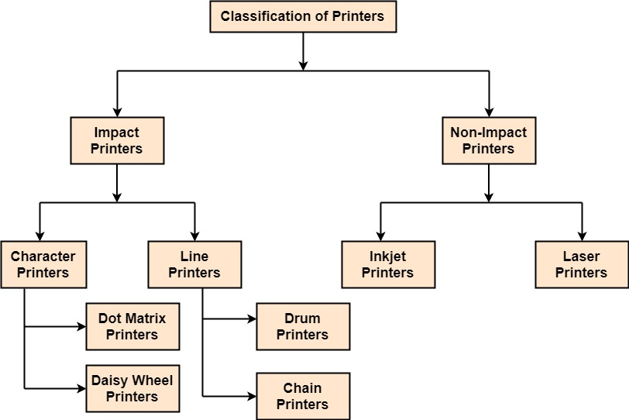
Printers
Printer is an output device, which is used to print information on paper.

Slide 34
Impact printers print the characters by striking them on the ribbon, which is then pressed on the paper.
Characteristics of Impact Printers
- Very low consumable costs
- Very noisy
- Useful for bulk printing due to low cost
- There is physical contact with the paper to produce an image

Slide 35
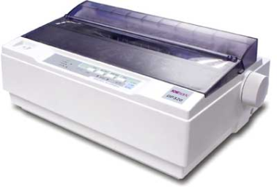
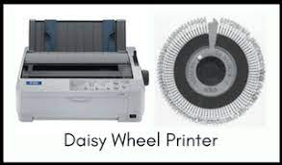
Character printers are the printers which print one character at a time.
Dot Matrix Printer
Daisy Wheel
- One of the most popular printers is Dot Matrix Printer.
Each character printed is in the form of pattern of dots and head consists of a Matrix of Pins of size which come out to form a character which is why it is called Dot Matrix Printer.
Advantages
Inexpensive
Widely Used
Other language characters can be printed
Disadvantages
Slow Speed
Poor Quality
Head is lying on a wheel and pins corresponding to characters are like petals of Daisy (flower) which is why it is called Daisy Wheel Printer. These printers are generally used for word-processing in offices that require a few letters to be sent here and there with very nice quality.
Advantages
More reliable than DMP
Better quality
Fonts of character can be easily changed
Disadvantages
Slower than DMP
Noisy
More expensive than DMP

Slide 36
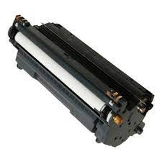
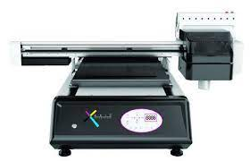
Line printers are the printers which print one line at a time.
Drum Printer
Chain Printer
- This printer is like a drum in shape hence it is called drum printer. The surface of the drum is divided into a number of tracks. Total tracks are equal to the size of the paper, i.e. for a paper width of 132 characters, drum will have 132 tracks. One rotation of drum prints one line. Drum printers are fast in speed and can print 300 to 2000 lines per minute.
Advantages
Very high speed
Disadvantages
Very expensive
Characters fonts cannot be changed
In this printer, a chain of character sets is used, hence it is called Chain Printer. A standard character set may have 48, 64, or 96 characters.
Advantages
Character fonts can easily be changed.
Different languages can be used with the same printer.
Disadvantages
Noisy

Slide 37
Non-impact printers ;- print the characters without using the ribbon. These printers print a complete page at a time, thus they are also called as Page Printers.
Characteristics of Non-impact Printers
Faster than impact printers
They are not noisy
High quality
Supports many fonts and different character size

Slide 38
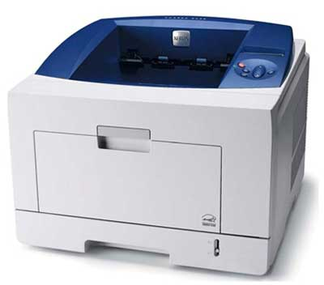
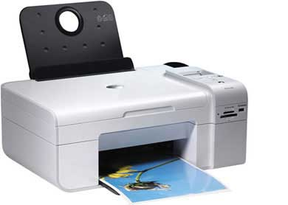
Laser Printers
Inkjet Printers
- These are non-impact page printers. They use laser lights to produce the dots needed to form the characters to be printed on a page.
Advantages
Very high speed
Very high quality output
Good graphics quality
Supports many fonts and different character size
Disadvantages
Expensive
Cannot be used to produce multiple copies of a document in a single printing
- Inkjet printers are non-impact character printers based on a relatively new technology.
- They print characters by spraying small drops of ink onto paper. Inkjet printers produce high quality output with presentable features. Color printing is also possible. Some models of Inkjet printers can produce multiple copies of printing also.
Advantages
High quality printing
More reliable
Disadvantages
Expensive as the cost per page is high
Slow as compared to laser printer

Slide 39
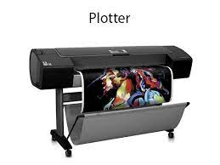
Plotter
Plotters actually draw point-to-point lines directly from vector graphics files.
The plotter was the first computer output device that could print graphics as well as accommodate full-size engineering and architectural drawings.
Using multiple colored pens, plotters were also able to print in color long before inkjet printers became an alternative.

Slide 40
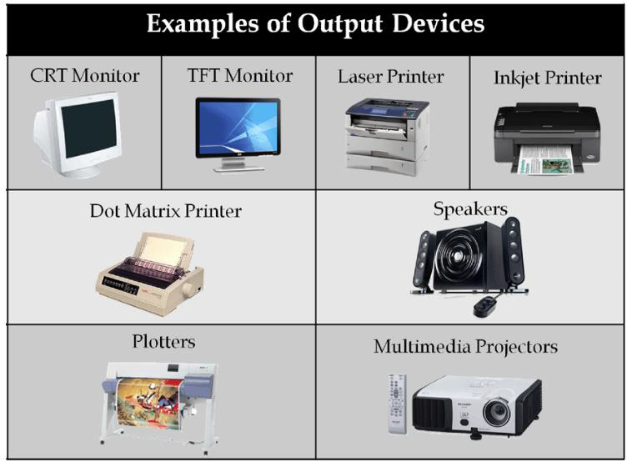

Slide 41
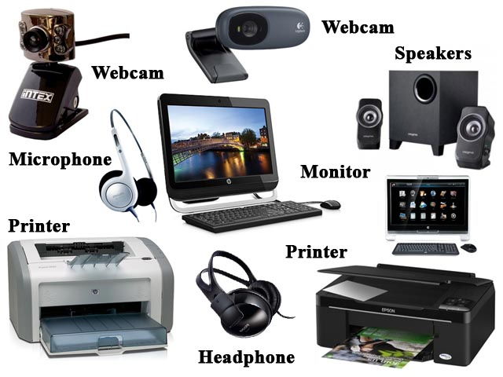
Output Devices

Slide 42
DESIGNING EFFICIENT PROGRAMS
C programming is considered as a structured language. It enforces a clear and logical programming structure that makes code easy to read and understand. C programming is a highly efficient language, making it ideal for writing software that needs to run quickly and efficiently.
Premature optimization is the root of all evil.
Adjust structure sizes to power of two.
Place case labels in narrow range.
Place frequent case labels first.
Break big switch statements into nested switches.
Minimize local variables.
Declare local variables in the inner most scope.
Reduce the number of parameters
Consider the locality of references for code and data

Slide 43
INTRODUCTION TO
C - LANGUAGE

Slide 44
A set of instructions given to the computer to achieve specific task.
PROGRAM
The process of providing instructions to solve a specific problem.
PROGRAMMING
PROGRAMMER
The person who writes the program.

Slide 45
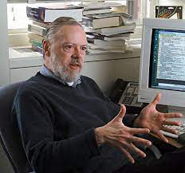
What is a C language?
C is a general-purpose programming language created by Dennis Ritchie at the Bell Laboratories in 1972.
It was named ‘C’ because many of its features were derived from earlier language called ‘B’.
It is a very popular and robust language, whose rich set of built in functions and operators can be used to write complex programs.
Dennis Ritchie

Slide 46

Why to Learn C?
It is one of the most popular programming language in the world.
If you know C, you will have no problem learning other popular programming languages such as Java, Python, C++, C#, etc, as the syntax is similar.
C is very fast, compared to other programming languages, like Java and Python.
C is very versatile; it can be used in both applications and technologies.

Slide 47
Steps to learn C Language
programs
Functions
Statements
Tokens
Characters
Story
Paragraphs
Sentences
Words
Alphabets
Process of learning English language
Process of learning
C language

Slide 48
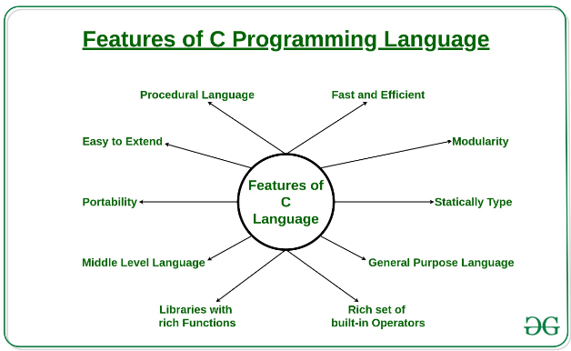

Slide 49
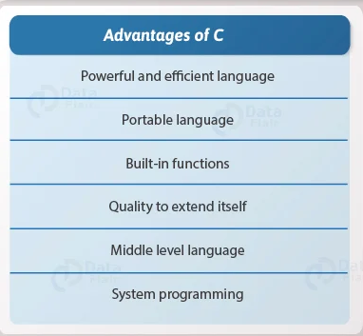
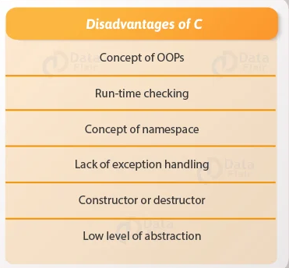
Advantages and disadvantages of C

Slide 50
Applications of C
System software
Operating system
Interpreters
Compilers
Assemblers
Editors
Loaders
Linkers
Application software
DBMS
Graphics packages
Spread sheets
CAD/CAM applications
Word processors
Office Automation tools
Scientific and Engineering applications

Slide 51

The basic structure of a C program:
preprocessor directives
global declarations;
main()
{
  local declarations;
  statement 1;
  statement 2;
  statement 3;
    .
    .
  statement n;
}
user defined functions;
Start with # symbol and used to include header files eg: #include<stdio.h> #include<conio.h>
Variables are declared in this session. Existence of variable known to all the functions in the program
Execution begins from the main function. Every C program must have only one main function.
Variables are declared in this session and may be initialized with their basic datatypes
Instructions given to the computer to perform specific task. They may be input-output statements, arithmetic statements or control statements.
Functions return by user and it is not compulsory. They may be return before or after the main()
Every c program uses a pair of curly braces {,}. The braces indicates the beginning and end of user defined functions

Slide 52
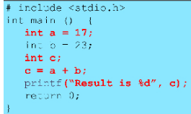

Slide 53
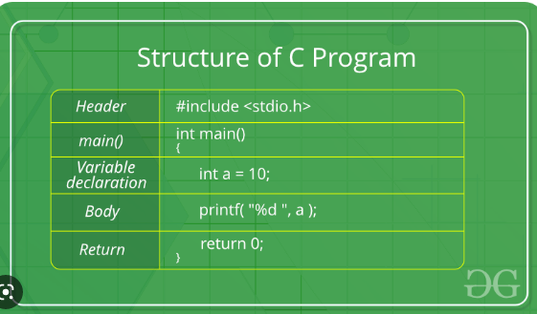

Slide 54
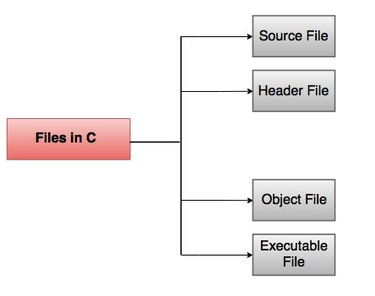
Files used in a C program

Slide 55
Source File
  This file includes the source code of the program.
The extension for these kind of files are '.c'. It defines the main and many more functions written in C.
main() is the starting point of the program. It may also contain other source code files.

Slide 56
Header Files
  They have an extension '.h'. They contain the C function declarations and macro definitions that are shared between various source files.
C provides us with some standard header files which are available easily.
Common standard header files are:
i) string.h – used for handling string functions.
ii) stdlib.h – used for some miscellaneous functions.
iii) stdio.h – used for giving standardized input and output.
iv) math.h – used for mathematical functions.
v) alloc.h – used for dynamic memory allocation.
vi) conio.h – used for clearing the screen.

Slide 57
Object files
  They are the files that are generated by the compiler as the source code file is processed.
  These files generally contain the binary code of the function definitions.
  The object file is used by the linker for producing an executable file for combining the object files together. It has a '.o' extension.
Executable file
  This file is generated by the linker.
  Various object files are linked by the linker for producing a binary file which will be executed directly.
  They have an '.exe' extension.

Slide 58
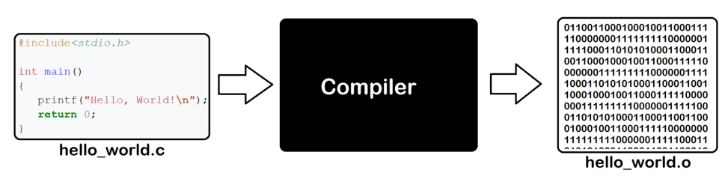
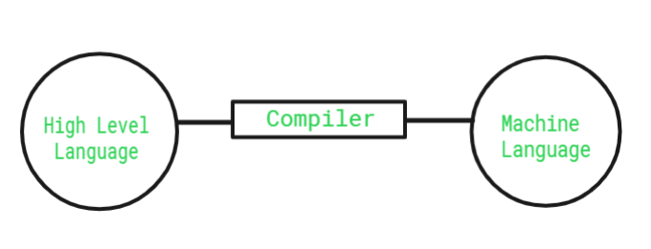
COMPILER
Compiler is a special program that translates a programming language's source code into machine code or another programming language.

Slide 59
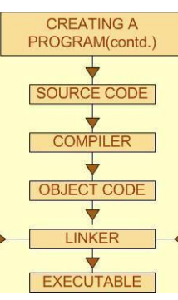
Compiling and Executing C programs

Slide 60
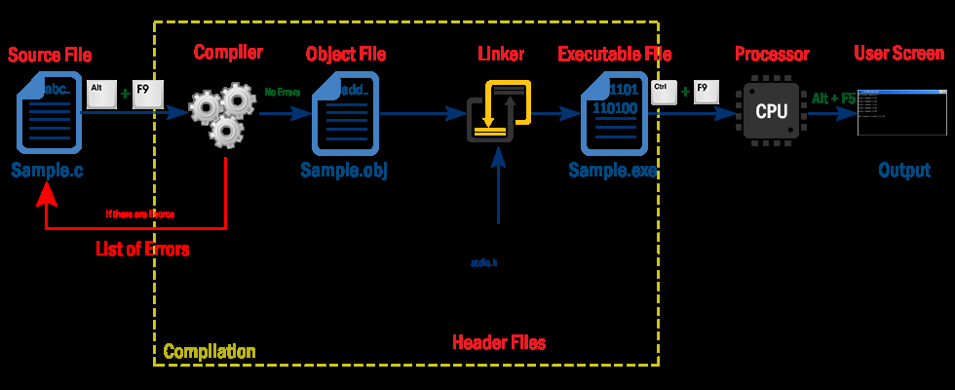

Slide 61
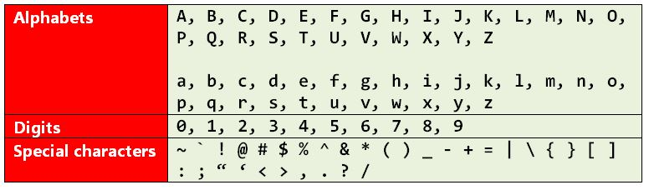
Character sets of C language
A symbol that is used while writing a program

Slide 62
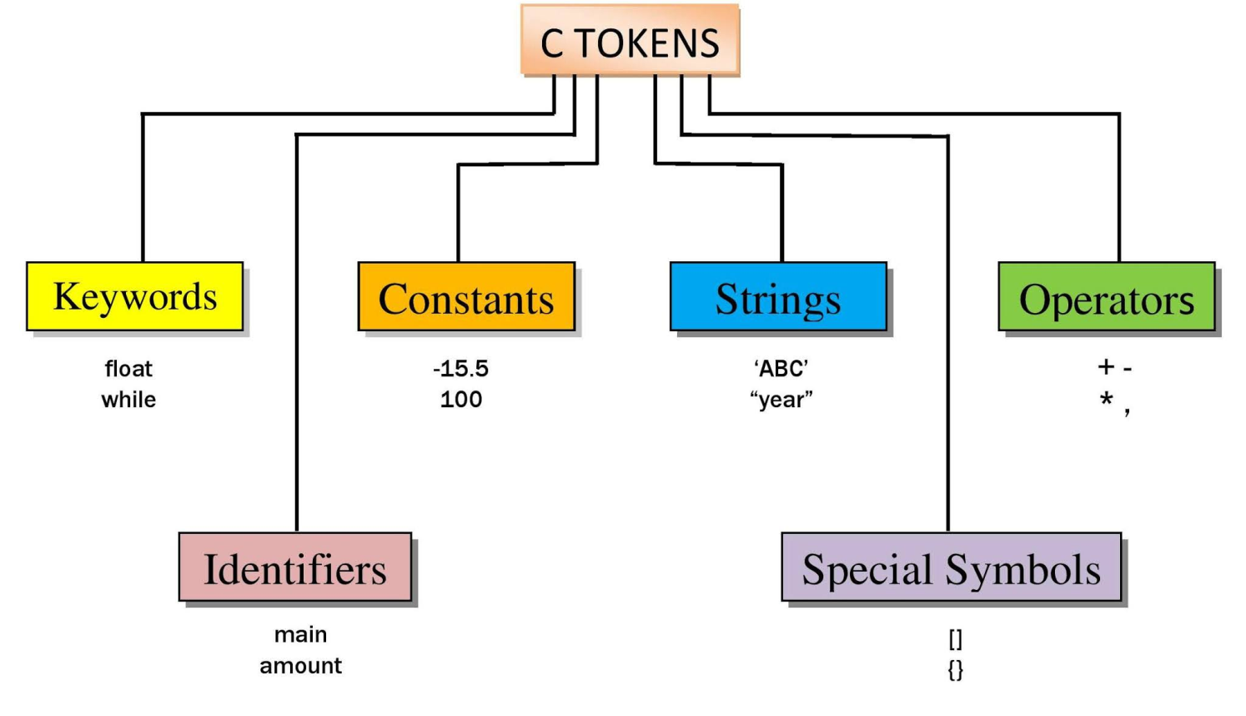
A token is a collection of characters. One or more characters of the character sets are combined to form meaningful words called tokens.
C- TOKENS

Slide 63
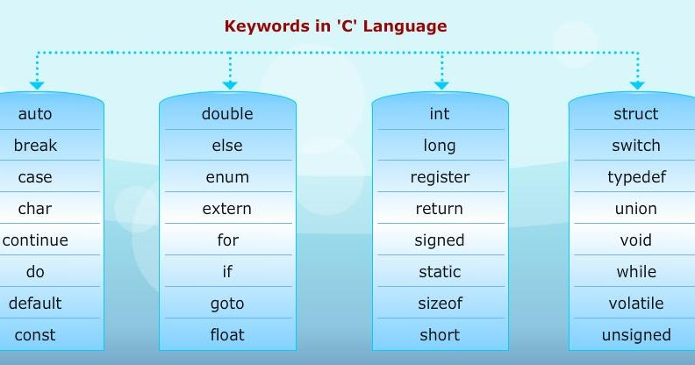
Keywords
- The tokens which have Predefined meaning in C language
- Keywords are also called as Reserve words
- There are 32 keywords in C, whose meaning is already known to the computer
How many keywords are there in C language

Slide 64
Rules while using keywords
The keywords should not be used as variables, function names or array names.
The meaning of the keywords cannot be changed by the user.
All keywords should be written in lowercase letters.

Slide 65
Identifiers
Identifiers are such words which do not have predefined meaning.
Identifiers helps us to identify data and other objects in the program
- They are the names given to different entities such as constants, variables, structures, functions, etc
- It is a name given to the memory location in the computer.

Slide 66
Rules for constructing identifiers names:-
1) The first characters in the name must be an alphabet (A-Z or a-z) or an underscore(_).
2) The first character may be followed by any number of letters or digits. (max length be <=8)
3) The only special symbol permitted in the identifies is an underscore(_).
4) Two successive underscores are not permitted.
5) A blank space is not allowed in an identifier.
6) Keywords can't be used as identifiers.

Slide 67
Valid Identifiers:
Manju
MANJU
maNJu123
Manju2_Sanju12
m_a_n_j_u
int amount;
double totalbalance;
Invalid Identifiers:
1manju
Manju,sanju
Man_ _ju
for
goto
Manju sanju

Slide 68
Data Types
The type of the data that variable can hold. They also specify, the number of bytes to be allocated.
There are 5 primitive data types in C
Data types in C language
int
float
double
char
void

Slide 69
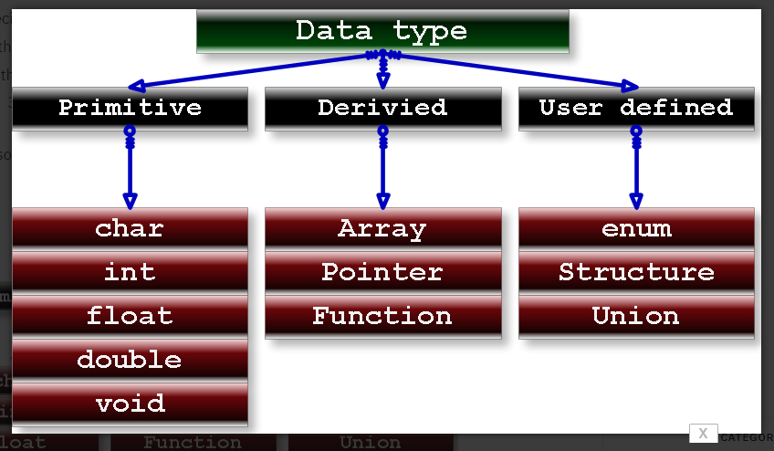

Slide 70
Data type | Purpose | No. of bytes allocated | Range
int | To hold integer constant | 2 bytes | -32768 to +32767
float | To hold real constant | 4 bytes | 3.4e-38 to +3.4e38
double | To hold real constant | 8 bytes | 1.7e-308 to +1.7e308
char | To hold character constant | 1 byte | -128 to +127
void | non-specific | No memory is allocated | ------

Slide 71
Differences between float and double datatype
float | double
Float type variables can hold real constants with lesser accuracy | double type variables can hold real constants with more accurancy
Real constants can be stored up to an accuracy of 8 digits after the decimal point | Real constants can be stored upto an accuracy of 16 digits after the decimal point
4 bytes are allocated | 8 bytes are allocated
-3.4e38 to +3.4e38 is the range | -1.7e308 to +1.7e308 is the range

Slide 72
Variables
Variables are memory locations(storage areas) in the C programming language.
The primary purpose of variables is to store data in memory for later use.
If you declare a variable in C, that means you are asking the operating system to reserve a piece of memory with that variable name.
The identifier is only used to identify an entity uniquely in a program at the time of execution whereas , a variable is a name given to a memory location to hold a value

Slide 73
The general syntax of declaring a variable is:
datatype variable;
(or)
datatype variable1, variable 2, ------ variable n;
int a;
float a, b,c;
double num, avg, abc;
Eg. for int:
int manju;
manju = 129;
Eg. for int:
int a, b;
a = 592;
b = 123;
Eg. for float:
float a,b,c;
Int d;
a = 35.56; //legal
b = 456.798876; //legal
c = 567.789654345; //illegal
d= 10;
Eg. for double:
double a,b,c;
// a = 23.45; //legal
b = 372.468789; //legal
c = 234.7787897897789789; //legal
Eg. for char:
char a, b
a = 'x';
b = '?';

Slide 74
Basic kinds of variables:-
Numeric
Character
Numeric Variables
Numeric variables are used to store either integers or floating point values.
Example:-4, 3.5 ,20…
Character Variables
It includes any letter from the alphabet and numbers from 0-9
Example:- a, ‘2’

Slide 75
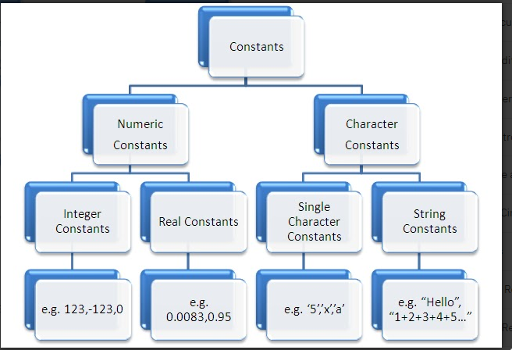
Constants
A quantity does not change during the execution of a program is called as Constant.
Constants are used to define fixed values such as pi.

Slide 76
Integer Constants
Rules:
- must have at least one digit
- must not have decimal point
- could be either +ve or -ve
- no commas or blank spaces are allowed
- default sign is +ve
Valid | Invalid
87 | 12.34
-63 | 8.7
+94 | 21 23
0723 | 100.
956 | 12,34

Slide 77
Floating Point (real)Constants
Rules:
- must have at least one digit
- must have decimal point
- could be either +ve or -ve
- no commas or blank spaces are allowed
- default sign is +ve
Valid | Invalid
82.1 | 234
1000.6 | 10.34.2
3.212 | 22/7
-0.5 | 1.2.3
100. | 112

Slide 78
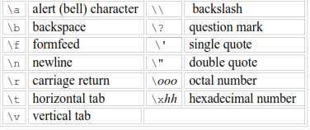
Single Character constants:
It can be single character enclosed within single quotes or a ‘\’ (backslash) followed by any character.
Example:- ‘a’
String constants:
These are a sequence of characters enclosed in double quotes, and they may include letters, digits, special characters, and blank spaces.
Example:- “a”, "Hello!", "2015",

Slide 79
.
Adding Comments to Code
Comments are plain simple text in a C program that is not compiled in the compilation process.
We can write comments in a program, to explain various parts of the program.
Although writing comments is not compulsory, but it is recommended to make your program more descriptive, and easier for others to understand.
There are two ways in which we can write comments.
Using //: This is used to write a single-line comment.
Using /* */: Anything enclosed within /* and */ , will treated as multi-line comments

Slide 80
/* Author: Reema Thareja
Description : To print ‘Welcome to the world of C’ on the screen */
#include <stdio.h>
int main()
{
printf(“ \n Welcome to the World C ");
// prints message
return 0;
}
Output
Welcome to the world of C
Example:-

Slide 81
INPUT AND OUTPUT STATEMENTS IN C
Input and output functions are available in the C language to perform the most common tasks. In every C program, three basic functions take place – accepting of data as input, the processing of data, and the generation of output. The acceptance of data refers to input and the presentation of data refers to the output.
In C Language input and output function are available as C compiler functions or C libraries provided with each C compiler implementation. These all functions are collectively known as Standard I/O Library function.
Here I/O stands for Input and Output used for different inputting and outputting statements. These I/O functions are categorized into three processing functions. Console input/output function (deals with keyboard and monitor), disk input/output function (deals with floppy or hard disk), and port input/output function (deals with a serial or parallel port).
As all the input/output statements deals with the console, so these are also Console Input/Output functions.

Slide 82
Input and Output statement are used to read and write the data in C programming. These are embedded in stdio.h (standard Input/Output header file).
Input means to provide the program with some data to be used in the program.
Output means to display data on screen or write the data to a printer or a file.
C programming language provides many built-in functions to read any given input and to display data on screen when there is a need to output the result.

Slide 83
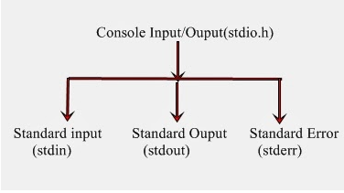
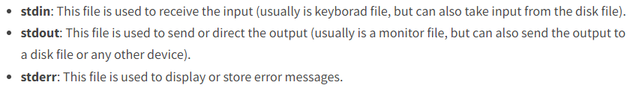
Console Input/Output function access the three major files before the execution of a C Program.
These are as follows:

Slide 84
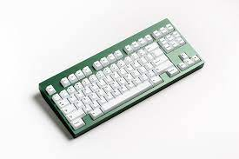
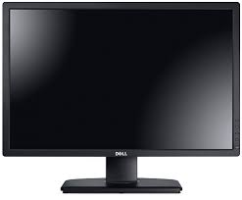
Managing Input and Output statements
Input functions gets the data from keyboard and sends it to the memory
Input Unit
Memory Unit
Output Unit
Output functions gets the data from memory unit and sends it to the monitor

Slide 85
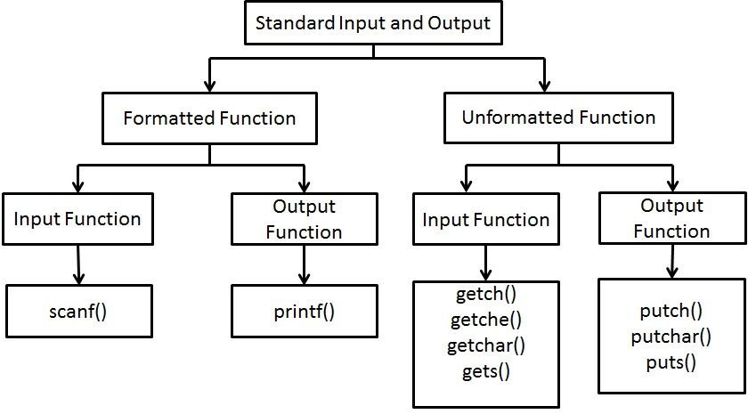

Slide 86
What is the difference between formatted and un-formated I/O functions?
-->Formatted I/O functions allows programmer to read input from keyboard and display output on monitor in more formatted form (user friendly or user readable).
-->Fine tuning of I/O operation is not possible using un-formated I/O functions

Slide 87

Reading and Writing a Character
The general form of the getch() is as given below -
Syntax:
ch = getch();
The general form of the putch() is as given below -
Syntax:
putch();
ch=getch() would place the character read from the keyboard onto the variable ch in memory
Input Unit
ch
putch(ch) would display the character ch on screen
Memory Unit
Output Unit

Slide 88
Formatted Input Output functions
scanf() - input function (read input from the keyboard)
printf() - output function (display output on the monitor)

Slide 89
The printf() function
The printf() function is the most used function in the C language.
It is used to display information required by the user and also prints the values of the variables.
This function is defined in the stdio.h header file and is used to show output.
printf() Code Example:- Print a sentence
#include <stdio.h>
int main()
{
// using printf()
printf(“\n I love my students");
return 0;
}
output
I love my students

Slide 90
Ex 1:
int a=2;
printf("the value of the a is %d", a);
O/p : the value of the a is 2
Ex 2:
int a=2;
int b=3;
printf("the value of the a is %d\n and b is %d", a,b);
O/p : the value of the a is 2
and b is 3
Ex 3:
int a=2;
float b=3.5;
char c='A';
printf("the value of the a is %d\t and b is %f\t and c is %c", a,b,c);
O/p : the value of the a is 2 and b is 3.500000 and c is A

Slide 91
The scanf() function
When we want to take input from the user, we use the scanf() function and store the input value into a variable.
It is used to read the formatted data from the keyboard.
scanf() Code Example
#include <stdio.h>
int main()
{
// using scanf() int user_input;
printf("Please enter a number: ");
scanf("%d", &user_input);
printf("You entered: %d", user_input);
return 0;
}
output
Please enter a number: 7 You entered: 7

Slide 92
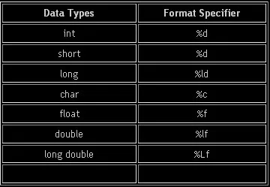
Format specifiers(conversion characters)

Slide 93
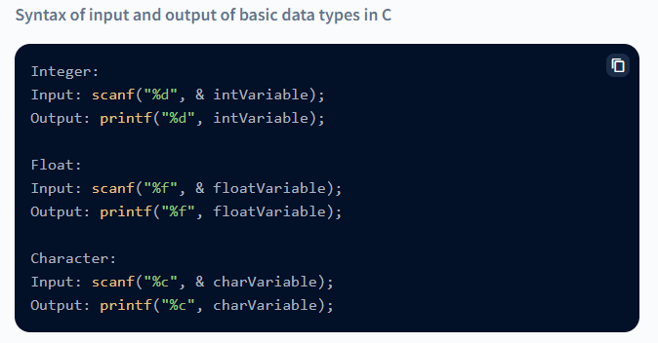

Slide 94
To read and print data, you can use the predefined functions scanf() and printf() in C programs.
#include <stdio.h>
void main()
{
int a, b, c;
printf("Please enter any two numbers: \n");
scanf("%d %d", &a, &b);
c = a + b;
printf("The addition of two number is: %d", c);
}

Slide 95
Advantages of formatted I/O functions
1. These functions can be used to read or write multiple values at a time.
2. Character, int, float, double type variables can be read and displayed on the screen.
3. Produce output in more formatted form i.e more user friendly and readable outputs.

Slide 96
Designing Efficient Programs
Designing efficient programs in C involves a combination of several techniques
Algorithm Design: Efficient programs start with efficient algorithms. Choose the right algorithm for the problem you're solving. Sometimes, a simple change in algorithm can lead to significant performance improvements.
Use Standard Libraries: Utilize standard libraries provided by C, such as <stdio.h> for input/output, <stdlib.h> for memory allocation, <string.h> for string manipulation, etc. These libraries are often optimized and well-tested.
Minimize Memory Allocation: Minimize unnecessary memory allocation and deallocation by reusing memory wherever possible. Also, remember to free dynamically allocated memory once it's no longer needed to avoid memory leaks.

Slide 97
Avoid Unnecessary Copying: In C, passing large structures or arrays to functions by value can lead to unnecessary copying, impacting performance. Instead, pass them by reference using pointers to avoid copying.
Optimize Loops: Loop optimization is crucial for performance. Minimize loop iterations, reduce function calls within loops, and avoid unnecessary computations inside loops.
Compiler Optimization: Modern compilers perform various optimizations automatically, but you can help them by writing clean and understandable code.
Data Structure Selection: Choose the right data structure for your problem. For example, use arrays for contiguous memory access, linked lists for frequent insertions/deletions.

Slide 98
Cache Awareness: Optimize your data structures and algorithms to take advantage of CPU cache. Accessing contiguous memory locations improves cache locality, leading to better performance.
Inline Functions: Consider using inline functions for small, frequently called functions. This reduces the overhead of function calls.
Reduce I/O Operations: Minimize disk I/O and network communication by batching operations, using buffering techniques, and optimizing file access patterns.

Slide 99
Precompute Values: If possible, precompute values or results that are used frequently instead of recalculating them each time.
Avoid Undefined Behavior: Ensure your code is free from undefined behavior, as it can lead to unpredictable results and hinder optimization efforts.
Use Bitwise Operations: In some cases, bitwise operations can offer more efficient solutions compared to arithmetic operations, especially for tasks like bit manipulation or optimizing memory usage.
Documentation and Comments: Document your code and use comments to explain complex algorithms or optimizations. This helps in maintaining and understanding the codebase, facilitating future optimizations.

Slide 100
THANK YOU

