Slide 1
MATHEMATICS-II FOR MECHANICAL ENGINEERING STREAMS
(BMATM201)
ATME COLLEGE OF ENGINEERING
DEPARTMENT OF MATHEMATICS

Slide 2
Course objectives:
The goal of the course Mathematics-II for mechanical engineering streams(BMATM201) is to
· Familiarize the importance of Integral calculus and Vector calculus essential for Mechanical engineering.
· Analyze Mechanical engineering problems applying Partial Differential Equations.
· Develop the knowledge of solving Mechanical engineering problems numerically

Slide 3
Course outcome (Course Skill Set)
After successfully completing the course, the student will have a good understanding of the following topics and their applications:
CO1: Apply the knowledge of multiple integrals to compute area and volume.
CO2: Understand the applications of vector calculus refer to solenoidal, ir-rotational vectors, line integral and surface integral.
CO3: Demonstrate partial differential equations and their solutions for physical interpretations.
CO4: Apply the knowledge numerical methods in solving physical and engineering phenomena.
CO5: Get familiarize with modern mathematical tools namely
Mathematica/MatLab/Python/Scilab

Slide 4
CONTENTS
Module-1: Integral Calculus
Module-2: Vector Calculus
Module-3: Partial Differential Equations (PDE's)
Module-4: Numerical methods -1
Module-5: Numerical methods -2

Slide 5
Module-1: Integral Calculus
Multiple Integrals: Evaluation of double and triple integrals
Evaluation of double integrals by change of order of integration, changing into polar coordinates.
Applications to find Area and Volume by a double integral-Problems.
Beta and Gamma functions: Definitions, properties, the relation between Beta and Gamma functions.
Problems on Beta and Gamma functions.
Self-study: Centre of gravity.

Slide 6
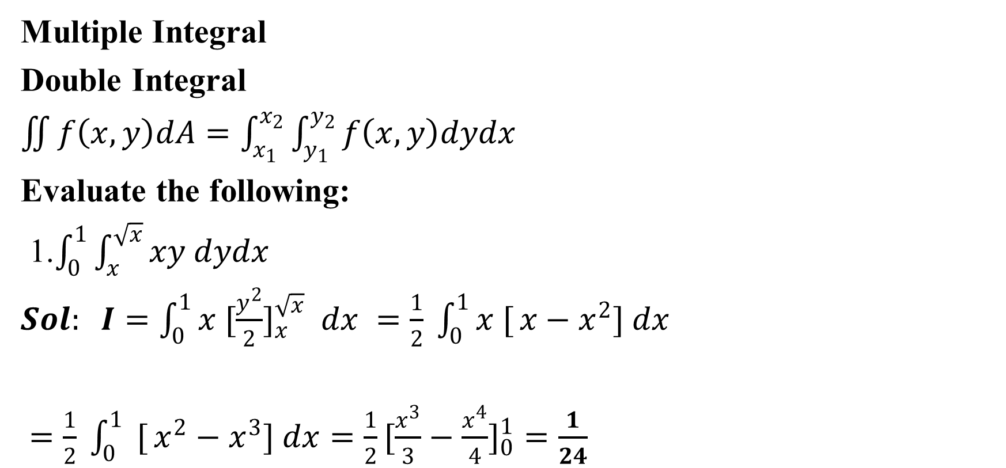
Multiple Integral
Double Integral
$\iint{f\left(x,y\right)dA}=\int_{x_{1}}^{x_{2}}{\int_{y_{1}}^{y_{2}}{f\left(x,y\right)dydx}}$
Evaluate the following:
1.$\int_{0}^{1}{\int_{x}^{\sqrt{x}}{xy dydx}}$
$Sol: I=\int_{0}^{1}{x [\frac{y^{2}}{2}}]_{x}^{\sqrt{x}} dx =\frac{1}{2} \int_{0}^{1}{x [}x−x^{2}] dx$
$=\frac{1}{2} \int_{0}^{1}{ [}x^{2}−x^{3}] dx=\frac{1}{2}[\frac{x^{3}}{3}−\frac{x^{4}}{4}]_{0}^{1}=\frac{1}{24}$

Slide 7
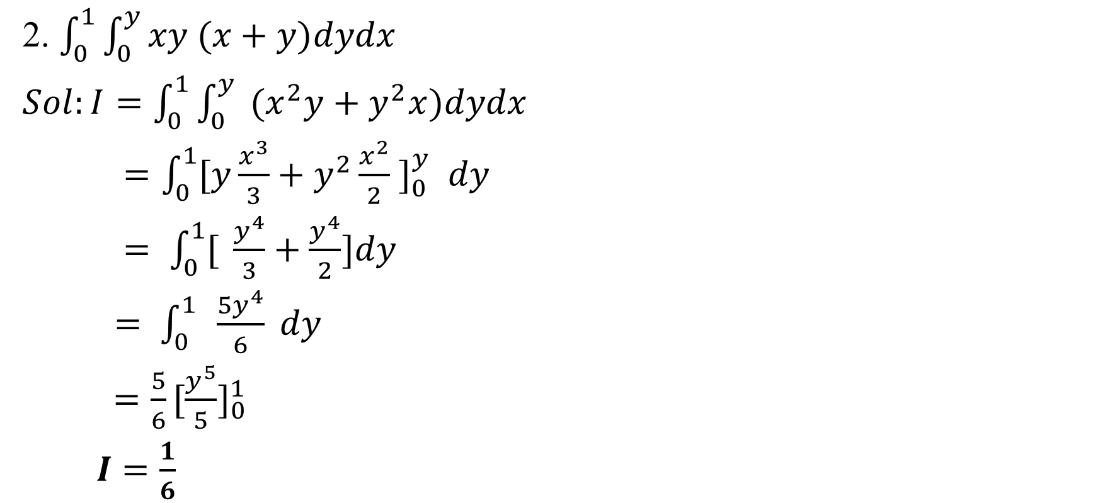
2. $\int_{0}^{1}{\int_{0}^{y}{xy (x+y)dydx}}$
$Sol:I=\int_{0}^{1}{\int_{0}^{y}{ (x^{2}y+y^{2}x)dydx}}$
$=\int_{0}^{1}{[y\frac{x^{3}}{3}+y^{2}\frac{x^{2}}{2} }]_{0}^{y} dy$
$= \int_{0}^{1}{[} \frac{y^{4}}{3}+\frac{y^{4}}{2}]dy$
$= \int_{0}^{1}{ }\frac{{5y}^{4}}{6} dy$
$=\frac{5}{6}[{\frac{y^{5}}{5}]}_{0}^{1}$
$I=\frac{1}{6}$

Slide 8
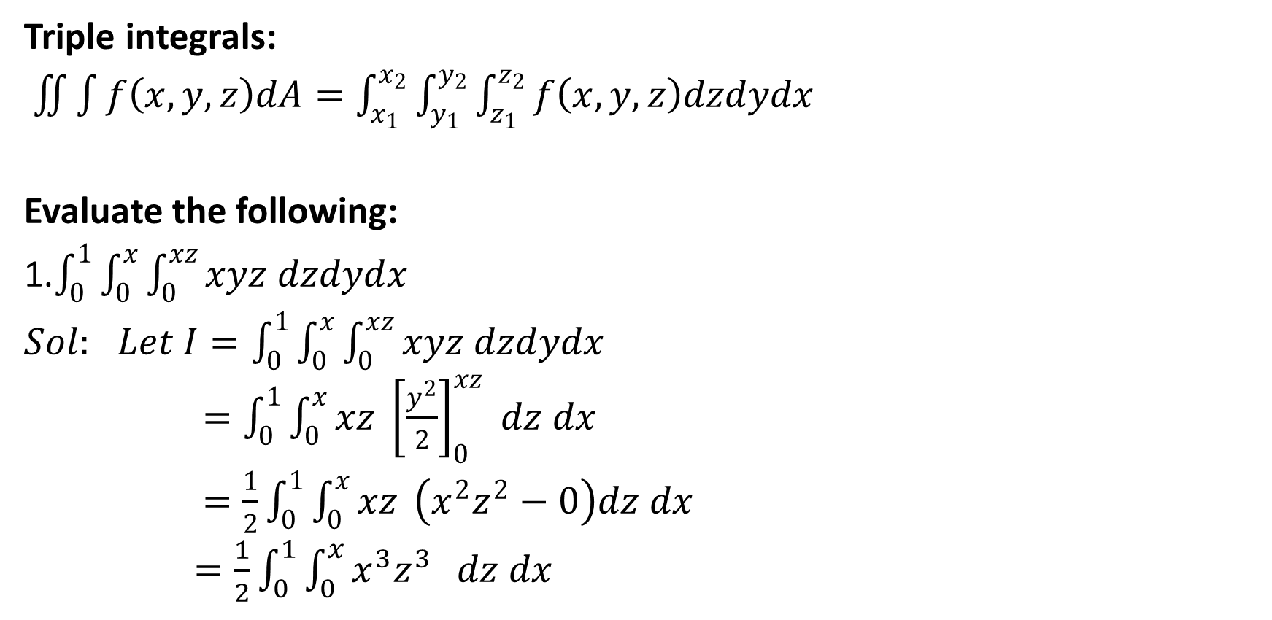
Triple integrals:
$\iint{\int{f\left(x,y,z\right)dA}}=\int_{x_{1}}^{x_{2}}{\int_{y_{1}}^{y_{2}}{\int_{z_{1}}^{z_{2}}{f\left(x,y,z\right)dzdydx}}}$
Evaluate the following:
1.$\int_{0}^{1}{\int_{0}^{x}{\int_{0}^{xz}{xyz dzdydx}}}$
$Sol:$ $Let I=\int_{0}^{1}{\int_{0}^{x}{\int_{0}^{xz}{xyz dzdydx}}}$
$=\int_{0}^{1}{\int_{0}^{x}{xz}} {\left[\frac{y^{2}}{2}\right]}_{0}^{xz} dz dx$
$=\frac{1}{2}\int_{0}^{1}{\int_{0}^{x}{xz}} \left(x^{2}z^{2}−0\right)dz dx$
$=\frac{1}{2}\int_{0}^{1}{\int_{0}^{x}{x^{3}z^{3}}} dz dx$

Slide 9
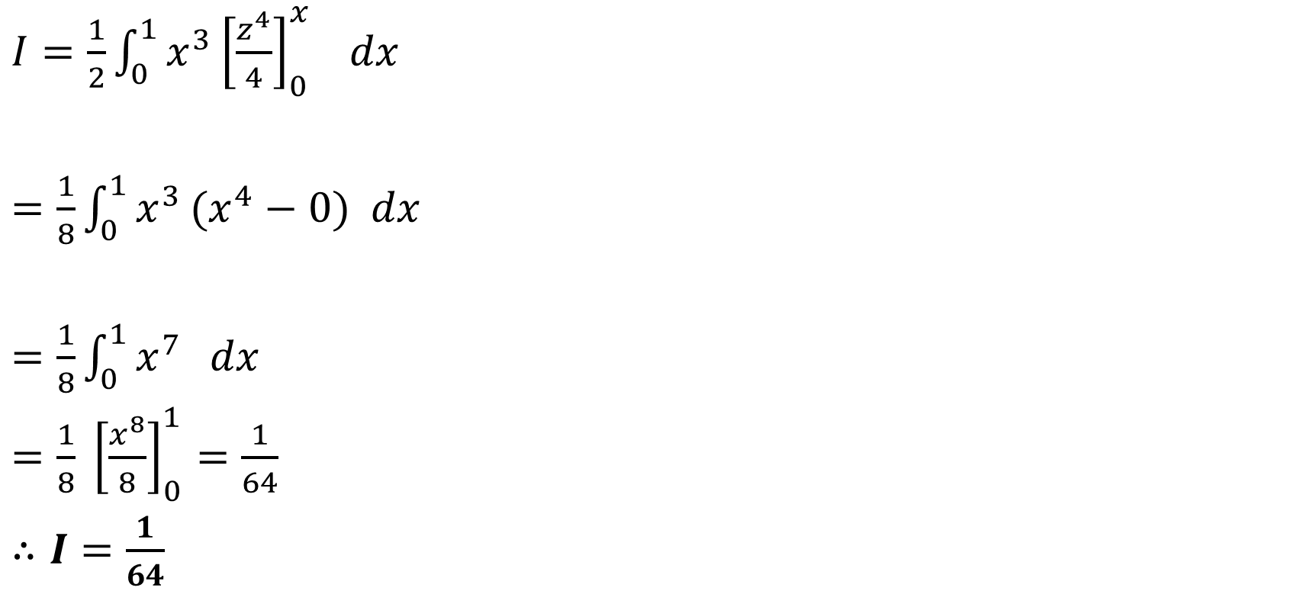
$I=\frac{1}{2}\int_{0}^{1}{x^{3}}{\left[\frac{z^{4}}{4}\right]}_{0}^{x} dx$
$=\frac{1}{8}\int_{0}^{1}{x^{3}}(x^{4}−0) dx$
$=\frac{1}{8}\int_{0}^{1}{x^{7}} dx$
$=\frac{1}{8} {\left[\frac{x^{8}}{8}\right]}_{0}^{1}=\frac{1}{64}$
$∴I=\frac{1}{64}$

Slide 10
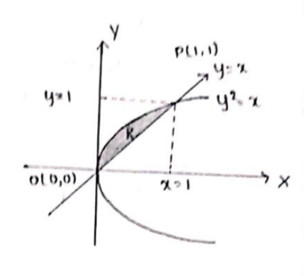
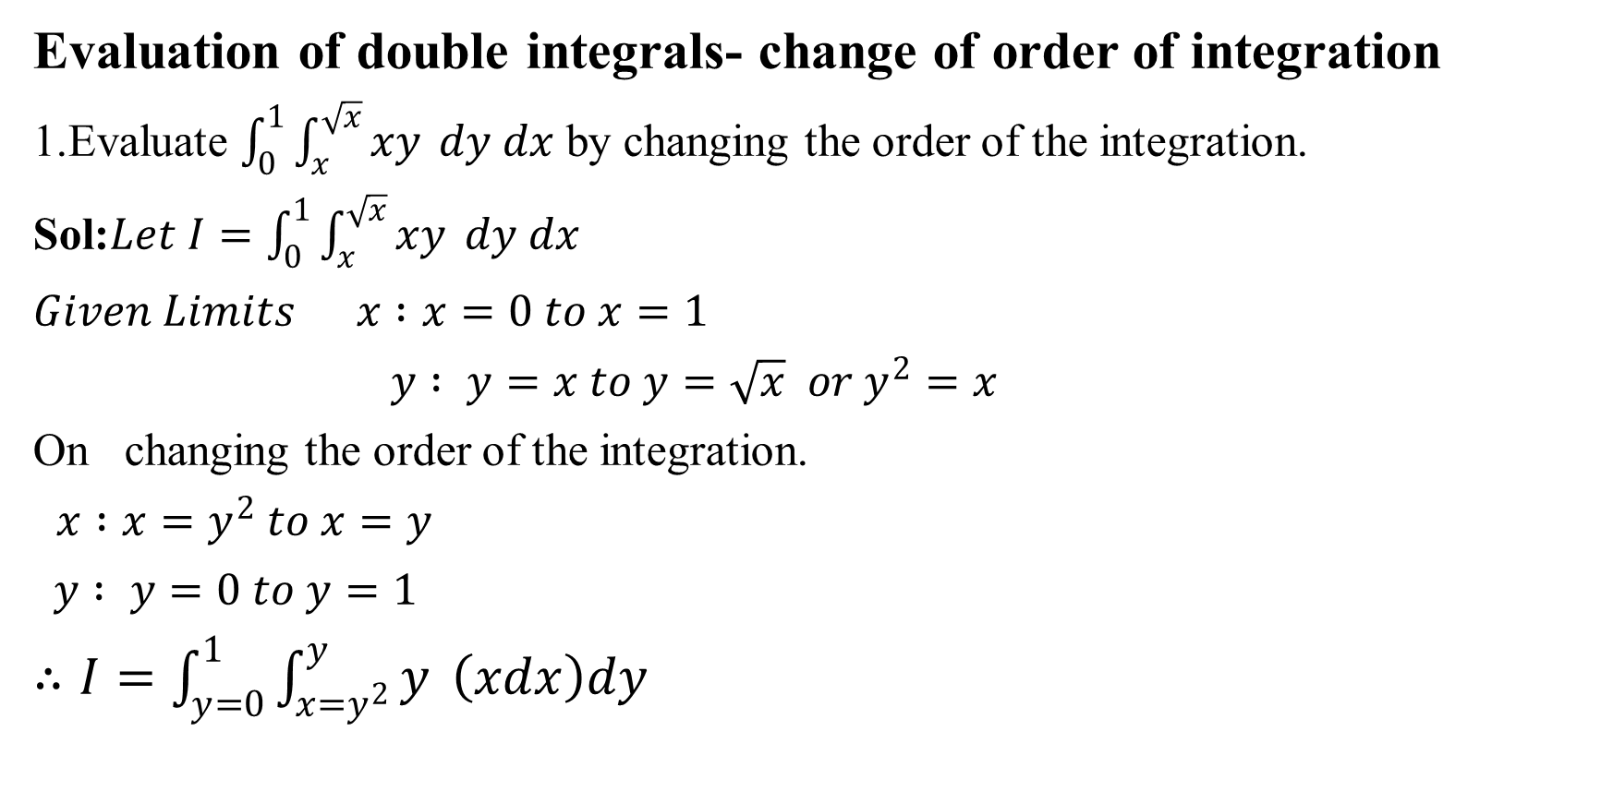
Evaluation of double integrals- change of order of integration
1.Evaluate $\int_{0}^{1}{\int_{x}^{\sqrt{x}}{xy} dy dx}$ by changing the order of the integration.
Sol:$Let I=\int_{0}^{1}{\int_{x}^{\sqrt{x}}{xy} dy dx}$
$Given Limits x :x=0 to x=1$
$y : y=x to y=\sqrt{x} or y^{2}=x$
On changing the order of the integration.
$x :x=y^{2} to x=y$
$y : y=0 to y=1$
$∴I=\int_{y=0}^{1}{\int_{x=y^{2}}^{y}{y} \left(xdx\right)dy }$

Slide 11
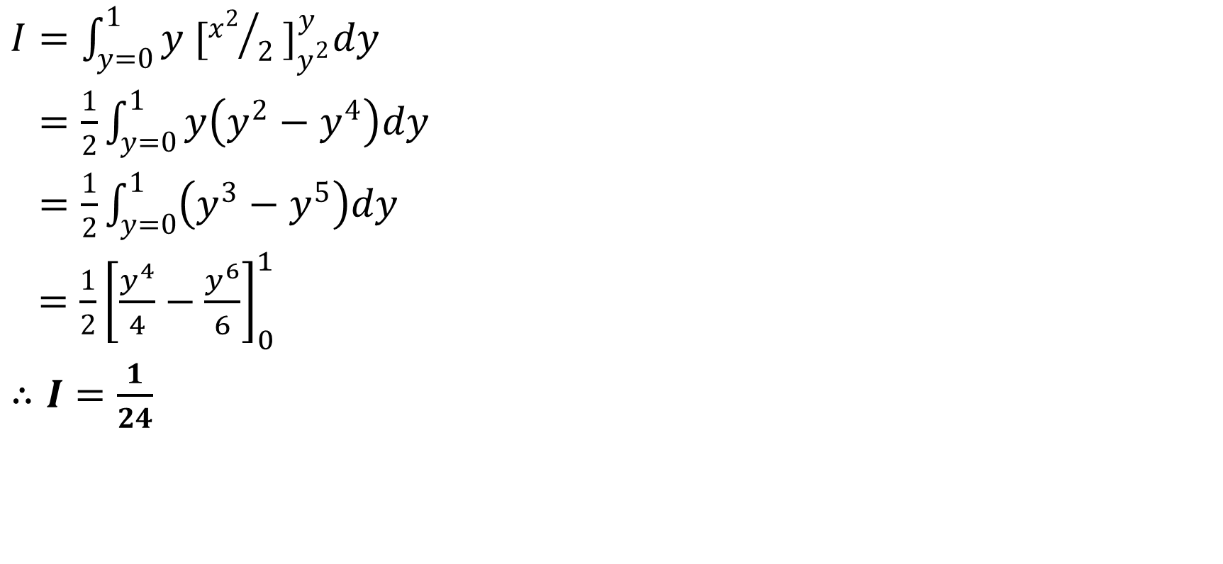
$I=\int_{y=0}^{1}{y{ [{x^{2}}/2 ]}_{y^{2}}^{y}dy}$
$=\frac{1}{2}\int_{y=0}^{1}{y\left(y^{2}−y^{4}\right)dy}$
$=\frac{1}{2}\int_{y=0}^{1}{\left(y^{3}−y^{5}\right)dy}$
$=\frac{1}{2}{\left[\frac{y^{4}}{4}−\frac{y^{6}}{6}\right]}_{0}^{1}$
$∴I=\frac{1}{24}$

Slide 12
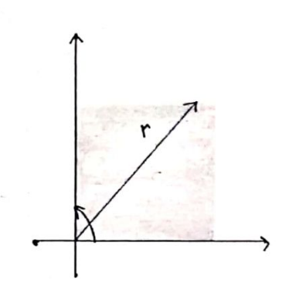
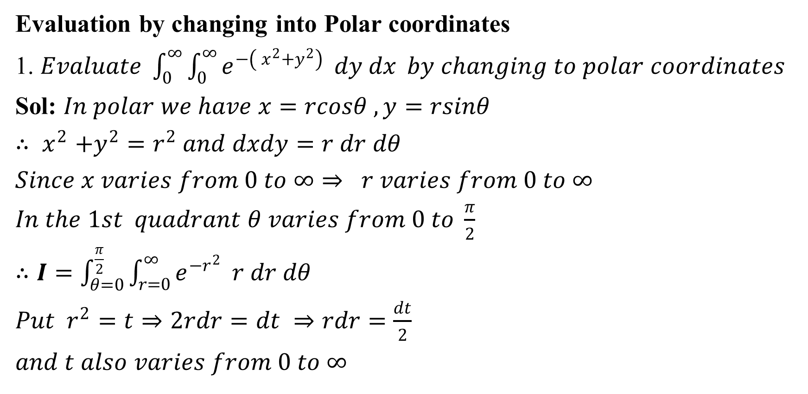
Evaluation by changing into Polar coordinates
1. $Evaluate \int_{0}^{∞}{\int_{0}^{∞}{e^{−\left( x^{2}+y^{2}\right)}} dy dx} by changing to polar coordinates$
Sol: $In polar we have x=rcosθ , y=rsinθ$
${∴ x}^{2}+y^{2}=r^{2} and dxdy=r dr dθ$
$Since x varies from 0 to ∞⇒ r varies from 0 to ∞$
$In the 1st quadrant θ varies from 0 to \frac{π}{2}$
$∴I=\int_{θ=0}^{\frac{π}{2}}{\int_{r=0}^{∞}{e^{−r^{2}}} r dr dθ}$
${Put r}^{2}=t⇒2rdr=dt ⇒rdr=\frac{dt}{2}$
$and t also varies from 0 to ∞$

Slide 13
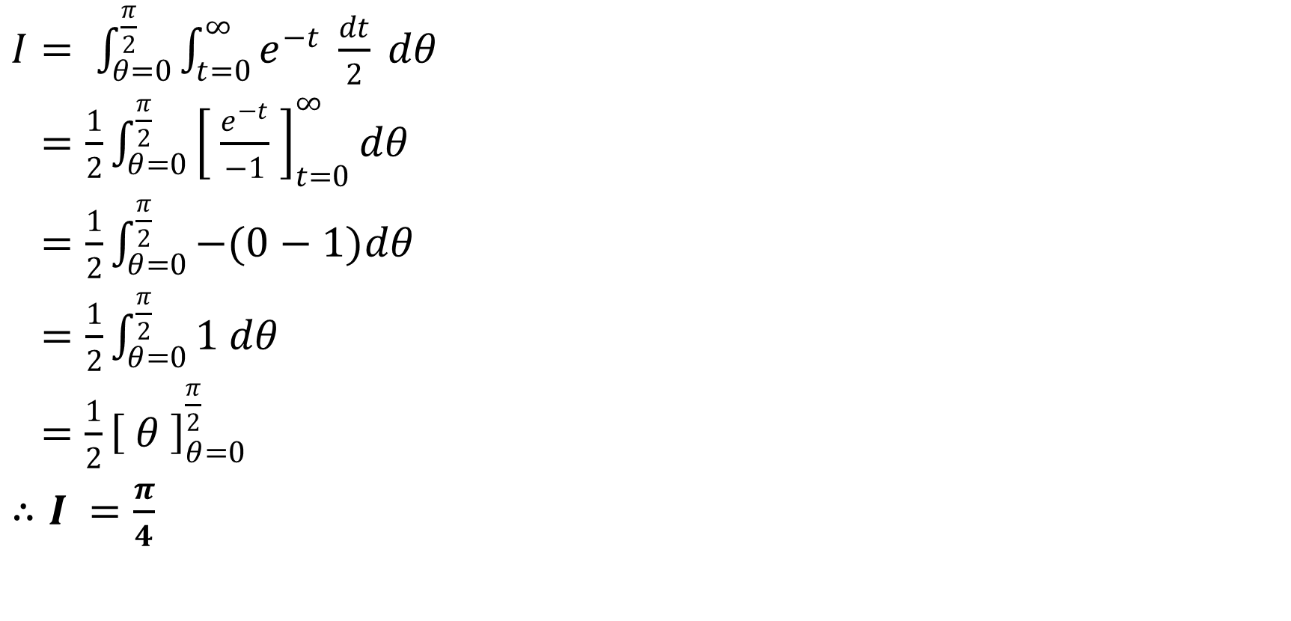
$I= \int_{θ=0}^{\frac{π}{2}}{\int_{t=0}^{∞}{e^{−t}} \frac{dt}{2} dθ}$
$=\frac{1}{2}\int_{θ=0}^{\frac{π}{2}}{{\left[ \frac{e^{−t}}{−1} \right]}_{t=0}^{∞}dθ}$
$=\frac{1}{2}\int_{θ=0}^{\frac{π}{2}}{−(0−1)dθ}$
$=\frac{1}{2}\int_{θ=0}^{\frac{π}{2}}{1 dθ}$
$=\frac{1}{2}{\left[ θ \right]}_{θ=0}^{\frac{π}{2}}$
$∴I =\frac{π}{4}$

Slide 14
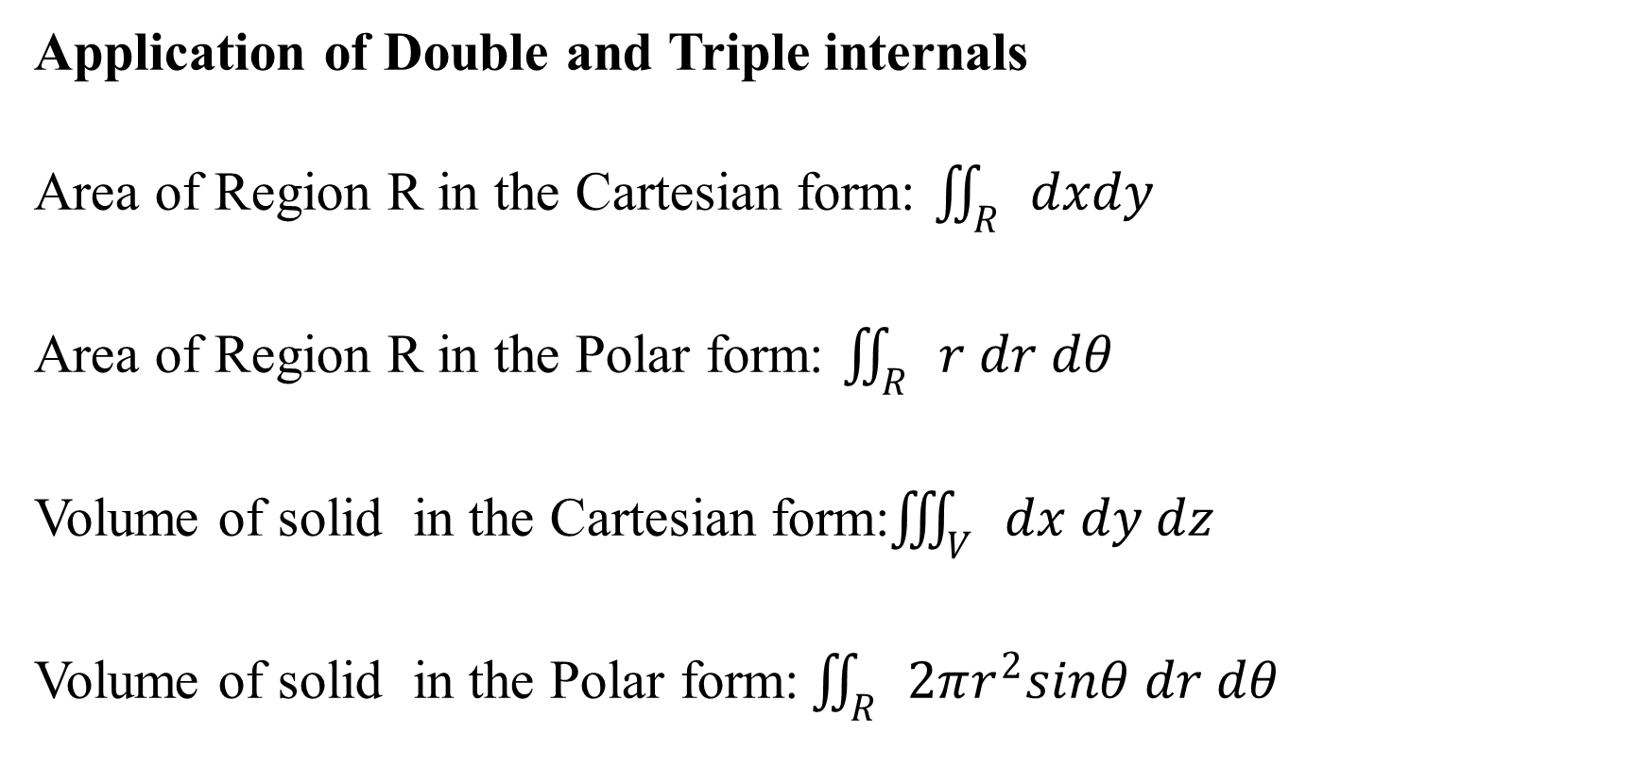
Application of Double and Triple internals
Area of Region R in the Cartesian form: $\iint_{R}{dxdy}$
Area of Region R in the Polar form: $\iint_{R}{r dr dθ}$
Volume of solid in the Cartesian form:$\iiint_{V}{dx dy dz}$
Volume of solid in the Polar form:$\iint_{R}{2πr^{2}sinθ dr dθ}$

Slide 15
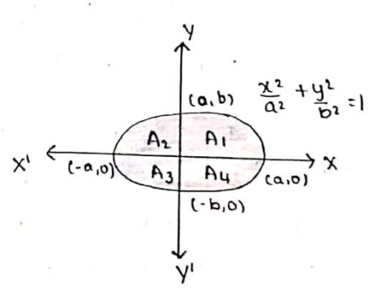
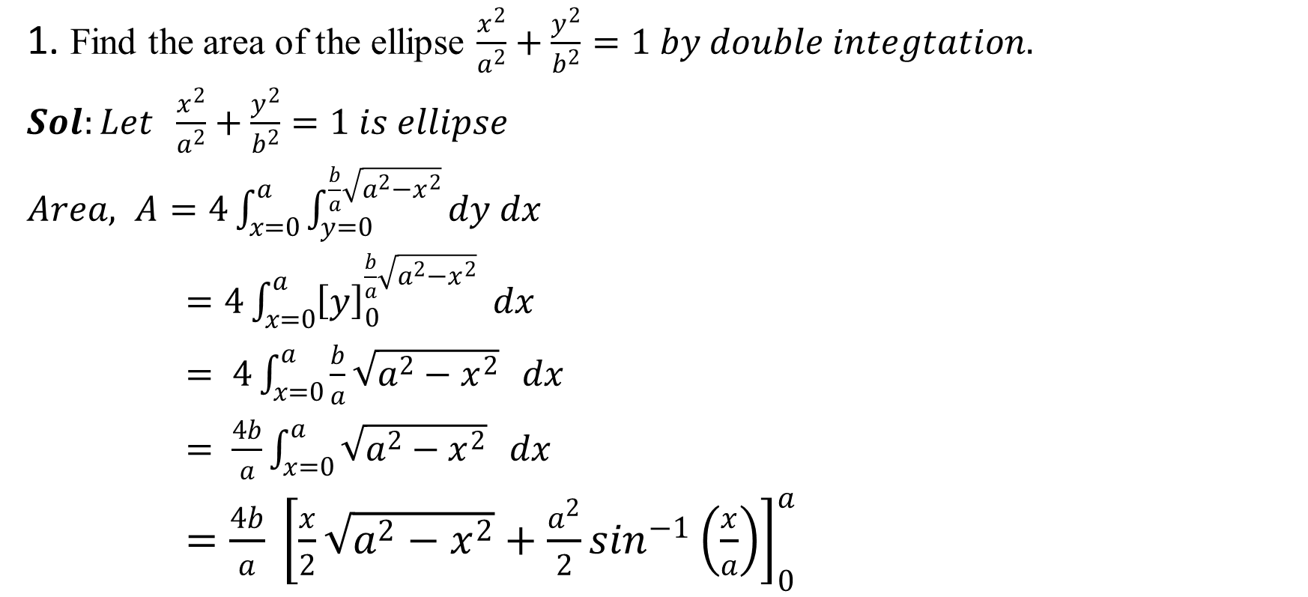
1. Find the area of the ellipse $\frac{x^{2}}{a^{2}}+\frac{y^{2}}{b^{2}}=1 by double integtation.$
$Sol:Let \frac{x^{2}}{a^{2}}+\frac{y^{2}}{b^{2}}=1 is ellipse$
$Area, A=4\int_{x=0}^{a}{\int_{y=0}^{\frac{b}{a}\sqrt{a^{2}−x^{2}}}{dy dx }}$
$=4\int_{x=0}^{a}{{\left[y\right]}_{0}^{\frac{b}{a}\sqrt{a^{2}−x^{2}}}} dx$
$= 4\int_{x=0}^{a}{\frac{b}{a}\sqrt{a^{2}−x^{2}}} dx$
$= \frac{4b}{a}\int_{x=0}^{a}{\sqrt{a^{2}−x^{2}}} dx$
$=\frac{4b}{a} {\left[\frac{x}{2}\sqrt{a^{2}−x^{2}}+\frac{a^{2}}{2}\sin^{−1}\left(\frac{x}{a}\right)\right]}_{0}^{a}$

Slide 16
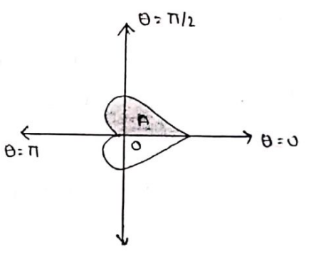
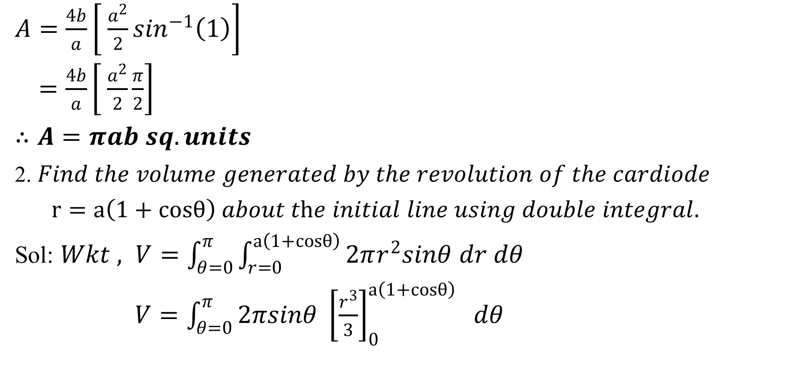
$A=\frac{4b}{a}\left[ \frac{a^{2}}{2}\sin^{−1}\left(1\right)\right]$
$=\frac{4b}{a}\left[ \frac{a^{2}}{2}\frac{π}{2}\right]$
$∴A=πab sq. units$
2. $Find the volume generated by the revolution of the cardiode$
$r=a\left(1+cosθ\right) about the initial line using double integral.$
Sol: $Wkt , V=\int_{θ=0}^{π}{\int_{r=0}^{a\left(1+cosθ\right)}{2πr^{2}sinθ dr dθ}}$
$V=\int_{θ=0}^{π}{2πsinθ {\left[\frac{r^{3}}{3}\right]}_{0}^{a\left(1+cosθ\right)} dθ}$

Slide 17
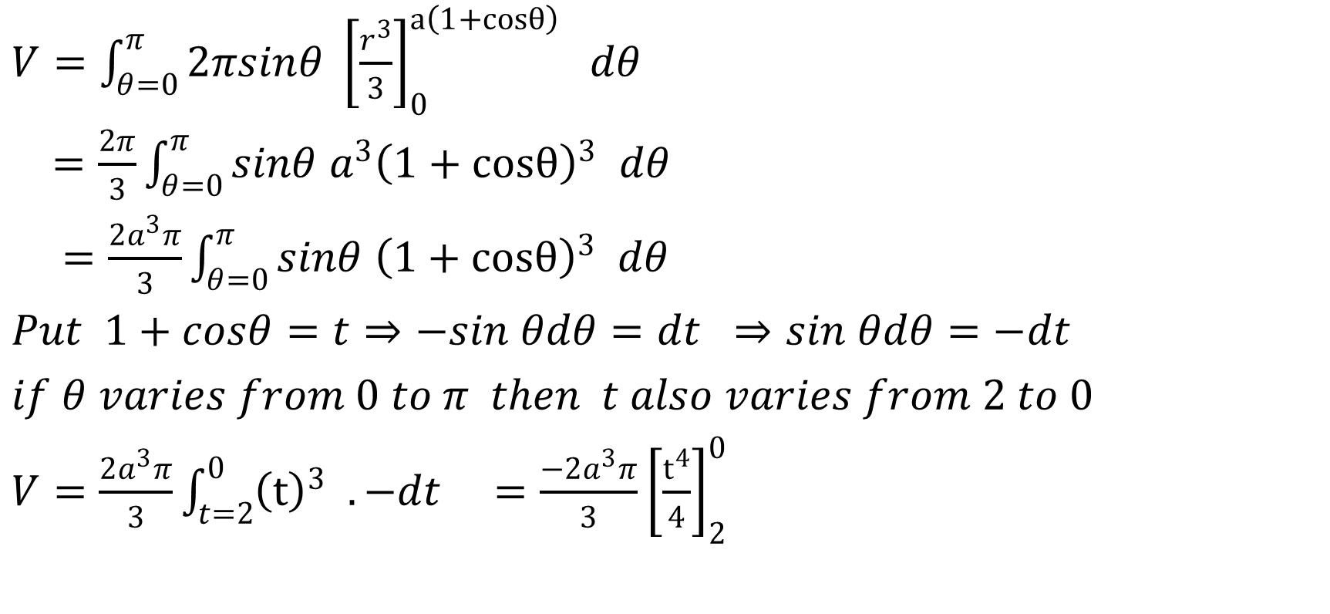
$V=\int_{θ=0}^{π}{2πsinθ {\left[\frac{r^{3}}{3}\right]}_{0}^{a\left(1+cosθ\right)} dθ}$
$=\frac{2π}{3}\int_{θ=0}^{π}{sinθ a^{3}{\left(1+cosθ\right)}^{3} dθ}$
$=\frac{2a^{3}π}{3}\int_{θ=0}^{π}{sinθ {\left(1+cosθ\right)}^{3} dθ}$
$Put 1+cosθ=t⇒−sin θdθ=dt ⇒sin θdθ=−dt$
$if θ varies from 0 to π then t also varies from 2 to 0$
$V=\frac{2a^{3}π}{3}\int_{t=2}^{0}{{\left(t\right)}^{3} . −dt =\frac{−2a^{3}π}{3}}{\left[\frac{t^{4}}{4}\right]}_{2}^{0}$

Slide 18
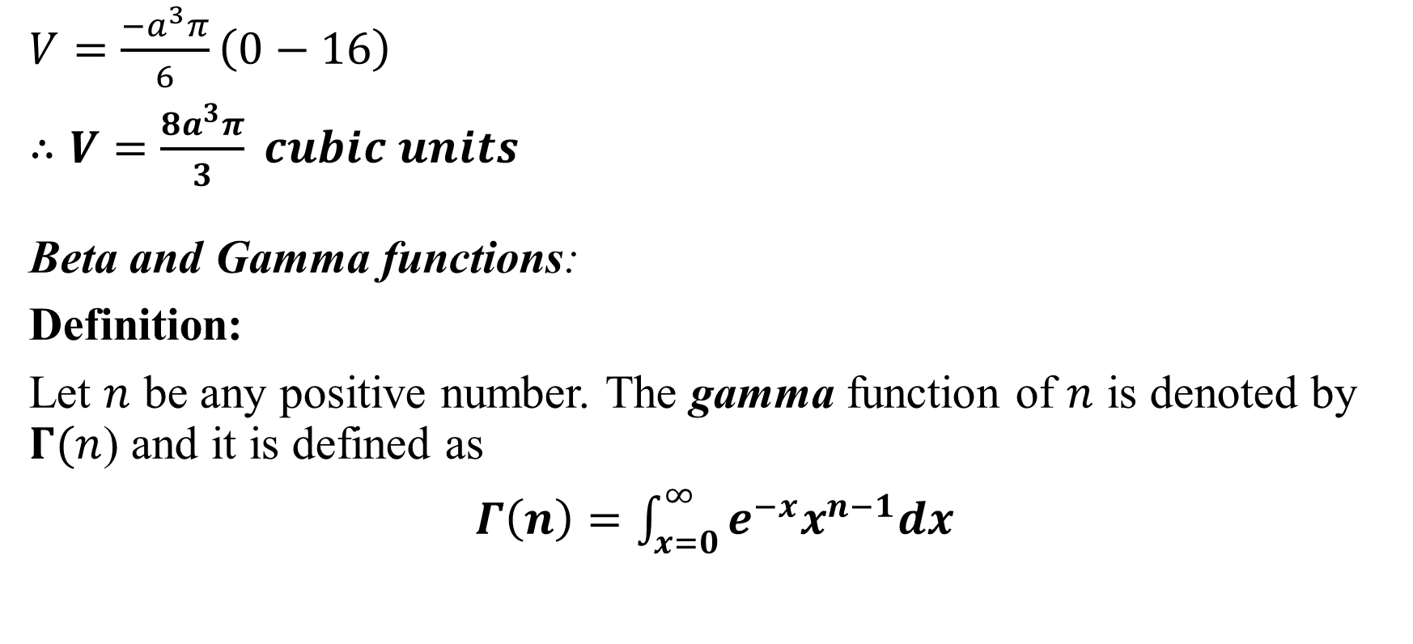
$V=\frac{−a^{3}π}{6}\left(0−16\right)$
$∴V=\frac{8a^{3}π}{3} cubic units$
Beta and Gamma functions:
Definition:
Let $n$ be any positive number. The gamma function of $n$ is denoted by $Γ(n$) and it is defined as
$Γ\left(n\right)=\int_{x=0}^{∞}{e^{−x}x^{n−1}dx}$

Slide 19
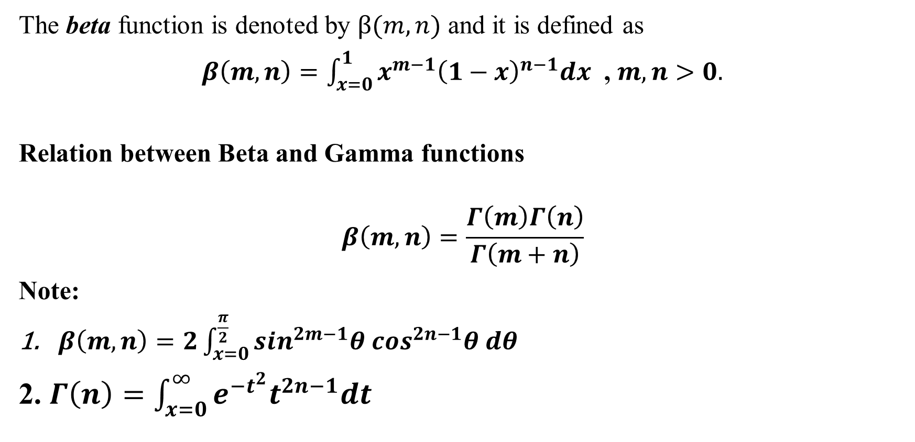
The beta function is denoted by $β(m,n)$ and it is defined as
$β\left(m,n\right)=\int_{x=0}^{1}{x^{m−1}{\left(1−x\right)}^{n−1}dx}$ , $m,n>0.$
Relation between Beta and Gamma functions
$$β\left(m,n\right)=\frac{Γ\left(m\right)Γ\left(n\right)}{Γ\left(m+n\right)}$$
Note:
$β\left(m,n\right)=2\int_{x=0}^{\frac{π}{2}}{\sin^{2m−1}θ\cos^{2n−1}θ dθ}$
2. $Γ\left(n\right)=\int_{x=0}^{∞}{e^{−t^{2}}t^{2n−1}dt}$

Slide 20
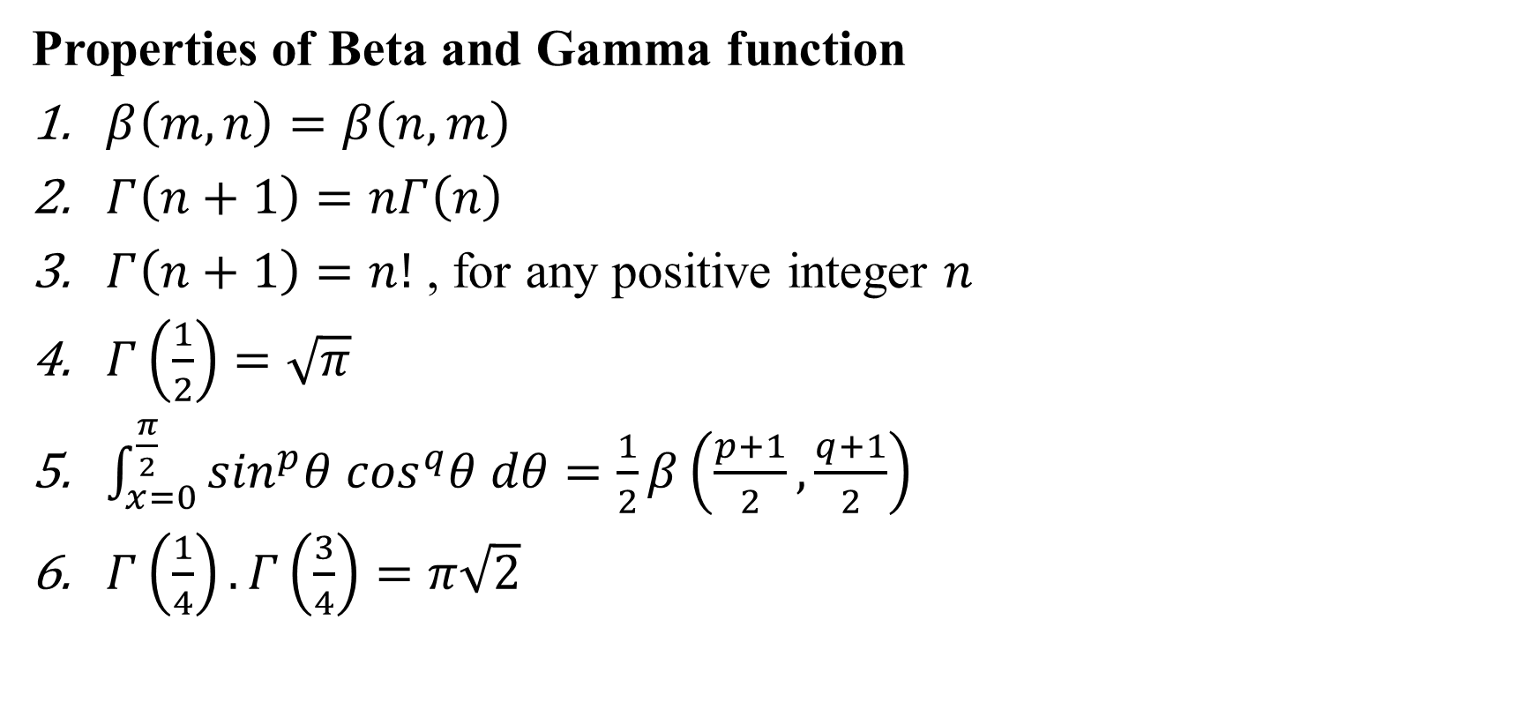
Properties of Beta and Gamma function
$β\left(m,n\right)=β\left(n,m\right)$
$Γ\left(n+1\right)=nΓ\left(n\right)$
$Γ\left(n+1\right)=n!$ , for any positive integer $n$
$Γ\left(\frac{1}{2}\right)=\sqrt{π}$
$\int_{x=0}^{\frac{π}{2}}{\sin^{p}θ\cos^{q}θ dθ=\frac{1}{2}β\left(\frac{p+1}{2},\frac{q+1}{2}\right)}$
$Γ\left(\frac{1}{4}\right).Γ\left(\frac{3}{4}\right)=π\sqrt{2}$

Slide 21
Module-2: Vector Calculus
Vector Differentiation: Scalar and vector fields. Gradient, directional derivative.
curl and divergence - physical interpretation, solenoidal and irrotational vector fields. Problems.
Vector Integration: Line integrals, Surface integrals.
Applications to work done by a force and flux.
Statement of Green’s theorem and Stoke’s theorem-Problems.
Self-study: Volume integral and Gauss divergence theorem.

Slide 22
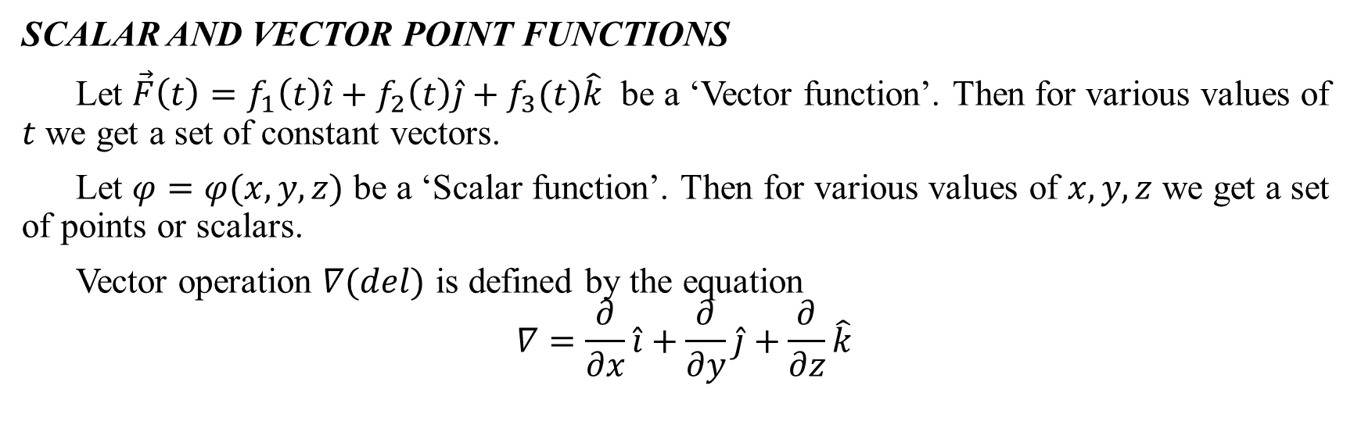
VECTOR CALCULUS
Vector calculus is a field of mathematics concerned with multivariate real analysis of vectors in two or more dimensions. It consists of set of problems solving techniques very useful for engineering and physics.
SCALAR AND VECTOR POINT FUNCTIONS
Let $\vec{F}\left(t\right)=f_{1}\left(t\right)\hat{i}+f_{2}\left(t\right)\hat{j}+f_{3}(t)\hat{k}$ be a ‘Vector function’. Then for various values of $t$ we get a set of constant vectors.
Let $φ=φ(x,y,z)$ be a ‘Scalar function’. Then for various values of $x,y,z$ we get a set of points or scalars.
Vector operation $∇(del)$ is defined by the equation
$$∇=\frac{∂}{∂x}\hat{i}+\frac{∂}{∂y}\hat{j}+\frac{∂}{∂z}\hat{k}$$

Slide 23
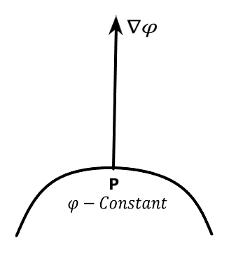
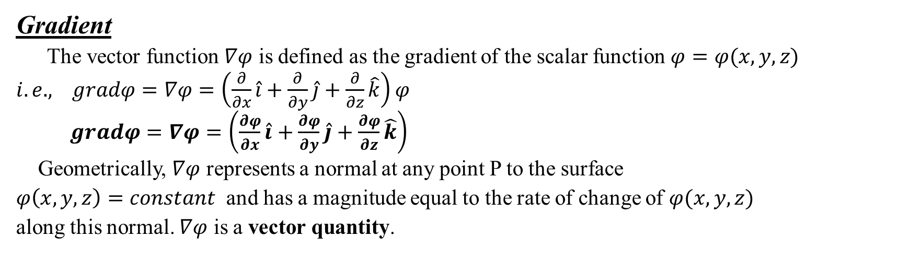
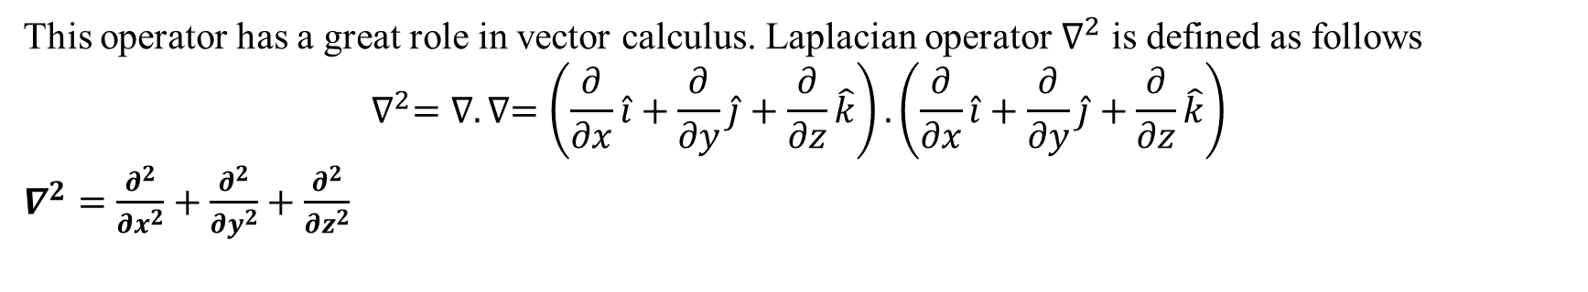
This operator has a great role in vector calculus. Laplacian operator $∇^{2}$ is defined as follows
$$∇^{2}=∇.∇=\left(\frac{∂}{∂x}\hat{i}+\frac{∂}{∂y}\hat{j}+\frac{∂}{∂z}\hat{k}\right).\left(\frac{∂}{∂x}\hat{i}+\frac{∂}{∂y}\hat{j}+\frac{∂}{∂z}\hat{k}\right)$$
$∇^{2}=\frac{∂^{2}}{{∂x}^{2}}+\frac{∂^{2}}{{∂y}^{2}}+\frac{∂^{2}}{{∂z}^{2}}$
Gradient
The vector function $∇φ$ is defined as the gradient of the scalar function $φ=φ(x,y,z)$
$i.e.,$ $gradφ=∇φ=\left(\frac{∂}{∂x}\hat{i}+\frac{∂}{∂y}\hat{j}+\frac{∂}{∂z}\hat{k}\right)φ$
$gradφ=∇φ=\left(\frac{∂φ}{∂x}\hat{i}+\frac{∂φ}{∂y}\hat{j}+\frac{∂φ}{∂z}\hat{k}\right)$
Geometrically, $∇φ$ represents a normal at any point P to the surface
$φ\left(x,y,z\right)=constant$ and has a magnitude equal to the rate of change of $φ(x,y,z)$
along this normal. $∇φ$ is a vector quantity.

Slide 24
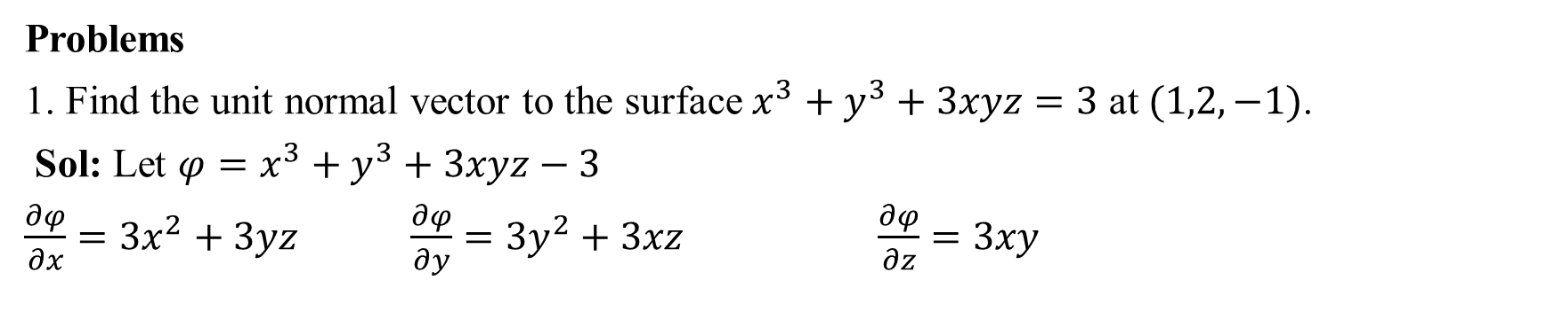
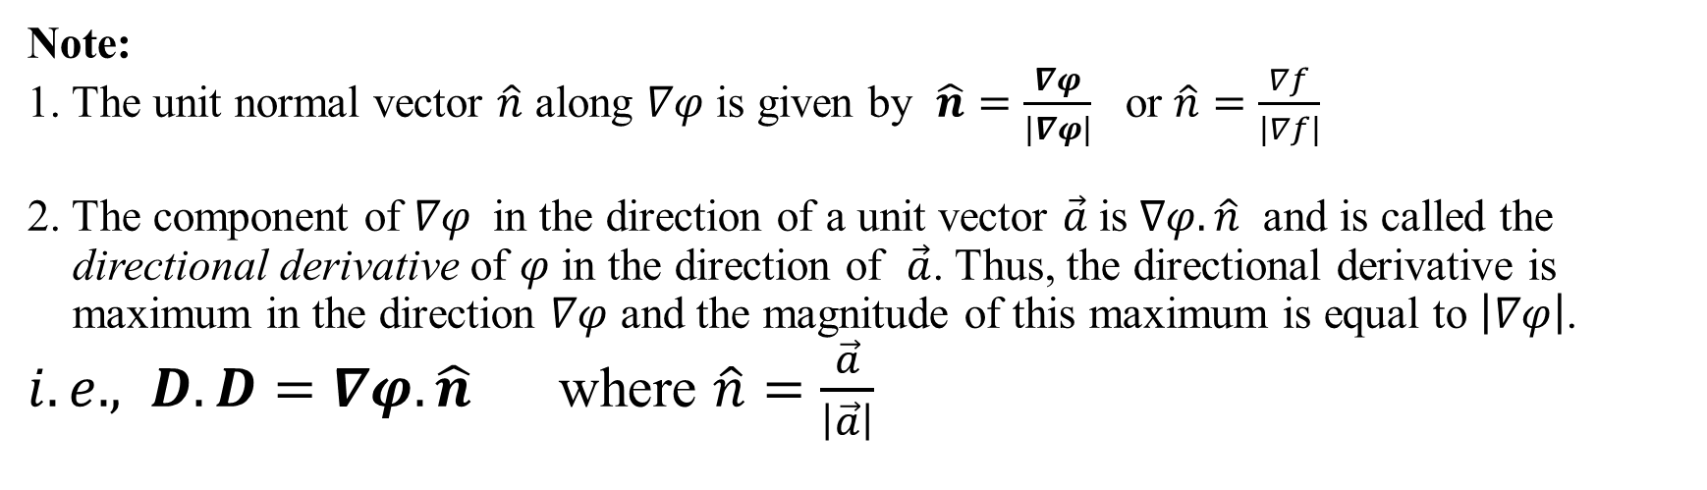
Note:
1. The unit normal vector $\hat{n}$ along $∇φ$ is given by $\hat{n}=\frac{∇φ}{\left|∇φ\right|}$ or $\hat{n}=\frac{∇f}{\left|∇f\right|}$
2. The component of $∇φ$ in the direction of a unit vector $\vec{a}$is $∇φ.\hat{n}$ and is called the directional derivative of $φ$ in the direction of $\vec{a}$. Thus, the directional derivative is maximum in the direction $∇φ$ and the magnitude of this maximum is equal to $\left|∇φ\right|$.
$i.e.,$ $D.D=∇φ.\hat{n}$ where $\hat{n}=\frac{\vec{a}}{\left|\vec{a}\right|}$
Problems
1. Find the unit normal vector to the surface $x^{3}+y^{3}+3xyz=3$ at $(1,2,−1)$.
Sol: Let ${φ=x}^{3}+y^{3}+3xyz−3$
$\frac{∂φ}{∂x}=3x^{2}+3yz$ $\frac{∂φ}{∂y}=3y^{2}+3xz$ $\frac{∂φ}{∂z}=3xy$

Slide 25
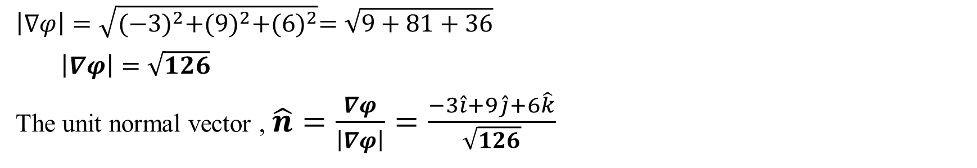
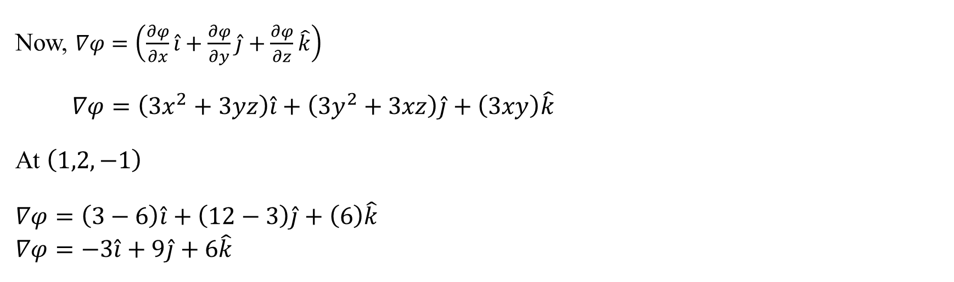
Now, $∇φ=\left(\frac{∂φ}{∂x}\hat{i}+\frac{∂φ}{∂y}\hat{j}+\frac{∂φ}{∂z}\hat{k}\right)$
$∇φ=\left(3x^{2}+3yz\right)\hat{i}+\left(3y^{2}+3xz\right)\hat{j}+\left(3xy\right)\hat{k}$
At $\left(1,2,−1\right)$
$$∇φ=\left(3−6\right)\hat{i}+\left(12−3\right)\hat{j}+\left(6\right)\hat{k}$$
$$∇φ=−3\hat{i}+9\hat{j}+6\hat{k}$$
$$\left|∇φ\right|=\sqrt{{(−3)}^{2}+{(9)}^{2}+{(6)}^{2}}=\sqrt{9+81+36}$$
$\left|∇φ\right|=\sqrt{126}$
The unit normal vector , $\hat{n}=\frac{∇φ}{\left|∇φ\right|}=\frac{−3\hat{i}+9\hat{j}+6\hat{k}}{\sqrt{126}}$

Slide 26
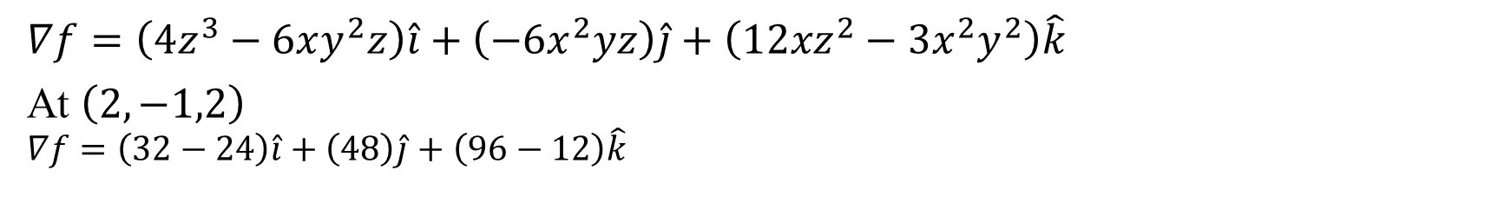
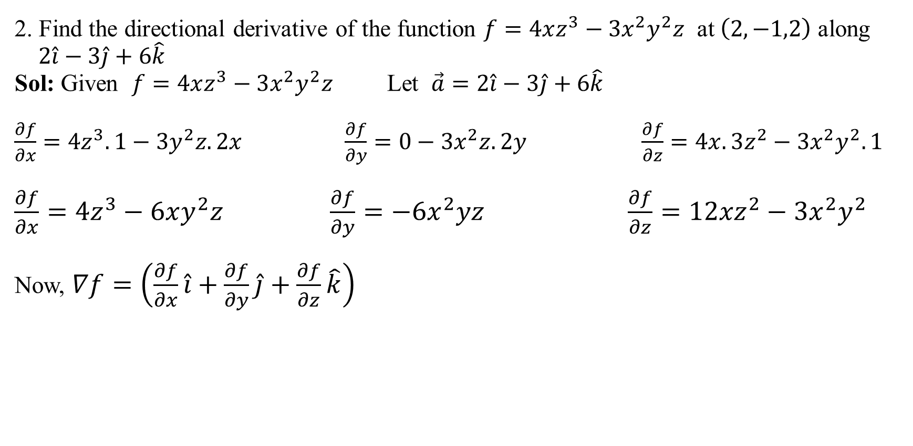
2. Find the directional derivative of the function $f=4xz^{3}−3x^{2}y^{2}z$ at $\left(2,−1,2\right)$ along
$2\hat{i}−3\hat{j}+6\hat{k}$
Sol: Given $f=4xz^{3}−3x^{2}y^{2}z$ Let $\vec{a}=2\hat{i}−3\hat{j}+6\hat{k}$
$\frac{∂f}{∂x}=4z^{3}.1−3y^{2}z.2x$ $\frac{∂f}{∂y}=0−3x^{2}z.2y$ $\frac{∂f}{∂z}=4x.3z^{2}−3x^{2}y^{2}.1$
$\frac{∂f}{∂x}=4z^{3}−6xy^{2}z \frac{∂f}{∂y}=−6x^{2}yz$ $\frac{∂f}{∂z}=12{xz}^{2}−3x^{2}y^{2}$
Now, $∇f=\left(\frac{∂f}{∂x}\hat{i}+\frac{∂f}{∂y}\hat{j}+\frac{∂f}{∂z}\hat{k}\right)$
$$∇f=\left(4z^{3}−6xy^{2}z\right)\hat{i}+\left(−6x^{2}yz\right)\hat{j}+\left(12{xz}^{2}−3x^{2}y^{2}\right)\hat{k}$$
At $\left(2,−1,2\right)$
$$∇f=\left(32−24\right)\hat{i}+\left(48\right)\hat{j}+\left(96−12\right)\hat{k}$$

Slide 27
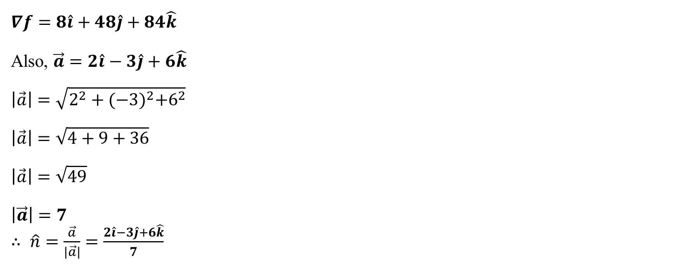
$$∇f=8\hat{i}+48\hat{j}+84\hat{k}$$
Also, $\vec{a}=2\hat{i}−3\hat{j}+6\hat{k}$
$$\left|\vec{a}\right|=\sqrt{2^{2}+{(−3)}^{2}+6^{2}}$$
$$\left|\vec{a}\right|=\sqrt{4+9+36}$$
$$\left|\vec{a}\right|=\sqrt{49}$$
$$\left|\vec{a}\right|=7$$
$∴$ $\hat{n}=\frac{\vec{a}}{\left|\vec{a}\right|}=\frac{2\hat{i}−3\hat{j}+6\hat{k}}{7}$
$$D.D=∇f.\hat{n}$$

Slide 28
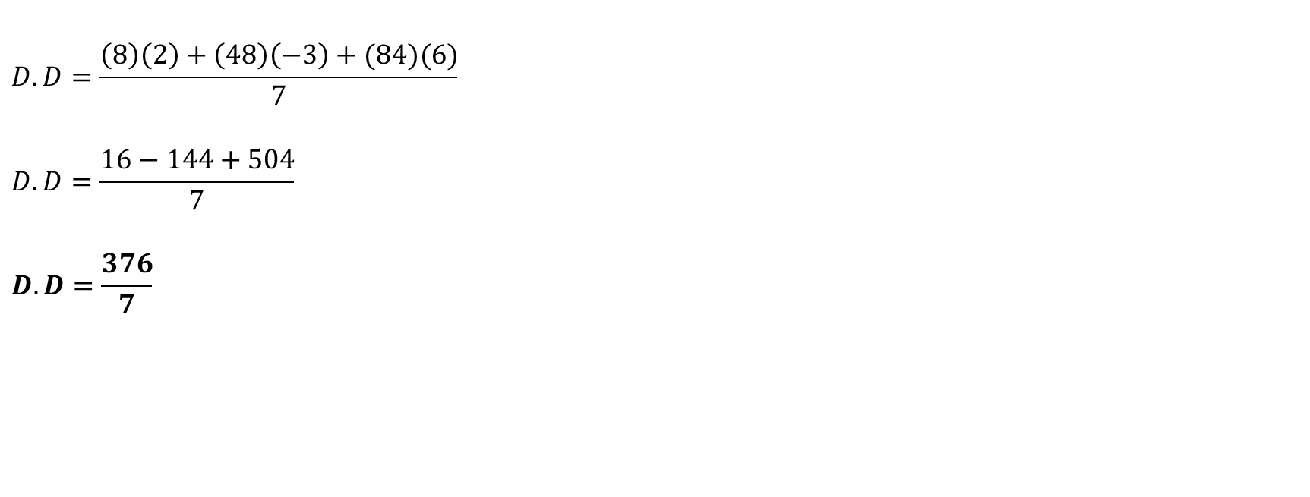
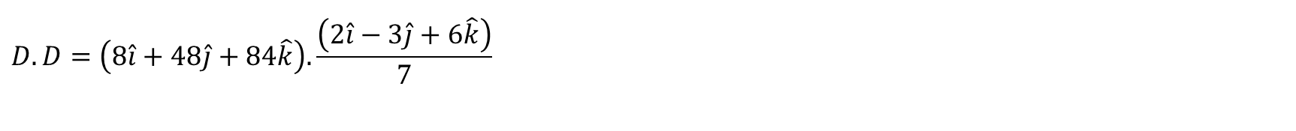
$$D.D=\left(8\hat{i}+48\hat{j}+84\hat{k}\right).\frac{\left(2\hat{i}−3\hat{j}+6\hat{k}\right)}{7}$$
$$D.D=\frac{\left(8\right)\left(2\right)+\left(48\right)\left(−3\right)+(84)(6)}{7}$$
$$D.D=\frac{16−144+504}{7}$$
$$D.D=\frac{376}{7}$$

Slide 29
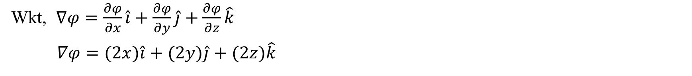
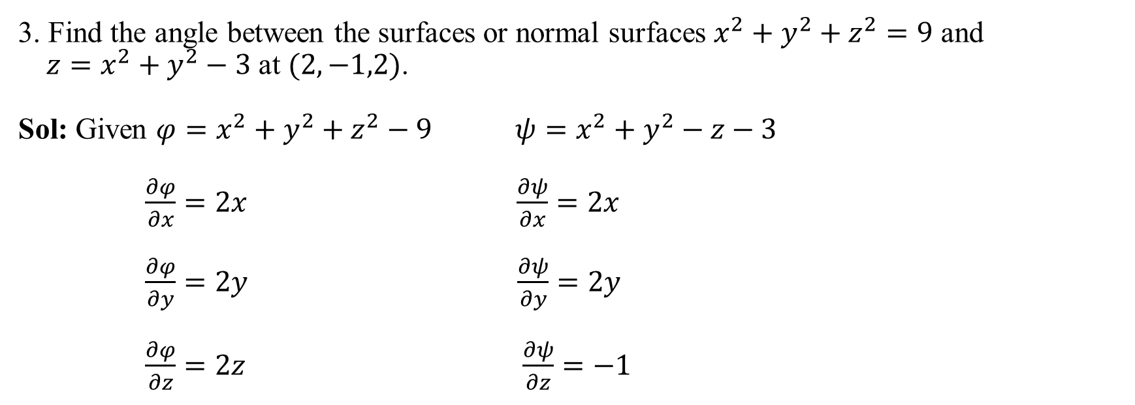
3. Find the angle between the surfaces or normal surfaces $x^{2}+y^{2}+z^{2}=9$ and
$z=x^{2}+y^{2}−3$ at $(2,−1,2)$.
Sol: Given $φ=x^{2}+y^{2}+z^{2}−9$ $ψ=x^{2}+y^{2}−z−3$
$\frac{∂φ}{∂x}=2x$ $\frac{∂ψ}{∂x}=2x$
$\frac{∂φ}{∂y}=2y$ $\frac{∂ψ}{∂y}=2y$
$\frac{∂φ}{∂z}=2z$ $\frac{∂ψ}{∂z}=−1$
Wkt, $∇φ=\frac{∂φ}{∂x}\hat{i}+\frac{∂φ}{∂y}\hat{j}+\frac{∂φ}{∂z}\hat{k}$
$∇φ=(2x)\hat{i}+(2y)\hat{j}+(2z)\hat{k}$

Slide 30
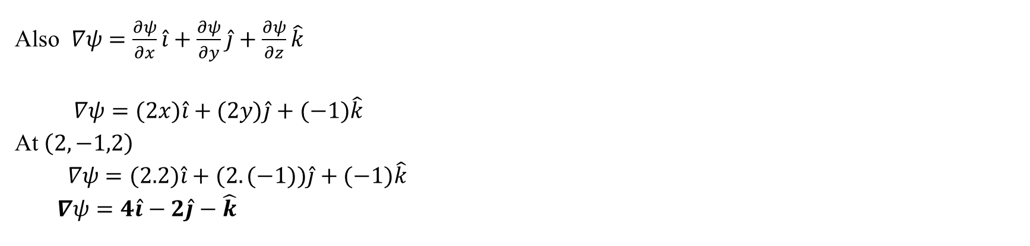
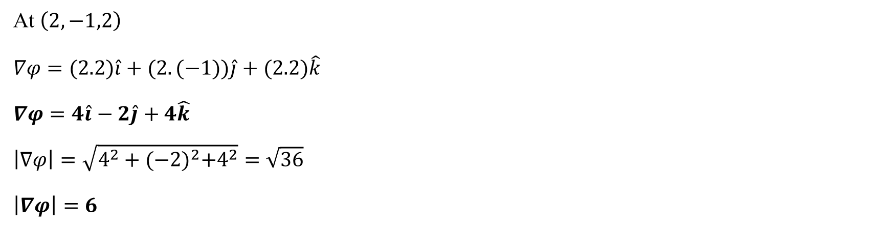
At $\left(2,−1,2\right)$
$$∇φ=(2.2)\hat{i}+(2.(−1))\hat{j}+(2.2)\hat{k}$$
$$∇φ=4\hat{i}−2\hat{j}+4\hat{k}$$
$$\left|∇φ\right|=\sqrt{4^{2}+{(−2)}^{2}+4^{2}}=\sqrt{36}$$
$$\left|∇φ\right|=6$$
Also $∇ψ=\frac{∂ψ}{∂x}\hat{i}+\frac{∂ψ}{∂y}\hat{j}+\frac{∂ψ}{∂z}\hat{k}$
$∇ψ=(2x)\hat{i}+(2y)\hat{j}+(−1)\hat{k}$
At $\left(2,−1,2\right)$
$∇ψ=(2.2)\hat{i}+(2.(−1))\hat{j}+(−1)\hat{k}$
$∇ψ=4\hat{i}−2\hat{j}−\hat{k}$

Slide 31
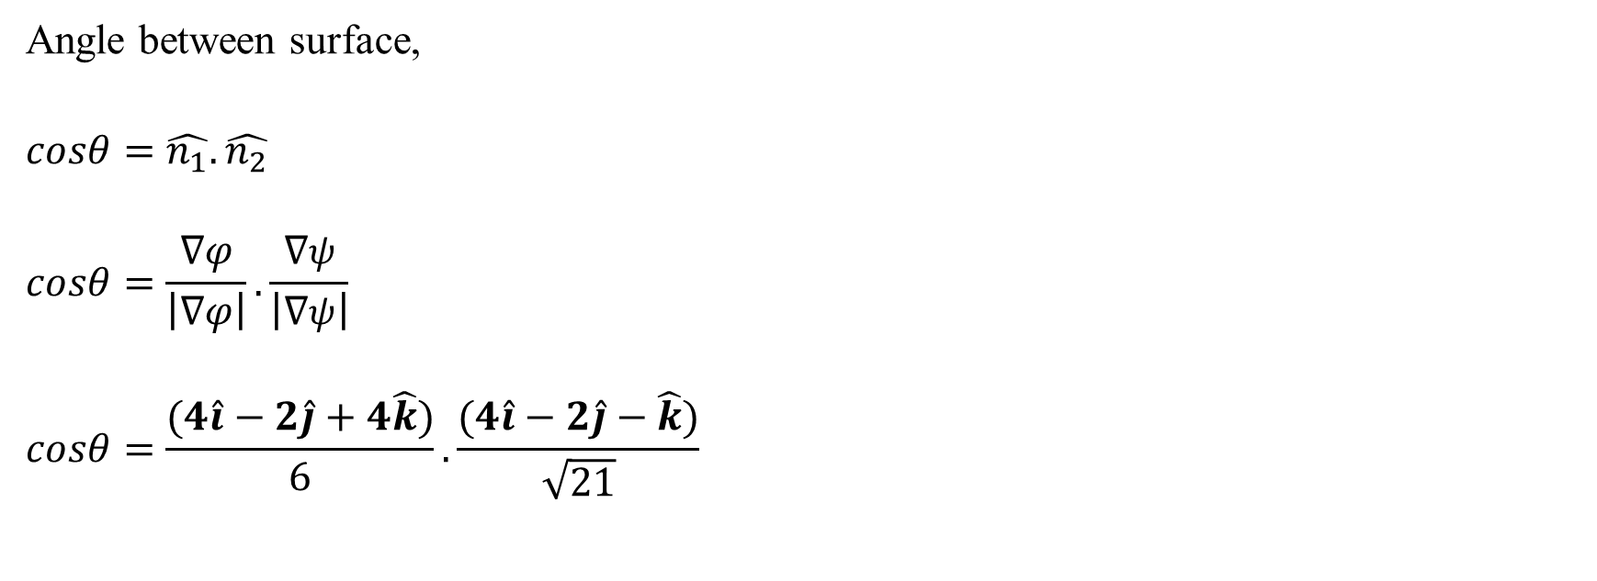
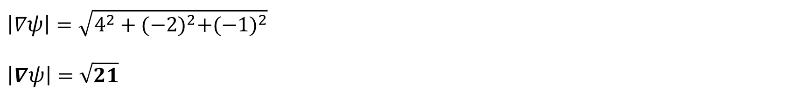
$$\left|∇ψ\right|=\sqrt{4^{2}+{(−2)}^{2}+{(−1)}^{2}}$$
$$\left|∇ψ\right|=\sqrt{21}$$
Angle between surface,
$$cosθ=\hat{n_{1}}.\hat{n_{2}}$$
$$cosθ=\frac{∇φ}{\left|∇φ\right|}.\frac{∇ψ}{\left|∇ψ\right|}$$
$$cosθ=\frac{(4\hat{i}−2\hat{j}+4\hat{k})}{6}.\frac{(4\hat{i}−2\hat{j}−\hat{k})}{\sqrt{21}}$$

Slide 32
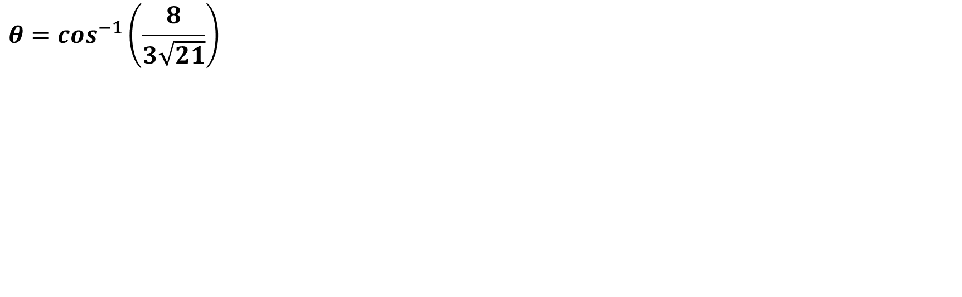
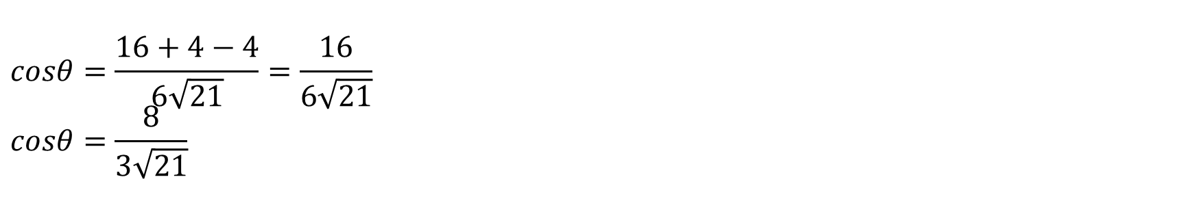
$$cosθ=\frac{16+4−4}{6\sqrt{21}}=\frac{16}{6\sqrt{21}} \\ cosθ=\frac{8}{3\sqrt{21}}$$
$$θ=\cos^{−1}\left(\frac{8}{3\sqrt{21}}\right)$$

Slide 33
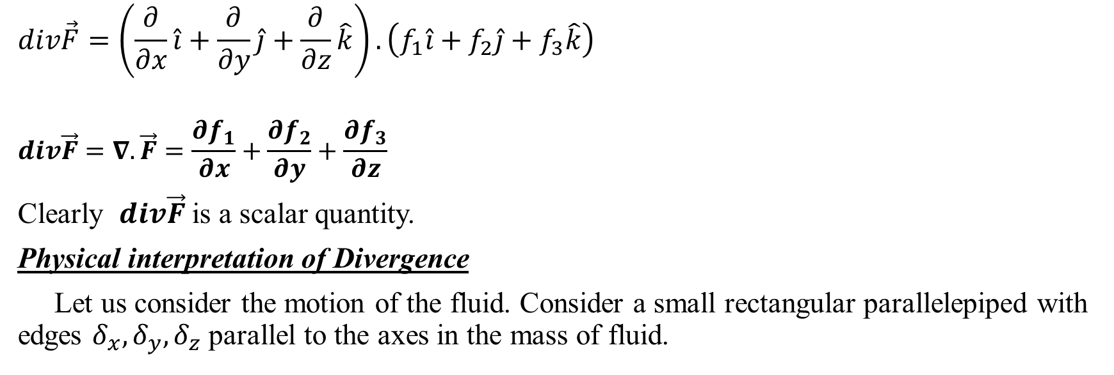
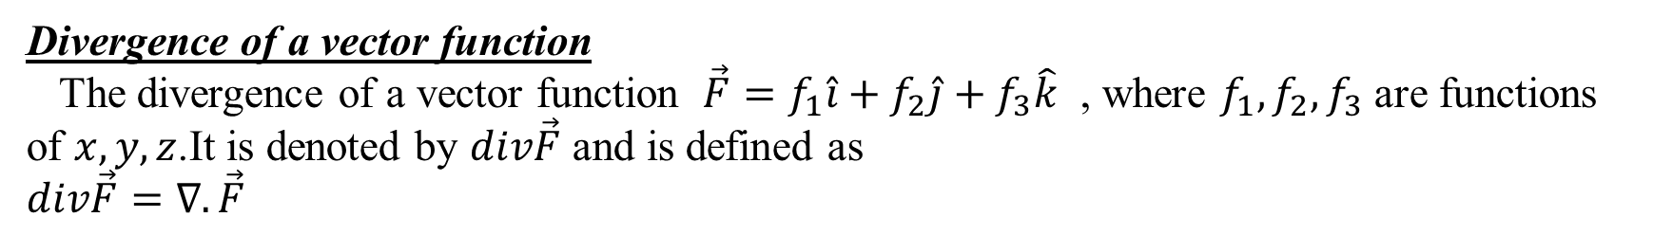
Divergence of a vector function
The divergence of a vector function $\vec{F}=f_{1}\hat{i}+f_{2}\hat{j}+f_{3}\hat{k}$ , where $f_{1},f_{2},f_{3}$ are functions of $x,y,z$.It is denoted by $div\vec{F}$ and is defined as
$$div\vec{F}=∇.\vec{F}$$
$$div\vec{F}=\left(\frac{∂}{∂x}\hat{i}+\frac{∂}{∂y}\hat{j}+\frac{∂}{∂z}\hat{k}\right).\left(f_{1}\hat{i}+f_{2}\hat{j}+f_{3}\hat{k}\right)$$
$$div\vec{F}=∇.\vec{F}=\frac{∂f_{1}}{∂x}+\frac{∂f_{2}}{∂y}+\frac{∂f_{3}}{∂z}$$
Clearly $div\vec{F}$ is a scalar quantity.
Physical interpretation of Divergence
Let us consider the motion of the fluid. Consider a small rectangular parallelepiped with edges $δ_{x},δ_{y},δ_{z}$ parallel to the axes in the mass of fluid.

Slide 34
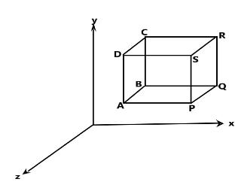
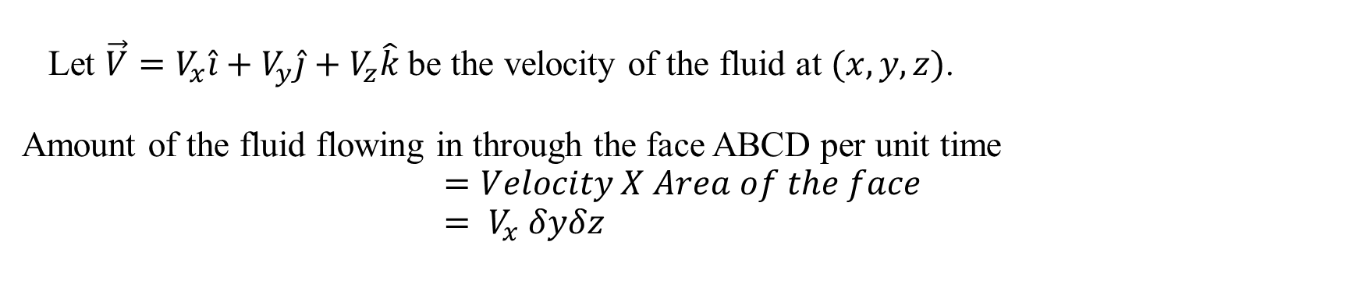
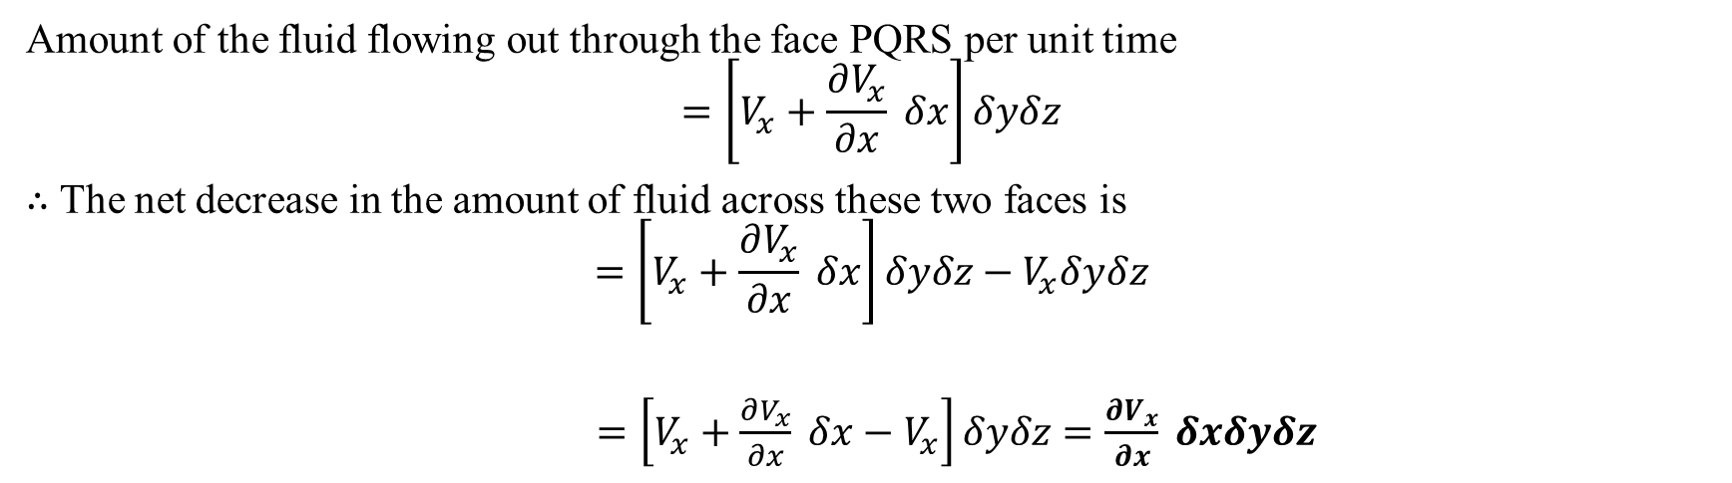
Let $\vec{V}=V_{x}\hat{i}+V_{y}\hat{j}+V_{z}\hat{k}$ be the velocity of the fluid at $(x,y,z)$.
Amount of the fluid flowing in through the face ABCD per unit time
$$=Velocity X Area of the face \\ = V_{x} δyδz$$
Amount of the fluid flowing out through the face PQRS per unit time
$$=\left[V_{x}+\frac{∂V_{x}}{∂x} δx\right]δyδz$$
$∴$ The net decrease in the amount of fluid across these two faces is
$$=\left[V_{x}+\frac{∂V_{x}}{∂x} δx\right]δyδz−V_{x}δyδz$$
$=\left[V_{x}+\frac{∂V_{x}}{∂x} δx−V_{x}\right]δyδz$ $=\frac{∂V_{x}}{∂x} δxδyδz$

Slide 35
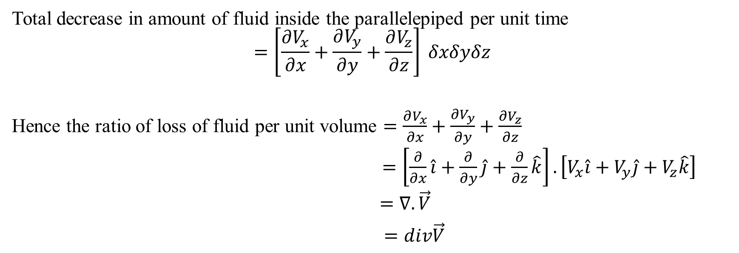
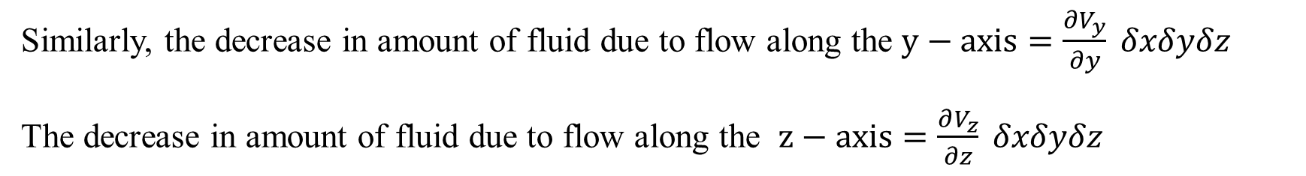
Similarly, the decrease in amount of fluid due to flow along the $y−axis=\frac{∂V_{y}}{∂y} δxδyδz$
The decrease in amount of fluid due to flow along the $z−axis=\frac{∂V_{z}}{∂z} δxδyδz$
Total decrease in amount of fluid inside the parallelepiped per unit time
$$=\left[\frac{∂V_{x}}{∂x}+\frac{∂V_{y}}{∂y}+\frac{∂V_{z}}{∂z}\right] δxδyδz$$
Hence the ratio of loss of fluid per unit volume $=\frac{∂V_{x}}{∂x}+\frac{∂V_{y}}{∂y}+\frac{∂V_{z}}{∂z}$
$=\left[\frac{∂}{∂x}\hat{i}+\frac{∂}{∂y}\hat{j}+\frac{∂}{∂z}\hat{k}\right].\left[V_{x}\hat{i}+V_{y}\hat{j}+V_{z}\hat{k}\right]$
$=∇.\vec{V}$
$=div\vec{V}$

Slide 36
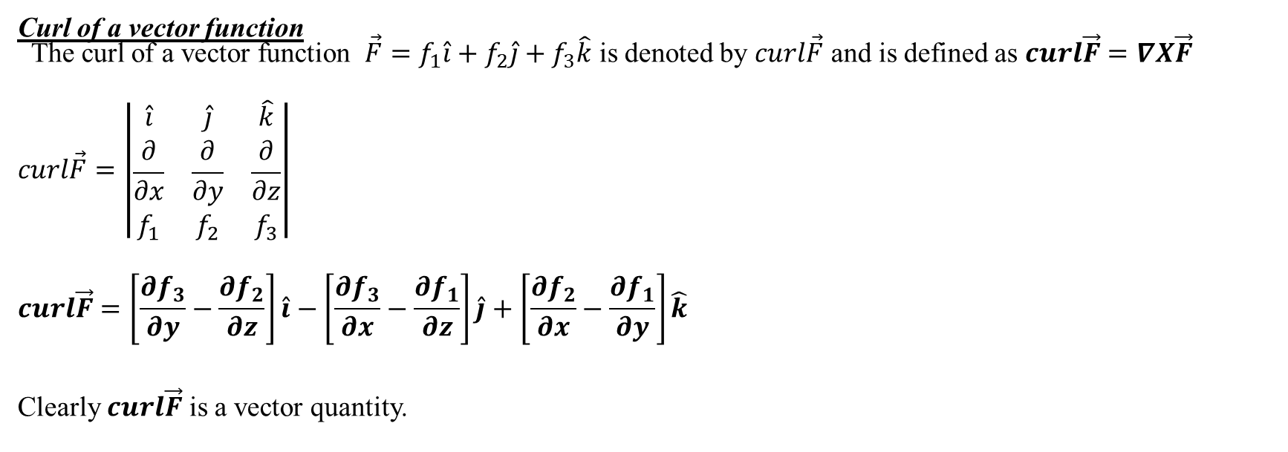
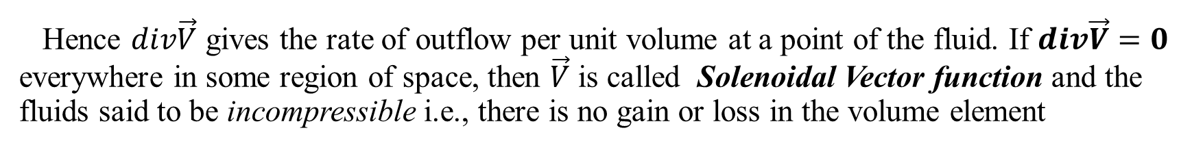
Hence $div\vec{V}$ gives the rate of outflow per unit volume at a point of the fluid. If $div\vec{V}=0$ everywhere in some region of space, then $\vec{V}$ is called Solenoidal Vector function and the fluids said to be incompressible i.e., there is no gain or loss in the volume element
Curl of a vector function
The curl of a vector function $\vec{F}=f_{1}\hat{i}+f_{2}\hat{j}+f_{3}\hat{k}$ is denoted by $curl\vec{F}$ and is defined as $curl\vec{F}=∇X\vec{F}$
$$curl\vec{F}=\left|\begin{matrix}\hat{i} & \hat{j} & \hat{k} \\ \frac{∂}{∂x} & \frac{∂}{∂y} & \frac{∂}{∂z} \\ f_{1} & f_{2} & f_{3}\end{matrix}\right|$$
$$curl\vec{F}=\left[\frac{∂f_{3}}{∂y}−\frac{∂f_{2}}{∂z}\right]\hat{i}−\left[\frac{∂f_{3}}{∂x}−\frac{∂f_{1}}{∂z}\right]\hat{j}+\left[\frac{∂f_{2}}{∂x}−\frac{∂f_{1}}{∂y}\right]\hat{k}$$
Clearly $curl\vec{F}$ is a vector quantity.

Slide 37
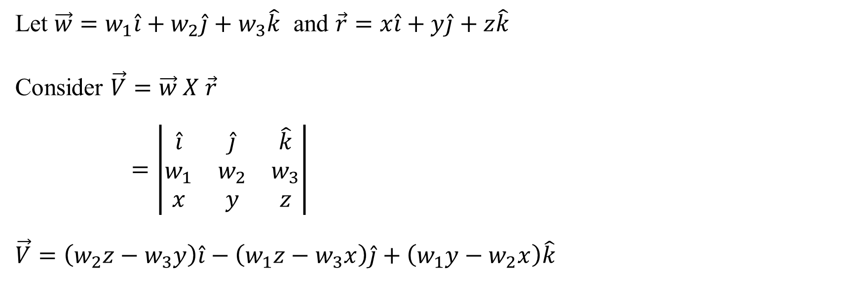

Physical interpretation of Curl
Consider a rigid body rotating about a fixed axis through origin. Let the uniform angular velocity be $\vec{w}=w_{1}\hat{i}+w_{2}\hat{j}+w_{3}\hat{k}$ , $w_{1}$, $w_{2}$, $w_{3}$ are constants. The velocity $\vec{V}$ of any point $P(x,y,z)$ on the body is given by $\vec{V}=\vec{w} X \vec{r}$ , where $\vec{r}$ is the position vector of P.
Let $\vec{w}=w_{1}\hat{i}+w_{2}\hat{j}+w_{3}\hat{k}$ and $\vec{r}=x\hat{i}+y\hat{j}+z\hat{k}$
Consider $\vec{V}=\vec{w} X \vec{r}$
$=\left|\begin{matrix}\hat{i} & \hat{j} & \hat{k} \\ w_{1} & w_{2} & w_{3} \\ x & y & z\end{matrix}\right|$
$$\vec{V}=\left(w_{2}z−w_{3}y\right)\hat{i}−\left(w_{1}z−w_{3}x\right)\hat{j}+\left(w_{1}y−w_{2}x\right)\hat{k}$$

Slide 38

$$curl\vec{V}=∇X\vec{V}$$
$$curl\vec{V}=∇ X \left[\left(w_{2}z−w_{3}y\right)\hat{i}−\left(w_{1}z−w_{3}x\right)\hat{j}+\left(w_{1}y−w_{2}x\right)\hat{k}\right]$$
$$curl\vec{V}=\left|\begin{matrix}\hat{i} & \hat{j} & \hat{k} \\ \frac{∂}{∂x} & \frac{∂}{∂y} & \frac{∂}{∂z} \\ \left(w_{2}z−w_{3}y\right) & \left(w_{3}x−w_{1}z\right) & \left(w_{1}y−w_{2}x\right)\end{matrix}\right|$$
$$curl\vec{V}=\left[w_{1}−(−w_{1}) \right]\hat{i}−\left[{−w}_{2}−w_{2}\right]\hat{j}+\left[w_{3}−(−w_{3})\right]\hat{k}$$
$$curl\vec{V}=\left[2w_{1} \right]\hat{i}+\left[{2w}_{2}\right]\hat{j}+\left[2w_{3}\right]\hat{k}$$
$$curl\vec{V}=2\left[w_{1}\hat{i}+w_{2}\hat{j}+w_{3}\hat{k}\right]$$

Slide 39


$$curl\vec{V}=2\vec{w}$$
$$\vec{w}=\frac{1}{2}curl\vec{V}$$
Thus the angular velocity of rotation at any point is equal to half of the curl of the velocity.
Note:
If $div\vec{F}=0$ , then we say that $\vec{F}$ is Solenoidal vector.
If $curl\vec{F}=0$ , then we say that $\vec{F}$ is irrotational vector.
Irrotational vector field is called as conservative field or potential field.
When $\vec{F}$ is irrotational there always exist a scalar point function such that $∇φ=\vec{F}$ , then
$φ$ is called a scalar potential of vector $\vec{F}$.

Slide 40


Problems
1. If $\vec{F}=xyz\hat{i}+3x^{2}y\hat{j}+(xz^{2}−y^{2}z)\hat{k}$ , find the $div\vec{F}$ and $curl\vec{F}$ at $\left(2,−1,1\right).$
Sol: Given $\vec{ F}=xyz\hat{i}+3x^{2}y\hat{j}+(xz^{2}−y^{2}z)\hat{k}$
Wkt $div\vec{F}=∇.\vec{F}$
$div\vec{F}=\frac{∂f_{1}}{∂x}+\frac{∂f_{2}}{∂y}+\frac{∂f_{3}}{∂z}$
$$div\vec{F}=\frac{∂}{∂x}\left(xyz\right)+\frac{∂}{∂y}\left({3x}^{2}y\right)+\frac{∂}{∂z}(xz^{2}−y^{2}z)$$
$$div\vec{F}=yz.1+3x^{2}.1+(x.2z−y^{2}.1)$$
$$div\vec{F}=yz+3x^{2}+2xz−y^{2}$$
At $\left(2,−1,1\right)$
$$div\vec{F}=(−1)(1)+3{.\left(2\right)}^{2}+2(2)(1)−{(−1)}^{2}$$
$$div\vec{F}=−1+12+4−1$$
$div\vec{F}=$14

Slide 41


Also, $curl\vec{F}=∇ X \vec{F}$
$=\left|\begin{matrix}\hat{i} & \hat{j} & \hat{k} \\ \frac{∂}{∂x} & \frac{∂}{∂y} & \frac{∂}{∂z} \\ (xyz) & (3x^{2}y) & (xz^{2}−y^{2}z)\end{matrix}\right|$
$$curl\vec{F}=\left[\frac{∂}{∂y}\left(xz^{2}−y^{2}z\right)−\frac{∂}{∂z}(3x^{2}y)\right]\hat{i}−\left[\frac{∂}{∂x}\left(xz^{2}−y^{2}z\right)−\frac{∂}{∂z}\left(xyz\right)\right]\hat{j}+\left[\frac{∂}{∂x}\left(3x^{2}y\right)−\frac{∂}{∂y}(xyz)\right]\hat{k}$$
$$curl\vec{F}=\left[\left(−2yz\right)−0\right]\hat{i}−\left[\left(z^{2}−0\right)−\left(xy\right)\right]\hat{j}+\left[\left(6xy\right)− (xz)\right]\hat{k}$$
$$curl\vec{F}=\left[−2yz\right]\hat{i}−\left[z^{2}−xy\right]\hat{j}+\left[6xy−xz\right]\hat{k}$$
At (2,-1,1)
$$curl\vec{F}=\left[−2(−1)(1)\right]\hat{i}−\left[1^{2}−2(−1)\right]\hat{j}+\left[6(2)(−1)−(2)(1)\right]\hat{k}$$
$$curl\vec{F}=2\hat{i}−3\hat{j}−14\hat{k}$$

Slide 42


2. Find $div\vec{F}$ and $curl\vec{F}$ where $\vec{F}=grad\left(x^{3}+y^{3}+z^{3}−3xyz\right)$.
Sol: Let $φ=x^{3}+y^{3}+z^{3}−3xyz$
$$\vec{F}=gradφ$$
$$\vec{F}=∇φ$$
$$\vec{F}=\frac{∂φ}{∂x}\hat{i}+\frac{∂φ}{∂y}\hat{j}+\frac{∂φ}{∂z}\hat{k}$$
$$\vec{F}=(3x^{2}−3yz)\hat{i}+(3y^{2}−3xz)\hat{j}+(3z^{2}−3xy)\hat{k}$$
Now, $div\vec{F}=∇.\vec{F}$
$div\vec{F}=\frac{∂}{∂x}(3x^{2}−3yz$)+$\frac{∂}{∂y}$($3y^{2}−3xz)$+$\frac{∂}{∂z}(3z^{2}−3xy)$
$div\vec{F}=\left(6x−0\right)+\left(6y−0\right)+(6z−0)$
$div\vec{F}=6x+6y+6z$

Slide 43

$$curl\vec{F}=∇ X \vec{F}$$
$$curl\vec{F}=\left|\begin{matrix}\hat{i} & \hat{j} & \hat{k} \\ \frac{∂}{∂x} & \frac{∂}{∂y} & \frac{∂}{∂z} \\ \left(3x^{2}−3yz\right) & \left(3y^{2}−3xz\right) & \left(3z^{2}−3xy\right)\end{matrix}\right|$$
$$curl\vec{F}=\left[\frac{∂}{∂y}\left(3z^{2}−3xy\right)−\frac{∂}{∂z}\left(3y^{2}−3xz\right)\right]\hat{i}−\left[\frac{∂}{∂x}\left(3z^{2}−3xy\right)−\frac{∂}{∂z}\left(3x^{2}−3yz\right)\right]\hat{j}+\left[\frac{∂}{∂x}\left(3y^{2}−3xz\right)−\frac{∂}{∂y}\left(3x^{2}−3yz\right)\right]\hat{k}$$
$$curl\vec{F}=\left[\left(0−3x\right)−\left(0−3x\right)\right]\hat{i}−\left[\left(0−3y\right)−\left(0−3y\right)\right]\hat{j}+\left[\left(0−3z\right)−\left(0−3z\right)\right]\hat{k}$$
$$curl\vec{F}=\left[−3x+3x\right]\hat{i}−\left[−3y+3y\right]\hat{j}+\left[−3z+3z\right]\hat{k}$$
$$curl\vec{F}=0\hat{i}−0\hat{j}+0\hat{k}$$
$$curl\vec{F}=\vec{0}$$

Slide 44

3. Show that $\vec{F}=\frac{x\hat{i}+y\hat{j}}{\left(x^{2}+y^{2}\right)}$ is both solenoidal and irrotational.
Sol: Given $\vec{F}=\frac{x}{\left(x^{2}+y^{2}\right)}\hat{i}+\frac{y}{\left(x^{2}+y^{2}\right)}\hat{j}$
Wkt, $div\vec{F}=∇.\vec{F}$
$div\vec{F}=\frac{∂}{∂x}\left(\frac{x}{\left(x^{2}+y^{2}\right)}\right)$+$\frac{∂}{∂y}\left(\frac{y}{\left(x^{2}+y^{2}\right)}\right)$
$div\vec{F}=\frac{\left(x^{2}+y^{2}\right).1−x.2x}{{\left(x^{2}+y^{2}\right)}^{2}}+\frac{\left(x^{2}+y^{2}\right).1−y.2y}{{\left(x^{2}+y^{2}\right)}^{2}}$
$div\vec{F}=\frac{x^{2}+y^{2}−{2x}^{2}+x^{2}+y^{2}−2y^{2}}{{\left(x^{2}+y^{2}\right)}^{2}}$
$div\vec{F}=0$
$∴$ $\vec{F}$ is Solenoidal.

Slide 45


Now, $curl\vec{F}=∇ X \vec{F}$
$$curl\vec{F}=\left|\begin{matrix}\hat{i} & \hat{j} & \hat{k} \\ \frac{∂}{∂x} & \frac{∂}{∂y} & \frac{∂}{∂z} \\ \frac{x}{\left(x^{2}+y^{2}\right)} & \frac{y}{\left(x^{2}+y^{2}\right)} & 0\end{matrix}\right|$$
$$curl\vec{F}=\left[\frac{∂}{∂y}\left(0\right)−\frac{∂}{∂z}\left(\frac{y}{\left(x^{2}+y^{2}\right)}\right)\right]\hat{i}−\left[\frac{∂}{∂x}\left(0\right)−\frac{∂}{∂z}\left(\frac{x}{\left(x^{2}+y^{2}\right)}\right)\right]\hat{j}+\left[\frac{∂}{∂x}\left(\frac{y}{\left(x^{2}+y^{2}\right)}\right)−\frac{∂}{∂y}\left(\frac{x}{\left(x^{2}+y^{2}\right)}\right)\right]\hat{k}$$
$$curl\vec{F}=\left[\left(0\right)−\left(0\right)\right]\hat{i}−\left[\left(0\right)−\left(0\right)\right]\hat{j}+\left[\frac{−2xy}{\left(x^{2}+y^{2}\right)}+\frac{2xy}{\left(x^{2}+y^{2}\right)}\right]\hat{k}$$
$$curl\vec{F}=0\hat{i}−0\hat{j}+0\hat{k}$$
$$curl\vec{F}=\vec{0}$$
$∴$ $\vec{F}$ is irrotational.

Slide 46

4. P.T $\vec{F}=\left(y+z\right)\hat{i}+\left(z+x\right)\hat{j}+\left(x+y\right)\hat{k}$ is irrotational. Also find a scalar point function
$φ$ such that $\vec{F}=∇φ.$
Sol: Given $\vec{F}=\left(y+z\right)\hat{i}+\left(z+x\right)\hat{j}+\left(x+y\right)\hat{k}$
$$curl\vec{F}=∇ X \vec{F}$$
$$curl\vec{F}=\left|\begin{matrix}\hat{i} & \hat{j} & \hat{k} \\ \frac{∂}{∂x} & \frac{∂}{∂y} & \frac{∂}{∂z} \\ \left(y+z\right) & \left(z+x\right) & \left(x+y\right)\end{matrix}\right|$$
$$curl\vec{F}=\left[\frac{∂}{∂y}\left(x+y\right)−\frac{∂}{∂z}\left(z+x\right)\right]\hat{i}−\left[\frac{∂}{∂x}\left(x+y\right)−\frac{∂}{∂z}\left(y+z\right)\right]\hat{j}+\left[\frac{∂}{∂x}\left(z+x\right)−\frac{∂}{∂y}\left(y+z\right)\right]\hat{k}$$
$$curl\vec{F}=\left[\left(1\right)−\left(1\right)\right]\hat{i}−\left[\left(1\right)−\left(1\right)\right]\hat{j}+\left[\left(1\right)−\left(1\right)\right]\hat{k}$$
$$curl\vec{F}=0\hat{i}−0\hat{j}+0\hat{k}$$

Slide 47

$$curl\vec{F}=\vec{0} \\ ∴ \vec{F} \text{is} \text{irrotational}\text{.}$$
To find $φ$
Consider $∇φ=\vec{F}$
$$\frac{∂φ}{∂x}\hat{i}+\frac{∂φ}{∂y}\hat{j}+\frac{∂φ}{∂z}\hat{k}=\left(y+z\right)\hat{i}+\left(z+x\right)\hat{j}+\left(x+y\right)\hat{k}$$
$\frac{∂φ}{∂x}=$ $y+z$ $\frac{∂φ}{∂y}=z+x$ $\frac{∂φ}{∂z}=x+y$
Integrating we get
$φ=(y+z)\int{1 dx}$ $φ=(z+x)\int{1 dy}$ $φ=(x+y)\int{1 dz}$
$φ=\left(y+z\right)x+f(y,z)$ $φ=\left(z+x\right)y+f(x,z)$ $φ=\left(x+y\right)z+f(x,y)$
$φ=xy+xz+f(y,z)$ $φ=yz+xy+f(x,z)$ $φ=xz+yz+f(x,y)$

Slide 48

$$curl\vec{F}=\vec{0} \\ ∴ \vec{F} \text{is} \text{irrotational}\text{.}$$
To find $φ$
Consider $∇φ=\vec{F}$
$$\frac{∂φ}{∂x}\hat{i}+\frac{∂φ}{∂y}\hat{j}+\frac{∂φ}{∂z}\hat{k}=\left(y+z\right)\hat{i}+\left(z+x\right)\hat{j}+\left(x+y\right)\hat{k}$$
$\frac{∂φ}{∂x}=$ $y+z$ $\frac{∂φ}{∂y}=z+x$ $\frac{∂φ}{∂z}=x+y$
Integrating we get
$φ=(y+z)\int{1 dx}$ $φ=(z+x)\int{1 dy}$ $φ=(x+y)\int{1 dz}$
$φ=\left(y+z\right)x+f(y,z)$ $φ=\left(z+x\right)y+f(x,z)$ $φ=\left(x+y\right)z+f(x,y)$
$φ=xy+xz+f(y,z)$ $φ=yz+xy+f(x,z)$ $φ=xz+yz+f(x,y)$

Slide 49

$$curl\vec{F}=\vec{0} \\ ∴ \vec{F} \text{is} \text{irrotational}\text{.}$$
To find $φ$
Consider $∇φ=\vec{F}$
$$\frac{∂φ}{∂x}\hat{i}+\frac{∂φ}{∂y}\hat{j}+\frac{∂φ}{∂z}\hat{k}=\left(y+z\right)\hat{i}+\left(z+x\right)\hat{j}+\left(x+y\right)\hat{k}$$
$\frac{∂φ}{∂x}=$ $y+z$ $\frac{∂φ}{∂y}=z+x$ $\frac{∂φ}{∂z}=x+y$
Integrating we get
$φ=(y+z)\int{1 dx}$ $φ=(z+x)\int{1 dy}$ $φ=(x+y)\int{1 dz}$
$φ=\left(y+z\right)x+f(y,z)$ $φ=\left(z+x\right)y+f(x,z)$ $φ=\left(x+y\right)z+f(x,y)$
$φ=xy+xz+f(y,z)$ $φ=yz+xy+f(x,z)$ $φ=xz+yz+f(x,y)$
$∴ φ=xy+xz+yz$ , where $f\left(y,z\right)=yz$ , $f\left(x,z\right)=xz$ , $f\left(x,y\right)=xy$

Slide 50

VECTOR INTEGRATION
Line Integral
Consider a curve $C$ in space which consists of infinitesimally small elements of length
$dr$. Then the line integral of a vector $\vec{A}\left(x,y,z\right)$ along the curve $C$ is defined to be the sum of the scalar products of $\vec{A}$ ,$d\vec{r}$ and is represented by $\int_{C}{\vec{A}}.d\vec{r}$ .
If $\vec{F}$ is the force acted upon by a particle in displacing it along the curve $C$ then $\int_{C}{\vec{F}}.d\vec{r}$ represents the total work done by a force , it also represents the circulation of $\vec{F}$ about $C$where $\vec{F}$ represents the velocity of a fluid.
$\vec{F}$ is said to be irrotational if $\oint_{C}{\vec{F}.d\vec{r}}=0$.

Slide 51


Problems
1. If $\vec{F}=\left(5xy−6x^{2}\right)\hat{i}+\left(2y−4x\right)\hat{j},$ evaluate $\int_{C}{\vec{F}}.d\vec{r}$ where $C$ is the curve $y=x^{3}$ from the point $\left(1,1\right)$to the point $\left(2,8\right)$.
Sol: Given $\vec{F}=\left(5xy−6x^{2}\right)\hat{i}+\left(2y−4x\right)\hat{j}$
$d\vec{r}=dx\hat{i}+dy\hat{j}+dz\hat{k}$
Consider, $\vec{F}.d\vec{r}=\left[\left(5xy−6x^{2}\right)\hat{i}+\left(2y−4x\right)\hat{j}\right].\left[dx\hat{i}+dy\hat{j}+dz\hat{k}\right]$
$\vec{F}.d\vec{r}=\left(5xy−6x^{2}\right)dx+\left(2y−4x\right)dy$ --- (1)
In $C$: $y=x^{3}$ Points: $\left(1,1\right)$ $\left(2,8\right)$
$dy=3x^{2}dx$
(1)$⇒$ $\vec{F}.d\vec{r}=\left(5x^{4}−6x^{2}\right)dx+\left(2x^{3}−4x\right).3x^{2}dx$
$\vec{F}.d\vec{r}=\left(5x^{4}−6x^{2}+6x^{5}−12x^{3}\right)dx$

Slide 52

$$\int_{C}{\vec{F}}.d\vec{r}=\int_{1}^{2}{\left(5x^{4}−6x^{2}+6x^{5}−12x^{3}\right)dx }$$
$$\int_{C}{\vec{F}}.d\vec{r}=5{\left[\frac{x^{5}}{5}\right]}_{x=1}^{x=2}−6{\left[\frac{x^{3}}{3}\right]}_{x=1}^{x=2}+6{\left[\frac{x^{6}}{6}\right]}_{x=1}^{x=2}−12{\left[\frac{x^{4}}{4}\right]}_{x=1}^{x=2}$$
$=\left(2^{5}−1\right)−2\left(2^{3}−1\right)+\left(2^{6}−1\right)−3\left(2^{4}−1\right)$
$=31−14+63−45$
$$\int_{C}{\vec{F}}.d\vec{r}=35$$
2. Evaluate $\int_{C}{\vec{F}}.d\vec{r}$ along the circle $x^{2}+y^{2}=4$ , where $\vec{F}=3xy\hat{i}−y\hat{j}+2z\hat{k}$.

Slide 53


Sol: Given $\vec{F}=3xy\hat{i}−y\hat{j}+2z\hat{k}$
$d\vec{r}=dx\hat{i}+dy\hat{j}+dz\hat{k}$
Consider, $\vec{F}.d\vec{r}=\left[3xy\hat{i}−y\hat{j}+2z\hat{k}\right].\left[dx\hat{i}+dy\hat{j}+dz\hat{k}\right]$
$\vec{F}.d\vec{r}=\left(3xy\right)dx+\left(−y\right)dy+\left(2z\right)dz$ --- (1)
In $C$: $x^{2}+y^{2}=4$ , $z=0$
$x^{2}+y^{2}=2^{2}$ $(x^{2}+y^{2}=r^{2}$)
Put $x=rcosθ$ ; $y=rsinθ$ ; $z=0$
$x=2cosθ$ ; $y=2sinθ$
$dx=−2sinθdθ$ ; $dy=2cosθdθ$ ; $dz=0$
$θ:θ=0 to θ=2π$
(1)$⇒$ $\vec{F}.d\vec{r}=\left(3. 2cosθ. 2sinθ\right)\left(−2sinθdθ\right)+\left(−2sinθ\right).(2cosθdθ)$
$\vec{F}.d\vec{r}=\left(−24cosθ\sin^{2}θ−4sinθcosθ\right)dθ$

Slide 54


$$\int_{C}{\vec{F}}.d\vec{r}=\int_{θ=0}^{2π}{\left(−24\sin^{2}θcosθ−4sinθcosθ\right)dθ}$$
$\int_{C}{\vec{F}}.d\vec{r}=−24{\left[\frac{\sin^{3}θ}{3}\right]}_{0}^{2π}−4{\left[\frac{\sin^{2}θ}{2}\right]}_{0}^{2π}$ $\left\{\int{{\left[f\left(x\right)\right]}^{n}f^{′}\left(x\right)dx=\frac{{\left[f(x)\right]}^{n+1}}{n+1}}\right\}$
$$\int_{C}{\vec{F}}.d\vec{r}=−8\left(0−0\right)−2\left(0−0\right) \left\{sin2π=0=sin0\right\}$$
$$\int_{C}{\vec{F}}.d\vec{r}=0.$$

Slide 55

3. Find the total work done by a force $\vec{F}=2xy\hat{i}−4z\hat{j}+5x\hat{k}$ along the curve $x=t^{2} ,$ y=(2t+1) , $z=t^{3}$ from the point $t=1$ to $t=2.$
Sol: Given $\vec{F}=2xy\hat{i}−4z\hat{j}+5x\hat{k}$
$d\vec{r}=dx\hat{i}+dy\hat{j}+dz\hat{k}$
Consider, $\vec{F}.d\vec{r}=\left[2xy\hat{i}−4z\hat{j}+5x\hat{k}\right].\left[dx\hat{i}+dy\hat{j}+dz\hat{k}\right]$
$\vec{F}.d\vec{r}=2xydx−4zdy+5xdz$ --- (1)
In $C$: $x=t^{2}$; $y=2t+1$ ; $z=t^{3}$
$dx=2td$t; $dy=2d$t ; $dz=3t^{2}dt$
$t:t=1 to t=2$
(1)$⇒$ $\vec{F}.d\vec{r}=\left(2t^{2}(2t+1)\right)2tdt−4\left(t^{3}\right).2dt+\left(5t^{2}\right){3t}^{2}dt$
$\vec{F}.d\vec{r}=\left(8t^{4}+4t^{3}−8t^{3}+15t^{4}\right)dt$

Slide 56

$$\vec{F}.d\vec{r}=\left(23t^{4}−4t^{3}\right)dt$$
The work done by a force $=\int_{C}{\vec{F}}.d\vec{r}$
$$\int_{C}{\vec{F}.}d\vec{r}=\int_{t=1}^{2}{\left(23t^{4}−4t^{3}\right)dt }$$
$=23{\left[\frac{t^{5}}{5}\right]}_{t=1}^{2}−4{\left[\frac{t^{4}}{4}\right]}_{t=1}^{2}$
$=\frac{23}{5}\left(2^{5}−1\right)−(2^{4}−1)$
$=\frac{23(31)}{5}−15=\frac{713−75}{5}$
Work done , $\int_{C}{\vec{F}}.d\vec{r}=\frac{638}{5}$ units

Slide 57


Green’s Theorem
Let $M(x,y)$ and $N(x,y)$ be two functions defined in region $′R′$ and the $xy−Plane$ with simple closed curve $C$ has its boundary , then $\oint_{C}{Mdx+Ndy}=\iint_{R}{\left[\frac{∂M}{∂x}−\frac{∂N}{∂y}\right]}dydx$
Note:
1. $Area=\iint_{R}{dydx}=\frac{1}{2}\int_{C}{\left(xdy−ydx\right)}$
Problems
Evaluate $\int_{C}{\left(xy−x^{2}\right)dx+x^{2}ydy}$ where $C$ is the closed curve bounded by $y=0$,
$x=1$ and $y=x$.
Sol: Green’s Theorem:$\oint_{C}{Mdx+Ndy}=\iint_{R}{\left[\frac{∂N}{∂x}−\frac{∂M}{∂y}\right]}dydx$ --- (1)

Slide 58

Given $\int_{C}{\left(xy−x^{2}\right)dx+x^{2}ydy}$
Here, $M=xy−x^{2}$ ${N=x}^{2}y$
$\frac{∂M}{∂y}=x$ $\frac{∂N}{∂x}=2xy$
In ‘R’
$$x:x=0 to x=1$$
$$y:y=0 to y=x$$
$⇒$ $\int_{C}{\left(xy−x^{2}\right)dx+x^{2}ydy=\int_{x=0}^{1}{\int_{y=0}^{x}{\left(2xy−x\right)dydx}}}$
$=\int_{x=0}^{1}{\left[2x{\left[\frac{y^{2}}{2}\right]}_{0}^{x}−x{\left[y\right]}_{0}^{x}\right]dx}$
$=\int_{x=0}^{1}{\left[x\left(x^{2}−0\right)−x\left(x−0\right)\right]dx}$

Slide 59

$$\int_{C}{\left(xy−x^{2}\right)dx+x^{2}ydy=\int_{x=0}^{1}{\left(x^{3}−x^{2}\right)}dx}$$
${=\left[\frac{x^{4}}{4}\right]}_{x=0}^{1}−{\left[\frac{x^{3}}{3}\right]}_{x=0}^{1}$
$=\frac{1}{4}−\frac{1}{3}=\frac{3−4}{12}$
$$\int_{C}{\left(xy−x^{2}\right)dx+x^{2}ydy=\frac{−1}{12}}$$
2. Use Green’s theorem to evaluate $\int_{C}{\left(x^{2}+y^{2}\right)dx+{3x}^{2}ydy}$ where $C$ is the circle
$x^{2}+y^{2}=4$ traced in the positive sign.

Slide 60


Sol: Green’s Theorem: $\oint_{C}{Mdx+Ndy}=\iint_{R}{\left[\frac{∂N}{∂x}−\frac{∂M}{∂y}\right]}dydx$ --- (1)
Given $\int_{C}{\left(x^{2}+y^{2}\right)dx+{3x}^{2}ydy}$
Here, $M=x^{2}+y^{2} {N=3x}^{2}y$
$\frac{∂M}{∂y}=2y$ $\frac{∂N}{∂x}=6xy$
In ‘R’
$$x:x=−2 to x=2$$
$$y:y=−\sqrt{4−x^{2}} to y=\sqrt{4−x^{2}}$$
(1)$⇒$ $\int_{C}{\left(x^{2}+y^{2}\right)dx+{3x}^{2}ydy=\int_{x=−2}^{2}{\int_{y=−\sqrt{4−x^{2}}}^{\sqrt{4−x^{2}}}{\left(6xy−2y\right)dydx}}}$
$=\int_{x=−2}^{2}{\left[6x{\left[\frac{y^{2}}{2}\right]}_{−\sqrt{4−x^{2}}}^{\sqrt{4−x^{2}}}−2{\left[\frac{y^{2}}{2}\right]}_{−\sqrt{4−x^{2}}}^{\sqrt{4−x^{2}}}\right]dx}$

Slide 61


$=\int_{x=−2}^{2}{\left[3x\left[{\left[\sqrt{4−x^{2}}\right]}^{2}−{\left[−\sqrt{4−x^{2}}\right]}^{2}\right]−\left[{\left[\sqrt{4−x^{2}}\right]}^{2}−{\left[−\sqrt{4−x^{2}}\right]}^{2}\right]\right]dx}$
$$\int_{C}{\left(x^{2}+y^{2}\right)dx+{3x}^{2}ydy=}\int_{x=−2}^{2}{\left[3x\left[\left(4−x^{2}\right)−\left(4−x^{2}\right)\right]−\left[\left(4−x^{2}\right)−\left(4−x^{2}\right)\right]\right]dx}$$
$\int_{C}{\left(x^{2}+y^{2}\right)dx+{3x}^{2}ydy=}0.$

Slide 62

Stoke’s Theorem
If $S$ is a surface bounded by a simple closed curve $C$ and if $\vec{F}$ is any continuously
differentiable vector function then
$$\oint_{C}{\vec{F}.d\vec{r}}=\iint_{S}{curl\vec{F}}.\hat{n} ds=\iint_{S}{\left(∇X\vec{F}\right)}.\hat{n} ds$$
Problems
1.Verify Stoke’s theorem for $\vec{F}=y\hat{i}+z\hat{j}+x\hat{k}$ where $S$ is the upper half of the sphere
$x^{2}+y^{2}+z^{2}=1$ and $C$ is its boundary.
Sol: By Stoke’s theorem,
$\oint_{C}{\vec{F}.d\vec{r}}=\iint_{S}{curl\vec{F}}.\hat{n} ds$ , $C$ is the circle in the $xy−plane$ whose centre is the origin and radius equal to unity.

Slide 63


i.e., $x^{2}+y^{2}=1$ and $z=0$
$dz=0$
Put $x=cosθ$ $y=sinθ$ ; $0≤θ≤2π$
LHS, $\oint_{C}{\vec{F}.d\vec{r}}=\oint_{C}{ydx+zdy+xdz}$
$=\int_{θ=0}^{2π}{(sinθ)(−sinθdθ)+(0)+(0)}$
$=−\int_{θ=0}^{2π}{\sin^{2}θdθ}$
$=−\int_{θ=0}^{2π}{\frac{\left(1−cos2θ\right)}{2}dθ}$
$=−\frac{1}{2}\int_{θ=0}^{2π}{\left(1−cos2θ\right)dθ}$
$=−\frac{1}{2}\left\{{\left[θ\right]}_{0}^{2π}−{\left[\frac{sin2θ}{2}\right]}_{0}^{2π}\right\}$
$=−\frac{1}{2}\left\{\left[2π−0\right]−\frac{1}{2}\left[sin4π−sin0\right]\right\}$

Slide 64


$$\oint_{C}{\vec{F}.d\vec{r}}=−\frac{1}{2}\left(2π\right)$$
$$\oint_{C}{\vec{F}.d\vec{r}}=−π$$
Now, $curl\vec{F}=∇X\vec{F}$
$=\left|\begin{matrix}\hat{i} & \hat{j} & \hat{k} \\ \frac{∂}{∂x} & \frac{∂}{∂y} & \frac{∂}{∂z} \\ y & z & x\end{matrix}\right|$
$=\left[\frac{∂}{∂y}\left(x\right)−\frac{∂}{∂z}(z)\right]\hat{i}−\left[\frac{∂}{∂x}\left(x\right)−\frac{∂}{∂z}(y)\right]\hat{j}+\left[\frac{∂}{∂x}\left(z\right)−\frac{∂}{∂y}(y)\right]\hat{k}$
$=\left[0−1\right]\hat{i}−\left[1−0\right]\hat{j}+\left[0−1\right]\hat{k}$

Slide 65

$$curl\vec{F}=−\hat{i}−\hat{j}−\hat{k} \\ \hat{n}ds=dydz\hat{i}+dxdz\hat{j}+dxdy\hat{k}$$
$\hat{n}ds=0.\hat{i}+0.\hat{j}+dxdy\hat{k}$ $\left(Since z=0, dz=0\right)$
$$curl\vec{F}.\hat{n}ds=\left(−\hat{i}−\hat{j}−\hat{k} \right). (0.\hat{i}+0.\hat{j}+dxdy\hat{k})$$
$$curl\vec{F}.\hat{n}ds=−dxdy$$
RHS, $\iint_{S}{curl\vec{F}}.\hat{n} ds=\iint_{S}{−dxdy}$
$$\iint_{S}{curl\vec{F}}.\hat{n} ds=−\iint_{S}{dxdy}$$
$\iint_{S}{curl\vec{F}}.\hat{n} ds=−π$ $\left(Since\iint_{S}{dxdy}=Area of circle,x^{2}+y^{2}=1=π{(1)}^{2}=π\right)$
LHS = RHS

Slide 66

2. Evaluate $\oint_{C}{\left(xydx+xy^{2}dy\right) }$by Stoke’s theorem where $C$ is the square in $xy− plane$with vertices $\left(1,0\right) \left(−1,0\right) \left(0,1\right) \left(0,−1\right).$
Sol: Given $\oint_{C}{\left(xydx+xy^{2}dy\right) }$
$$\oint_{C}{\vec{F}.d\vec{r}}=\oint_{C}{\left(xydx+xy^{2}dy\right) }$$
Here, $\vec{F}=xy\hat{i}+xy^{2}\hat{j}+0\hat{k}$
Now, $curl\vec{F}=∇X\vec{F}$
$=\left|\begin{matrix}\hat{i} & \hat{j} & \hat{k} \\ \frac{∂}{∂x} & \frac{∂}{∂y} & \frac{∂}{∂z} \\ xy & xy^{2} & 0\end{matrix}\right|$
$=\left[\frac{∂}{∂y}\left(0\right)−\frac{∂}{∂z}(xy^{2})\right]\hat{i}−\left[\frac{∂}{∂x}\left(0\right)−\frac{∂}{∂z}(xy)\right]\hat{j}+\left[\frac{∂}{∂x}\left(xy^{2}\right)−\frac{∂}{∂y}(xy)\right]\hat{k}$

Slide 67




$$curl\vec{F}=\left[0−0\right]\hat{i}−\left[0−0\right]\hat{j}+\left[y^{2}−x\right]\hat{k} \\ \hat{n}ds=dydz\hat{i}+dxdz\hat{j}+dxdy\hat{k} \\ curl\vec{F}.\hat{n}ds=\left(0.\hat{i}−0.\hat{j}+\left[y^{2}−x\right]\hat{k} \right). (dydz\hat{i}+dxdz\hat{j}+dxdy\hat{k})$$
$$curl\vec{F}.\hat{n}ds=\left[y^{2}−x\right]dxdy$$
Wkt , $\oint_{C}{\vec{F}.d\vec{r}}=\iint_{R}{curl\vec{F}}.\hat{n} ds$
$=\iint_{R}{\left[y^{2}−x\right]dxdy}$
$=\int_{x=−1}^{1}{\int_{y=−1}^{1}{\left[y^{2}−x\right]dydx}}$
$=\int_{x=−1}^{1}{\left\{{\left[\frac{y^{3}}{3}\right]}_{−1}^{1}−x{\left[y\right]}_{−1}^{1}\right\}}dx$
$=\int_{x=−1}^{1}{\left[\frac{1}{3}\left[1−\left(−1\right)\right]−x\left[1−\left(−1\right)\right]\right]}dx$

Slide 68


$$\oint_{C}{\vec{F}.d\vec{r}}=\int_{x=−1}^{1}{\left[\frac{2}{3}−2x\right]}dx$$
$$\oint_{C}{\vec{F}.d\vec{r}}=\frac{2}{3}{\left[x\right]}_{−1}^{1}−2{\left[\frac{x^{2}}{2}\right]}_{−1}^{1}$$
$$\oint_{C}{\vec{F}.d\vec{r}}=\frac{2}{3}\left[1−(−1)\right]−\left[{(1)}^{2}−{(−1)}^{2}\right]$$
$$\oint_{C}{\vec{F}.d\vec{r}}=\frac{2}{3}\left[2\right]−\left[0\right]$$
$$\oint_{C}{\vec{F}.d\vec{r}}=\frac{4}{3}$$

Slide 69


Problem on flux
If $\vec{F}=2xy\hat{i}+{yz}^{2}\hat{j}+xz\hat{k}$ and $S$ is the rectangular parallelepiped bounded by $x=0, y=0,z=0, x=2,$ $y=1,z=3.$Find the flux across S.
Sol: Here$\vec{F}=2xy\hat{i}+{yz}^{2}\hat{j}+xz\hat{k}$
Now, $div\vec{F}=∇.\vec{F}$
$=\left[\frac{∂}{∂x}\hat{i}+\frac{∂}{∂y}\hat{j}+\frac{∂}{∂z}\hat{k}\right].\left[2xy\hat{i}+{yz}^{2}\hat{j}+xz\hat{k}\right]$
$div\vec{F}=\frac{∂}{∂x}\left(2xy\right)+\frac{∂}{∂y}\left({yz}^{2}\right)$+$\frac{∂}{∂z}\left(xz\right)$
$div\vec{F}=2y+z^{2}+x$
$Flux across S=$ $\iint_{S}{\vec{F}}.\hat{n} ds$
By divergence theorem, $\iint_{S}{\vec{F}}.\hat{n} ds$ $=\iiint_{V}{div\vec{F} dv}$

Slide 70


$$\iint_{S}{\vec{F}}.\hat{n} ds=\int_{z=0}^{3}{\int_{y=0}^{1}{\int_{x=0}^{2}{\left(2y+z^{2}+x \right) dx dy dz}}}$$
$=\int_{z=0}^{3}{\int_{y=0}^{1}{\left[\left(2y+z^{2}\right) {\left[x\right]}_{0}^{2}+{\left[\frac{y^{2}}{2}\right]}_{0}^{2}\right]dy dz}}$
$=\int_{z=0}^{3}{\int_{y=0}^{1}{\left(4y+2z^{2}+2\right) dy dz}}$
$=\int_{z=0}^{3}{\left\{4{\left[\frac{y^{2}}{2}\right]}_{0}^{1}+\left(2z^{2}+2\right){\left[y\right]}_{0}^{1}\right\}dz}$
$=\int_{z=0}^{3}{\left\{2+2z^{2}+2\right\}dz}$
$=\int_{z=0}^{3}{\left\{2z^{2}+4\right\}dz}$

Slide 71

$$\iint_{S}{\vec{F}}.\hat{n} ds=2{\left[\frac{z^{3}}{3}\right]}_{0}^{3}+4{\left[z\right]}_{0}^{3}$$
$=2\left(9−0\right)+4(3−0)$
$$\iint_{S}{\vec{F}}.\hat{n} ds=30$$

Slide 72
Module-3: Partial Differential Equations
Formation of PDE's by elimination of arbitrary constants and functions.
Solution of non-homogeneous PDE by direct integration.
Homogeneous PDEs involving derivative with respect to one independent variable only.
Solution of Lagrange's linear PDE.
Derivation of one-dimensional heat equation and wave equation.
Self-study: Solution of one-dimensional heat equation and wave equation by the method of separation of variables.

Slide 73

Definition
An equation involving one or more partial derivatives of a function of two or more variables is called a Partial differential equation[PDE].
The order of a PDE is the order of the highest derivative and the degree of highest order derivative after clearing the equation of fractional powers.
A PDE is said to be linear if it is of first first degree in the dependent variable and its partial derivatives.
If each term of the PDE contains either the dependent variable or one of its partial derivatives, the PDE is said to be homogeneous. Otherwise it is said to be a nonhomogeneous PDE.
Examples
1. $\frac{∂z}{∂x}+\frac{∂z}{∂y}=0$ $\left[Order−1, Degree−1, Homogeneous PDE\right]$

Slide 74

2. $\frac{∂^{2}z}{∂x∂y}=xy$ $\left[Order−2, Degree−1, NonHomogeneous PDE\right]$
3. $\frac{∂^{2}z}{∂x^{2}}=\frac{∂z}{∂y}+2z$ $\left[Order−2, Degree−1, Homogeneous PDE\right]$
4. $\frac{∂^{2}z}{∂x^{2}}+\frac{∂^{2}z}{∂y^{2}}=0$ $\left[Order−2, Degree−1, Homogeneous PDE\right]$
5. $\frac{∂^{3}z}{∂x^{2}∂y}=cos⁡(2x+3y)$ $\left[Order−3, Degree−1, NonHomogeneous PDE\right]$
$\frac{∂^{2}u}{∂x^{2}}=x+y$ $\left[Order−2, Degree−1, NonHomogeneous PDE\right]$
$\frac{∂^{2}z}{∂x^{2}}−16z=0$ $\left[Order−2, Degree−1, Homogeneous PDE\right]$
8. $\frac{∂^{2}u}{∂x∂y}+4\frac{∂u}{∂y}=0 \left[Order−2, Degree−1, NonHomogeneous PDE\right]$

Slide 75

Formation of PDE by eliminating arbitrary constants and arbitrary functions
Note:
If $z=f(x,y)$ , then
$$z_{x}=\frac{∂z}{∂x}=p$$
$$z_{y}=\frac{∂z}{∂y}=q$$
$$z_{xx}=\frac{∂^{2}z}{∂x^{2}}=r$$
$$z_{xy}=\frac{∂^{2}z}{∂x∂y}=s$$
$$z_{yy}=\frac{∂^{2}z}{∂y^{2}}=t$$

Slide 76

Problems
Form the PDE by eliminating the arbitrary constant in the following
$z=\left(x+a\right)\left(y+b\right)$
Sol: Given $z=\left(x+a\right)\left(y+b\right)$ --- (1)
Differentiate (1) w.r.t ‘x’ and ‘y’ partially
$\frac{∂z}{∂x}=\left(y+b\right).1$ ⇒ $p=\left(y+b\right)$
Also, $\frac{∂z}{∂y}=\left(x+a\right).1$ ⇒ $q=\left(x+a\right)$
⇒ $z=q.p$
$z=pq$ , is the required PDE

Slide 77

Form the PDE by eliminating arbitrary functions in the following
$z=f\left(x^{2}+y^{2}\right)$
Sol: Given $z=f\left(x^{2}+y^{2}\right)$ --- (1)
Differentiating (1) partially w.r.t ‘$x$’ and ‘$y$’ , we have
$\frac{∂z}{∂x}=p=f^{′}\left(x^{2}+y^{2}\right).2x$ $\frac{∂z}{∂y}=q=f^{′}\left(x^{2}+y^{2}\right).2y$
$\frac{p}{x}={2f}^{′}\left(x^{2}+y^{2}\right)$ --- (2) $\frac{q}{y}={2f}^{′}\left(x^{2}+y^{2}\right)$ --- (3)
From (2) and (3) , we have
$$\frac{p}{x}=\frac{q}{y}$$
$$py=qx$$
$py−qx=0$ , is the required PDE.

Slide 78

Solution of Non Homogeneous PDE by Direct Integration
1. Solve $\frac{∂^{2}u}{{∂x}^{2}}=x+y$
Sol: Given $\frac{∂^{2}u}{{∂x}^{2}}=x+y$
$\frac{∂}{∂x}\left(\frac{∂u}{∂x}\right)=x+y$
Integrate w.r.t $′x′$
$\frac{∂u}{∂x}=\int{x dx+y\int{1 dx}}$
$\frac{∂u}{∂x}=\frac{x^{2}}{2}+yx+f(y)$
Again integrating w.r.t $′x′$
$u=\frac{1}{2}\int{x^{2} dx+y}\int{x dx+f(y)\int{1 dx}}$

Slide 79

$$u=\frac{1}{2}\left[\frac{x^{3}}{3}\right]+y\left[\frac{x^{2}}{2}\right]+f\left(y\right).x+g(y)$$
$u=\frac{x^{3}}{6}+\frac{x^{2}y}{2}+xf\left(y\right)+g(y)$ , is the required solution.
Solution of Homogeneous PDE involving derivatives with respect to one independent variable only
Solve $\frac{∂^{2}z}{∂x^{2}}+z=0$ given that when $x=0$, $z=e^{y}$ and $\frac{∂z}{∂x}=1$.
Sol: Given $\frac{∂^{2}z}{∂x^{2}}+z=0$
$\left(D^{2}+1\right)z=0$
A.E : $m^{2}+1=0$
$m^{2}=−1$
$m=±\sqrt{−1}$
$m=±i$
$$z_{c}=e^{0.x}\left[c_{1}cosx+c_{2}sinx\right]$$

Slide 80


The G.S is
$$z= z_{c} \\ z=c_{1}cosx+c_{2}sinx$$
The solution for PDE is
$z=f(y)cosx+g(y)sinx$ --- (1)
By data, When $x=0$, $z=e^{y}$
(1) $⇒ e^{y}=f(y)cos⁡(0)+g(y)sin⁡(0)$ $[ sin\left(0\right)=0,\cos\left(0\right)=1 ]$
$e^{y}=f(y)$
${f\left(y\right)=e}^{y}$
Differentiate (1) w.r.t ‘$x$’
$\frac{∂z}{∂x}=−f\left(y\right)sinx+g\left(y\right)cosx$ --- (2)
when $\frac{∂z}{∂x}=1$ and $x=0$

Slide 81

(2) $⇒ 1=−f\left(y\right)sin⁡(0)+g\left(y\right)cos⁡(0)$ $[ sin\left(0\right)=0,\cos\left(0\right)=1 ]$
$1=g(y)$
$g\left(y\right)=1$
$∴$ (1) $⇒ z=e^{y}cos⁡x+1.sin⁡x$
$z=e^{y}cos⁡x+sin⁡x$ , is the solution.
Solution of the Lagrange’s linear PDE
Lagrange’s linear PDE is of the form $Pp+Qq=R$. Let us consider two equations: $u\left(x,y,z\right)=c_{1}$ , $v\left(x,y,z\right)=c_{2}$ where $c_{1}$and $c_{2}$ are constants.
By the rule of cross multiplication we have,
$$\frac{dx}{P}=\frac{dy}{Q}=\frac{dz}{R}$$
Above equation is regarded as a system of simultaneous equations in three variables and relations $u\left(x,y,z\right)=c_{1}$ , $v\left(x,y,z\right)=c_{2}$ satisfy these equations.
Thus $φ\left(u,v\right)=0$ is a general solution of Lagrange’s linear PDE.

Slide 82
Problems
1. Solve $yzp+xzq=xy$
Sol: Given $\left(yz\right)p+\left(xz\right)q=xy$
$\left\langle Pp+Qq=R \right\rangle$
Here $P=yz$ $Q=xz$ $R=xy$
Auxilary equations
$\frac{dx}{P}=\frac{dy}{Q}=\frac{dz}{R}$
$\frac{dx}{yz}=\frac{dy}{xz}=\frac{dz}{xy}$
Comparing,
$\frac{dx}{yz}=\frac{dy}{xz}$ $\frac{dy}{xz}=\frac{dz}{xy}$

Slide 83
$\frac{dx}{y}=\frac{dy}{x}$ $\frac{dy}{z}=\frac{dz}{y}$
Integrating Integrating
$\int{x dx}=\int{y dy}$ $\int{y dy}=\int{z dz}$
$\frac{x^{2}}{2}=\frac{y^{2}}{2}+c_{1}$ $\frac{y^{2}}{2}=\frac{z^{2}}{2}+c_{2}$
$x^{2}=y^{2}+2c_{1}$ $y^{2}=z^{2}+2c_{2}$
$x^{2}−y^{2}=k_{1}$ $y^{2}−z^{2}=k_{2}$
Thus the solution is, $φ\left(u,v\right)=0$
$φ\left(\left(x^{2}−y^{2}\right),\left(y^{2}−z^{2}\right)\right)=0$.

Slide 84

Derivation of One dimensional Wave Equation $\left[u_{tt}=c^{2}u_{xx}\right]$
Consider a flexible string tightly stretched between two fixed points at a distance ‘l’ apart.
Let $′ρ′$ be the mass per unit length. We assume
1. The tension T of the string is same throughout.
2. The effect of gravity can be ignored due to large tension ‘T’.
3. The motion of string is in small transverse vibration.

Slide 85
Let us consider the forces acting on a small element PQ of length $δx$.
Let $T_{1}$ and $T_{2}$ be the tensions at the points P and Q.
$∴$ $T_{1}cosα=T_{2}cosβ=T$ [ Since there is no motion in horizontal direction]
$T_{1}cosα=T$ , $T_{2}cosβ=T$
$cosα=\frac{T}{T_{1}}$ , $cosβ=\frac{T}{T_{2}}$
$\frac{1}{cosα}=\frac{T_{1}}{T}$ , $\frac{1}{cosβ}=\frac{T_{2}}{T}$--- (1)
Vertical component of tension are ${−T}_{1}sinα$ and $T_{2}sinβ$ , where the $−ve sign$ is used because $T_{1}$ is directed downwards.
Thus, Resultant force ${F=T}_{2}sinβ−T_{1}sinα$
Applying Newton’s second law of motion,
$F=mass∗acceleraion$

Slide 86
$T_{2}sinβ−T_{1}sinα=ρδx∗\frac{∂^{2}u}{∂t^{2}}$ [density=mass/length ]
Divide throughout by $T$
$\frac{T_{2}}{T}sinβ−\frac{T_{1}}{T}sinα=\frac{ρδx}{T}∗\frac{∂^{2}u}{∂t^{2}}$
$\frac{1}{cosβ}.sinβ−\frac{1}{cosα}.sinα=\frac{ρδx}{T}∗\frac{∂^{2}u}{∂t^{2}}$ [From (1) ]
$tanβ−tanα=\frac{ρ}{T}.δx.\frac{∂^{2}u}{∂t^{2}}$
${\left(\frac{∂u}{∂x}\right)}_{x+δx}−{\left(\frac{∂u}{∂x}\right)}_{x}=\frac{ρ}{T}.δx.\frac{∂^{2}u}{∂t^{2}}$
$\frac{{\left(\frac{∂u}{∂x}\right)}_{x+δx}−{\left(\frac{∂u}{∂x}\right)}_{x}}{δx}=\frac{ρ}{T}.\frac{∂^{2}u}{∂t^{2}}$

Slide 87
$$\lim_{x→0}{\frac{{\left(\frac{∂u}{∂x}\right)}_{x+δx}−{\left(\frac{∂u}{∂x}\right)}_{x}}{δx}}=\lim_{x→0}{\frac{ρ}{T}.\frac{∂^{2}u}{∂t^{2}}}$$
$\frac{∂}{∂x}\left(\frac{∂u}{∂x}\right)=\frac{ρ}{T}.\frac{∂^{2}u}{∂t^{2}}$
$\frac{∂^{2}u}{∂x^{2}}=\frac{ρ}{T}.\frac{∂^{2}u}{∂t^{2}}$
$\frac{∂^{2}u}{∂t^{2}}=\frac{T}{ρ}.\frac{∂^{2}u}{∂x^{2}}$
$\frac{∂^{2}u}{∂t^{2}}=c^{2}\frac{∂^{2}u}{∂x^{2}}$ $\left[c^{2}=\frac{T}{ρ}\right]$
OR
$u_{tt}=c^{2}u_{xx}$

Slide 88

Derivation of One dimensional Heat Equation $\left[u_{t}=c^{2}u_{xx}\right]$
Consider a homogeneous bar of uniform cross section $A$. Suppose that the sides are covered with a material impervious to heat so that streamlines of heat-flow are all parallel and perpendicular to area. Take one end of the bar as the origin and the direction of flow as the positive x-axis.
Let $u=u(x,t)$ be the temperature of the slab at a distance $x$ from the origin.Consider an element of slab between the plane $PQRS$ and $ABCD$ at a distance $x$ and $x+δx$ from the end $O$.Let $ρ$ be the density,s the specific heat and k the thermal conductivity.
Let $δu$ be the change in temperature in a slab of thickness $δx$ of the bar.
The mass of the element $=Aρδx$
The quantity of heat stored in the slab element $=Aρsδxδu$
$∴$ Rate of increase of heat in this slab element is R $=(Aρsδx)\frac{∂u}{∂t}$

Slide 89
Let $R_{1}$ be the rate of inflow of heat and $R_{2}$ is the outflow of heat.
We have, $R_{1}=−kA{\left[\frac{∂u}{∂x}\right]}_{x}$ , $R_{2}=−kA{\left[\frac{∂u}{∂x}\right]}_{x+δx}$
The negative sign is due to decrease in temperature as increase in $t$
Thus, ${R=R}_{1}−R_{2}$
$(Aρsδx)\frac{∂u}{∂t}=−kA{\left[\frac{∂u}{∂x}\right]}_{x}+kA{\left[\frac{∂u}{∂x}\right]}_{x+δx}$
$(Aρsδx)\frac{∂u}{∂t}=kA\left[{\left[\frac{∂u}{∂x}\right]}_{x+δx}−{\left[\frac{∂u}{∂x}\right]}_{x}\right]$ [ Divide by $A$]
$ρs\frac{∂u}{∂t}=k\frac{\left[{\left[\frac{∂u}{∂x}\right]}_{x+δx}−{\left[\frac{∂u}{∂x}\right]}_{x}\right]}{δx}$
$$\lim_{x→0}ρs\frac{∂u}{∂t}=\lim_{x→0}k\frac{\left[{\left[\frac{∂u}{∂x}\right]}_{x+δx}−{\left[\frac{∂u}{∂x}\right]}_{x}\right]}{δx}$$

Slide 90

$ρs\frac{∂u}{∂t}=k\frac{∂}{∂x}\left(\frac{∂u}{∂x}\right)$
$\frac{∂u}{∂t}=\frac{k}{ρs}\frac{∂^{2}u}{∂x^{2}}$
$\frac{∂u}{∂t}=c^{2}\frac{∂^{2}u}{∂x^{2}}$ $\left[c^{2}=\frac{k}{ρs}\right]$
OR
$u_{t}=c^{2}u_{xx}$

Slide 91
Module-4: Numerical Methods-1
Solution of polynomial and transcendental equations: Regula-Falsi and Newton-Raphson methods (only formulae).
Finite differences, Interpolation using Newton’s forward and backward difference formulae.
Newton’s divided difference formula and Lagrange’s interpolation formula.
Numerical integration: Simpson's (1/3)rd and (3/8)th rules(without proof)-Problems.
Self-study: Bisection method, Lagrange’s inverse Interpolation,
Weddle's rule.

Slide 92
Numerical Methods
Numerical method provide various technique to find approximate solution to different problem using simple operation.
Numerical Solution of Polynomial and Transcendental Equations
Given an equation $f\left(x\right)=0$ it is generally not possible to find roots $′x′$ such that $f\left(x\right)$ becomes zero exactly. We discuss two numerical methods for the solution of algebraic and transcendental equation.
Equation involving algebraic quantity like $x$,$x^{2}$, $x^{3}$,… are called algebraic equation.
Eg: $x^{3}−3x−4=0$ , $x^{4}+x^{3}=80$
Equation involving non algebraic quantity like $e^{x},logx,sinx,tanx,…$ are called transcendental equation.
Eg: ${xe}^{x}−2=0$ , $xlogx−1.2=0$, $tanx=2x$

Slide 93
Numerical methods are often a repetitive nature. This consist repeated execution of the same process where at each step to result of the previous step is used. This is known as iterative process.
We discuss two numerical methods
Regula-Falsi method
Newton-Raphson method
Regula-Falsi method (or) Method of False position
Formula:
$x_{n}=\frac{af\left(b\right)−bf(a)}{f\left(b\right)−f(a)}$

Slide 94
Problems
Using the method of false position find the real root correct to 3 decimal places
of the equation $x^{3}+5x−11=0.$
Sol: Given ${f\left(x\right)=x}^{3}+5x−11$
$f\left(0\right)=−11$
$f\left(1\right)=−5<0$
$f\left(2\right)=7>0$
The root lies between $\left(1,2\right).$
Wkt,
$x_{n}=\frac{af\left(b\right)−bf(a)}{f\left(b\right)−f(a)}$

Slide 95

Step-1: $a=1$ $b=$ 2
$f\left(a\right)=−5$ $f\left(b\right)=7$
$x_{1}=\frac{1.\left(7\right)−2.\left(−5\right)}{\left(7\right)−\left(−5\right)}$
$x_{1}=\frac{7+10}{7+5}$
$x_{1}=1.417$
$f\left(1.417\right)=−1.070<0$
$f\left(2\right)=7>0$
The root lies between $\left(1.417,2\right).$
Step-2: $a=1.417$ $b=$ 2
$f\left(a\right)=−1.070$ $f\left(b\right)=7$

Slide 96

$x_{2}=\frac{\left(1.417\right).\left(7\right)−2.\left(−1.070\right)}{\left(7\right)−\left(−1.070\right)}$
$x_{2}=1.494$
$f\left(1.494\right)=−0.195<0$
$f\left(2\right)=7>0$
The root lies between $\left(1.417,2\right).$
Step-3: $a=1.494$ $b=$ 2
$f\left(a\right)=−0.195$ $f\left(b\right)=7$
$x_{3}=\frac{\left(1.494\right)\left(7\right)−2\left(−0.195\right)}{\left(7\right)−\left(−0.195\right)}$
$x_{3}=1.508$
$f\left(1.508\right)=−0.031<0$
$f\left(2\right)=7>0$
The root lies between $\left(1.508,2\right).$

Slide 97

Step-4: $a=1.508$ $b=$ 2
$f\left(a\right)=−0.031$ $f\left(b\right)=7$
$x_{4}=\frac{\left(1.508\right)\left(7\right)−2\left(−0.031\right)}{\left(7\right)−\left(−0.031\right)}$
$x_{4}=1.510$
$f\left(1.510\right)=−0.007<0$
$f\left(2\right)=7>0$
The root lies between $\left(1.510,2\right).$
Step-5: $a=1.510$ $b=$ 2
$f\left(a\right)=−0.007$ $f\left(b\right)=7$
$x_{5}=\frac{\left(1.510\right)\left(7\right)−2\left(−0.007\right)}{\left(7\right)−\left(−0.007\right)}$
$x_{5}=1.510$
$∴$ The real root is 1.510

Slide 98

Newton-Raphson Method
Formula:
$x_{n+1}=x_{n}−\frac{f\left(x_{n}\right)}{f^{′}\left(x_{n}\right)}$ ; $f^{′}\left(x_{n}\right)≠0$ , $n=0,1,2,3,…$
$n=0$ , $x_{1}=x_{0}−\frac{f\left(x_{0}\right)}{f^{′}\left(x_{0}\right)}$ ; $f^{′}\left(x_{0}\right)≠0$
$n=1$ , $x_{2}=x_{1}−\frac{f\left(x_{1}\right)}{f^{′}\left(x_{1}\right)}$ ; $f^{′}\left(x_{1}\right)≠0$ and so on.
Problems
1. Use NR method to find the real root of the equation $x^{3}−3x−5=0$ , correct to 3
decimal places.
Sol: Given ${f\left(x\right)=x}^{3}−3x−5$

Slide 99

$f\left(0\right)=−5$
$f\left(1\right)=−7$
$f\left(2\right)=−3$
$f\left(3\right)=13$
The root lies between $\left(2,3\right)$.
Since $f\left(2\right)$ lies nearer to 0.
Let $x_{0}=2$
We know that $x_{n+1}=x_{n}−\frac{f\left(x_{n}\right)}{f^{′}\left(x_{n}\right)}$
Here ${f\left(x\right)=x}^{3}−3x−5$
$f^{′}\left(x\right)=3x^{2}−3$
Step 1: $x_{1}=x_{0}−\frac{f\left(x_{0}\right)}{f^{′}\left(x_{0}\right)}$

Slide 100

$x_{1}=2−\frac{f\left(2\right)}{f^{′}\left(2\right)}$
$x_{1}=2−\frac{\left(−3\right)}{\left(9\right)}$
$x_{1}=2.333$
Step 2: $x_{2}=x_{1}−\frac{f\left(x_{1}\right)}{f^{′}\left(x_{1}\right)}$
$x_{2}=2.333−\frac{f\left(2.333\right)}{f^{′}\left(2.333\right)}$
$x_{2}=2.333−\frac{\left(0.699\right)}{\left(13.329\right)}$
$x_{2}=2.281$
Step 3: $x_{3}=x_{2}−\frac{f\left(x_{2}\right)}{f^{′}\left(x_{2}\right)}$
$x_{3}=2.281−\frac{f\left(2.281\right)}{f^{′}\left(2.281\right)}$

Slide 101

$x_{3}=2.281−\frac{\left(0.025\right)}{\left(12.609\right)}$
$x_{3}=2.279$
Step 4: $x_{4}=x_{3}−\frac{f\left(x_{3}\right)}{f^{′}\left(x_{3}\right)}$
$x_{4}=2.279−\frac{f\left(2.279\right)}{f^{′}\left(2.279\right)}$
$x_{4}=2.279−\frac{\left(0\right)}{\left(12.582\right)}$
$x_{4}=2.279$
$∴$ The real root is $2.279$.

Slide 102

FINITE DIFFERENCES
Newton’s Forward interpolation formula (NFIF)
The value of $y=f(x)$ at $x=x_{0}+rh$ is approximately given by
$$y=y_{0}+r∆y_{0}+\frac{r\left(r−1\right)}{2!}∆^{2}y_{0}+\frac{r\left(r−1\right)\left(r−2\right)}{3!}∆^{3}y_{0}+…+\frac{r\left(r−1\right)\left(r−2\right)…\left[r−\left(n−1\right)\right]}{n!}∆^{n}y_{0}$$
Where, $′r′$ is any real number , $r=\frac{x−x_{0}}{h}$ ; $h$ is step length.
Newton’s Backward interpolation formula (NBIF)
The value of $y=f(x)$ at $x=x_{n}+rh$ is approximately given by
$$y=y_{n}+r∇y_{n}+\frac{r\left(r+1\right)}{2!}∇^{2}y_{n}+\frac{r\left(r+1\right)\left(r+2\right)}{3!}∇^{3}y_{n}+…+\frac{r\left(r+1\right)\left(r+2\right)…\left[r+\left(n−1\right)\right]}{n!}∇^{n}y_{n}$$
Where, $′r′$ is any real number , $r=\frac{x−x_{n}}{h}$ ; $h$ is step length.

Slide 103

1. The population of a town is given by the following data
Using appropriate interpolation formula calculate the increase in the population from the year 1975 to 2005.
Sol: a)To find $f\left(1975\right)$ $⇒x=1975$
Here $h=10$ , $x_{0}=1971$
$r=\frac{x−x_{0}}{h}$
$r=\frac{1975−1971}{10}$
$r=0.4$
Year | 1971 | 1981 | 1991 | 2001 | 2011
Population ( in thousand ) | 19.96 | 39.65 | 58.81 | 77.18 | 94.58

Slide 104
$$x$$ | $$y$$ | $I D$ | $II D$ | $III D$ | $$IV D$$
$x_{0}=$1971 1981 1991 2001 $x_{n}=$2011 | $$y_{0}=19.96$$ 39.65 58.81 77.18 $y_{n}=94$.58 | $$∆y_{0}=19.69$$ $$19.16$$ $$18.37$$ $$∇y_{n}=17.40$$ | $$∆^{2}y_{0}=−0.53$$ $−0.79$ $$∇^{2}y_{n}=−0.97$$ | $$∆^{3}y_{0}=−0.26$$ $$∇^{3}y_{n}=−0.18$$ | $$∆^{4}y_{0}=0.08=∇^{4}y_{n}$$

Slide 105

By NFIF,
$y=y_{0}+r∆y_{0}+\frac{r\left(r−1\right)}{2!}∆^{2}y_{0}+\frac{r\left(r−1\right)\left(r−2\right)}{3!}∆^{3}y_{0}+\frac{r\left(r−1\right)\left(r−2\right)\left(r−3\right)}{4!}∆^{4}y_{0}$
$$y=19.96+\left(0.4\right)\left(19.69\right)+\frac{\left(0.4\right)\left(0.4−1\right)}{2}\left(−0.53\right)+\frac{\left(0.4\right)\left(0.4−1\right)\left(0.4−2\right)}{6}\left(−0.26\right)+\frac{\left(0.4\right)\left(0.4−1\right)\left(0.4−2\right)\left(0.4−3\right)}{24}\left(0.08\right)$$
$y=27.8797$
Thus, $f\left(1975\right)=27.8797$
b) To find $f(2005)⇒x=2005$
Here $h=0.05$ , $x_{n}=2011$
$r=\frac{x−x_{n}}{h}$
$r=\frac{2005−2011}{10}$
$r=−0.6$

Slide 106

By NBIF,
$y=y_{n}+r∇y_{n}+\frac{r\left(r+1\right)}{2!}∇^{2}y_{n}+\frac{r\left(r+1\right)\left(r+2\right)}{3!}∇^{3}y_{n}+\frac{r\left(r+1\right)\left(r+2\right)\left(r+3\right)}{4!}∇^{4}y_{n}$
$$y=94.58+\left(−0.6\right)\left(17.40\right)+\frac{\left(−0.6\right)\left(−0.6+1\right)}{2}\left(−0.97\right)+\frac{\left(−0.6\right)\left(−0.6+1\right)\left(−0.6+2\right)}{6}\left(−0.18\right)+\frac{\left(−0.6\right)\left(−0.6+1\right)\left(−0.6+2\right)\left(−0.6+3\right)}{24}\left(0.08\right)$$
$y=84.2638$
Thus, $f\left(2015\right)=84.2638$
The increase in population from the year 1975 to 2005$=f\left(1975\right)−f(2005)$
$=84.2638−27.8797$
$=56.3841$ ( in thousands )

Slide 107

Interpolation formula for unequal intervals
Newton’s Divided Difference Formula or Newton’s general interpolation formula
If $f\left(x_{0}\right), f\left(x_{1}\right), f\left(x_{2}\right),$…, $f\left(x_{n}\right)$ be a set of values of an unknown function $f\left(x\right)$ corresponding to the values $x_{0}$, $x_{1}$, $x_{2}$,…, $x_{n}$ at unequal intervals, then
$$y=f\left(x_{0}\right)+\left(x−x_{0}\right)f\left(x_{0},x_{1}\right)+\left(x−x_{0}\right)\left(x−x_{1}\right)f\left(x_{0},x_{1},x_{2}\right)+…$$
$+\left(x−x_{0}\right)\left(x−x_{1}\right)…\left(x−x_{n−1}\right)f\left(x_{0},x_{1},…,x_{n}\right)$
Here $f\left(x_{0},x_{1}\right)=\frac{f\left(x_{1}\right)−f\left(x_{0}\right)}{\left(x_{1}−x_{0}\right)}$ ; $f\left(x_{0},x_{1},x_{2}\right)=\frac{f\left(x_{1},x_{2}\right)−f\left(x_{0},x_{1}\right)}{\left(x_{2}−x_{0}\right)}$ ;
$f\left(x_{0},x_{1},x_{2},x_{3}\right)=\frac{f\left(x_{1},x_{2},x_{3}\right)−f\left(x_{0},x_{1},x_{2}\right)}{\left(x_{3}−x_{0}\right)}$

Slide 108



Problems
Use NDDF to find $f(43)$ , given that
Sol:
$$x$$ | 40 | 42 | 44 | 45
$f(x)$ | 43833 | 46568 | 49431 | 50912
$$x$$ | $f(x)$ | $I DD$ | $II DD$ | $III DD$
$$x_{0}=40$$ $$x_{1}=42$$ $$x_{2}=44$$ $$x_{3}=45$$ | $$f\left(x_{0}\right)=43833$$ $$f\left(x_{1}\right)=46568$$ $$f\left(x_{2}\right)=49431$$ $$f\left(x_{3}\right)=50912$$ | $$f\left(x_{0},x_{1}\right)=\frac{46568−43833}{42−40}=1367.5$$ $$f\left(x_{1},x_{2}\right)=\frac{49431−46568}{44−42}=1431.5$$ $$f\left(x_{2},x_{3}\right)=\frac{50912−49431}{45−44}=1481$$ | $$f\left(x_{0},x_{1,}x_{2}\right)=\frac{1431.5 −1367.5 }{44−40}=16$$ $$f\left(x_{1},x_{2},x_{3}\right)=\frac{1481−1431.5}{45−42}=16.5$$ | $$f\left(x_{0},x_{1,}x_{2},x_{3}\right)=\frac{16.5 −16 }{45−40}=0.1$$

Slide 109

By NDDF,
$$y=f\left(x_{0}\right)+\left(x−x_{0}\right)f\left(x_{0},x_{1}\right)+\left(x−x_{0}\right)\left(x−x_{1}\right)f\left(x_{0},x_{1},x_{2}\right)+\left(x−x_{0}\right)\left(x−x_{1}\right)\left(x−x_{2}\right)f\left(x_{0},x_{1},x_{2},x_{3}\right)$$
$$y=43833+\left(43−40\right)\left(1367.5\right)+\left(43−40\right)\left(43−42\right)\left(16\right)+\left(43−40\right)\left(43−42\right)\left(43−44\right)\left(0.1\right)$$
$$y=47983.2$$
Thus, $f\left(43\right)=47983.2$

Slide 110

Lagrange’s formula for interpolation
If $f\left(x_{0}\right), f\left(x_{1}\right), f\left(x_{2}\right),$…, $f\left(x_{n}\right)$ be a set of values of an unknown function $f\left(x\right)$ corresponding to the values $x_{0}$, $x_{1}$, $x_{2}$,…, $x_{n}$ not necessarily at equal intervals, then
$$y=f\left(x\right)=\frac{\left(x−x_{1}\right)\left(x−x_{2}\right)…\left(x−x_{n}\right)}{\left(x_{0}−x_{1}\right)\left(x_{0}−x_{2}\right)…\left(x_{0}−x_{n}\right)}y_{0}+\frac{\left(x−x_{0}\right)\left(x−x_{2}\right)…\left(x−x_{n}\right)}{\left(x_{1}−x_{0}\right)\left(x_{1}−x_{2}\right)…\left(x_{1}−x_{n}\right)}y_{1}+…$$
$+\frac{\left(x−x_{0}\right)\left(x−x_{1}\right)…\left(x−x_{n−1}\right)}{\left(x_{n}−x_{0}\right)\left(x_{n}−x_{2}\right)…\left(x_{n}−x_{n−1}\right)}y_{n}$
Lagrange’s inverse interpolation formula for $x=f\left(y\right)$ is
$$x=f\left(y\right)=\frac{\left(y−y_{1}\right)\left(y−y_{2}\right)…\left(y−y_{n}\right)}{\left(y_{0}−y_{1}\right)\left(y_{0}−y_{2}\right)…\left(y_{0}−y_{n}\right)}x_{0}+\frac{\left(y−y_{0}\right)\left(y−y_{2}\right)…\left(y−y_{n}\right)}{\left(y_{1}−y_{0}\right)\left(y_{1}−y_{2}\right)…\left(y_{1}−y_{n}\right)}x_{1}+…$$
$+\frac{\left(y−y_{0}\right)\left(y−y_{1}\right)…\left(y−y_{n−1}\right)}{\left(y_{n}−y_{0}\right)\left(y_{n}−y_{2}\right)…\left(y_{n}−y_{n−1}\right)}x_{n}$

Slide 111


Problems
1. Apply Lagrange’s interpolation formula to find $y\left(11\right)$ from the following data
Sol: Given $x_{0}=2$ $x_{1}=5$ $x_{2}=8$ $x_{3}=14$
$y_{0}=94.8$ $y_{1}=87.9$ $y_{2}=81.3$ $y_{3}=68.7$
To find $y\left(11\right)$ ⇒ $x=11$
Wkt
$$y=\frac{\left(x−x_{1}\right)\left(x−x_{2}\right)\left(x−x_{3}\right)}{\left(x_{0}−x_{1}\right)\left(x_{0}−x_{2}\right)\left(x_{0}−x_{3}\right)}y_{0}+\frac{\left(x−x_{0}\right)\left(x−x_{2}\right)\left(x−x_{3}\right)}{\left(x_{1}−x_{0}\right)\left(x_{1}−x_{2}\right)\left(x_{1}−x_{3}\right)}y_{1}+\frac{\left(x−x_{0}\right)\left(x−x_{1}\right)\left(x−x_{3}\right)}{\left(x_{2}−x_{0}\right)\left(x_{2}−x_{1}\right)\left(x_{2}−x_{3}\right)}y_{2}+\frac{\left(x−x_{0}\right)\left(x−x_{1}\right)\left(x−x_{2}\right)}{\left(x_{3}−x_{0}\right)\left(x_{3}−x_{1}\right)\left(x_{3}−x_{2}\right)}y_{3}$$
$$y=\frac{\left(11−5\right)\left(11−8\right)\left(11−14\right)}{\left(2−5\right)\left(2−8\right)\left(2−14\right)}\left(94.8\right)+\frac{\left(11−2\right)\left(11−8\right)\left(11−14\right)}{\left(5−2\right)\left(5−8\right)\left(5−14\right)}\left(87.9\right)+\frac{\left(11−2\right)\left(11−5\right)\left(11−14\right)}{\left(8−2\right)\left(8−5\right)\left(8−14\right)}\left(81.3\right)$$
$+\frac{\left(11−2\right)\left(11−5\right)\left(11−8\right)}{\left(14−2\right)\left(14−5\right)\left(14−8\right)}\left(68.7\right)$
$$x$$ | 2 | 5 | 8 | 14
$$y$$ | 94.8 | 87.9 | 81.3 | 68.7

Slide 112


$y=74.925$
$y\left(11\right)=74.925$
2. Fit an interpolating polynomial for the following data
Sol: Given $x_{0}=0$ $x_{1}=1$ $x_{2}=2$ $x_{3}=5$
$y_{0}=2$ $y_{1}=3$ $y_{2}=12$ $y_{3}=147$
Wkt
$$y=\frac{\left(x−x_{1}\right)\left(x−x_{2}\right)\left(x−x_{3}\right)}{\left(x_{0}−x_{1}\right)\left(x_{0}−x_{2}\right)\left(x_{0}−x_{3}\right)}y_{0}+\frac{\left(x−x_{0}\right)\left(x−x_{2}\right)\left(x−x_{3}\right)}{\left(x_{1}−x_{0}\right)\left(x_{1}−x_{2}\right)\left(x_{1}−x_{3}\right)}y_{1}+\frac{\left(x−x_{0}\right)\left(x−x_{1}\right)\left(x−x_{3}\right)}{\left(x_{2}−x_{0}\right)\left(x_{2}−x_{1}\right)\left(x_{2}−x_{3}\right)}y_{2}+\frac{\left(x−x_{0}\right)\left(x−x_{1}\right)\left(x−x_{2}\right)}{\left(x_{3}−x_{0}\right)\left(x_{3}−x_{1}\right)\left(x_{3}−x_{2}\right)}y_{3}$$
$$y=\frac{\left(x−1\right)\left(x−2\right)\left(x−5\right)}{\left(0−1\right)\left(0−2\right)\left(0−5\right)}\left(2\right)+\frac{\left(x−0\right)\left(x−2\right)\left(x−5\right)}{\left(1−0\right)\left(1−2\right)\left(1−5\right)}\left(3\right)+\frac{\left(x−0\right)\left(x−1\right)\left(x−5\right)}{\left(2−0\right)\left(2−1\right)\left(2−5\right)}\left(12\right)$$
$+\frac{\left(x−0\right)\left(x−1\right)\left(x−2\right)}{\left(5−0\right)\left(5−1\right)\left(5−2\right)}\left(147\right)$
$$x$$ | 0 | 1 | 2 | 5
$$y$$ | 2 | 3 | 12 | 147

Slide 113

Wkt $\left(x−a\right)\left(x−b\right)\left(x−c\right)=x^{3}−\left(a+b+c\right)x^{2}+\left(ab+bc+ca\right)x−abc$
$$y=\frac{\left(x^{3}−8x^{2}+17x−10\right)}{\left(−10\right)}\left(2\right)+\frac{\left(x^{3}−7x^{2}+10x\right)}{\left(4\right)}\left(3\right)+\frac{\left(x^{3}−6x^{2}+5x\right)}{\left(−6\right)}\left(12\right)+\frac{\left(x^{3}−3x^{2}+2x\right)}{\left(60\right)}\left(147\right)$$
$$y=\frac{−\left(x^{3}−8x^{2}+17x−10\right)}{5}+\frac{\left({3x}^{3}−21x^{2}+30x\right)}{4}−\frac{\left(2x^{3}−12x^{2}+10x\right)}{1}+\frac{\left(147x^{3}−441x^{2}+294x\right)}{60}$$
$$y=\frac{−12\left(x^{3}−8x^{2}+17x−10\right)+15\left({3x}^{3}−21x^{2}+30x\right)−60\left(2x^{3}−12x^{2}+10x\right)+\left(147x^{3}−441x^{2}+294x\right)}{60}$$
$$y=\frac{−12x^{3}+96x^{2}−204x+120+{45x}^{3}−315x^{2}+450x−120x^{3}+720x^{2}−600x+147x^{3}−441x^{2}+294x}{60}$$
$$y=\frac{60x^{3}+60x^{2}−60x+120}{60}$$
$y=x^{3}+x^{2}−x+2$ , is the required polynomial.

Slide 114

Numerical Integration
The process of obtaining approximate value of the definite integration $I=\int_{a}^{b}{y dx}$ without actually integrating function but only using the value of $′y′$ at some point of $x$ is equally placed over $\left[a,b\right]$.
Simpson’s ${\frac{1}{3}}^{rd}$ rule
Formula:
$$\int_{a}^{b}{y dx=\frac{h}{3}\left[\left(y_{0}+y_{n}\right)+4\left(y_{1}+y_{3}+y_{5}+…+y_{n−1}\right)+2\left(y_{2}+y_{4}+y_{6}+…+y_{n−2}\right)\right]}$$
Where, $h=\frac{b−a}{n}$
Note: To apply ${\frac{1}{3}}^{rd}$ rule $n$ must be multiple of 2.

Slide 115


Problems
Evaluate $\int_{0}^{6}{3x^{2} dx}$ dividing the interval $\left[0,6\right]$ in 6 equal parts (7 ordinate) by applying
Simpson’s ${\frac{1}{3}}^{rd}$rule.
Sol: Given $a=0$ , $b=6$ , $y=3x^{2}$
Now, $h=\frac{b−a}{n}$
$h=\frac{6−0}{6}$
$h=1$ , $n=6$
$$x$$ | 0 | 1 | 2 | 3 | 4 | 5 | 6
$$y=3x^{2}$$ | 0 | 3 | 12 | 27 | 48 | 75 | 108

Slide 116

Wkt,
$$\int_{a}^{b}{y dx=\frac{h}{3}\left[\left(y_{0}+y_{6}\right)+4\left(y_{1}+y_{3}+y_{5}\right)+2\left(y_{2}+y_{4}\right)\right]}$$
$$\int_{0}^{6}{3x^{2} dx=\frac{1}{3}\left[\left(0+108\right)+4\left(3+27+75\right)+2\left(12+48\right)\right]}$$
$$\int_{0}^{6}{3x^{2} dx=216.}$$

Slide 117

Simpson’s ${\frac{3}{8}}^{th}$ rule
Formula:
$$\int_{a}^{b}{y dx=\frac{3h}{8}\left[\left(y_{0}+y_{n}\right)+3\left(y_{1}+y_{2}+y_{4}+…+y_{n−1}\right)+2\left(y_{3}+y_{6}+y_{9}+…+y_{n−3}\right)\right]}$$
Where, $h=\frac{b−a}{n}$
Note: To apply ${\frac{3}{8}}^{th}$ rule $n$ must be multiple of 3.

Slide 118


Problems
Evaluate $\int_{0}^{1}{\frac{1}{\left(1+x\right)} dx}$ by taking 7 ordinate using Simpson’s ${\frac{3}{8}}^{th}$ rule. Hence deduce the value of log2.
Sol: Given $a=0$ , $b=1$ , $y=\frac{1}{\left(1+x\right)}$
Now, $h=\frac{b−a}{n}$ , $n=6$
$h=\frac{1−0}{6}$
$h=\frac{1}{6}$
$$x$$ | 0 | $$\frac{1}{6 }$$ | $$\frac{2}{6 }$$ | $$\frac{3}{6 }$$ | $$\frac{4}{6 }$$ | $$\frac{5}{6 }$$ | 1
$$y=\frac{1}{\left(1+x\right)}$$ | 1 | 0.8571 | 0.75 | 0.6667 | 0.6 | 0.5455 | 0.5

Slide 119

Wkt,
$$\int_{a}^{b}{y dx=\frac{3h}{8}\left[\left(y_{0}+y_{6}\right)+3\left(y_{1}+y_{2}+y_{4}+y_{5}\right)+2\left(y_{3}\right)\right]}$$
$$\int_{0}^{1}{\frac{1}{\left(1+x\right)}dx=\frac{3∗\frac{1}{6 }}{8}\left[\left(1+0.5\right)+3\left(0.8571+0.75+0.6+0.5455\right)+2\left(0.6667\right)\right]}$$
$$\int_{0}^{1}{\frac{1}{\left(1+x\right)}dx=0.6932}$$
By integration,
$\int_{0}^{1}{\frac{1}{1+x}dx={\left[log\left(1+x\right)\right]}_{0}^{1}}$
$0.6932=\left[log2−log1\right]$
$$log2=0.6932$$

Slide 120
Module-5: Numerical Methods-2
Numerical solution of ordinary differential equations of first order and first degree
Taylor’s series method.
Modified Euler’s method.
Runge-Kutta method of fourth-order.
Milne’s predictor-corrector formula.
Self-studyAdam-Bashforth method.

Slide 121
Numerical solution of ordinary differential equations of first order and first degree
A numerical method can be used to get an accurate approximate solution to a differential equation. There are many programs and packages available for solving these differential equations. With today's computer, an accurate solution can be obtained rapidly. In this chapter we focus on basic numerical methods for solving initial value problems.
Analytical methods, when available, generally enable to find the value of y for all values of x. Numerical methods, on the other hand, lead to the values of y corresponding only to some finite set of values of x. That is the solution is obtained as a table of values, rather than as continuous function. Moreover, analytical solution, if it can be found, is exact, whereas a numerical solution inevitably involves an error which should be small but may, if it is not controlled, swamp the true solution. Therefore we must be concerned with two aspects of numerical solutions of ODEs: both the method itself and its accuracy.

Slide 122

The most general form of an ODE of first order and first degree is given by
$$\frac{dy}{dx}=f\left(x,y\right)where y\left(x_{0}\right)=y_{0}$$
Let x by an independent variable and y be dependent variable .
Let us consider the differential equation $\frac{dy}{dx}=f\left(x,y\right)where y\left(x_{0}\right)=y_{0}$--(1)
If particular values are given to the constants then the resulting solution is called a particular solution.
To obtain a particular solution from the general solution (1), we must be given initial conditions so that the constants can be determined. If all the initial conditions are specified at the same value of x then the problem is termed as initial value problem. If the conditions are specified at more than one value of x, then the problem is termed as boundary value problem.

Slide 123

Though there are many analytical methods for finding the solution of the equation of the form (1), there exist large number of ODE’s whose solution cannot be obtained by the known analytical methods. In such cases, we use numerical methods to get an approximate solution of a given differential equation under the prescribed conditions
Consider the first order differential equation $\frac{dy}{dx}=f(x,y)$
Let y(x₀), y(x₁), y(x₂), y(x₃)..... y(x_{m}) be the solution values at the points x_{0,} x_{1,} x_{2,} x_{3,-----} x_{m}
We wish to find the approximate values y₀ , y₁, ........, y_{m} to these solution values.
Let the initial condition be y(x₀ ) = y₀ . Let the exact solution y(x) of the given differential equation be represented by a continuous curve. Divide the interval (Xo,Xm))on which the solution is derived into a finite number of equispaced subintervals.

Slide 124

Approximate solution
Exact solution
For each x_{i}, the approximate values of the dependent variable y(x) are calculated using a suitable recursive formula. These values are y₀, y₁, ......, y_{m} and these are shown by points. Computation of these approximate values is known as Numerical solution of the Differential equation.

Slide 125

An Initial Value Problem (IVP) consists of a differential equation and a condition which the solution much satisfies (or several conditions referring to the same value of x if the differential equation is of higher order).
$\frac{dy}{dx}=f\left(x,y\right)where y\left(x_{0}\right)=y_{0 }$--- (1)
The following methods are used to solve the IVP (1).
1. Taylor’s Series Method
2. Modified Euler’s Method
3. Runge - Kutta Method
4. Milne’s Method

Slide 126

Taylor’s Series Method
Let y=f(x) be a solution of the equation Expanding it by Taylor’s series about x - x₀ we get
$$f\left(x\right)=y_{0}+\frac{\left(x−x_{0}\right)}{1!}{y_{0}}^{1}+\frac{{\left(x−x_{0}\right)}^{2}}{2!}{y_{0}}^{2}+\frac{{\left(x−x_{0}\right)}^{3}}{3!}{y_{0}}^{3}+….$$
1.Using the Taylor’s series method , find an approximate solution correct to four
decimals at x=0.1 for the IVP$\frac{dy}{dx}=2y+3e^{x},y\left(0\right)=0$
Sol:
$y_{1} =2y+3e^{x}$ $y_{1}\left(0\right)=0+3e^{0}=3$
Differentiating w.r.t x we get
$y_{2}=2y_{1}+3e^{x}$ $y_{2}\left(0\right)=2∗3+3e^{0}=9$

Slide 127

$y_{3}=2y_{2}+3e^{x}$ $y_{3}\left(0\right)=2∗9+3e^{0}=21$
$y_{4}=2y_{3}+3e^{x}$ $y_{4}\left(0\right)=2∗21+3e^{0}=45$
Wkt,
$f\left(x\right)=y_{0}+\frac{(x−x_{0})}{1!}{y_{0}}^{1}+\frac{{(x−x_{0})}^{2}}{2!}{y_{0}}^{2}+\frac{{(x−x_{0})}^{3}}{3!}{y_{0}}^{3}+….$
Where $x$=0.1 and $x_{0}=0$ we get
$y_{1}=f\left(0.1\right)=0+\frac{0.1}{1!}\left(3\right)+\frac{{0.1}^{2}}{2!}\left(9\right)+\frac{{0.1}^{3}}{3!}\left(21\right)+\frac{{0.1}^{4}}{4!}\left(45\right)+…$
$y$(0.1)=0.3487

Slide 128

Modified Euler’s Method
Consider the IVP $\frac{dy}{dx}=f(x,y),y\left(0\right)=y_{0}$ --- (1)
To determine the solution of this problem at $x_{n}=x_{0}+nh$ bu using Euler’s method.
$y_{n}^{(E)}=y_{n−1}+hf(x_{n−1},y_{n−1})$ ---(2)
The expression (2) gives an approximate value of y at $x_{n}$. . To improve the approximation the following formula has been suggested
$y_{n}=y_{n−1}+\frac{h}{2}\left[f\left(x_{n−1},y_{n−1}\right)+f(x_{n},y_{n}^{(E)})\right]$---(3)
The method of computing $y_{n}$ using (3) is known as Modified Euler’s method.

Slide 129

The process of improving the approximation can be continued by obtaining replacing $y_{n}^{(1)},y_{n}^{(2)},y_{n}^{(3)}$ until the desired degree of accuracy is obtained.
First approximation $y_{1}^{(E)}=y_{0}+hf(x_{0},y_{0})$
Second approximation $y_{1}^{(1)}=y_{0}+\frac{h}{2}\left[f\left(x_{0},y_{0}\right)+f(x_{1},y_{1}^{(E)})\right]$
Third approximation $y_{1}^{(2)}=y_{0}+\frac{h}{2}\left[f\left(x_{0},y_{0}\right)+f(x_{1},y_{1}^{(1)})\right]$ and so on.
1.Using the modified Euler’s method, solve the IVP $\frac{dy}{dx}=\frac{1}{x+y}, y\left(0\right)=1$ at points x=0.5 and x=1 in steps of length h=0.5. Carry out two modifications at each step.
Sol:
$\frac{dy}{dx}=f(x,y)=\frac{1}{x+y}$ $x_{0}=0 ,y_{0}=1 taking h=0.5$

Slide 130

$y_{1}^{(E)}=y_{0}+hf(x_{0},y_{0})$ = $y_{0}+h\frac{1}{x_{0}+y_{0}} =1+\frac{0.5}{0+1}=1.5$
First modification $y_{1}^{(1)}=y_{0}+\frac{h}{2}\left[f\left(x_{0},y_{0}\right)+f(x_{1},y_{1}^{(E)})\right]$
$=y_{0}+\frac{h}{2}\left[\frac{1}{x_{0}+y_{0}}+\frac{1}{x_{0}+y_{1}^{E}} \right]$
$=1+\frac{0.5}{2}\left[\frac{1}{0+1}+\frac{1}{0.5+1.5} \right]=1.375$
Second modification $y_{1}^{(2)}=y_{0}+\frac{h}{2}\left[f\left(x_{0},y_{0}\right)+f(x_{1},y_{1}^{(1)})\right]$
$$=y_{0}+\frac{h}{2}\left[\frac{1}{x_{0}+y_{0}}+\frac{1}{x_{0}+y_{1}^{1}} \right]$$
$=1+\frac{0.5}{2}\left[\frac{1}{0+1}+\frac{1}{0.5+1.375} \right]=1.3833$

Slide 131

Next, to compute the solution $y_{2}=y\left(1\right)and let us consider x_{0}=0.5 ,y_{0}=1.3833$
$y_{1}^{(E)}=y_{0}+hf(x_{0},y_{0})$ = $y_{0}+h\frac{1}{x_{0}+y_{0}} =1.3833+\frac{0.5}{0.5+1.3833}=1.6488$
First modification $y_{1}^{(1)}=y_{0}+\frac{h}{2}\left[f\left(x_{0},y_{0}\right)+f(x_{1},y_{1}^{(E)})\right]$
$=y_{0}+\frac{h}{2}\left[\frac{1}{x_{0}+y_{0}}+\frac{1}{x_{0}+y_{1}^{E}} \right]$
$=1.3833+\frac{0.5}{2}\left[\frac{1}{0.5+1.3833}+\frac{1}{1+1.6488}\right]=1.6104$
Second modification $y_{1}^{(2)}=y_{0}+\frac{h}{2}\left[f\left(x_{0},y_{0}\right)+f(x_{1},y_{1}^{(1)})\right]$
$=y_{0}+\frac{h}{2}\left[\frac{1}{x_{0}+y_{0}}+\frac{1}{x_{0}+y_{1}^{1}} \right]$
$=1.3833+\frac{0.5}{2}\left[\frac{1}{0.5+1.3833}+\frac{1}{1+1.6104}\right]=1.6118$
The required solution are y(0.5)=1.3833 and y(1)=1.6118

Slide 132

RUNGE- KUTTA METHOD (R-K METHOD)
Consider the IVP $\frac{dy}{dx}=f(x,y),y\left(0\right)=y_{0}$ ---- (1)
To determine the solution of this problem at $x_{n}=x_{0}+nh$ by using this method, where h is step length
According to the Euler’s method , the solution at $x_{1} is y_{0}+hf(x_{0},y_{0})$.
This can be rewritten as $y_{1}=y_{0}+K$
Where $k_{1}=hf(x_{0},y_{0})$
$$k_{2}=hf\left(x_{0}+\frac{h}{2},y_{0}+\frac{k_{1}}{2}\right)$$
$$k_{3}=hf\left(x_{0}+\frac{h}{2},y_{0}+\frac{k_{2}}{2}\right)$$
$$k_{4}=hf\left(x_{0}+h,y_{0}+k_{3}\right)$$

Slide 133

$y_{1}=y_{0}+\frac{k_{1}+2k_{2}+2k_{3}+k_{4}}{6}$ is an approximate solution for the equation (1) at x_{1 ,}
known as Runge-Kutta method of order four.
1.Using RK method of fourth order , to find y(0.2), given that $\frac{dy}{dx}=\frac{y−x}{y+x}$ $and y\left(0\right)=1$
$take h=0.2$
Sol:
Given $\frac{dy}{dx}=f\left(x,y\right)=\frac{y−x}{y+x} {,x }_{0}=0,y_{0}=1 and h=0.2$ then $x_{1}= x_{0}+h=0.2$
$k_{1}=hf\left(x_{0},y_{0}\right)$
$=h\left(\frac{y_{0}−x_{0}}{y_{0}+x_{0}}\right)$
=(0.2$)\left(\frac{1−0}{1+0}\right)$
$k_{1}=0.2$

Slide 134

$k_{2}=hf\left(x_{0}+\frac{h}{2},y_{0}+\frac{k_{1}}{2}\right)$
$=0.2 \left(\frac{1.1−0.1}{1.1+0.1}\right)$
$k_{2}=0.1667$
$k_{3}=hf\left(x_{0}+\frac{h}{2},y_{0}+\frac{k_{2}}{2}\right)$
$=0.2 \left(\frac{1.0834−0.1}{1.0834+0.1}\right)$
$k_{3}=0.1662$
$k_{4}=hf\left(x_{0}+h,y_{0}+k_{3}\right)$
$=0.2 \left(\frac{1.1662−0.2}{1.1662+0.2}\right)$
$k_{4}=0.1414$

Slide 135

Wkt,
$y_{1}=y_{0}+\frac{k_{1}+2k_{2}+2k_{3}+k_{4}}{6}$
$=1+\frac{(0.2+2(0.1667+0.1662)+0.1414)}{6}$
$y(0.2)=1.1679$
Milne’s Method:
The method in which the construction of y_{n} involves the use of not only y_{n-1}but also predecessors are called multi step methods. In multi-step methods two formulas are used in conjunction with each other- one for predicting the value of y_{n} and the other for correcting the predicted value of y_{n.}

Slide 136

Consider the IVP $\frac{dy}{dx}=f\left(x,y\right)−−−\left(1\right)$
Let y₀=y(x₀),y₁=y(x₁),y₂=y(x₂) and y₃=y(x₃) be these known solutions.
Suppose we wish to determine the solution of equation (1) at the point x₄ = x₃+h.
Let us denote the required solution by y₄=y(x₄).
First we predict the value of y₄=y(x₄) by using Milne’s predictor formula:
$y_{4}^{(p)}=y_{0}+\frac{4h}{3}\left(2f_{1}−f_{2}+2f_{3}\right)$--- (2)
$which can be computed with the help of the speciied x_{0},x_{1},x_{2} ,x_{3}andy_{0}, y_{1},y_{2},y_{3}.$
Next we correct the value of y₄ by using the Milne’s corrector formula:
$y_{4}^{(c)}=y_{2}+\frac{h}{3}\left(f_{2}+{4f}_{3}+f_{4}^{(p)}\right)$--- (3)
$where {f_{4}^{(p)}=f(x_{4},y}_{4}^{(p)})$

Slide 137


$$If we wish to have more accurate approximation for y , we employ the process repeatedly$$
1. Use Milne’s predictor –corrector method to find the value of y at x=0.8, given $\frac{dy}{dx}=x−y^{2}$
Where y(0)=0 , y(0.2)=0.02 , y(0.4)=0.0795 , y(0.6)=0.1762. Apply corrector formula twice.
Sol:
$Here f\left(x,y\right)=x−y^{2}, h=0.2$
x | Y | $$f\left(x,y\right)=x−y^{2}$$
x₀=0 | y₀=0 | $$f_{0=0−0^{2}=0}$$
x₁=0.2 | y₁=0.02 | $$f_{1=0.2−{0.02}^{2}=0.1996}$$
x₂=0.4 | y₂=0.0795 | $$f_{2=0.4−{0.0795}^{2}=0.3937}$$
x₃=0.6 | y₃=0.1762 | $$f_{3=0.6−{0.1762}^{2}=0.5689}$$

Slide 138

Now , Milne’s Predictor formula yields the predicted value of y₄ as
$y_{4}^{(p)}=y_{0}+\frac{4h}{3}\left(2f_{1}−f_{2}+2f_{3}\right)$
$=0+\frac{4∗0.2}{3}\left(2(0.1996)−0.3937+2(0.5689\right))$
$y_{4}^{(p)}=0.3048$
${f_{4}^{(p)}=f(x_{4},y}_{4}^{(p)})= x_{4}−{y_{4}^{\left(p\right)}}^{2}=0.8−{\left(0.30488\right)}^{2}$
$f_{4}^{(p)}=0.7070$
Now , the Milne’s corrector formula gives a corrected value of y₄ as
$y_{4}^{(c)}=y_{2}+\frac{h}{3}\left(f_{2}+{4f}_{3}+f_{4}^{(p)}\right)$
$=0.0795+\frac{0.2}{3}\left(0.3937+4(0.5689)+0.7070\right)$

Slide 139

$y_{4}^{(c)}=0.3046$
To apply corrector formula second time we must use corrector as predictor and substitute in $f_{4}^{(p)}$
${f_{4}^{(p)}=f(x_{4},y}_{4}^{(p)})= x_{4}−{y_{4}^{\left(p\right)}}^{2}=0.8−{\left(0.3046\right)}^{2}$
$f_{4}^{(p)}=0.7072$
$$y_{4}^{\left(c\right)}=y_{2}+\frac{h}{3}\left(f_{2}+{4f}_{3}+f_{4}^{\left(p\right)}\right)=0.0795+\frac{0.2}{3}\left(0.3937+4\left(0.5689\right)+0.7072\right)$$
$y_{4}^{\left(c\right)}=03046$
Thus, $y(0.8)=03046$

Slide 140
Thank You

