Slide 1
MATHEMATICS-II FOR ELECTRICAL ENGINEERING STREAMS
(BMATE201)
ATME COLLEGE OF ENGINEERING
DEPARTMENT OF MATHEMATICS

Slide 2
Course objectives:
The goal of the course Mathematics-II for Electrical engineering streams(BMATE201) is to
· Familiarize the importance of Integral calculus and Vector calculus essential for Mechanical engineering.
· Analyze Mechanical engineering problems applying Partial Differential Equations.
· Develop the knowledge of solving Mechanical engineering problems numerically

Slide 3
Course outcome (Course Skill Set)
After successfully completing the course, the student will have a good understanding of the following topics and their applications:
CO1: Understand the applications of vector calculus refer to solenoidal, ir-rotational vectors, line integral and surface integral.
CO2: Demonstrate the idea of Linear dependence and independence of sets in the vector space, and linear transformation
CO3: To understand the concept of Laplace transform and to solve initial value problems.
CO4: Apply the knowledge numerical methods in solving physical and engineering phenomena.
C05: Get familiarize with modern mathematical tools namely Mathematica/MatLab/Python/Scilab

Slide 4
CONTENTS
Module-1:Vector Calculus
Module-2:Vector Space and Linear Transformations
Module-3:Laplace Transforms
Module-4: Numerical methods -1
Module-5: Numerical methods -2

Slide 5
Module-1: Vector Calculus
Vector Differentiation: Scalar and vector fields. Gradient, directional derivative.
curl and divergence - physical interpretation, solenoidal and irrotational vector fields. Problems.
Vector Integration: Line integrals, Surface integrals.
Applications to work done by a force and flux.
Statement of Green’s theorem and Stoke’s theorem-Problems.
Self-study: Volume integral and Gauss divergence theorem.

Slide 6
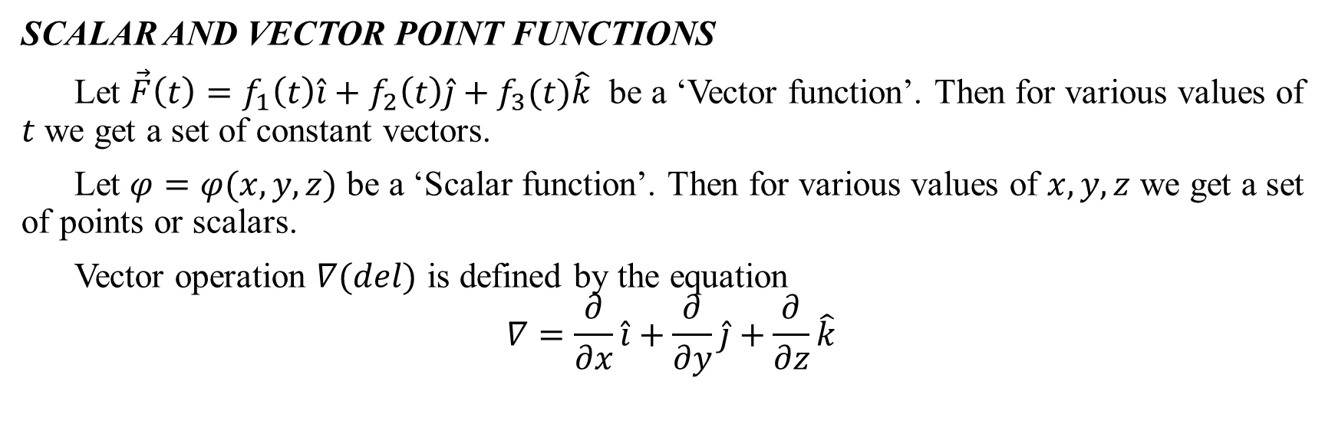
VECTOR CALCULUS
Vector calculus is a field of mathematics concerned with multivariate real analysis of vectors in two or more dimensions. It consists of set of problems solving techniques very useful for engineering and physics.
SCALAR AND VECTOR POINT FUNCTIONS
Let $\vec{F}\left(t\right)=f_{1}\left(t\right)\hat{i}+f_{2}\left(t\right)\hat{j}+f_{3}(t)\hat{k}$ be a ‘Vector function’. Then for various values of $t$ we get a set of constant vectors.
Let $φ=φ(x,y,z)$ be a ‘Scalar function’. Then for various values of $x,y,z$ we get a set of points or scalars.
Vector operation $∇(del)$ is defined by the equation
$$∇=\frac{∂}{∂x}\hat{i}+\frac{∂}{∂y}\hat{j}+\frac{∂}{∂z}\hat{k}$$

Slide 7
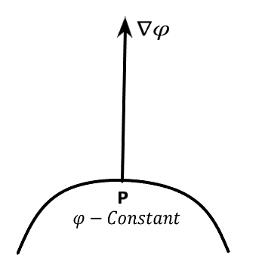
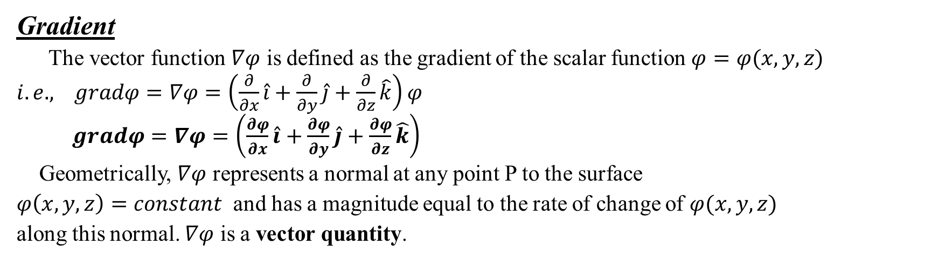
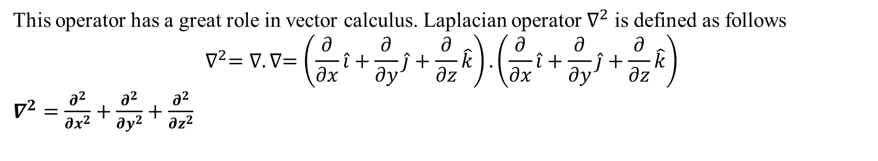
This operator has a great role in vector calculus. Laplacian operator $∇^{2}$ is defined as follows
$$∇^{2}=∇.∇=\left(\frac{∂}{∂x}\hat{i}+\frac{∂}{∂y}\hat{j}+\frac{∂}{∂z}\hat{k}\right).\left(\frac{∂}{∂x}\hat{i}+\frac{∂}{∂y}\hat{j}+\frac{∂}{∂z}\hat{k}\right)$$
$∇^{2}=\frac{∂^{2}}{{∂x}^{2}}+\frac{∂^{2}}{{∂y}^{2}}+\frac{∂^{2}}{{∂z}^{2}}$
Gradient
The vector function $∇φ$ is defined as the gradient of the scalar function $φ=φ(x,y,z)$
$i.e.,$ $gradφ=∇φ=\left(\frac{∂}{∂x}\hat{i}+\frac{∂}{∂y}\hat{j}+\frac{∂}{∂z}\hat{k}\right)φ$
$gradφ=∇φ=\left(\frac{∂φ}{∂x}\hat{i}+\frac{∂φ}{∂y}\hat{j}+\frac{∂φ}{∂z}\hat{k}\right)$
Geometrically, $∇φ$ represents a normal at any point P to the surface
$φ\left(x,y,z\right)=constant$ and has a magnitude equal to the rate of change of $φ(x,y,z)$
along this normal. $∇φ$ is a vector quantity.

Slide 8
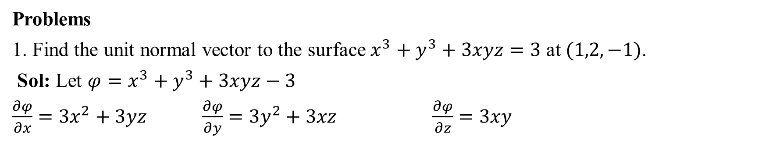
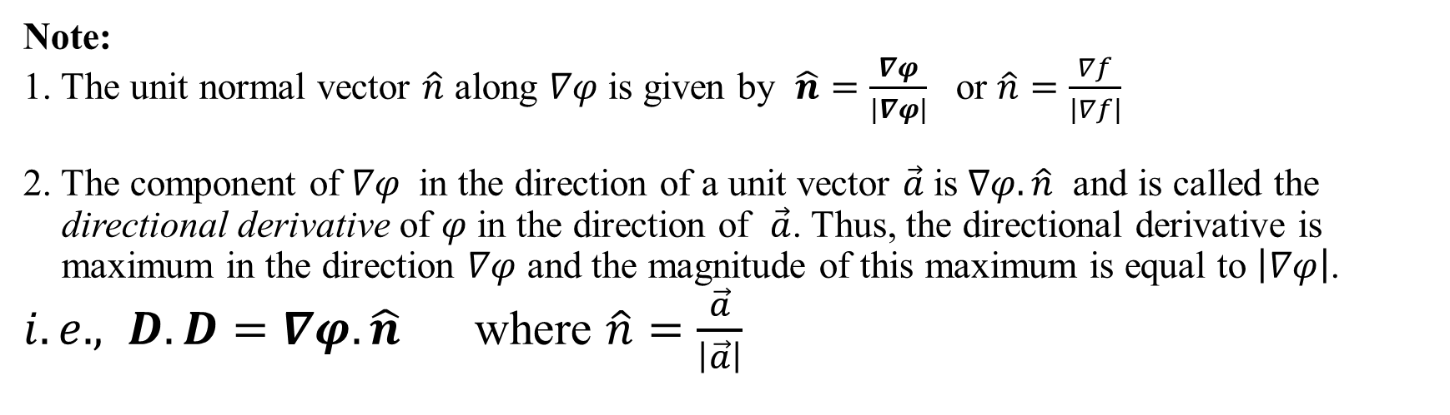
Note:
1. The unit normal vector $\hat{n}$ along $∇φ$ is given by $\hat{n}=\frac{∇φ}{\left|∇φ\right|}$ or $\hat{n}=\frac{∇f}{\left|∇f\right|}$
2. The component of $∇φ$ in the direction of a unit vector $\vec{a}$is $∇φ.\hat{n}$ and is called the directional derivative of $φ$ in the direction of $\vec{a}$. Thus, the directional derivative is maximum in the direction $∇φ$ and the magnitude of this maximum is equal to $\left|∇φ\right|$.
$i.e.,$ $D.D=∇φ.\hat{n}$ where $\hat{n}=\frac{\vec{a}}{\left|\vec{a}\right|}$
Problems
1. Find the unit normal vector to the surface $x^{3}+y^{3}+3xyz=3$ at $(1,2,−1)$.
Sol: Let ${φ=x}^{3}+y^{3}+3xyz−3$
$\frac{∂φ}{∂x}=3x^{2}+3yz$ $\frac{∂φ}{∂y}=3y^{2}+3xz$ $\frac{∂φ}{∂z}=3xy$

Slide 9
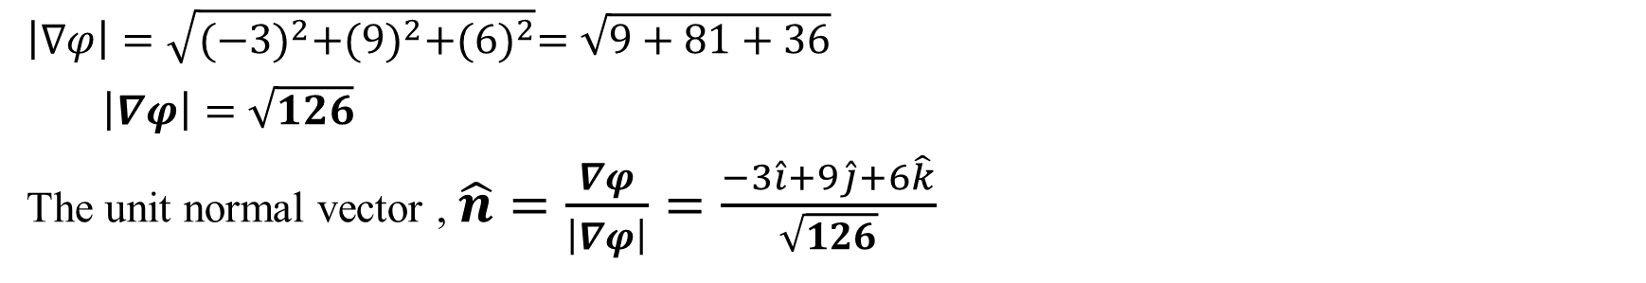
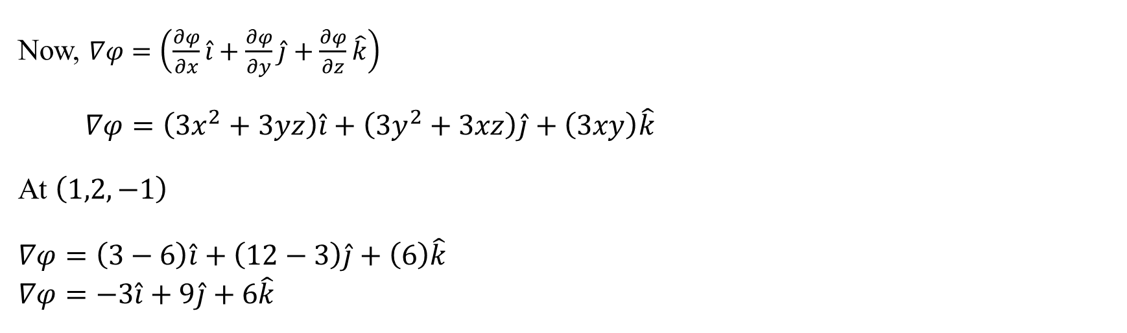
Now, $∇φ=\left(\frac{∂φ}{∂x}\hat{i}+\frac{∂φ}{∂y}\hat{j}+\frac{∂φ}{∂z}\hat{k}\right)$
$∇φ=\left(3x^{2}+3yz\right)\hat{i}+\left(3y^{2}+3xz\right)\hat{j}+\left(3xy\right)\hat{k}$
At $\left(1,2,−1\right)$
$$∇φ=\left(3−6\right)\hat{i}+\left(12−3\right)\hat{j}+\left(6\right)\hat{k}$$
$$∇φ=−3\hat{i}+9\hat{j}+6\hat{k}$$
$$\left|∇φ\right|=\sqrt{{(−3)}^{2}+{(9)}^{2}+{(6)}^{2}}=\sqrt{9+81+36}$$
$\left|∇φ\right|=\sqrt{126}$
The unit normal vector , $\hat{n}=\frac{∇φ}{\left|∇φ\right|}=\frac{−3\hat{i}+9\hat{j}+6\hat{k}}{\sqrt{126}}$

Slide 10
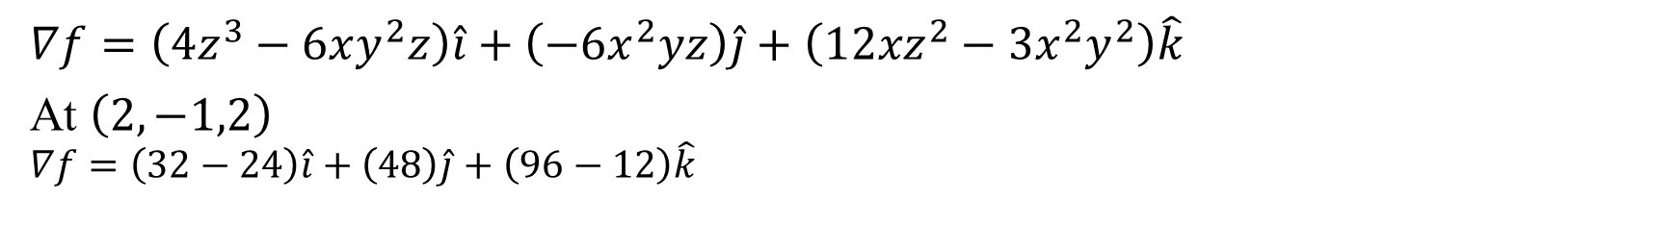
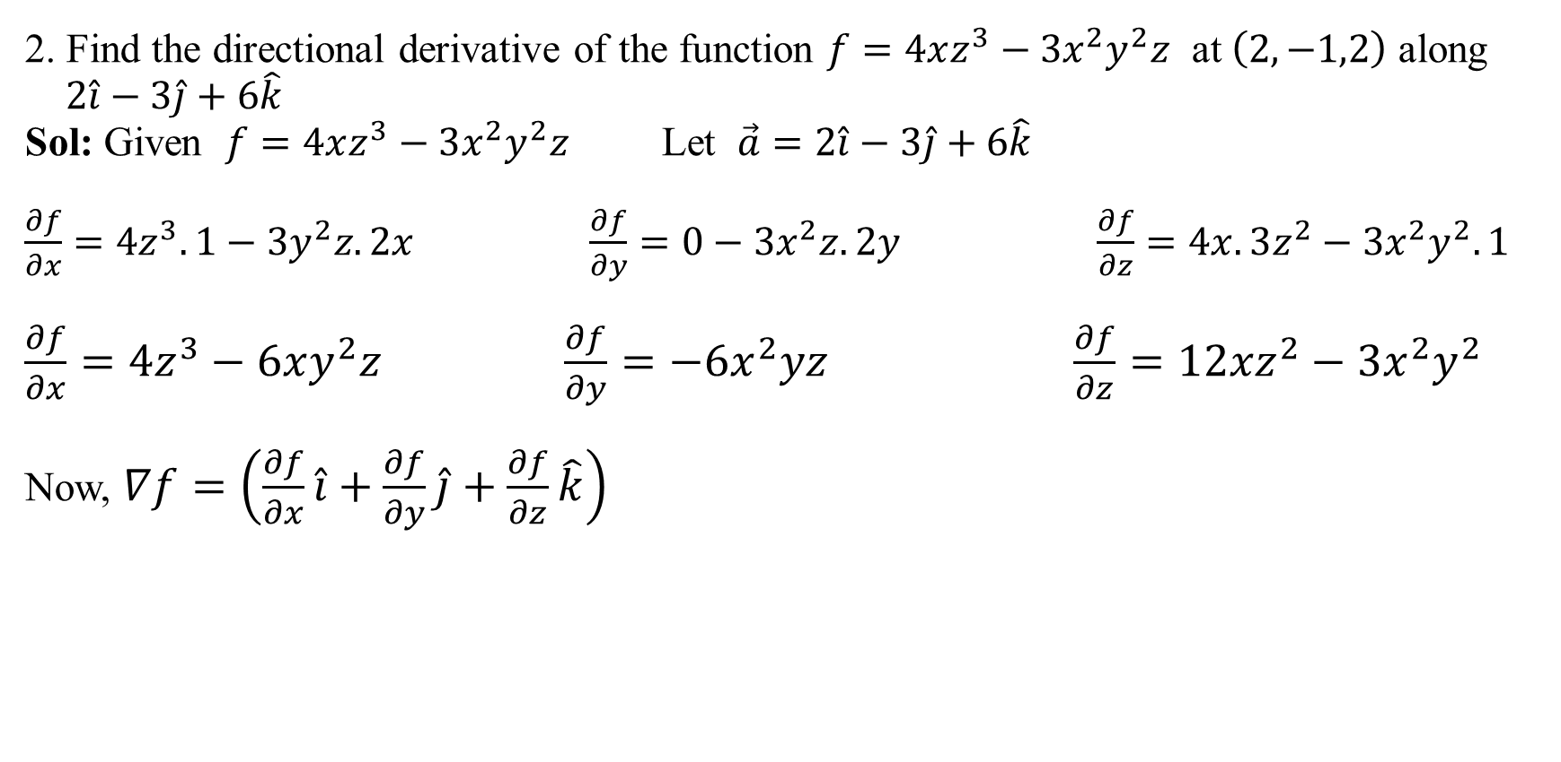
2. Find the directional derivative of the function $f=4xz^{3}−3x^{2}y^{2}z$ at $\left(2,−1,2\right)$ along
$2\hat{i}−3\hat{j}+6\hat{k}$
Sol: Given $f=4xz^{3}−3x^{2}y^{2}z$ Let $\vec{a}=2\hat{i}−3\hat{j}+6\hat{k}$
$\frac{∂f}{∂x}=4z^{3}.1−3y^{2}z.2x$ $\frac{∂f}{∂y}=0−3x^{2}z.2y$ $\frac{∂f}{∂z}=4x.3z^{2}−3x^{2}y^{2}.1$
$\frac{∂f}{∂x}=4z^{3}−6xy^{2}z \frac{∂f}{∂y}=−6x^{2}yz$ $\frac{∂f}{∂z}=12{xz}^{2}−3x^{2}y^{2}$
Now, $∇f=\left(\frac{∂f}{∂x}\hat{i}+\frac{∂f}{∂y}\hat{j}+\frac{∂f}{∂z}\hat{k}\right)$
$$∇f=\left(4z^{3}−6xy^{2}z\right)\hat{i}+\left(−6x^{2}yz\right)\hat{j}+\left(12{xz}^{2}−3x^{2}y^{2}\right)\hat{k}$$
At $\left(2,−1,2\right)$
$$∇f=\left(32−24\right)\hat{i}+\left(48\right)\hat{j}+\left(96−12\right)\hat{k}$$

Slide 11
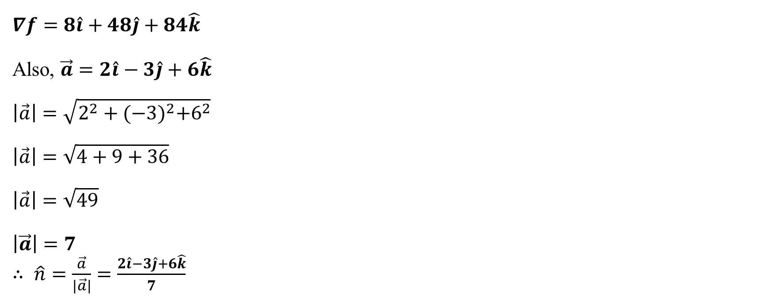
$$∇f=8\hat{i}+48\hat{j}+84\hat{k}$$
Also, $\vec{a}=2\hat{i}−3\hat{j}+6\hat{k}$
$$\left|\vec{a}\right|=\sqrt{2^{2}+{(−3)}^{2}+6^{2}}$$
$$\left|\vec{a}\right|=\sqrt{4+9+36}$$
$$\left|\vec{a}\right|=\sqrt{49}$$
$$\left|\vec{a}\right|=7$$
$∴$ $\hat{n}=\frac{\vec{a}}{\left|\vec{a}\right|}=\frac{2\hat{i}−3\hat{j}+6\hat{k}}{7}$
$$D.D=∇f.\hat{n}$$

Slide 12
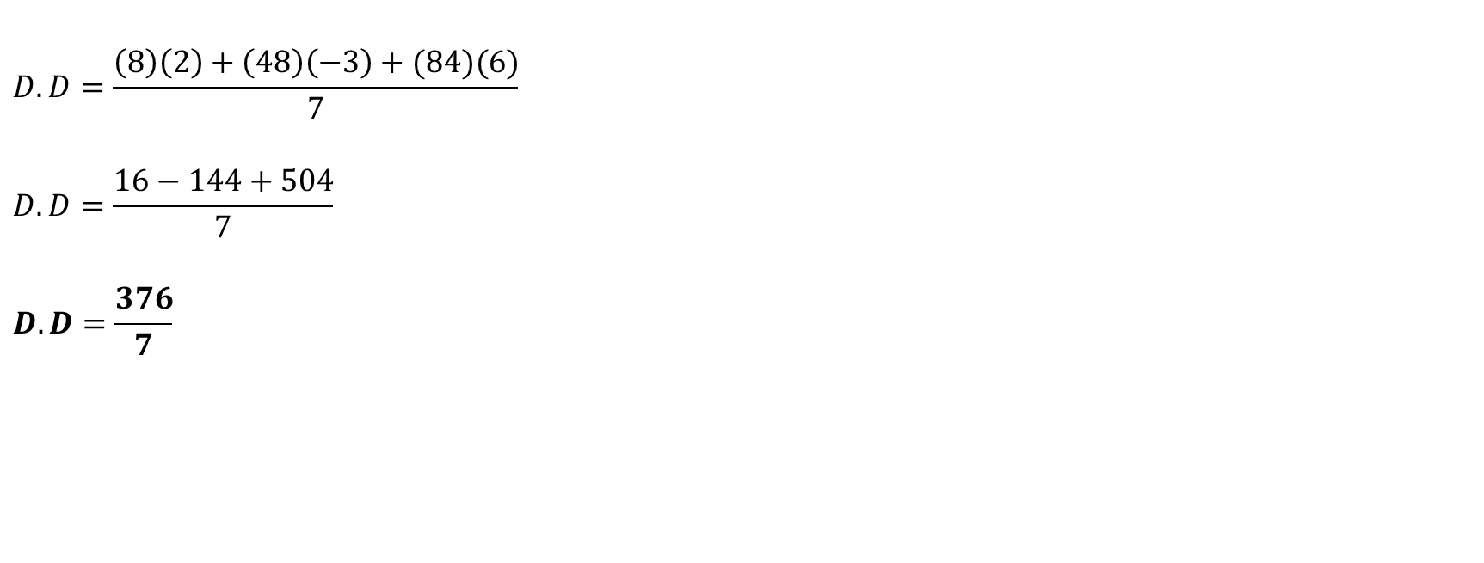
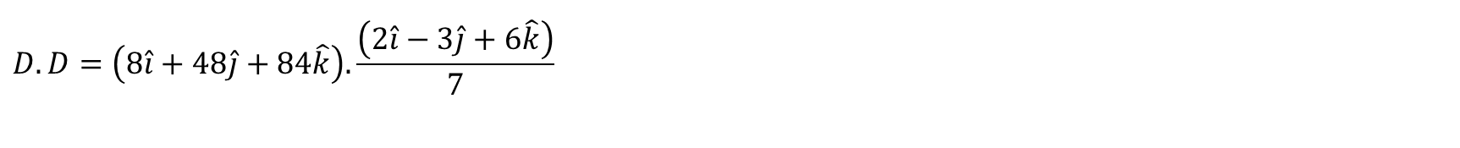
$$D.D=\left(8\hat{i}+48\hat{j}+84\hat{k}\right).\frac{\left(2\hat{i}−3\hat{j}+6\hat{k}\right)}{7}$$
$$D.D=\frac{\left(8\right)\left(2\right)+\left(48\right)\left(−3\right)+(84)(6)}{7}$$
$$D.D=\frac{16−144+504}{7}$$
$$D.D=\frac{376}{7}$$

Slide 13
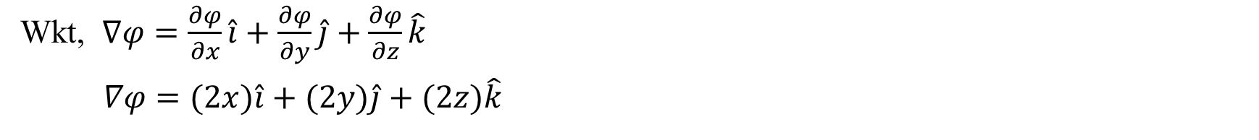
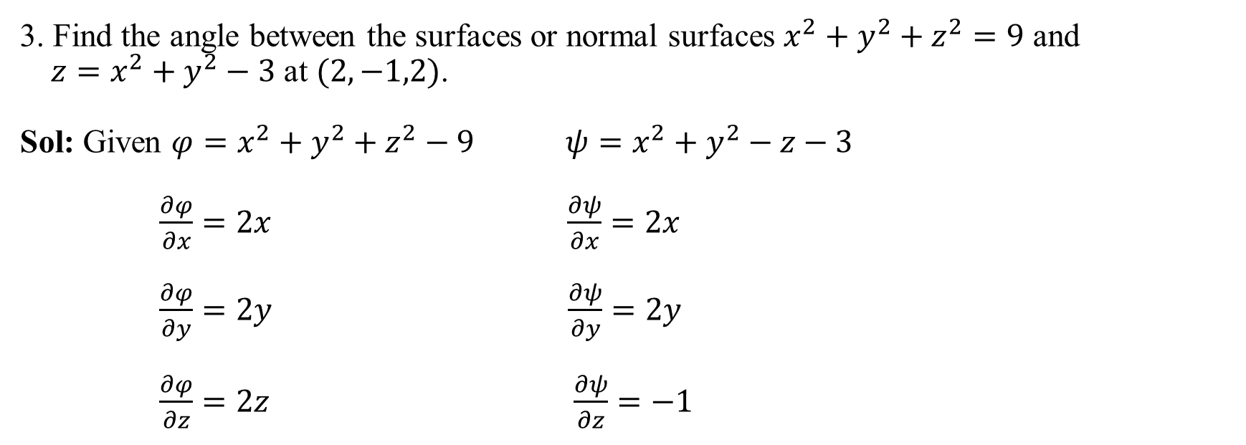
3. Find the angle between the surfaces or normal surfaces $x^{2}+y^{2}+z^{2}=9$ and
$z=x^{2}+y^{2}−3$ at $(2,−1,2)$.
Sol: Given $φ=x^{2}+y^{2}+z^{2}−9$ $ψ=x^{2}+y^{2}−z−3$
$\frac{∂φ}{∂x}=2x$ $\frac{∂ψ}{∂x}=2x$
$\frac{∂φ}{∂y}=2y$ $\frac{∂ψ}{∂y}=2y$
$\frac{∂φ}{∂z}=2z$ $\frac{∂ψ}{∂z}=−1$
Wkt, $∇φ=\frac{∂φ}{∂x}\hat{i}+\frac{∂φ}{∂y}\hat{j}+\frac{∂φ}{∂z}\hat{k}$
$∇φ=(2x)\hat{i}+(2y)\hat{j}+(2z)\hat{k}$

Slide 14
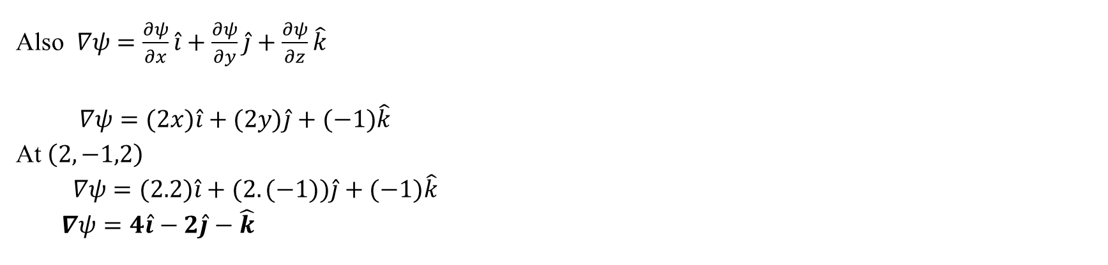
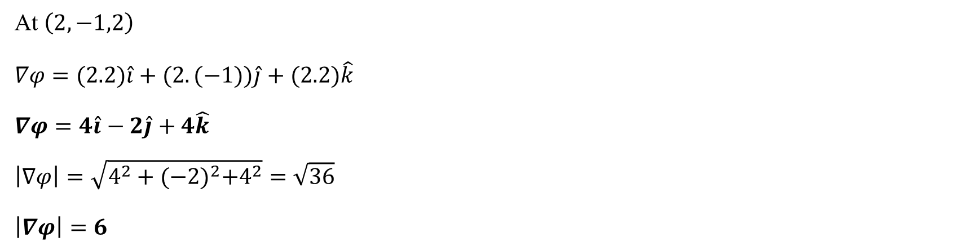
At $\left(2,−1,2\right)$
$$∇φ=(2.2)\hat{i}+(2.(−1))\hat{j}+(2.2)\hat{k}$$
$$∇φ=4\hat{i}−2\hat{j}+4\hat{k}$$
$$\left|∇φ\right|=\sqrt{4^{2}+{(−2)}^{2}+4^{2}}=\sqrt{36}$$
$$\left|∇φ\right|=6$$
Also $∇ψ=\frac{∂ψ}{∂x}\hat{i}+\frac{∂ψ}{∂y}\hat{j}+\frac{∂ψ}{∂z}\hat{k}$
$∇ψ=(2x)\hat{i}+(2y)\hat{j}+(−1)\hat{k}$
At $\left(2,−1,2\right)$
$∇ψ=(2.2)\hat{i}+(2.(−1))\hat{j}+(−1)\hat{k}$
$∇ψ=4\hat{i}−2\hat{j}−\hat{k}$

Slide 15
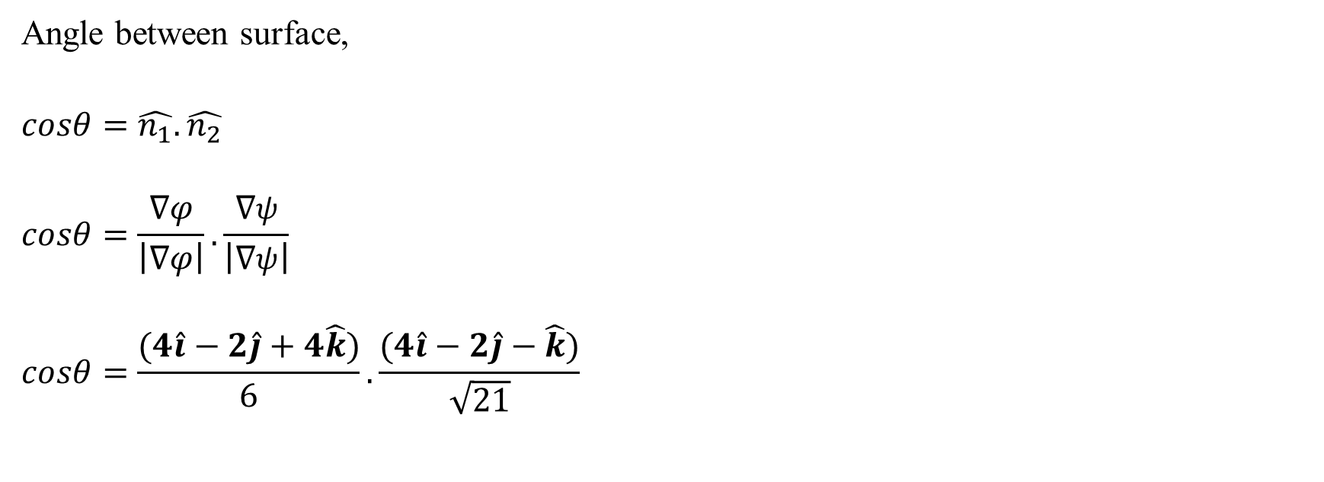
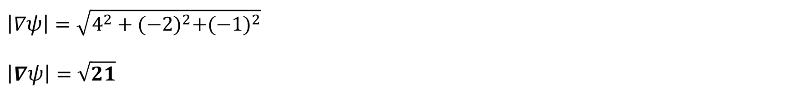
$$\left|∇ψ\right|=\sqrt{4^{2}+{(−2)}^{2}+{(−1)}^{2}}$$
$$\left|∇ψ\right|=\sqrt{21}$$
Angle between surface,
$$cosθ=\hat{n_{1}}.\hat{n_{2}}$$
$$cosθ=\frac{∇φ}{\left|∇φ\right|}.\frac{∇ψ}{\left|∇ψ\right|}$$
$$cosθ=\frac{(4\hat{i}−2\hat{j}+4\hat{k})}{6}.\frac{(4\hat{i}−2\hat{j}−\hat{k})}{\sqrt{21}}$$

Slide 16
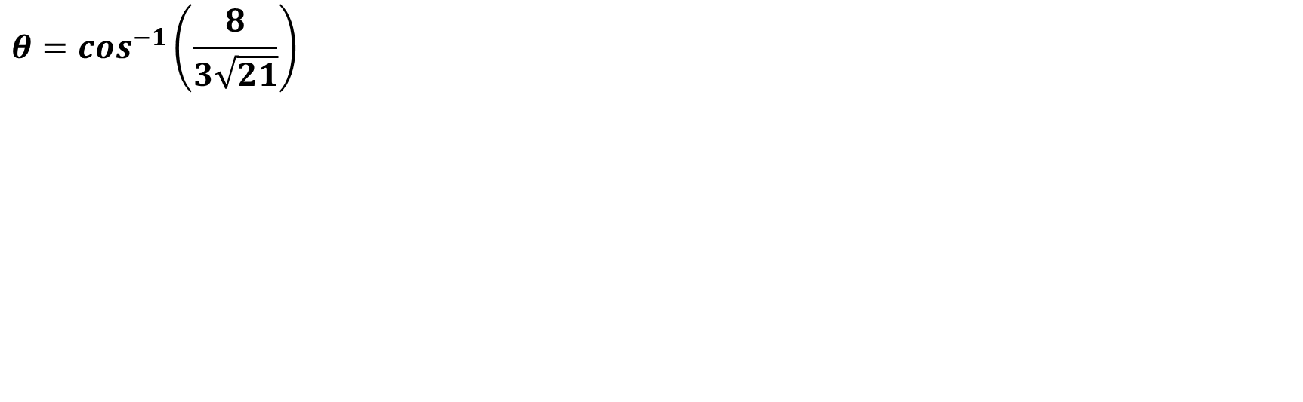
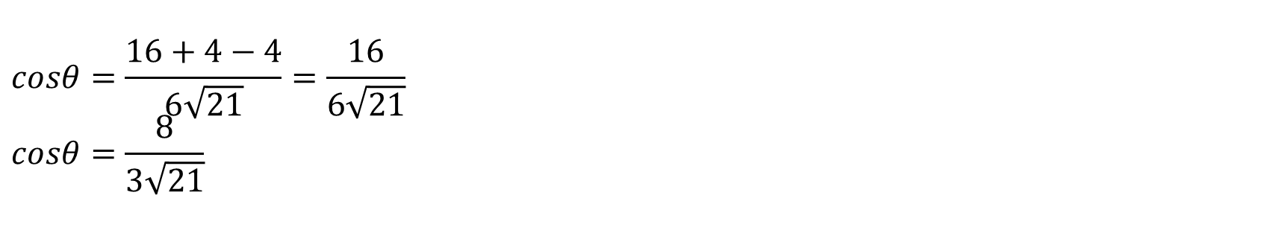
$$cosθ=\frac{16+4−4}{6\sqrt{21}}=\frac{16}{6\sqrt{21}} \\ cosθ=\frac{8}{3\sqrt{21}}$$
$$θ=\cos^{−1}\left(\frac{8}{3\sqrt{21}}\right)$$

Slide 17
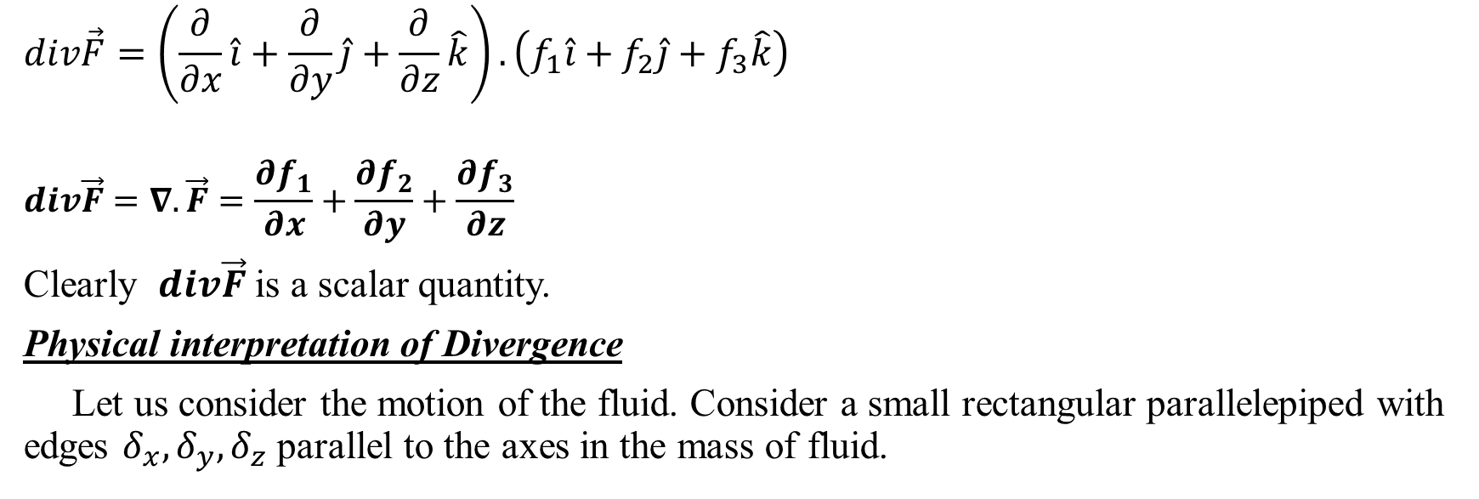
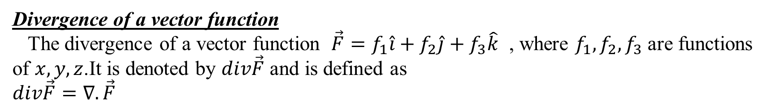
Divergence of a vector function
The divergence of a vector function $\vec{F}=f_{1}\hat{i}+f_{2}\hat{j}+f_{3}\hat{k}$ , where $f_{1},f_{2},f_{3}$ are functions of $x,y,z$.It is denoted by $div\vec{F}$ and is defined as
$$div\vec{F}=∇.\vec{F}$$
$$div\vec{F}=\left(\frac{∂}{∂x}\hat{i}+\frac{∂}{∂y}\hat{j}+\frac{∂}{∂z}\hat{k}\right).\left(f_{1}\hat{i}+f_{2}\hat{j}+f_{3}\hat{k}\right)$$
$$div\vec{F}=∇.\vec{F}=\frac{∂f_{1}}{∂x}+\frac{∂f_{2}}{∂y}+\frac{∂f_{3}}{∂z}$$
Clearly $div\vec{F}$ is a scalar quantity.
Physical interpretation of Divergence
Let us consider the motion of the fluid. Consider a small rectangular parallelepiped with edges $δ_{x},δ_{y},δ_{z}$ parallel to the axes in the mass of fluid.

Slide 18
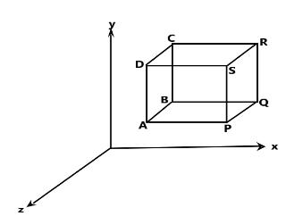
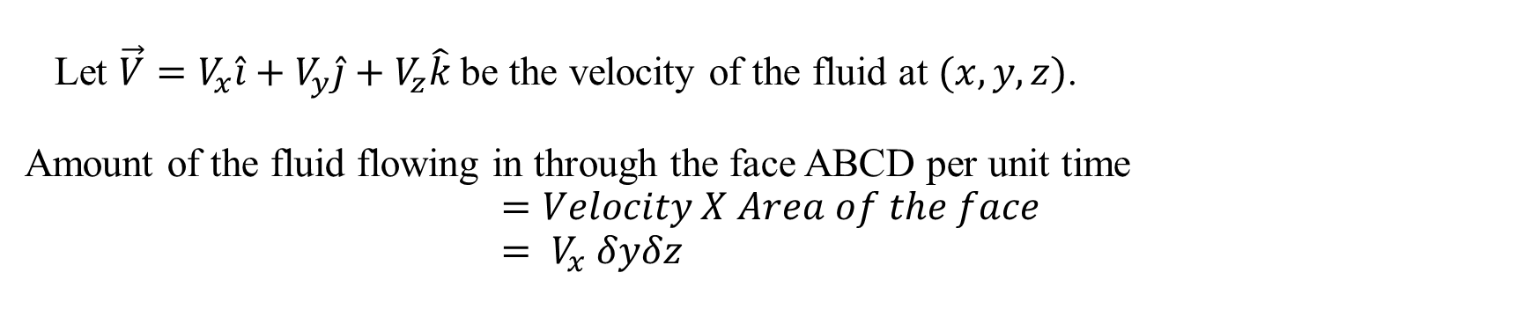
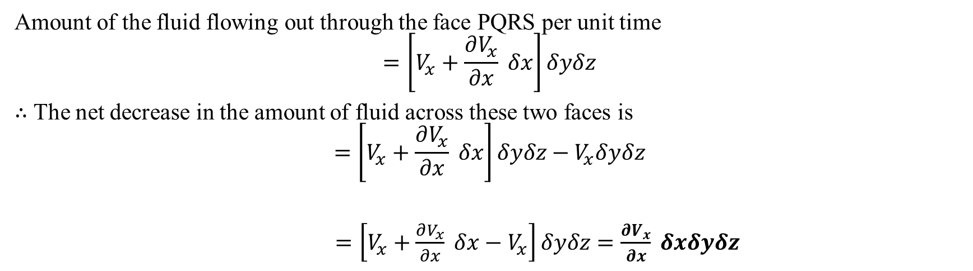
Let $\vec{V}=V_{x}\hat{i}+V_{y}\hat{j}+V_{z}\hat{k}$ be the velocity of the fluid at $(x,y,z)$.
Amount of the fluid flowing in through the face ABCD per unit time
$$=Velocity X Area of the face \\ = V_{x} δyδz$$
Amount of the fluid flowing out through the face PQRS per unit time
$$=\left[V_{x}+\frac{∂V_{x}}{∂x} δx\right]δyδz$$
$∴$ The net decrease in the amount of fluid across these two faces is
$$=\left[V_{x}+\frac{∂V_{x}}{∂x} δx\right]δyδz−V_{x}δyδz$$
$=\left[V_{x}+\frac{∂V_{x}}{∂x} δx−V_{x}\right]δyδz$ $=\frac{∂V_{x}}{∂x} δxδyδz$

Slide 19
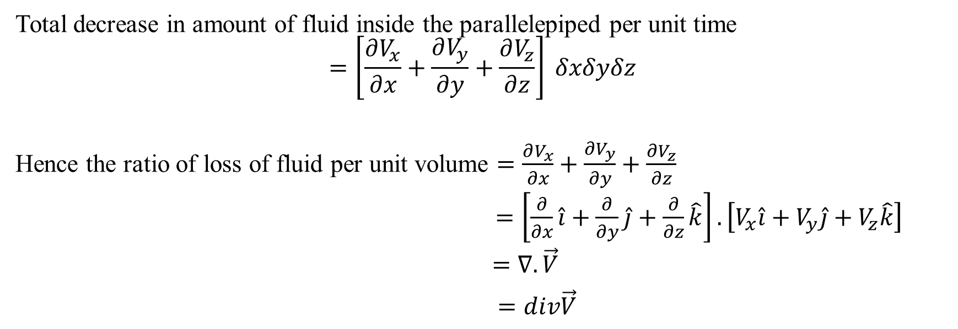
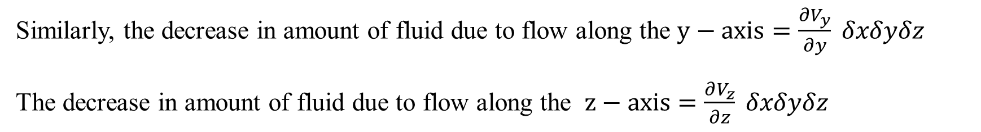
Similarly, the decrease in amount of fluid due to flow along the $y−axis=\frac{∂V_{y}}{∂y} δxδyδz$
The decrease in amount of fluid due to flow along the $z−axis=\frac{∂V_{z}}{∂z} δxδyδz$
Total decrease in amount of fluid inside the parallelepiped per unit time
$$=\left[\frac{∂V_{x}}{∂x}+\frac{∂V_{y}}{∂y}+\frac{∂V_{z}}{∂z}\right] δxδyδz$$
Hence the ratio of loss of fluid per unit volume $=\frac{∂V_{x}}{∂x}+\frac{∂V_{y}}{∂y}+\frac{∂V_{z}}{∂z}$
$=\left[\frac{∂}{∂x}\hat{i}+\frac{∂}{∂y}\hat{j}+\frac{∂}{∂z}\hat{k}\right].\left[V_{x}\hat{i}+V_{y}\hat{j}+V_{z}\hat{k}\right]$
$=∇.\vec{V}$
$=div\vec{V}$

Slide 20
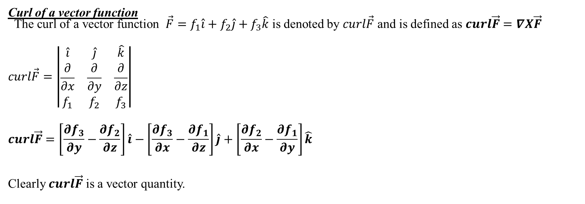
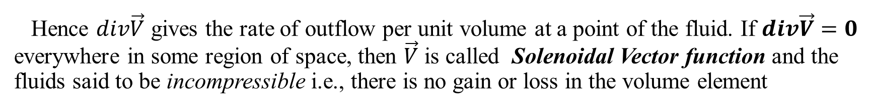
Hence $div\vec{V}$ gives the rate of outflow per unit volume at a point of the fluid. If $div\vec{V}=0$ everywhere in some region of space, then $\vec{V}$ is called Solenoidal Vector function and the fluids said to be incompressible i.e., there is no gain or loss in the volume element
Curl of a vector function
The curl of a vector function $\vec{F}=f_{1}\hat{i}+f_{2}\hat{j}+f_{3}\hat{k}$ is denoted by $curl\vec{F}$ and is defined as $curl\vec{F}=∇X\vec{F}$
$$curl\vec{F}=\left|\begin{matrix}\hat{i} & \hat{j} & \hat{k} \\ \frac{∂}{∂x} & \frac{∂}{∂y} & \frac{∂}{∂z} \\ f_{1} & f_{2} & f_{3}\end{matrix}\right|$$
$$curl\vec{F}=\left[\frac{∂f_{3}}{∂y}−\frac{∂f_{2}}{∂z}\right]\hat{i}−\left[\frac{∂f_{3}}{∂x}−\frac{∂f_{1}}{∂z}\right]\hat{j}+\left[\frac{∂f_{2}}{∂x}−\frac{∂f_{1}}{∂y}\right]\hat{k}$$
Clearly $curl\vec{F}$ is a vector quantity.

Slide 21
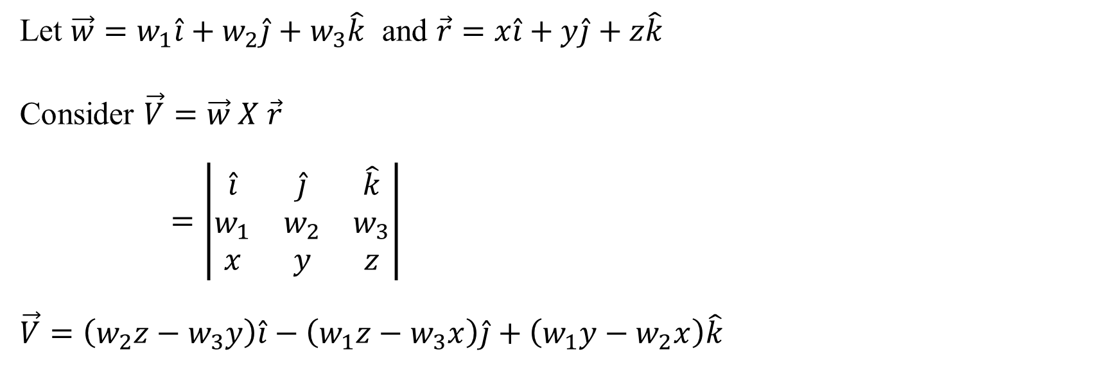
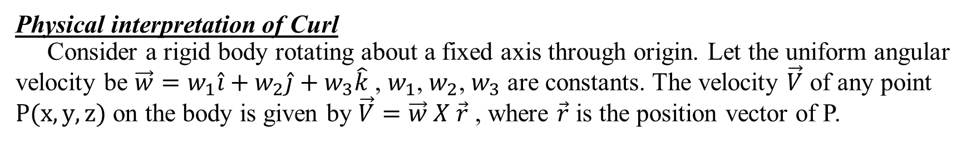
Physical interpretation of Curl
Consider a rigid body rotating about a fixed axis through origin. Let the uniform angular velocity be $\vec{w}=w_{1}\hat{i}+w_{2}\hat{j}+w_{3}\hat{k}$ , $w_{1}$, $w_{2}$, $w_{3}$ are constants. The velocity $\vec{V}$ of any point $P(x,y,z)$ on the body is given by $\vec{V}=\vec{w} X \vec{r}$ , where $\vec{r}$ is the position vector of P.
Let $\vec{w}=w_{1}\hat{i}+w_{2}\hat{j}+w_{3}\hat{k}$ and $\vec{r}=x\hat{i}+y\hat{j}+z\hat{k}$
Consider $\vec{V}=\vec{w} X \vec{r}$
$=\left|\begin{matrix}\hat{i} & \hat{j} & \hat{k} \\ w_{1} & w_{2} & w_{3} \\ x & y & z\end{matrix}\right|$
$$\vec{V}=\left(w_{2}z−w_{3}y\right)\hat{i}−\left(w_{1}z−w_{3}x\right)\hat{j}+\left(w_{1}y−w_{2}x\right)\hat{k}$$

Slide 22
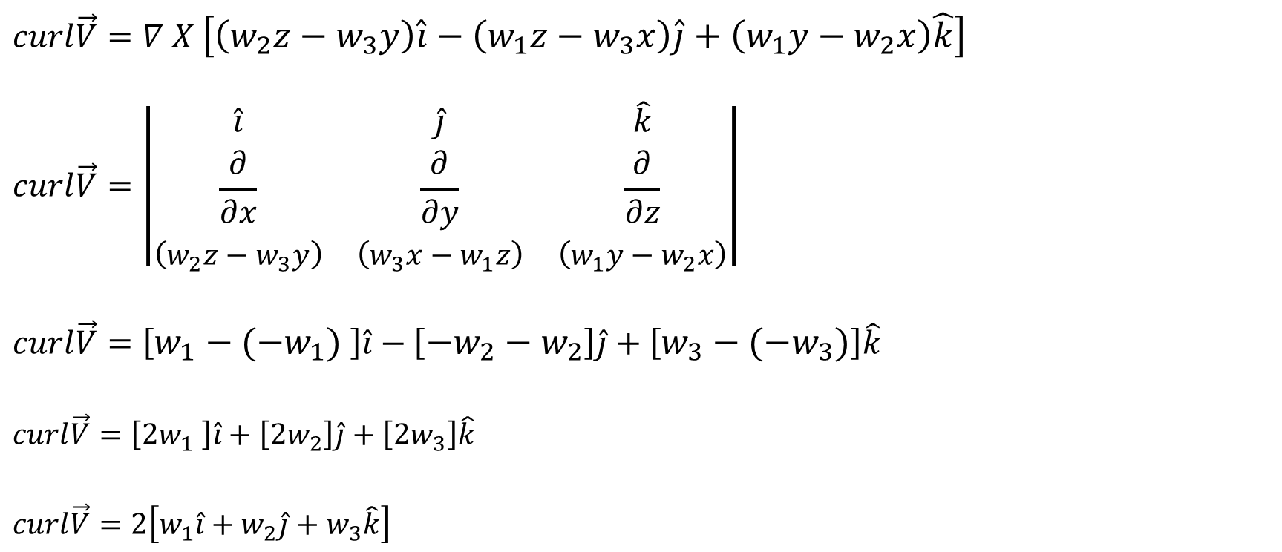
$$curl\vec{V}=∇X\vec{V}$$
$$curl\vec{V}=∇ X \left[\left(w_{2}z−w_{3}y\right)\hat{i}−\left(w_{1}z−w_{3}x\right)\hat{j}+\left(w_{1}y−w_{2}x\right)\hat{k}\right]$$
$$curl\vec{V}=\left|\begin{matrix}\hat{i} & \hat{j} & \hat{k} \\ \frac{∂}{∂x} & \frac{∂}{∂y} & \frac{∂}{∂z} \\ \left(w_{2}z−w_{3}y\right) & \left(w_{3}x−w_{1}z\right) & \left(w_{1}y−w_{2}x\right)\end{matrix}\right|$$
$$curl\vec{V}=\left[w_{1}−(−w_{1}) \right]\hat{i}−\left[{−w}_{2}−w_{2}\right]\hat{j}+\left[w_{3}−(−w_{3})\right]\hat{k}$$
$$curl\vec{V}=\left[2w_{1} \right]\hat{i}+\left[{2w}_{2}\right]\hat{j}+\left[2w_{3}\right]\hat{k}$$
$$curl\vec{V}=2\left[w_{1}\hat{i}+w_{2}\hat{j}+w_{3}\hat{k}\right]$$

Slide 23
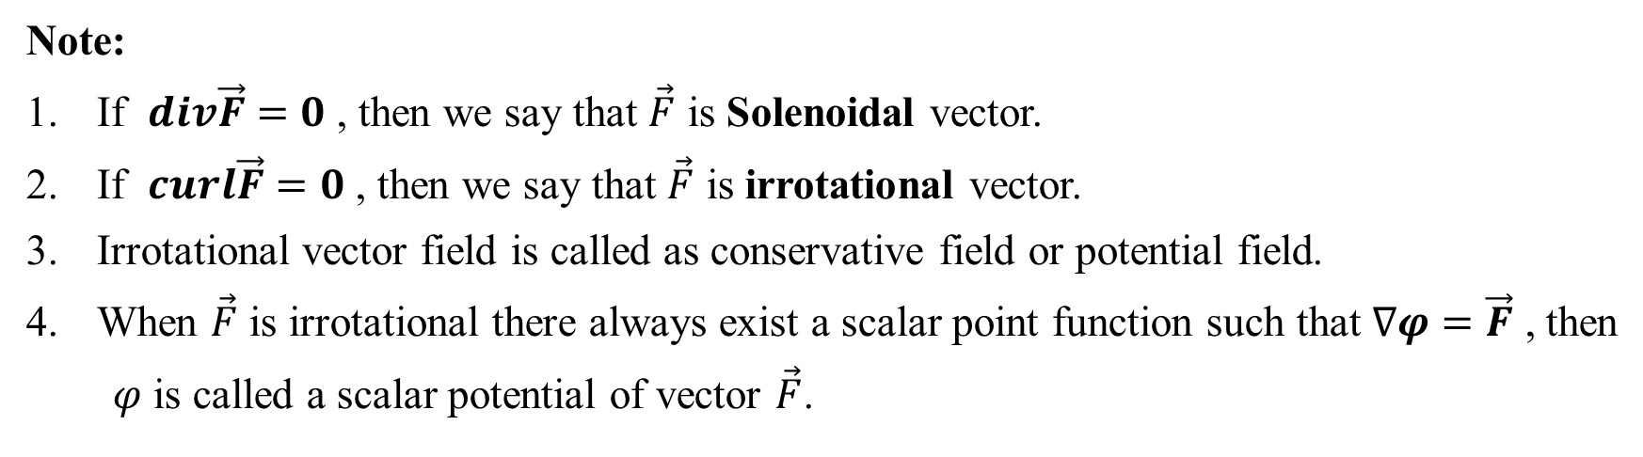
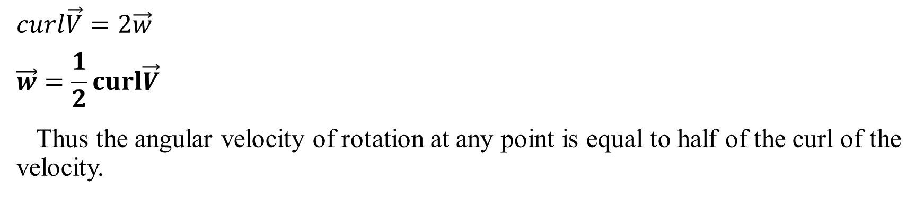
$$curl\vec{V}=2\vec{w}$$
$$\vec{w}=\frac{1}{2}curl\vec{V}$$
Thus the angular velocity of rotation at any point is equal to half of the curl of the velocity.
Note:
If $div\vec{F}=0$ , then we say that $\vec{F}$ is Solenoidal vector.
If $curl\vec{F}=0$ , then we say that $\vec{F}$ is irrotational vector.
Irrotational vector field is called as conservative field or potential field.
When $\vec{F}$ is irrotational there always exist a scalar point function such that $∇φ=\vec{F}$ , then
$φ$ is called a scalar potential of vector $\vec{F}$.

Slide 24
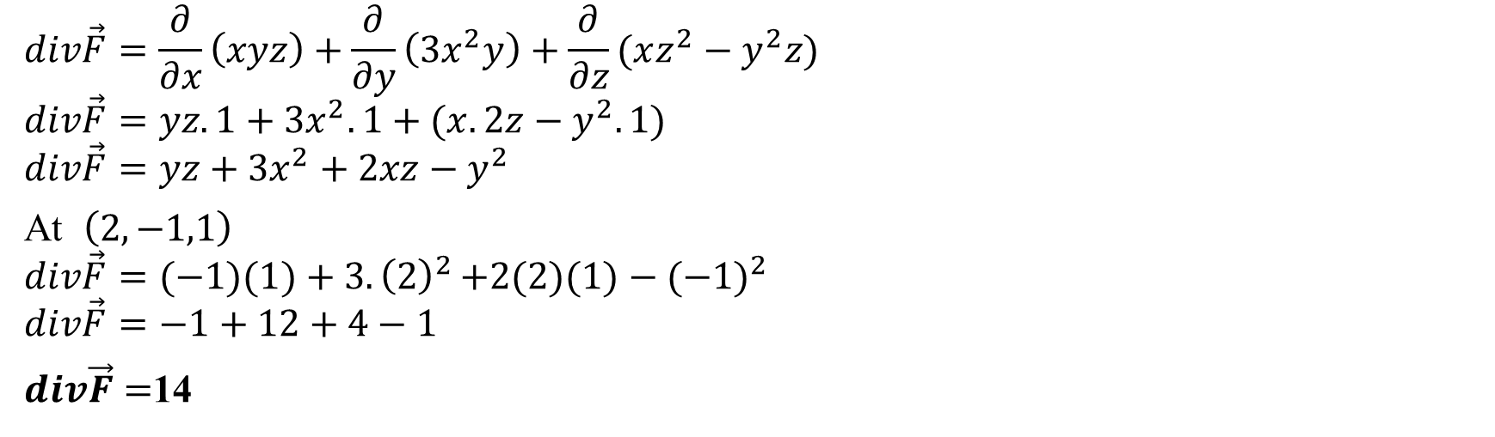
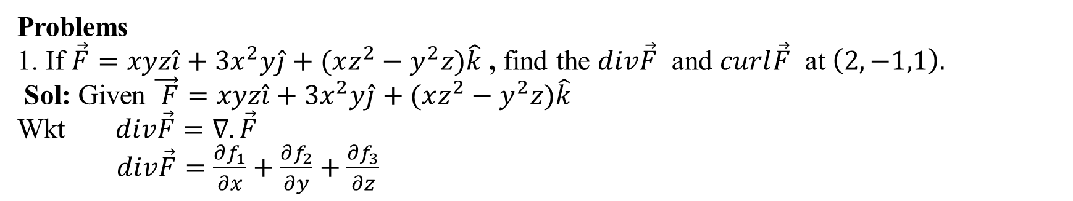
Problems
1. If $\vec{F}=xyz\hat{i}+3x^{2}y\hat{j}+(xz^{2}−y^{2}z)\hat{k}$ , find the $div\vec{F}$ and $curl\vec{F}$ at $\left(2,−1,1\right).$
Sol: Given $\vec{ F}=xyz\hat{i}+3x^{2}y\hat{j}+(xz^{2}−y^{2}z)\hat{k}$
Wkt $div\vec{F}=∇.\vec{F}$
$div\vec{F}=\frac{∂f_{1}}{∂x}+\frac{∂f_{2}}{∂y}+\frac{∂f_{3}}{∂z}$
$$div\vec{F}=\frac{∂}{∂x}\left(xyz\right)+\frac{∂}{∂y}\left({3x}^{2}y\right)+\frac{∂}{∂z}(xz^{2}−y^{2}z)$$
$$div\vec{F}=yz.1+3x^{2}.1+(x.2z−y^{2}.1)$$
$$div\vec{F}=yz+3x^{2}+2xz−y^{2}$$
At $\left(2,−1,1\right)$
$$div\vec{F}=(−1)(1)+3{.\left(2\right)}^{2}+2(2)(1)−{(−1)}^{2}$$
$$div\vec{F}=−1+12+4−1$$
$div\vec{F}=$14

Slide 25
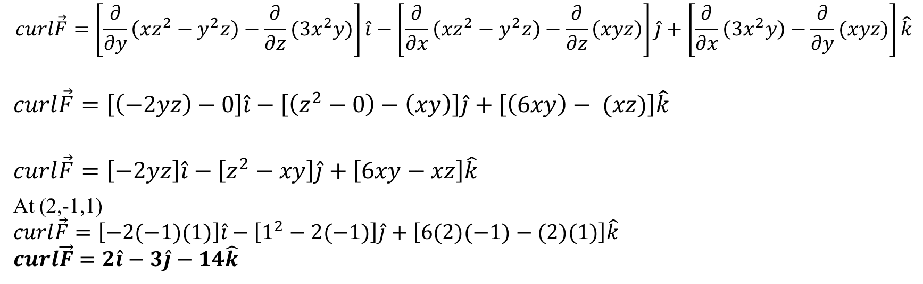
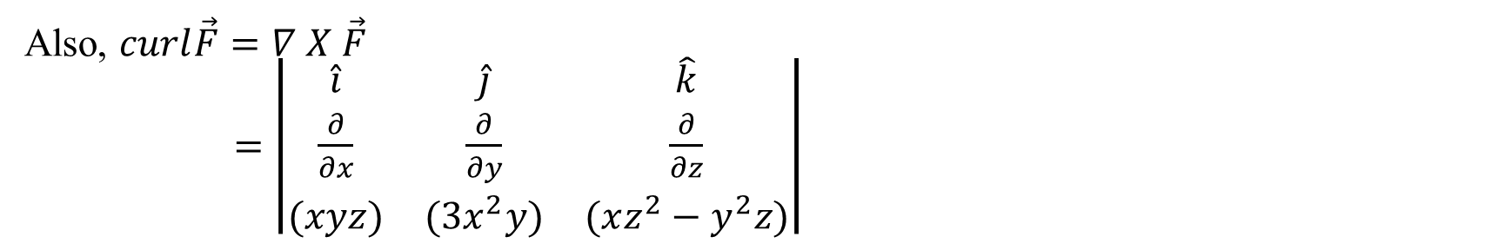
Also, $curl\vec{F}=∇ X \vec{F}$
$=\left|\begin{matrix}\hat{i} & \hat{j} & \hat{k} \\ \frac{∂}{∂x} & \frac{∂}{∂y} & \frac{∂}{∂z} \\ (xyz) & (3x^{2}y) & (xz^{2}−y^{2}z)\end{matrix}\right|$
$$curl\vec{F}=\left[\frac{∂}{∂y}\left(xz^{2}−y^{2}z\right)−\frac{∂}{∂z}(3x^{2}y)\right]\hat{i}−\left[\frac{∂}{∂x}\left(xz^{2}−y^{2}z\right)−\frac{∂}{∂z}\left(xyz\right)\right]\hat{j}+\left[\frac{∂}{∂x}\left(3x^{2}y\right)−\frac{∂}{∂y}(xyz)\right]\hat{k}$$
$$curl\vec{F}=\left[\left(−2yz\right)−0\right]\hat{i}−\left[\left(z^{2}−0\right)−\left(xy\right)\right]\hat{j}+\left[\left(6xy\right)− (xz)\right]\hat{k}$$
$$curl\vec{F}=\left[−2yz\right]\hat{i}−\left[z^{2}−xy\right]\hat{j}+\left[6xy−xz\right]\hat{k}$$
At (2,-1,1)
$$curl\vec{F}=\left[−2(−1)(1)\right]\hat{i}−\left[1^{2}−2(−1)\right]\hat{j}+\left[6(2)(−1)−(2)(1)\right]\hat{k}$$
$$curl\vec{F}=2\hat{i}−3\hat{j}−14\hat{k}$$

Slide 26
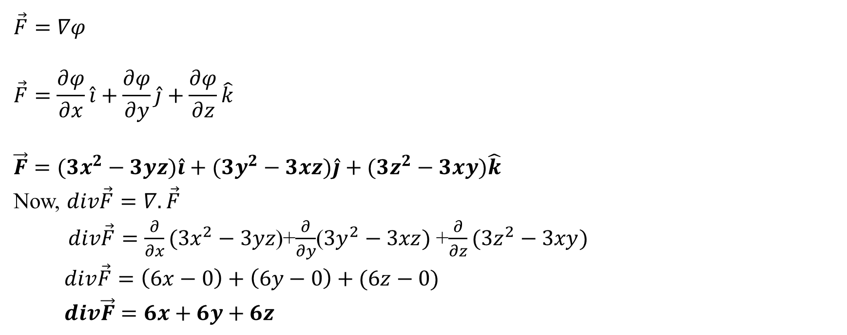
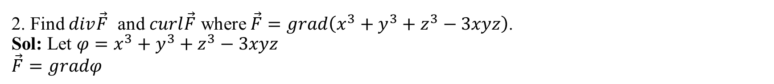
2. Find $div\vec{F}$ and $curl\vec{F}$ where $\vec{F}=grad\left(x^{3}+y^{3}+z^{3}−3xyz\right)$.
Sol: Let $φ=x^{3}+y^{3}+z^{3}−3xyz$
$$\vec{F}=gradφ$$
$$\vec{F}=∇φ$$
$$\vec{F}=\frac{∂φ}{∂x}\hat{i}+\frac{∂φ}{∂y}\hat{j}+\frac{∂φ}{∂z}\hat{k}$$
$$\vec{F}=(3x^{2}−3yz)\hat{i}+(3y^{2}−3xz)\hat{j}+(3z^{2}−3xy)\hat{k}$$
Now, $div\vec{F}=∇.\vec{F}$
$div\vec{F}=\frac{∂}{∂x}(3x^{2}−3yz$)+$\frac{∂}{∂y}$($3y^{2}−3xz)$+$\frac{∂}{∂z}(3z^{2}−3xy)$
$div\vec{F}=\left(6x−0\right)+\left(6y−0\right)+(6z−0)$
$div\vec{F}=6x+6y+6z$

Slide 27
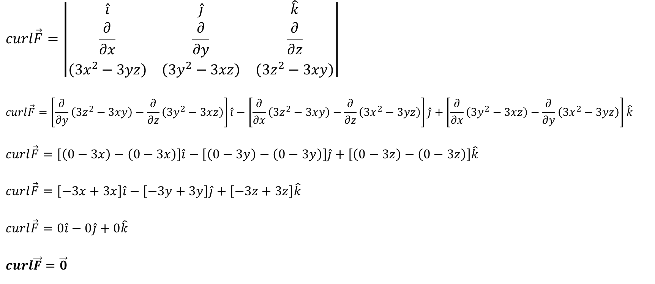
$$curl\vec{F}=∇ X \vec{F}$$
$$curl\vec{F}=\left|\begin{matrix}\hat{i} & \hat{j} & \hat{k} \\ \frac{∂}{∂x} & \frac{∂}{∂y} & \frac{∂}{∂z} \\ \left(3x^{2}−3yz\right) & \left(3y^{2}−3xz\right) & \left(3z^{2}−3xy\right)\end{matrix}\right|$$
$$curl\vec{F}=\left[\frac{∂}{∂y}\left(3z^{2}−3xy\right)−\frac{∂}{∂z}\left(3y^{2}−3xz\right)\right]\hat{i}−\left[\frac{∂}{∂x}\left(3z^{2}−3xy\right)−\frac{∂}{∂z}\left(3x^{2}−3yz\right)\right]\hat{j}+\left[\frac{∂}{∂x}\left(3y^{2}−3xz\right)−\frac{∂}{∂y}\left(3x^{2}−3yz\right)\right]\hat{k}$$
$$curl\vec{F}=\left[\left(0−3x\right)−\left(0−3x\right)\right]\hat{i}−\left[\left(0−3y\right)−\left(0−3y\right)\right]\hat{j}+\left[\left(0−3z\right)−\left(0−3z\right)\right]\hat{k}$$
$$curl\vec{F}=\left[−3x+3x\right]\hat{i}−\left[−3y+3y\right]\hat{j}+\left[−3z+3z\right]\hat{k}$$
$$curl\vec{F}=0\hat{i}−0\hat{j}+0\hat{k}$$
$$curl\vec{F}=\vec{0}$$

Slide 28
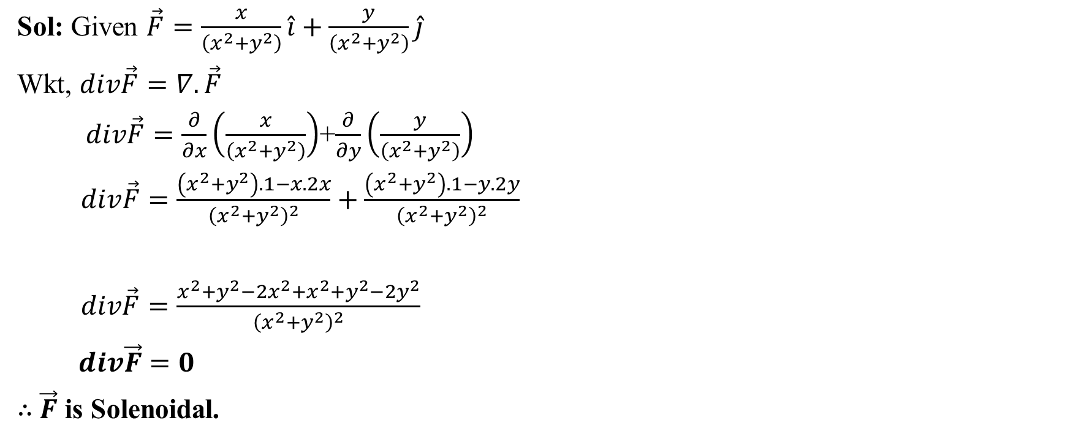
3. Show that $\vec{F}=\frac{x\hat{i}+y\hat{j}}{\left(x^{2}+y^{2}\right)}$ is both solenoidal and irrotational.
Sol: Given $\vec{F}=\frac{x}{\left(x^{2}+y^{2}\right)}\hat{i}+\frac{y}{\left(x^{2}+y^{2}\right)}\hat{j}$
Wkt, $div\vec{F}=∇.\vec{F}$
$div\vec{F}=\frac{∂}{∂x}\left(\frac{x}{\left(x^{2}+y^{2}\right)}\right)$+$\frac{∂}{∂y}\left(\frac{y}{\left(x^{2}+y^{2}\right)}\right)$
$div\vec{F}=\frac{\left(x^{2}+y^{2}\right).1−x.2x}{{\left(x^{2}+y^{2}\right)}^{2}}+\frac{\left(x^{2}+y^{2}\right).1−y.2y}{{\left(x^{2}+y^{2}\right)}^{2}}$
$div\vec{F}=\frac{x^{2}+y^{2}−{2x}^{2}+x^{2}+y^{2}−2y^{2}}{{\left(x^{2}+y^{2}\right)}^{2}}$
$div\vec{F}=0$
$∴$ $\vec{F}$ is Solenoidal.

Slide 29
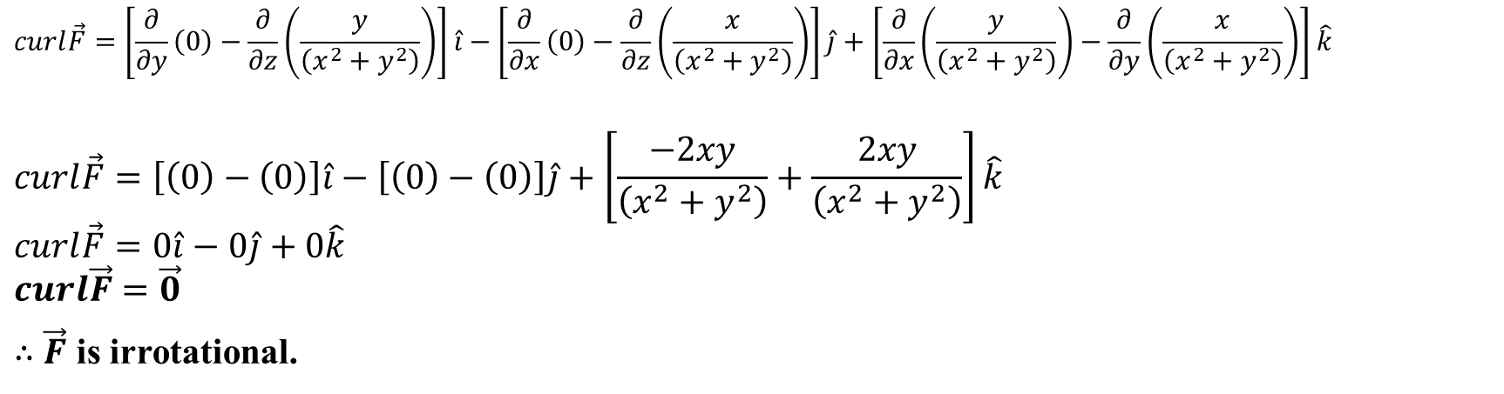
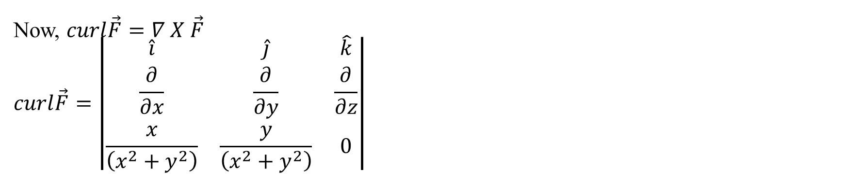
Now, $curl\vec{F}=∇ X \vec{F}$
$$curl\vec{F}=\left|\begin{matrix}\hat{i} & \hat{j} & \hat{k} \\ \frac{∂}{∂x} & \frac{∂}{∂y} & \frac{∂}{∂z} \\ \frac{x}{\left(x^{2}+y^{2}\right)} & \frac{y}{\left(x^{2}+y^{2}\right)} & 0\end{matrix}\right|$$
$$curl\vec{F}=\left[\frac{∂}{∂y}\left(0\right)−\frac{∂}{∂z}\left(\frac{y}{\left(x^{2}+y^{2}\right)}\right)\right]\hat{i}−\left[\frac{∂}{∂x}\left(0\right)−\frac{∂}{∂z}\left(\frac{x}{\left(x^{2}+y^{2}\right)}\right)\right]\hat{j}+\left[\frac{∂}{∂x}\left(\frac{y}{\left(x^{2}+y^{2}\right)}\right)−\frac{∂}{∂y}\left(\frac{x}{\left(x^{2}+y^{2}\right)}\right)\right]\hat{k}$$
$$curl\vec{F}=\left[\left(0\right)−\left(0\right)\right]\hat{i}−\left[\left(0\right)−\left(0\right)\right]\hat{j}+\left[\frac{−2xy}{\left(x^{2}+y^{2}\right)}+\frac{2xy}{\left(x^{2}+y^{2}\right)}\right]\hat{k}$$
$$curl\vec{F}=0\hat{i}−0\hat{j}+0\hat{k}$$
$$curl\vec{F}=\vec{0}$$
$∴$ $\vec{F}$ is irrotational.

Slide 30
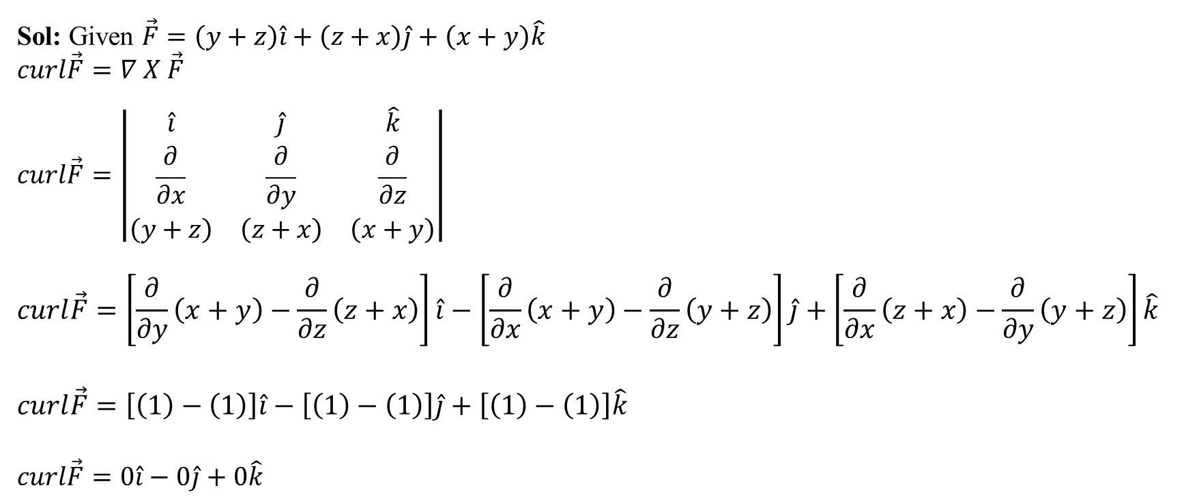
4. P.T $\vec{F}=\left(y+z\right)\hat{i}+\left(z+x\right)\hat{j}+\left(x+y\right)\hat{k}$ is irrotational. Also find a scalar point function
$φ$ such that $\vec{F}=∇φ.$
Sol: Given $\vec{F}=\left(y+z\right)\hat{i}+\left(z+x\right)\hat{j}+\left(x+y\right)\hat{k}$
$$curl\vec{F}=∇ X \vec{F}$$
$$curl\vec{F}=\left|\begin{matrix}\hat{i} & \hat{j} & \hat{k} \\ \frac{∂}{∂x} & \frac{∂}{∂y} & \frac{∂}{∂z} \\ \left(y+z\right) & \left(z+x\right) & \left(x+y\right)\end{matrix}\right|$$
$$curl\vec{F}=\left[\frac{∂}{∂y}\left(x+y\right)−\frac{∂}{∂z}\left(z+x\right)\right]\hat{i}−\left[\frac{∂}{∂x}\left(x+y\right)−\frac{∂}{∂z}\left(y+z\right)\right]\hat{j}+\left[\frac{∂}{∂x}\left(z+x\right)−\frac{∂}{∂y}\left(y+z\right)\right]\hat{k}$$
$$curl\vec{F}=\left[\left(1\right)−\left(1\right)\right]\hat{i}−\left[\left(1\right)−\left(1\right)\right]\hat{j}+\left[\left(1\right)−\left(1\right)\right]\hat{k}$$
$$curl\vec{F}=0\hat{i}−0\hat{j}+0\hat{k}$$

Slide 31
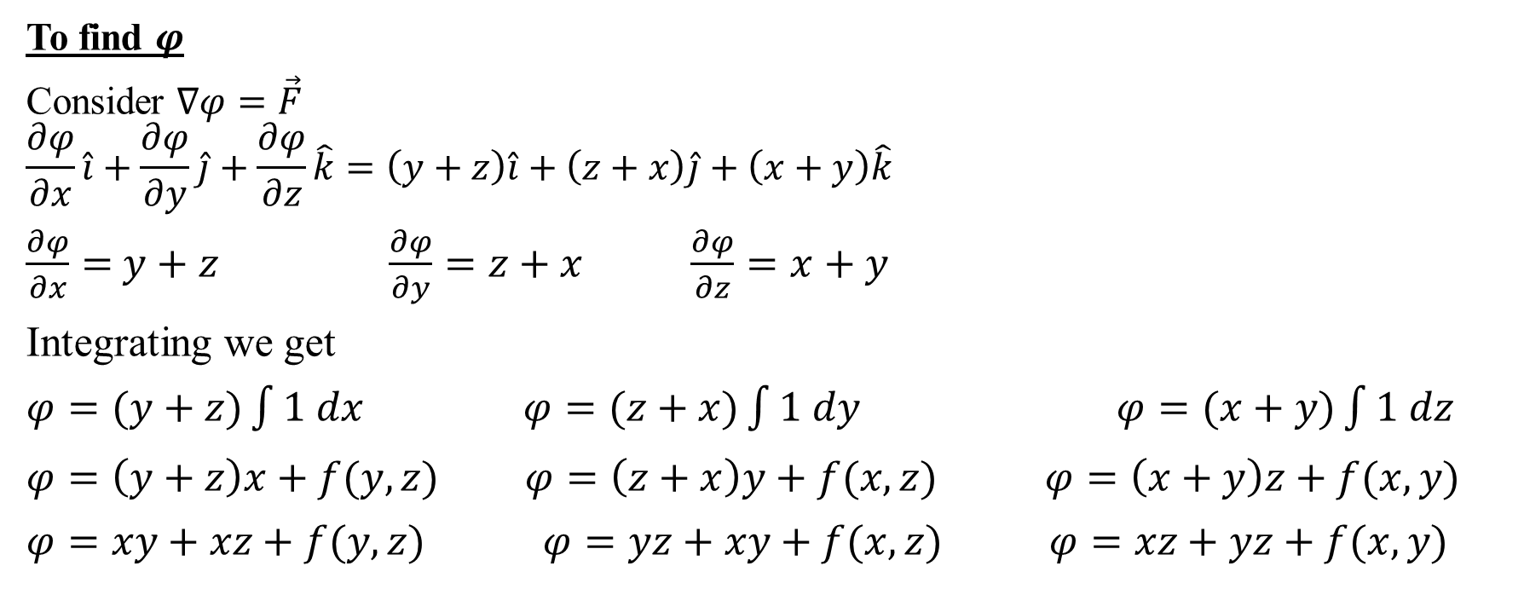
$$curl\vec{F}=\vec{0} \\ ∴ \vec{F} \text{is} \text{irrotational}\text{.}$$
To find $φ$
Consider $∇φ=\vec{F}$
$$\frac{∂φ}{∂x}\hat{i}+\frac{∂φ}{∂y}\hat{j}+\frac{∂φ}{∂z}\hat{k}=\left(y+z\right)\hat{i}+\left(z+x\right)\hat{j}+\left(x+y\right)\hat{k}$$
$\frac{∂φ}{∂x}=$ $y+z$ $\frac{∂φ}{∂y}=z+x$ $\frac{∂φ}{∂z}=x+y$
Integrating we get
$φ=(y+z)\int{1 dx}$ $φ=(z+x)\int{1 dy}$ $φ=(x+y)\int{1 dz}$
$φ=\left(y+z\right)x+f(y,z)$ $φ=\left(z+x\right)y+f(x,z)$ $φ=\left(x+y\right)z+f(x,y)$
$φ=xy+xz+f(y,z)$ $φ=yz+xy+f(x,z)$ $φ=xz+yz+f(x,y)$

Slide 32
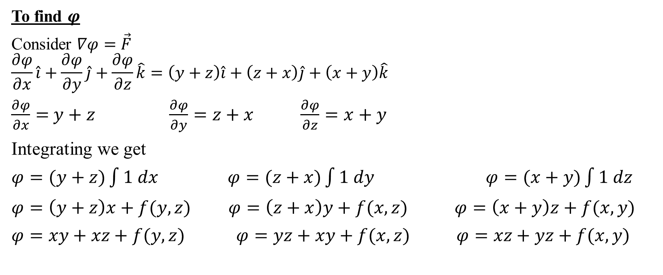
$$curl\vec{F}=\vec{0} \\ ∴ \vec{F} \text{is} \text{irrotational}\text{.}$$
To find $φ$
Consider $∇φ=\vec{F}$
$$\frac{∂φ}{∂x}\hat{i}+\frac{∂φ}{∂y}\hat{j}+\frac{∂φ}{∂z}\hat{k}=\left(y+z\right)\hat{i}+\left(z+x\right)\hat{j}+\left(x+y\right)\hat{k}$$
$\frac{∂φ}{∂x}=$ $y+z$ $\frac{∂φ}{∂y}=z+x$ $\frac{∂φ}{∂z}=x+y$
Integrating we get
$φ=(y+z)\int{1 dx}$ $φ=(z+x)\int{1 dy}$ $φ=(x+y)\int{1 dz}$
$φ=\left(y+z\right)x+f(y,z)$ $φ=\left(z+x\right)y+f(x,z)$ $φ=\left(x+y\right)z+f(x,y)$
$φ=xy+xz+f(y,z)$ $φ=yz+xy+f(x,z)$ $φ=xz+yz+f(x,y)$

Slide 33
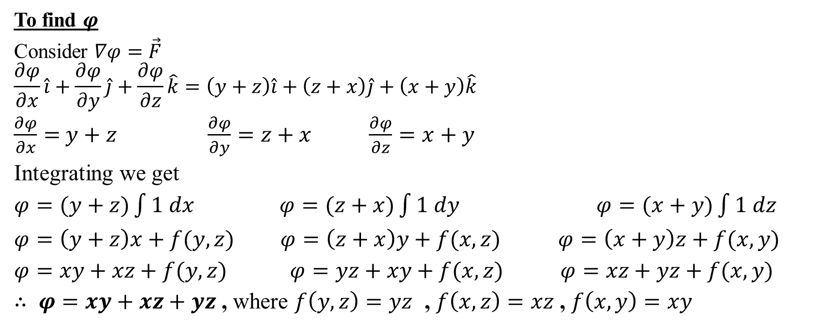
$$curl\vec{F}=\vec{0} \\ ∴ \vec{F} \text{is} \text{irrotational}\text{.}$$
To find $φ$
Consider $∇φ=\vec{F}$
$$\frac{∂φ}{∂x}\hat{i}+\frac{∂φ}{∂y}\hat{j}+\frac{∂φ}{∂z}\hat{k}=\left(y+z\right)\hat{i}+\left(z+x\right)\hat{j}+\left(x+y\right)\hat{k}$$
$\frac{∂φ}{∂x}=$ $y+z$ $\frac{∂φ}{∂y}=z+x$ $\frac{∂φ}{∂z}=x+y$
Integrating we get
$φ=(y+z)\int{1 dx}$ $φ=(z+x)\int{1 dy}$ $φ=(x+y)\int{1 dz}$
$φ=\left(y+z\right)x+f(y,z)$ $φ=\left(z+x\right)y+f(x,z)$ $φ=\left(x+y\right)z+f(x,y)$
$φ=xy+xz+f(y,z)$ $φ=yz+xy+f(x,z)$ $φ=xz+yz+f(x,y)$
$∴ φ=xy+xz+yz$ , where $f\left(y,z\right)=yz$ , $f\left(x,z\right)=xz$ , $f\left(x,y\right)=xy$

Slide 34
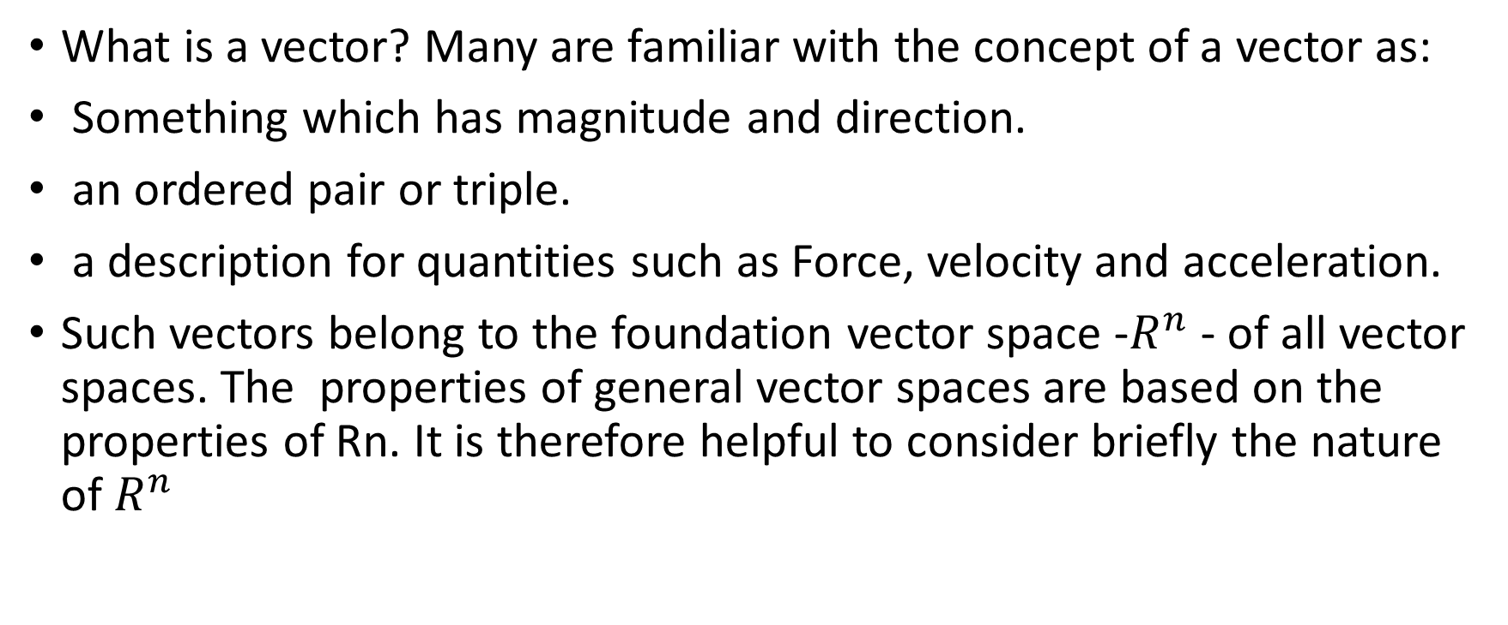
Module-2 Vector Space and Linear Transformation
What is a vector? Many are familiar with the concept of a vector as:
Something which has magnitude and direction.
an ordered pair or triple.
a description for quantities such as Force, velocity and acceleration.
Such vectors belong to the foundation vector space -$R^{n}$ - of all vector spaces. The properties of general vector spaces are based on the properties of Rn. It is therefore helpful to consider briefly the nature of $R^{n}$

Slide 35

Definitions
Two vectors u = (u1, u2, . . . , un) and v = (v1, v2, . . . , vn) in Rn are called equal If u1 = v1, u2 = v2, . . . , un = $v_{n}$
The sum u + v is defined by u + v = (u1 + v1, u2 + v2, . . . , un + vn)
Let k be any scalar, then the scalar multiple ku is defined by
ku = (ku1, ku2, . . . , kun)
• These two operations of addition and scalar multiplication are called the standard operations on Rn.
The zero vector in $R_{n}$ is denoted by 0 and is defined to be the vector
0 = (0, 0, . . . , 0)

Slide 36
The negative (or additive inverse) of u is denoted by -u and is defined by
−u = (−u1,−u2, . . . ,−un)
The difference of vectors in Rn is defined by v − u = v + (−u)
The most important arithmetic properties of addition and scalar multiplication of vectors in Rn are listed in the following theorem. This theorem enables us to manipulate vectors in Rn without expressing the vectors in terms of components.

Slide 37
Linear Combinations of Vectors and Systems of Linear Equations
Have m linear equations in n variables:
a11x1 + a12x2 + · · · + a1nxn = b1
a21x1 + a22x2 + · · · + a2nxn = b2
...
am1x1 + am2x2 + · · · + amnxn = bm
Write in matrix form: Ax = b.
A = [aij ] is the m × n coefficient matrix.

Slide 38

Linear combinations Definitions
A vector w is called a linear combination of the vectors v1, v2, . . . , vr if it can be expressed in the form w = k1v1 + k2v2 + · · · + krvr
where k1, k2, . . . , kr are scalars.
Example : Consider the vectors u = (1, 2,−1) and v = (6, 4, 2) in R3. Show that w = (9, 2, 7) is a linear combination of u and v and that $w_{0}$= (4,−1, 8) is not a linear combination of u and v.
Spanning
If S = {v1, v2, . . . , vr} is a set of vectors in a vector space V , then the subspace
W of V consisting of all linear combinations of the vectors in S is called the
space spanned by v1, v2, . . . , vr, and it is said that the vectors v1, v2, . . . , vr
span W. To indicate that W is the space spanned by the vectors in the set
S = {v1, v2, . . . , vr} the below notation is used.
W = span(S) or W = span{v1, v2, . . . , vr}

Slide 39

Linear transformations: A linear transformation T : V1 $→$ V2 between two vector spaces is a function preserving all of the algebra; that is, T($α$v+$β$u) = $α$T(v)+ $β$T(u) for all scalars $α$, $β ∈$R and vectors v; u $∈$V1. V1 is called the domain of T and V2 is called the codomain of T.
A linear transformation T : V1 $→$ V2 is onto if for each u $∈$ V2 there is at least one v $∈$ V1 such that u = T(v). Formal differentiation is an onto linear transformation.
A linear transformation T : V1 $→$ V2 is an isomorphism if it is one to one and onto. When T is an isomorphism, we say V1 and V2 are isomorphic vector spaces and we write V1 $≃$V2.
If T : V1 $→$ V2 is an isomorphism then for any u $∈$V2 there is exactly one v $∈$ V1 such that u = T(v). Thus, we can define a function $T^{−1}$ : V1 $→$ V2 by taking $T^{−1}$(u) to be the unique v $∈$ V1 such that u = T(v). $T^{−1}$is linear whenever T is linear and $T^{−1}$ is an isomorphism of vector spaces whenever T is an isomorphism.

Slide 40

Null space.
(a) The Kernel or Null Space of a linear transformation T : V1 $→$ V2 is Nul(T) = {u/0= T(u)}
(b) Nul(T) is a subspace of V1.
(c) When T is a matrix transformation, row reducing the augmented matrix [T|0] to reduced echelon form produces a vector equation describing Nul(T). We call this equation the kernel equation of the matrix. It provides us with a basis of Nul(T) (see ”basis” below).
Linearly Independence :A subset B of a vector space is linearly independent if any finite linear combination $α_{1}b_{1}$ + ::: + $α_{n}b_{n}$ = 0 of elements $b_{1}$,…… $b_{n}$ $∈$B implies $α$1 = 0,..., $α$n = 0.
Basis: (a) A basis of a vector space V is a set of linearly independent vectors spanning V .
(b) {$e_{1,}e_{2,}$……. $e_{n,}$} is a basis of Rn. It is called the standard basis of Rn.
(c) The set of vectors {$1,t,t^{2}$, $t^{3}$……$t^{n}$} is a basis of $P_{n}$. It is the standard basis of $P_{n}$.
THEOREM: If {$b_{1,}b_{2,}$……. $b_{n,}$} is a basis of a vector space and if v is any vector in the space then there is exactly one set {$α_{1,}α_{2,}$……. $α_{n,}$} of scalars such that v = $α_{1}b_{1}$+$α_{2}b_{2}$+$α_{3}b_{3}$………….. $α_{n}b_{n}$
If any vector not in a basis is added to the basis then the resulting set is not a basis.

Slide 41

If V has a basis = {v1, v2} and T : V $→$V is a linear transformation given By T(v1) = 2v1 + 3v2, T(v2) = −7v1 + 8v2
To find T T(−v1 + 3v2) takes two steps as shown below.
T(−v1 + 3v2) = −T(v1) + 3T(v2)
= −2v1 − 3v2 + 3(−7v1 + 8v2)
= −23v1 + 21v2
Hence T(−v1 + 3v2) = T(−23v1 + 21v2)
= −23T(v1) + 21T(v2)
= −23(2v1 + 3v2) + 21(−7v1 + 8v2)
= −193v1 + 99v2

Slide 42
MODULE - 3
LAPLACE TRANSFORMS
Mathematics

Slide 43
TOPICS
1. Laplace Transform: Definition and Laplace transforms of elementary functions (statements only). Laplace transforms of Periodic functions (statement only) and unit-step function – problems .
2. Inverse Laplace Transform: Definition & problems, Convolution theorem to find the inverse Laplace Transforms(without Proof) and Problems .
3. Solution of linear differential equations using Laplace Transforms.
Mathematics

Slide 44

Mathematics

Slide 45


Mathematics

Slide 46


Mathematics

Slide 47


Mathematics

Slide 48


Mathematics

Slide 49


Mathematics

Slide 50


Mathematics

Slide 51


Mathematics

Slide 52


Mathematics

Slide 53


Mathematics

Slide 54


Mathematics

Slide 55



Mathematics

Slide 56

Mathematics

Slide 57


Mathematics

Slide 58
To solve the problem related to communication and network analysis.
OTHER APPLICATIONS
4
To find moment generating function in statistics
2
5
To make a equation in simple form from hard equation like vibration of spring
1
6
To determine structure of astronomical object from spectrum
To solve mixing problem involving two tanks.
Mathematics

Slide 59
Module-4: Numerical Methods-1
Solution of polynomial and transcendental equations: Regula-Falsi and Newton-Raphson methods (only formulae).
Finite differences, Interpolation using Newton’s forward and backward difference formulae.
Newton’s divided difference formula and Lagrange’s interpolation formula.
Numerical integration: Simpson's (1/3)rd and (3/8)th rules(without proof)-Problems.
Self-study: Bisection method, Lagrange’s inverse Interpolation,
Weddle's rule.

Slide 60

Numerical Methods
Numerical method provide various technique to find approximate solution to different problem using simple operation.
Numerical Solution of Polynomial and Transcendental Equations
Given an equation $f\left(x\right)=0$ it is generally not possible to find roots $′x′$ such that $f\left(x\right)$ becomes zero exactly. We discuss two numerical methods for the solution of algebraic and transcendental equation.
Equation involving algebraic quantity like $x$,$x^{2}$, $x^{3}$,… are called algebraic equation.
Eg: $x^{3}−3x−4=0$ , $x^{4}+x^{3}=80$
Equation involving non algebraic quantity like $e^{x},logx,sinx,tanx,…$ are called transcendental equation.
Eg: ${xe}^{x}−2=0$ , $xlogx−1.2=0$, $tanx=2x$

Slide 61

Numerical methods are often a repetitive nature. This consist repeated execution of the same process where at each step to result of the previous step is used. This is known as iterative process.
We discuss two numerical methods
Regula-Falsi method
Newton-Raphson method
Regula-Falsi method (or) Method of False position
Formula:
$x_{n}=\frac{af\left(b\right)−bf(a)}{f\left(b\right)−f(a)}$

Slide 62

Problems
Using the method of false position find the real root correct to 3 decimal places
of the equation $x^{3}+5x−11=0.$
Sol: Given ${f\left(x\right)=x}^{3}+5x−11$
$f\left(0\right)=−11$
$f\left(1\right)=−5<0$
$f\left(2\right)=7>0$
The root lies between $\left(1,2\right).$
Wkt,
$x_{n}=\frac{af\left(b\right)−bf(a)}{f\left(b\right)−f(a)}$

Slide 63


Step-1: $a=1$ $b=$ 2
$f\left(a\right)=−5$ $f\left(b\right)=7$
$x_{1}=\frac{1.\left(7\right)−2.\left(−5\right)}{\left(7\right)−\left(−5\right)}$
$x_{1}=\frac{7+10}{7+5}$
$x_{1}=1.417$
$f\left(1.417\right)=−1.070<0$
$f\left(2\right)=7>0$
The root lies between $\left(1.417,2\right).$
Step-2: $a=1.417$ $b=$ 2
$f\left(a\right)=−1.070$ $f\left(b\right)=7$

Slide 64

$x_{2}=\frac{\left(1.417\right).\left(7\right)−2.\left(−1.070\right)}{\left(7\right)−\left(−1.070\right)}$
$x_{2}=1.494$
$f\left(1.494\right)=−0.195<0$
$f\left(2\right)=7>0$
The root lies between $\left(1.417,2\right).$
Step-3: $a=1.494$ $b=$ 2
$f\left(a\right)=−0.195$ $f\left(b\right)=7$
$x_{3}=\frac{\left(1.494\right)\left(7\right)−2\left(−0.195\right)}{\left(7\right)−\left(−0.195\right)}$
$x_{3}=1.508$
$f\left(1.508\right)=−0.031<0$
$f\left(2\right)=7>0$
The root lies between $\left(1.508,2\right).$

Slide 65

Step-4: $a=1.508$ $b=$ 2
$f\left(a\right)=−0.031$ $f\left(b\right)=7$
$x_{4}=\frac{\left(1.508\right)\left(7\right)−2\left(−0.031\right)}{\left(7\right)−\left(−0.031\right)}$
$x_{4}=1.510$
$f\left(1.510\right)=−0.007<0$
$f\left(2\right)=7>0$
The root lies between $\left(1.510,2\right).$
Step-5: $a=1.510$ $b=$ 2
$f\left(a\right)=−0.007$ $f\left(b\right)=7$
$x_{5}=\frac{\left(1.510\right)\left(7\right)−2\left(−0.007\right)}{\left(7\right)−\left(−0.007\right)}$
$x_{5}=1.510$
$∴$ The real root is 1.510

Slide 66

Newton-Raphson Method
Formula:
$x_{n+1}=x_{n}−\frac{f\left(x_{n}\right)}{f^{′}\left(x_{n}\right)}$ ; $f^{′}\left(x_{n}\right)≠0$ , $n=0,1,2,3,…$
$n=0$ , $x_{1}=x_{0}−\frac{f\left(x_{0}\right)}{f^{′}\left(x_{0}\right)}$ ; $f^{′}\left(x_{0}\right)≠0$
$n=1$ , $x_{2}=x_{1}−\frac{f\left(x_{1}\right)}{f^{′}\left(x_{1}\right)}$ ; $f^{′}\left(x_{1}\right)≠0$ and so on.
Problems
1. Use NR method to find the real root of the equation $x^{3}−3x−5=0$ , correct to 3
decimal places.
Sol: Given ${f\left(x\right)=x}^{3}−3x−5$

Slide 67

$f\left(0\right)=−5$
$f\left(1\right)=−7$
$f\left(2\right)=−3$
$f\left(3\right)=13$
The root lies between $\left(2,3\right)$.
Since $f\left(2\right)$ lies nearer to 0.
Let $x_{0}=2$
We know that $x_{n+1}=x_{n}−\frac{f\left(x_{n}\right)}{f^{′}\left(x_{n}\right)}$
Here ${f\left(x\right)=x}^{3}−3x−5$
$f^{′}\left(x\right)=3x^{2}−3$
Step 1: $x_{1}=x_{0}−\frac{f\left(x_{0}\right)}{f^{′}\left(x_{0}\right)}$

Slide 68

$x_{1}=2−\frac{f\left(2\right)}{f^{′}\left(2\right)}$
$x_{1}=2−\frac{\left(−3\right)}{\left(9\right)}$
$x_{1}=2.333$
Step 2: $x_{2}=x_{1}−\frac{f\left(x_{1}\right)}{f^{′}\left(x_{1}\right)}$
$x_{2}=2.333−\frac{f\left(2.333\right)}{f^{′}\left(2.333\right)}$
$x_{2}=2.333−\frac{\left(0.699\right)}{\left(13.329\right)}$
$x_{2}=2.281$
Step 3: $x_{3}=x_{2}−\frac{f\left(x_{2}\right)}{f^{′}\left(x_{2}\right)}$
$x_{3}=2.281−\frac{f\left(2.281\right)}{f^{′}\left(2.281\right)}$

Slide 69

$x_{3}=2.281−\frac{\left(0.025\right)}{\left(12.609\right)}$
$x_{3}=2.279$
Step 4: $x_{4}=x_{3}−\frac{f\left(x_{3}\right)}{f^{′}\left(x_{3}\right)}$
$x_{4}=2.279−\frac{f\left(2.279\right)}{f^{′}\left(2.279\right)}$
$x_{4}=2.279−\frac{\left(0\right)}{\left(12.582\right)}$
$x_{4}=2.279$
$∴$ The real root is $2.279$.

Slide 70

FINITE DIFFERENCES
Newton’s Forward interpolation formula (NFIF)
The value of $y=f(x)$ at $x=x_{0}+rh$ is approximately given by
$$y=y_{0}+r∆y_{0}+\frac{r\left(r−1\right)}{2!}∆^{2}y_{0}+\frac{r\left(r−1\right)\left(r−2\right)}{3!}∆^{3}y_{0}+…+\frac{r\left(r−1\right)\left(r−2\right)…\left[r−\left(n−1\right)\right]}{n!}∆^{n}y_{0}$$
Where, $′r′$ is any real number , $r=\frac{x−x_{0}}{h}$ ; $h$ is step length.
Newton’s Backward interpolation formula (NBIF)
The value of $y=f(x)$ at $x=x_{n}+rh$ is approximately given by
$$y=y_{n}+r∇y_{n}+\frac{r\left(r+1\right)}{2!}∇^{2}y_{n}+\frac{r\left(r+1\right)\left(r+2\right)}{3!}∇^{3}y_{n}+…+\frac{r\left(r+1\right)\left(r+2\right)…\left[r+\left(n−1\right)\right]}{n!}∇^{n}y_{n}$$
Where, $′r′$ is any real number , $r=\frac{x−x_{n}}{h}$ ; $h$ is step length.

Slide 71

1. The population of a town is given by the following data
Using appropriate interpolation formula calculate the increase in the population from the year 1975 to 2005.
Sol: a)To find $f\left(1975\right)$ $⇒x=1975$
Here $h=10$ , $x_{0}=1971$
$r=\frac{x−x_{0}}{h}$
$r=\frac{1975−1971}{10}$
$r=0.4$
Year | 1971 | 1981 | 1991 | 2001 | 2011
Population ( in thousand ) | 19.96 | 39.65 | 58.81 | 77.18 | 94.58

Slide 72

$$x$$ | $$y$$ | $I D$ | $II D$ | $III D$ | $$IV D$$
$x_{0}=$1971 1981 1991 2001 $x_{n}=$2011 | $$y_{0}=19.96$$ 39.65 58.81 77.18 $y_{n}=94$.58 | $$∆y_{0}=19.69$$ $$19.16$$ $$18.37$$ $$∇y_{n}=17.40$$ | $$∆^{2}y_{0}=−0.53$$ $−0.79$ $$∇^{2}y_{n}=−0.97$$ | $$∆^{3}y_{0}=−0.26$$ $$∇^{3}y_{n}=−0.18$$ | $$∆^{4}y_{0}=0.08=∇^{4}y_{n}$$

Slide 73

By NFIF,
$y=y_{0}+r∆y_{0}+\frac{r\left(r−1\right)}{2!}∆^{2}y_{0}+\frac{r\left(r−1\right)\left(r−2\right)}{3!}∆^{3}y_{0}+\frac{r\left(r−1\right)\left(r−2\right)\left(r−3\right)}{4!}∆^{4}y_{0}$
$$y=19.96+\left(0.4\right)\left(19.69\right)+\frac{\left(0.4\right)\left(0.4−1\right)}{2}\left(−0.53\right)+\frac{\left(0.4\right)\left(0.4−1\right)\left(0.4−2\right)}{6}\left(−0.26\right)+\frac{\left(0.4\right)\left(0.4−1\right)\left(0.4−2\right)\left(0.4−3\right)}{24}\left(0.08\right)$$
$y=27.8797$
Thus, $f\left(1975\right)=27.8797$
b) To find $f(2005)⇒x=2005$
Here $h=0.05$ , $x_{n}=2011$
$r=\frac{x−x_{n}}{h}$
$r=\frac{2005−2011}{10}$
$r=−0.6$

Slide 74

By NBIF,
$y=y_{n}+r∇y_{n}+\frac{r\left(r+1\right)}{2!}∇^{2}y_{n}+\frac{r\left(r+1\right)\left(r+2\right)}{3!}∇^{3}y_{n}+\frac{r\left(r+1\right)\left(r+2\right)\left(r+3\right)}{4!}∇^{4}y_{n}$
$$y=94.58+\left(−0.6\right)\left(17.40\right)+\frac{\left(−0.6\right)\left(−0.6+1\right)}{2}\left(−0.97\right)+\frac{\left(−0.6\right)\left(−0.6+1\right)\left(−0.6+2\right)}{6}\left(−0.18\right)+\frac{\left(−0.6\right)\left(−0.6+1\right)\left(−0.6+2\right)\left(−0.6+3\right)}{24}\left(0.08\right)$$
$y=84.2638$
Thus, $f\left(2015\right)=84.2638$
The increase in population from the year 1975 to 2005$=f\left(1975\right)−f(2005)$
$=84.2638−27.8797$
$=56.3841$ ( in thousands )

Slide 75

Interpolation formula for unequal intervals
Newton’s Divided Difference Formula or Newton’s general interpolation formula
If $f\left(x_{0}\right), f\left(x_{1}\right), f\left(x_{2}\right),$…, $f\left(x_{n}\right)$ be a set of values of an unknown function $f\left(x\right)$ corresponding to the values $x_{0}$, $x_{1}$, $x_{2}$,…, $x_{n}$ at unequal intervals, then
$$y=f\left(x_{0}\right)+\left(x−x_{0}\right)f\left(x_{0},x_{1}\right)+\left(x−x_{0}\right)\left(x−x_{1}\right)f\left(x_{0},x_{1},x_{2}\right)+…$$
$+\left(x−x_{0}\right)\left(x−x_{1}\right)…\left(x−x_{n−1}\right)f\left(x_{0},x_{1},…,x_{n}\right)$
Here $f\left(x_{0},x_{1}\right)=\frac{f\left(x_{1}\right)−f\left(x_{0}\right)}{\left(x_{1}−x_{0}\right)}$ ; $f\left(x_{0},x_{1},x_{2}\right)=\frac{f\left(x_{1},x_{2}\right)−f\left(x_{0},x_{1}\right)}{\left(x_{2}−x_{0}\right)}$ ;
$f\left(x_{0},x_{1},x_{2},x_{3}\right)=\frac{f\left(x_{1},x_{2},x_{3}\right)−f\left(x_{0},x_{1},x_{2}\right)}{\left(x_{3}−x_{0}\right)}$

Slide 76



Problems
Use NDDF to find $f(43)$ , given that
Sol:
$$x$$ | 40 | 42 | 44 | 45
$f(x)$ | 43833 | 46568 | 49431 | 50912
$$x$$ | $f(x)$ | $I DD$ | $II DD$ | $III DD$
$$x_{0}=40$$ $$x_{1}=42$$ $$x_{2}=44$$ $$x_{3}=45$$ | $$f\left(x_{0}\right)=43833$$ $$f\left(x_{1}\right)=46568$$ $$f\left(x_{2}\right)=49431$$ $$f\left(x_{3}\right)=50912$$ | $$f\left(x_{0},x_{1}\right)=\frac{46568−43833}{42−40}=1367.5$$ $$f\left(x_{1},x_{2}\right)=\frac{49431−46568}{44−42}=1431.5$$ $$f\left(x_{2},x_{3}\right)=\frac{50912−49431}{45−44}=1481$$ | $$f\left(x_{0},x_{1,}x_{2}\right)=\frac{1431.5 −1367.5 }{44−40}=16$$ $$f\left(x_{1},x_{2},x_{3}\right)=\frac{1481−1431.5}{45−42}=16.5$$ | $$f\left(x_{0},x_{1,}x_{2},x_{3}\right)=\frac{16.5 −16 }{45−40}=0.1$$

Slide 77

By NDDF,
$$y=f\left(x_{0}\right)+\left(x−x_{0}\right)f\left(x_{0},x_{1}\right)+\left(x−x_{0}\right)\left(x−x_{1}\right)f\left(x_{0},x_{1},x_{2}\right)+\left(x−x_{0}\right)\left(x−x_{1}\right)\left(x−x_{2}\right)f\left(x_{0},x_{1},x_{2},x_{3}\right)$$
$$y=43833+\left(43−40\right)\left(1367.5\right)+\left(43−40\right)\left(43−42\right)\left(16\right)+\left(43−40\right)\left(43−42\right)\left(43−44\right)\left(0.1\right)$$
$$y=47983.2$$
Thus, $f\left(43\right)=47983.2$

Slide 78

Lagrange’s formula for interpolation
If $f\left(x_{0}\right), f\left(x_{1}\right), f\left(x_{2}\right),$…, $f\left(x_{n}\right)$ be a set of values of an unknown function $f\left(x\right)$ corresponding to the values $x_{0}$, $x_{1}$, $x_{2}$,…, $x_{n}$ not necessarily at equal intervals, then
$$y=f\left(x\right)=\frac{\left(x−x_{1}\right)\left(x−x_{2}\right)…\left(x−x_{n}\right)}{\left(x_{0}−x_{1}\right)\left(x_{0}−x_{2}\right)…\left(x_{0}−x_{n}\right)}y_{0}+\frac{\left(x−x_{0}\right)\left(x−x_{2}\right)…\left(x−x_{n}\right)}{\left(x_{1}−x_{0}\right)\left(x_{1}−x_{2}\right)…\left(x_{1}−x_{n}\right)}y_{1}+…$$
$+\frac{\left(x−x_{0}\right)\left(x−x_{1}\right)…\left(x−x_{n−1}\right)}{\left(x_{n}−x_{0}\right)\left(x_{n}−x_{2}\right)…\left(x_{n}−x_{n−1}\right)}y_{n}$
Lagrange’s inverse interpolation formula for $x=f\left(y\right)$ is
$$x=f\left(y\right)=\frac{\left(y−y_{1}\right)\left(y−y_{2}\right)…\left(y−y_{n}\right)}{\left(y_{0}−y_{1}\right)\left(y_{0}−y_{2}\right)…\left(y_{0}−y_{n}\right)}x_{0}+\frac{\left(y−y_{0}\right)\left(y−y_{2}\right)…\left(y−y_{n}\right)}{\left(y_{1}−y_{0}\right)\left(y_{1}−y_{2}\right)…\left(y_{1}−y_{n}\right)}x_{1}+…$$
$+\frac{\left(y−y_{0}\right)\left(y−y_{1}\right)…\left(y−y_{n−1}\right)}{\left(y_{n}−y_{0}\right)\left(y_{n}−y_{2}\right)…\left(y_{n}−y_{n−1}\right)}x_{n}$

Slide 79


Problems
1. Apply Lagrange’s interpolation formula to find $y\left(11\right)$ from the following data
Sol: Given $x_{0}=2$ $x_{1}=5$ $x_{2}=8$ $x_{3}=14$
$y_{0}=94.8$ $y_{1}=87.9$ $y_{2}=81.3$ $y_{3}=68.7$
To find $y\left(11\right)$ ⇒ $x=11$
Wkt
$$y=\frac{\left(x−x_{1}\right)\left(x−x_{2}\right)\left(x−x_{3}\right)}{\left(x_{0}−x_{1}\right)\left(x_{0}−x_{2}\right)\left(x_{0}−x_{3}\right)}y_{0}+\frac{\left(x−x_{0}\right)\left(x−x_{2}\right)\left(x−x_{3}\right)}{\left(x_{1}−x_{0}\right)\left(x_{1}−x_{2}\right)\left(x_{1}−x_{3}\right)}y_{1}+\frac{\left(x−x_{0}\right)\left(x−x_{1}\right)\left(x−x_{3}\right)}{\left(x_{2}−x_{0}\right)\left(x_{2}−x_{1}\right)\left(x_{2}−x_{3}\right)}y_{2}+\frac{\left(x−x_{0}\right)\left(x−x_{1}\right)\left(x−x_{2}\right)}{\left(x_{3}−x_{0}\right)\left(x_{3}−x_{1}\right)\left(x_{3}−x_{2}\right)}y_{3}$$
$$y=\frac{\left(11−5\right)\left(11−8\right)\left(11−14\right)}{\left(2−5\right)\left(2−8\right)\left(2−14\right)}\left(94.8\right)+\frac{\left(11−2\right)\left(11−8\right)\left(11−14\right)}{\left(5−2\right)\left(5−8\right)\left(5−14\right)}\left(87.9\right)+\frac{\left(11−2\right)\left(11−5\right)\left(11−14\right)}{\left(8−2\right)\left(8−5\right)\left(8−14\right)}\left(81.3\right)$$
$+\frac{\left(11−2\right)\left(11−5\right)\left(11−8\right)}{\left(14−2\right)\left(14−5\right)\left(14−8\right)}\left(68.7\right)$
$$x$$ | 2 | 5 | 8 | 14
$$y$$ | 94.8 | 87.9 | 81.3 | 68.7

Slide 80


$y=74.925$
$y\left(11\right)=74.925$
2. Fit an interpolating polynomial for the following data
Sol: Given $x_{0}=0$ $x_{1}=1$ $x_{2}=2$ $x_{3}=5$
$y_{0}=2$ $y_{1}=3$ $y_{2}=12$ $y_{3}=147$
Wkt
$$y=\frac{\left(x−x_{1}\right)\left(x−x_{2}\right)\left(x−x_{3}\right)}{\left(x_{0}−x_{1}\right)\left(x_{0}−x_{2}\right)\left(x_{0}−x_{3}\right)}y_{0}+\frac{\left(x−x_{0}\right)\left(x−x_{2}\right)\left(x−x_{3}\right)}{\left(x_{1}−x_{0}\right)\left(x_{1}−x_{2}\right)\left(x_{1}−x_{3}\right)}y_{1}+\frac{\left(x−x_{0}\right)\left(x−x_{1}\right)\left(x−x_{3}\right)}{\left(x_{2}−x_{0}\right)\left(x_{2}−x_{1}\right)\left(x_{2}−x_{3}\right)}y_{2}+\frac{\left(x−x_{0}\right)\left(x−x_{1}\right)\left(x−x_{2}\right)}{\left(x_{3}−x_{0}\right)\left(x_{3}−x_{1}\right)\left(x_{3}−x_{2}\right)}y_{3}$$
$$y=\frac{\left(x−1\right)\left(x−2\right)\left(x−5\right)}{\left(0−1\right)\left(0−2\right)\left(0−5\right)}\left(2\right)+\frac{\left(x−0\right)\left(x−2\right)\left(x−5\right)}{\left(1−0\right)\left(1−2\right)\left(1−5\right)}\left(3\right)+\frac{\left(x−0\right)\left(x−1\right)\left(x−5\right)}{\left(2−0\right)\left(2−1\right)\left(2−5\right)}\left(12\right)$$
$+\frac{\left(x−0\right)\left(x−1\right)\left(x−2\right)}{\left(5−0\right)\left(5−1\right)\left(5−2\right)}\left(147\right)$
$$x$$ | 0 | 1 | 2 | 5
$$y$$ | 2 | 3 | 12 | 147

Slide 81

Wkt $\left(x−a\right)\left(x−b\right)\left(x−c\right)=x^{3}−\left(a+b+c\right)x^{2}+\left(ab+bc+ca\right)x−abc$
$$y=\frac{\left(x^{3}−8x^{2}+17x−10\right)}{\left(−10\right)}\left(2\right)+\frac{\left(x^{3}−7x^{2}+10x\right)}{\left(4\right)}\left(3\right)+\frac{\left(x^{3}−6x^{2}+5x\right)}{\left(−6\right)}\left(12\right)+\frac{\left(x^{3}−3x^{2}+2x\right)}{\left(60\right)}\left(147\right)$$
$$y=\frac{−\left(x^{3}−8x^{2}+17x−10\right)}{5}+\frac{\left({3x}^{3}−21x^{2}+30x\right)}{4}−\frac{\left(2x^{3}−12x^{2}+10x\right)}{1}+\frac{\left(147x^{3}−441x^{2}+294x\right)}{60}$$
$$y=\frac{−12\left(x^{3}−8x^{2}+17x−10\right)+15\left({3x}^{3}−21x^{2}+30x\right)−60\left(2x^{3}−12x^{2}+10x\right)+\left(147x^{3}−441x^{2}+294x\right)}{60}$$
$$y=\frac{−12x^{3}+96x^{2}−204x+120+{45x}^{3}−315x^{2}+450x−120x^{3}+720x^{2}−600x+147x^{3}−441x^{2}+294x}{60}$$
$$y=\frac{60x^{3}+60x^{2}−60x+120}{60}$$
$y=x^{3}+x^{2}−x+2$ , is the required polynomial.

Slide 82

Numerical Integration
The process of obtaining approximate value of the definite integration $I=\int_{a}^{b}{y dx}$ without actually integrating function but only using the value of $′y′$ at some point of $x$ is equally placed over $\left[a,b\right]$.
Simpson’s ${\frac{1}{3}}^{rd}$ rule
Formula:
$$\int_{a}^{b}{y dx=\frac{h}{3}\left[\left(y_{0}+y_{n}\right)+4\left(y_{1}+y_{3}+y_{5}+…+y_{n−1}\right)+2\left(y_{2}+y_{4}+y_{6}+…+y_{n−2}\right)\right]}$$
Where, $h=\frac{b−a}{n}$
Note: To apply ${\frac{1}{3}}^{rd}$ rule $n$ must be multiple of 2.

Slide 83


Problems
Evaluate $\int_{0}^{6}{3x^{2} dx}$ dividing the interval $\left[0,6\right]$ in 6 equal parts (7 ordinate) by applying
Simpson’s ${\frac{1}{3}}^{rd}$rule.
Sol: Given $a=0$ , $b=6$ , $y=3x^{2}$
Now, $h=\frac{b−a}{n}$
$h=\frac{6−0}{6}$
$h=1$ , $n=6$
$$x$$ | 0 | 1 | 2 | 3 | 4 | 5 | 6
$$y=3x^{2}$$ | 0 | 3 | 12 | 27 | 48 | 75 | 108

Slide 84

Wkt,
$$\int_{a}^{b}{y dx=\frac{h}{3}\left[\left(y_{0}+y_{6}\right)+4\left(y_{1}+y_{3}+y_{5}\right)+2\left(y_{2}+y_{4}\right)\right]}$$
$$\int_{0}^{6}{3x^{2} dx=\frac{1}{3}\left[\left(0+108\right)+4\left(3+27+75\right)+2\left(12+48\right)\right]}$$
$$\int_{0}^{6}{3x^{2} dx=216.}$$

Slide 85

Simpson’s ${\frac{3}{8}}^{th}$ rule
Formula:
$$\int_{a}^{b}{y dx=\frac{3h}{8}\left[\left(y_{0}+y_{n}\right)+3\left(y_{1}+y_{2}+y_{4}+…+y_{n−1}\right)+2\left(y_{3}+y_{6}+y_{9}+…+y_{n−3}\right)\right]}$$
Where, $h=\frac{b−a}{n}$
Note: To apply ${\frac{3}{8}}^{th}$ rule $n$ must be multiple of 3.

Slide 86


Problems
Evaluate $\int_{0}^{1}{\frac{1}{\left(1+x\right)} dx}$ by taking 7 ordinate using Simpson’s ${\frac{3}{8}}^{th}$ rule. Hence deduce the value of log2.
Sol: Given $a=0$ , $b=1$ , $y=\frac{1}{\left(1+x\right)}$
Now, $h=\frac{b−a}{n}$ , $n=6$
$h=\frac{1−0}{6}$
$h=\frac{1}{6}$
$$x$$ | 0 | $$\frac{1}{6 }$$ | $$\frac{2}{6 }$$ | $$\frac{3}{6 }$$ | $$\frac{4}{6 }$$ | $$\frac{5}{6 }$$ | 1
$$y=\frac{1}{\left(1+x\right)}$$ | 1 | 0.8571 | 0.75 | 0.6667 | 0.6 | 0.5455 | 0.5

Slide 87

Wkt,
$$\int_{a}^{b}{y dx=\frac{3h}{8}\left[\left(y_{0}+y_{6}\right)+3\left(y_{1}+y_{2}+y_{4}+y_{5}\right)+2\left(y_{3}\right)\right]}$$
$$\int_{0}^{1}{\frac{1}{\left(1+x\right)}dx=\frac{3∗\frac{1}{6 }}{8}\left[\left(1+0.5\right)+3\left(0.8571+0.75+0.6+0.5455\right)+2\left(0.6667\right)\right]}$$
$$\int_{0}^{1}{\frac{1}{\left(1+x\right)}dx=0.6932}$$
By integration,
$\int_{0}^{1}{\frac{1}{1+x}dx={\left[log\left(1+x\right)\right]}_{0}^{1}}$
$0.6932=\left[log2−log1\right]$
$$log2=0.6932$$

Slide 88
Module-5: Numerical Methods-2
Numerical solution of ordinary differential equations of first order and first degree
Taylor’s series method.
Modified Euler’s method.
Runge-Kutta method of fourth-order.
Milne’s predictor-corrector formula.
Self-studyAdam-Bashforth method.

Slide 89
Numerical solution of ordinary differential equations of first order and first degree
A numerical method can be used to get an accurate approximate solution to a differential equation. There are many programs and packages available for solving these differential equations. With today's computer, an accurate solution can be obtained rapidly. In this chapter we focus on basic numerical methods for solving initial value problems.
Analytical methods, when available, generally enable to find the value of y for all values of x. Numerical methods, on the other hand, lead to the values of y corresponding only to some finite set of values of x. That is the solution is obtained as a table of values, rather than as continuous function. Moreover, analytical solution, if it can be found, is exact, whereas a numerical solution inevitably involves an error which should be small but may, if it is not controlled, swamp the true solution. Therefore we must be concerned with two aspects of numerical solutions of ODEs: both the method itself and its accuracy.

Slide 90

The most general form of an ODE of first order and first degree is given by
$$\frac{dy}{dx}=f\left(x,y\right)where y\left(x_{0}\right)=y_{0}$$
Let x by an independent variable and y be dependent variable .
Let us consider the differential equation $\frac{dy}{dx}=f\left(x,y\right)where y\left(x_{0}\right)=y_{0}$--(1)
If particular values are given to the constants then the resulting solution is called a particular solution.
To obtain a particular solution from the general solution (1), we must be given initial conditions so that the constants can be determined. If all the initial conditions are specified at the same value of x then the problem is termed as initial value problem. If the conditions are specified at more than one value of x, then the problem is termed as boundary value problem.

Slide 91

Though there are many analytical methods for finding the solution of the equation of the form (1), there exist large number of ODE’s whose solution cannot be obtained by the known analytical methods. In such cases, we use numerical methods to get an approximate solution of a given differential equation under the prescribed conditions
Consider the first order differential equation $\frac{dy}{dx}=f(x,y)$
Let y(x₀), y(x₁), y(x₂), y(x₃)..... y(x_{m}) be the solution values at the points x_{0,} x_{1,} x_{2,} x_{3,-----} x_{m}
We wish to find the approximate values y₀ , y₁, ........, y_{m} to these solution values.
Let the initial condition be y(x₀ ) = y₀ . Let the exact solution y(x) of the given differential equation be represented by a continuous curve. Divide the interval (Xo,Xm))on which the solution is derived into a finite number of equispaced subintervals.

Slide 92

Approximate solution
Exact solution
For each x_{i}, the approximate values of the dependent variable y(x) are calculated using a suitable recursive formula. These values are y₀, y₁, ......, y_{m} and these are shown by points. Computation of these approximate values is known as Numerical solution of the Differential equation.

Slide 93

An Initial Value Problem (IVP) consists of a differential equation and a condition which the solution much satisfies (or several conditions referring to the same value of x if the differential equation is of higher order).
$\frac{dy}{dx}=f\left(x,y\right)where y\left(x_{0}\right)=y_{0 }$--- (1)
The following methods are used to solve the IVP (1).
1. Taylor’s Series Method
2. Modified Euler’s Method
3. Runge - Kutta Method
4. Milne’s Method

Slide 94

Taylor’s Series Method
Let y=f(x) be a solution of the equation Expanding it by Taylor’s series about x - x₀ we get
$$f\left(x\right)=y_{0}+\frac{\left(x−x_{0}\right)}{1!}{y_{0}}^{1}+\frac{{\left(x−x_{0}\right)}^{2}}{2!}{y_{0}}^{2}+\frac{{\left(x−x_{0}\right)}^{3}}{3!}{y_{0}}^{3}+….$$
1.Using the Taylor’s series method , find an approximate solution correct to four
decimals at x=0.1 for the IVP$\frac{dy}{dx}=2y+3e^{x},y\left(0\right)=0$
Sol:
$y_{1} =2y+3e^{x}$ $y_{1}\left(0\right)=0+3e^{0}=3$
Differentiating w.r.t x we get
$y_{2}=2y_{1}+3e^{x}$ $y_{2}\left(0\right)=2∗3+3e^{0}=9$

Slide 95

$y_{3}=2y_{2}+3e^{x}$ $y_{3}\left(0\right)=2∗9+3e^{0}=21$
$y_{4}=2y_{3}+3e^{x}$ $y_{4}\left(0\right)=2∗21+3e^{0}=45$
Wkt,
$f\left(x\right)=y_{0}+\frac{(x−x_{0})}{1!}{y_{0}}^{1}+\frac{{(x−x_{0})}^{2}}{2!}{y_{0}}^{2}+\frac{{(x−x_{0})}^{3}}{3!}{y_{0}}^{3}+….$
Where $x$=0.1 and $x_{0}=0$ we get
$y_{1}=f\left(0.1\right)=0+\frac{0.1}{1!}\left(3\right)+\frac{{0.1}^{2}}{2!}\left(9\right)+\frac{{0.1}^{3}}{3!}\left(21\right)+\frac{{0.1}^{4}}{4!}\left(45\right)+…$
$y$(0.1)=0.3487

Slide 96

Modified Euler’s Method
Consider the IVP $\frac{dy}{dx}=f(x,y),y\left(0\right)=y_{0}$ --- (1)
To determine the solution of this problem at $x_{n}=x_{0}+nh$ bu using Euler’s method.
$y_{n}^{(E)}=y_{n−1}+hf(x_{n−1},y_{n−1})$ ---(2)
The expression (2) gives an approximate value of y at $x_{n}$. . To improve the approximation the following formula has been suggested
$y_{n}=y_{n−1}+\frac{h}{2}\left[f\left(x_{n−1},y_{n−1}\right)+f(x_{n},y_{n}^{(E)})\right]$---(3)
The method of computing $y_{n}$ using (3) is known as Modified Euler’s method.

Slide 97

The process of improving the approximation can be continued by obtaining replacing $y_{n}^{(1)},y_{n}^{(2)},y_{n}^{(3)}$ until the desired degree of accuracy is obtained.
First approximation $y_{1}^{(E)}=y_{0}+hf(x_{0},y_{0})$
Second approximation $y_{1}^{(1)}=y_{0}+\frac{h}{2}\left[f\left(x_{0},y_{0}\right)+f(x_{1},y_{1}^{(E)})\right]$
Third approximation $y_{1}^{(2)}=y_{0}+\frac{h}{2}\left[f\left(x_{0},y_{0}\right)+f(x_{1},y_{1}^{(1)})\right]$ and so on.
1.Using the modified Euler’s method, solve the IVP $\frac{dy}{dx}=\frac{1}{x+y}, y\left(0\right)=1$ at points x=0.5 and x=1 in steps of length h=0.5. Carry out two modifications at each step.
Sol:
$\frac{dy}{dx}=f(x,y)=\frac{1}{x+y}$ $x_{0}=0 ,y_{0}=1 taking h=0.5$

Slide 98

$y_{1}^{(E)}=y_{0}+hf(x_{0},y_{0})$ = $y_{0}+h\frac{1}{x_{0}+y_{0}} =1+\frac{0.5}{0+1}=1.5$
First modification $y_{1}^{(1)}=y_{0}+\frac{h}{2}\left[f\left(x_{0},y_{0}\right)+f(x_{1},y_{1}^{(E)})\right]$
$=y_{0}+\frac{h}{2}\left[\frac{1}{x_{0}+y_{0}}+\frac{1}{x_{0}+y_{1}^{E}} \right]$
$=1+\frac{0.5}{2}\left[\frac{1}{0+1}+\frac{1}{0.5+1.5} \right]=1.375$
Second modification $y_{1}^{(2)}=y_{0}+\frac{h}{2}\left[f\left(x_{0},y_{0}\right)+f(x_{1},y_{1}^{(1)})\right]$
$$=y_{0}+\frac{h}{2}\left[\frac{1}{x_{0}+y_{0}}+\frac{1}{x_{0}+y_{1}^{1}} \right]$$
$=1+\frac{0.5}{2}\left[\frac{1}{0+1}+\frac{1}{0.5+1.375} \right]=1.3833$

Slide 99

Next, to compute the solution $y_{2}=y\left(1\right)and let us consider x_{0}=0.5 ,y_{0}=1.3833$
$y_{1}^{(E)}=y_{0}+hf(x_{0},y_{0})$ = $y_{0}+h\frac{1}{x_{0}+y_{0}} =1.3833+\frac{0.5}{0.5+1.3833}=1.6488$
First modification $y_{1}^{(1)}=y_{0}+\frac{h}{2}\left[f\left(x_{0},y_{0}\right)+f(x_{1},y_{1}^{(E)})\right]$
$=y_{0}+\frac{h}{2}\left[\frac{1}{x_{0}+y_{0}}+\frac{1}{x_{0}+y_{1}^{E}} \right]$
$=1.3833+\frac{0.5}{2}\left[\frac{1}{0.5+1.3833}+\frac{1}{1+1.6488}\right]=1.6104$
Second modification $y_{1}^{(2)}=y_{0}+\frac{h}{2}\left[f\left(x_{0},y_{0}\right)+f(x_{1},y_{1}^{(1)})\right]$
$=y_{0}+\frac{h}{2}\left[\frac{1}{x_{0}+y_{0}}+\frac{1}{x_{0}+y_{1}^{1}} \right]$
$=1.3833+\frac{0.5}{2}\left[\frac{1}{0.5+1.3833}+\frac{1}{1+1.6104}\right]=1.6118$
The required solution are y(0.5)=1.3833 and y(1)=1.6118

Slide 100

RUNGE- KUTTA METHOD (R-K METHOD)
Consider the IVP $\frac{dy}{dx}=f(x,y),y\left(0\right)=y_{0}$ ---- (1)
To determine the solution of this problem at $x_{n}=x_{0}+nh$ by using this method, where h is step length
According to the Euler’s method , the solution at $x_{1} is y_{0}+hf(x_{0},y_{0})$.
This can be rewritten as $y_{1}=y_{0}+K$
Where $k_{1}=hf(x_{0},y_{0})$
$$k_{2}=hf\left(x_{0}+\frac{h}{2},y_{0}+\frac{k_{1}}{2}\right)$$
$$k_{3}=hf\left(x_{0}+\frac{h}{2},y_{0}+\frac{k_{2}}{2}\right)$$
$$k_{4}=hf\left(x_{0}+h,y_{0}+k_{3}\right)$$

Slide 101

$y_{1}=y_{0}+\frac{k_{1}+2k_{2}+2k_{3}+k_{4}}{6}$ is an approximate solution for the equation (1) at x_{1 ,}
known as Runge-Kutta method of order four.
1.Using RK method of fourth order , to find y(0.2), given that $\frac{dy}{dx}=\frac{y−x}{y+x}$ $and y\left(0\right)=1$
$take h=0.2$
Sol:
Given $\frac{dy}{dx}=f\left(x,y\right)=\frac{y−x}{y+x} {,x }_{0}=0,y_{0}=1 and h=0.2$ then $x_{1}= x_{0}+h=0.2$
$k_{1}=hf\left(x_{0},y_{0}\right)$
$=h\left(\frac{y_{0}−x_{0}}{y_{0}+x_{0}}\right)$
=(0.2$)\left(\frac{1−0}{1+0}\right)$
$k_{1}=0.2$

Slide 102

$k_{2}=hf\left(x_{0}+\frac{h}{2},y_{0}+\frac{k_{1}}{2}\right)$
$=0.2 \left(\frac{1.1−0.1}{1.1+0.1}\right)$
$k_{2}=0.1667$
$k_{3}=hf\left(x_{0}+\frac{h}{2},y_{0}+\frac{k_{2}}{2}\right)$
$=0.2 \left(\frac{1.0834−0.1}{1.0834+0.1}\right)$
$k_{3}=0.1662$
$k_{4}=hf\left(x_{0}+h,y_{0}+k_{3}\right)$
$=0.2 \left(\frac{1.1662−0.2}{1.1662+0.2}\right)$
$k_{4}=0.1414$

Slide 103

Wkt,
$y_{1}=y_{0}+\frac{k_{1}+2k_{2}+2k_{3}+k_{4}}{6}$
$=1+\frac{(0.2+2(0.1667+0.1662)+0.1414)}{6}$
$y(0.2)=1.1679$
Milne’s Method:
The method in which the construction of y_{n} involves the use of not only y_{n-1}but also predecessors are called multi step methods. In multi-step methods two formulas are used in conjunction with each other- one for predicting the value of y_{n} and the other for correcting the predicted value of y_{n.}

Slide 104

Consider the IVP $\frac{dy}{dx}=f\left(x,y\right)−−−\left(1\right)$
Let y₀=y(x₀),y₁=y(x₁),y₂=y(x₂) and y₃=y(x₃) be these known solutions.
Suppose we wish to determine the solution of equation (1) at the point x₄ = x₃+h.
Let us denote the required solution by y₄=y(x₄).
First we predict the value of y₄=y(x₄) by using Milne’s predictor formula:
$y_{4}^{(p)}=y_{0}+\frac{4h}{3}\left(2f_{1}−f_{2}+2f_{3}\right)$--- (2)
$which can be computed with the help of the speciied x_{0},x_{1},x_{2} ,x_{3}andy_{0}, y_{1},y_{2},y_{3}.$
Next we correct the value of y₄ by using the Milne’s corrector formula:
$y_{4}^{(c)}=y_{2}+\frac{h}{3}\left(f_{2}+{4f}_{3}+f_{4}^{(p)}\right)$--- (3)
$where {f_{4}^{(p)}=f(x_{4},y}_{4}^{(p)})$

Slide 105


$$If we wish to have more accurate approximation for y , we employ the process repeatedly$$
1. Use Milne’s predictor –corrector method to find the value of y at x=0.8, given $\frac{dy}{dx}=x−y^{2}$
Where y(0)=0 , y(0.2)=0.02 , y(0.4)=0.0795 , y(0.6)=0.1762. Apply corrector formula twice.
Sol:
$Here f\left(x,y\right)=x−y^{2}, h=0.2$
x | Y | $$f\left(x,y\right)=x−y^{2}$$
x₀=0 | y₀=0 | $$f_{0=0−0^{2}=0}$$
x₁=0.2 | y₁=0.02 | $$f_{1=0.2−{0.02}^{2}=0.1996}$$
x₂=0.4 | y₂=0.0795 | $$f_{2=0.4−{0.0795}^{2}=0.3937}$$
x₃=0.6 | y₃=0.1762 | $$f_{3=0.6−{0.1762}^{2}=0.5689}$$

Slide 106

Now , Milne’s Predictor formula yields the predicted value of y₄ as
$y_{4}^{(p)}=y_{0}+\frac{4h}{3}\left(2f_{1}−f_{2}+2f_{3}\right)$
$=0+\frac{4∗0.2}{3}\left(2(0.1996)−0.3937+2(0.5689\right))$
$y_{4}^{(p)}=0.3048$
${f_{4}^{(p)}=f(x_{4},y}_{4}^{(p)})= x_{4}−{y_{4}^{\left(p\right)}}^{2}=0.8−{\left(0.30488\right)}^{2}$
$f_{4}^{(p)}=0.7070$
Now , the Milne’s corrector formula gives a corrected value of y₄ as
$y_{4}^{(c)}=y_{2}+\frac{h}{3}\left(f_{2}+{4f}_{3}+f_{4}^{(p)}\right)$
$=0.0795+\frac{0.2}{3}\left(0.3937+4(0.5689)+0.7070\right)$

Slide 107

$y_{4}^{(c)}=0.3046$
To apply corrector formula second time we must use corrector as predictor and substitute in $f_{4}^{(p)}$
${f_{4}^{(p)}=f(x_{4},y}_{4}^{(p)})= x_{4}−{y_{4}^{\left(p\right)}}^{2}=0.8−{\left(0.3046\right)}^{2}$
$f_{4}^{(p)}=0.7072$
$$y_{4}^{\left(c\right)}=y_{2}+\frac{h}{3}\left(f_{2}+{4f}_{3}+f_{4}^{\left(p\right)}\right)=0.0795+\frac{0.2}{3}\left(0.3937+4\left(0.5689\right)+0.7072\right)$$
$y_{4}^{\left(c\right)}=03046$
Thus, $y(0.8)=03046$

Slide 108
Thank You

