Slide 1

BIDTK258:Innovation and Design Thinking
Prepared By,
Vinod Kumar P
Electrical and Electronics Engineering
ATME College of Engineering, Mysuru
ATME College of Engineering, Mysuru
Department of EEE, ATMECE

Slide 2
CONTENTS
Course Overview
ATME College of Engineering, Mysuru
Department of EEE, ATMECE

Slide 3
Course Credit Description:
SL.No. | Course Code | Course Type | Course | Teaching Hours /Week | Exam Duration in Hours | Theory Marks | I.A Marks | Total Marks | Credits
1 | BIDTK258 | AEC | IDT | 01 | 1 | 50 | 50 | 100 | 1
AEC- Ability Enhancement Course
ATME College of Engineering, Mysuru
Department of EEE, ATMECE

Slide 4
Preamble
This course provides an introduction to the basic concepts and techniques of engineering and reverses engineering, the process of design, analytical thinking and ideas, basics, and Development of engineering drawing, and application of engineering drawing with computer aid.
Vinod Kumar P
IDT- Department of EEE, ATMECE

Slide 5
Course objectives
Toexplaintheconceptofdesignthinkingforproductandservicedevelopment.
Toexplainthefundamentalconceptofinnovationanddesignthinking.
Todiscussthemethodsofimplementingdesignthinkingintherealworld.
Vinod Kumar P
IDT- Department of EEE, ATMECE

Slide 6
TLP Mode
Teaching-Learning Process (General Instructions) These are sample Strategies; which teachers can use to accelerate the attainment of the various course outcomes.
1. Lecturer method (L) does not mean only the traditional lecture method, but a different type of teaching method may be adopted to develop the outcomes.
2. Show Video/animation films to explain concepts 3. Encourage collaborative (Group Learning) Learning in the class
Vinod Kumar P
IDT- Department of EEE, ATMECE

Slide 7
TLP Mode
4. Ask at least three HOTS (Higher-order Thinking) questions in the class, which promotes critical thinking
5. Adopt Problem Based Learning (PBL), which fosters students’ Analytical skills, develops thinking skills such as the ability to evaluate, generalize, and analyze information rather than simply recall it.
6. Topics will be introduced in multiple representations.
Vinod Kumar P
IDT- Department of EEE, ATMECE

Slide 8
TLP Mode
7. Show the different ways to solve the same problem and encourage the students to come up with their own creative ways to solve them. 8. Discuss how every concept can be applied to the real world - and when that's possible, it helps improve the students' understanding.
Vinod Kumar P
IDT- Department of EEE, ATMECE

Slide 9
Module Overview
Module-1: PROCESS OF DESIGN
Understanding Design thinking
Shared model in team-based design – Theory and practice in Design thinking – Explore the presentation signers across globe – MVP or Prototyping
TLP: Introduction about the design thinking: Chalk and Talk method Theory and practice through presentation MVP and Prototyping through live examples and videos
Vinod Kumar P
IDT- Department of EEE, ATMECE

Slide 10
Module Overview
Module-2: Tools for Design Thinking
Real-Time design interaction capture and analysis – Enabling efficient collaboration in digital space – Empathy for design – Collaboration in distributed Design
TLP: Case studies on design thinking for real-time interaction and analysis Simulation exercises for collaborated enabled design thinking Live examples on the success of collaborated design thinking
Vinod Kumar P
IDT- Department of EEE, ATMECE

Slide 11
Module Overview
Module-3: Design Thinking in IT
Design Thinking to Business Process Modelling – Agile in Virtual collaboration environment – Scenario based Prototyping
TLP: Case studies on design thinking and business acceptance of the design
Simulation on the role of virtual eco-system for collaborated prototyping
Vinod Kumar P
IDT- Department of EEE, ATMECE

Slide 12
Module Overview
Module-4: DT For strategic innovations
Growth – Story telling representation – Strategic Foresight - Change – Sense Making – Maintenance Relevance – Value redefinition - Extreme Competition – experience design - Standardization – Humanization - Creative Culture – Rapid prototyping, Strategy and Organization – Business Model design.
TLP: Business model examples of successful designs
Presentation by the students on the success of design
Live project on design thinking in a group of 4 students
Vinod Kumar P
IDT- Department of EEE, ATMECE

Slide 13
Module Overview
Module-5: Design thinking workshop
Design Thinking Work shop Empathize, Design, Ideate, Prototype and Test
TLP: 8 hours design thinking workshop from the expect and then presentation by the students on the learning from the workshop
Vinod Kumar P
IDT- Department of EEE, ATMECE

Slide 14
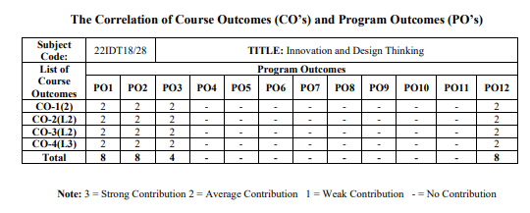
Course Outcome
CO1: Appreciate various design process procedure [L2]
CO2: Generate and develop design ideas through different technique [L2]
CO3: Identify the significance of reverse Engineering to Understand products [L2]
CO4: Draw technical drawing for design ideas [L3]
BIDTK258
Vinod Kumar P
IDT- Department of EEE, ATMECE

Slide 15
Resources
Text Books :
1. John.R.Karsnitz, Stephen O’Brien and John P. Hutchinson, “Engineering Design”, Cengage learning (International edition) Second Edition, 2013.
2. Roger Martin, "The Design of Business: Why Design Thinking is the Next Competitive Advantage", Harvard Business Press , 2009.
3. Hasso Plattner, Christoph Meinel and Larry Leifer (eds), "Design Thinking: Understand – Improve – Apply", Springer, 2011
4. Idris Mootee, "Design Thinking for Strategic Innovation: What They Can't Teach You at Business or Design School", John Wiley & Sons 2013.
Vinod Kumar P
IDT- Department of EEE, ATMECE

Slide 16
Resources
Reference Books :
Yousef Haik and Tamer M.Shahin, “Engineering Design Process”, Cengage Learning, Second Edition, 2011.
Book - Solving Problems with Design Thinking - Ten Stories of What Works (Columbia Business School Publishing) Hardcover – 20 Sep 2013 by Jeanne Liedtka (Author), Andrew King (Author), Kevin Bennett (Author)
Vinod Kumar P
IDT- Department of EEE, ATMECE

Slide 17
Web- Resources
1.www.tutor2u.net/business/presentations/./productlifecycle/default.html
2.https://docs.oracle.com/cd/E11108_02/otn/pdf/./E11087_01.pdf
3.www.bizfilings.com›Home›Marketing›ProductDevelopmen
4.https://www.mindtools.com/brainstm.html
5.https://www.quicksprout.com/./how-to-reverse-engineer-your-competit
6.www.vertabelo.com/blog/documentation/reverse-engineering
7.https://support.microsoft.com/en-us/kb/273814
8.https://support.google.com/docs/answer/179740?hl=en
9. https://www.youtube.com/watch?v=2mjSDIBaUlM
10.thevirtualinstructor.com/foreshortening.html
Vinod Kumar P
IDT- Department of EEE, ATMECE

Slide 18
Web- Resources
https://dschool.stanford.edu/.../designresources/.../ModeGuideBOOTCAMP2010L.pdf
https://dschool.stanford.edu/use-our-methods/
https://www.interactiondesign.
org/literature/article/5-stages-in-the-design-thinking-process
http://www.creativityatwork.com/design-thinking-strategy-for-innovation/
https://www.nngroup.com/articles/design-thinking/
https://designthinkingforeducators.com/design-thinking/10.
www.designthinkingformobility.org/wp-content/.../10/NapkinPitch_Worksheet.pdf
Activity Based Learning (Suggested Activities in Class)/ Practical Based learning
http://dschool.stanford.edu/dgift/
https://onlinecourses.nptel.ac.in/noc19_mg60/preview
Vinod Kumar P
IDT- Department of EEE, ATMECE

Slide 19
Module-1
What is Design?
Design involves finding solutions that fit the user, task, and context of use. Properly
designed objects --including software, tools, and web sites --fit their context so well
that they are easy to use and beneficial to the user.
Designis:
Adisciplinethatexploresthedialoguebetweenproducts,people,andcontexts.
Aprocessthatdefinesasolutiontohelppeopleachievetheirgoals.
Anartifactproducedastheresultofsolutiondefinition.
Vinod Kumar P
IDT- Department of EEE, ATMECE

Slide 20
Module-1
What Is Design Thinking?
Design Thinking is both an ideology and a process, concerned with solving complex problems in a highly user- centric way.
DesignThinkingisanapproachusedforpracticalandcreativeproblem-solving.Itisbasedheavilyonthe
methodsandprocessesthatdesignersuse(hencethename),butithasactuallyevolvedfromarangeof
differentfields—includingarchitecture,engineeringandbusiness.DesignThinkingcanalsobeappliedtoany
field;itdoesn‘tnecessarilyhavetobedesign-specific.
DesignThinkingisextremelyuser-centric.Itfocusesonhumansfirstandforemost,seekingtounderstand
people‘sneedsandcomeupwitheffectivesolutionstomeetthoseneeds.Itiswhatwecallasolution-based
approachtoproblem-solving.
Vinod Kumar P
IDT- Department of EEE, ATMECE

Slide 21
Module-1
The Four Principles of Design Thinking
Thehumanrule:Nomatterwhatthecontext,alldesignactivityissocialinnature,andany
socialinnovationwillbringusbacktothe―human-centricpointofview‖.
Theambiguityrule:Ambiguityisinevitable,anditcannotberemovedoroversimplified.
Experimentingatthelimitsofyourknowledgeandabilityiscrucialinbeingabletoseethings
differently.
Theredesignrule:Alldesignisredesign.Whiletechnologyandsocialcircumstancesmay
changeandevolve,basichumanneedsremainunchanged.Weessentiallyonlyredesignthe
meansoffulfillingtheseneedsorreachingdesiredoutcomes.
Thetangibilityrule:Makingideastangibleintheformofprototypesenablesdesignersto
communicatethemmoreeffectively.
Vinod Kumar P
IDT- Department of EEE, ATMECE

Slide 22
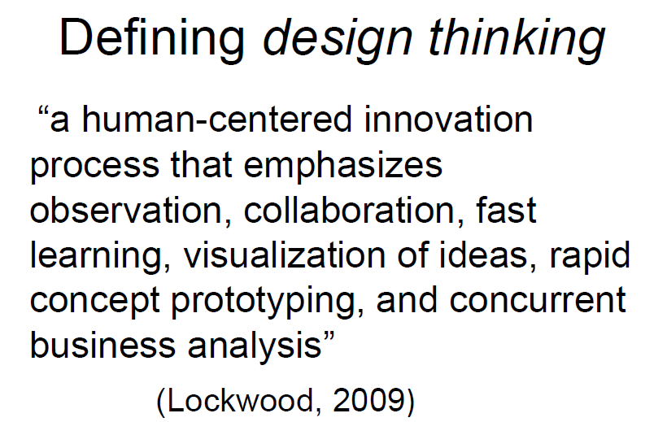
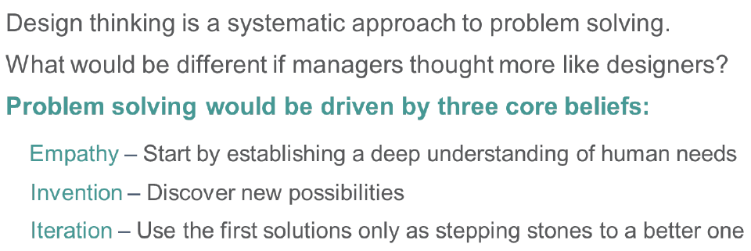
Module-1
Vinod Kumar P
IDT- Department of EEE, ATMECE

Slide 23
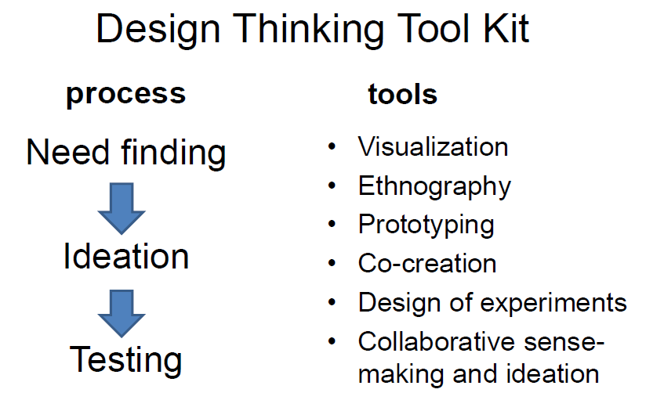
Module-1
Vinod Kumar P
IDT- Department of EEE, ATMECE

Slide 24
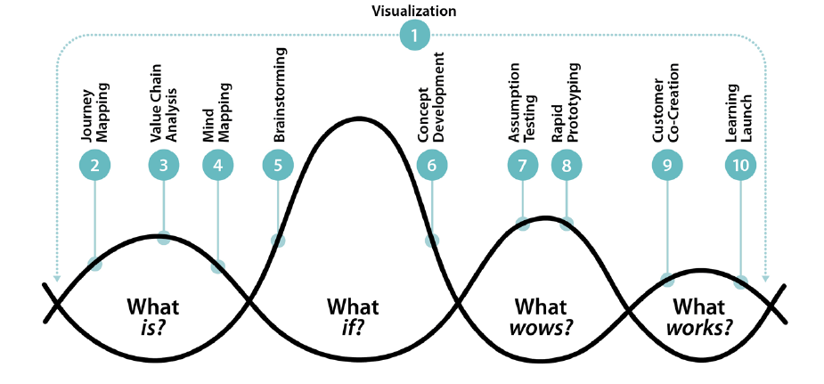
Module-1
Vinod Kumar P
IDT- Department of EEE, ATMECE

Slide 25
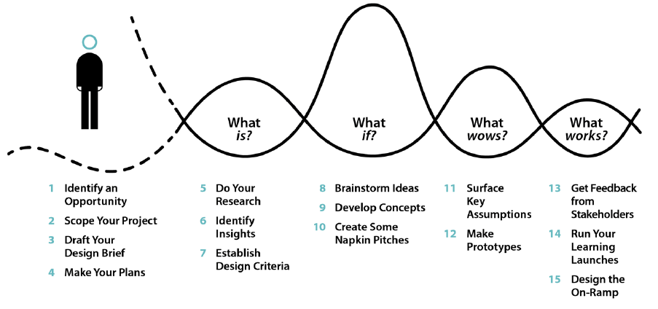
Module-1
Vinod Kumar P
IDT- Department of EEE, ATMECE

Slide 26
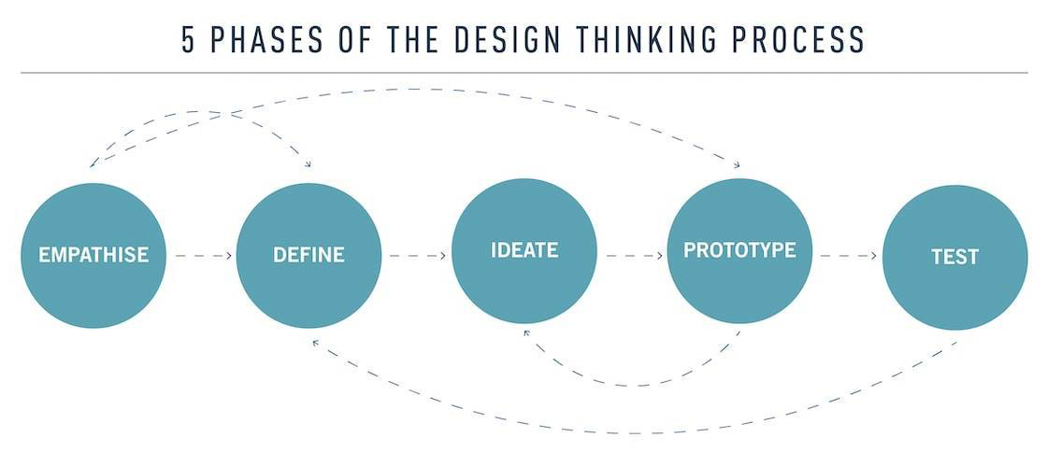
Module-1
DesignThinkingprocess
canbebrokendowninto
fivestepsorphases,
➢Empathise,
➢Define,
➢Ideate,
➢Prototype
➢Test.
Vinod Kumar P
IDT- Department of EEE, ATMECE

Slide 27
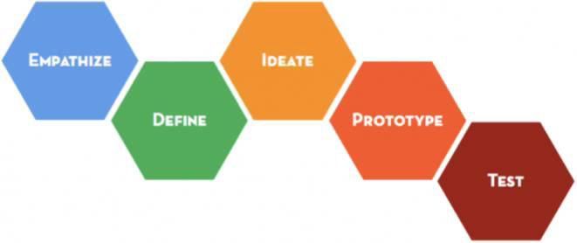
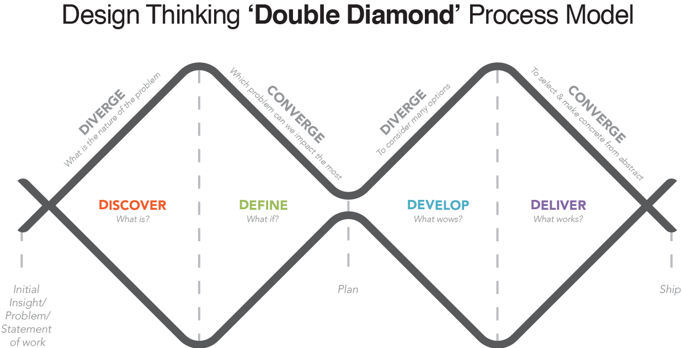
Module-1
Design thinking is a systematic method of
solvingproblems.Thismethodisuniquethatit
starts and ends with humans. The design
thinkersstartbyobserving,interviewingorjust
plain experiencing a situation. Then, they
proceed to improve the situation of the
humansbysolvingproblemsforthem.
Vinod Kumar P
IDT- Department of EEE, ATMECE

Slide 28
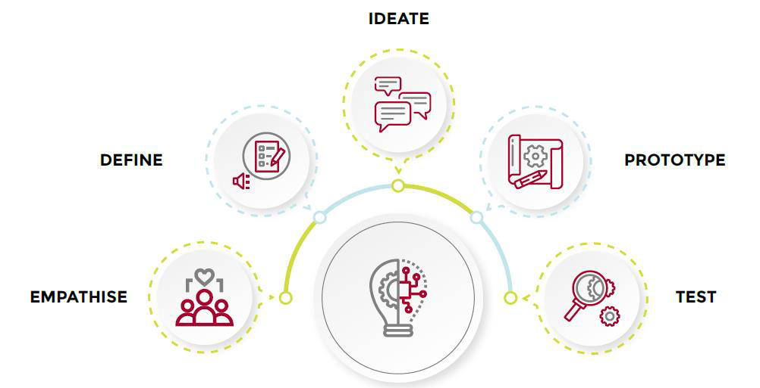
Module-1
Vinod Kumar P
IDT- Department of EEE, ATMECE

Slide 29
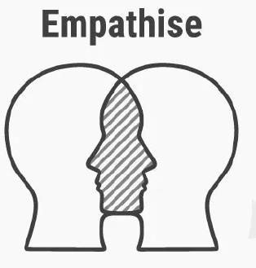
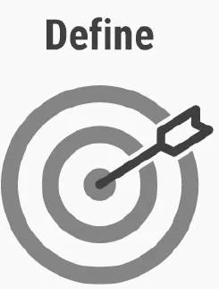
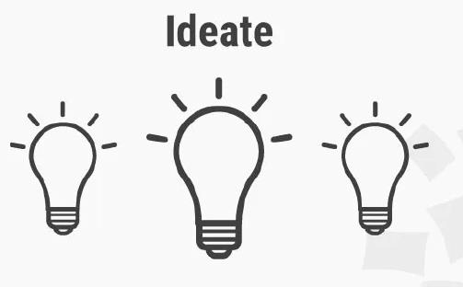
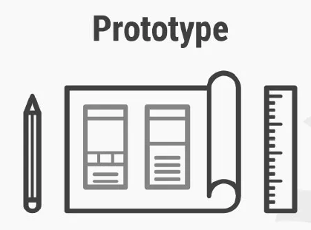

Module-1
Vinod Kumar P
IDT- Department of EEE, ATMECE

Slide 30


Module-1
Empathy ^{Collaboration}
Vinod Kumar P
IDT- Department of EEE, ATMECE

Slide 31

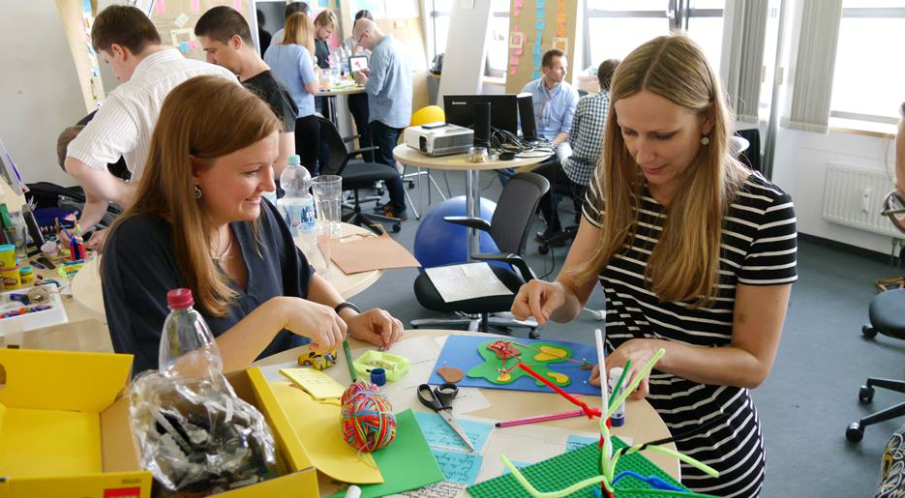
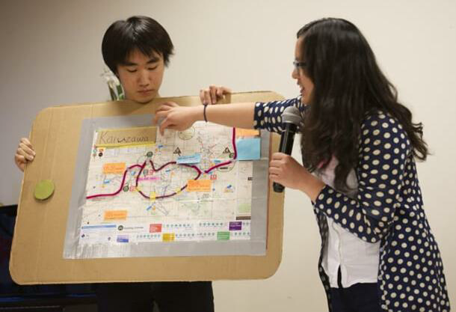
Module-1
Inclusion
Repeat/Iterate
Vinod Kumar P
IDT- Department of EEE, ATMECE

Slide 32
Design Thinking
Empathizewith people's needs,
Collaboratewith others across disciplines, skill, sets, and perspectives.
Includeevery ideain visible formfor evaluation,
Repeat, iteratingand testingsolutions to perfect them, always with human needs at the center.
Vinod Kumar P
IDT- Department of EEE, ATMECE

Slide 33
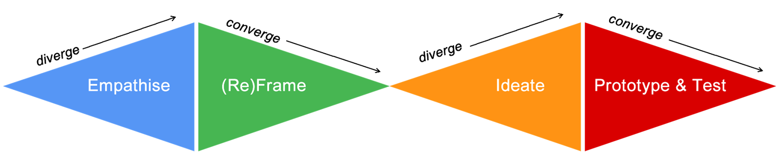
Design Thinking
Design Thinking Process
P r o b l e m S p a c e S o l u t i o n S p a c e
Design
Challenge
Design
Solution
Vinod Kumar P
IDT- Department of EEE, ATMECE

Slide 34
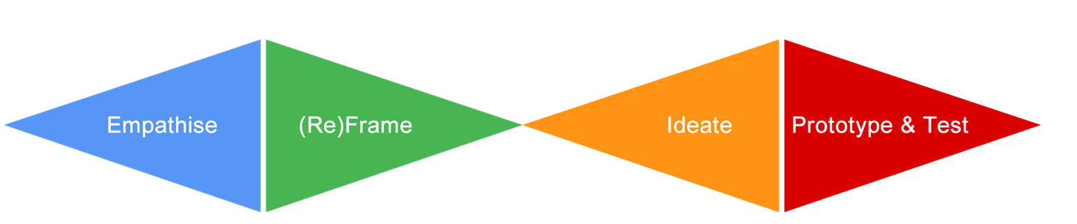
Design Thinking
Design Thinking Branding
Design Thinkers Group Empathize |(Re)frame |Ideate |Prototype |Test
Stanford d.school
Ideo
Ideo v2.0
Luma Institute
IBM
FSU Innovation Hub
Empathize |Define |Ideate |Prototype |Test
Gather |Generate |Make |Share
Inspiration |Ideation |Implementation
Looking |Understanding |Making
Observe |Reflect |Make
Empathize |Ideate |Build
Vinod Kumar P
IDT- Department of EEE, ATMECE

Slide 35
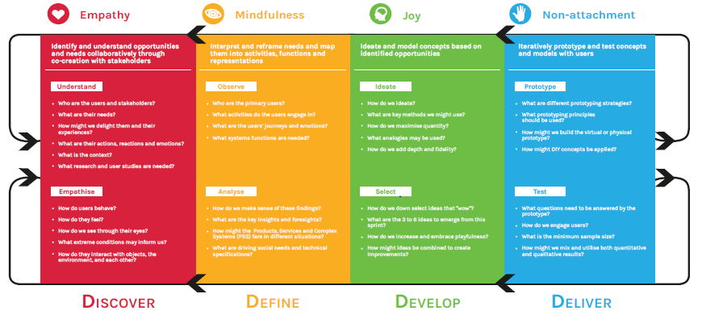
Design Thinking
Vinod Kumar P
IDT- Department of EEE, ATMECE

Slide 36
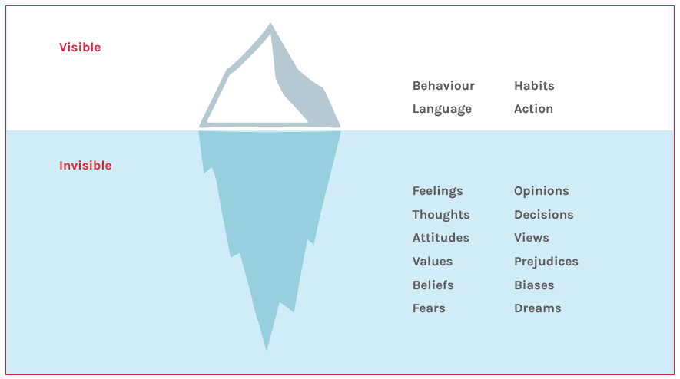
Design Thinking
Vinod Kumar P
IDT- Department of EEE, ATMECE

Slide 37
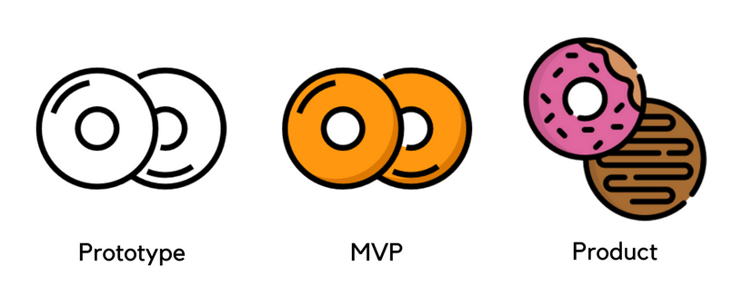
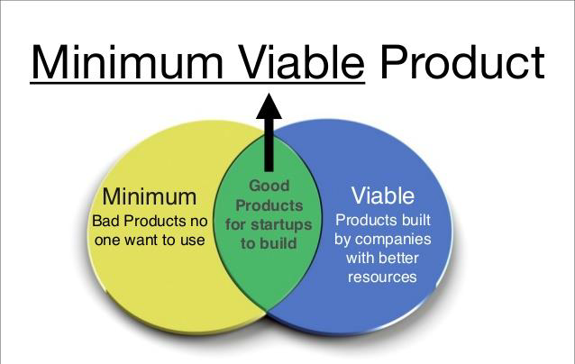
Design Thinking
Vinod Kumar P
IDT- Department of EEE, ATMECE

Slide 38
MVP
WhatisMVP?
MVP(MinimumViableProduct)istheproposedinvestmentcapableofworkingsuccessfullyforaproduct
madewithlessfeaturesorproductmadeforcalculatingtheoddandevenoftheproduct,featuredwithless
rawmaterialforearlyadoptersoftheproducttograspfeedbackabouttheproductandthenmaximizing
productfeaturestoavoidmarketrisk.Tohavethepriormarketingoftheproductandlearncustomers
demand.
EricRies,theauthorof“TheLeanStartup”,firstusedthetermMVPanddescribeditas:‘AMinimumViable
Productisthatversionofanewproductwhichallowsateamtocollectthemaximumamountofvalidated
learningaboutcustomerswiththeleasteffort’.
TipsforyourMVP:
MVPisactuallytotesttheusageoftheproductbycustomersratherthanthisitismorehelpfulforthe
companytovalidatethefinalproduct.
Vinod Kumar P
IDT- Department of EEE, ATMECE

Slide 39
MVP
MVPhasthreedistinctfeatures:-
1. Oneisthatitwillhaveenoughfeaturesforconsumerstopurchasetheproduct.
2. Theotheristhatitwillhavesomesortofafeedbackmechanismwhereinuserswouldbeabletosend
theirfeedbackabouttheproduct.
3. Thirdlyitshouldhaveenoughfuturebenefitsforconsumers,toadopttheproductfirst.
Forexample-Intheonlineworld,awebsiteislaunchedwithbasicfeaturestoshowcasetheprovided
productsofsell,purchaseweatherit’sofFMCG(fastmovingconsumergoods),goods,electronic,clothingetc.
Thentakecluesfromtheusersandgatherwhatexactlytheyareexpectingfromtheproduct.
Vinod Kumar P
IDT- Department of EEE, ATMECE

Slide 40
MVP
Next step after MVP :
1. Analyzethecustomerfeedback
2. Workandmakechangesinyourproductaccordingly
3. Thancomeupwithyournewmodifiedfinalproduct
4. Nowhavethefinalproductfeedbackfromtheoldcustomers(duringMVP)
5. Makethefewsmallchangesandthefinalproductisallsettogetinthemarketwiththecompetitors.
6. Enjoythesuccessoftheproduct,ifrequiredchangeshaveitfromtimetotime.
Vinod Kumar P
IDT- Department of EEE, ATMECE

Slide 41
MVP
MVPisaproductmanagementconceptthatworksexceptionallywellwhenbringinganewproductto
market.ThemaingoalofMVPistodeliverthebarefunctionalitythatwillmeettheessentialneedsofthe
usersandsolveaspecificproblemeffectively.Suchanapproachhasnumerousbenefitsincludingcost
efficiency,minimalrisks,productclarity,andothersfeaturedinthearticle.
1.FocusOnCoreFunctionalities
TheMVPapproachhelpstofindclarityandfocusonthecorefunctionalityofyourproduct.Itallowsyouto
testyourbusinessconceptwithminimumcostsandtime.Themajorityofproductownersareproneto
addingredundantfunctionalitybeforetheproductevenentersthemarket.Byaddingahugeamountof
functionality,it’sveryeasytolosefocusonthespecificproblemyouaimtosolve.
2.ClarityofVision
Attheinitialstageofyourproduct’sdevelopment,youshouldspecifythecorefeaturesandcustomervalue
ofthesoftwareandwriteeverythingdown.Afterachecklistiscreated,shareitwiththeteam.Thisprimary
visionwilldefinitelyhelpyoutostayontrackandmakebetterdecisionsinthelongrun.
Vinod Kumar P
IDT- Department of EEE, ATMECE

Slide 42
MVP
3. Development of Early Relationship With Customers
Timing plays a significant role in business. It helps to engage new users and stakeholders at the initial stage of the development. Early adopters will spread the word about your product and give priceless feedback. What can be better for making your product 100 % customer-oriented?
4. A Better Understanding of Customer’s Needs
Collected data and detailed research of the target audience can not be overestimated. Feedback from early adopters is much more valuable than the best assumptions of business analytics and experienced advisers. The sooner a client can test the product, the more effective development you get. Your users will tell you which functionality they appreciate the most, which –the less and what features you should add in the next release.
Vinod Kumar P
IDT- Department of EEE, ATMECE

Slide 43
MVP
5. Clear User Interface
The MVP approach prevents your initial product from getting cluttered with unwanted features. As a result, the product is easily adopted and not complicated in usage. That’s also a good chance to try how different features work. You can investigate each one separately without a need to keep an eye on everything.
6. Quicker Release
The decision to develop only core functionality significantly speeds up the release of the product. After the release of
your first product’s version, you can test key hypotheses quickly and gather users’ feedback on both core and desired
features. Procrastination with the release date can lead to the development of useless features and wasting time on
expensive bug fixes. There always is someone who can release the same good app before you. Do your best to keep
your initial release minimal, and subsequent releases incremental. It will make you much more responsive to the
market.
Vinod Kumar P
IDT- Department of EEE, ATMECE

Slide 44
MVP
7.FlexibilityAndConstantUpdates
ThenextadvantageofbuildinganMVPisapossibilitytobeexceptionallyresponsivetotheneedsofthemodernfast pacedmarket.TheMVPapproachcreatesspaceforupdatesandnewfeaturesthatcustomersaskfor.Also,your productcanbenefitfromnewertechnologyandtoolsastheybecomeavailable.Itwillhelpyoutokeepteproduct
relevantinacompetitivemarket.
8.DevelopmentWithMinimalRisks
Itisveryimportanttokeepinmindthatpolishedlarge scaleappstakeyearstocraftandrequirelot’sofmoney,time
andeffort.Allthemostusedandpopularsoftwareproductsstartedsmallandwereadoptingcostlyextensivefeatures
Over the years.
Facebook,Instagram,Snapchat,Spotify,Airbnb,Uber,Zappos,Dropbox,etcweredevelopedasMVPsfirst.
Vinod Kumar P
IDT- Department of EEE, ATMECE

Slide 45
Innovation
Definitions of innovation
Theapproachestothetypologyofdiverseinnovations,therearerepresentationsofvariousauthors. Intheinstitutionalsciencealsohasitsownapproachtothetypologyofinnovationasthegoodand
thetypologyofthesubjectsofinnovation,therelationshipbetweenthefirstandseconddisclosethe
advantagesofusingcertaintypesofinnovationactor’sspecificinnovation.Thus,thethemeofthis
workisrelevantenough.
Vinod Kumar P
IDT- Department of EEE, ATMECE

Slide 46
Innovation
Definitions of innovation
“Innovationconsistsofthegenerationofanewideaanditsimplementationintoanewproduct,
processorservice,leadingtothedynamicgrowthofthenationaleconomyandtheincreaseof
employment as well as to a creation of pure profitfortheinnovativebusinessenterprise.
Innovationisneveraone-timephenomenon,butalongandcumulativeprocessofagreatnumber
oforganizationaldecision-makingprocesses,rangingfromthephaseofgenerationofanewideato
itsimplementationphase.Newideareferstotheperceptionofanewcustomerneedoranewway
toproduce.Itisgeneratedinthecumulativeprocessofinformation-gathering,coupledwithanever-
challengingentrepreneurialvision.Throughtheimplementationprocessthenewideaisdeveloped
andcommercializedintoanewmarketableproductoranewprocesswithattendantcostreduction
andincreasedproductivity”
Vinod Kumar P
IDT- Department of EEE, ATMECE

Slide 47
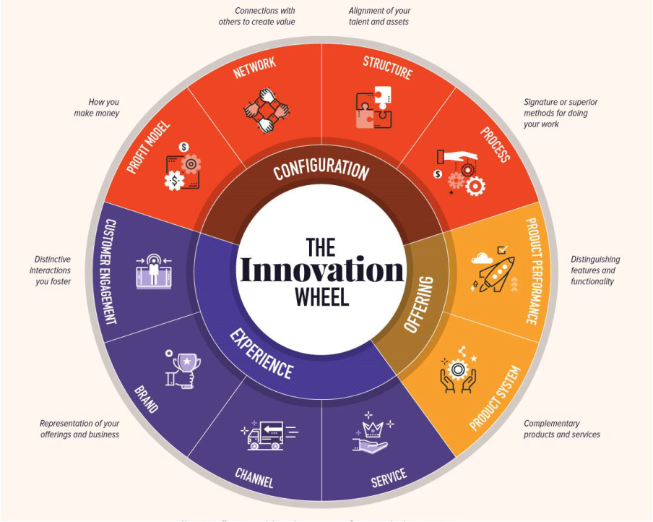
Innovation
Vinod Kumar P
IDT- Department of EEE, ATMECE

Slide 48
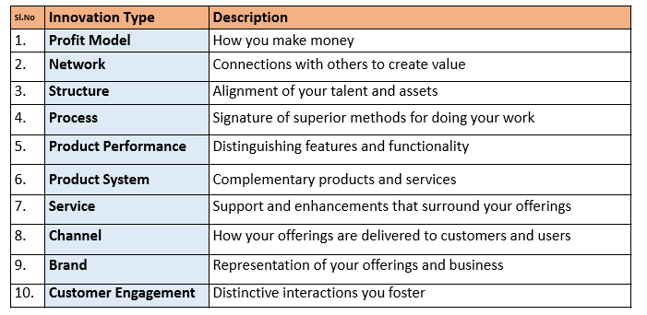
Innovation
Vinod Kumar P
IDT- Department of EEE, ATMECE

Slide 49
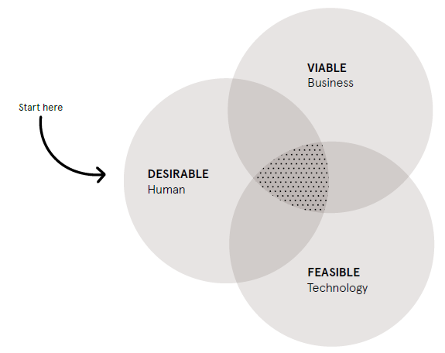
Innovation
Vinod Kumar P
IDT- Department of EEE, ATMECE

Slide 50
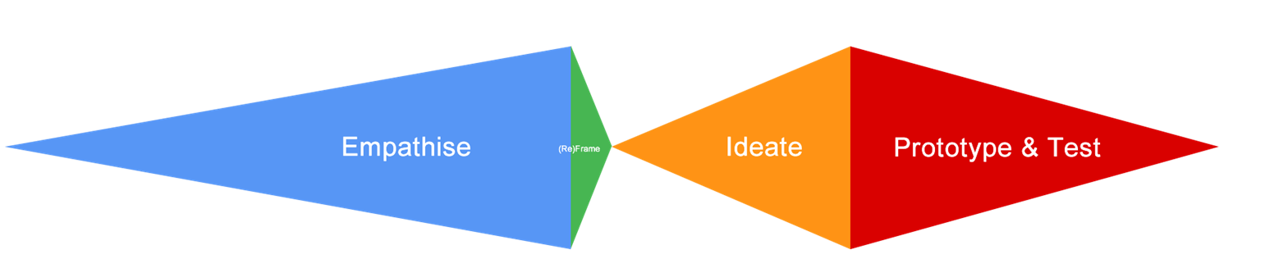
Design Thinking Steps in Perspective
Vinod Kumar P
IDT- Department of EEE, ATMECE

Slide 51
➢Visualization
➢Journeymapping
➢Valuechainanalysis
➢Mindmapping
➢Rapidconceptdevelopment
➢Assumptiontesting
➢Prototyping
➢Co-creation
➢Learninglaunches
➢Storytelling
Vinod Kumar P
IDT- Department of EEE, ATMECE

Slide 52
•Visualizationreferstoanyactivitythattakesinformationbeyondtextand
numbersandintoimages,maps,andstories.
•Atitssimplestlevel,visualizationisaboutcreatingphysicalimagesand
picturesandsteppingawayfromourrelianceasmanagersonnumbers
andtext.
•Atadeeperlevel,itisaboutseeingwithourmind’seye:conjuringup
mental images, vivid depictions of our ideas and insights about
customersandtheirexperiences,inawaythatmakesthemhumanand
compelling.
Vinod Kumar P
IDT- Department of EEE, ATMECE

Slide 53
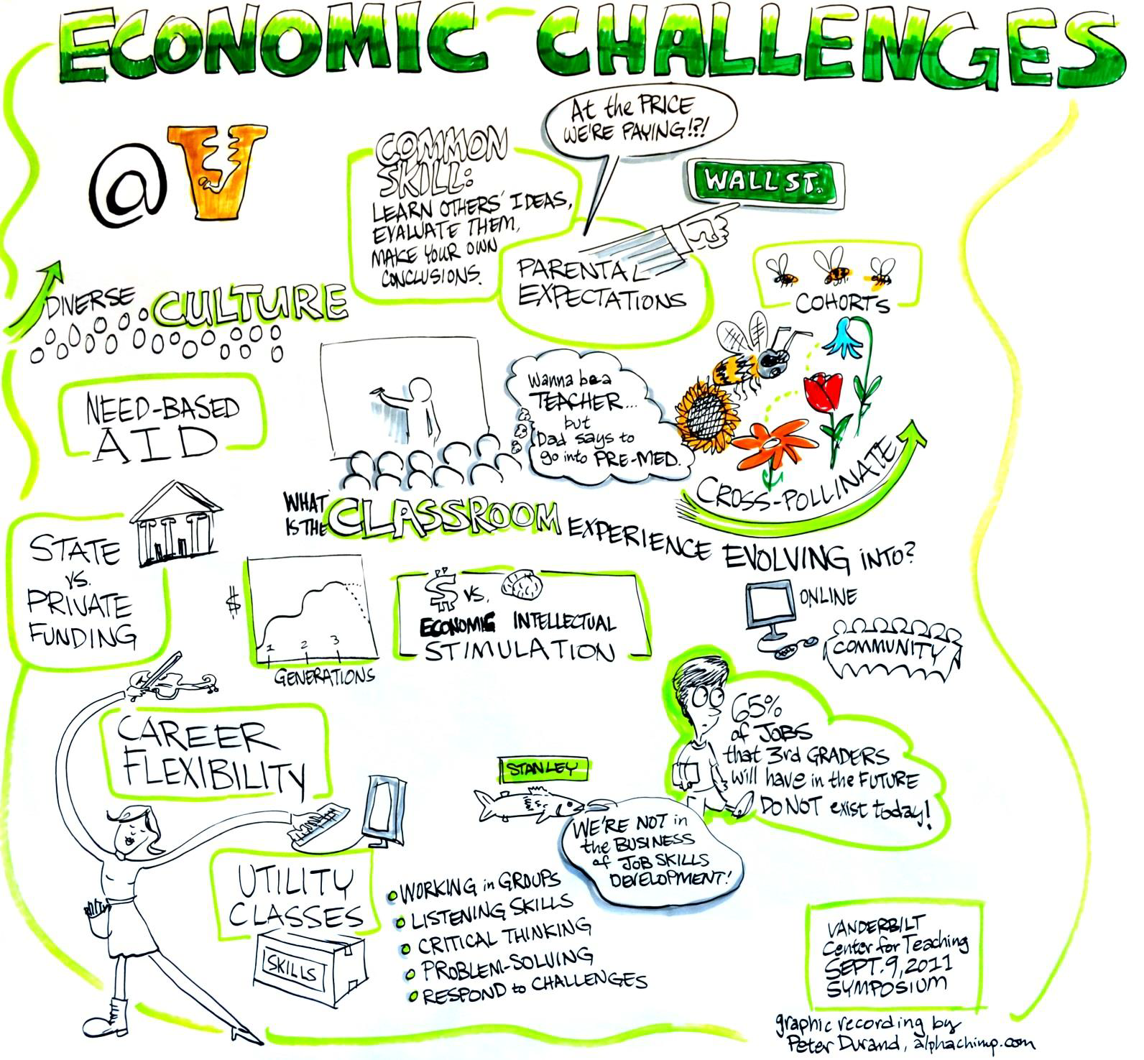
Vinod Kumar P
IDT- Department of EEE, ATMECE

Slide 54
Journey Mapping
Journey mapping (or experience mapping) is an
ethnographicresearchmethodthatfocusesontracingthe
customer’s “journey” as he or she interacts with an
organizationwhileintheprocessofreceivingaservice,
with special attention to emotional highs and lows.
Experience mapping is used with the objective of
identifying needs that customers are often unable to
articulate.
Vinod Kumar P
IDT- Department of EEE, ATMECE

Slide 55
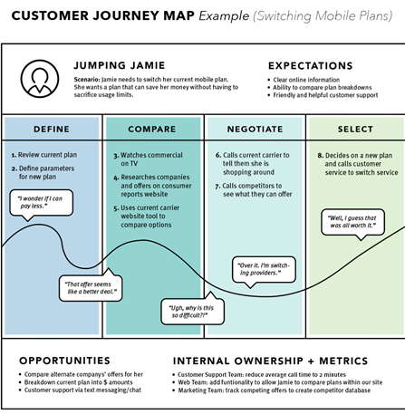
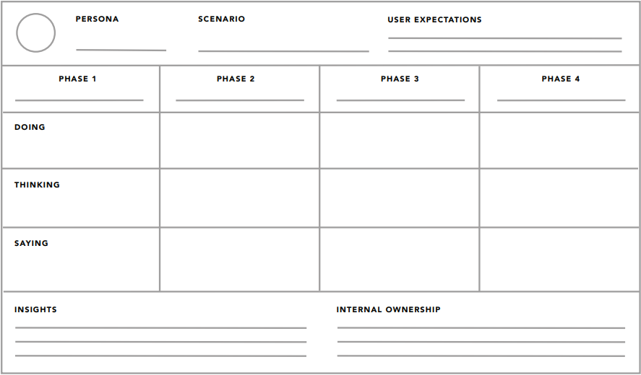
Journey Mapping
Customer Journey Map (Buying EV –Motorcycle)
Vinod Kumar P
IDT- Department of EEE, ATMECE

Slide 56
Mind Mapping
•Mindmappingisusedtorepresenthowideasorother
itemsarelinkedtoacentralideaandtoeachother.
Mindmapsareusedtogenerate,visualize,structure,
andclassifyideastolookforpatternsandinsightsthat
providekeydesigncriteria.
Vinod Kumar P
IDT- Department of EEE, ATMECE

Slide 57
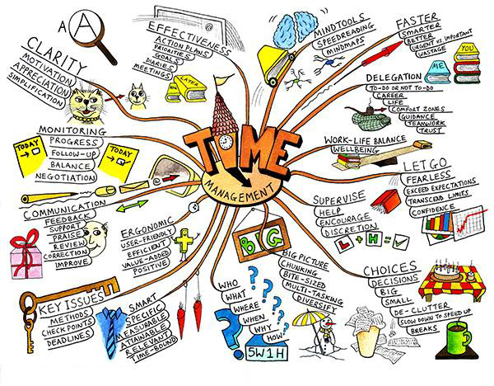
Mind Mapping
Vinod Kumar P
IDT- Department of EEE, ATMECE

Slide 58
Rapid Concept Development
•Rapidconceptdevelopmentisatoolforusingtheinsightsanddesign
criteriawehavegeneratedtodevelopnewbusinessopportunities.
Whenpeopleheartheterm“innovationprocess,”conceptdevelopment
maybetheonlythingtheythinkof,andtheyoftenequateitwith
brainstorming.
Vinod Kumar P
IDT- Department of EEE, ATMECE

Slide 59
Assumption Testing
Assumptiontestingisatoolforbringingtothesurfacethekey
assumptions underlying the attractiveness of a new business
conceptandusingavailabledatatoassessthelikelihoodthatthese
assumptionsaretrue.Thisapproachacknowledgesthatanynew
businessconceptisactuallyahypothesis—awell-informedguess
aboutwhatcustomersdesireandwhattheywillvalue.
Vinod Kumar P
IDT- Department of EEE, ATMECE

Slide 60
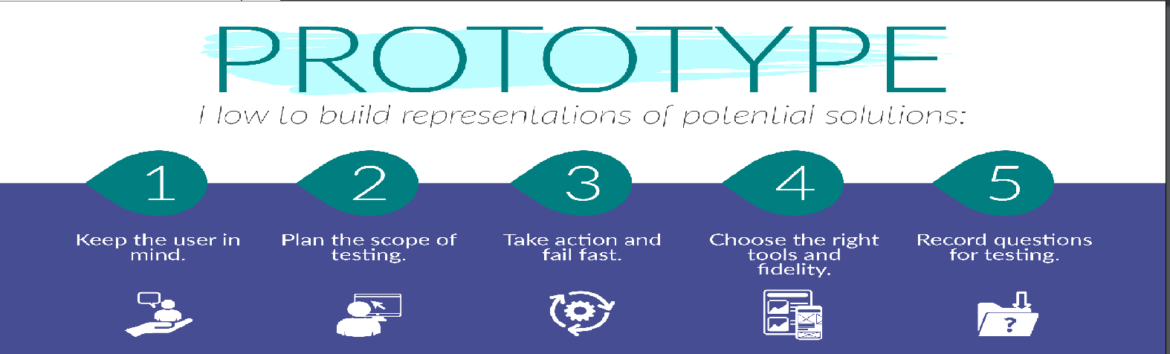
Prototyping
Aprototypeisasimpleexperimentalmodelofaproposed
solutionusedtotestorvalidateideas,design assumptions and
otheraspectsofitsconceptualizationquicklyandcheaply,so
that the designer/s involved can make appropriate
refinementsorpossiblechangesindirection.
Vinod Kumar P
IDT- Department of EEE, ATMECE

Slide 61
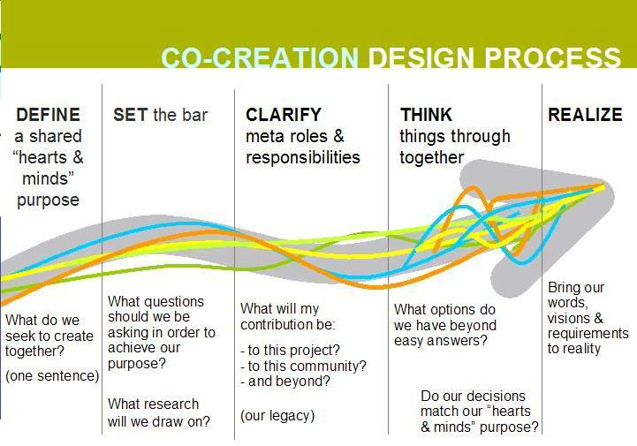
Co-creation
•Co-creation is based on the
beliefthattheusers'presence
is essential in the creative
process, as the users provide
insightintowhatisvaluableto
them. At its core, this means
thatco-creationisliterallyany
process that brings together
users and designers to work
towardasharedgoal.
Vinod Kumar P
IDT- Department of EEE, ATMECE

Slide 62
Learning Launches
Learning launches
•Learninglaunchesaredesignedtotestthekeyunderlyingvalue-generating
assumptionsofapotentialnew-growthinitiativeinthemarketplace.Incontrast
to a full new-product rollout, a learning launch is a learning experiment
conductedquicklyandinexpensivelytogathermarket-drivendata.
Vinod Kumar P
IDT- Department of EEE, ATMECE

Slide 63
Storytelling
Storytelling
•Storytellingisexactlyhowitsounds:weavingtogetherastory
ratherthanjustmakingaseriesofpoints.Itisacloserelativeof
visualization—anotherwaytomakenewideasfeel realand
compelling.Visualstorytellingisactuallythemostcompelling
typeof story.Allgoodpresentations—whetheranalyticalor
design-oriented—tellapersuasivestory.
Vinod Kumar P
IDT- Department of EEE, ATMECE

Slide 64
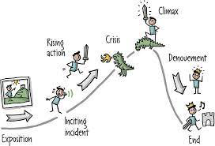
Storytelling
Story of Successful
Product/ Service
Vinod Kumar P
IDT- Department of EEE, ATMECE

Slide 65
Design Thinking in IT
Design thinking in IT industries
Design thinking to BusinessProcess Model
Design thinking for Agile Software Development
Virtual Collaboration
Scenario Based Prototyping
Vinod Kumar P
IDT- Department of EEE, ATMECE

Slide 66






Understanding IT industry with an example
XYZ InfoTech
promises to use technology to
solve all of your problems!
ITcompanies-Theybuildsoftwaretomakeotherbusinessesrunsmoothly!
NowifIknowsometechnologyandaskaprogrammertosolveproblemsbybuildingspecificpiecesofsoftware
ITcompaniesbuildormaintainsoftwaresothatbusinessesrun
more smoothly. Anyone who builds or maintains software
belongstotheITsector.
Vinod Kumar P
IDT- Department of EEE, ATMECE

Slide 67
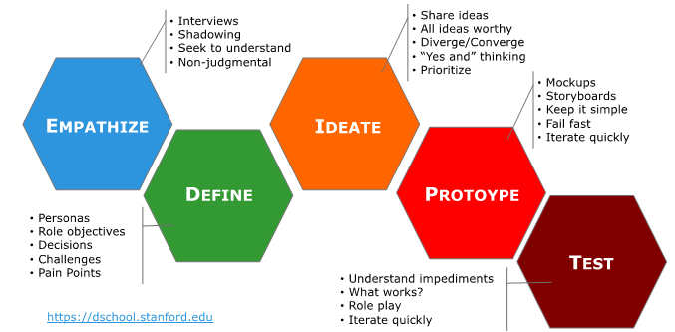
Design Thinking in General
Vinod Kumar P
IDT- Department of EEE, ATMECE

Slide 68
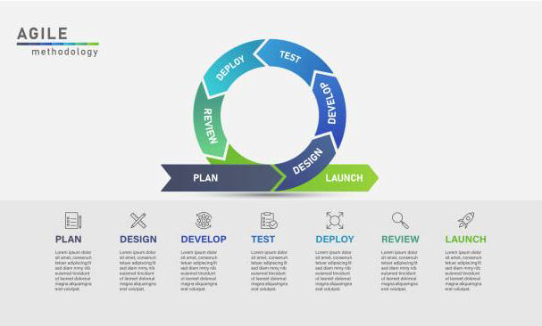

Design Thinking in General
Project
management
IT Industry
Vinod Kumar P
IDT- Department of EEE, ATMECE

Slide 69


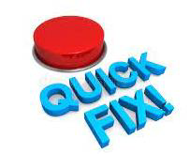
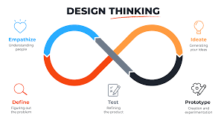
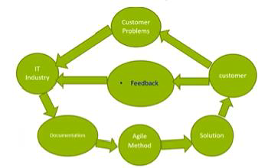
Design Thinking in General
Vinod Kumar P
IDT- Department of EEE, ATMECE

Slide 70
Agile
What is Agile?
➢Agileistheabilitytocreateandrespondtochange.Itisawayofdealingwith,and
ultimatelysucceedingin,anuncertainandturbulentenvironment.
➢TheauthorsoftheAgileManifestochose“Agile”asthelabelforthiswholeidea
becausethatwordrepresentedtheadaptivenessandresponsetochangewhich
wassoimportanttotheirapproach.
➢It’sreallyaboutthinkingthroughhowyoucanunderstandwhat’sgoingoninthe
environmentthatyou’reintoday,identifywhatuncertaintyyou’refacing,and
figureouthowyoucanadapttothatasyougoalong.
Vinod Kumar P
IDT- Department of EEE, ATMECE

Slide 71
Agile
Agile is a Mindset
➢Ultimately,AgileisamindsetinformedbytheAgileManifesto’svaluesandprinciples.Those
valuesandprinciplesprovideguidanceonhowtocreateandrespondtochangeandhowtodeal
withuncertainty.
➢YoucouldsaythatthefirstsentenceoftheAgileManifestoencapsulatesthewholeidea:“Weare
uncoveringbetterwaysofdevelopingsoftwarebydoingitandhelpingothersdoit.”
➢Whenyoufaceuncertainty,trysomethingyouthinkmightwork,getfeedback,andadjust
accordingly.
➢
Keep the values and principles in mind when you do this. Let your context guide which
frameworks,practices,andtechniquesyouusetocollaboratewithyourteamanddelivervalue
toyourcustomers.
Vinod Kumar P
IDT- Department of EEE, ATMECE

Slide 72
What is Agile Software Development?
➢AgilesoftwaredevelopmentismorethanframeworkssuchasScrum,ExtremeProgramming,orFeature-Driven
Development(FDD).
➢Agilesoftwaredevelopmentismorethanpracticessuchaspairprogramming,test-drivendevelopment,stand-
ups,planningsessions,andsprints.
➢Agilesoftwaredevelopmentisanumbrellatermforasetofframeworksandpracticesbasedonthevaluesand
principlesexpressedintheManifestoforAgileSoftwareDevelopmentandthe12Principlesbehindit.Whenyou
approachsoftwaredevelopmentinaparticularmanner,it’sgenerallygoodtolivebythesevaluesandprinciples
andusethemtohelpfigureouttherightthingstodogivenyourparticularcontext.
➢OnethingthatseparatesAgilefromotherapproachestosoftwaredevelopmentisthefocusonthepeopledoing
theworkandhowtheyworktogether.Solutionsevolvethroughcollaborationbetweenself-organizingcross-
functionalteamsutilizingtheappropriatepracticesfortheircontext.
➢There’sabigfocusintheAgilesoftwaredevelopmentcommunityoncollaborationandtheself-organizingteam.
Vinod Kumar P
IDT- Department of EEE, ATMECE

Slide 73
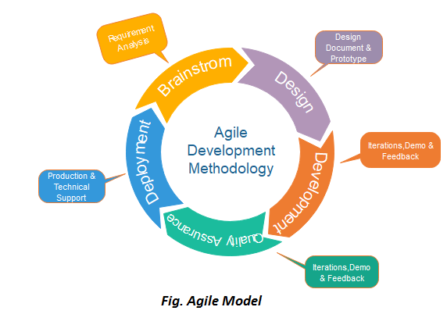
Agile Model of Project
Management
Vinod Kumar P
IDT- Department of EEE, ATMECE

Slide 74
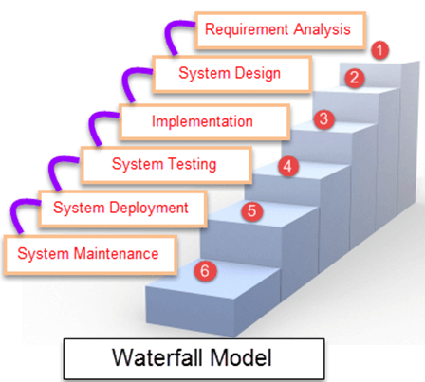
Agile Model of Project
Management
Waterfall Model
Best practices for combining Design thinking and Agile methodology
Invest in user research
A clearly defined problem statement
Build a productive team culture
Optimal use of Design thinking
Design patterns and periodic testing
Vinod Kumar P
IDT- Department of EEE, ATMECE

Slide 75
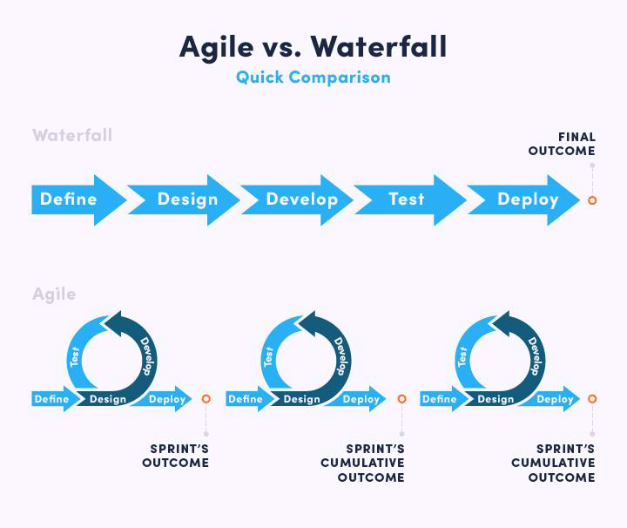
Agile Model of Project
Management
Vinod Kumar P
IDT- Department of EEE, ATMECE

Slide 76






Agile Model of Project
Management
Agile is an iterative and
incremental method of
managing development and
_{Test} design
Configure
Release
Build
Design
Vinod Kumar P
IDT- Department of EEE, ATMECE

Slide 77





Thank You

